Slide 1
EYE LID
BY DR SUJATA CHAREL

Slide 2
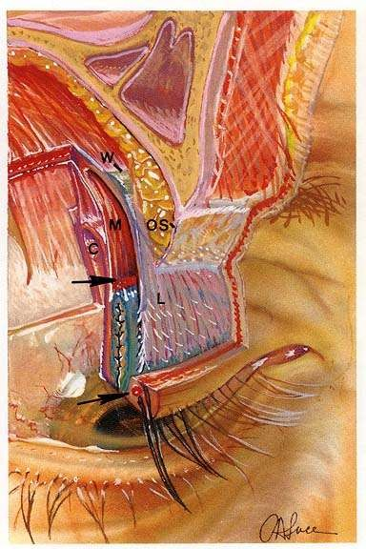
EYELID ANATOMY
Anterior lamella
Skin
Orbicularis muscle
Posterior lamella
Tarsal plate
conjunctiva

Slide 3
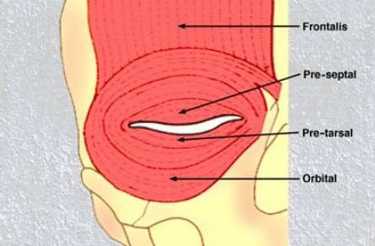
Anatomy of eyelids:-
SKIN- thin, stretches with age & there is usually excess available for a full thickness skin graft.
ORBICULARIS MUSCLE:-

Slide 4
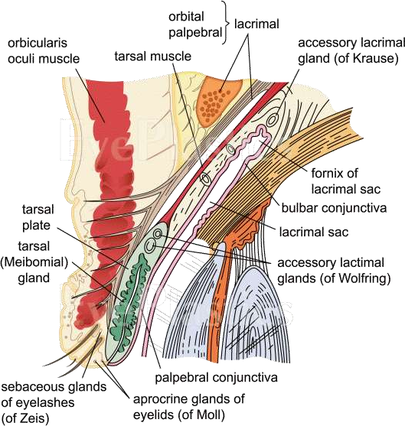
UPPER EYELID ANATOMY

Slide 5
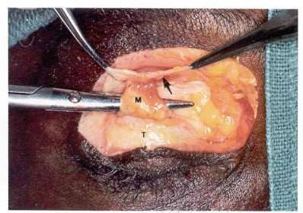
Eyelid Anatomy
Upper lid retractors
  Levator palpebrae superioris
  Whitnall’s ligament
  Muller’s muscle

Slide 6
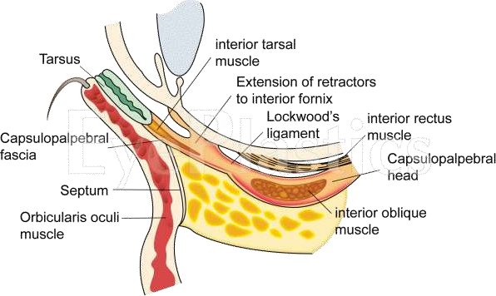
LOWER EYELID ANATOMY

Slide 7
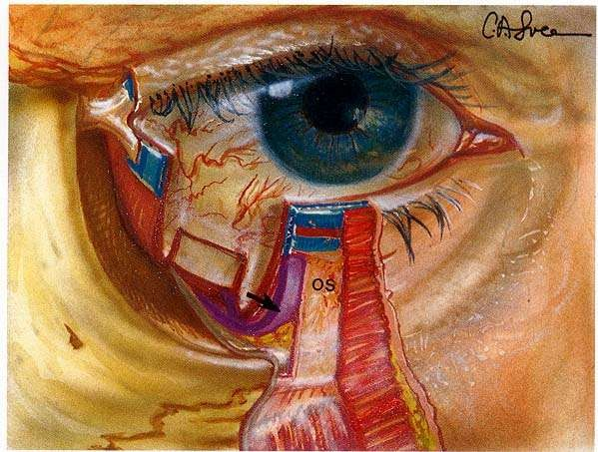
Eyelid Anatomy
Lower lid retractors
  Capsulopalpebral fascia- origin from the capsulopalpebral head of the inferior rectus muscle
  Lockwood’s ligament – its head splits & its two heads fuse anterior to inferior oblique to form lockwood ligament.
  Inferior tarsal muscle

Slide 8
ECTROPION
Definition: It is outward turning of the eye lid away from the globe.
Clinical features: 1. In case of lower lid involvement inferior
punctum is not in contact with the globe excoriation of the skin around the lid.
2. Chronic exposure of the conjunctiva
epiphora and
secondary infection and
keratinisation keratitis or frank corneal ulcer.
Classification:
1.involutional.
2.cicatrical.
3. paralytic.
4.congenital.
5.mechanical.

Slide 9
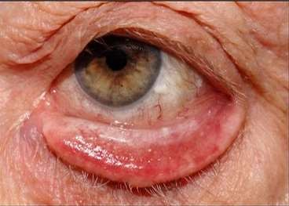
INVOLUTIONAL [senile] ECTROPION

Slide 10
INVOLUTIONAL [senile] ECTROPION
It is the commenest form, which affects in elderly. It is due to excessive horizontal lid-length with weakness of the preseptal portion of the orbicularis oculi.
Treatment: It is corrected by reducing the horizontal lid laxity ,
Zeiglers cautery: to correct the medial lid laxity with punctal eversion.
Medial conjunctivoplasty: for mild cases of medial ectropion
Horizontal lid shortening: to correct ectropion involving the whole lid.
Bick’s procedure: excision of a full thickness triangular wedge of lid at the outer canthus and then suture vertically.
Byron- smith modification of kuhnt szymanowski procedure: pentagonal wedge resection of the lid margin, along with excision of a triangular skin flap laterally.

Slide 11


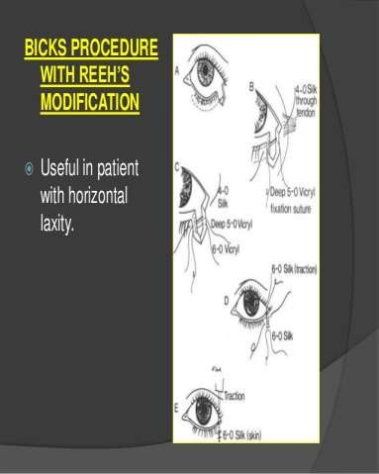
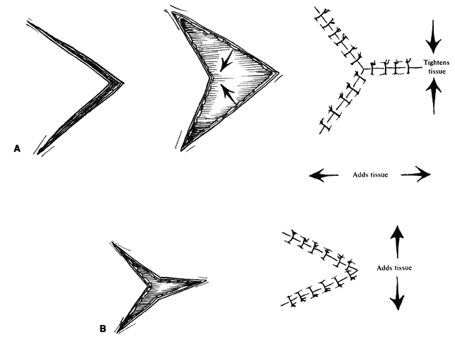

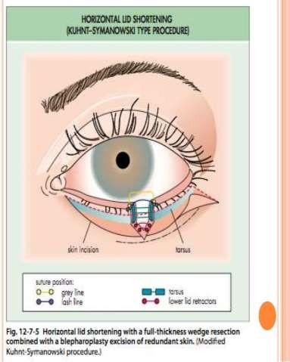

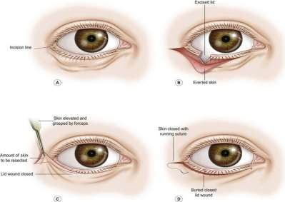
V – Y PROCEDURE

Slide 12
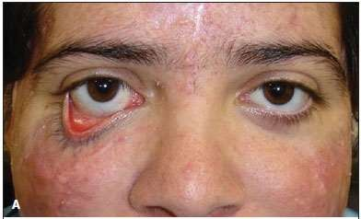
CICATRICIAL ECTROPION

Slide 13
CICATRICIAL ECTROPION
It is caused by contracture of the skin and underlying tissues.
Causes:
1. Burns [chemical/ thermal].
2. Trauma.
3.Inflammation.
[it affects either the or lower lid]
Treatment:
1. Excision of the scar with a skin graft to the raw area. Skin of the opposite upper eye lid is ideal for this purpose.
2.Lengthening of the vertical shortening of the lid – by Z- Plasty.

Slide 14
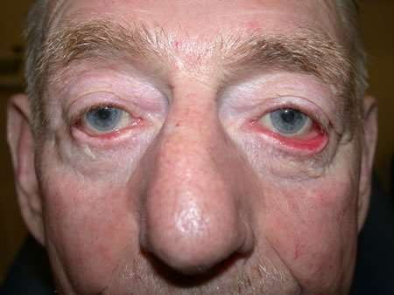
PARALYTIC ECTROPION

Slide 15
PARALYTIC ECTROPION
Due to paralysis of the orbicularis oculi and also assosiated with
lagophthalmos.
Treatment: the main aim is to prevent exposure keratitis.
1. in mild cases:
Frequent instillation of artificial tears- to prevent corneal drying.
Antibiotic ointment, or an adhesive tape to close the lid at night to
prevent corneal exposure.
2. in severe cases:
Tarsorrhaphy: shortening of the palpebral aperture by lateral tarsorrhaphy.
Lateral canthoplasty: more acceptable cosmetically.
Correction by silicon slings.

Slide 16
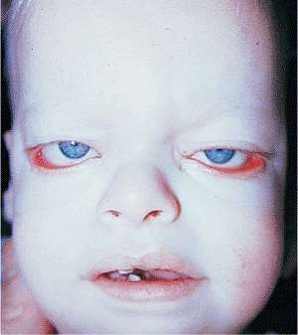
CONGENITAL ECTROPION
RARE, may be assosiated with Blepharophimosis.
In severe cases surgery is needed.

Slide 17
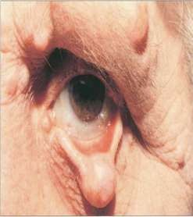
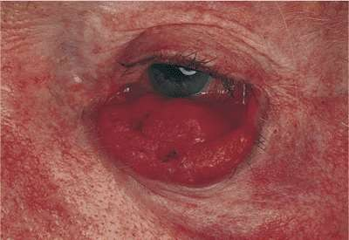
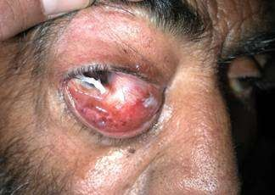
MECHANICAL ECTROPION
This is the sequelae to a swelling of the lower lid eg: large chalazion, a tumour, or even lid oedema. It can be easily rectified.

Slide 18
ENTROPION
Definition: Entropion is an inward turning of the eye lid with rubbing of eye lashes on the conjunctiva or on the cornea.
Classification:
A. involutional or Atonic { senile}
B.Cicatrical
C.Spastic [Acute]
Congenital.

Slide 19
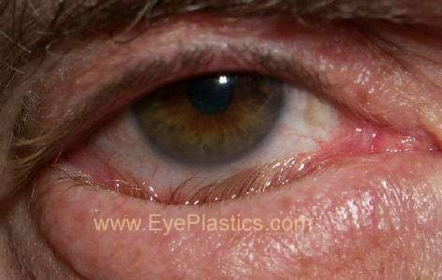
INVOLUTIONAL ENTROPION

Slide 20
INVOLUTIONAL ENTROPION
Most common type and affects the lower lid only.
Aetiopathology:
Due to 4 changes:
1. Upward movement of pre septal part of orbicularis oculi of lower lid.
2. A thinning of the tsrsal plate with subsequent atrophy- Leading to horizontal lid laxity.
3.thinning of the orbital septum and weakening of the lower lid retractors – lead to decrease in vertical lid stability.
4. A relative disparity between lid and globe [ enophthalmos] from the atrophy of adipose tissue.

Slide 21
SYMPTOMS: FB sensation, pain, lacrimation, and discharge.
SIGNS: Inturning of the lower lid, conjunctival congestion, discharge with matting of the eye lashes, blepharo spasm, superfecial corneal opacities. Rarely corneal ulceration.
TREATMENT:
1. Temporary procedures :
Adhesive tape: Pulling the skin outwards with a strip of adhesive tape.
Cautery : Over the skin below the Lashes.
Tranverse lid entering suture.
Alcohol injection - Along the edge of the lid

Slide 22
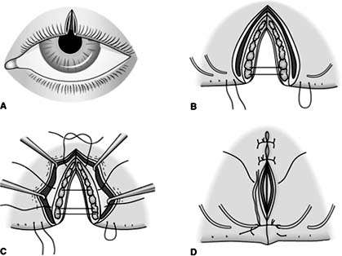
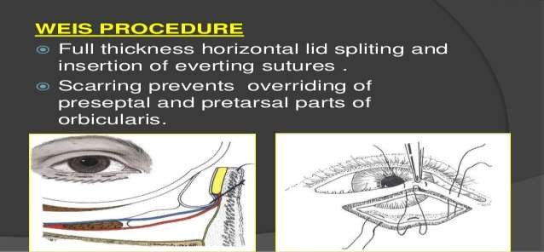
Permanent procedures:
WEIS PROCEDURE: A full thickness horizontal lid splitting with marginal rotation.
HORIZONTAL LID SHORTENING: an excision of full – thickness trapezoid area of the lid at lateral canthus and then sutering the margins; to treat horizontal lid laxity.
Tuckling of lid retractors: may be done as a primary procedure or in recurrent cases or in recurrent cases.
Fox procedure: excising a base down triangle of the tarsus and conjunctiva , and then sutured togather.
FOX PROCEDURE

Slide 23
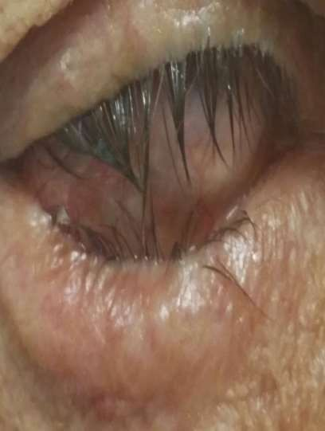
CICATRICAL ENTROPION
.It is due to scarring of palpabral conjunctiva. It may involve both the upper and lower lids.
Frequently , the tarsus is deformed and thickened.
CAUSES:
1. Chemical injuries.
2. Lacerated injuries.
3. Trachoma.
4. Radiation
5. Steven johnson syndrome.
6.Oclar pemphigoid.

Slide 24
TREATMENT:
AIM to keep the lashes away from the globe,
1. soft contact lens
2.Various plstic operations are:
A]To alter the direction of lashes.
B] To Transplant the lashes.
C] To straighten the distorted tarsus.
3. mucous membrane grafting.

Slide 25
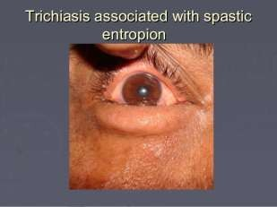
ACUTE SPASTIC ENTROPION
It result from excessive contraction of the orbicularis oculi. It affects mainly the lower lid.
Causes:
1.Chronic conjunctivitis.
2.Keratitis.
3.Post operative.
Treatment:
1. Removal of the cause, and it resolve spontaneosly.
2.Removal of the bandage in post operative cases.
3.Temporary relief by – Lid everting suture and Adhesive tape.

Slide 26
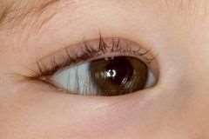
CONGENITAL ENTROPION.
It is rare and usually caused by deformity of the tarsal plate. And it may be assosiated with Microphthalmos or anophthalmos.
Treatment: Resection of abnormal portion of the tarsus.

Slide 27
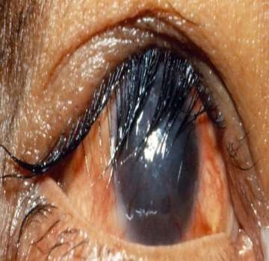
TRICHIASIS
Trichiasis is a misdirection of cilia so that they are directed backwards and rub against the conea.
Etiology: common causes:
1. trachoma
2. spastic entropion
Other causes:
1. Blepharitis
2. ocular pemphigoid
3. scars resulting from injuries
4. chemical burns
5. destructive inflammations such as stevens johnson syndrome
6. congental distichiasis
Symptoms: FB sensation with irritation in the eye, pain ,conjuntival
congestion,reflex blepharo spasm, and lacrimation.
Complications : Recurrent erosions, superfecial corneal opacities, recurrent corneal ulcers, corneal vascularization. Sometime it may threaten the Vision.

Slide 28
Treatment of Trichiasis:
Epilation: Isolated misdirected cilia may be removed by epilation, which must be repeated every few weeks .
Electrolysis: Destruction of hair folicle by diathermy or electrolysis and cryo surgery and argon laser application.
Diathermy: A fine needle is inserted in to hair folicle and a current of 30 mA applied for 10 sec.
Cryo epilation .
Surgery: If many cilia are displaced, operative procedures, as for as entropion.

Slide 29
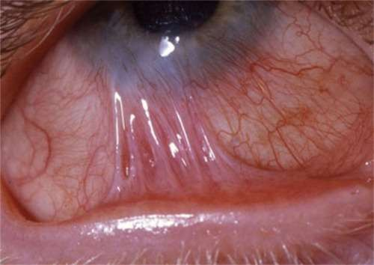
SYMBLEPHARON
This is the condition where adhesion of the lid
the globe take place.
Any cause which produces raw surfaces on two opposed areas of the palpabral and bulbar conjunctiva will lead to adhesion during the healing process.
Aetiology:
  Chemical burns { alkali }
  Thermal burns 3.membranous conjunctivitis 4.ocular pemphigoid.
steven johnson syndrome.
post operative. 7.trachoma.

Slide 30
Pathology of symblepharon:
Bands of fibrous tissue are formed and stretching between the
lid and the globe.
The bands may be broad or narrow.
Cornea also involved in severe cases.
TYPES OF SYMBLEPHARON:
Anterior symblepharon: Bands are limitted to the anterior parts , and not involving the fornix.
Posterior symblepharon: Bands are obliterating to the fornix only.
Total symblepharon: The Lids are completely plastered against the
globe .

Slide 31
SYMPTOMS:
Pain and redness due to exposure.
Watering due to inadequte lacrimal drainage.
Diplopia due to Limitation of ocular movements resulting from pronoun adhesion.
Cosmetic disfigurement.
SIGNS:
Sign of exposure
Limitation of ocular movements
Visible fibrotic band
Obliteration of the fornix at places.

Slide 32
TREATMENT:
Prevention:
Sweeping a glass rod- well coated with ointment,around the upper and lower fornices repeated several times a day.
Scleral contact shell fitting
When established:If it is small band, just excise the band.
If it is extensive : 1. Radical excision of the scarred conjuntival tissue, 2. Mucus membrane graft to cover the bare area.[ from upper fornix of opposite eye or from buccal mucosa ].
•
Prevention of recurrence of adhesion:
By therapeutic contact lens
By scleral shell atleast for six weeks
High dose of steroids to prevent excessive granulation tissues.

Slide 33
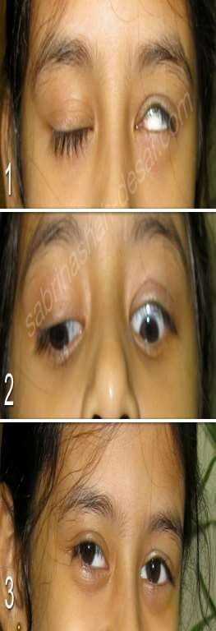
LAGOPHTHALMOS
DEFINITION: This is the condition of inadequate closure of the eye lids., resulting in exposure of the eye.
The word “LAGOS” is a greek word for hare, an animal which always sleeps with its eyes open.
Aetiology:
Nocturnal lagophthalmos: it is found in children, in Mongolian races, terminal ill patient. If Bells phenomenon is good during sleep, there will not be any problem.

Slide 34
Pathological:
1. Facial palsy.
2.Proptosis and thyroid exophthalmos.
3.comatose patient.
4.cicatrical deformity of the upper lid.
SEQUELAE:
Eye is red , irritable, and watering.
Dryness of lower part of bulbar conjunctiva and cornea.
Exposure keratitis → Corneal ulceration → corneal perforation

Slide 35
TREATMENT:
Nocturnal lagophthalmos: does not require any treatment.
Instilation of artificial tears and adhesive taping is necessary to protect cornea from exposure keratitis.
Soft bandage contact lens along with artificial tears to pevent exposure keratitis.
Tarsorraphy: a temporary or permanent adhesion is created between upper and lower lids which may be lateral or paracentral.
LID { UPPER} load operation with gold plate is usefulin facial palsy.

Slide 36
PTOSIS
Definition:
Abnormal dropping of the upper eyelid is called ptosis.
Normally upper lid covers about upper one-sixth of the cornea i.e., about 2mm.
In ptosis it covers more than 2mm.
TYPES:
Congenital ptosis
Acquired ptosis

Slide 37
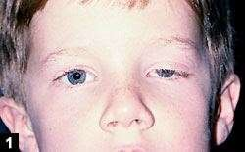







CONGENITAL PTOSIS
Associated with congenital weakness (maldevelopment) of the levator palpabrae superioris.
It may occur in following forms
Simple congenital ptosis
(not associated with anomaly)
Congenital ptosis with weakness of superior rectus muscle.
Blepharophimosis syndrome – congenital ptosis, blepharophimosis, telecanthus and epicanthus inversus.
Congenital synkinetic ptosis (Marcus Gunn jaw winking ptosis) – occur retraction of the ptotic lid withnjaw movements i.e., with stimulation of ipsilateral pterygoid muscle.

Slide 38

ACQUIRED PTOSIS
Aponeurotic Ptosis:
Develops due to defects of levator aponeurosis in the presence of normal functioning muscles
Causes: Senile ptosis, post-operative, trauma
Neurogenic:
Partial or complete 3rd nerve palsy
Horner’s syndrome
Myogenic:
Myasthenia gravis
Ocular myopathy
Senile
Mechanical:
Excess of weight due to edema, tumours, large chalazion etc
Conjunctival scarring
Symblepharon of the upper lid
Pseudo – ptosis:
Due to surgical anophthalmos, microphthalmos and phthisis bulbi.
Due to hypotropia
Due to dermatochalasis

Slide 39

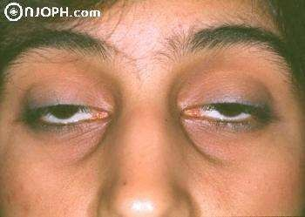
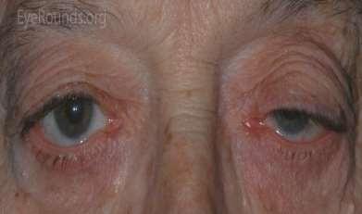
Neurogenic ptosis
Myogenic ptosis
Aponeurotic ptosis

Slide 40
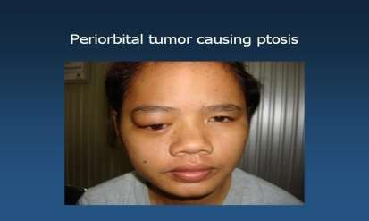
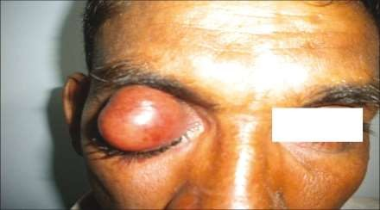
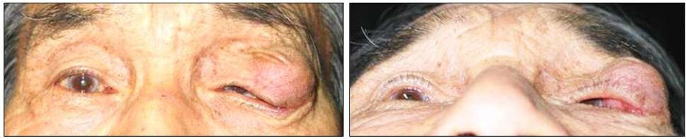
Mechanical Ptosis

Slide 41
Clinical evaluation of ptosis
A. History:
Age of onset
Family history
Presence of diplopia
Variability of ptosis
Symptoms of systemic problems
Any contributing factors
B. Examination:
Amount of ptosis: by noting the ptotic lid margin with respect to the limbus and pupil.
  Mild ptosis = 2mm
  Moderate ptosis = 3mm
  Severe ptosis = 4mm

Slide 42
2. Assessment of levator function:
The brow is immobilized by pressure with the thumb ( to negate the action
of frontalis).
Patient is asked to look down and then to look up.
Amount of excursion of the upper lid margin is the measured with a ruler. (2mm of movement is contributed by superior rectus muscle)
Normal = 15mm
Good = 8mm or more
Fair = 5- 7mm
Poor = 4mm or less.
Ocular motility testing
Jaw winking phenomenon
Bell’s phenomenon
Corneal sensitivity in neurogenic ptosis

Slide 43
Photograph: as pre-operative record
Tensilon test: is to exclude myathenia gravis. Improvement of ptosis with intravenous injection of edrophonium (Tensilon) or prostigmin if the ptosis is due to myathenia.
Neurological evaluation: if the ptosis is neurogenic

Slide 44
TREATMENT
Fasanella-Servat operation:
Is a simple tarso-conjunctival resection.
Useful in mild ptosis with good levator function.
Levator resection:
Useful in congenital unilateral ptosis with fair to good levator function.
It may be via
Skin approach (Everbusch’s) – especially where larger resection is necessary.
Conjunctival approach (Blaskowics’)paricularly useful for moderate resection of LPS.
Brow (Frontalis) suspension
In bilateral cases where the levator action is poor.
The tarsus is fixed to the frontalis muscle via a sling of fascia lata or non- absobable materials.

Slide 45
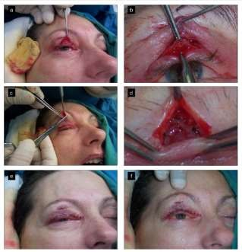
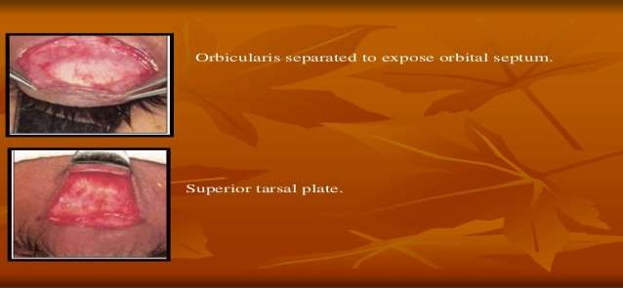
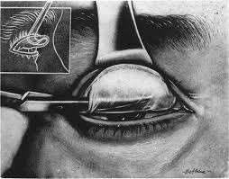
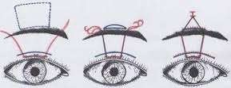
FASANELLA SERVAT PROCEDURE
EVERBUSCH’S (SKIN APPROACH)
FRONTALIS SLING PROCEDURE
BLASKOVIC’S (CONJUNCTIVAL APPROACH)

Slide 46





Aponeurosis strengthening :
Useful for acquired ptosis with good levator function
Performed either by advancement or by tucking
Advancement may be combined with levator resection in severe ptosis.
Timing of surgery in congenital ptosis:
Severe ptosis: Early intervention is necessary due to danger of stimulus deprivation ambylopia.
Mild to moderate ptosis: Surgical resection is done between 3-4
years when accurate measurement can be obtained.

