Slide 1
LENS & CATARACT
Dr. H.D.AHIR

Slide 2
Anatomical Considerations
Biconvex Lens
Diameter varies from 8.8 to 9.2
Lens grow in size continuously throughout life. Its weight is about 65 mgm at the birth and up-to 258 mgm by 80 years of age.
Antero-posterior thickness changes with accommodation. Thickness is 4.75 – 5 mm (un-accommodated) in adults.
Circumference is known as equator

Slide 3
Lens
Lens is suspended in eye by Zonules which are inserted on anterior surface and equatorial lens capsule and attached to ciliary body. Zonular fibres are series of fibrillin rich fibre.

Slide 4
Lens - Anatomy
Histologically lens consists of three major components:*
1. Capsule – is a thick collagenese basement membrane which is transparent, elastic acellular envelop, thick at anterior pre-equatorial region (21 micron m), thinnest at the posterior pole (4 micron m). Anterior pole is approximately 14 micron m thick. It contains the epithelial cells and fibres as a structural unit and allows a passage of small molecules both into and out of lens

Slide 5
Lens - Anatomy
2. Lens Epithelium – It is a single layer of cells lining the anterior capsule and extends to the equatorial lens bow.
Zone of epithelial cells:
a. Central – cells do not actively divide, they divide under pathological conditions only.
b. Pre-equatorial germinal zone : cells rarely divide.

Slide 6
Lens - Anatomy
c. Germinal zone: constitute of the stem cell population. The newly formed cells from germinal zone are forced into transitional zone where they elongate and differentiate to form mass of the lens. The lens capsule secretes the lens capsule and also regulate the transport of metabolite, nutrients and electrolytes to the lens fibres.

Slide 7
Lens - Anatomy
3. Lens substance: It constitute the main mass of the lens. It is divide into-
a. Nucleus
b. Cortex
Nucleus: consists of
(i) Embryonic nucleus (it contains primary lens fibres that are formed in lens vesicle)

Slide 8
Lens - Anatomy
(ii) Fetal nucleus: it contains embryonic nucleus and all fibres added to the lens before birth
(iii) Infantile nucleus: it contains embryonic , fetal nucleus together with all the fibres added up-to the age of 4 years.
(iv) Adult nucleus: composed of all fibres added before sexual maturation
The nucleus consists of densely compacted lens fibres and higher refractive index than cortex.

Slide 9
Lens - Crystalline
  Lens fibres contain high concentrations of crystalline.
  Crystalline represent the major protein of the lens (constitute 90% of total protein content of lens). Crystalline has the following constituents:
  Alpha
  Beta and,
  Gamma

Slide 10
Lens - Functions
The lens serves two major functions:
  Focusing of visible light rays on the fovea
  Preventing damaging ultra-violet radiation from reaching the retina

Slide 11
Lens Cortex
The region between embryonic and fetal nuclear core and soft cortex i.e. infantile and adult nucleus is sometimes referred to as epinucleus. The region between deep cortex and adult nucleus is sometimes referred to as Perinuclear region.
Lens fibres are held together by interlocking of lateral plasma membranes of adjacent fibres to form ball-and-socket and tongue-and-groove joints.

Slide 12
Lens - Sutures
Are found both at anterior and posterior poles. They are formed by overlap of ends of secondary fibres in each growth shell. Each growth shell of secondary fibres formed before birth (fetal nucleus) has an anterior suture shaped as an erect Y and a posterior suture shaped as an inverted Y.

Slide 13
Lens - Physiology
Lens function is dependent on the metabolism of glucose to produce energy , protein synthesis and a complex antioxidant system. Glutathione is found in high concentration in lens and helps protect its structure from oxidative damage.

Slide 14
Lens - Physiology
The transparency is dependent on highly organized structure of lens, dense packing of crystalline
By act of accommodation it changes focusing power. Accommodation occurs by increasing the curvature of anterior surface thereby changing refractive index of lens. Light transmission and elasticity of lens decreases with age.

Slide 15
Age changes in the Lens
The lens exhibit age related changes in the structure, light transmission , metabolic capacities and enzyme activity.
Overall light transmission decreases with age, lens becomes less elastic, reducing its ability to accommodate which leads to presbyopia.
Metabolic activity is decreased , reduction in antioxidant system with age makes lens prone to oxidative damage.
Changes in the crystalline are characterized by aggregation, degradation and increased insolubility.

Slide 16
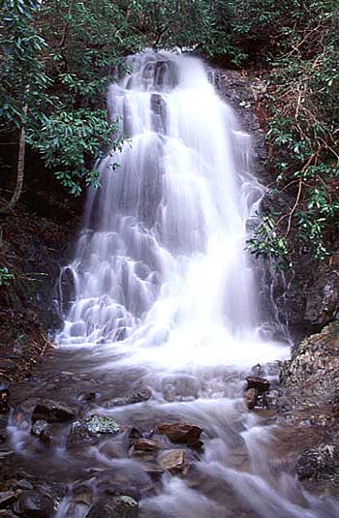
‘Cataracta’ (latin) means ‘waterfall’

Slide 17
Definition:
Cataract is caused by opacification and degeneration of lens fibres already formed, the formation of aberrant lens fibres or deposition of other materials in their place.

Slide 18
Classification of Cataract
Developmental
Age related (senile)
Cataract associated with ocular diseases

Slide 19
Contd…
4. Cataract associated with systemic diseases (pre-senile):
Diabetes, Hypoglycemia, Hypoparathyroidism, Myotonic Dystrophy, Galactosaemia, Alport Syndrome, Lowe Syndrome, Stickler Syndrome, Down Syndrome
Skin Diseases – Atopic Dermatitis, Ichthyosis

Slide 20
Contd…
5. Traumatic Cataract : Trauma (Blunt / Perforating) , Electric Shock, Radiation

Slide 21
Contd…
6. Drug induced cataract :
Corticosteroids, Anticholinesterases, Chlorpromazine, Busulfan, Choroquine, Amiodarone, Cigarette smoker, Copper, Iron, Gold.
Deficiency of amino-acids or Riboflavin (B2)

Slide 22
Etiopathogenesis of Cataract
Caused by degeneration and opacification of existing lens fibres, formation of aberrant fibres or deposition of other material in their place.
Loss of transparency occurs because of abnormalities of lens protein and consequent disorganization of the lens fibres

Slide 23
Etiopathogenesis of Cataract
Any factor that disturbs the critical intra and extra cellular equilibrium of water and electrolytes or deranges the colloid system within the fibres causing opacification.
Fibrous metaplasia of lens fibres occurs in complicated cataract.
Epithelial cell necrosis occurring in angle closure glaucoma leads to focal opacification of the lens epithelium (Glaucomflecken)

Slide 24
Etiopathogenesis of Cataract
Abnormal products of metabolism, drugs or metals can be deposited in storage diseases (Febry), metabolic diseases (Wilson) and toxic reactions (Siderosis)

Slide 25
Etiopathogenesis of Cataract
Three biochemical factors are evident in cataract formation:
1. Hydration: seen particularly in rapidly developing forms. Actual fluid droplets collect under the capsule forming lacunae between fibres, the entire tissue may swell (intumescent) and becomes opaque, this process is reversible in early stage, as in juvenile insulin dependent diabetes.

Slide 26
Etiopathogenesis of Cataract
Hydration may be due to osmotic changes in the lens or due to changes in the semi-permeability of the capsule.
In traumatic cataract, rupture of capsule gives rise to lens swelling.

Slide 27
Etiopathogenesis of Cataract
2. Denaturation of lens proteins - If the proteins are denatured with an increase in insoluble protein, a dense opacity is produced. This stage is irreversible and opacity do not clear, this change is seen in young lens or the cortex of the adult nucleus where metabolism is active (soft cataract).

Slide 28
Etiopathogenesis of Cataract
3. Sclerosis: Inactive fibres of the nucleus suffer from degenerative change of slow sclerosis (hard cataract).

Slide 29
Etiological theories of Cataract
Etiological Theories
Biological
a. An expression of senility
b. Genetic
2. Immunological
3. Functional, due to strain of excessive accommodative strain

Slide 30
Contd…
4. Local Disturbances
a. Nutritional supply
b. Of the chemistry of lens due to disturbances of permeability
c. Radiational damage due to sunlight

Slide 31
Contd…
5. General metabolic disturbances
a. changes in blood chemistry
b. toxic states
c. conditions of deficiency
d. endocrine disturbances

Slide 32
Miscellaneous causes
Can be produced by:
1. Mechanical injury – concussion, rupture of capsule
2. Physical causes – Osmotic influences, cold and heat, acidity, electricity current
3. Radiational Cataract – Micro-wave, thermal, UV and ionizing radiation

Slide 33
Contd…
Decrease in semi-permeability of capsule
Interference with nutrient supply, anoxia and asphyxia
Sugar Cataract – Galactose, xylose, glucose
Deficiency cataract- lack of proteins, specific amino acids and vitamins

Slide 34
Cont…
8. A low calcium / phosphate ratio in the blood – parathyroidectomy and tetany
9. Endocrine Cataract
10. Toxic cataract – Naphthaline, dinitrophenol, paradichlorbenzene, thallium, cobalt, anti-mitotic agents, enzyme inhibitors, cataractogenic drugs
11. Due to systemic infections

Slide 35
Age Related (Senile) Cataract

Slide 36
Age Related Senile Cataract
Age related cataract is universal in persons over 70 years of age. Both sexes are involved equally.*
There is considerable genetic influence.
Average age of onset of cataract is approximately 10 years earlier in tropical countries.

Slide 37
Senile Cataract
Types:
Cortical Cataract: Wherein classical sign of hydration followed by coagulation of protein appears in cortex
Nuclear or Sclerotic Cataract: Here the essential feature is slow necrosis of nucleus.

Slide 38
Cortical Cataract
1. Demarcation of cortical fibres due to their separation by fluid (Lamellar Separation)
Increased refractive index of cortex gives a grey appearance to the pupil as against the blackness seen in the young. The greyness is due to increase in reflection and scattering of light (and not due to cataractous changes)

Slide 39
Contd…
2. Incipient cataract: Wedge shaped spokes of opacities with clear areas in between them appear in peripheral lens and are common in lower nasal quadrant (Cuneiform opacities) . These opacities lies in the cortex in front and behind the nucleus. There is sectoral alteration in refractive indices of the lens fibres, producing irregularities in refraction. Patient experience visual deterioration and polyopia.

Slide 40
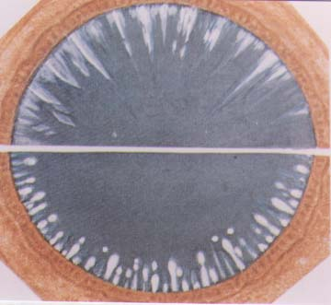
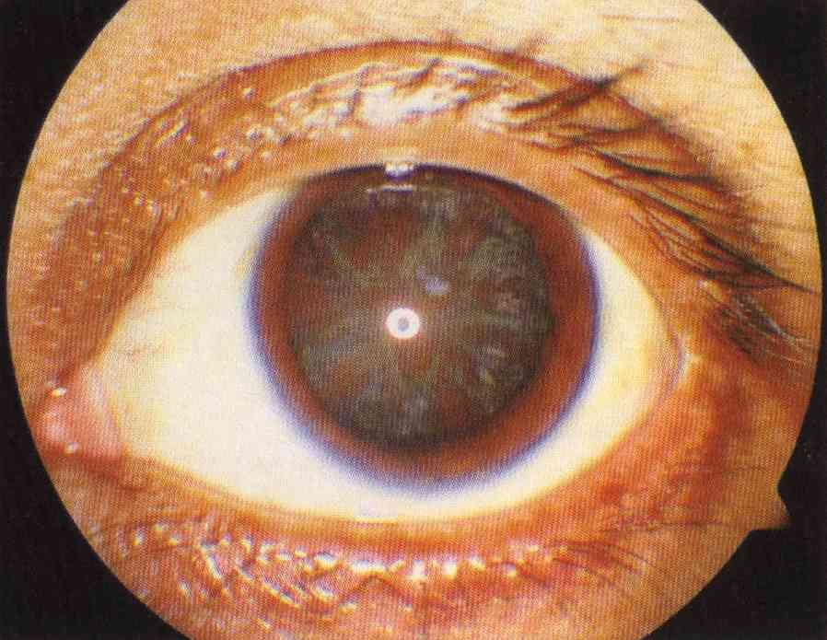

Slide 41
Contd…
3. Cupuliform Cataract: consisting of dense aggregation of opacities just beneath the capsule in posterior cortex. It is difficult to see with ophthalmoscope but can be detected as a dark shadow on distant direct ophthalmoscopy. Being near the nodal point of the eye the vision is diminished considerably.

Slide 42
Contd…
4. Perinuclear Punctate Cataract: Appears in elderly people often in association with a coronary cataract.
Recognized by a thickening and intensification of the appearance of the anterior and posterior bands of the adult nucleus, multiple small opaque dots with large plaques are seen in the deeper layers forming concentric lines and cloudy patches.

Slide 43
Contd…
Incipient cataract stage is followed by diffuse and irregular opacification of deeper layer of cortex which becomes cloudy and eventually uniform white and opaque. Progressive hydration of cortex may cause swelling of the lens, making the anterior chamber shallow (intumescent cataract) eventually entire cortex becomes opaque, swelling subside and cataract is termed as mature.

Slide 44
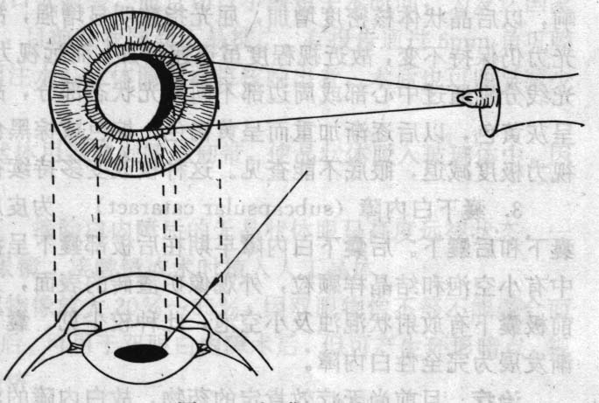
  Intumescent stage (immature):
    iris projection
    Induces acute angle-closure glaucoma

Slide 45
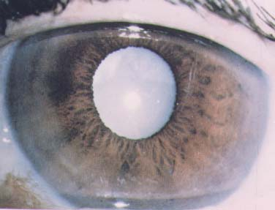
Mature cataract

Slide 46
Contd…
In the mean time the nucleus suffers progressive sclerosis. If the process is allowed to go uninterruptedly, the stage of hypermaturity sets in.

Slide 47
Hypermature Cataract
Types of hypermature cataract:
a. Hypermature shrunken cataract- when cortex disintegrate and transform into pultaceous mass. The lens become inspissated and shrunken, the anterior capsule become thickened. A dense white capsular cataract (sometimes with capsular calcification)

Slide 48
Hypermature Cataract
b. Morgagnian Hypermature Cataract: Following maturity, sometimes cortex becomes fluid and nucleus sink into the bottom. The liquefied cortex become milky and nucleus is seen as brown mass, visible as semicircular line in pupillary area altering its position with change in position of the head.

Slide 49
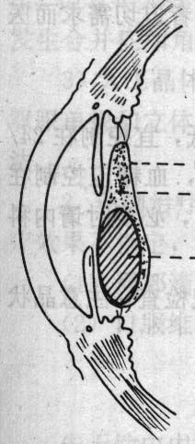
  Hypermature stage:
    Morgagnian cataract
    Phacoanaphylactic uveitis
    Phacolytic glaucoma

Slide 50
Senile Nuclear Sclerosis
The normal tendency of central nuclear fibres to become sclerosed is intensified. The cortical fibres remain transparent. This type of cataract tends to develop earlier than cortical type, usually in fifth decade. It typically blur the distant vision more than near vision.

Slide 51
Senile Nuclear Sclerosis
With time nucleus becomes diffusely cloudy. Cloudiness spread towards the cortex. Occasionally nucleus becomes tinted dark brown, dusty red or even black due to deposition of yellow pigmented protein derived from the amino acid tryptophan. The brown cataract is called cataract brunescens, and black cataract is termed as cataracta nigra.

Slide 52
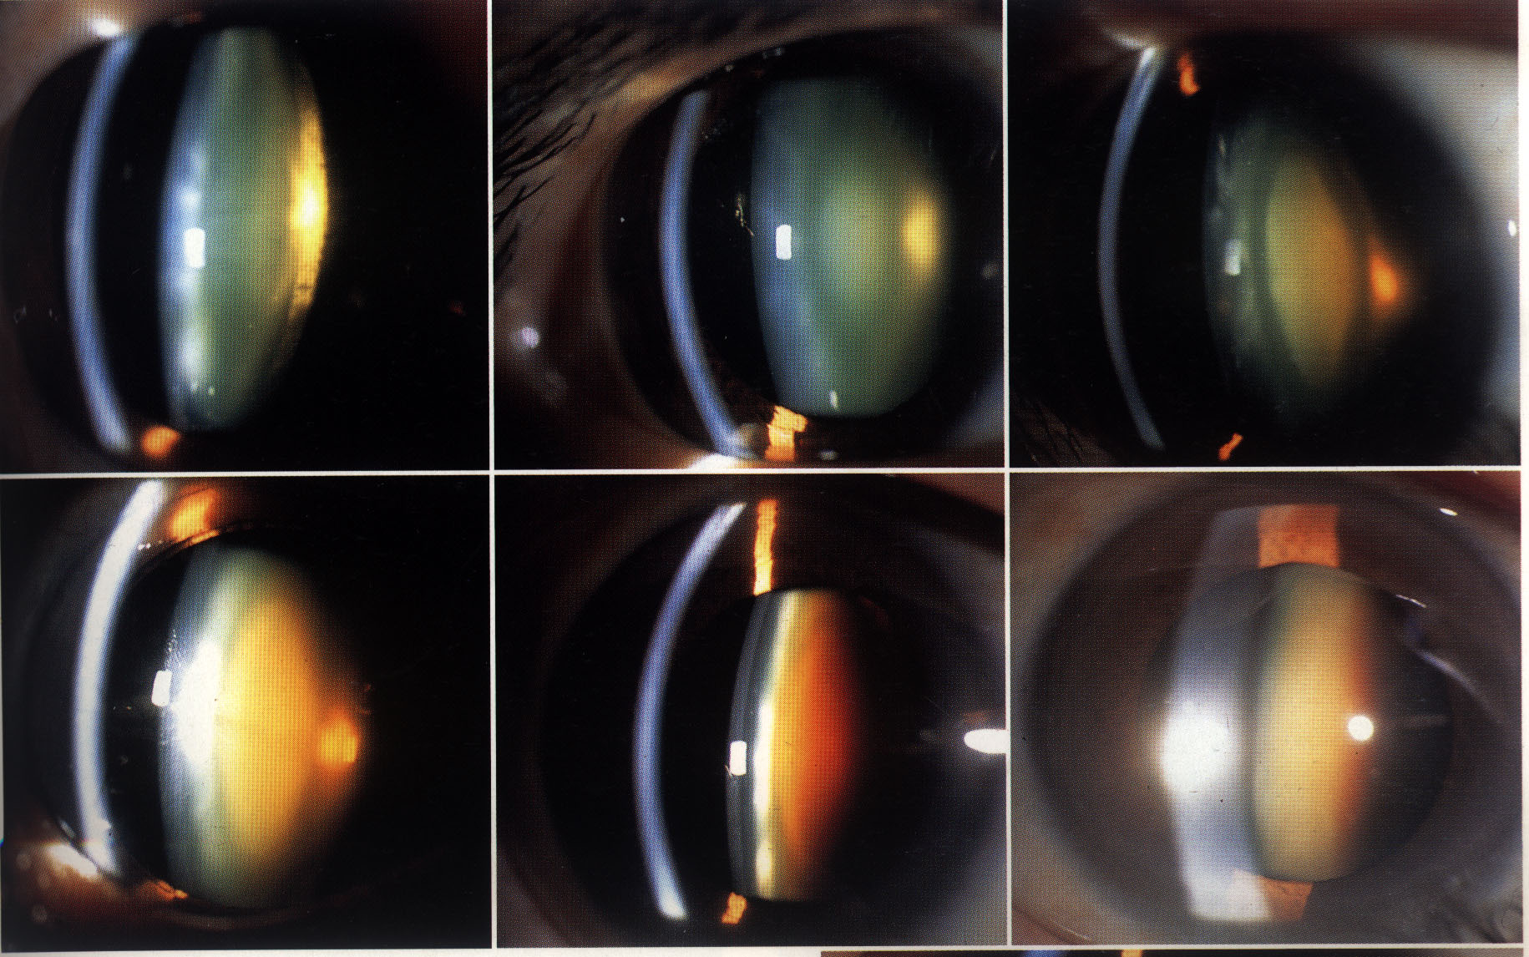
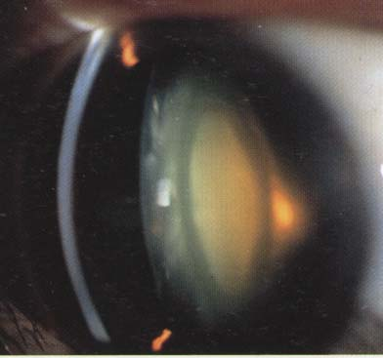

Slide 53
Symptoms of Cataract
1. Blurring of vision
2. Frequent change of glasses due to rapid change in refractive index of the lens
3. Painless, progressive, gradual diminution of vision due to reduction in transparency of the lens
4. Second sight or myopic shift in case of nuclear cataract causing index myopia, improving near vision.

Slide 54
Contd…
5. Loss or marked diminution of vision in bright sunlight or bright light beam in central posterior sub-capsular cataract.
6. Monocular diplopia or polyopia in presence of cortical spoke opacities
7. Glare in posterior sub-capsular cortical cataract due to increased scattering of light

Slide 55
Contd…
8. Colored haloes around the light as seen in cortical cataract due to irregular refractive index in different parts of the lens.
9. Color shift , reds are accentuated
10. Visual field loss, generalized reduction in sensitivity due to loss of transparency

Slide 56
Signs of senile cataract
Positive findings
Diminution of vision
Anterior chamber is shallow in cases of intumescent cataract and deep in cases of hypermature (shrunken) cataract
Tremulousness of iris in cases of hypermature shrunken cataract

Slide 57
Contd…
4. Lenticular opacity , grey or white opacity in lens. Iris shadow in immature cataract. No iris shadow in mature cataract
5. Morgagnian Cataract- is characterized by liquefied cortex, which is milky and nucleus is seen as brown mass, seen as semicircular line, altering its position with change in position of head

Slide 58
Contd…
6. Distant direct ophthalmoscopy will reveal black shadow against red background in cases of immature cataract.

Slide 59
Complications of Cataract
Secondary glaucoma during intumescent stage by causing angle closure and phacolytic glaucoma and lens induced uveitis in hypermature cataract
Anaphylactic irritation by the products of hypermaturity
Subluxation and dislocation of hypermature cataract

Slide 60
Differential Diagnosis of painless gradual diminution of vision
Chronic open angle glaucoma
Macular degeneration
Optic atrophy
Corneal dystrophy
Retinopathy associated with systemic disorders (hypertension or diabetes)

Slide 61
*Prevalence of age-related lens opacities in a population. The Beaver Dam Eye Study. Klein BE, Klein R, Linton KL Ophthalmology [1992, 99(4):546-552]
Klein BE, Klein R, Linton KL. | Prevalence of age-related lens opacities in a population. The Beaver Dam Eye Study. | This study highlights the prevalence and severity of lens opacities in a rural community in the United States. | Adults between the ages of 43 and 84 years were examined and participated in the study (n = 4926). Photographs were taken of the lenses and were graded in masked fashion according to a standardized protocol. | 17.3% had nuclear sclerosis more severe. Cortical opacities increased with increasing age and were more common in women. They were found in 16.3% of the population. There was a trend of greater prevalence at older ages, but no sex effect.

Slide 62
1. What is modern technique of cataract surgery called?
Trabeculectomy
Iredectomy
ICCE
Phacoemulsification

Slide 63
2Measures to avoid cataract formation
Wear sunglasses with 100% UV Protection.
Avoid smoking
Wear protective eye gear, to avoid eye trauma.
All of the above

Slide 64
.3 What is the most common cause of reduced vision after cataract surgery?
After cataract
Refractive error
Inflammation
All of the above

Slide 65
4. Phacoemulsification cataract surgery is performed through a ____________mm wound.
<3mm
6mm
>6mm
None of the above

Slide 66
Thank you

