Slide 1
Optic Nerve
Dr Hetaj Sheth

Slide 2
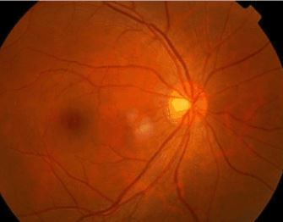
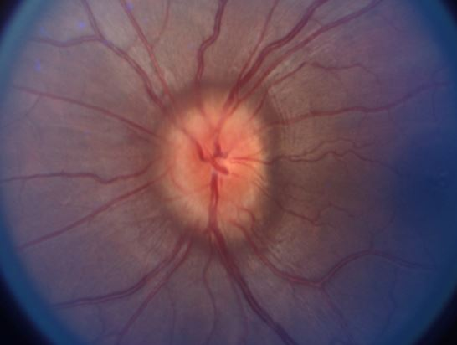
Disc EDEMA -
Swelling of Optic Nerve Head
Generally includes all causes of active & passive swelling of ONH (other than causes of papilledema)
It causes Disc elevation relative to the surrounding retina
You can also notice,
Disc hyperemia
Blurred disc margins
Nerve fiber layer swelling
Tortuous vessels

Slide 3
PSEUDO-PAPILLEDEMA - DISC ELEVATION WITHOUT A TRUE SWELLING
Pseudopapilledema is defined as anomalous elevation of one or both optic discs without edema of the retinal nerve fiber layer
OPTIC DISC ANOMALIES:
  Hypermetropic (Crowded) Optic disc
  Tilted disc
  Myelinated Nerve Fibre
  Hypoplastic Optic disc
  ONH Drusen
  Morning Glory Syndrome
  Bergmeister’s Papilla

Slide 4
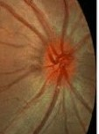
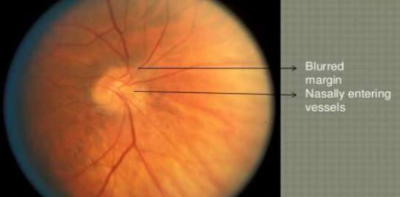
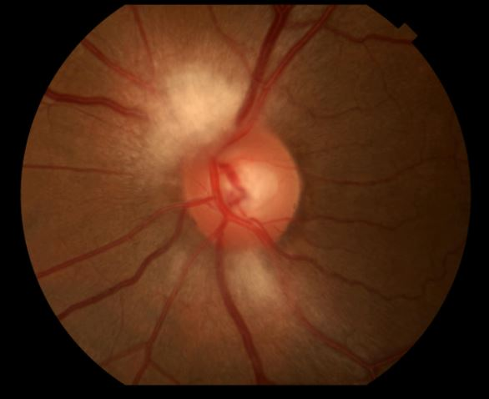
PSEUDO-PAPILLEDEMA - DISC ELEVATION WITHOUT A TRUE SWELLING
Pseudopapilledema is defined as anomalous elevation of one or both optic discs without edema of the retinal nerve fiber layer
OPTIC DISC ANOMALIES:
  Hypermetropic (Crowded) Optic disc
  Tilted disc
  Myelinated Nerve Fibre
  Hypoplastic Optic disc
  ONH Drusen
  Morning Glory Syndrome
  Bergmeister’s Papilla

Slide 5
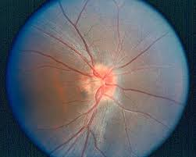
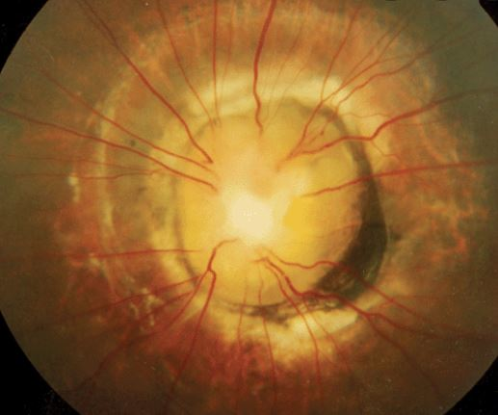
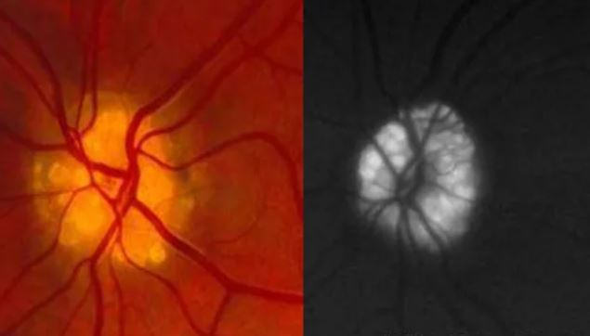
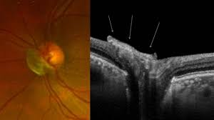
PSEUDO-PAPILLEDEMA - DISC ELEVATION WITHOUT A TRUE SWELLING
Pseudopapilledema is defined as anomalous elevation of one or both optic discs without edema of the retinal nerve fiber layer
OPTIC DISC ANOMALIES:
  Hypermetropic (Crowded) Optic disc
  Tilted disc
  Myelinated Nerve Fibre
  Hypoplastic Optic disc
  ONH Drusen
  Morning Glory Syndrome
  Bergmeister’s Papilla

Slide 6
FEATURES | PAPILLEDEMA | PSEUDO-PAPILLEDEMA
CAUSE | Increase ICP | Anomalies,Drusen etc
Vn COMPLAINTS | uncommon | Not new
LATERALITY | B/L | U/L or B/L
CLINICAL FEATURES | Asymptomatic (but Headache,N,V) | Are co-incidental
DISC ELEVATION | Elevation of Disc + RNFL | Elevation confined to disc
DISC MARGIN | Blurring | Distinct (blurring uncommon)
DICS CUP | Loss of Cup | Small cupless disc is frequent
DISC VASCULARITY | Hyperemic | Not Hyperemic
VESSEL AT DISC MARGIN | Blurred or Obscured by Swelling | Clearly Visible +/- Anomalous branching
SPONTANEOUS VENOUS PULSE | Lost | May be present
VENOUS CONGESTION | Present | No
PERIPAPILLARY H’GES | Present | No
EXUDATES | Present | No
OTHERS | Circumferential Retinal folds
COLOR VN | May be impaired | normal
VISUAL FIELD DEFECT | Enlarged Blindspot | normal
OTHER Ix | Differentiate betn Papilledema and Papillitis

Slide 7
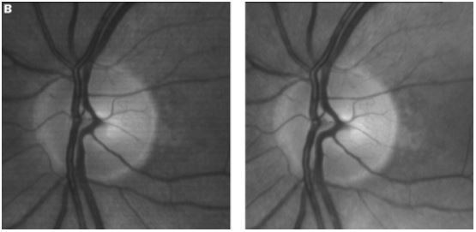
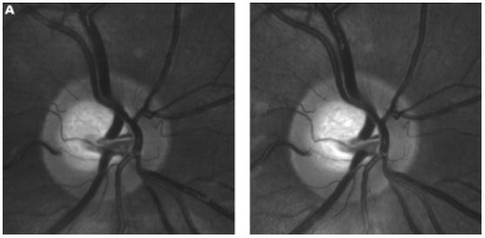

Slide 8
Papilledema

Slide 9
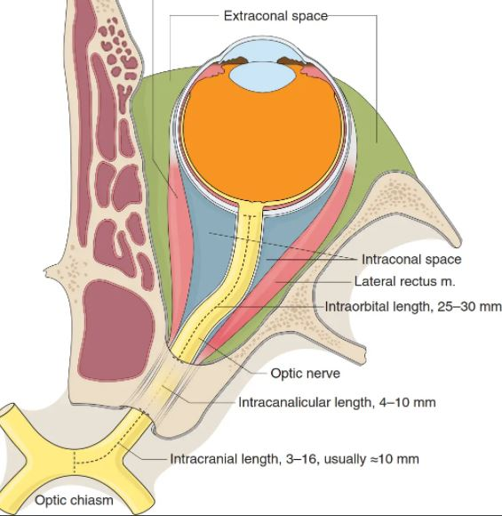
True Disc edema – Papilledema – Most Common cause
COMMON
Papilledema – CNS Causes
INFLAMMATORY - Optic Neuritis
VASCULAR / ISCHEMIC
LESS COMMON
TOXIC/ METABOLIC/ NUTRITIONAL
TRAUMATIC
COMPRESSIVE
INFILTRATIVE
LEBER’S HEREDITARY
OCULAR HYPOTONY
ETIOLOGY / CAUSES
Space occupying Lesion
Cerebral Edema
CSF – Inc prodn
-- Dec Absorb
Miscell

Slide 10
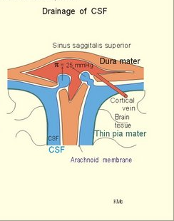
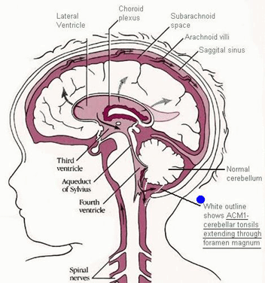
Papilledema - CSF flow
Choroid plexus
Lateral ventricles
Third ventricle
Fourth ventricle through Aqueduct of Sylvius
Enters subarachnoid space through foramen of Majendie & Luschka
CSF in subarachnoid space around spine and brain
Arachnoid villi
Drains into venous sinuses

Slide 11
Causes of Raised ICP
^ICP
SOL
CSF
TISSUE FLUID
CEREBRAL EDEMA
TRAUMA
Traumatic Brain injury
METABOLIC
Hepatic enceph
Diabtic keto acidosis
Nephritis
TOXIC
Reye’s Syndrome
CO poisoning
ANOXIC
Hypox Ische Enceph
Large Stroke
INFECTION
Encephalitis
Meningitis
VASULAR
Malignant Hypertension
Blood dyscrasias
SPACE OCCUPYING LESIONS
Brain Tumors
Brain Abscess
Intra cranial Hematoma
Inc prod
Choroidal Plexus papilloma
Dec Drain
BLOCKED FLOW
Obstructive Hydrocephalus
Communicating Hydrocephalus
DECREASED RESORPTION
A-V malform (Venous HT)
Cerebral venous thrombosis
Sub Arach Hemorrhage
Meningitis
MISELLANEOUS
Idiopathic Intracranial Hypertension d/t Tetracyline, Vit A , ontraceptives, Steroids
Dec size of cranium- Craniosynostosis

Slide 12
Papilledema – Stages
 | EARLY | ESTABLISHED | CHRONIC | ATROPHIC
Color | Disc hyperemia | Congested, Angry | Still Mild Hyperemia | Pale Disc
Cup | May/May not be present | Obliteration of Cup | Cup absent | Cup absent , Flat
Disc Edema | Swelling → I , S , N/T | Gross Elevation | Rounded app of disc | No Edema
Margins | Indistinct optic disc margins | Not demarcable | Hazy | Distinct
Vessels | obscures the fine peripapillary vessels. | Venous congestion tortuosity | Opto-ciliary shunts | Vessels Narrow +/- Sheathed
RNFL | Subtle edema of RNFL | Raised with Severe Edema, Circumferential Retinal folds (Paton’s Lines) | Raised but starting to thin out | Atrophy +/-Pigment changes
H’ge & Exu (Red Free) |  | Disc adjacent Splinter H’ge & Exudates | Resolved H’ges and exudates
Macula |  | Macular Star , (esp Nasal half) |  | Choroidal folds over macula

Slide 13
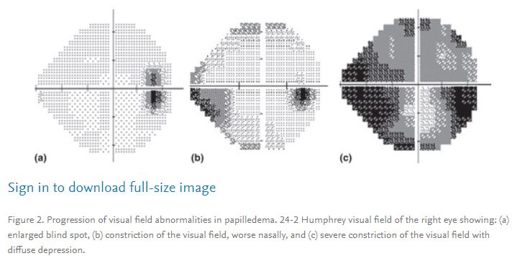
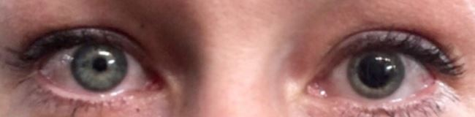

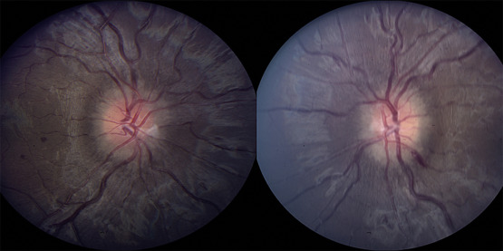
Papilledema – clinical features
NON-VISUAL SYMPTOMS:
Headache, Nausea, vomiting (projectile)
Loss of consciousness
Motor rigidity
VISUAL SYMPTOMS
Most cases Asymptomatic
Raised ICT → Decreased Blood flow to Brain→Transient visual obscurations esp. asso. with Postural changes
Visual field defects
    Enlargement of blind spot (most common)
    Arcuate scotomas
    Nasal worse than temporal
    Constriction of visual fields
Loss of central vision
Displacement of Brain tissue → 6th nerve palsy → Diplopia
Displacement of Brain tissue → 3rd nerve palsy → Hutchinson’s Pupil
SIGNS
Disc edema – Papilledema - Almost always Bilateral although it may be asymmetrical

Slide 14
Optic neuritis

Slide 15
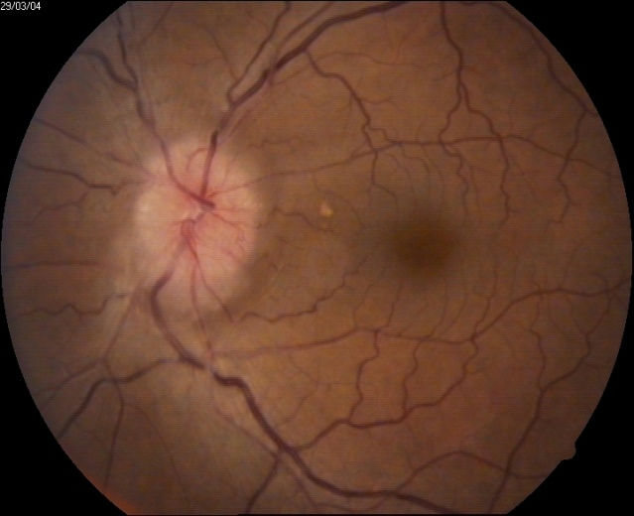
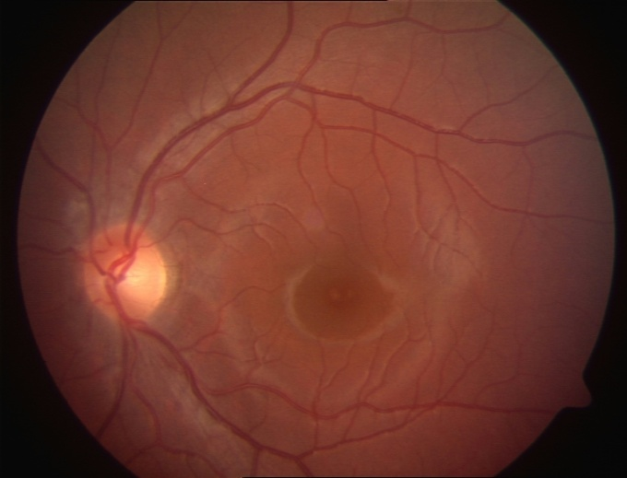
True Disc edema –
Papillitis
Hyperemia & disc edema
Peripapillary NFL Hges
Young adults
COMMON
Papilledema – CNS Causes
INFLAMMATORY - Optic Neuritis
2nd MC cause
VASCULAR / ISCHEMIC
LESS COMMON
TOXIC/ METABOLIC/ NUTRITIONAL
TRAUMATIC
COMPRESSIVE
INFILTRATIVE
LEBER’S HEREDITARY
OCULAR HYPOTONY
Morphological:
Papillitis
Neuroretinitis
Retrobulbar neuritis (Diagnosis of Exclusion)
NeuroRetinitis
Papillitis + RNFL infl’n + Macular star
Children,
B/L
Post infectious
RetroBulbar Neuritis
Normal ONH
Involves retrobulbar area
Temporal disc pale
Adults

Slide 16
Optic neuritis – etiology
  Demyelinating
  Isolated ,
  Multiple sclerosis
  Neuromyelitis Optica
  Infection:
  Local: Cellulitis, sinusitis, Retinochoroiditis
  Systemic:
    Viral-Influenza measles, mumps,Herpes
    Bacterial- TB, Syphilis, Cat-scratch, Lyme’s,
    Fungal- Cryptococcal, Histoplasmosis
    Others- Toxoplasma, Toxocara, Cysticercosis
  Post-viral, Post-vaccination
  Autoimmune
  Sarcoidosis
Site of affection
45% Ant On
60% Mid orbital
35% Intracanalicular
5% Prechiasmal (Intra cranial)
2% Chiasmal ( Intra Cranial)
Papillitis
Retro bulbar Neuritis

Slide 17
Optic neuritis
Predominantly affects females
Common in the age group of 20 to 50
Occasional in children or elderly
Uniocular mostly
Visual Loss – Sudden profound DOV
Often painful visual loss , Periocular Pain - aggravated by ocular movement esp up & down
Over hours to days , Peak within 2 weeks
Starts improving thereafter
RAPD +
Colour vision, contrast sensitivity, depth perception
  Loss of color vision much worse than ↓ vision
Symptoms of Multiple Sclerosis
Visual field defects, Marcus Gunn Pupil
Vision loss exacerbated by heat or exercise (Uhthoff phenomenon).
Objects moving in a straight line may appear to have a curved trajectory (Pulfrich phenomenon), presumably due to asymmetric conduction between the optic nerves.
Photopsias: positive visual phenomenon in 30% cases. Known as PHOSPHENES
DISC EDEMA:
  Present in about one third cases
  Disc margin slightly/ markedly blurred
  Degree of swelling do not correlate with severity of visual acuity or field loss
  Rarely hemorrhages and cotton wool spots Disc or peripapillary hges & segmental disc swelling less common than with AION
Fundus normal in retrobulbar neuritis
Any visual field defect may be seen- generalized depression common
VER- prolonged latency with normal or depressed amplitude.
Fellow eye defects viz. DOV, colour, contrast, V.fields.

Slide 18
Optic neuritis – special pointers
LEADING QUESTIONS
Pain (stationary & with movement)
Headache (IIH, Papilledema)
Previous H/o of similar complain
Prev H/o medical/ Ocular/Neuro Rx
Current Systemic Drugs
Recent Illness (post inf)
Pets
Occupation
Visit to endemic areas
Best corrected Vision
RAPD
Color Vn
Contrast Vn
SLE – Cells
Fundus
Ocular movement
Cranial nerves
Visual fields
VEP
CT , MRI,

Slide 19
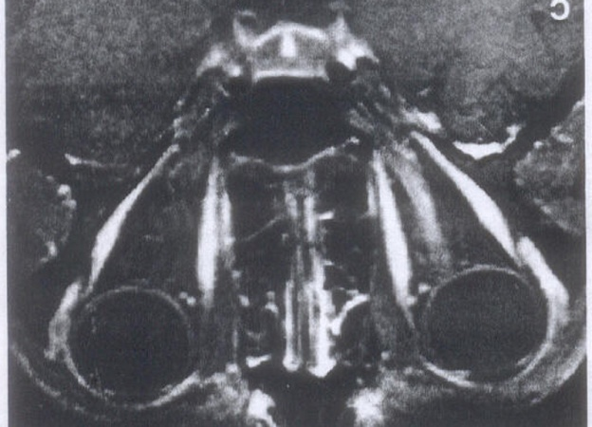
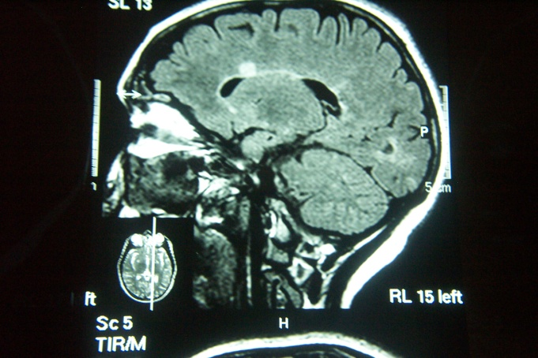
Optic neuritis - investigations
Periventricular Demyelination
X-ray (Chest) – r/o Infective etio
ANA, FTA-ABS &VDRL, serology and culture for bartonella, viral serology
S. Electrolytes and glucose (for steroid therapy)
Contrast enhanced MRI (Compressive pathology, prognostication, ischemic vs. inflammatory pathology, need for interferon therapy)
Ensure OT Macula is normal (NeuroRetinitis)
Baseline Visual Field
Enhancement of the left optic nerve following injection of contrast
Routine Ix is not requried in diagnosis of typical case of ON
MRI is useful to prognosticate the development of MS
Can’t be regarded as conclusive if its negative
CSF analysis is not req in Typical ON

Slide 20
Optic neuritis - Treatment
ONTT recommendations
IV Methyl Prednisolone
250 mg 6 hourly for 3 days followed by
Oral Prednisolone 1 mg/kg for 11 days followed by quick taper over 3 days
Cheaper Alternative dexamethasone i.v.
Intramuscular Interferon β1a(Avonex) has been used in a weekly dose - to delay the onset of multiple sclerosis in patients with signal abnormalities on MRI (CHAMPS, CHAMPION, ETMSS study)
Only Oral Prednisolone is ineffective in standard doses and is associated with increased rate of recurrence
Only factor predicting visual recovery is initial severity of VL
IVMP f/b Oral Pred only speeds recovery of VL & results in slightly better Vn @ 6mths
& decrease 2 yr incidence of MS
The prognosis for visual recovery is good (ONTT)
  95% visual acuity :- 20/40 or more
  03% visual acuity :- 20/200 or less
Residual Defects-30-40%
  Dyschromatopsias
  Defective stereoacuity
  RAPD
  Delayed latencies on VER

Slide 21
Neuro-retinitis
Optic disc edema with macular star
Common in younger patients
No gender predominance
Usually painless
Begins with optic disc edema followed by macular star
Star may not be present uptil days to weeks & may persists for upto one year after edema resolves
Self limiting disorder with good prognosis
d/D HT, DM, Neph, RVO,
FA shows normal macular vessels supporting primary ON pathophysiology
D/D : Papilloedema, Disc infiltration,ION, Hypertension (FA shows retinal vascular leaks in these conditions)
Infectious etiology : Visual prognosis usually excellent. Bartonellae henselae and rickettsiae have been commonly implicated.

Slide 22
 | Papilledema | Papillitis | Retrobulbar neuritis
Definition | Swelling of optic nerve head due to increased ICP | Inflammation or infarction of optic nerve head | Inflammation of orbital portion of optic nerve
Unilateral/bilateral | Bilateral | Unilateral | Unilateral
Vision impairment | Nil to Mild | Diffuse, Moderate to Severe | Diffuse, Moderate to Severe
Field Defects | Enlarged blind spot | Central/paracentral scotoma to complete blindness | Central/paracentral scotoma to complete blindness
Fundus appearance | Hyperemic disk | Hyperemic disk | Normal
Vessel appearance | Engorged, tortuous veins | Engorged vessels | Normal
Hemorrhages | Around disk, not periphery | Hemorrhages near or on optic head | Normal
Pupillary light reflex | Not affected | Depressed | Depressed
Treatment | Normalize ICP | Corticosteroids if cause known | Corticosteroids with caution

Slide 23
Other Atypical demyelinating pathologies
Isolated ON
MS asso ON
ON in syst disease other than MS
Atypical ON
Pediatric ON
NMO
ADEM
Transverse myelitis

Slide 24
 | Typical Optic neuritis | Atypical Optic neuritis (Think except Demyelin)
Age | 15-45 | Age outside 15-45 , mostly older
 | Females 5:1
Lat | U/L (mostly) & | B/L simultaneous
 |  | Or 2nd eye involv within 2wks of 1st eye
Visual Symp | Acute DOV , over couple of days | Chronic DOV
 | & Moderate to Severe Vn loss | Only mild loss
 | Vn loss stabilise by day 14 | Worsen beyond Day14 (in strict sense1wk)
 | improves thereafter | fails to improve 1line in 3wk ( with Rx )
Other Symp | Pain (retro-orbital) on movememnt | Painless
 |  | OR Persistent Pain >7days
Pupil | RAPD | No RAPD
Fundus | Disc edema with peripapillary hges | UL Optic atrophy
 | OR Normal in Retrobulbar neuritis | Any inflammation,vitritis,
 |  | Macular star, retinal exudates
Color, Contrast,VFA | Poor Color & Contrast Vn, Gen depression of Field
Miscell | Systemic features of MS | Features suggestive of other diseases
Response |  | No Response to Steroids

Slide 25
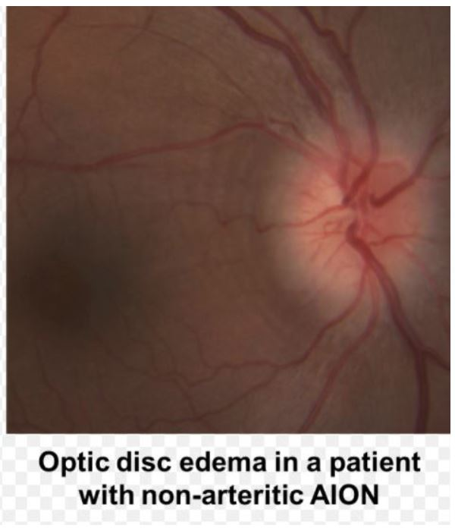
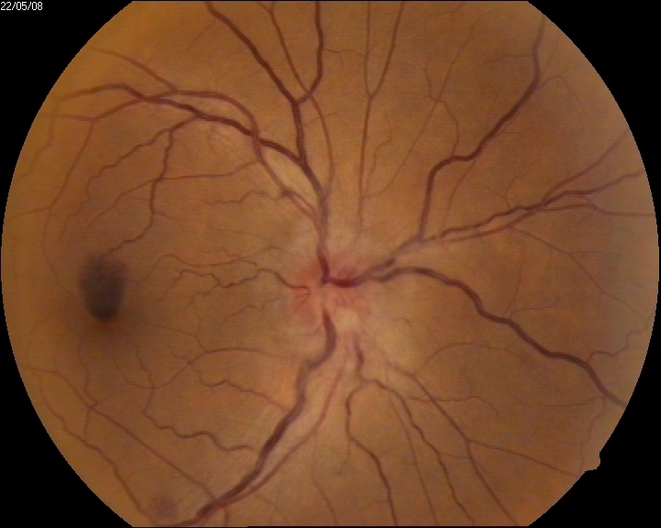
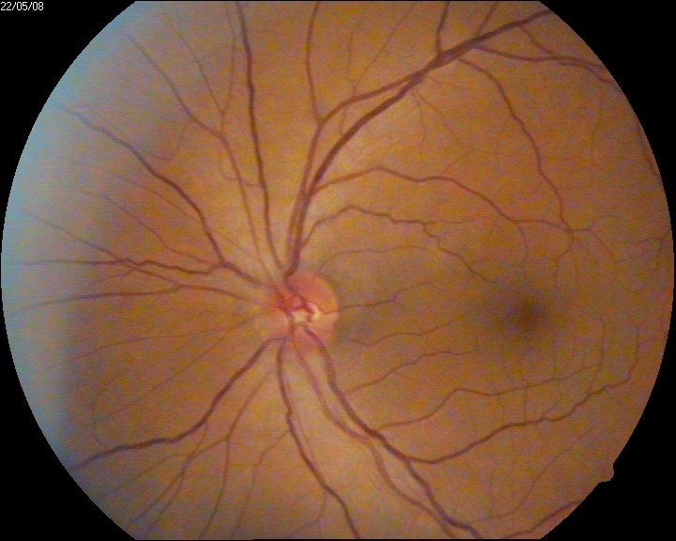
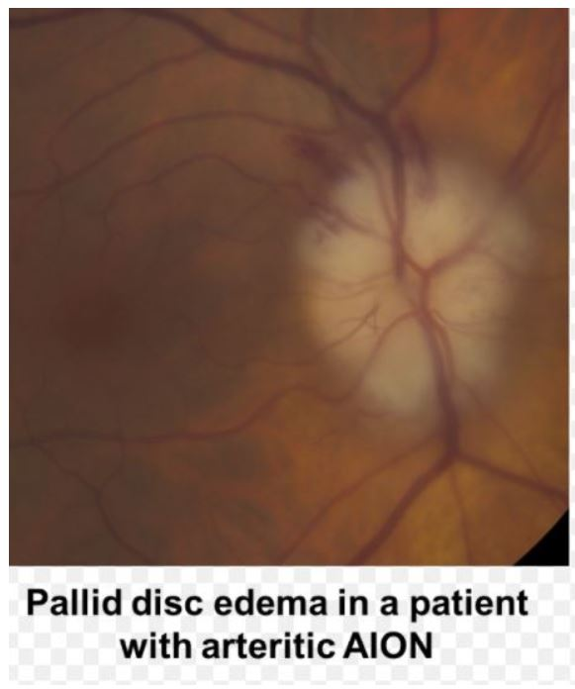
Anterior Ischemic optic neuropathy
Fellow eye small cup-disc ratio(disc at risk)

Slide 26
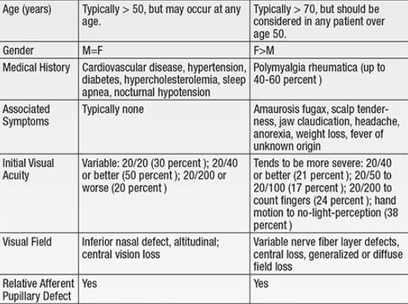
NA-AION A-AION

Slide 27
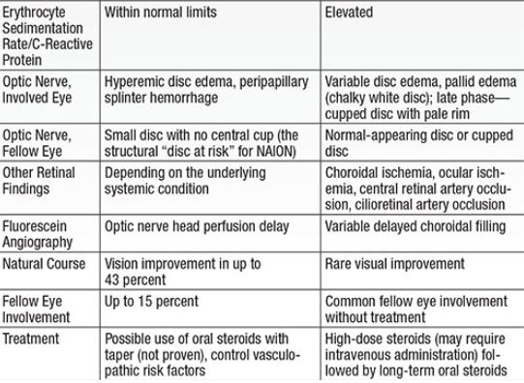
NA-AION A-AION

Slide 28
TOXIC OPTIC NEUROPATHIES
Disc swelling in some intoxications e.g. Alcohol, Tobacco, Ethambutol/ isoniazid/ amiodarone / Lead poison
Bilateral & simultaneous
Painless
Dyschromatopsia
DOV rarely less than 20/400 (3/60)
  Exception: methanol can produce complete blindness
Visual field defects
Disc normal/hyperemic
Temporal disc pallor, optic atrophy.
DRUG RELATED TOXIITY
Ethambutol (No Disc edema )
Isoniazid (Disc edema + peripheral neuropathy)
Months of starting AKT
B/L Color Vn problems
Progressive painless
No RAPD but sluggish
Stop both
May continue to deteriorate
Steroid of ?able help
Rx Vit B inj
Methanol Poisoning
Acute (<48hrs)
Headache N,V, Abd pain
Metabolic acidosis
Acute DOV with Disc Edema
Optic atrophy in 2-3 months

Slide 29
NUTRITIONAL OPTIC NEUROPATHIES
Thiamin is co-factor for glucose to Acetyl CoA
Folate & B12 detoxify cynide & formic acid both of which interfere with Mitochondrial oxidative phosphorylation
This Dysfn leads impairment of axoplasmic transport in longest axon causing peripheral neuropathy
Least medulated axons such as papillo-macular bundle show conduction deficit and degn
Lag period of 4 -6 month
Color VL is early
B/L Mod central VL may be assymm
No Nyctalopia,metamorphopsia,photophobia
No RAPD
Late Atrophy (Wernicke’s enceph)
asso Painful keratopathy
asso Sensoryneural Hearing loss
asso Peripheral Neuropathy
VFA, MRI, VEP to r/o Malignancy, Inflammatory lesion
Supplement all Nutritional deficits

