Slide 1
LACRIMAL SYSTEM
DR. H. D. AHIR
ASSOCIATE PROFESSOR
OPHTHALMOLOGY

Slide 2
WATERING
A. HYPERSECRETION
- Increased secretion of tears
- (secretary system)
B. EPIPHORA
- Due to defective drainage
- (excretory system)

Slide 3
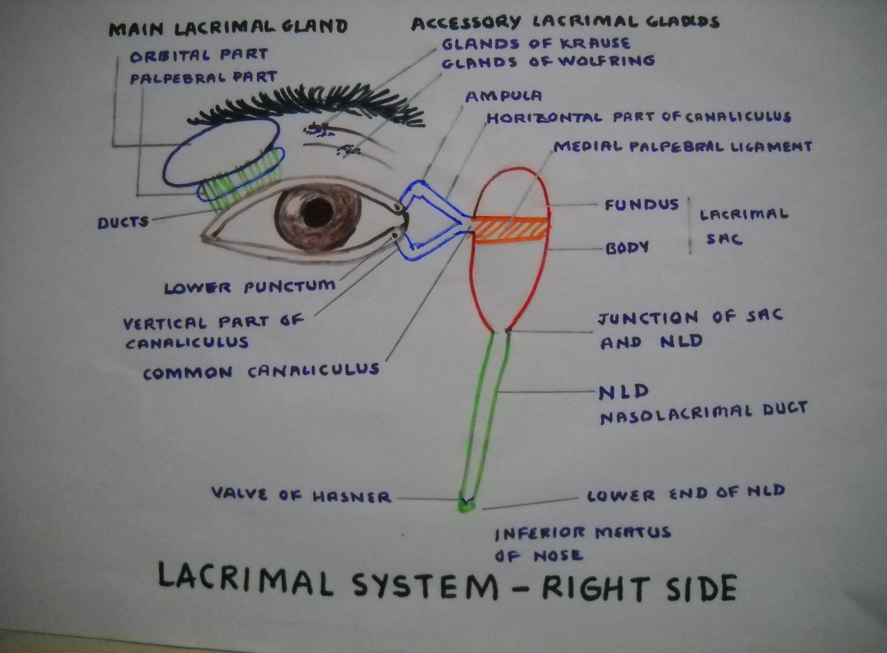

Slide 4
LACRIMAL DRAINAGE SYSTEM
THE MOST COMMON SYMPTOM IS WATERING
EPIPHORA: Watering due to obstruction, stenosis, malposition of puncta or functional disorders of lacrimal passages.
CAUSES:
PUNCTA: Absence, stenosis, foreign bodies (cilia) or malposition (Ectropion)
Treatment :Treatment of the cause
CANALICULI: Occlusion-slit open the canaliculi
LACRIMAL SAC AND NASOLACRIMAL DUCT
(Most common cause in adult and child)
-Congenital blockage of nasolacrimal duct in child
-Chronic dacryocystitis in adult

Slide 5
CONGENITAL DACRYOCYSTITIS
(NLD BLOCKAGE)
Present since birth;
AETIOLOGY:
Non-canalization of lower end of NLD
Presence of septa
Debris or mucosa in duct
Symptoms are:
Watering
Discharge
Photophobia

Slide 6
CONGENITAL DACRYOCYSTITIS
(CONTD)
TREATMENT
Local antibiotic drops and ointment
Systemic antibiotics if infection
Massage over sac area
If no relief – PROBING OF NLD after 1 year
under G. A. ( Downwards, outwards and backwards) with Bowman’s Probe
Complications-False passage, Perforation of palate and Failure of surgery- Rpt Probing
If no relief after 2-3 times probing then go for
DCR-DacryoCystoRhinostomy as for adult

Slide 7
INFLAMMATION OF SAC
(DACRYOCYSTITIS)
ACUTE DACRYOCYSTITIS
Acute purulent inflammation of sac with painful swelling
AETIOLOGY:
-Exacerbation of chronic dacryocystitis
-Spread of infection from nose, sinuses or
bones surrounding it
ORGANISMS: Staphylococci, streptococci, pneumococci
STAGES:
STAGE 1 CELLULITIS
Painful, red, hot swelling over sac area with surrounding
oedema spreading to lower lid and cheek with watering and discharge
Systemic manifestations like fever and malaise

Slide 8
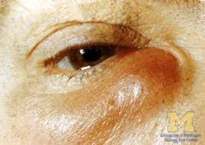

Slide 9
ACUTE DACRYOCYSTITIS (CONTD)
STAGE 2- LACRIMAL ABSCESS
Blockage of canaliculi and NLD ->Pus collection in sac-> Rupture at lower end -> Pericystitis
STAGE 3- FISTULA FORMATION
TREATMENT
Ophthalmic emergency
No syringing or probing
Local and systemic antibiotics
Anti-inflammatory analgesics
Hot fomentation
If pus pointing > drainage
If fistula formation > on healing DCR with fistulectomy

Slide 10
ACUTE DACRYOCYSTITIS
(CONTD)
COMPLICATIONS
Conjunctivitis
Corneal ulcer
Osteomyelitis
Orbital cellulitis
Cavernous sinus thrombosis
Lid abscess
Septicaemia
Chronic dacryocystitis with fistula or sinus

Slide 11
CHRONIC DACRYOCYSTITIS
AETIOLOGY: OBSTRUCTION at JN--> INFECTION
ORGANISMS: Same as in acute case
FEMALES>MALES Narrow NLD
SYMPTOMS:
Watering
Discharge
Swelling over sac area- mucocoele
Redness over medial canthus
SIGNS:
Prominent tear film
Discharge mucoid/mucopurulent
Swelling over sac area-Below medial palp.ligament
Regurgitation of mucous on pressing over sac area with subsidence of the swelling

Slide 12
INVESTIGATIONS
1. JONES DYE TEST 1
Fluorescein dye instilled in eye. Cotton swab put in nose. Look for staining of swab after 5 minutes. If stain –positive –PATENT. If negative-
2. JONES DYE TEST 2
DO SAC SYRINGING
If comes in nose/throat –positive-FUNCTIONAL BLOCK
If does not come in throat- negative-ORGANIC BLOCK
3. DYE DISAPPEARANCE TEST
Dye remains in conjunctival sac after 5 minutes
4. DCG –DACRYOCYSTOGRAPHY –X-Ray of lacrimal passages after injecting radio-opaque dye in it.
ADVANTAGE: Exact site of blockage, diverticulum's, growth, sinus, fistula –clearly seen with records
Modified DCG- MacroDCG, Substraction DCG

Slide 13
TREATMENT
1. SYSTEMIC AND LOCAL ANTIBIOTICS
2. SURGERY – DCR – DacryoCystoRhinostomy
Types:- TOTI’S-Flaps not sutured.
- DUPY DUTEMPS-Flaps sutured
COMPLICATIONS OF DCR SURGERY
Failure of surgery
Ectropion of lower lid
Sinusitis
Orbital cellulitis
CONTRAINDICATIONS OF DCR SURGERY
Sac malignancy,
Chronic infll of sac (TB,Syphilis)
ENT Conditions-Atropic rhinitis, Deviated nasal septum, Hypertrophied conches or inferior turbinate, large polyp
Small ,fibrosed shrunken sac
Resurgery

Slide 14
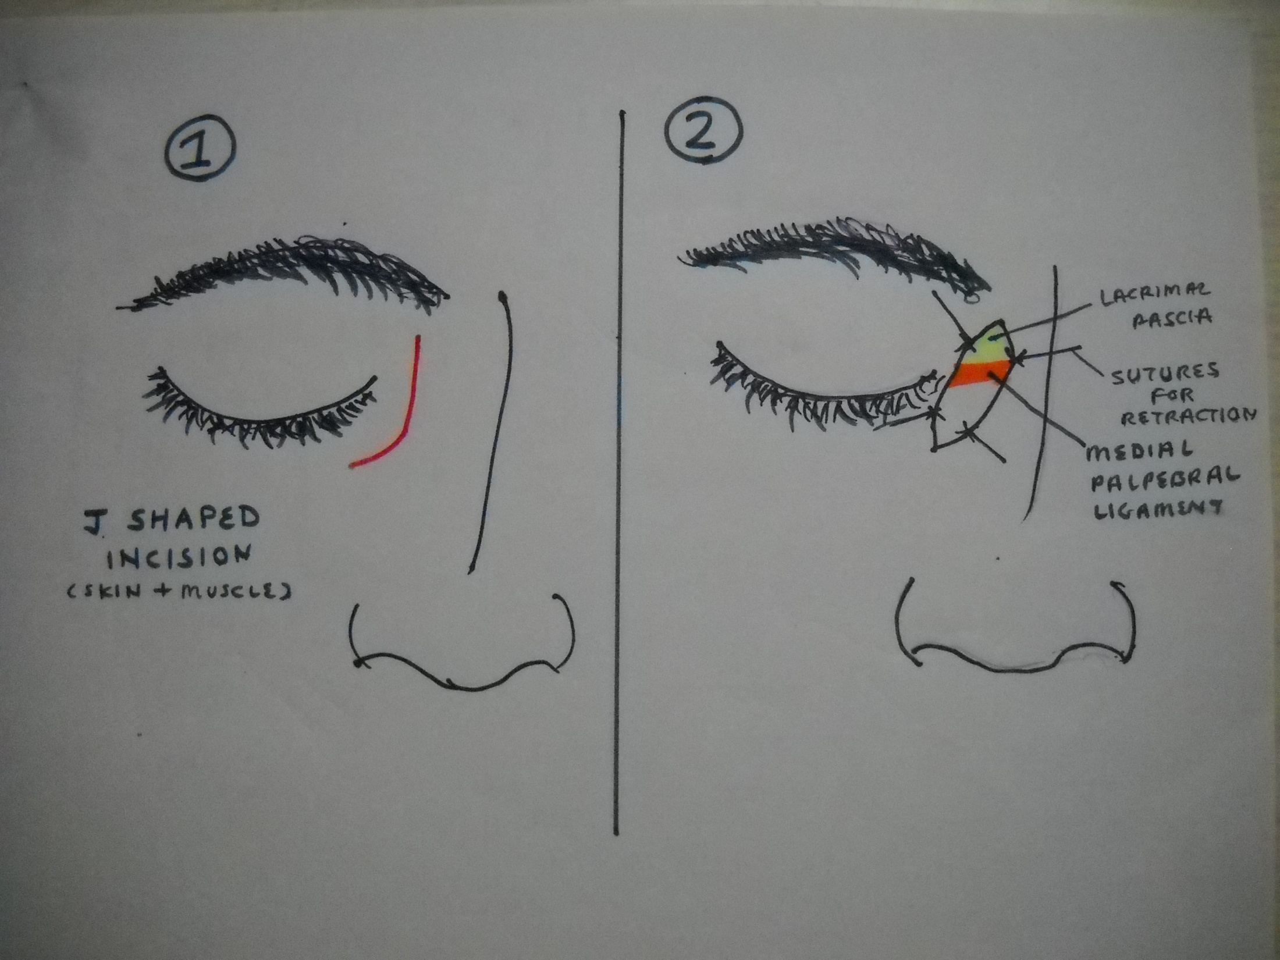

Slide 15
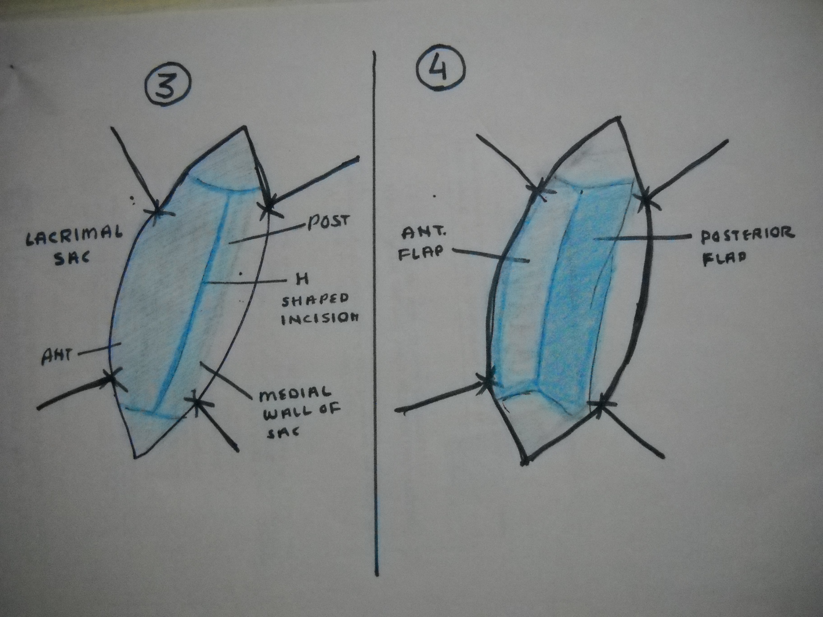

Slide 16
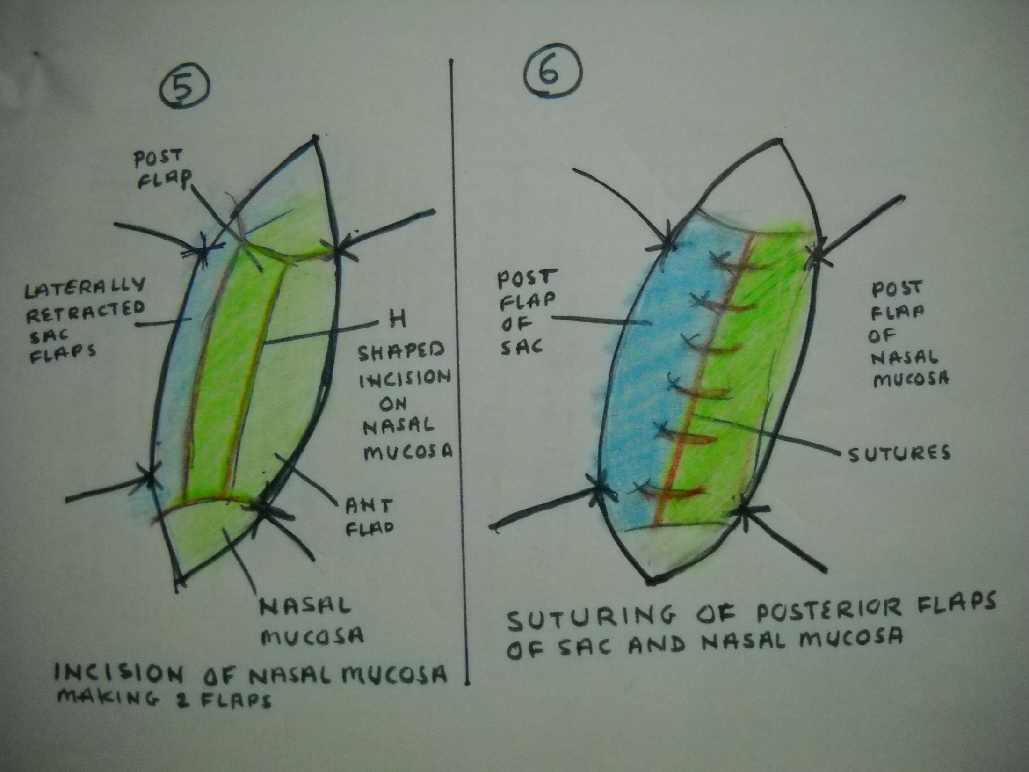

Slide 17
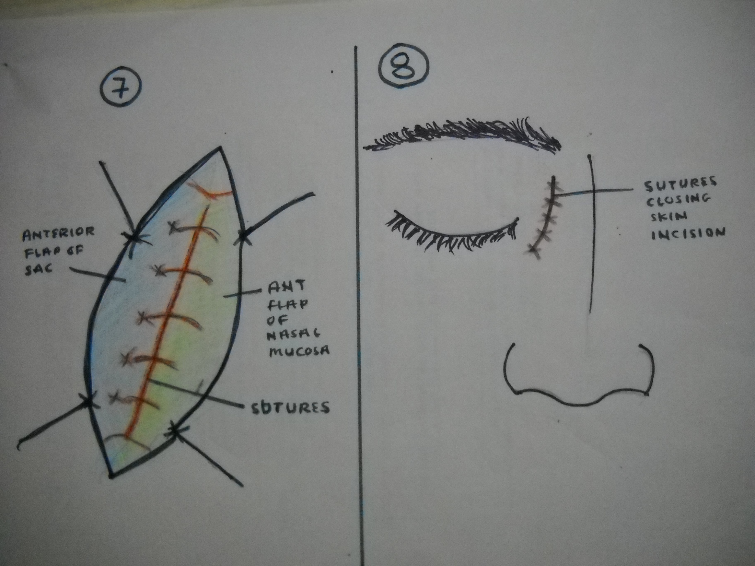

Slide 18
TREATMENT (CONTD)
DC-(DACRYOCTECTOMY)
Lacrimal sac is totally removed
In conditions mentioned earlier (contraindications of DCR) as sac malignancy etc.
MODIFICATIONS OF DCR SURGERY
CANALICULO-DCR
CONJUNCTIVO-DCR
PAWAR’S IMPLANT
ENDONASAL DCR
ENDOLASER DCR

Slide 19
CHRONIC DACRYOCYSTITIS
IMPORTANCE (SIGNIFICANCE)
Common cause of watering
Causes chronic conjunctivitis
Cause for non-healing corneal ulcer
No intraocular surgery can be performed in presence of chronic dacryocystitis ---> leads to ENDOPHTHALMITIS
-----------------------

