Slide 1
Squint
By-Dr.PUNIT SINGH

Slide 2
Extraocular muscles
Medial rectus
Inferior rectus
Lateral rectus
Superior rectus
: 5.5 mm
: 6.5 mm
: 6. 9 mm
: 7.7 mm
superior oblique muscle
inferior oblique muscle

Slide 3
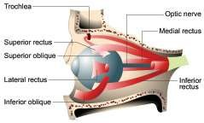
Extraocular muscles

Slide 4
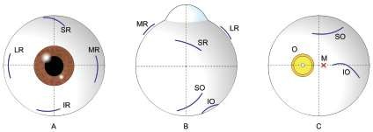
Origin of the rectus muscles and the superior oblique muscle

Slide 5
Nerve supply
Oculomotor- superior, medial, inferior recti and inferior oblique muscles.
Trochlear- Superior oblique
Abducent- Lateral rectus muscle.

Slide 6
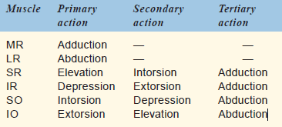
Action of the extraocular muscles

Slide 7

Action of the extraocular muscles

Slide 8
OCULAR MOTILITY
Uniocular movements- ‘ductions’
Binocular movements-
versions vergences.

Slide 9
Uniocular movements- ‘ductions’
1. Adduction
2. Abduction
3. Supraduction.
4. Infraduction
5. Incycloduction
6. Excycloduction

Slide 10
Binocular movements- Versions
1. Dextroversion
2. Levoversion.
3. Supraversion
4. Infraversion
5. Dextrocycloversion.
6. Levocycloversion

Slide 11
Binocular movements- Vergences
1. Convergence
2. Divergence

Slide 13
BINOCULAR SINGLE VISION
Grades of binocular single vision
Grade I —
Grade II—
Grade III—
Simultaneous perception Fusion.
Stereopsis.

Slide 14
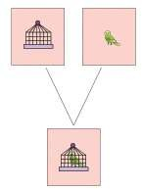
Simultaneous perception

Slide 15
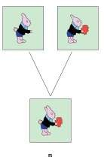
Fusion

Slide 16
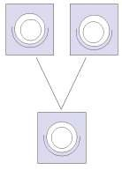
stereopsis

Slide 17
Anomalies of binocular vision
Suppression, Amblyopia
Abnormal retinal correspondence (ARC), Confusion
Diplopia.

Slide 18
STRABISMUS
A misalignment of the visual axes of the two eyes is called squint or strabismus.

Slide 19
Classification of strabismus
I. Apparent squint or pseudostrabismus.
II. Latent squint (Heterophoria)
III. Manifest squint (Heterotropia)
  Concomitant squint
  Incomitant squint.

Slide 20
HETEROPHORIA
Heterophoria also known as ‘latent strabismus’, is a condition in which
the tendency of the eyes to deviate is kept latent by fusion.

Slide 21
Types of heterophoria
1. Esophoria
i Convergence
ii Divergence
2. Exophoria
3. Hyperphoria
4. Cyclophoria

Slide 22
Etiology
Orbital asymmetry.
Abnormal interpupillary distance (IPD)
Faulty insertion of extraocular muscle.
A mild degree of extraocular muscleweakness.
Anomalous central distribution ofthe tonic innervation of the two eyes
Anatomical variation in he position of the macula

Slide 23
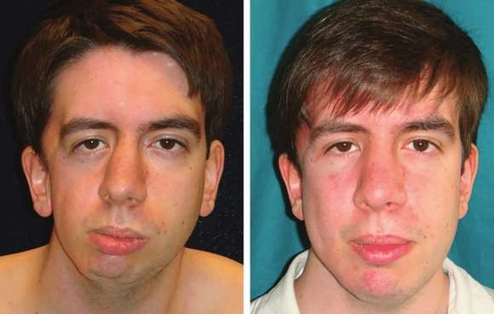
Orbital asymmetry

Slide 24
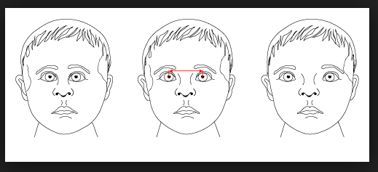
Abnormal interpupillary distance (IPD)

Slide 25
Symptoms
1. Symptoms of muscular fatigue.
2. Symptoms of failure to maintain binocular single
3. Symptoms of defective postural sensations cause

Slide 26
Examination of a case of heterophoria
1. Testing for vision and refractive error
2. Cover-uncover test.
3. Prism cover test
4. Maddox rod test
5. Maddox wing test.
6. Measurement of convergence and accommodation
7. Measurement of fusional reserve

Slide 27
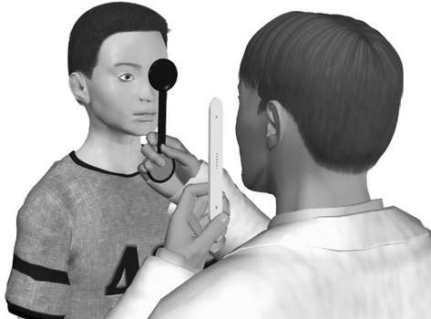
Cover-uncover test

Slide 28
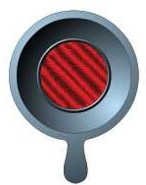
Maddox rod.

Slide 29
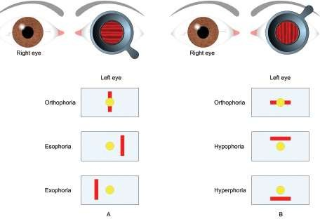
Maddox rod test

Slide 30
Treatment
1. Correction of refractive error
2. Orthoptic treatment
3. Prescription of prism in glasses
4. Surgical treatment

Slide 31
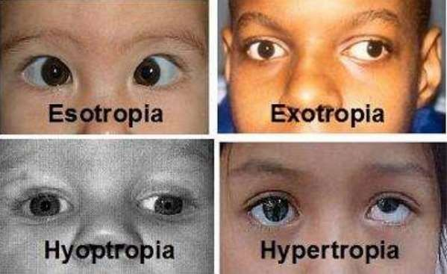
Manifest squint

Slide 32
Etiology
Refractive errors,
Prolonged use of incorrect spectacles,
Anisometropia,
Corneal opacities,
Lenticular opacities,
Diseases of macula (e.g., central chorioretinitis),
Optic atrophy, and
Obstruction in the pupillary area due to congenital ptosis.

Slide 33
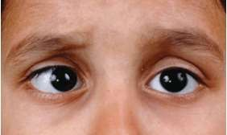
CONVERGENT SQUINT

Slide 34
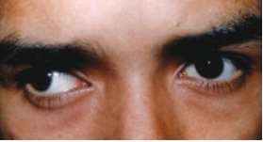
DIVERGENT SQUINT

Slide 35
EVALUATION OF A CASE OF CONCOMITANT STRABISMUS
I. History
II. Examination
1. Inspection
2. Ocular movements.
3. Pupillary reactions
4. Media and fundus examination.
5. Testing of vision and refractive error
6. Cover tests
i. Direct cover test
ii. Alternate cover test
7. Estimation of angle of deviation
i. Hirschberg corneal reflex test
ii. The prism and cover test
iii. Krimsky corneal reflex test.

Slide 36
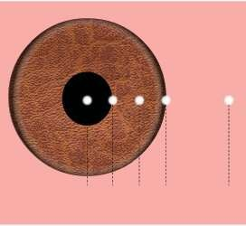
Hirschberg corneal reflex test.

Slide 37
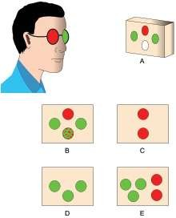
Worth’s four-dot test.

Slide 38
TREATMENT
1. Spectacles with full correction of refractive error
2. Occlusion therapy
3. Preoperative orthoptic exercises
4. Squint surgery

Slide 39
Surgical techniques
1. Muscle weakening procedures
2. Muscle strengthening procedures
3. Procedures that change direction of muscle action

Slide 40
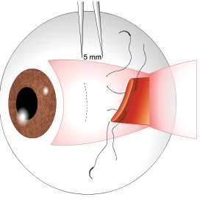
Technique of recession.

Slide 41
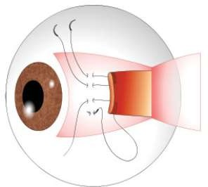
Technique of resection.

