Slide 1
COMPLICATIONS OF RHINOSINUSITIS

Slide 2
COMPLICATIONS
1. Acute
    A. Orbital
    B. Intracranial
    C. Bony
    D. Dental
    E. Toxic shock syndrome
2. Chronic
    Mucocele/Pyocele
3. Associated Diseases
    A. Otitis media
    B. Adenotonsillitis

Slide 3
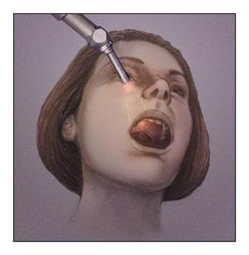
OSTEOMYELITIS/OSTEITIS
C/F:
Erythema
Swelling of cheek
Edema of lower lid
Purulent nasal discharge
Fever
Subperiosteal abscess
Sequestration
COMPLICATIONS:
Damage to teeth
Maldevelopment
Oroantral fistula
Persistently draining sinus
Epiphora
MAXILLARY BONE

Slide 4
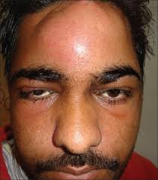
OSTEOMYELITIS/OSTEITIS
TRAETMENT
Antibiotics
Drainage of abscess
Trephination
Removal of sequestra
POTT’S PUFFY TUMOUR

Slide 5
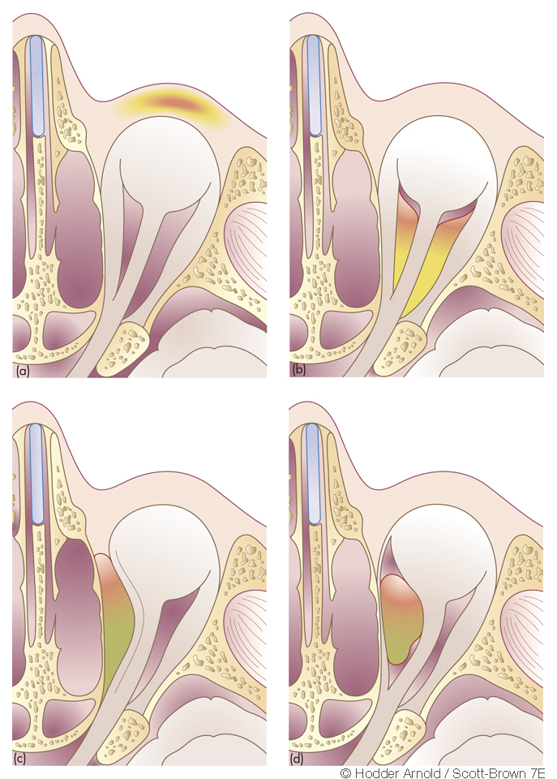
ORBITAL CELLULITIS ^{(**)}
1. Preseptal cellulitis
2. Postseptal cellulitis
3. Subperiosteal abscess
4. Orbital abscess
5.Cavernous sinus thrombosis

Slide 6
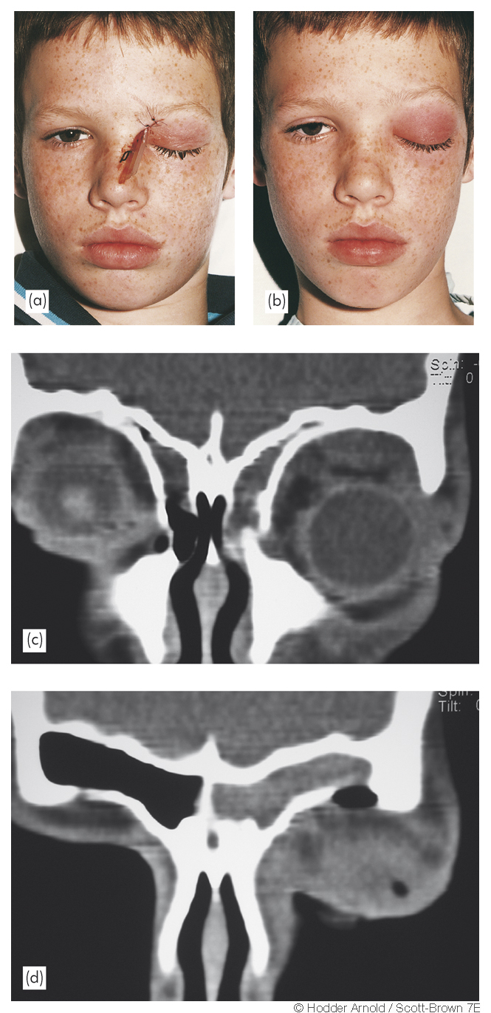
CLINICAL FEATURES:
Children & Young adults ^{(1, 2)}
History
Visual problems
Progressive ophthalmoplegia
Superior orbital fissure syndrome
INVESTIGATIONS:
Endoscopic examination
Hematological
Radiology
Others

Slide 7
TREATMENT
MEDICAL ⁽³⁾
AIM:
1. Treat complications
2. Treat primary rhinosinusitis
ETIOLOGY:
Strept. Pneumoniae
Staph. Aureus
M. catarrhalis
H. influenzae
Anerobes
SURGICAL
Ethmoidectomy
Endoscopic
External

Slide 8
INTRACRANIAL COMPLICATIONS
1. Meningitis
2. Encephalitis
3. Cavernous sinus thrombosis
4. Abscess:
          Extradural
          Subdural
          Brain

Slide 9
CHRONIC COMPLICATIONS
1. Mucoceles/Pyoceles
2. Dental problems
3 Chronic otitis media and chronic tonsilitis

Slide 10
REFERENCES
Singh B. The management of sinogenic orbital complications. Journal of laryngology and otology. 1995; 109:300-3.
Hawkins DB, Clark RW. Orbital involvement in acute rhinosinusitis. Lessons from 24 childhood patients. Clinical pediatrics. 1977; 16:464-71.
No authors given. Steroid therapy of acute ent infections: Rarely indicated. Prescrire international. 2001; 10:185-7.

Slide 11
THANK YOU

