Slide 1
NONALLERGIC PERENNIAL RHINITIS

Slide 2
Levels of Evidence
Grade A – Systemic reviews, Meta analyses, RCT
Grade B – Non-randomised studies
Grade C – Observational studies
Grade D – Case Series, Expert opinion

Slide 3
Evidence scoring
**** - systemic reviews, meta-analysis of RCT
*** - non- randomized studies
** - observational or non experimental studies
* - expert opinion

Slide 4
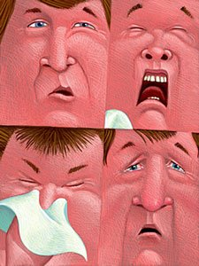
Perennial Nonallergic Rhinitis
> 9 months/year
Symptoms :
            Blockage
            Sneezing
            Hyper-secretion
            Postnasal drip

Slide 5
NON ALLERGIC
Idiopathic
Occupational
Hormonal
Drug-induced
Other

Slide 6
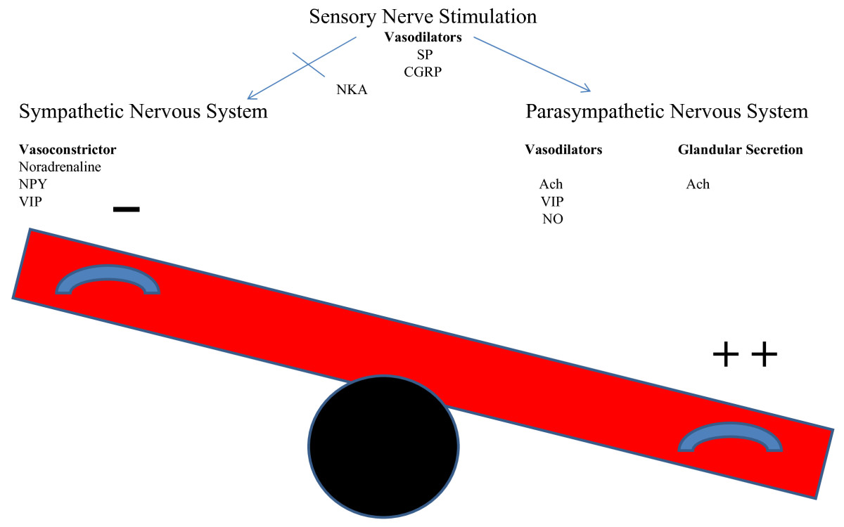
Idiopathic Rhinitis ⁽¹⁾

Slide 7
Vasomotor
Blockers
Nasal congestion
Blockage
Runners
Rhinorrhea

Slide 8
Occupational Rhinitis ^{(2,3)}
Non immunological Triggers
Aldehyde
Isocyanate
Aircraft fuel
Solvents
Physical

Slide 9
Occupational Rhinitis
Compost workers ⁽⁴⁾
Boiler makers[****/***]
Total cells
Myeloperoxidase
IL-8
Nitric oxide
Albumin
Vanadium Pentoxide:
          Fuel oil ash
          Respiratory irritant
          PMN

Slide 10
Hormonal Rhinitis
Oestrogen
Nasalobstruction
Nasal hyper-secretion
Beta-oesradiol & Progesterone (5)
Histamine H1
Eosinophil migration
Testosterone (6)
↓ Eosinophil activation
↓ Eosinophil viability

Slide 11
Drug-induced Rhinitis
Aspirin & other NSAIDs
Beta-blockers
ACE inhibitors
Methyldopa
Oral Contraceptives
Nasal topical decongestant

Slide 12
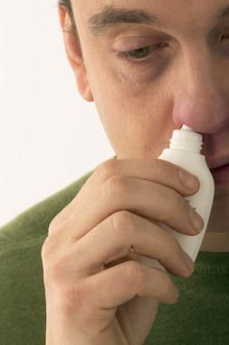
Rhinitis Madicamentosa [****/***/**]
Rebound effect
Nasal hyper-reactivity
Nasal mucosa hypertrophy

Slide 13
NARES
>20% eosinophils in nasal smear
Perennial sneezing
Profuse watery rhinorrhea
Nasal pruritis
Incomplete nasal obstruction
Loss of smell
Negative skin prick test
Absence of IgE antibodies

Slide 14
Food Induced Rhinitis
Hot & Spicy food
Alcoholic beverages
Capsaicin
Gustatory rhinitis
Neuropeptides
Tachykinins
Vasodilatation

Slide 15
Emotionally Induced Rhinitis⁽⁷⁾
Stress
Sexual arousal
Autonomic stimulation

Slide 16
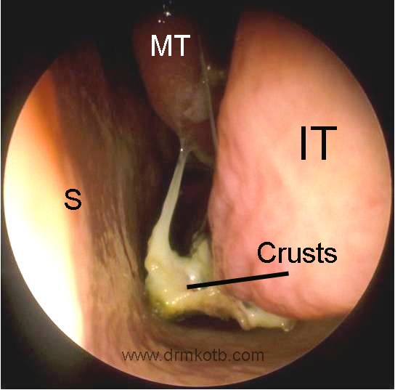
Atrophic Rhinitis
Women
Ozaena
Klebsiella ozaene
TYPES:
        Primary
        Secondary

Slide 17
A Step Wise Approach
Check possible stimuli , severity and duration
Check drug use ,exposure at work place , hormonal status
Exclude other nasal disease
Exclude allergy
Exclude CRS

Slide 18
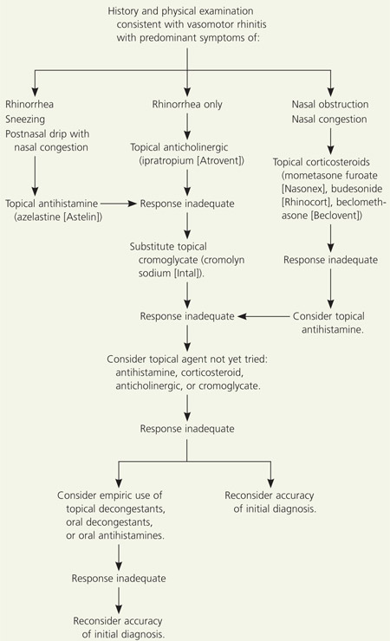

Slide 19
Recent
Surgical intervention:
                Reduce the size of turbinate
                Ethmoid and Vidian neurectomies [****/***]
Nonconventional therapy:
                Silver nitrate
                Botulin toxin
                Intranasal capsaicin ⁽⁸⁾

Slide 20
References

Slide 21
1. Nozad et al. clinical and molecular allergy. 2010 ; 8: 1.
2. Van Cauwenberge PB , Wang D – Y , Ingels KJAO , Bachert C. Rhinitis: the spectrum of the disease. In : Busse WW , Holgate ST. Asthma and rhinitis , 2nd edn. Oxferd : Blackwell science ltd , 2000 : 6-13.
3. Tunnicliffe WS , O’Hickey SP , Fletcher TJ , Miles TF , Burge PS , Ayers JG . Pulmonary function and respiratory symptoms in a population of airport workers. Occupational and environmental medicine. 1999 ; 56:118-23.
4. Douwes J , Wouters I , Dubbeld H , van Zweiten L et al. Upper airway inflammation assessed by nasal lavage in compost workers. American journal of industrial medicine.2000 ; 37 : 459-68.
5. Hamano N , Terda N , Maesako K et al. Expression of histamine receptors in nasal epithelial cells and endothelial cells. International archives of allergy and immunology. 1998 ; 115: 220-7
6. Hamano N , Terda N , Maesako K et al. Effect of sex hormones on eosinophilic inflammation in nasal mucosa. Allergy and asthma proceedings. 1998; 19:263-9.
7. Shah A, Sircar M. post coital asthma and rhinitis. Chest.1991 ; 100:1039-41.
8. Blom HM, van Rijswijk JB, Garrelds IM et al. intranasal capsaicin is effaicacious in nonallergic non infectious perennial rhinitis. A placebo controlled study. Clinical and experimental allergy 1997; 27: 796-801.

Slide 22
NAME OF STUDY | NAME OF AUTHOR | REFERENCE DETAILS | SAMPLE SIZE | RESULT | P VALUE | CONCLUSION
Perennial rhinitis: An independent risk factor for asthma in nonatopic subjects: results from the European Community Respiratory Health Survey. | Leynaert B¹, Bousquet J, Neukirch C, Liard R, Neukirch F. | J Allergy Clin Immunol. 1999 Aug;104(2 Pt 1):301-4. | 1412 | Subjects with perennial rhinitis (n = 1412) were more likely than control subjects (n = 5198) to have current asthma. After adjustment for sex, age, smoking habit, family history of asthma, geographic area. | <0.005 | The strong association between perennial rhinitis and asthma in nonatopic subjects with normal IgE levels is consistent with the hypothesis that rhinitis is an independent risk factor for asthma

Slide 23
Q-1 Contents of Nasal douching all except
Sodium carbonate
Sodium biborate
Sodium bicarbonate
Sodium chloride

Slide 24
Q-2 Atrophic rhinitis is caused by
Staph aureus
Strept viridans
Moraxella catarhalis
Klebsiella ozaene

Slide 25
Q-3 Symptoms of allergic rhinitis
Frequent sneezing
Watery nasal discharge
Headache
All of the above

Slide 26
Q-4 Samter’s triad includes
Nasal polyps
Aspirin sensitivity
Brnchial asthma
Bronchiectasis

Slide 27
Q-5 Prolonged and repeated use of nasal decongestant leads to
Rhinitis medicamentosa
Bronchitis
Both
none

Slide 28
Thank You…

