Slide 1
Fungal infections

Slide 2
Fungal skin infections
Infection
Causative agent
Dermatophytoses
(Tinea infections)
Candidiasis Candida
Pityriasis versicolor Pityrosporum
Dermatophytes

Slide 3
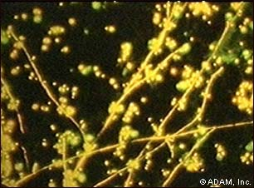
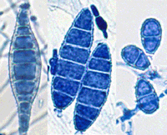
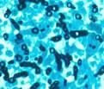
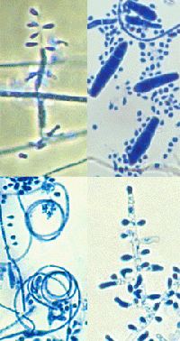
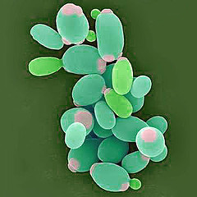
Fungi Causing Skin Infections
There are two main types of superficial fungal infection:
Dermatophytes, particularly Trichophyton rubrum, Trichophyton mentagrophytes, Trichophyton tonsurans and Epidermophyton floccosum.
Yeasts infection caused bu Candida albicans and Malasezzia furfur

Slide 4



Dermatophytes
Dermapophytes are moulds, also known as 'ringworm' or 'tinea'.
Dermatophytes can be transmitted from human to human.
Humans can also catch animal ringworm, particularly Microsporum canis and Trichophyton verrucosum, from domestic animals.
Names of infections are derived from the area infected:

Slide 5


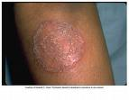


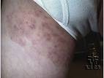
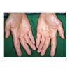
Hair
Tinea
Infections
Tinea capitis
Tinea corporis
Tinea pedis
Tinea mannum
Tinea cruris
Tinea barbae
Tinea ungium
Nail Bed
Bare & Smooth
Skin
Beard Hair
Feet
Groin &
Buttocks
Hands

Slide 6
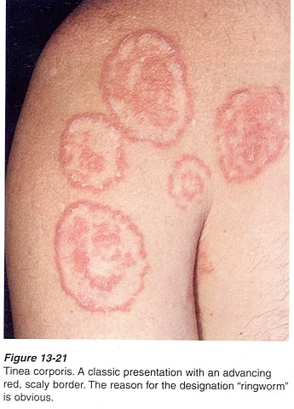
Clinical feature
Ring type lesions with redness and scaling at the border and occasional blister formation and itching

Slide 7
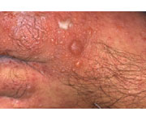
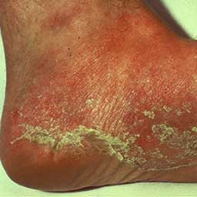
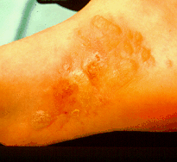
Tinea Pedis
http://www.patient.co.uk/showdoc/40001023/
Tinea Pedis: (athlete's foot):
Mainly occurs between the toes.
Is either dry with scaling or moist with maceration, peeling and fissuring of toe webs.
The skin is red and itchy, often presenting in late childhood or young adulthood.

Slide 8
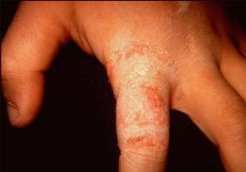
Tinea mannum
Tinea manuum (hand):
Usually only affects the dominant hand and associated with Tinea pedis.
They are seen as well-demarcated patches of scaling, hyperkeratosis especially on creases of palm.
Tinea mannum often involves dorsa and sides of fingers.

Slide 9
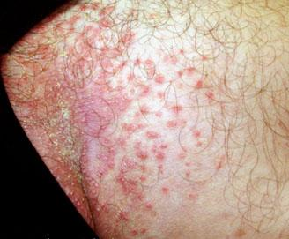
Tinea cruris
Tinea cruris (groin): are Large well-demarcated plaques of scaling dull red/brown skin with possible papules or pustules at margin in groin and on thighs, with possible extension to buttocks.

Slide 10
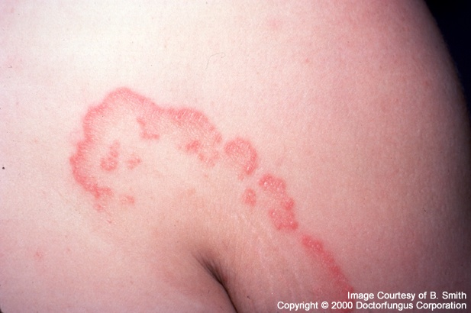
Tinea corporis
Tinea corporis (body/trunk): appears as sharply marginated plaques, scaling and/or with pustules or vesicles; enlarges from the edge with central clearing with concentric rings.
Usually present as a single patch.
Infection caught from animals are more inflamed with vesicles, crusting and blisters.

Slide 11
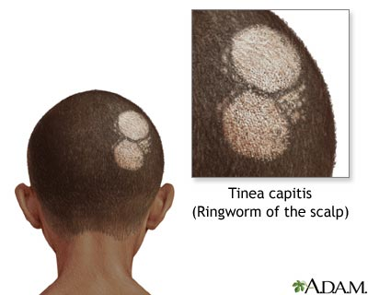
Tinea capitis
Tinea Capitis is the Dermatophyte infection of hair shaft
Scalp is seen with well circumscribed pruritic scaling area of hair loss, with variable inflammatory response
Tinea capitis may cause extensive hair loss, skin atrophy leading to permanent alopecia, and scales on remaining hair.

Slide 12
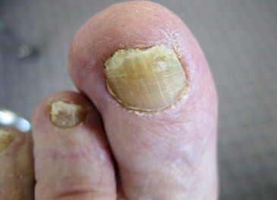
Onychomycosis
Superficial fungal infection of nails is called Onychomycosis.
Usually caused by dermatophytes known as Tineaunguium.
More difficult to treat compared to other tineas.
Toenails more frequent than fingernails

Slide 13
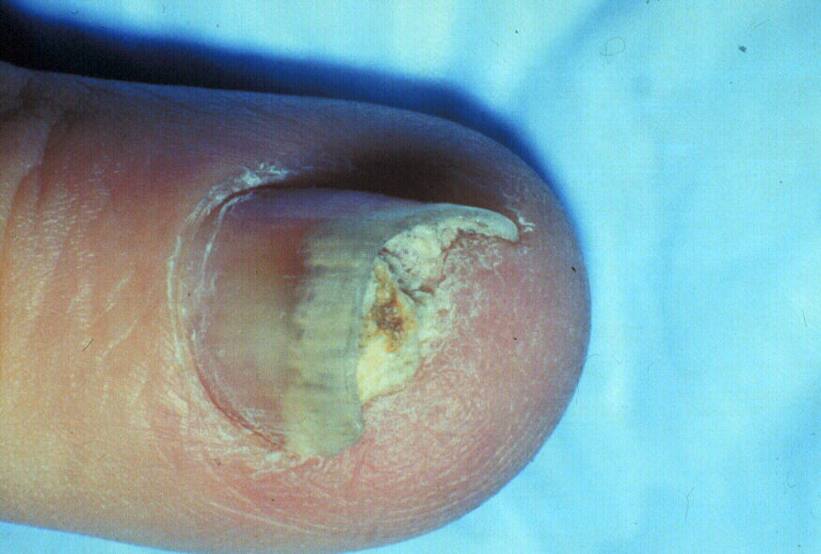
Clinical Features
Discoluration
Onycholysis
Subungual hyperkeratosis

Slide 14
CULTURE MEDIA FOR FUNGI
Water Agar (WA)--use for isolating fungi from surface-sterilized substrates.
Antibiotic Agar (AA)--use for isolating fungi from substrates not readily surface-sterilized, or to clean up a culture contaminated with bacteria.

Slide 15
Acidified Cornmeal Agar (ACMA)--use for isolating fungi from substrates that are likely to be contaminated with bacteria. Not a substitute for AA, but the acidity inhibits bacteria and the medium supports the growth of a wide range of fungi.

Slide 16
Cornmeal Agar (CMA)--use for growing a wide range of fungi, particularly members of the Fungi imperfecti; provides a good balance of mycelial growth and sporulation.
Potato Carrot Agar (PCA)--considered a relatively weak medium somewhat comparable to CMA, good for some Fungi imperfecti.

Slide 17
Malt Agar (MA)--lacks peptone, and is useful for culturing many Ascomycota; sporulation in some species is inhibited by peptone.
Malt Extract Agar (MEA)--a good growth medium for soil fungi, fungi isolated from wood, basidiomycetes, etc. An all-purpose type of medium.

Slide 18
Potato Dextrose Agar (PDA)--a relatively rich medium for growing a wide range of fungi.
Potato Dextrose-Yeast Extract Agar (PDYA)---good for growing cultures derived from mushrooms.

Slide 19
Oral Drugs for Onychomycosis
Drugs | Doses | Duration Onychomycosis Fingernail Toenail
Terbinafine(continuous) | 250 mg OD | 6 weeks 12 weeks
Terbinafine (Pulse therapy) | 250 mg BD x 7 days/month | 2 pulses 3 – 4 pulses
Itraconazole (daily therapy) | 200 mg OD | 6 weeks 12 weeks
Itraconazole (Pulse therapy) | 200 mg BD x 7days/month | 2 pulse 3 pulse
Fluconazole | 150-300 mg (Once a week) | 6 month 12 month
Griseofulvin | 200 mg BD/500 mg OD | 24 week 48-72 weeks

Slide 20
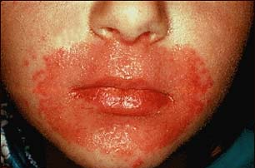
Cutaneous candidiasis
Candida albicans
Skin folds (Moist areas)
Redness, scaling, itching

Slide 21
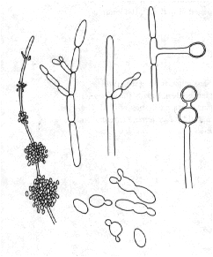

Slide 22
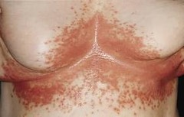

Slide 23
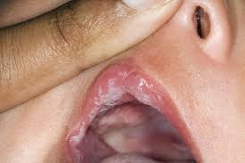

Slide 24
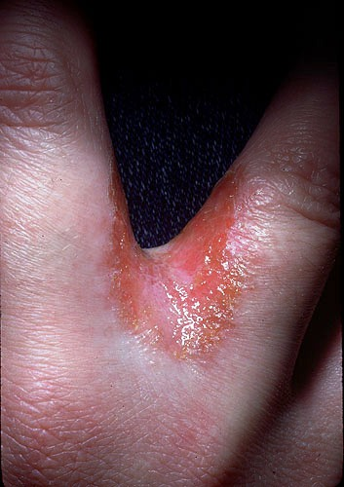

Slide 25
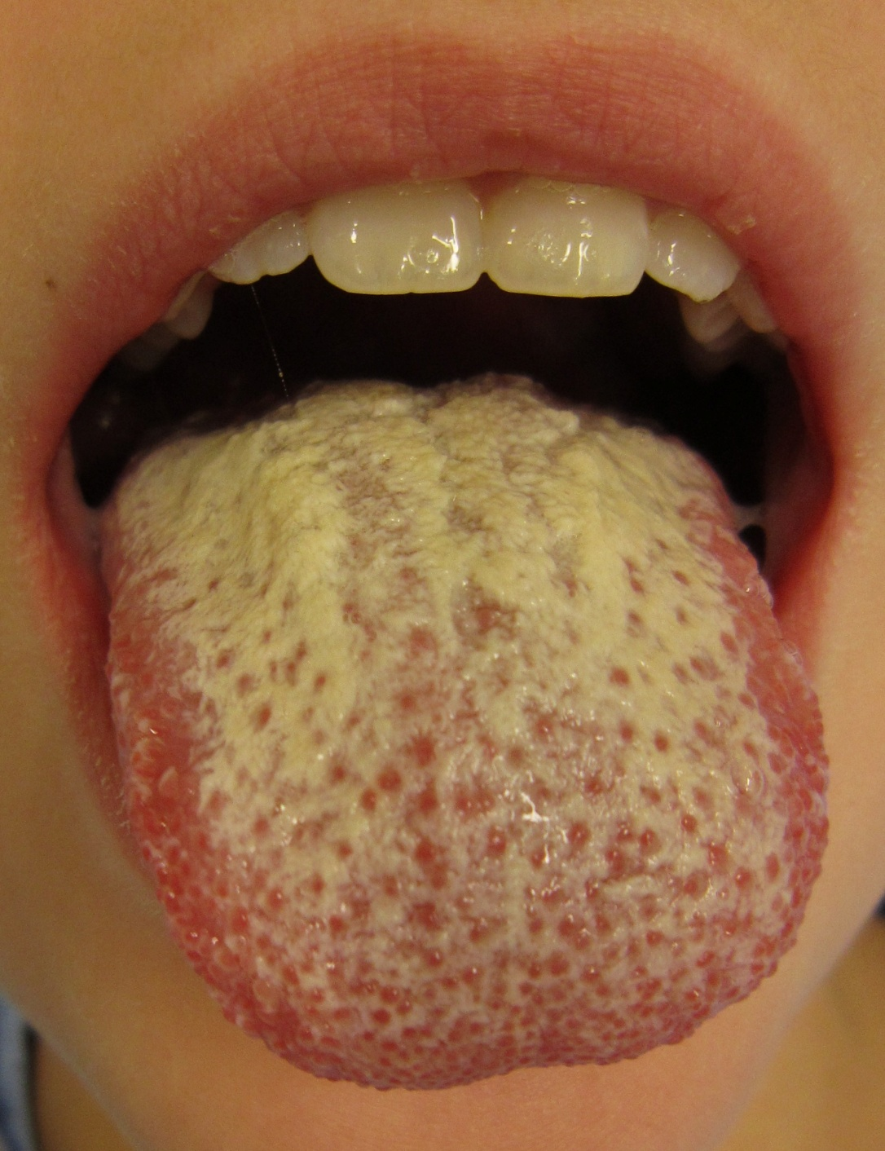

Slide 26
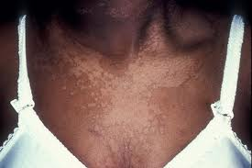

Slide 27
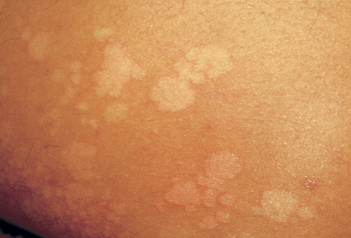

Slide 28
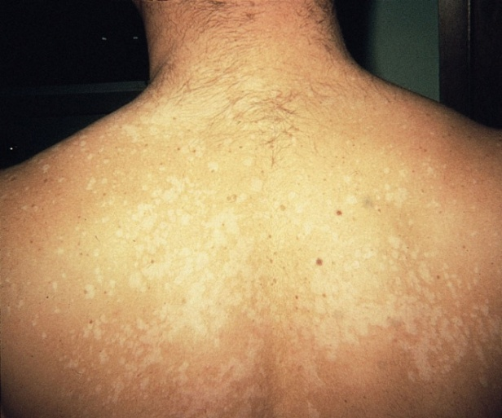
Pityriasis versicolor
Pityriasis versicolor: Is caused by an overgrowth of Malassezia furfur, which is part of the normal skin flora. Pityrosporon orbiculare,
Mainly found on the upper trunk, neck and arms.
Is a chronic, asymptomatic condition, appearing as well demarked scaling patches of variable pigmentation,

Slide 29
Investigations
Scraping for direct microscopy and culture; examination of skin scrapings are particularly important if systemic therapy is being considered or where there is doubt about the diagnosis.
Examination with Wood's (UV) lamp - blue-green fluorescence of the scales.
Microscopy: If scale from Pityriasis versicolor is treated with KOH solution and heated, microscopy shows filamentous hyphae and round yeast forms called "spaghetti and meat balls".

Slide 30
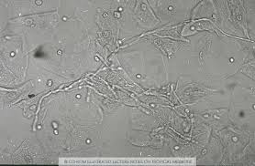

Slide 31
Topical Antifungal Agents
DRUGS | DOSAGE | DURATION
Terbinafine | Twice daily | 1 week
Butenafine | Once daily Twice daily | 4 weeks 1 week
Ketoconazole | Once daily | 2-6 weeks
Clotrimazole | Twice daily | 2-4 weeks

Slide 32
Oral Antifungal drugs used in Superficial Mycosis
Terbinafine
Itraconazole
Fluconazole
Griseofulvin

Slide 33
Candidiasis
Candidal skin infections:
  May be treated with topical imidazole antifungals, e.g. clotrimazole, ketoconazole, miconazole; topical terbinafine is an alternative.
  Topical application of nystatin is also effective for candidiasis but it is ineffective against dermatophytosis.
  Refractory candidiasis requires systemic treatment, usually with fluconazole.
  Systemic treatment with terbinafine is not appropriate for refractory candidiasis.

Slide 34
Pityriasis versicolor
May be treated with ketoconazole shampoo or selenium sulphide shampoo used as a lotion (diluted with water to reduce irritation).
Topical imidazole antifungals are alternatives but large quantities may be required. If topical therapy fails, or if the infection is widespread, pityriasis versicolor may require systemic treatment with itraconazole or fluconazole.
Relapse is common, especially in the immunocompromised.

Slide 35
Oral Antifungal drugs used in Superficial Mycosis
Terbinafine
Itraconazole
Fluconazole
Griseofulvin

Slide 36
journal | Title Level of evidence | method | result | conclusion
British Journal of Dermatology Volume 150, Issue 3, pages 537–544, March 2004 | Cumulative meta-analysis of systemic antifungal agents for the treatment of onychomycosis Level 1a | studies evaluating the efficacy of the oral antifungal agents terbinafine, itraconazole (pulse or continuous), fluconazole and griseofulvin for treating dermatophyte toenail onychomycosis. Studies included in this meta-analysis required a standard accepted the date of publicadosage regimen, treatment duration and follow-up period. To determine the cumulative meta-analytical average, studies were sequentially pooled by adding one study at a time according to tion (i.e. earliest to the most recent | ): terbinafine, 78 ± 6% (n = 2 studies, 79 patients) to 76 ± 3% (n = 18 studies, 993 patients) (P = 0·68); itraconazole pulse, 75 ± 10% (n = 1 study, 20 patients) to 63 ± 7% (n = 6 studies, 318 patients) (P = 0·25); itraconazole continuous, 63 ± 5% (n = 1 study, 84 patients) to 59 ± 5% (n = 7 studies, 1131 patients) (P = 0·47); fluconazole, 53 ± 6% (n = 1 study, 72 patients) to 48 ± 5% (n = 3 studies, 131 patients) (P = 0·50); and griseofulvin, 55 ± 8% (n = 2 studies, 109 patients | Conclusions The cumulative meta-analysis of cure rates for RCTs suggests that over time, as new RCTs have been conducted, the efficacy rates have remained consistent. The efficacy rates of open studies are substantially higher compared with RCTs and may therefore overestimate cure rates.

Slide 37
Multiple choice questions
1.Tinea capitis is more common in
a)School going children
b)adults
c)Old patients
d)All of the above
2.Favus is caused by
a)t. rubrum
b)t. violaceum
c)m. canis
d)t. schonleini
3.Athlete foot is synonym for
a)Teniapedis
b)mycetoma
c)Podophyllum foot
d)Plantar warts

Slide 38
4.dhobi’s itch is
a)Taeniacorporis
b)Taeniacruris
c)Taeniamannum
d)Taeniapedis
5.Taenia versicolor is caused by
a)Trubrum
b)Piedra
c)Malesseziafurfur
d)Demodex

Slide 39
THANK YOU

