Slide 1
Scabies

Slide 2
Definition
Scabies is a common parasitic infection caused by the mite, arthropod-acarina, Sarcoptes scabiei var hominis

Slide 3
Incidence and prevalence
300 million cases yearly world wide
Incidence common in all ages, sexes, ethnic & socio-economic groups, urban > rural.
Throughout the year, more in winter
Overcrowding, poor socio-economic conditions, institutions, immuno-compromised, mental retardation
Ref. :- IADVL Textbook of Dermatology

Slide 4
Mite
Fertilized female mite: 300 microns
Eggs → larva → nymph → adults
male: dies after fertilization
female: lays 2-3 eggs/day (max 20-25), mature by 2-3 weeks

Slide 5
Transmission
Skin to skin : predominantly.
? Fomites, clothing, furniture-rare
Sexually transmitted
Incubation period in new cases : 1 month
Symptoms due to hypersensitivity to mite and products
Reinfection- incubation period: 1-3 days
Ref. :- Burgess I. Sarcoptes scabiei and scabies. Adv Parasitol 1994;33:235-92

Slide 6
Clinical features
Symptoms
- Itching-worse at night, with skin rash
- Family members affected
Signs
- Characteristic distribution along the circle of
Herba.
- Papules, vesicles
- Burrow- grey-brown line 5mm, seen on webs &
genitalia with mite as black dot at the end
- Burrow may be a dot, dotted line, curve or curved line

Slide 7
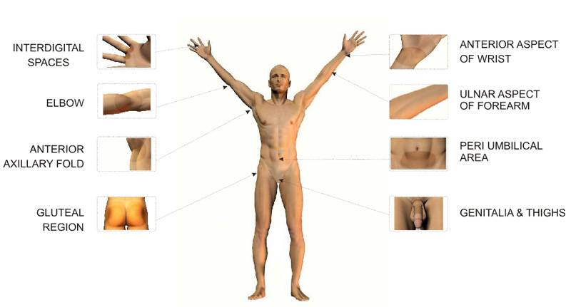

Slide 8
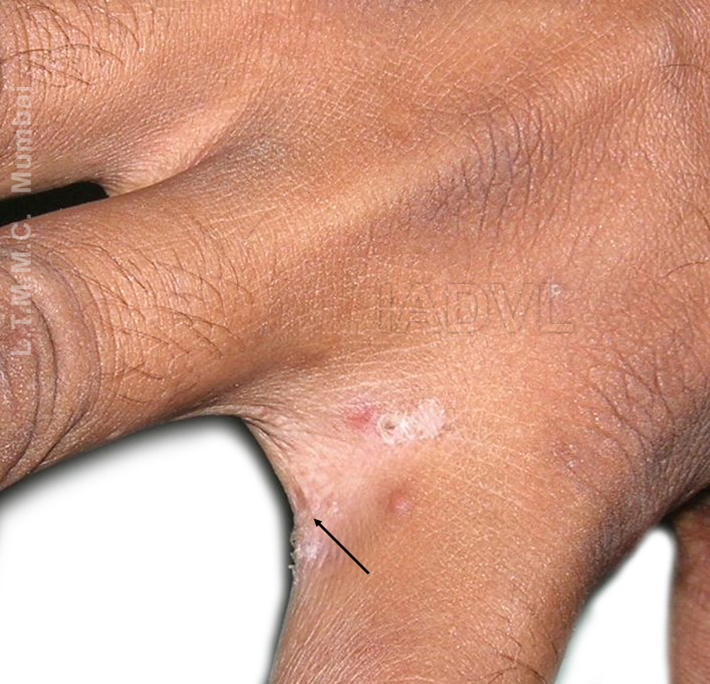
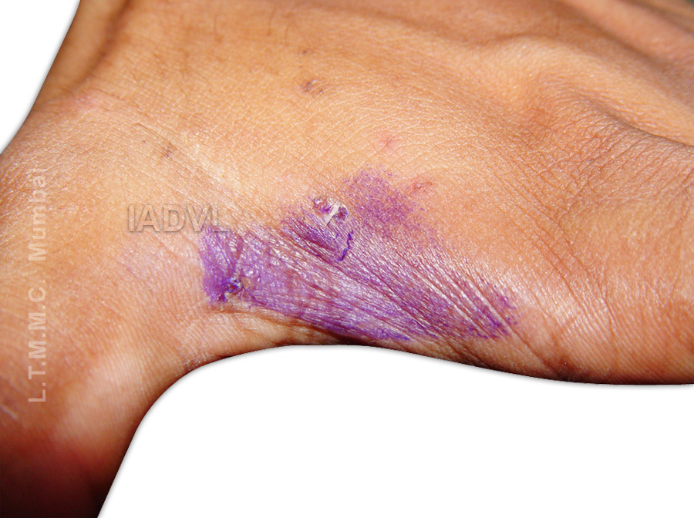

Slide 9
Clinical types
Classical Scabies: characteristic distribution of lesions along the circle of Hebra
Genital Scabies: sexually transmitted
Scabies in clean: fewer, atypical, severe itching
Incognito: who has applied topical/systemic steroids
Infants: scalp, palms, soles
Nodular (sensitization): scrotum, penis, elbows, axillary folds, periareolar

Slide 10
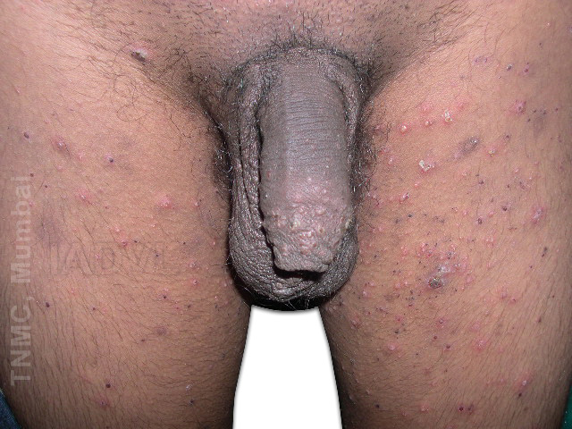
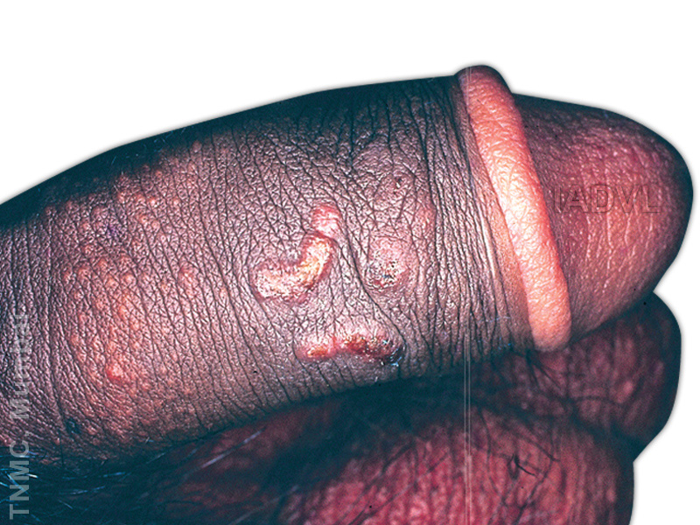

Slide 11
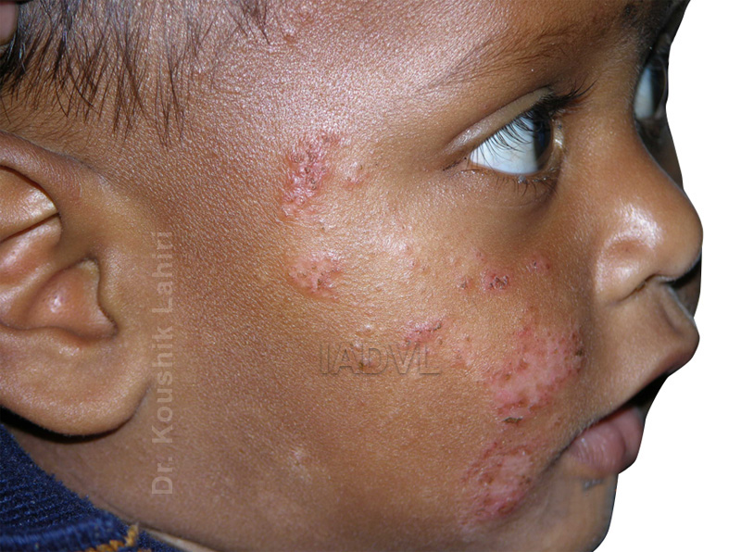

Slide 12
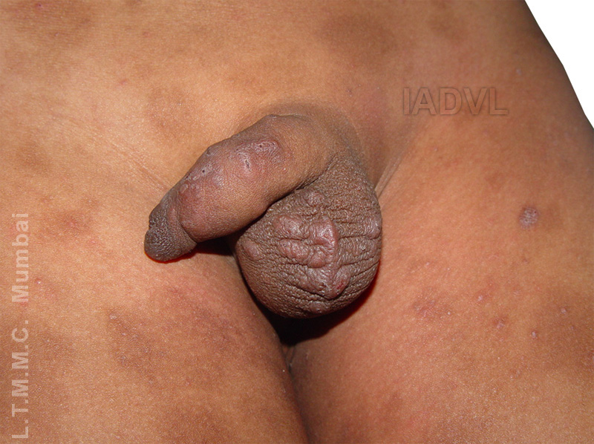

Slide 13
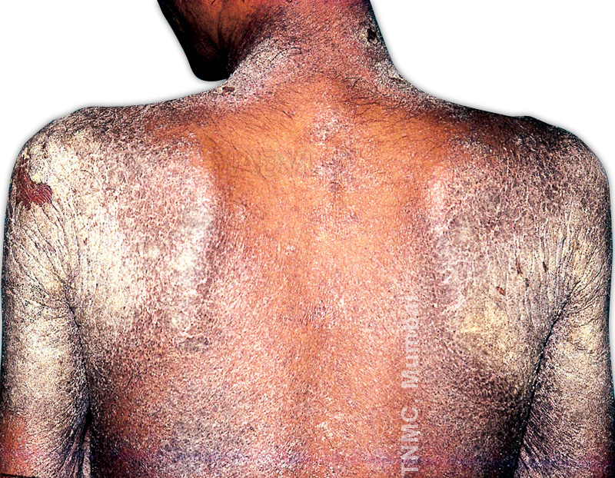

Slide 14
Clinical types
Crusted (Norwegian scabies):
mentally retarded, paralysis, immuno-compromised, leprosy; highly infectious, millions of mites
Animal scabies

Slide 15
Complications
Secondary infection
Eczematization
Glomerulonephritis
Phimosis, Paraphimosis
Urticaria
Erythroderma
Immunologic sequelae?
Drug reactions: irritation, eczematization

Slide 16
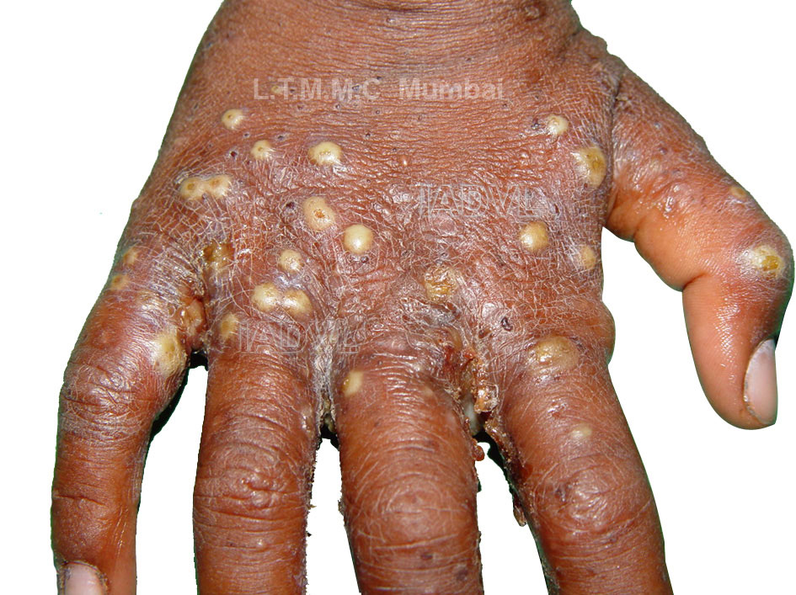

Slide 17
Investigations
Scraping: from papule, burrow to demonstrate mite, egg, scyballa
Ig E- specific levels

Slide 18
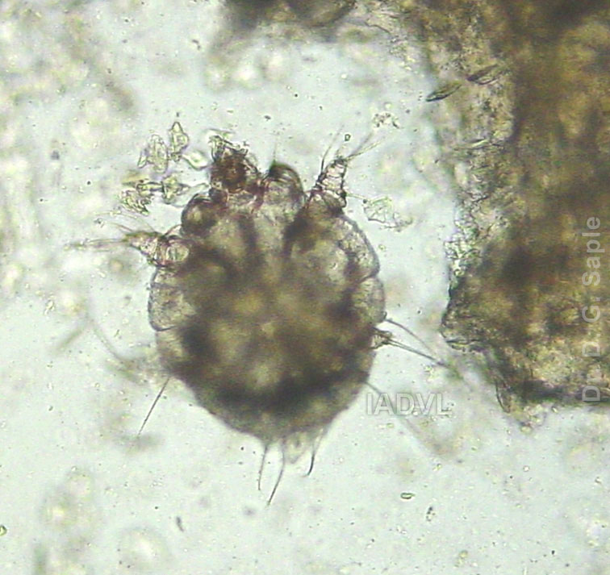

Slide 19
Treatment-principles
Treat secondary complications first
Treat all household members
Treat all inmates and caretakers in institution
Treat fomites by putting in hot water, insecticides for 2-4 days
Scabicides to be applied throughly behind ears and from neck to toes; repeat application depending upon scabicides used

Slide 20
Topical Treatment
Drug | Application/ Duration | Pregnancy | Side effects
Permethrin 5% | 8-14 hrs | B | Expensive
Lindane / GBH 1% | 8 hrs, repeat after 1week | B | Seizures
Benzoyl benzoate 10-25% | 3 consecutive nights | none | Burning, dryness

Slide 21
Topical Treatment
Drug | Application/ Duration | Pregnancy | Remarks
Crotamiton 10% | 2 application in 48hr period | C | Not very effective
Precipitated sulphur 3-6% | 3 consecutive nights

Slide 22
Ref. :- Walker GJ, Johnstone PW. Interventions for treating scabies. Cochrane Database Syst Rev 2000;(3):CD000320

Slide 23
Systemic treatment
Ivermectin: 200 microgms/kg
single dose; 56% cure; repeat 14 days later, 96% cure
Act by interrupting glutamate and aminobutyric acid induced neurotransmission in parasite causing paralysis & death
Lacks ovicidal action
Better with eczematised patients

Slide 24
Ref. :- Madan V, Jaskiran K, Gupta U, Gupta DK,. Oral ivermectin in scabies patients: a comparison with 1% topical lindane lotion. J Dermatol 2001;28:481-4.

Slide 25
Supportive treatment
Antihistaminics
Antibiotics: systemic, local
Emollients
Soaps?
Steroids: Topical /Systemic (in eczematised scabies)
Keratolytics in crusted scabies
Future trends: Local Ivermectin, tea tree oil

Slide 26
Failure of treatment
Improper treatment
Poor compliance
House hold and/or institutions contacts not treated
Resistance to drugs

Slide 27
Causes of itching even after treatment
Re-infection/relapse
Eczematous reaction
Contact irritation to drugs
Sensitization
Delusion of parasitosis (acarophobia)
Other skin problems
Itching persists for few days even after successful treatment

Slide 28
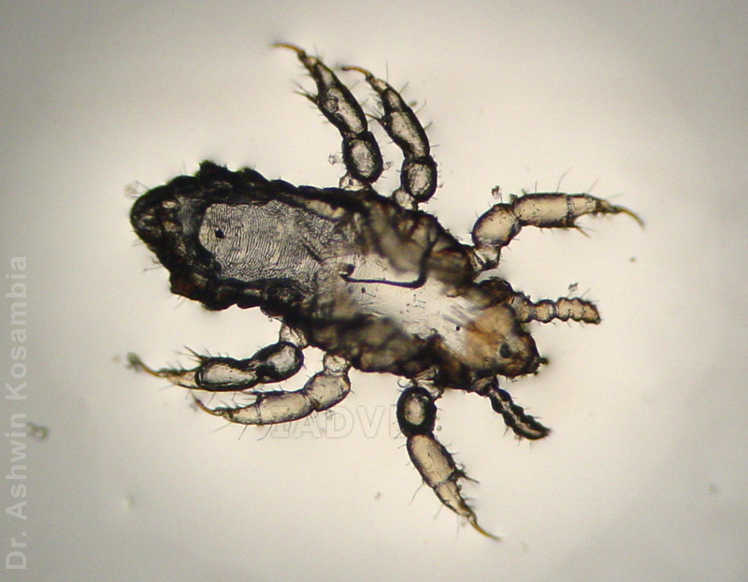

Slide 29
Pediculosis
Types:
- Pediculuscapitis -head louse
- Pediculushumanus -body louse
- Pthirus pubis- pubic/crab louse
Morphology:
- Head louse & body louse morphology identical
(Thin & long)
- Crab louse (broad & short)

Slide 30
Normal Habitat
Pediculosiscapitis:
scalp hair of host.
Children(3-11 yrs), Females>males
Pediculosiscorporis:
Clothing close to skin of host
Vagabond’s disease
Phthiriasis :
Pubic , axillary, beard hair, eyebrows; eyelashes; hair of trunk & limbs; rarely scalp margins.
Sexually active young adults; in children due to sexual abuse or parental contact.

Slide 31
Clinical features
Pediculosiscapitis:
Scalp pruritus
Detection of nits/adults lice on scalp hair
Secondary bacterial infection
Cervical lymphadenopathy
Matting of hair with pus and exudate -plicapolonica
Eczematization- neck /generalized

Slide 32
Clinical features
Pediculosiscorporis:
Body pruritus
Detection of nits /lice on clothing
Secondary bacterial infection
Post inflammatory hyperpigmentation of skin
Phthiriasis:
Nocturnal pruritus
Detection of nits & louse on affected hair
Blue grey macules (maculae caerulae) / Rust coloured speckles on skin

Slide 33
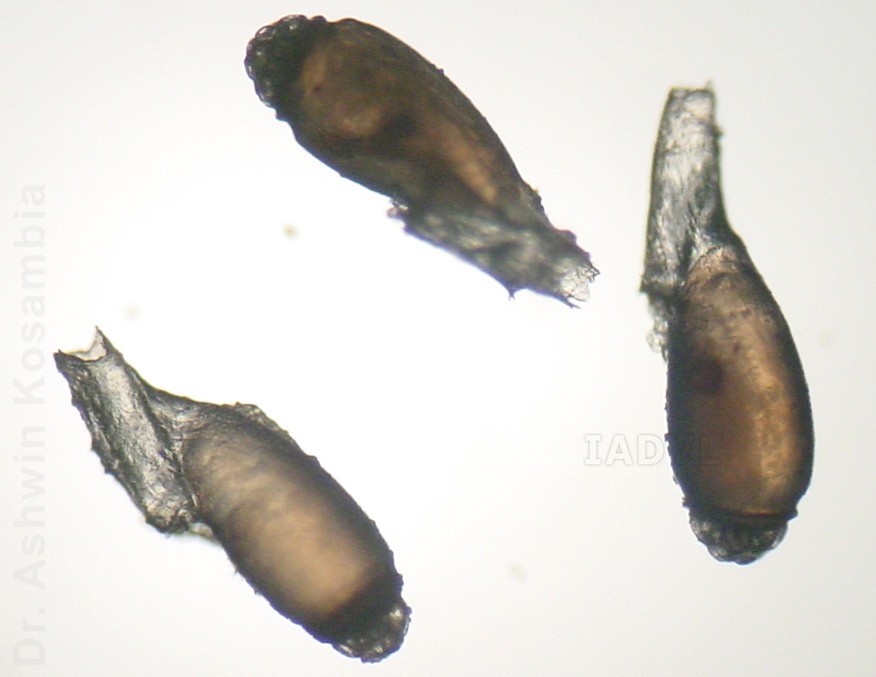

Slide 34
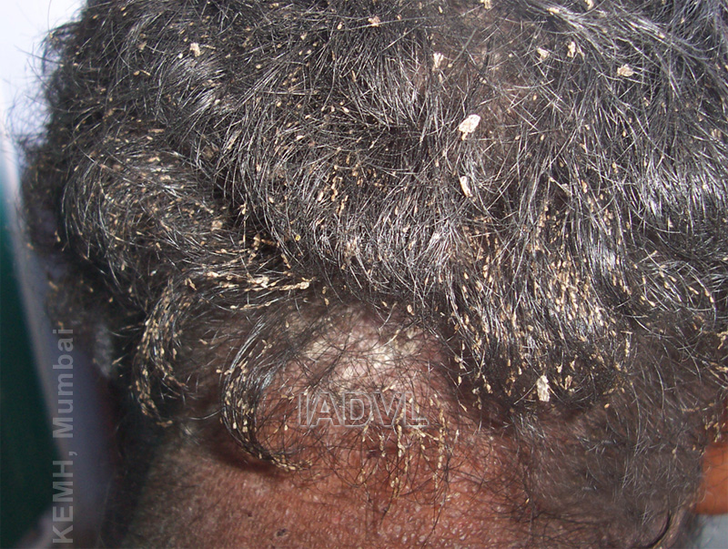

Slide 35
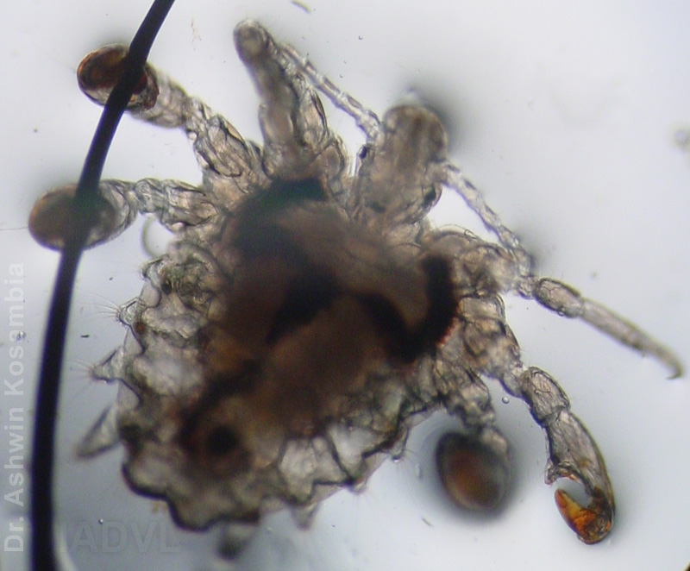

Slide 36
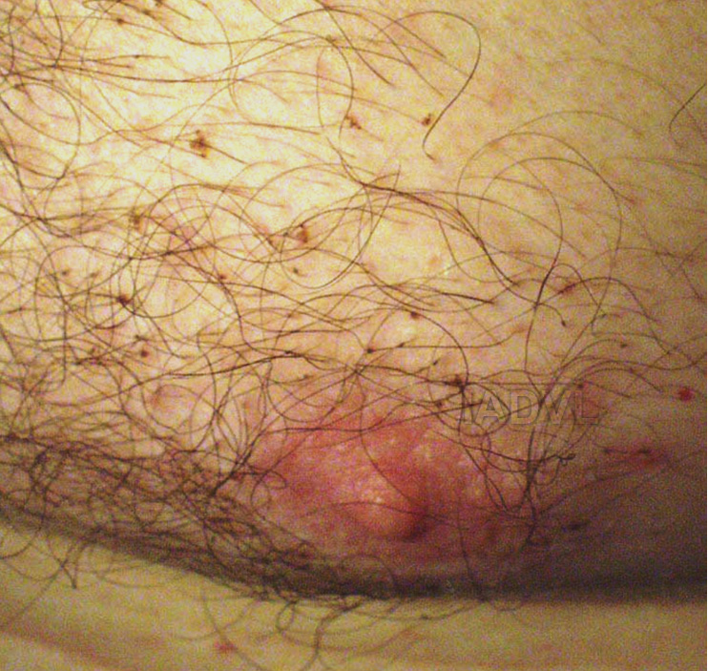

Slide 37
Pediculocides
Topical treatment:
Drug | Dose | Remark
Malathion 0.5% | 12 hrs | Repeat after 10 days
Carbaryl | 12 hrs | Repeat after 10 days
GBH 1% | 8-12 hrs | 2 applications
Permethrin 1% | 8-12 hrs | Single application
Oral treatment:
Ivermectin 200 mcg/kg, Cotrimoxazole

Slide 38
Pediculosis : Treatment
Pediculosiscapitis / Phthiriasis:
Good hygiene
Treatment of patients & contacts.
Removal of nits & lice with comb, vinegar,
kerosene application.
Eyelash infection (phthriasispalpebrum):
Mechanical removal, Epilation, Topical agents, Cryotherapy, Laser.
Pediculosiscorporis:
Treatment of clothing; not patient.
Treatment of clothes with topical pediculicides& laundering

Slide 39
Scabies
Evidence
based
Studies
Journal | Title Level of evidence | Methods | Results | Conclusion
Indian Journal of Dermatology Venereology and Leprology. Year : 2011 Volume : 77 Issue : 5 Page : 581-586 | Topical permethrin and oral ivermectin in the management of scabies: A prospective, randomized, double blind, controlled study. Level I | 120 clinically diagnosed cases of scabies (>5 years of age and/or >15 kg) were randomized into three treatment groups A, B, C of 40 patients each; receiving either topical 5% permethrin (group A) or oral ivermectin (200 μg/kg/dose) in a single dose (group B) or double dose regimen (group C) repeated at 2 weeks interval. Patients were followed up at 1, 2, and 4 weeks interval. At each visit, cure rate (>50% improvement in lesion count and pruritus and negative microscopy) was assessed and compared. | Cure rate in three treatment groups at the end of 4 weeks was 94.7% (A), 90% (B), 89.7%(C), and thus all three treatment modalities were equally efficacious. | Both permethrin and ivermectin in both single and two dose regimen are equally efficacious and well tolerated in scabies.
Journal of Infection (2005) 50 , 375–381 | Crusted scabies: clinical and immunological findings in seventy-eight patients and a review of the literature Level III | All patients requiring inpatient treatment for crusted scabies in the ‘top end’ of the northern territory of Australia over a 10 year period were prospectively identified. | More than half the patients with crusted scabies had identifiable immunosuppressive risk factors. Eosinophilia and elevated IgE levels occurred in 58% and 96% of patients, respectively, with median IgE levels 17 times the upper limit of normal. Seventeen percent had a history of leprosy but 42% had no identifiable risk factors. | Crusted scabies often occurs in patients with identifiable immuno- suppressive risk factors. In patients without such risk factors, it is possible that the crusted response to infection results from a tendency to preferentially mount a Th2 response.

Slide 40
Pediculosis
Journal | Title | Methods | Results | Conclusion
International Journal of Dermatology Volume 36, Issue 11 Pages 819–825 November 1997 | Head louse infestations: epidemiologic survey and treatment evaluation in Argentinian schoolchildren Level IV | An educational and motivational program was designed for pupils, parents, and teachers: 326 children and 15 adults were subjected to clinical and parasitologic evaluation. The recorded parameters included the age, sex, hair style and length, presence of other dermatologic diseases, degree of infestation, clinical remission, parasitologic remission, dwelling type and features, need to share a bed with co-dwellers, availability of home tap water supply, level of family income, and periodic medical controls. The entire population received treatment with neutral shampoo and rinsing cream containing 1% permethrin. Exclusion criteria were the presence of acute scalp inflammation and a history of pyrethrin and/or pyrethroid sensitivity. | The overall infestation prevalence rate was 81.5%, the highest values corresponding to children from 6 to 11 years of age, with a slight predominance in males (55.4% vs. 44.6%). A significantly greater rate of clinical remission was observed in subjects enjoying home tap water supplies (p<0.01). | The model of research plus action adopted allows the following conclusions to be drawn; (i) individual and isolated treatments for pediculosis are useful, but will not by themselves allow for the epidemiologic control of this parasitosis; (ii) massive, complete, and simultaneous treatments lead to a significant decrease in infestation prevalence; (iii) educational measures tending to foster collective awareness enable greater epidemiologic surveillance to be achieved; (iv) careful inspection of the entire scalp is essential with the use of a powerful light source and lenses with high magnification, as the parasite has no predilection for any given area; (iv) socio-economic and cultural conditions are not relevant for infestation, although a good home tap water supply is essential for treatment.
Evidence
based
Studies

Slide 41
International Journal of Dermatology Volume 48 Issue 11, Pages 1201–1205, November 2009 | Impact of ivermectin drug combinations on Pediculushumanus capitis infestation in primary schoolchildren of south Indian rural villages Level III | Primary school children (n = 534) of age 6–10 years from four villages of South India were examined for the presence of head lice before and after single dose of DEC + ivermectin drug combination. The effectiveness and the duration of cure sustained by these drugs were quantified. The head louse was examined by “combing method” during post-treatment periods at 15, 45, 60 and 75 days interval. | The antifilarial drug consumption rate was similar (96–98%) in all treatment arms. In pre-treatment survey the prevalence of head lice in children administered with DEC, DEC + ALB, IVR + DEC and IVR + ALB arm was 86%, 80%, 87% and 80%, respectively, with the latter two arms demonstrating significant reduction in louse infestation (P < 0.05) for 60 days. | Single dose with IVR combination demonstrates a greater impact in reducing head louse infestation in the endemic rural communities for nearly 60 days. Therefore, in regions such as Africa where ivermectin is part of the antifilariasis campaign, this drug will have an additional benefit in reducing head lice infestation.

Slide 42
Multiple choice questions
1.name the causative organism of scabies.
A)streptocooci
B)fungi
C)sarcoptesscabii
D)leptospira
2.the parasite dies after copulation.
A)male
B)female
C)both
D)none
3.pruritus in scabies is
A)paroxysmal nocturnal
B)whole day
C)nopruritus

Slide 43
4.Drug for topical application is
a)Clotrimazole
b)Fusidic acid
c)5% permethrin
d)Keratolytic
5.Oral antiscabetic drug is
a)Azithromycin
b)Ivermectol
c)Terbinafine
d)Azelic acid

Slide 44
Thank you

