Slide 1
Learning Theories
BY DR.LAKHAN KATARIA
PROF AND HEAD
DEPT OF PSYCHIATRY
SBKS MI AND RC

Slide 2
What is Learning?
Learning can be defined as any relatively permanent change in behavior that occurs as a result of practice or experience.
Types of Learning :
  Habituation
  Associative learning- Classical & instrumental conditioning
  Spatial learning
  observational learning

Slide 3
Habituation
A simple form of learning in which the response to a stimulus decreases after lengthy or repeated presentation.
What happens before habituation ?
  Each time an organisms encounters a new or unexpected object , there is a surprise reaction known as orienting reflex.
This reflex is one of the physiological arousal in which
The eyebrows lift slightly
the eyes widen
heart beats faster
Muscle slightly tense
Skin resistance drops
After habituation the same object causes no such reflex.

Slide 4
Associative learning
Learning a correlation between two events.
It includes Classical & instrumental conditioning.

Slide 5
Classical conditioning
Also called respondent conditioning or Pavlovian conditioning.
It was actually discovered accidentally by Ivan Pavlov, a Russian physiologist who discovered this phenomenon while doing research on digestion.
His research was aimed at better understanding of digestive pattern of dogs.

Slide 6
During his experiments he would put meat powder in the mouth of dogs who had tubes inserted into various organs to measure bodily responses.
He discovered that the dogs began to salivate before the meat powder was presented to them.
Then the dogs began to salivate as soon as the person feeding them entered the room.

Slide 7
Soon he began to gain interest in this phenomenon and abandoned his study of digestion.
He started pairing a bell sound with the meat powder and found that even if the meat powder was not presented, the dog would eventually salivate after hearing the bell.
Since the meat powder results in salivation, these two variables are called the unconditioned stimulus(UCS) and unconditioned response(UCR),respectively.
The bell and salivation are not naturally occurring, the dog was conditioned to respond to the bell.
Therefore ,the bell is considered conditioned stimulus(CS) and the salivation to the bell is considered conditioned response(CR).

Slide 8
Since the meat powder results in salivation, these two variables are called the unconditioned stimulus(UCS) and unconditioned response(UCR),respectively.
The bell and salivation are not naturally occurring, the dog was conditioned to respond to the bell.
Therefore ,the bell is considered conditioned stimulus(CS) and the salivation to the bell is considered conditioned response(CR).

Slide 9
Effects of Conditioning on Behavior
Food aversion: Through conditioning, humans and other animals may learn to like or dislike different foods
For eg- chemotherapy can make cancer patients sick, and can therefore cause the conditioning of an aversion to a food that was eaten recently (or to the clinic itself).
Drug abuse: Whenever a drug is taken, in addition to reinforcing the behaviors that lead to its ingestion, the drug constitutes a US, and may be associated with potential CSs that are present at the time (rooms, odors, injections etc.)

Slide 10
Anxiety disorders: CSs associated with frightening USs can elicit a whole system of conditioned fear responses, broadly designed to help the organism cope.
In panic disorder, people who have unexpected panic attacks can become anxious about having another one. In this case, the panic attack (the US or UR) may condition anxiety to the external situation in which it occurs (e.g., a crowded bus) and also internal (“interoceptive”) CSs created by early symptoms of the attack (e.g., dizziness or a sudden pounding of the heart).
Panic disorder may begin because external cues associated with panic can arouse anxiety, which may then exacerbate the next unconditional panic attack and/or panic response elicited by an interoceptive CS.

Slide 11
Theories about classical conditioning
Stimulus substitution: an association (a link or a bond) is formed between the CS and the US so that the CS becomes the equivalent of the US in eliciting a response.
Information and Expectation: It states that when the CS is presented, the US is expected and the learner response in accordance with this expectation.

Slide 12
Principles of classical conditioning
Acquisition:
The process by which an organism learns an association is known as acquisition.
The conditioned stimulus and the unconditioned stimulus are paired; the experimenter waits a short time, then presents the US-UCS pairing again.
Each pairing is called a trial.
As the CS and UCS are repeatedly paired response to the CS become stronger and quicker.

Slide 13
Second order conditioning:
The form of learning in which a CS become associated with a second neutral stimulus that precedes it , which then evokes conditioned response itself
ex. If Pavlov's bell to which dog is already conditioned is repeatedly paired with a second neutral stimulus (flashing light ) , the second stimulus become associated with first ( the bell ) ,and new CS ( the light) soon begins to elicit the CR (salivation )

Slide 14
Extinction
The gradual decline and disappearance of the conditioned response when it no longer is reinforced
Extinction has to do with dissociating two stimuli.
The process of extinction is used by therapist to help people overcome phobias or irrational fear (this extinction technique is known as systemic desensitization)
Flooding – Another extinction technique in which phobic person is encouraged to remain in the presence of the feared stimulus despite the overwhelming flood of terror.

Slide 15
Spontaneous recovery
The reappearance of an extinguished response upon returning to the familiar situation and the conditioned stimulus.
The organism apparently learns that one event will not follow another.
however, after complete extinction,if the UCS is once again paired with the old CS, the extinguished response will be quickly relearned. This learning of a conditioned then extinguished response is called reconditioning

Slide 16
Stimulus Generalization: A tendency to respond to stimuli that are similar, but not identical, to a conditioned stimulus (e.g., responding to a buzzer banging when the conditioning stimulus was a bell)
If you have an extremely warm relationship with an aunt, for eg, you may find that your affection extends to people who resemble her. You may begin your acquaitance with such people already expecting to look them simply because they look like your aunt.

Slide 17
Stimulus Discrimination: The ability to respond differently to various stimuli (e.g., a child responds differently to various bells (alarms, school, timer)
A dog quickly learns to discriminate its owner’s whistle (which is followed by dinner, an unconditioned stimulus) from the whistle of others who don’t feed it.

Slide 18
Critical factors in Classical Conditioning
Information value of conditioned stimulus: it means that the CS must communicate relevant information. The CS must serve as a signal or predictor of UCS, but for that to happen, the absence of CS must also predict the absence of UCS.
Biological constraints on conditioning: Genetic factors play a role, since species seem to be genetically prepared to make some kinds of associations more readily than others.

Slide 19
Instrumental /operant conditioning
The form of learning in which a voluntary response is strengthened or diminished by its consequences.
In this form of conditioning, our response operates on the environment and is instrumental in producing or affecting the consequences.

Slide 20
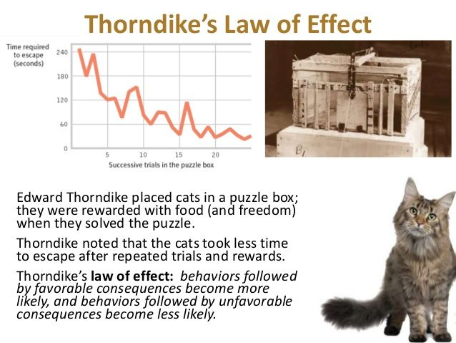

Slide 21
Principles of Instrumental conditioning
B.F. Skinner established basic principles of instrumental conditioning which are:
Reinforcement
Punishment
Acquisition
Extinction
Recovery
Generalization
Discrimination

Slide 22
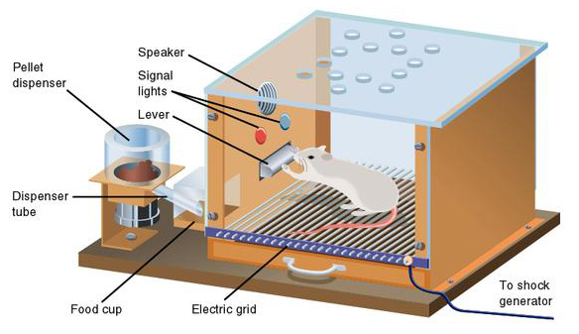
Skinner’s experiment
Working with Thorndike’s law of effect as his foundation, Skinner began conducting scientific experiments on animals (mainly rats and pigeons) to determine how organisms learn through operant conditioning.
He placed these animals inside an operant conditioning chamber, which has come to be known as a “Skinner box”.
A Skinner box contains a lever (for rats) or disk (for pigeons) that the animal can press or peck for a food reward via the dispenser.
The rate at which the rat first presses the bar is the baseline level.

Slide 23
After establishing the baseline level, the experimenter activates a food magazine located outside the box.
Now, every time the rat presses the bar, a small food pellet is released into the dish. The rat eats the food pellet and soon presses the bar again.
The food reinforces bar pressing, and the rate of pressing increases dramatically.
If the food magazine is disconnected and pressing the bar no longer delivers food, the rate of bar pressing diminishes. An instrumental response that is not reinforced undergoes extinction, just as a classically conditioned response does.

Slide 24
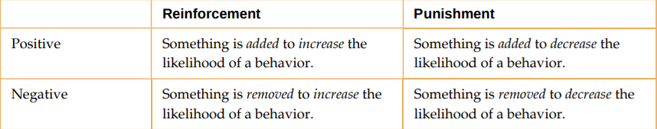
Consequences and Reinforcement
Positive Reinforcement | Negative Reinforcement
Strengthening a response by rewarding it | Strengthening the response that leads to removal of an aversive stimulus.
Punishment
Weakening or suppressing a response by producing an aversive consequence

Slide 25
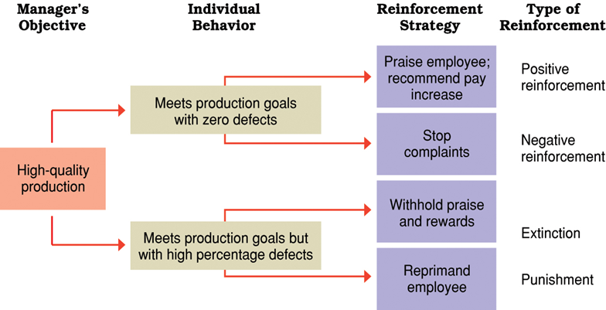

Slide 26
Shaping
Instead of rewarding only the target behavior, in shaping, we reward successive approximations of a target behavior.
Shaping is needed because it is extremely unlikely that an organism will display anything but the simplest of behaviors spontaneously.
In shaping, behaviors are broken down into many small, achievable steps.

Slide 27
The specific steps used in the process are the following:
Reinforce any response that resembles the desired behavior.
Then reinforce the response that more closely resembles the desired behavior. You will no longer reinforce the previously reinforced response.
Next, begin to reinforce the response that even more closely resembles the desired behavior.
Continue to reinforce closer and closer approximations of the desired behavior.
Finally, only reinforce the desired behavior.

Slide 28
Aspects of Reinforcement
Primary Reinforcers: Any stimuli or events that reduce basic drives or needs.
(food for a hungry animal, escape from pain)
Secondary Reinforcer: A secondary reinforcer has no inherent value and only has reinforcing qualities when linked with a primary reinforcer.
(money, is only worth something when you can use it to buy other basic needs (food, water, shelter—all primary reinforcers) or other secondary reinforcers. If you were on a remote island in the middle of the Pacific Ocean and you had stacks of money, the money would not be useful if you could not spend it.

Slide 29
REINFORCEMENT SCHEDULES
When an organism receives a reinforcer each time it displays a behavior, it is called continuous reinforcement
In partial reinforcement (intermittent reinforcement), the person or animal does not get reinforced every time they perform the desired behavior.
There are several different types of partial reinforcement schedules.

Slide 30
These schedules are described as:
Fixed refers to the number of responses between reinforcements, or the amount of time between reinforcements, which is set and unchanging.
Variable refers to the number of responses or amount of time between reinforcements, which varies or changes.
Interval means the schedule is based on the time between reinforcements,
Ratio means the schedule is based on the number of responses between reinforcements.

Slide 31
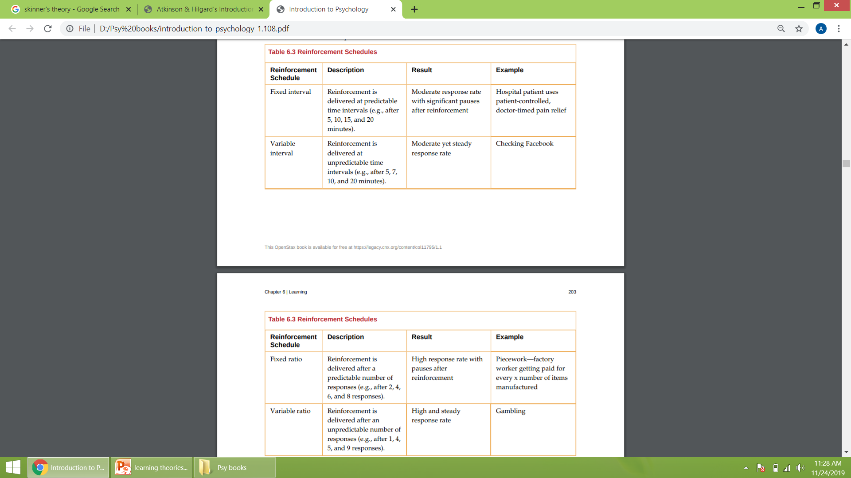
REINFORCEMENT SCHEDULES

Slide 32
Aversive conditioning
The form of learning based on aversive stimuli.
It includes:-
Escape Learning
Avoidance Learning
Punishment Learning
Escape Learning: learning of a response which produces relief, or escape, from an aversive situation. (for example, we may leave a room if there is a painfully loud noise there)
Avoidance Learning: The organism learns to make a certain response to prevent an aversive event from even starting( we pay our bills on time to avoid late charges, we carry an umbrella to avoid getting wet when it rains)

Slide 33
Spatial learning
Understanding of the location of objects in space and our own orientation in the physical environment.
Cognitive maps: an integrated internal representation of the way objects and landmarks are arranged in the environment.
Organism learn a cognitive map of an environment by exploring it, noting the landmarks along their route.

Slide 34
Cognitive learning
A change in the way Information is processed as a experience a person has had
It involves the forming of new associations and the perceiving of new relationships among events.
It is not responses to particular stimuli that are learned; instead links are made among stimuli so called stimulus-stimulus associations are learned.

Slide 35
Why is this form of Learning called Cognitive?
Cognition refers to the processing of the Information about the environment that is received from the senses
Cognitive processes involves:
Selection of information
Making of alterations in the selected information
Association of items of information with each other
Elaborations of information in thought
Storage of information in the Memory
Retrieval of stored information

Slide 36
Types of cognitive Learning
Latent Learning: The word Latent means hidden and thus Latent learning is learning that occurs but not evident in behavior until late, when its conditions of its appearance are favorable
It is said to occur without Reinforcement of particular responses.
For example, a child’s dad drives him to school every day. In this way, he learns the route from his house to his school, but he’s never driven there himself, so he has not had a chance to demonstrate that he’s learned the way. One morning his dad has to leave early for a meeting, so he can’t drive him to school. Instead, he follows the same route on his bike that his dad would have taken in the car.

Slide 37
Insight learning: perceptual reorganization of the environment so that objects take on new meanings and new relationships are seen among them.
Imitation: response that is like the stimulus triggering the response; a person or animal watches or hears another do or say something, then responds in the same way.

Slide 38
Observational learning
The form of learning by watching others and noting the consequences of their behavior.
Model: a person from whom behavior is learned by observation.
Many of us imitate parents, teachers or friends and some of us imitate prestigious people we will never meet- movie stars, fictional characters, athletes.
Models don’t have to be present for learning to occur: through symbolic modeling, (child can learn a behavior by watching someone demonstrate it on television.)

Slide 39
An analysis of Observational Learning
It consists of 4 subprocesses:
Attention: attention paid to the model depends on such factors as the model’s attractiveness, engaging personal qualities, prestige, age, race, religious beliefs, political attitudes and general similarity to the viewer.
Retention: we retain modeled behavior by creating internal images or linguistic descriptions of the model’s actions.
Motor reproduction: we must reproduce the model’s movements or mental steps.
Motivation: finally, our motivation to imitate any act depends in good part on the consequences that befall the model and on how the outcome corresponds to our own needs.

Slide 40
LEARNING AND THE BRAIN
Repetition of the same response leads to permanent changes at the synapses between neurons. This idea is known as the Hebbian learning rule.
Notes:
Atkinson & Hilgard’s Introduction to Psychology, 15th Edition

Slide 41
What actually happens in the nervous system when conditioning takes place?
Some studies indicate there may be an increase in the efficiency of existing neural pathways.
Learning may also lead to establishment of entirely new connections- either excitatory or inhibitory.
Notes:
Psychology Today, an Introduction, Seventh Edition, Bootzin, Bower, Crocker, Hall

Slide 42
THANK YOU.

