Slide 1
Transcultural Psychiatry
By:-
Dr. Nisheet Patel
Assistant Professor
Department of Psychiatry
SBKS MI & RC

Slide 2
What is culture??
Culture is defined as a set of meanings, norms, beliefs, values, and behavior patterns shared by a group of people.
These values include social relationships, language, nonverbal expression of thoughts and emotions, moral and religious beliefs, rituals, technology, and economic beliefs and practices, among other items.
Sadock BJ, Sadock VA, Ruiz P, Comprehensive Textbook of Psychiatry, Tenth Edition, Volume 1, Pg 788-793
Notes:
Culture influences the meanings that are given to the symptoms, and impacts the interaction between the patient and his/her family and the physician and the health care system within which the latter operates

Slide 3
Culture has six essential components:
2. Culture can be passed on from one generation to the next.
1. Culture is learned.
3. Culture involve a set of meaning in which words, behaviours, events, and symbols have meanings agreed upon by the cultural group.
4. Culture act as a template to shape and orient future behaviours and perspectives within and between generations, and to take account of novel situations encountered by the group.
5. Culture exists in a constant state of change.
6. Culture includes patterns of both subjective and objective component of human behaviour.
Sadock BJ, Sadock VA, Ruiz P, Comprehensive Textbook of Psychiatry, Tenth Edition, Volume 1, Pg 788-793

Slide 4
Race is a concept that entails people being grouped primarily by physiognomy.
Ethnicity refers to the subjective sense of belonging to a group of people with a common national or regional origin and shared beliefs, values, and practices, including religion. It is part of every person’s identity and self-image.
Sadock BJ, Sadock VA, Ruiz P, Comprehensive Textbook of Psychiatry, Tenth Edition, Volume 1, Pg 788-793
Notes:
Appearance , features and shape of persons face.

Slide 5
Transcultural psychiatry
Cross cultural psychiatry or transcultural psychiatry is a branch of psychiatry concerned with the cultural context of mental disorders and the challenges of addressing ethnic diversity in psychiatric services.
Vyas JN, Ghimire SR, Textbook of Postgraduate Psychiatry, 3rd edition, Volume 2, Pg-1808

Slide 6
Cultural Formulation
Cultural identity of the individual
Cultural conceptualizations of distress
Psychosocial stressors and cultural features of vulnerability and resilience
Cultural features of the relationship between the individual and the clinician
Overall cultural assessment
Sadock BJ, Sadock VA, Ruiz P, Comprehensive Textbook of Psychiatry, Tenth Edition, Volume 1, Pg 788-793

Slide 7
Cultural Identity of the Individual
Cultural identity refers to the characteristics shared by a person’s cultural group.
Factors that comprise an individual’s cultural identity include:
Race
Ethnicity
Country of origin
Language use
Religious and tradition-nourished beliefs
Socioeconomic status
Sexual orientation
Migration history
Experience of acculturation
The degree of affiliation with the individual’s group of origin
Sadock BJ, Sadock VA, Ruiz P, Comprehensive Textbook of Psychiatry, Tenth Edition, Volume 1, Pg 788-793

Slide 8
Cultural Identity of the Individual continued……
emerges throughout the individual’s life and in social context.
Evaluating the cultural identity of the patient allows identification of potential areas of strength and support that may enhance treatment effectiveness, as well as vulnerabilities that may interfere with the progress of treatment.
Sadock BJ, Sadock VA, Ruiz P, Comprehensive Textbook of Psychiatry, Tenth Edition, Volume 1, Pg 788-793

Slide 9
Cultural Conceptualization of Distress
The conceptualizations of distress represent ways in which the individual patient “experiences, understands, and communicates his or her symptoms to others.”
Severity, meaning of the experiences, coping, and help-seeking patterns are part of this representation.
Sadock BJ, Sadock VA, Ruiz P, Comprehensive Textbook of Psychiatry, Tenth Edition, Volume 1, Pg 788-793
Notes:
Cultural conceptualization of distress also includes the patient’s understanding of their symptoms and attempt to explain why he or she became ill.

Slide 10
Difficulties may arise when there are conceptual differences in the explanatory model of illness between clinician, patient, family, and community.
Conflicts between the patient’s and the clinician’s explanatory models may lead to
Conflicts between the patient’s and the family’s explanatory models of illness may result in
Conflicts between the patient’s and the community’s explanatory models could lead to
diminished rapport or treatment noncompliance.
lack of support from the family and family discord.
social isolation and stigmatization of the patient.
Sadock BJ, Sadock VA, Ruiz P, Comprehensive Textbook of Psychiatry, Tenth Edition, Volume 1, Pg 788-793

Slide 11
Explanatory models of illness:
The moral model implies that the patient’s illness is caused by a moral defect such as selfishness or moral weakness.
The religious model suggests that the patient is being punished for a religious failing or transgression.
The magical or supernatural explanatory model may involve attributions of sorcery or witchcraft as being the cause of the symptoms.
The medical model attributes the patient’s illness primarily to a biological etiology.
The psychosocial model infers that overwhelming psychosocial stressors cause or are primary contributors to the illness.
Sadock BJ, Sadock VA, Ruiz P, Comprehensive Textbook of Psychiatry, Tenth Edition, Volume 1, Pg 788-793

Slide 12
Psychosocial Stressors and Cultural Features of Vulnerability and Resilience
Assessing the patient’s psychosocial environment and level of functioning needs an understanding of the patient’s:
family dynamics
social networks
religion in its cultural context
Sadock BJ, Sadock VA, Ruiz P, Comprehensive Textbook of Psychiatry, Tenth Edition, Volume 1, Pg 788-793

Slide 13
For immigrants and refugees
Openness of the host society
For example, older immigrants may experience familial and communal role reversals and erosion of self-esteem in situations in which the older generation becomes dependent on the younger generation, due to the younger members greater language fluency and conceptual ability to deal with the institutions of the host culture, such as hospitals and government agencies.
Conversely, feelings of alienation may occur when young people in immigrant families feel cut off from their heritage and from the usual association of wisdom and experience with parents and other adults of their cultural group.
Sadock BJ, Sadock VA, Ruiz P, Comprehensive Textbook of Psychiatry, Tenth Edition, Volume 1, Pg 788-793

Slide 14
Cultural Features of the Relationship between the Individual and the Clinician
The cultural identity of the clinician and of the mental health team has an impact on patient care as it influences diagnosis and treatment.
Unacknowledged differences between the clinician’s and the patient’s cultural identity can result in assessment and treatment that is unintentionally biased and stressful for all.
Sadock BJ, Sadock VA, Ruiz P, Comprehensive Textbook of Psychiatry, Tenth Edition, Volume 1, Pg 788-793

Slide 15
Culture influences transference and countertransference in the clinical relationship between people seeking psychiatric care and their treating clinicians.
Transference relationships and dynamics are affected when the patient and clinician have different cultural background characteristics.
When the patient and clinician are of different genders, culturally ingrained role assumptions may pose difficulties.
Sadock BJ, Sadock VA, Ruiz P, Comprehensive Textbook of Psychiatry, Tenth Edition, Volume 1, Pg 788-793

Slide 16
Overall Cultural Assessment
In making a psychiatric diagnosis, the clinician should take into account principles of cultural relativism.
Diagnostic dilemmas may arise in patients of diverse cultural backgrounds. Some of these dilemmas may include
problems in judging distortion from reality,
problems in assessing unfamiliar behaviors,
problems in distinguishing pathological from normal cultural behavior.
Sadock BJ, Sadock VA, Ruiz P, Comprehensive Textbook of Psychiatry, Tenth Edition, Volume 1, Pg 788-793

Slide 17
Cultural Formulation Interview
The CFI is a semi structured interview that includes explicit instructions to the interviewer.
It uses a person-centered approach to conduct a cultural assessment by eliciting information from the patient about his or her views and those of others in their family and social network, and thereby avoids stereotyping about the way that patients interpret their illness experience.
Sadock BJ, Sadock VA, Ruiz P, Comprehensive Textbook of Psychiatry, Tenth Edition, Volume 1, Pg 788-793

Slide 18
The CFI is especially useful when:
There are significant differences in the cultural, religious, or socioeconomic background of clinician and patient;
There is uncertainty about culturally distinctive symptoms, their meaning and significance to the patient and their relationship with existing, conventional diagnostic criteria;
There is difficulty judging illness severity or extent of impairment;
There is disagreement between patient and clinician about the recommended course of treatment;
There are concerns about the patient’s acceptance, engagement, and adherence to recommended treatment.
Sadock BJ, Sadock VA, Ruiz P, Comprehensive Textbook of Psychiatry, Tenth Edition, Volume 1, Pg 788-793

Slide 19
CFI comprises four sections:
Cultural definition of the presenting problem
Cultural perceptions of cause, context, and support available
The role of cultural identity
Cultural factors affecting coping and health seeking practices, including misunderstandings in the clinician–patient relationship
The CFI also includes an informant version that can be used to supplement information from the core CFI or when the patient is unable to provide sufficient information.
Sadock BJ, Sadock VA, Ruiz P, Comprehensive Textbook of Psychiatry, Tenth Edition, Volume 1, Pg 788-793

Slide 20
Acculturation, and acculturative stress.
Acculturation is deﬁned as socio-cultural adjustment and acquisition of dominant cultural norms by members of a non- dominant group.
Acculturative stress refers to the psychological, somatic, and social difﬁculties that may accompany acculturation processes. It was suggested that acculturative stress is a fundamental psychological force in acculturative processes.
Acculturation is by no means a stress free process. Mental health problems could be exacerbated by the acculturation stress, leading to a possible conﬂict with the traditional culture of their ethnic group.
Sadock BJ, Sadock VA, Ruiz P, Comprehensive Textbook of Psychiatry, Tenth Edition, Volume 1, Pg 788-793

Slide 21
There are 4 possible outcomes of acculturative stress:
REJECTION is characterised by individuals wishes, both conscious and intuitive, to maintain their cultural integrity, by actively resisting the incorporation of the values and social behaviour patterns of another culture groups.
ASSIMILATION is the psychological process of the conscious or unconscious giving up of the unique characteristics of one’s culture of origin in favour of the more or less complete incorporation of the values and the behaviour characteristics of the another culture group, usually, but not always, the majority culture
MARGINALIZATION is deﬁned by the psychological characteristics of rejection or the progressive loss of valuation of one’s cultural heritage, while at the same time rejecting, or being alienated from the deﬁning values and behaviour norms of another cultural group, usually that of the majority population.
INTEGRATION derives from the wish to both maintain the values and behaviour pattern of one’s culture of origin and at the same time incorporate norms of other culture groups to feel and behave like that culture groups, principally the majority host culture

Slide 22
PSYCHIATRIC ASSESSMENT OF IMMIGRANTS AND REFUGEES
Immigration may result in :
losses of social networks, including family and friends;
material losses, such as business, career, and property;
loss of the cultural, including their familiar community and religious life.
Obtaining a thorough migration history will assist in understanding background and precipitating stressors and help guide development of an appropriate treatment plan.
Sadock BJ, Sadock VA, Ruiz P, Comprehensive Textbook of Psychiatry, Tenth Edition, Volume 1, Pg 788-793

Slide 23
Pre-migration history
inquiry about the patient’s social support network
social and psychological functioning
significant pre migration life events
Information about the country and region of origin
the family history in the country of origin
Pre migration political issues
trauma, war, and natural disaster faced by the patient and family
Sadock BJ, Sadock VA, Ruiz P, Comprehensive Textbook of Psychiatry, Tenth Edition, Volume 1, Pg 788-793

Slide 24
CULTURE AND PSYCHOPATHOLOGY
Tseng gave seven types of relations between culture and psychopathology.
Pathogenic effects
Patho-selective effects
Patho-plastic effects
Patho-elaborating effects
Patho-facilitative effects
Patho-discriminating effects
Patho-reactive effects
Vyas JN, Ghimire SR, Textbook of Postgraduate Psychiatry, 3rd edition, Volume 2, Pg-1808

Slide 25
Pathogenic effects
It refers to situations where culture is a direct causative factor in forming or generating psychopathology.
stress can be created by culturally formed anxiety, culturally demanded performance or culturally prescribed roles and duties.
Eg- Culture bound syndromes
Vyas JN, Ghimire SR, Textbook of Postgraduate Psychiatry, 3rd edition, Volume 2, Pg-1808

Slide 26
Patho-selective effects
Cultural choice to stress reaction that shapes the nature of psychopathology.
Eg – Running amok in Malaysia, Familial suicide in some cultures.
Vyas JN, Ghimire SR, Textbook of Postgraduate Psychiatry, 3rd edition, Volume 2, Pg-1808

Slide 27
Patho-plastic effects
The ways in which culture contributes to modeling or plastering of manifestation of psychopathology.
Grandiose delusion
Vyas JN, Ghimire SR, Textbook of Postgraduate Psychiatry, 3rd edition, Volume 2, Pg-1808

Slide 28
Patho-elaborating effects
Certain behaviour may become exaggerated to the extreme by cultural reinforcement
Hara kiri- formal way of suicide by a soldier In Japan
Vyas JN, Ghimire SR, Textbook of Postgraduate Psychiatry, 3rd edition, Volume 2, Pg-1808

Slide 29
Patho-facilitative effects
Many psychiatric disorders are intimately tied to psychological and sociocultural variables in their development.
Some conditions are more common in some cultures.
eg- Excessive concern with body weight, cultural permission to consume alcohol.
Vyas JN, Ghimire SR, Textbook of Postgraduate Psychiatry, 3rd edition, Volume 2, Pg-1808

Slide 30
Patho-discriminating effects
Socio cultural labeling of behaviour as normal or abnormal (several mental conditions or behaviours.)
Eg – personality disorder, substance abuse are accepted or rejected as per the social discrimination according to cultural factors.
Vyas JN, Ghimire SR, Textbook of Postgraduate Psychiatry, 3rd edition, Volume 2, Pg-1808

Slide 31
Patho-reactive effects
Culture influences how people label a disorder and how they emotionally react to it.
Prognosis of schizophrenia is better in less developed, rural, farming societies.
PTSD
Vyas JN, Ghimire SR, Textbook of Postgraduate Psychiatry, 3rd edition, Volume 2, Pg-1808

Slide 32
Cultural influences on classification of mental disorder
Different culture are often in disagreement as to what behavior they label normal or abnormal.
The processes of diagnosis and treatment may differ in different culture 4 ways
In the interpretation and presumed cause of such symptoms
In definitions of what constitute symptoms of disease
In the classification of the symptoms in to syndromes
In the perception about what constitute an acceptable method of treatment.
Vyas JN, Ghimire SR, Textbook of Postgraduate Psychiatry, 3rd edition, Volume 2, Pg-1808

Slide 33
Culture and communication
Language as a subset of culture , has a more concrete influences on the diagnose and psychiatry
Some culture facilitate the expression of complaints whereas other culture may inhibit the communication of inner feeling to health professionals.
For better communication a doctor should :
Be aware that person’s culture will shape how they understand the health and ill health.
Learning about the specific culture belief that surround mental illness in the person’s community
Know what is normal and what is not in the persons culture
Know what culturally appropriate communication is.
Learning how mental illness is described in person community
Be aware of what concepts behavior or language are taboo.
Vyas JN, Ghimire SR, Textbook of Postgraduate Psychiatry, 3rd edition, Volume 2, Pg-1808

Slide 34
Religion and Spirituality in mental illness
Spike et al. suggested 4 general types of effect of religion on mental illness.
Religion allow and fosters mental illness eg – by encouraging guilt .
Religion controls or suppresses mental illness eg- by encouraging happiness.
Religion may protect from stress or its effects eg- by rising self esteem.
Religion may be therapeutically useful eg – by providing sympathetic counselors .
Vyas JN, Ghimire SR, Textbook of Postgraduate Psychiatry, 3rd edition, Volume 2, Pg-1818

Slide 35
Cultural Syndrome
cluster or group of co-occurring symptoms found in a specific cultural group, community, or context.
The syndrome may or may not be recognized as an illness within the culture.
The term culture bound was used in the past to describe patterned behaviors of distress or illness whose phenomenology appeared distinct from psychiatric categories and were considered unique to particular cultural settings.
Sadock BJ, Sadock VA, Ruiz P, Comprehensive Textbook of Psychiatry, Tenth Edition, Volume 1, Pg 788-793

Slide 36
DSM-5 includes in its Appendix:
Ataque de nervios
Dhat syndrome
Khyâl cap
Kufungisisa
Maladi moun
Nervios
Shenjing shuairuo
Susto
Tajin kyofusho
Sadock BJ, Sadock VA, Ruiz P, Comprehensive Textbook of Psychiatry, Tenth Edition, Volume 1, Pg 788-793

Slide 37
Amok
Amok is a dissociative episode that is characterized by a period of depression followed by an outburst of violent, aggressive, or homicidal behavior.
Episodes tend to be caused by a perceived insult and are often accompanied by persecutory ideas, amnesia, and exhaustion.
Patients return to premorbid states following the episode.
Amok seems to be prevalent only among males.
Sadock BJ, Sadock VA, Ruiz P, Synopsis of Psychiatry, eleventh Edition, Pg 145-150

Slide 38
Other names:
The term originated in Malaysia, but similar behavior patterns can be found in
Laos, Philippines, Polynesia (cafard or cathard),
Papua New Guinea, and Puerto Rico (mal de pelea),
Navajo (iich’aa)
Sadock BJ, Sadock VA, Ruiz P, Synopsis of Psychiatry, eleventh Edition, Pg 145-150

Slide 39
Afflicted individuals in 20th-century Malaysia have been exempted from legal or moral responsibility for acts committed while in a state of amok by means of a kind of “insanity defense,” which characterizes the attack as “unconscious” and beyond the subject’s control.
Sadock BJ, Sadock VA, Ruiz P, Synopsis of Psychiatry, eleventh Edition, Pg 145-150

Slide 40
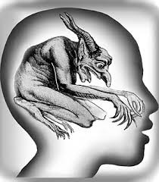
Possession Syndrome
Diagnosable under Dissociative disorders.
Patient is possessed usually by ‘spirit/soul’ of deceased relative or a local deity.
Speaks in changed tone, even gender changes at times if the possessing soul is of opposite sex.
Usually seen in rural areas or in migrants from rural areas.
Majority of these patients are females who otherwise don’t have any outlet to express their emotions.
Vishal Chhabra, M.S. Bhatia, Ravi Gupta, Delhi Psychiatry Journal 2008; 11:(1) © Delhi Psychiatric Society

Slide 41
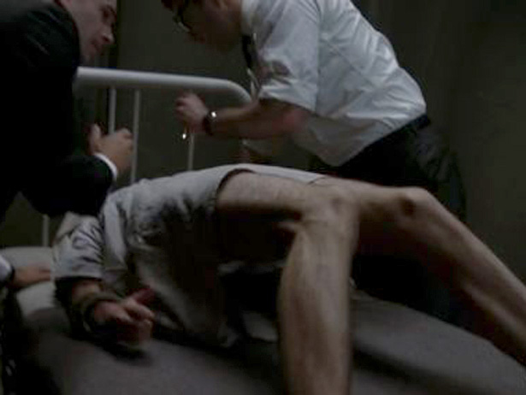
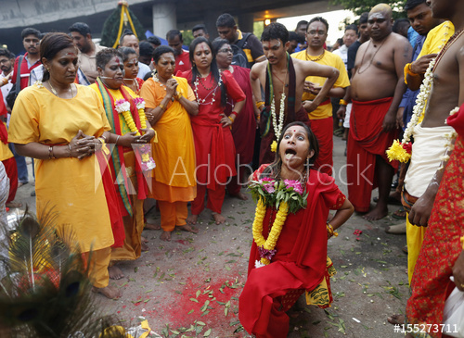
Many religious shrines hold special annual festivals where hundreds of people get possessed simultaneously.
These people are looked upon as special by their families and villages which reinforce the secondary gains.
Included in ICD-10 under Dissociative disorders

Slide 42
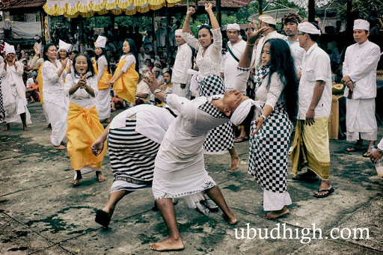
Possession refers to a general ideology describing the full range of direct spirit influences on human affairs including effects on physical, psychological, spiritual, social, and ecological realms.
Possession trance refers to specific alterations in consciousness, memory, behavior, and identity attributed to direct spirit influence.
Sadock BJ, Sadock VA, Ruiz P, Synopsis of Psychiatry, eleventh Edition, Pg 145-150
Notes:
as a subset of general possession experience, possession trance

Slide 43
A prototypical episode is composed of the following elements:
Onset occurs typically due to sub acute conflict or stress
Behavior during the altered state consists of :
Dramatic, semi-purposeful movements, such as head bobbing, bodily shaking, or falling to the ground, accompanied by incoherent verbalizations, such as mumbling, moaning.
Aggressive or violent actions directed at self or at others, (typically considered by observers to be uncharacteristic of the subject’s usual behavior)
Specific gestures, comments or requests denoting the appearance of a known possessing personality.
Sadock BJ, Sadock VA, Ruiz P, Synopsis of Psychiatry, eleventh Edition, Pg 145-150

Slide 44
This state is marked by the emergence of one or several secondary personalities distinct from that of the subject.
Possession by the secondary personality(ies) is episodic, resulting in alternation between the usual personality of the subject and the altered state.
Sadock BJ, Sadock VA, Ruiz P, Synopsis of Psychiatry, eleventh Edition, Pg 145-150
Notes:
The subject in his or her usual identity appears in a daze, exhausted, distressed, or confused

Slide 45
Epidemiology
female-to-male ratio of approx. 3 to 1
Age of onset is usually between 15 and 35 years
Precipitants
marked social or family conflicts(marital conflict, abuse, and neglect)
stressful life transitions(forced marriage; widowhood, death of a family member; difficulty finding employment and financial difficulties)
Sadock BJ, Sadock VA, Ruiz P, Synopsis of Psychiatry, eleventh Edition, Pg 145-150

Slide 46
Treatment
careful exploration of underlying stress which precipitated the possession attack.
Antidepressants and anxiolytics are helpful in certain cases
Sadock BJ, Sadock VA, Ruiz P, Synopsis of Psychiatry, eleventh Edition, Pg 145-150

Slide 47
Shenjing Shuairuo
“weakness of the nervous system” in Mandarin Chinese
translation and cultural adaptation of the term “neurasthenia,”(Greek for “lack of nerve strength”)
a heterogeneous syndrome of lassitude, pain, poor concentration, headache, irritability, dizziness, insomnia, and over 50 other symptoms.
Seen in mainland China, Taiwan, Hong Kong, in Chinese migrant communities, and in Japan, where a similar syndrome is labeled shinkei suijaku.
Sadock BJ, Sadock VA, Ruiz P, Synopsis of Psychiatry, eleventh Edition, Pg 145-150

Slide 48
Chinese Classification of Mental Disorders (CCMD-2-R)(revised)
The CCMD-2-R diagnosis requires three symptoms out of 5 nonhierarchical symptom clusters:
Weakness symptoms
Emotional symptoms
Excitement symptoms
nervous symptoms
sleep disturbances.
Like other neurotic disorders in the Chinese manual, the condition must last at least 3 months, and should
lower the efficiency of work, study, or social function
cause mental distress
precipitate treatment seeking
Sadock BJ, Sadock VA, Ruiz P, Synopsis of Psychiatry, eleventh Edition, Pg 145-150

Slide 49
Clinical feature:
Insomnia
affective dysphoria
Headache
bodily pains and distortions (e.g., “swelling” of the head),
Dizziness
difficulty concentrating
tension and anxiety
Worry
Fatigue
Weakness
gastrointestinal problems
“troubled vexation” (fan nao). It is a form of irritability mixed with worry and distress over “conflicting thoughts and unfulfilled desires,” that may be partially concealed for the sake of preserving social harmony.
Sadock BJ, Sadock VA, Ruiz P, Synopsis of Psychiatry, eleventh Edition, Pg 145-150

Slide 50
Precipitants:
work-related stressors(unwelcome work assignments, job postings that caused family separations, harsh criticism at work, excessive workloads, monotonous tasks)
interpersonal and family-related stressors included romantic disappointments, marital conflict, and the death of a spouse or other relative.
Treatment:
traditional Chinese medicines
Polypharmacy was common, combining sedatives, traditional herbs, antianxiety agents, vitamins, and other tonics
Sadock BJ, Sadock VA, Ruiz P, Synopsis of Psychiatry, eleventh Edition, Pg 145-150

Slide 51
Dhat Syndrome
It is characterized by nocturnal emission of semen leading to severe anxiety often associated with sexual impotence.
‘Dhatu’ (meaning precious fluid).
Dhatus in sanskrit means elixir of body and is considered to be the most precious elixir.
This gives rise to belief that loss of excessive semen in any form e.g. masturbation, nocturnal emissions etc. is harmful. On the other hand its preservation will lead to health and longevity.
Vishal Chhabra, M.S. Bhatia, Ravi Gupta, Delhi Psychiatry Journal 2008; 11:(1) © Delhi Psychiatric Society

Slide 52
Other names:
Sri Lanka (Sukra Prameha)
China (Sen-k’uri)
South East Asia (Jiryan)
Vishal Chhabra, M.S. Bhatia, Ravi Gupta, Delhi Psychiatry Journal 2008; 11:(1) © Delhi Psychiatric Society

Slide 53
The symptoms are….
Generalized weakness
Aches and pains all over the body
Easy fatigue
Loss of appetite, weight loss
Excessive worrying
Sadness of mood
Feelings of guilt (especially towards masturbation during adolescence)
Premature ejaculation and erectile dysfunction
Vishal Chhabra, M.S. Bhatia, Ravi Gupta, Delhi Psychiatry Journal 2008; 11:(1) © Delhi Psychiatric Society

Slide 54
Treatment
Dispelling of myth by pschoeducation
Reassuring the patient
Treating underlying psychiatric disorder
Vishal Chhabra, M.S. Bhatia, Ravi Gupta, Delhi Psychiatry Journal 2008; 11:(1) © Delhi Psychiatric Society

Slide 55
Koro
There is intense fear of genitalia retracting into abdomen leading ultimately to death.
It is seen in both sexes.
Person applies external retractors to the genitalia in form of clamps, chains etc. to avoid it retracting back.
It may occur as an epidemic.
Seen in northeastern states like Assam
Vishal Chhabra, M.S. Bhatia, Ravi Gupta, Delhi Psychiatry Journal 2008; 11:(1) © Delhi Psychiatric Society

Slide 56
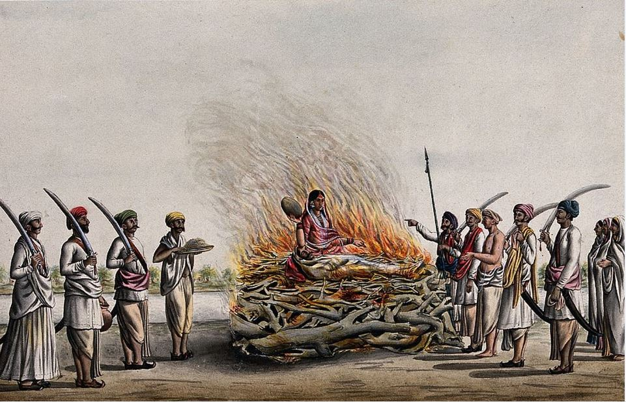
Culture bound suicide
Sati is a form of culture bound suicide in which there is self immolation by a widow on her husband’s pyre.
Was seen mostly in Upper Castes notably Brahmins and Kshatriyas.
Banned in India since 19th century.
Only one known case since 1904 (in Rajasthan)
Vishal Chhabra, M.S. Bhatia, Ravi Gupta, Delhi Psychiatry Journal 2008; 11:(1) © Delhi Psychiatric Society

Slide 57
Jouhar : Suicide committed by a women even before the death of her Husband when faced by prospect of dishonor from another man (usually a conquering king)
Most notable example is Rani Padmini of Chittor (Rajasthan) to evade the invading army of Sultan from Delhi in 15th century.
More recently, hundreds of women killed themselves by jumping in wells during partition of India to avoid rioters
Santhara/Sallekhana : voluntarily giving up life by fasting unto death over a period of time for religious reasons to attain God/ Moksha.
Seen in Jain Community who celebrates these events as religious festivals
Person initially takes liquids, later even refusing to take them.
Vishal Chhabra, M.S. Bhatia, Ravi Gupta, Delhi Psychiatry Journal 2008; 11:(1) © Delhi Psychiatric Society

Slide 58
Jhin Jhinia
In vernacular "Jhin-Jhini" means tingling and numbness.
The disease struck an individual unexpectedly with sensation of tingling and numbness in the legs which spread upward all through the body. Inside a couple of moments, the patient is seized with the loathsomeness of looming demise and sobs for help before he ends up noticeably astounded and unmoving. Unless saved, he would crash on the ground.
Kapoor et.al.: Cultural specific syndromes in india – an overview, Int J Cur Res Rev | Vol 10 • Issue 11 • June 2018

Slide 59
Suudu
It is a culture specific syndrome of painful urination and pelvic “heat” familiar in south India, especially in the Tamil culture.
It occurs in both males and females.
It is popularly attributed to an increase in the “inner heat” of the body often due to dehydration.
It is usually treated by the following:
Applying a few drops of sesame oil or castor oil in the navel and the pelvic region
Having an oil massage followed by a warm water bath
Intake of fenugreek seeds soaked overnight in water
Vishal Chhabra, M.S. Bhatia, Ravi Gupta, Delhi Psychiatry Journal 2008; 11:(1) © Delhi Psychiatric Society

Slide 60
Gilhari Syndrome
Charecterized by patient complaining of small swelling on the body changing its position from time to time as if a gilhari (squirrel) is travelling in the body.
also known as the “squirrel or lizard syndrome” and is highly prevalent among the regions of west Rajasthan
The individual emphatically trusts that the condition is intense and lethal.
Medicinal professionals explain that the Gilhari disorder is only the strong contraction or movements of the particular group of muscles that is caused by the serious tension and stress in a person
Vishal Chhabra, M.S. Bhatia, Ravi Gupta, Delhi Psychiatry Journal 2008; 11:(1) © Delhi Psychiatric Society
Kapoor et.al.: Cultural specific syndromes in india – an overview, Int J Cur Res Rev | Vol 10 • Issue 11 • June 2018

Slide 61
Mass Hysteria
Short lasting epidemics of Mass Hysteria where hundreds to thousands of people were seen to be believing and behaving in a manner in which ordinarily they wont.
E.g. the God Ganesha’s idols drinking milk all over India in 2006 lasted for almost a week
Vishal Chhabra, M.S. Bhatia, Ravi Gupta, Delhi Psychiatry Journal 2008; 11:(1) © Delhi Psychiatric Society

Slide 62
Suchi-bai Syndrome
A vernacular term ‘suchibai’ in Bengali dialect means a condition like obsessional neurosis.
Common symptoms of these patients include
washing too often
not eating anywhere outside
changing of street clothes (own and sometime compulsorily for all family members)
washing of money (including currency notes)
bathing for four hours twice a day
hanging out street clothes outside on a tree and entering house naked
hopping while walking (to avoid touching anything dirty in the streets)
remaining immersed in the holy river for best part of the day
sprinkling of cow dung water on all visitors etc.
Kapoor et.al.: Cultural specific syndromes in india – an overview, Int J Cur Res Rev | Vol 10 • Issue 11 • June 2018

Slide 63
Cultural Idiom of Distress
is a linguistic term, phrase or way of talking about suffering, shared with other people from the same culture (i.e., ethnicity, religion, community) and used to express, communicate, or comment on distress in general.
An idiom of distress need not be associated with specific symptoms, syndromes, or causal explanations.
It may be used to convey a wide range of uncomfortable, emotional pain or social shakiness including subclinical conditions or everyday experiences that do not necessarily constitute mental disorders
Sadock BJ, Sadock VA, Ruiz P, Synopsis of Psychiatry, eleventh Edition, Pg 145-150

Slide 64
Ataque de Nervios
(attack of nerves, in Spanish)
Ataque de nervios is an idiom of distress principally reported among Latinos from the Caribbean, but recognized among many Latin American and Latin Mediterranean groups
Sadock BJ, Sadock VA, Ruiz P, Synopsis of Psychiatry, eleventh Edition, Pg 145-150

Slide 65
Phenomenology
Exposure to a frequently sudden, stressful stimulus, typically eliciting feelings of fear, grief, or anger, and involving a person close to the subject
a sense of loss of control (emotional expressions).
These are accompanied by all or some of the following:
A . bodily sensations: Trembling, chest tightness, headache, difficulty breathing, palpitations, heat in the chest, paresthesias, difficulty moving limbs, blurred vision, or dizziness.
B. Behaviors (action dimension): Shouting, crying, swearing, moaning, breaking objects, striking out at others or at self, attempting to harm self, falling to the ground, shaking with convulsive movements, or lying “as if dead.”
4. Cessation may be abrupt or gradual, but it is usually rapid
Sadock BJ, Sadock VA, Ruiz P, Synopsis of Psychiatry, eleventh Edition, Pg 145-150

Slide 66
Epidemiology
The strongest predictors of ataque are female gender, lower formal education, and disrupted marital status (i.e., divorced, widowed, or separated).
Sadock BJ, Sadock VA, Ruiz P, Synopsis of Psychiatry, eleventh Edition, Pg 145-150

Slide 67
Culture shock
It is the difficulty people have adjusting to a new culture that differs markedly from their own, usually occurs during visiting a new place or during a short term sojourn (international students).
Thorough phases of initial excitement and then negotiation and adjustment, people usually master the new environment.
Vyas JN, Ghimire SR, Textbook of Postgraduate Psychiatry, 3rd edition, Volume 2, Pg-1808

Slide 68
People may also feel conflict over which of their life-styles to maintain, change or adopt.
Younger immigrants often learn the new language more easily and continue to mature in the new culture, whereas those who are more senior, having had more stability and unchanging routines in their formal culture, struggle more to adapt.
Sadock BJ, Sadock VA, Ruiz P, Comprehensive Textbook of Psychiatry, Eighth Edition

Slide 69
Signs and symptoms:
General unease with new situation
Irrational fears
Difficulty with sleeping
Feeling sick
Anxiety and Depression
Preoccupation with health
Homesickness
Isolation
Sense of loss of identity
Vyas JN, Ghimire SR, Textbook of Postgraduate Psychiatry, 3rd edition, Volume 2, Pg-1808

Slide 70
Brainwashing
First practice by Chinese community in American prisoners during the Korean war .
It includes deliberate creation of culture shock.
Individual are isolated and made to feel different and out of place who destroy their coping skills.
Once a person appears weak and helpless, the aggressor impose new ideas that they would have never accepted in normal state.
Sadock BJ, Sadock VA, Ruiz P, Comprehensive Textbook of Psychiatry, Eighth Edition

Slide 71
Upon release and return to their home , this brainwashed individual with PTSD require deep programming including reeducation and supportive psychotherapy on and individual and group basis.
Treatment is to rebuild:
healthy self esteem
Coping skills
Sadock BJ, Sadock VA, Ruiz P, Comprehensive Textbook of Psychiatry, Eighth Edition

Slide 72
CULTURE MAKES SOCIETY PERFECT, ISN’T IT..!!!
Thank you

