Slide 1

NUTRITION FOR ADOLESCENTS
Meghana Patel
Assistant Professor
Clinical Nutrition and Dietetics
SBKS Medical Institute and Research Centre
Sumandeep Vidyapeeth

Slide 2

ADOLESCENCE
A transitional stage from childhood to adulthood
Adolescence is a nutritionally vulnerable time when rapid physical growth increases nutrient demands.
Dietary behaviours established in adolescence may contribute to nutrition-related problems that have consequences for long-term health.

Slide 3

INTRODUCTION
Eating healthy food is important at any age, but it’s especially important for teenagers.
As a teenager, you’ll start to become more independent and make your own food choices.
As your body is still growing, it’s vital that you eat enough good quality food and the right kinds to meet your energy and nutrition needs.
Being a teenager can be fun, but it can also be difficult as your body shape changes. These physical changes can be hard to deal with if they aren’t what you are expecting.
There can be pressure from friends to be or look a certain way, and this might affect the foods you eat.
It’s not a good time to crash diet, as you won’t get enough nutrients, and you may not reach your full potential.
Following a sensible, well-balanced diet is a much better option, both for now and in the long term.

Slide 4

WHAT SHOULD WE EAT?
Eating three regular meals a day with some snacks will help you meet your nutrition needs.
Skipping meals means you will miss out on vitamins, minerals Proteins and complex carbohydrates, which can leave you lacking energy or finding it hard to concentrate.
Here is a guide to help you understand the value of what you eat.

Slide 5
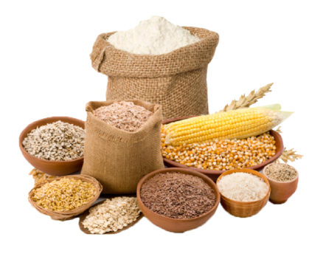
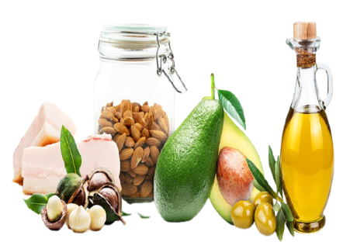
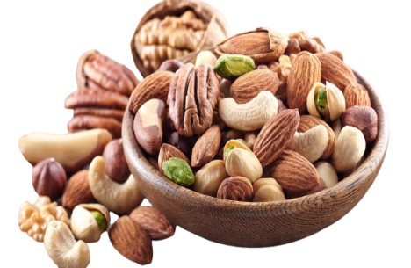
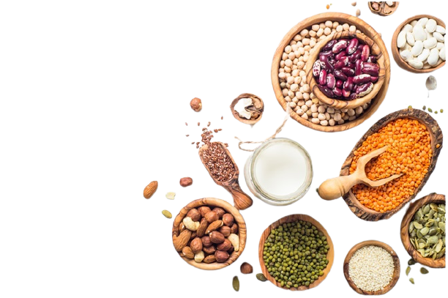
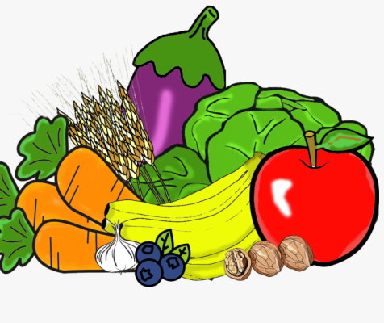

6 ESSENTIAL NUTRIENTS
Carbohydrates
Fats
Minerals
Protein
Vitamins
Water

Slide 6


Carbohydrates
Cereals and millets are excellent sources of carbohydrates that provide energy for your brain and muscles.
Without enough carbohydrates you may feel tired and run down.
Try to include some carbohydrates at each mealtime.
Simple Carbohydrate
Fruits, juices, milk, and yogurt, Candy, soda, and jelly.
Starches or Complex carbohydrate
Peas, beans, whole grains and vegetables.
RDA
BOYS- 130 gm
Girls- 130 gm

Slide 7
Protein
It is a major component of the skin, muscle, bone, organs, hair, and nails.
It helps the body to build and repair cells and tissues.
RDA
BOYS- 55 gm
Girls- 46 gm
Food Sources:
Meat, fish, eggs, poultry, dairy products,
legumes, nuts and seeds.

Slide 8
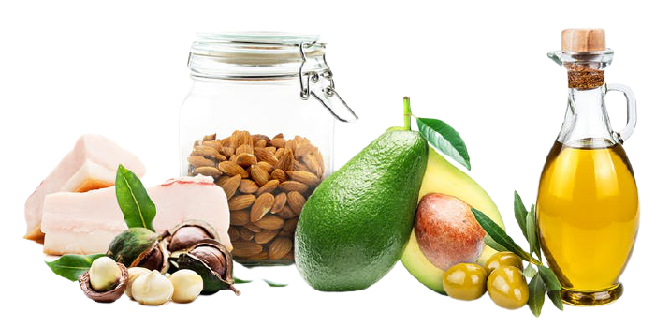
Fats
Saturated Fat:
  Fats that are usually solid at room temperature.
  The type of fat most strongly linked to high cholesterol and increased risk of heart disease.
Unsaturated Fat
  Fats that are liquid at room temperature.
  Polyunsaturated Fat Provide two essential fatty acids necessary for bodily functions.
  Monounsaturated Fat May play a role in reducing the risk of heart disease.
Food Sources:
Butter, vegetable oils, salad dressings, nuts and seeds, dairy products , meats, poultry
RDA
BOYS- 25 gm
Girls- 20 gm

Slide 9
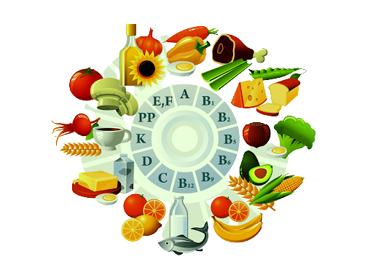
Vitamins
Fat Soluble Vitamins
  Vitamins A, D, E, K
  Require fat for the stomach to allow them to be carried into the blood stream for use (absorption).
  Can be stored in the body for later use.
Water Soluble Vitamins
  Vitamins C and B-complex
  Require water for absorption.
  Easily absorbed and passed through the body as waste.
Fruit and vegetables have lots of vitamins which help boost your immune system and keep you from getting sick.
It’s recommended you eat two servings of fruit and three servings of vegetables a day.

Slide 10
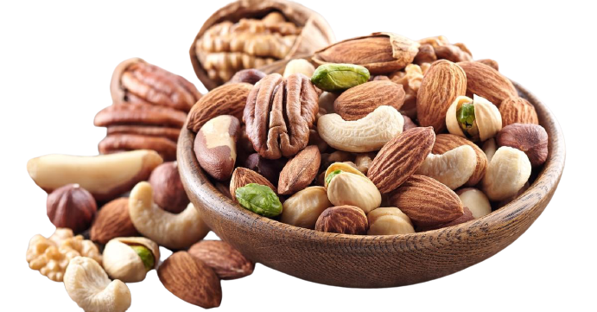
Minerals
The body is depended on minerals for practically every process necessary for life.
Essential minerals are divided up into major minerals (macro minerals) and trace minerals (micro minerals).
Calcium ,Phosphorus ,Magnesium ,Sodium ,Potassium ,Iron.
Others include: Iodine, Zinc, Copper, Sulfur, Chloride, etc.
Food Sources:
Meats, beans, nuts, fruits, vegetables, dairy products, and grains.

Slide 11
Water
Water carries nutrients to your cells and carries waste from your body.
Regulates body temperature.
Dissolves vitamins, minerals, amino acids and other nutrients.
Lubricates joints.
Did you know?
  1/2 to 3/4 of the human body consists of water!
6-8 glasses of water each day is recommended.
This is in addition to around 4 cups of water you get from food each day.

Slide 12
BALANCED DIET
B: Be sure to allot time for efficient digestion. Have at least a 5-hour interval between meals and the last meal of the day should be taken at least 3 hours before sleeping.
A: Avoid tea, coffee, alcoholic and carbonated beverages such as soft drinks.
L: Light supper, a moderate lunch and a heavy breakfast are advisable.
A: At least one serving of dark vegetables a day is good for the body.
N: Never skip a meal. Eat 3 meals a day instead of eating frequent ones or eating between meals.
C: Choose foods of the right kind, at the right time and interval, in the right amount and in the right condition of the mind. Eating in a relaxed atmosphere is ideal.
E: Establish a regular eating habit.
D: Drink at least 8 glasses of water in a day.
D: Do not hurry your meal. Take time to enjoy your food.
I: include a variety of foods in each meal.
E: Eat more fresh fruits instead of rich desserts.
T: Take some time refer food intake and amount eaten in food guide pyramid.

Slide 13
Five Food Groups System
FOOD GROUP | MAIN NUTRIENTS
1. Cereal grains and products: (rice, wheat, ragi, bajra, maize, jowar) | Energy, Protein, Invisible fat, Vitamin-B1, Vitamin-B2, Folic acid, Iron, Fibre.
2. Pulses and Legumes: (Black gram, red gram, lentil, rajma, peas, cowpea, soyabeans) | Energy, Protein, Invisible fat, Vitamin-B1, Vitamin-B2, Folic acid, Iron, Fibre, Calcium.
3. Milk and Meat products: Milk, curd, cheese, skimmed milk, chicken, liver, fish, egg, meat) | Protein, Fat, Vitamin-B2, Calcium
4. Fruits and Vegetables: Fruits: Mango, Guava, Tomato, Papaya, Orange, watermelon Vegetables: Spinach, Drumstick leaves, Coriander leaves, Fenugreek leaves. Other Vegetables: Carrots, Brinjal, Cauliflower, Capsicum, Onion. | Carotenoids, Vitamin-C, Fibre, Invisible fat, Vitamin-B2, Folic acid, Iron. Carotenoids, Vitamin-B2, Folic acid, Calcium, Iron, Fibre. Carotenoids, Folic acid, Calcium, Fibre.
5. Fats and Sugar: Fats: Butter, Ghee, Cooking oils like mustard, Groundnut. Sugar: jaggery and Sugar. | Energy, Fat, Essential Fatty acids. Energy.

Slide 14
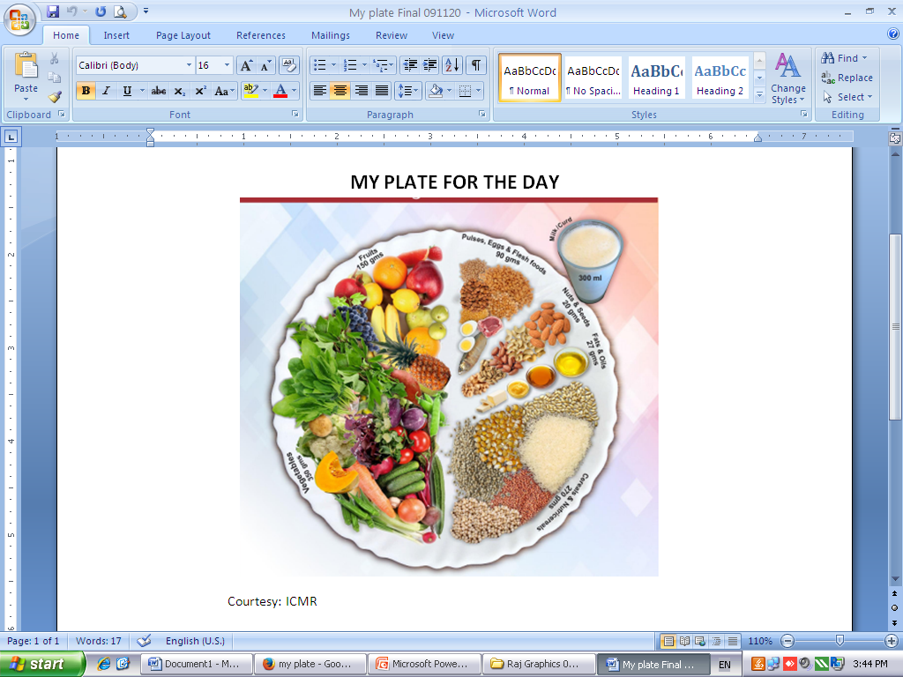
DIETARY GUIDELINES
Start your day with healthy breakfast
If you have fast foods, choose wisely.
Keep healthy snacks on hand.
Don’t skip dairy products.
Limit your sugar intake
Have salad in your plate while having lunch and dinner.
Drink lot of fluid
Practice moderation.
Enjoy your meal.

Slide 15
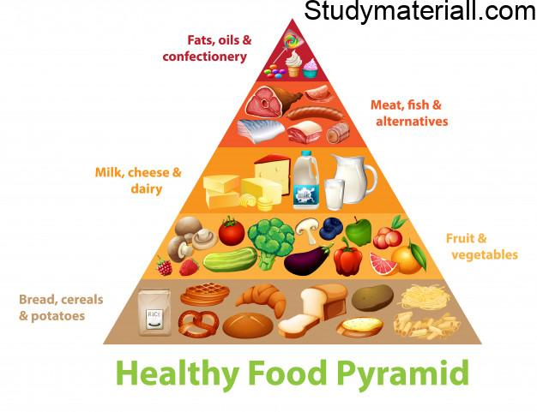
The food guide pyramid is an educational tool that shows the dietary guidelines in the easily understood graphic format. It was originally prepared by the Human Nutrition Information Service and published in 1992 by the U.S. Department of Agriculture.

Slide 16
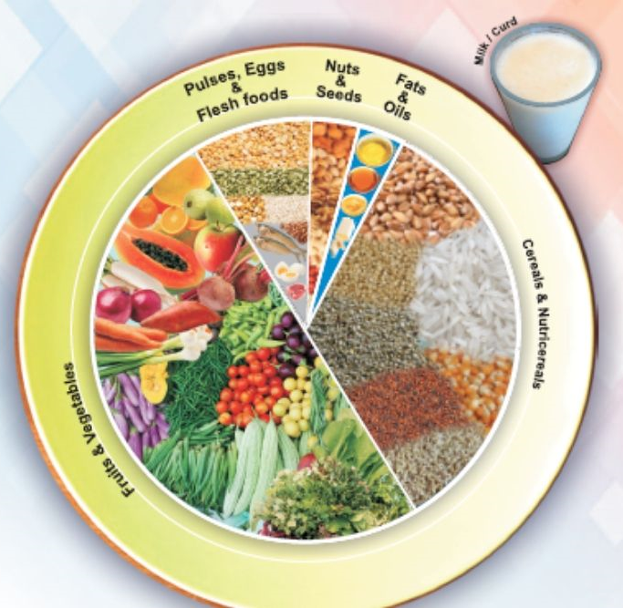
My plate
Consumption of proportions of food groups indicated in the plate helps prevent macronutrient & micronutrient malnutrition (Hidden Hunger)
The proportion indicated in the plate ensures adequate intake of all micronutrients (vitamins & minerals), bioactive compounds, functional foods, antioxidants etc.
No vitamin or mineral (micronutrients) supplements will provide the adequacy of all nutrients that can be met from this model plate
Routine consumption of certain nutrients as supplements will interfere with absorption of other nutrients.
Micronutrients from food are better absorbed and more bioavailable than vitamin and mineral supplements/tablets/capsules/fortification
A complete diet as indicated in the model plate provides many unknown substances/nutrients that cannot be met from supplements or fortified foods

Slide 17
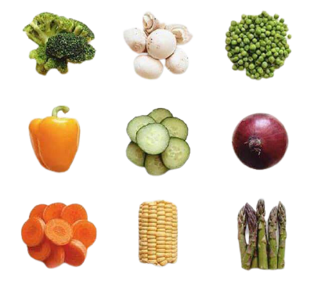
CALORIES IN VEGETABLES
THIS
SHOULD
REALLY
BE
THE
LEAST
OF
YOUR
CONCERNS

Slide 18

You

Slide 19


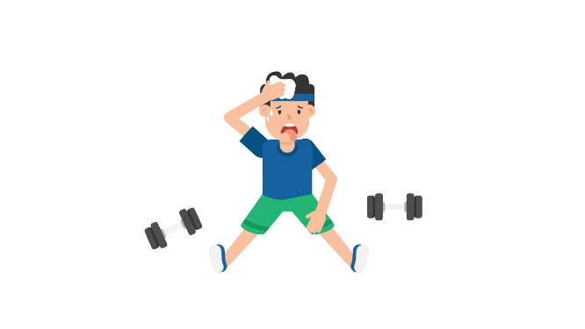


How much to burn?

Slide 20
BREAKFAST
Kick-start your metabolism by including Carbohydrate and protein in breakfast.
Whatever you do, don't skip breakfast as this sets your blood sugar off on a roller-coaster that means you'll end up choosing the wrong foods later in the day.
Remember breakfast makes an important contribution towards your daily intake and it plays a key role in maintaining a healthy weight.

Slide 21
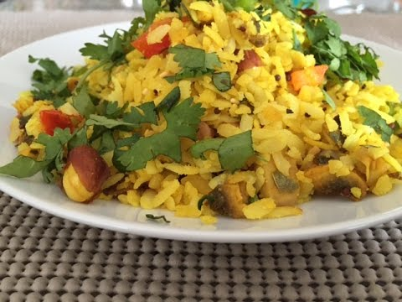
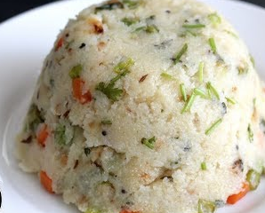



HEALTHY BREAKFAST
Veg Poha
Veg Upma
Stuffed Paratha
Omelette
Add curd /milk with breakfast

Slide 22
MID MORNING SNACKS
Make every snack count with nourishing options that supply both the 'pick me up' you need while topping up your five-a-day.

Slide 23
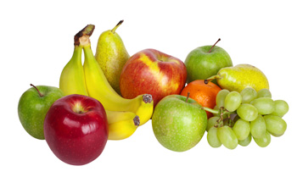

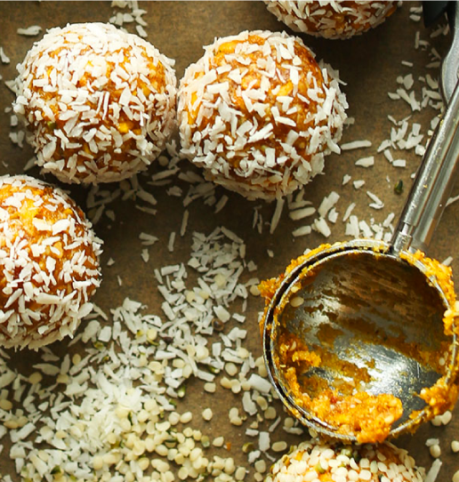
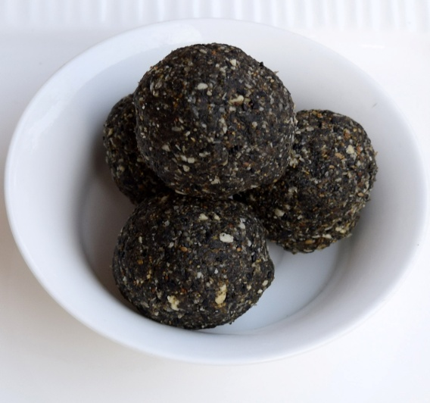
MID MORNING MUNCHIES
ANY ONE

Slide 24
LUNCH
Make lunch a mix of lean protein and starchy carbs.
Carb-rich foods supply energy and without them you're more likely to suffer that classic mid-afternoon slump.
Fill your half plate with colourful variety of vegetable salad.

Slide 25
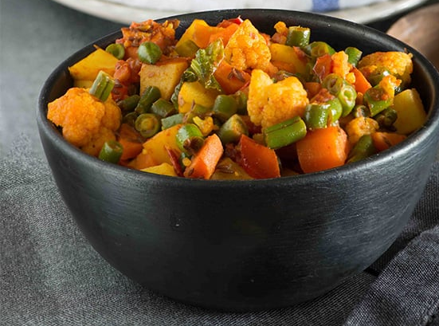
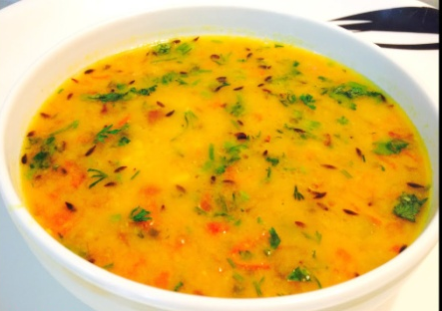

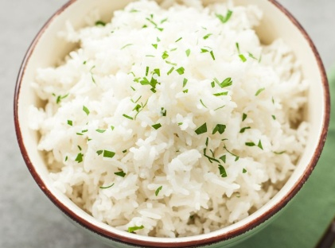

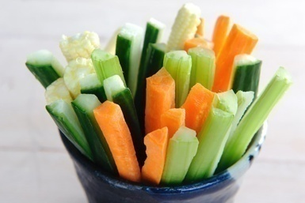

MY PLATE PACKED LUNCH
₊
₊
₊
OR
OR
WITH
Roti Sabji/ Rice Sabji / Dal Rice
Salad
With curd/buttermilk

Slide 26
AFTERNOON SNACKS
Satisfy the sweet craving and the need for energy with seasonal fruits.
A handful of dry fruits provides protein and healthy fats to keep you satisfied till supper.

Slide 27
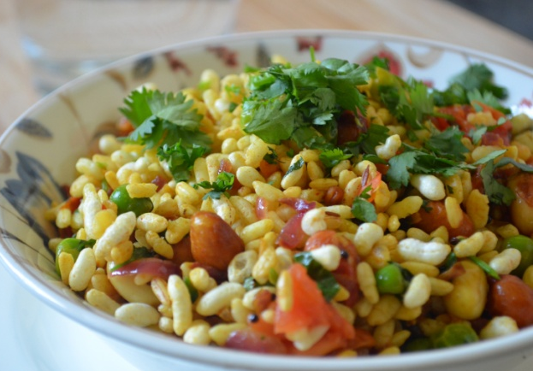
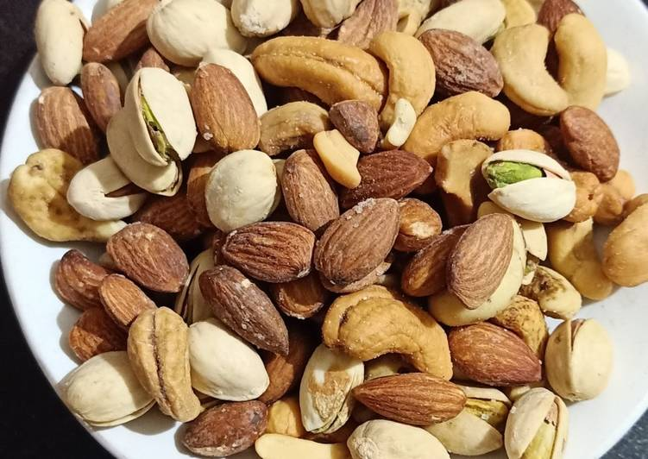
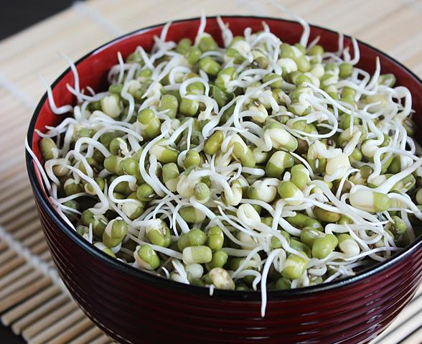
CHOOSE MID-NOON MUNCHIES

Slide 28
DINNER
Don't curfew carbs. They're fibre-rich that helps you relax in the evening.
Combine them with healthy fats and protein. Your body can use these healthy fats along with protein overnight for regeneration and repair, important for maintaining healthy skin and hair.

Slide 29
IN A GIST..
Maintain body weight
Increase fiber intake
Increase fruits and vegetable intake
Meet calcium and iron needs
Get active

Slide 30
THANK YOU

