Slide 1
UNIT 1:GENERAL MICROBIOLOGY
TOPIC:BACTERIAL CELL WALL
PRESENTATION BY:
Ms. Pooja Shashikant Chavan (2021-22)
F Y Microbiology for B. Sc Cardiac/Perfusion
Radio Imaging/Medical Laboratory Technology/OT

Slide 2
INTRODUCTION
It is important to note that not all bacteria have a cell wall. Having said that though, it is also important to note that most bacteria (about 90%) have a cell wall and they typically have one of two types: a gram positive cell wall or a gram negative cell wall.
The two different cell wall types can be identified in the lab by a differential stain known as the Gram stain. Developed in 1884, it’s been in use ever since. Originally, it was not known why the Gram stain allowed for such reliable separation of bacterial into two groups. Once the electron microscope was invented in the 1940s, it was found that the staining difference correlated with differences in the cell walls. After this stain technique is applied the gram positive bacteria will stain purple, while the gram negative bacteria will stain pink.

Slide 3
A cell wall, not just of bacteria but for all organisms, is found outside of the cell membrane. It’s an additional layer that typically provides some strength that the cell membrane lacks, by having a semi-rigid structure.
Both gram positive and gram negative cell walls contain an ingredient known as peptidoglycan (also known as murein). This particular substance hasn’t been found anywhere else on Earth, other than the cell walls of bacteria. But both bacterial cell wall types contain additional ingredients as well, making the bacterial cell wall a complex structure overall, particularly when compared with the cell walls of eukaryotic microbes. The cell walls of eukaryotic microbes are typically composed of a single ingredient, like the cellulose found in algal cell walls or the chitin in fungal cell walls.

Slide 4
CELL WALL FUNCTIONS
The bacterial cell wall performs several functions as well, in addition to providing overall strength to the cell.
It also helps maintain the cell shape, which is important for how the cell will grow, reproduce, obtain nutrients, and move.
It protects the cell from osmotic lysis, as the cell moves from one environment to another or transports in nutrients from its surroundings.
Since water can freely move across both the cell membrane and the cell wall, the cell is at risk for an osmotic imbalance, which could put pressure on the relatively weak plasma membrane.
Studies have actually shown that the internal pressure of a cell is similar to the pressure found inside a fully inflated car tire. That is a lot of pressure for the plasma membrane to withstand.
The cell wall can keep out certain molecules, such as toxins, particularly for gram negative bacteria. And lastly, the bacterial cell wall can contribute to the pathogenicity or disease –causing ability of the cell for certain bacterial pathogens.

Slide 5
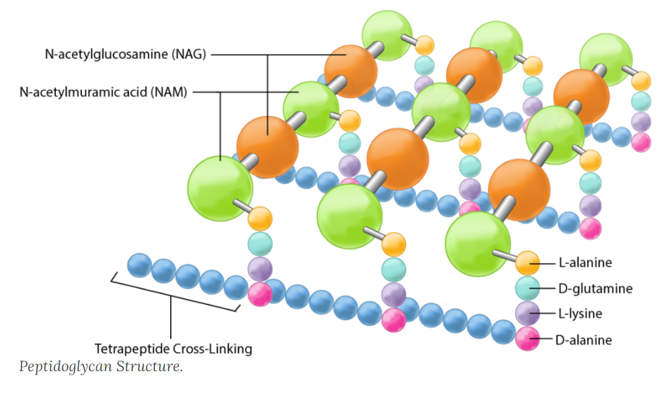
STRUCTURE OF PEPTIDOGLYCAN

Slide 6
PEPTIDOGLYCAN
Peptidoglycan is an ingredient that both bacterial cell walls have in common .Peptidoglycan is a polysaccharide made of two glucose derivatives, N-acetylglucosamine (NAG) and N-acetylmuramic acid (NAM), alternated in long chains.
The chains are cross-linked to one another by a tetrapeptide that extends off the NAM sugar unit, allowing a lattice-like structure to form. The four amino acids that compose the tetrapeptide are: L-alanine, D-glutamine, L-lysine or meso-diaminopimelic acid (DPA), and D-alanine.
Typically only the L-isomeric form of amino acids are utilized by cells but the use of the mirror image D-amino acids provides protection from proteases that might compromise the integrity of the cell wall by attacking the peptidoglycan. The tetrapeptides can be directly cross-linked to one another, with the D-alanine on one tetrapeptide binding to the L-lysine/ DPA on another tetrapeptide.
In many gram positive bacteria there is a cross-bridge of five amino acids such as glycine (peptide interbridge) that serves to connect one tetrapeptide to another. In either case the cross-linking serves to increase the strength of the overall structure, with more strength derived from complete cross-linking, where every tetrapeptide is bound in some way to a tetrapeptide on another NAG-NAM chain.

Slide 7
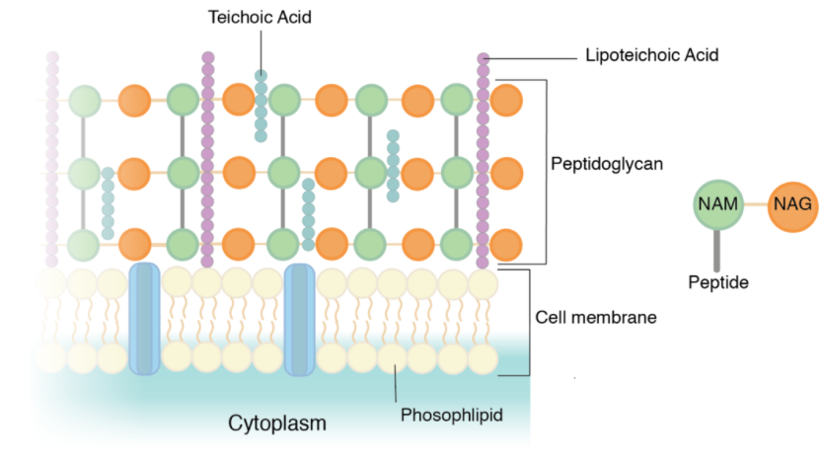
GRAM POSITIVE CELL WALLS
The cell walls of gram positive bacteria are composed predominantly of peptidoglycan. In fact, peptidoglycan can represent up to 90% of the cell wall, with layer after layer forming around the cell membrane. The NAM tetrapeptides are typically cross-linked with a peptide interbridge and complete cross-linking is common. All of this combines together to create an incredibly strong cell wall.

Slide 8
The additional component in a gram positive cell wall is teichoic acid, which is embedded within the peptidoglycan layers. Teichoic acid is believed to play several important roles for the cell, such as generation of the net negative charge of the cell, which is essential for development of a proton motive force.
Teichoic acid contributes to the overall rigidity of the cell wall, which is important for the maintenance of the cell shape, particularly in rod-shaped organisms. There is also evidence that teichoic acids participate in cell division, by interacting with the peptidoglycan biosynthesis machinery.
Lastly, teichoic acids appear to play a role in resistance to adverse conditions such as high temperatures and high salt concentrations, as well as to β-lactam antibiotics. Teichoic acids can either be covalently linked to peptidoglycan (wall teichoic acids or WTA) or connected to the cell membrane via a lipid anchor, in which case it is referred to as lipoteichoic acid.
Since peptidoglycan is relatively porous, most substances can pass through the gram positive cell wall with little difficulty. But some nutrients are too large, requiring the cell to rely on the use of exoenzymes. These extracellular enzymes are made within the cell’s cytoplasm and then secreted past the cell membrane, through the cell wall, where they function outside of the cell to break down large macromolecules into smaller components.

Slide 9
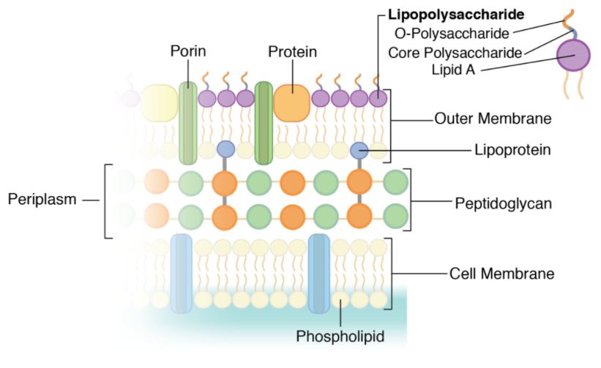
GRAM NEGATIVE CELL WALLS

Slide 10
The cell walls of gram negative bacteria are more complex than that of gram positive bacteria, with more ingredients overall. They do contain peptidoglycan as well, although only a couple of layers, representing 5-10% of the total cell wall. What is most notable about the gram negative cell wall is the presence of a plasma membrane located outside of the peptidoglycan layers, known as the outer membrane.
This makes up the bulk of the gram negative cell wall. The outer membrane is composed of a lipid bilayer, very similar in composition to the cell membrane with polar heads, fatty acid tails, and integral proteins. It differs from the cell membrane by the presence of large molecules known as lipopolysaccharide (LPS), which are anchored into the outer membrane and project from the cell into the environment. LPS is made up of three different components: 1) the O-antigen or O-polysaccharide, which represents the outermost part of the structure , 2) the core polysaccharide, and 3) lipid A, which anchors the LPS into the outer membrane.\
LPS is known to serve many different functions for the cell, such as contributing to the net negative charge for the cell, helping to stabilize the outer membrane, and providing protection from certain chemical substances by physically blocking access to other parts of the cell wall. In addition, LPS plays a role in the host response to pathogenic gram negative bacteria. The O-antigen triggers an immune response in an infected host, causing the generation of antibodies specific to that part of LPS (think of E. coli O157). Lipid A acts as a toxin, specifically an endotoxin, causing general symptoms of illness such as fever and diarrhea. A large amount of lipid A released into the bloodstream can trigger endotoxic shock, a body-wide inflammatory response which can be life-threatening.

Slide 11
The outer membrane does present an obstacle for the cell. While there are certain molecules it would like to keep out, such as antibiotics and toxic chemicals, there are nutrients that it would like to let in and the additional lipid bilayer presents a formidable barrier. Large molecules are broken down by enzymes, in order to allow them to get past the LPS.
Instead of exoenzymes (like the gram positive bacteria), the gram negative bacteria utilize periplasmic enzymes that are stored in the periplasm. Where is the periplasm, you ask? It is the space located between the outer surface of the cell membrane and the inner surface of the outer membrane, and it contains the gram negative peptidoglycan.
Once the periplasmic enzymes have broken nutrients down to smaller molecules that can get past the LPS, they still need to be transported across the outer membrane, specifically the lipid bilayer. Gram negative cells utilize porins, which are transmembrane proteins composed of a trimer of three subunits, which form a pore across the membrane.
Some porins are non-specific and transport any molecule that fits, while some porins are specific and only transport substances that they recognize by use of a binding site. Once across the outer membrane and in the periplasm, molecules work their way through the porous peptidoglycan layers before being transported by integral proteins across the cell membrane.
The peptidoglycan layers are linked to the outer membrane by the use of a lipoprotein known as Braun’s lipoprotein (good ol’ Dr. Braun). At one end the lipoprotein is covalently bound to the peptidoglycan while the other end is embedded into the outer membrane via its polar head. This linkage between the two layers provides additional structural integrity and strength.

Slide 12
