Slide 1
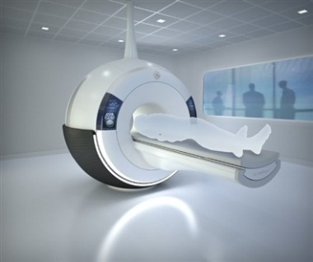
GRE PULSE SEQUENCES
By Passang D. Sherpa
Coordinator of
Radio-imaging Technology
Dpt. Of paramedical science

Slide 2
What is a pulse sequence?
An MRI sequence is an ordered combination of RF and gradient pulses designed to acquire the data to form the Image.
Carefully coordinated & timed sequence of events generate a particular type of contrast.
Spin echo, gradient & EPI pulse sequences.

Slide 3
Gradient-echo pulse sequences differ from spin-echo pulse sequences in two ways:
They use variable RF excitation pulse flip angles as opposed to 90° RF excitation pulse flip angles
Use gradients rather than RF pulses to rephase the magnetic moments of hydrogen nuclei to form an echo.
Purpose of these two mechanisms is to enable shorter TRs and therefore scan times

Slide 4
Variable flip angle
A gradient-echo pulse sequence uses an RF excitation pulse that is variable and therefore flips the NMV through any angle (not just 90°).
Gradient rephasing:
After the RF excitation pulse is withdrawn, the FID immediately occurs due to inhomogeneities in the magnetic field and T2* decay.
Gradient is used to rephase transverse magnetization

Slide 5
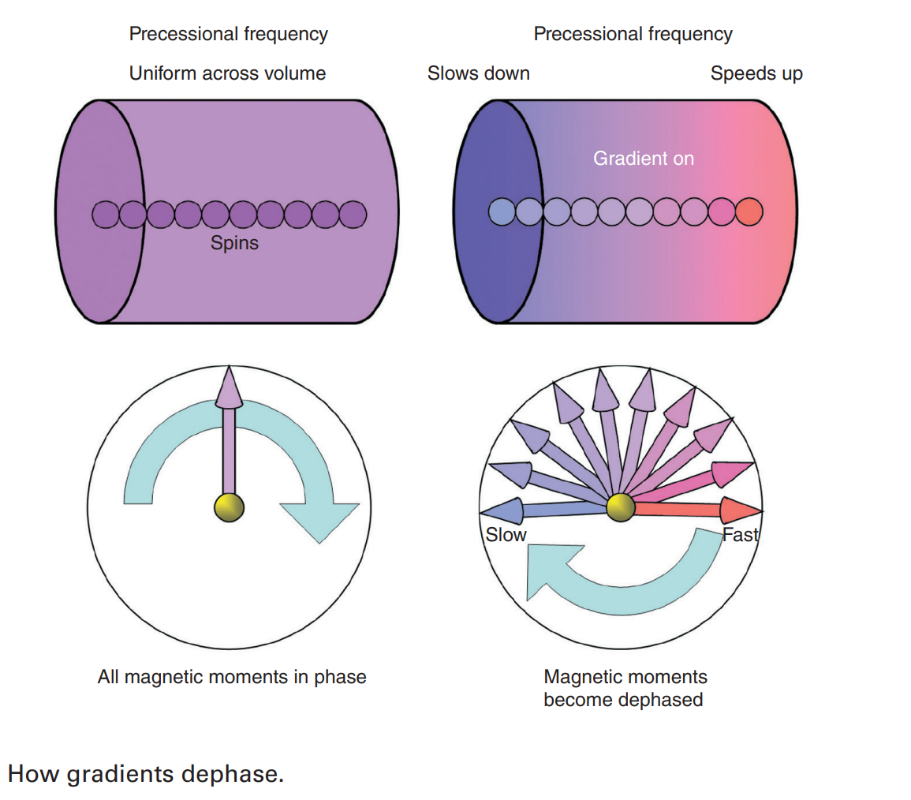
How gradients dephase

Slide 6
A gradient is applied to coherent (in phase) magnetization
The gradient alters the magnetic field strength experienced by the coherent magnetization.
Some of the magnetic moments speed up, and some slow down, depending on their position along the gradient axis.
Magnetic moments fan out or dephase because their frequencies are changed by the gradient
Trailing edge of the fan (purple)–slow down - lower magnetic field strength relative to isocenter.
leading edge of the fan (red) -speed up -higher magnetic field strength relative to isocentre
Process of dephasing magnetic moments with gradients is called gradient spoiling

Slide 7
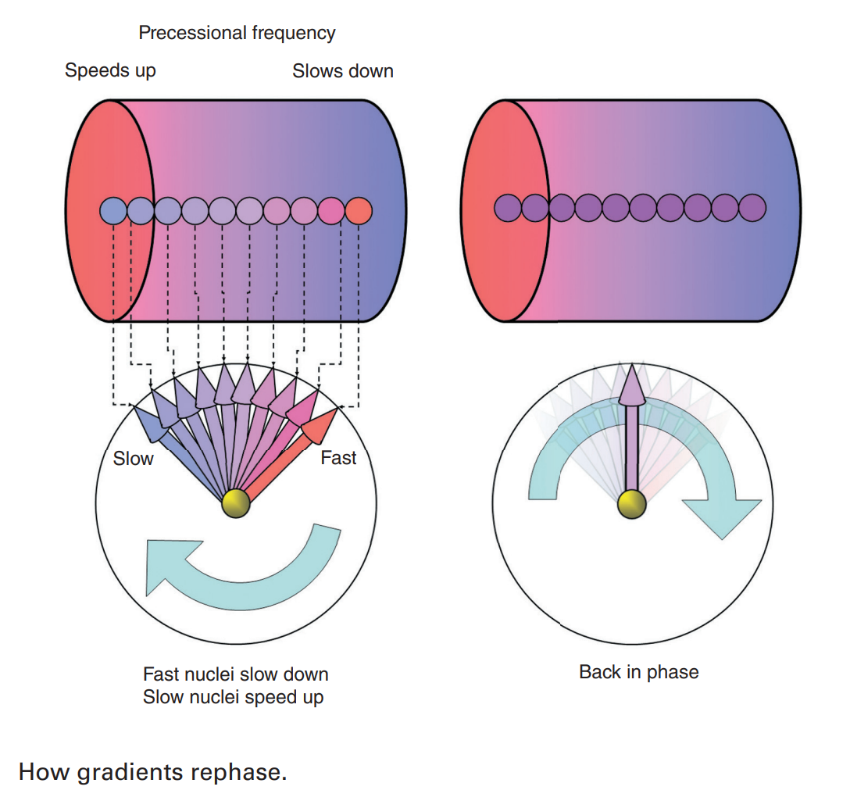
How gradients rephase

Slide 8
A gradient is applied to incoherent (out of phase) magnetization to rephase it.
A gradient is then applied so that the magnetic field strength is altered in a linear fashion along the axis of the gradient.
Trailing edge of the fan experience an increased magnetic field strength and speed up
leading edge of the fan experience a decreased magnetic field strength and slow down

Slide 9
After a short period of time, the slow magnetic moments speed up sufficiently to meet the faster ones that are slowing down
All the magnetic moments are in the same place at the same time and are therefore rephased by the gradient
A maximum signal is induced in the receiver coil, and this signal is called a gradient-echo
Gradients that rephase in this way are called rewinders

Slide 10
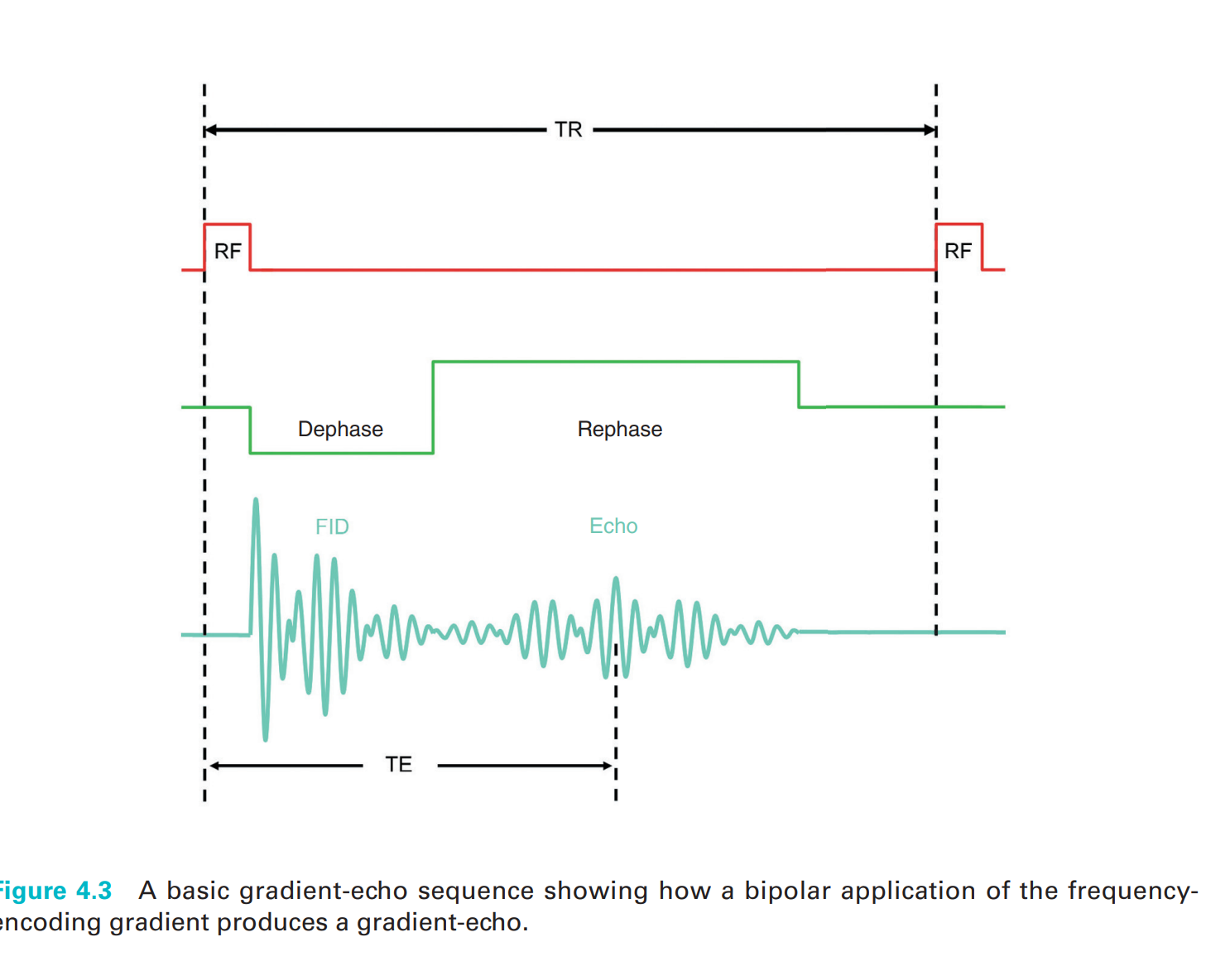
Gradient-echoes are created by a bipolar gradient
Two lobes- one negative and one positive.
It is initially applied negatively, which increases dephasing and eliminates the FID.
Its polarity is then reversed, which rephases only those magnetic moments that were dephased by the negative lobe.
create the gradient-echo at time TE

Slide 11
Weighting in gradient-echo pulse sequences
Essentially three different processes that affect weighting in gradient-echo pulse sequences
Extrinsic parameters (TR, TE, and flip angle)
The steady state
Residual transverse magnetization.

Slide 12
Weighting mechanism 1 – extrinsic contrast parameters
In gradient-echo pulse sequences, the TR and the flip angle control the amount of T1 relaxation and saturation that occurs
T2 is termed T2* to reflect the fact that magnetic field inhomogeneities are not compensated for by gradient rephasing
If the combination of flip angle and TR causes saturation of the vectors (i.e. they never fully recover their longitudinal magnetization during the TR period), then T1 contrast is maximized.

Slide 13
If the combination of flip angle and TR does not cause saturation of the vectors (i.e. they recover most, or all, of their longitudinal magnetization during the TR period), then T1 contrast is minimized.

Slide 14
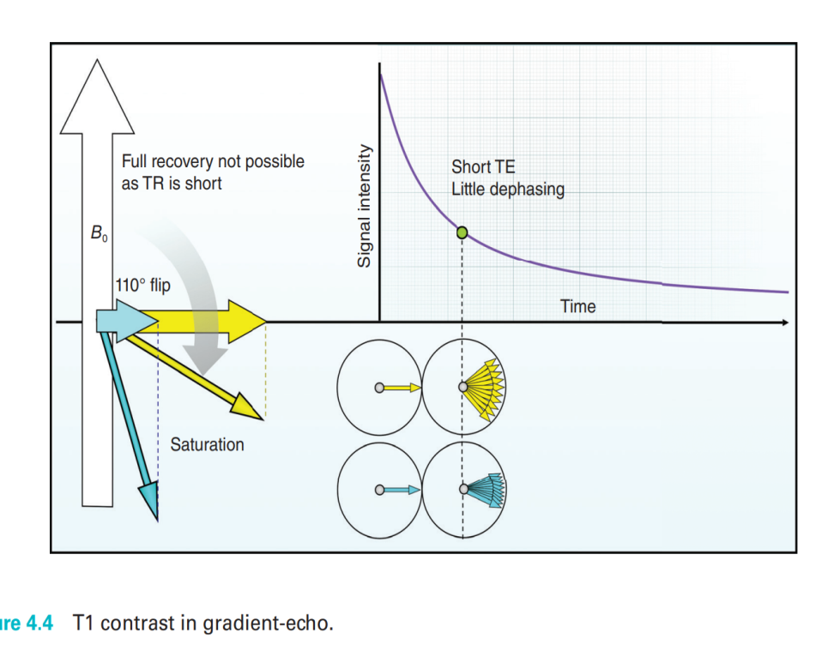
Using extrinsic contrast parameters in gradient-echo – T1 weighting
Differences in the T1 recovery times of the tissues are maximized, and differences in the T2* decay times of the tissues are minimized.
To avoid full recovery of their longitudinal magnetization- flip angle large and TR short so that the fat and water vectors are still in the process of recovering when the next RF excitation pulse is applied.
To minimize differences in T2* decay times, the TE is short so that neither fat nor water has time to decay

Slide 15
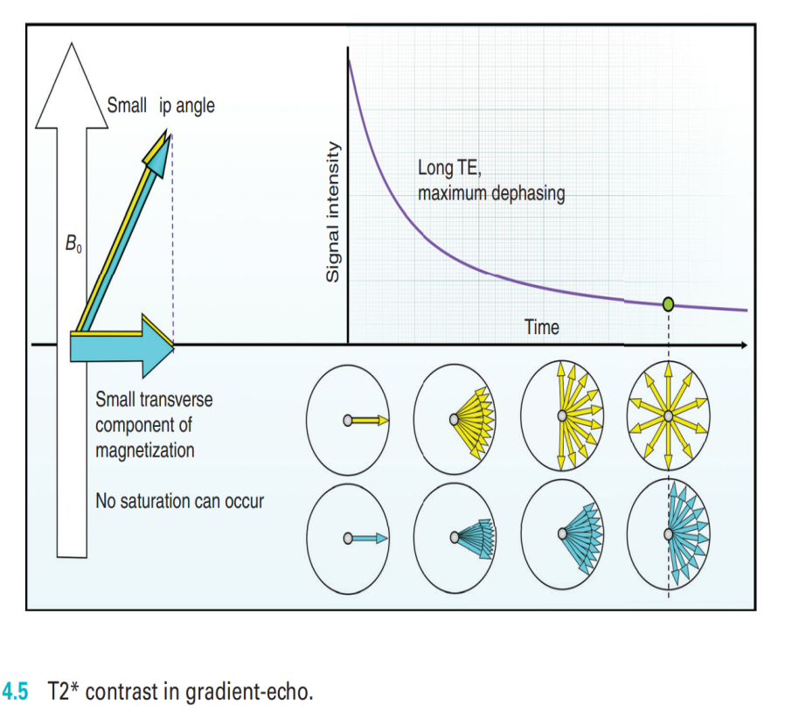
Using extrinsic contrast parameters in gradient-echo – T2* weighting
To obtain a T2*-weighted image, differences in the T2* decay times of the tissues are maximized, and differences in the T1 recovery times are minimized.
To maximize differences in T2* decay times-Long TE
To minimize differences in T1 recovery times-Small flip angle and long TR

Slide 16
Using extrinsic contrast parameters in gradient-echo – PD weighting
Both T1 and T2* processes are minimized so that the differences in proton density of the tissues are demonstrated.
To minimize T2* decay- TE is short so that neither the fat nor the water vectors have had time to decay.
To minimize T1 recovery-flip angle is small and the TR long enough to permit full recovery of longitudinal magnetization before the next RF excitation pulse is applied.

Slide 17
Conventional gradient echo
Gradient echo sequence use variable flip angle so that TR & therefore scan time can be reduced without producing saturation.
A gradient is used to rephase the FID rather then a 180⁰ RF pulse.
Gradients are quicker to apply than a 180⁰ pulse, therefore the minimum TE can be reduced.

Slide 18
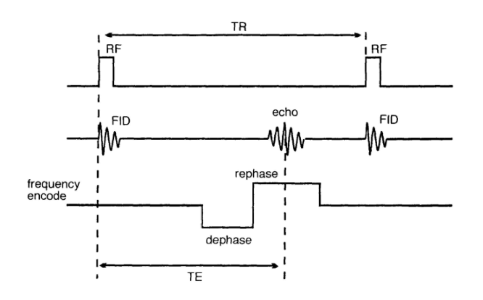
Gradient echo pulse sequence

Slide 19
Uses
To acquire T2*, T1 & proton density weighting.
Can reduce scan time as TR is greatly reduced.
Application -
Single slice breath hold acquisition
Dynamic contrast enhancement.
Angiographic imaging.

Slide 20
Parameter
Contrast Parameter | T1 weighting | T2* weighting | Proton density weighting
Flip angle | 70-110 | 5-20 | 5-20
TR | Short, <50 ms | Long , to max. saturation | Long , to max. saturation
TE | 5-10 ms | Long ,15-25ms | Short , 5-10 ms
Scan time | Several seconds - minute | several seconds to minutes | several seconds to minutes

Slide 21
GRE SEQUENCES
GRADIENT ECHO
Steady state free precession
(SSFP)
COHERENT
INCOHERENT
SPGR
BALANCED GRADIENT

Slide 22
The steady state & echo formation
The steady state is generically defined as a stable condition that does not change over time.
Steady state- A condition in which TR is shorter then the T1 & T2 relaxation time.
In steady state, there is a co-existence of both transverse & longitudinal magnetization.
Critical values of flip angle &TR maintains the steady state during data acquisition.
A flip angle of 30⁰-45 in conjunction with a TR of 20-50 ms achieve the steady state.

Slide 23
RF excitation pulse gives energy to hydrogen nuclei, and the amount of energy applied is determined by the flip angle.
Energy is lost by hydrogen nuclei through spin-lattice energy transfer, and the amount of lost energy is determined by the TR.
Selecting certain combination of TR and flip angle, the overall energy of the system remains constant, as the energy “in” as determined by the flip angle equals the energy “out” as determined by the TR

Slide 24
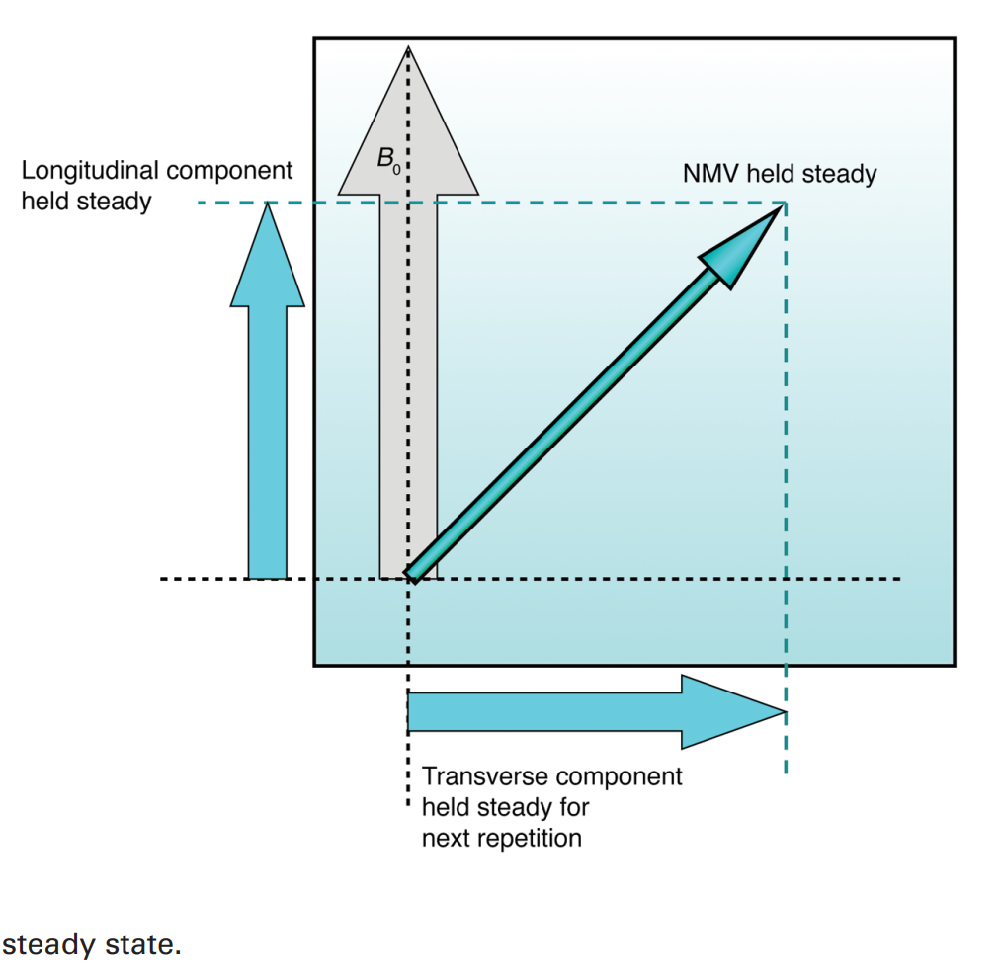
In the steady state, image contrast is not due to differences in the T1 recovery and T2 decay times of tissues but rather due to the ratio of T1 recovery time to T2 decay time.
Tissues where T1 recovery and T2 decay times are similar, signal intensity is high, and where they are dissimilar, signal intensity is low.

Slide 25
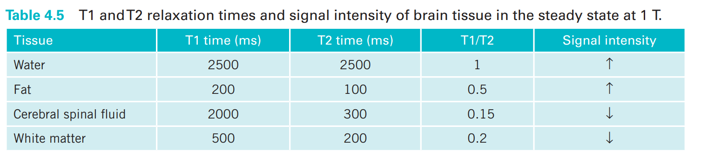
fat and water have this parity (fat-very short T1 recovery and T2 decay times & water-very long T1 recovery and T2 decay times)-tissues return high signal intensity in steady state sequences
Tissues such as muscle do not have this parity (very short T2 decay time and very long T1 recovery time), so they return a low signal in steady state sequences.

Slide 26
Residual transverse magnetization
The transverse component of magnetization does not have time to decay and builds up over successive TRs.
This transverse magnetization is produced because of previous RF excitation pulses but remains over several TR periods in the transverse plane- called residual transverse magnetization
Tissues with long T2 decay times (i.e. water) are the main component of this residual transverse magnetization and enhance T2 contrast.

Slide 27
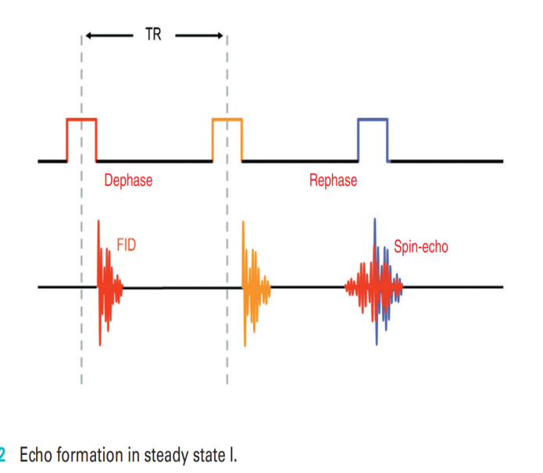
First RF pulse is an excitation pulse and, therefore, produces a FID when it is switched off.
The second RF pulse is applied a short TR period later.
because the TR between RF pulses 1 and 2 is shorter than the relaxation times of the tissues, residual transverse magnetization is still present when the RF pulse 2 is applied
RF pulse 2 produces a FID but also rephases the residual transverse magnetization still present from the first RF pulse
An echo is therefore produced.

Slide 28
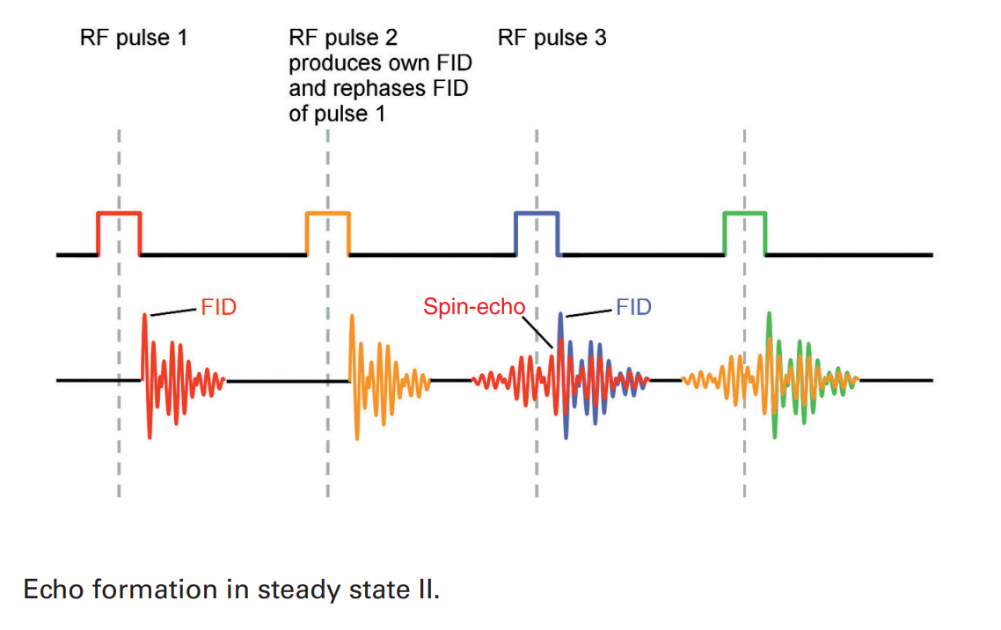
Same occurs with the third RF excitation pulse because the time for rephasing this residual transverse magnetization after RF pulse 2 is the same time it took to dephase before RF pulse 2

Slide 29
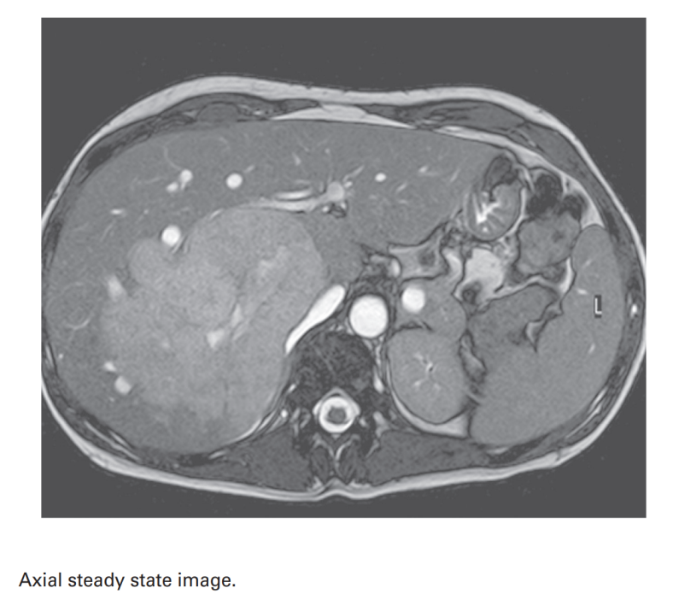
The effect of residual transverse magnetization is seen from the high signal from water in the stomach.
Water is also hyperintense in this image because water has a good parity between its T1 recovery and T2 decay times.
Fat is also bright on this image for the same reason.
Muscle is hypointense because it does not have a parity between its T1 recovery and T2 decay times

Slide 30
Coherent gradient echo
Uses a variable flip angle excitation pulse followed by gradient rephasing to produce a gradient echo.
The steady state is maintained by selecting a TR shorter than the T1 and T2 relaxation times of tissues.
Residual transverse magnetization left over when the next RF excitation pulse is applied.
These sequences keep residual transverse magnetization in phase i.e. coherent by a process rewinding.
Rewinding- Reversing the slope of the phase encoding gradient after readout.
Resultant echo contains info. from the FID & stimulated echo.

Slide 31
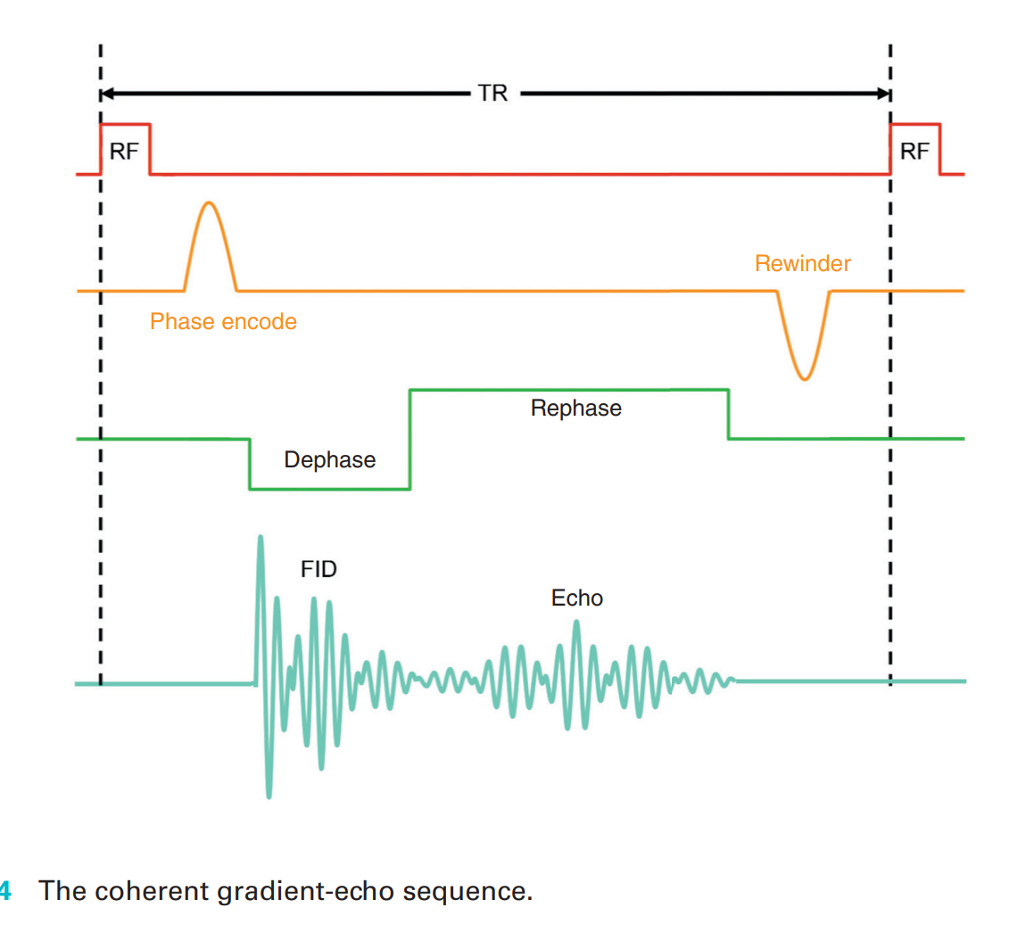

Slide 32
Uses
To achieve T1, PD & T2* weighted images in a very short scan time
Application –
In angiographic, myelographic, arthrographic effects.
Acquired slice by slice or 3D- volume acquisition
As the TR is short, slices can be acquired in a single breath-hold.

Slide 33
Parameters
To maintain steady state-
Flip angle- 30-45 degree
TR - 20-50 ms
To maximize T2*-
Long TE: 15-25 ms
Use gradient moment rephasing to reduce flow artefacts
Average scan time- seconds for single slice, 4-5 min. for volume acquisitions.

Slide 34
Advantages-
fast scanning, breath hold imaging possible,
sensitive to flow, useful for angiography
volume acquisition possible.
Disadvantages -
Poor SNR in 2D acquisition.
Magnetic susceptibility increases.
Loud gradient noise.

Slide 35
Incoherent gradient echo(spoiled)
Begin with variable flip angle & use gradient for rephasing.
The steady state is maintained so that residual transverse magnetization is left over from previous TR periods.
These sequences dephase or spoil magnetization so that its effect on image contrast is minimal.

Slide 36
Only transverse magnetization from the previous excitation is used, i.e. the FID
Only the FID is sampled so that T1 weighting predominates
Two ways to achieve dephasing /spoiling-
RF spoiling
Gradient spoiling

Slide 37
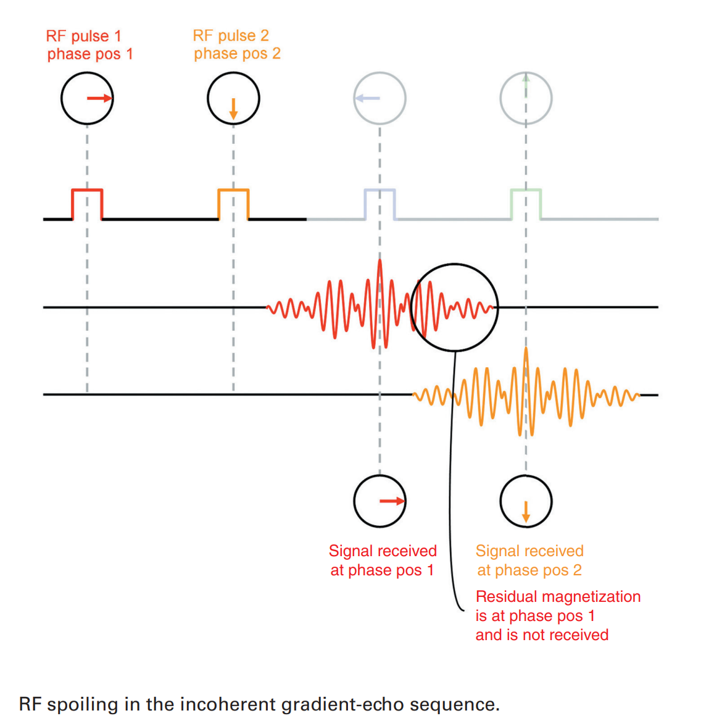
RF spoiling
RF excitation pulses are transmitted not only at a certain frequency to excite each slice but also at a specific phase.
Every TR, the phase angle of the transverse magnetization is changed

Slide 38
Only frequencies from the echo that has been created by excitation pulse are digitized.
It enable only information from most recently created transverse magnetization(gradient echo)

Slide 39
Gradient spoiling
Gradients can be used to rephase & dephase the residual magnetization.
Gradient spoiling is opposite of rewinding.
Slice-select, phase encoding, and frequency-encoding gradients are used to dephase residual magnetization so that it is incoherent at the beginning of the next TR period.
T2* or T2 effect are reduced.

Slide 40
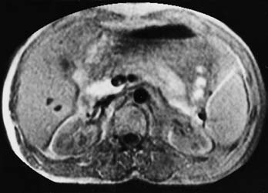
Uses
Used to produce T1-W & proton density images.
2D & volume acquisitions
T1-W breath hold images.
Axial breath-hold T1 weighted incoherent (spoiled) GRE image
showing normal appearances

Slide 41
Parameters
To maintain steady state-
Flip angle- 30-45 degree
TR - 20-50 ms
To maximize T1-
Short TE 5-10 ms
Average scan time- seconds for single slice, 4-5 min. for volume acquisitions.

Slide 42
Advantages-
Breath holding possible,
Good SNR & anatomical detail in volume.
Volume/ 2D acquisition possible.
Disadvantages -
Poor SNR in 2D acquisition.
Loud gradient noise.

Slide 43
Steady state free precession(SSFP)/
Reverse-echo gradient-echo
In gradient-echo sequences, the TE is not long enough to measure the T2 decay time of tissues
Gradient rephasing is inefficient so that gradient-echoes are dominated by T2* effects
True T2 weighting is difficult to achieve
Reverse -echo gradient-echo overcomes this problem in obtaining images that have a sufficiently long TE and less T2* than in other steady state sequences.
Uses info.(digitize frequence) only from stimulated echo & not from the FID.

Slide 44
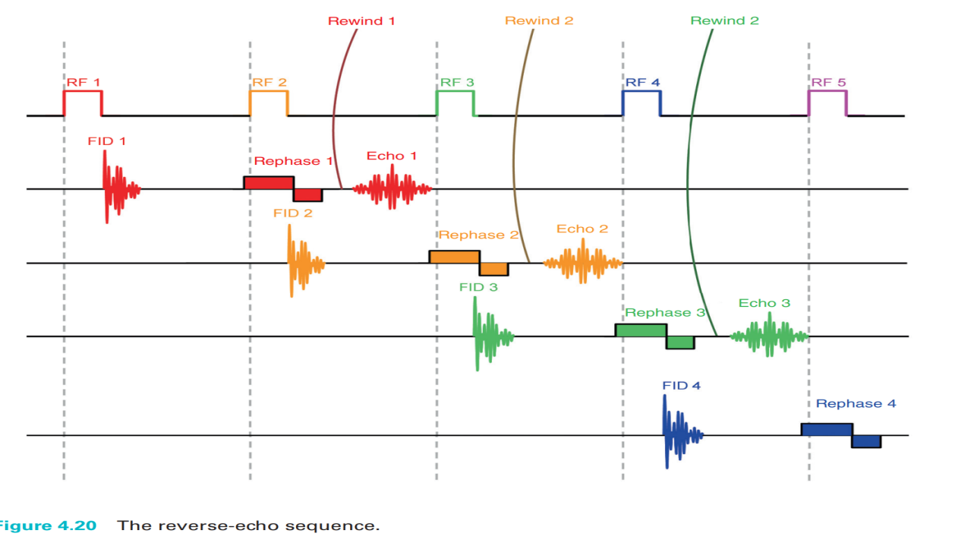
Achieved by a rewinder gradient which speeds up the rephasing process initiated by RF pulse
Rewinding is achieved by applying the positive lobe of the frequency-encoding gradient
Resultant echo demonstrates better T2-W than conventional sequences.

Slide 45
In SSFP, there are two TEs-
The actual TE is the time between the peak of the gradient-echo and the next RF excitation pulse. But it is not the TE that determines T2 contrast.
The effective TE is the time from the peak of the gradient-echo to a previous RF excitation pulse (i.e. the RF pulse that created its FID).
This is the TE that determines T2 contrast, as this is the time allowed for T2 decay in the gradient-echo.

Slide 46
Uses
Acquisition of true T2 weighting image.
Useful in Brain and Joints.
2D and 3D volume acquisition.

Slide 47
Parameters
To maintain the steady state-
Flip angle 30-45 degree
TR 20-50 ms
Average scan time 4-15 min volume acquisition

Slide 48
Advantages-
Can be acquired in a Volume & in 2D
True T2 weighting achieved
Disadvantages -
Image quality can be poor
Susceptible to artefacts
Loud gradient noise.

Slide 49
Balanced gradient echo
Modification of coherent gradient echo.
Uses
A balanced gradient scheme to correct for phase errors in flowing blood & CSF.
Alternating RF excitation scheme to enhance steady state effects
Higher flip angle and shorter TR is used to maintain steady state.
Higher SNR & shorter scan time.

Slide 50
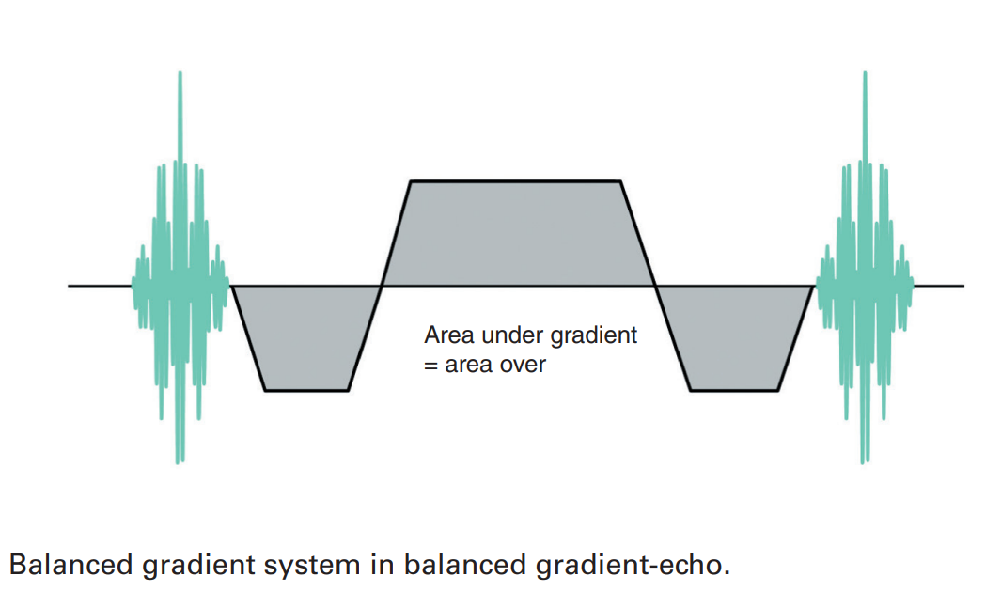
Moving spins accumulate a zero phase change as they pass along the gradient
As a result, Magnetic moments of flowing spins are coherent and have a high signal intensity
Balanced gradient system in balanced gradient echo

Slide 51
Combination of flip angle and TR results in saturation and therefore enhanced T1 contrast.
However, saturation is avoided by changing the phase of the RF excitation pulse every TR.
Achieved by selecting a flip angle of 90°, for example, but in the first TR period only applying half of this, i.e. 45°.
In successive TRs, the full flip angle is applied but with alternating phase angles
Resultant transverse magnetization is created at a different phase every TR
Consequently, saturation is avoided, and fat and water, which have T1/T2 relaxation times approaching parity, return a higher signal than tissues that do not.

Slide 52
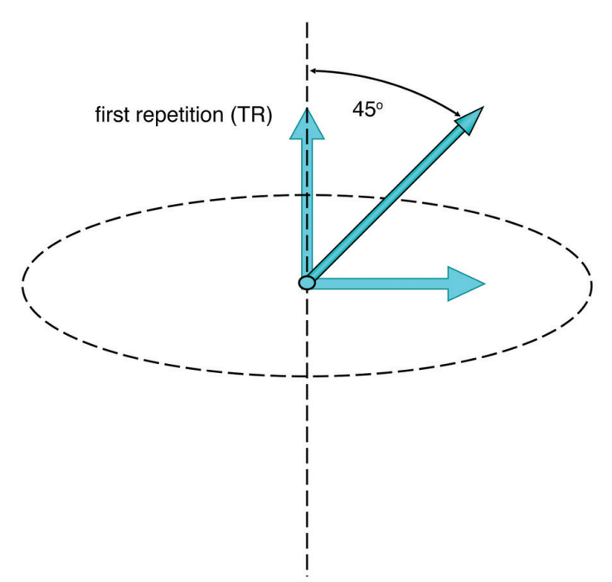
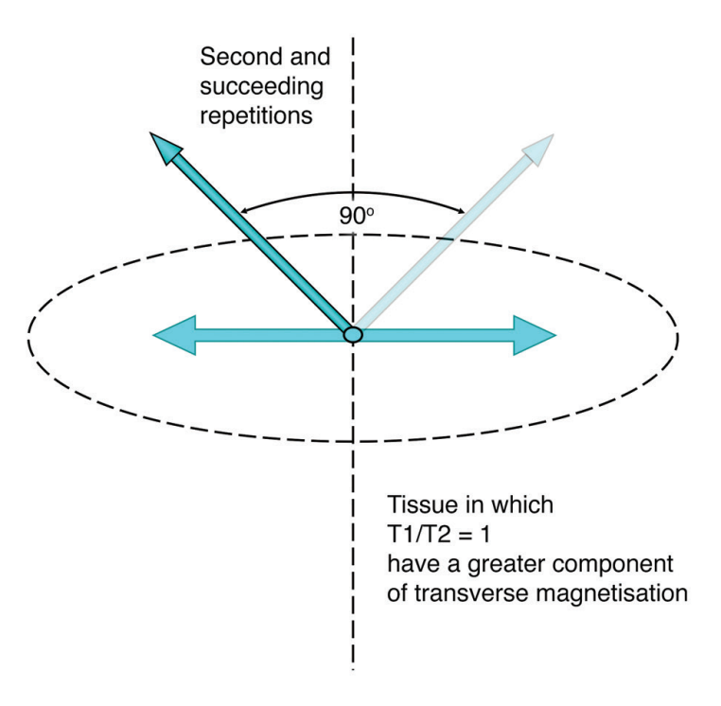
Steady state in Balanced gradient echo
Second and succeeding TR
First TR
Maintenance of steady state in balanced gradient echo

Slide 53
APPLICATIONS
Initially developed for imaging the heart & great vessels.
Spinal imaging
Internal auditory meatus.
PARAMETERS.
Flip angle :- 90⁰
TR ;- 10 ms
TE ;- 15 ms

Slide 54
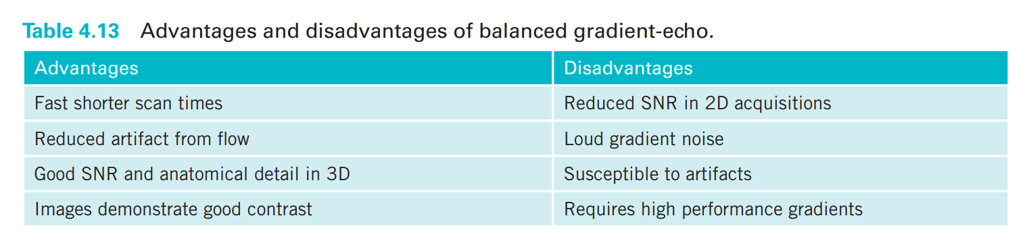

Slide 55
Fast gradient echo
Very fast pulse sequences - can acquire several slices or a volume in single breath hold
Employ coherent & incoherent GRE sequences with significantly reduced TE.
Only a portion of RF excitation pulse is applied, so less time is needed to apply & switch off.
Only a proportion of echo is read(partial echo)
If TE is min. TR & scan time can be reduced accordingly.

Slide 56
Many fast sequences use extra pulses applied before the pulse sequence begins- to pre-magnetize the tissue
A 180⁰ RF pulse- inverts the NMV into full saturation, then at a specific time delay sequence itself begins
Enhances T1 contrast and may also null signal from certain organs and tissues as in inversion recovery pulse sequences
Fast gradient systems permit multislice gradient-echo sequences with very short TEs.
Multiple images are therefore acquired in a single breath-hold a
After the administration of contrast agents when the selection of fast gradient-echo permits dynamic imaging of an enhancing lesion

Slide 57
Echo planar imaging
Echo planar imaging (EPI) is a rapid acquisition technique that begins with a sequence of one or more RF pulses and is followed by a series of gradient-echoes.
Gradient-echoes are typically generated by oscillation of the readout gradient.
Different image contrast is achieved by beginning the sequence either with a variable RF excitation pulse termed gradient-echo EPI (GE-EPI) or with 90° and 180° RF pulses termed spin-echo EPI (SE-EPI).

Slide 58
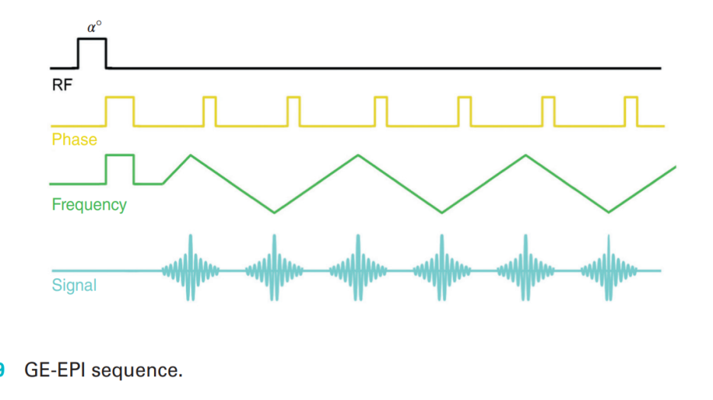
GE-EPI
Begins with an RF excitation pulse of any flip angle and is followed by EPI readout of gradient-echoes
Images are acquired in one TR period.

Slide 59
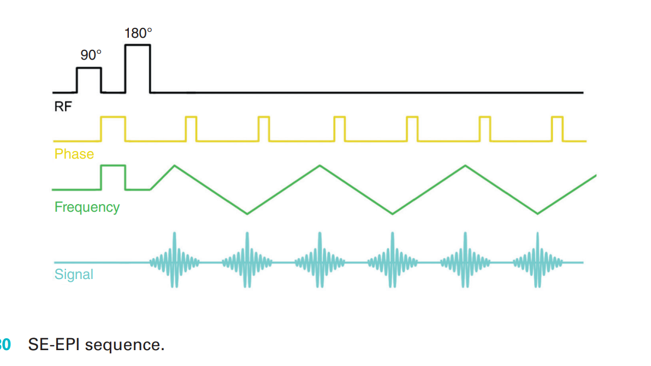
SE-EPI
SE-EPI begins with a 90° RF excitation pulse followed by a 180° RF rephasing pulse followed by an EPI readout of gradient-echoes
SE-EPI has longer scan times but generally a better image quality than GE-EPI

Slide 60
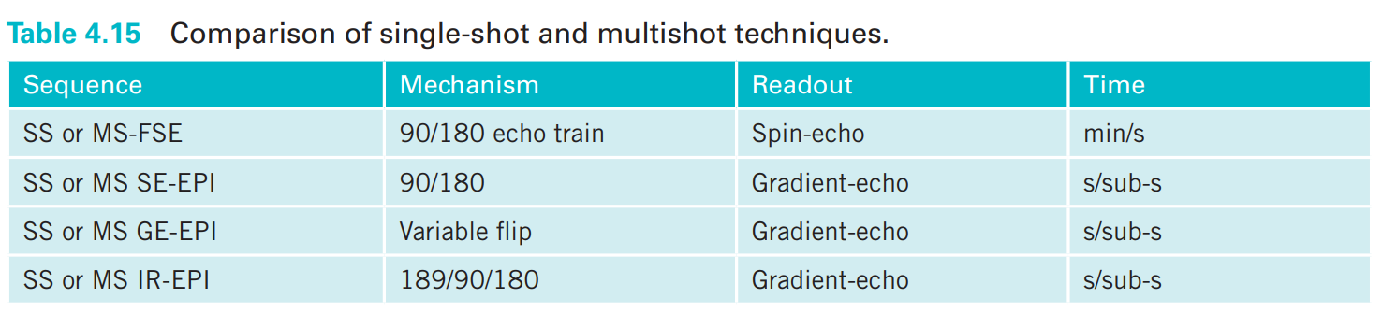
EPI sequences can begin with any type of RF pulse.
An example is EPI-FLAIR (180°/90°/180° followed by EPI readout) where CSF is nulled, but the sequence is significantly faster than in conventional FLAIR sequencing
EPI sequences are often run in conjunction with single-shot imaging
All k-space is filled at once so the recovery rates of vectors in individual tissues are not critical
TR is said to equal infinity (because it is infinitely long)

Slide 61
GRASE
Hybrid sequences combine gradient- and spin-echoes, such as GRASE (gradient- and spin echo).
Typically, a series of gradient rephasing is followed by an RF rephasing pulse.
The hybrid sequence uses the benefits of both types of rephasing methods; i.e. the speed of gradient rephasing and the ability of the RF pulse to compensate for T2* effects

Slide 62
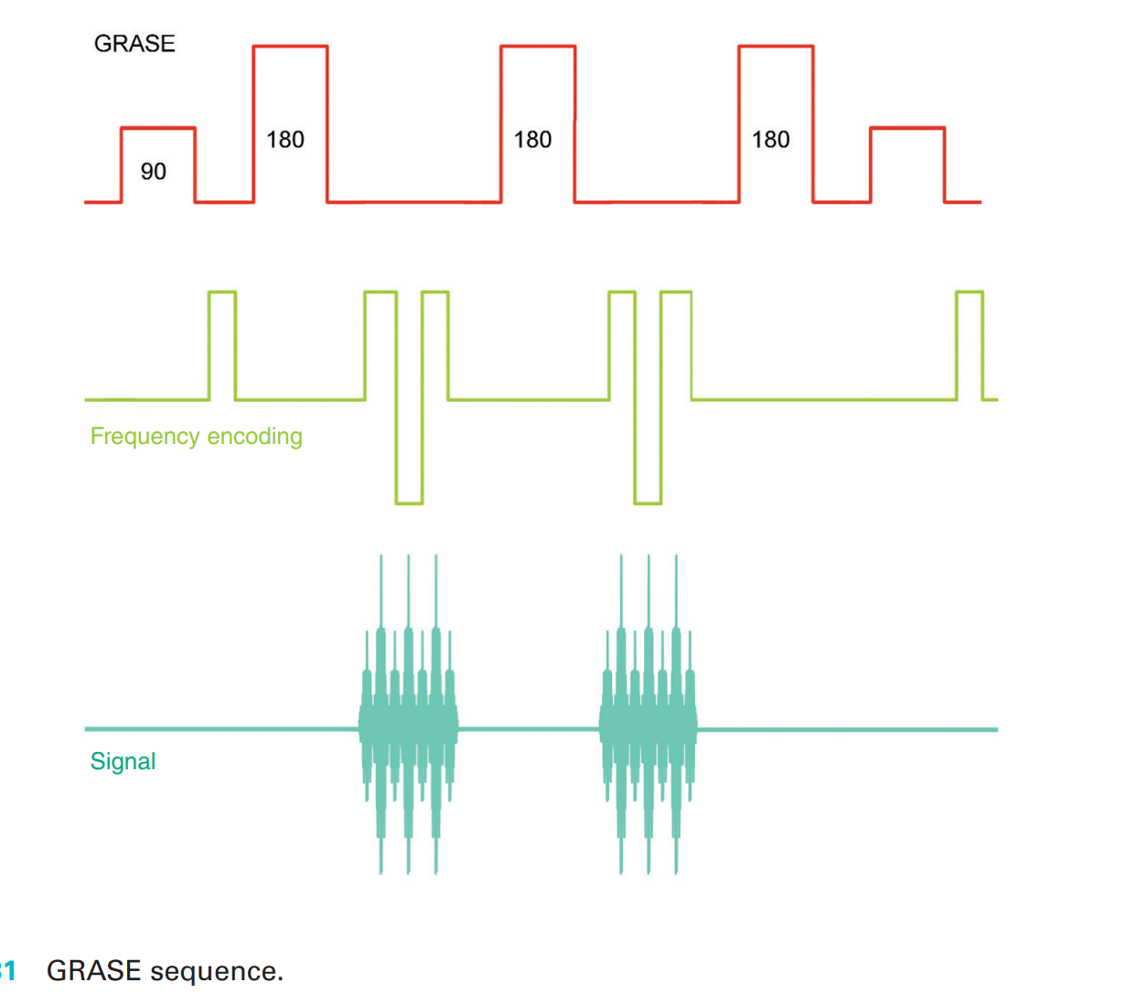

Slide 63
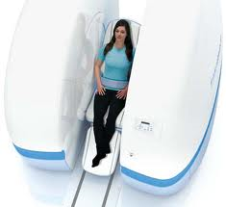
Thank you

