Slide 1
CATHETERS AND GUIDE WIRES
By Passang D. Sherpa
Coordinator of
Radio-imaging Technology
Dpt. Of paramedical science

Slide 2
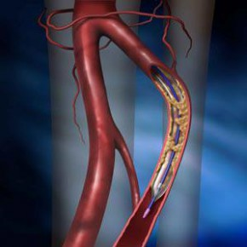
INTRODUCTION
Catheters are pipe lines that are used to transport fluids from or to the human body cavities
Guide wires help in the easy accurate placement of catheters into vascular structures

Slide 3
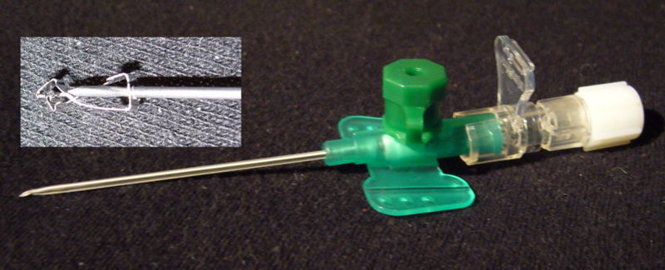
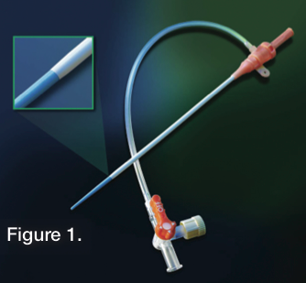
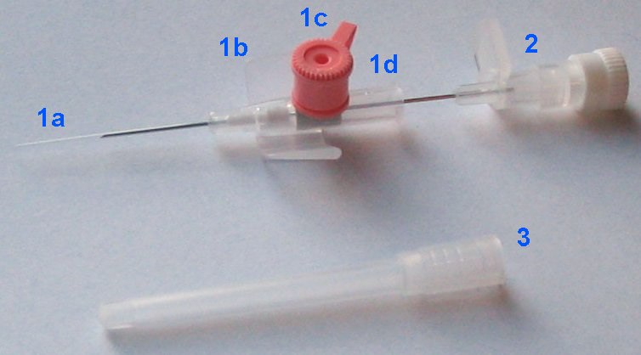
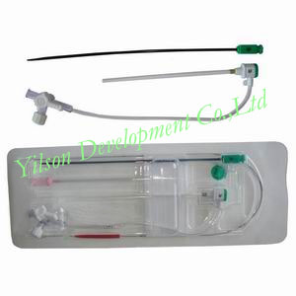
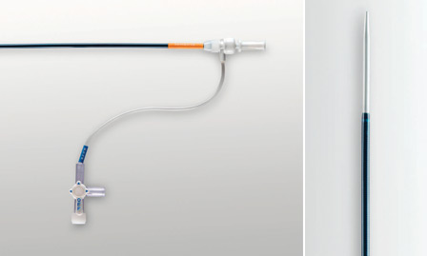
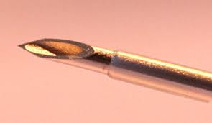

Slide 4
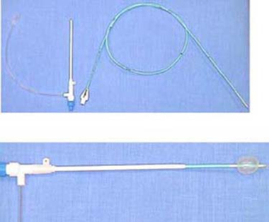

Slide 5

CATHETERS

Slide 6

CHARACTERISTICS OF A GOOD CATHETER
Good torque response
Radiopacity
Flexible a-traumatic tip
Low surface frictional resistance
Good tractability over a guide wire
Good memory

Slide 7
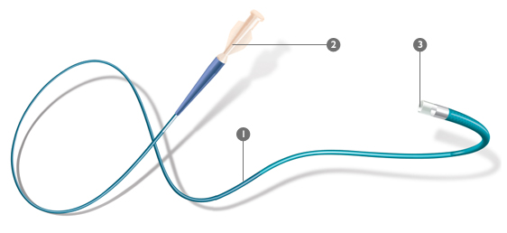
MATERIAL
Radiopaque- lead Ba salt Bismuth is added to the polymer
Radiolucent – to visualize air bubbles , guide wire is present between them

Slide 8
TEFLON:
Lowest Coefficient Of Friction
Excellent Memory
Ability To Withstand High Temperature ( Autoclaved)
POLYETHYELENE
Moderate Coefficient Of Friction
Softer Than Teflon
Sterilized With Hot/Cold Gas
POLYURATHANE:
Same As Polyethylene But Some Consider It Having Better Torque Control

Slide 9
Measurement
French
Gauge
1 F = 0.0131 inch = 0.033 mm
1 inch = 254 mm
1 mm= 0.394 inch
In general, good practice is to use the smallest diameter catheter feasible for any particular study
Reuse of catheter discouraged

Slide 10



TIPS AND SIDE HOLES
Tips should be tapered in order to reduce trauma to vessel
Catheter With End Hole
  Used In Selective Angio
  Emit Strong Stream Contrast
Catheters With Multiple Holes
  Reduce Trauma To Vessel
  Increase Mixing Of Contrast And Blood
  Reduce Catheter Recoil(catheter Whipping)
But Increased Blood Clot Around Guide Wire
Catheters Without End-hole And With Side Holes
  Intracardiac And Pulmonary Arteries
  Jet Effect And Recoil Is Greatly Reduced
Guidewire Cannot Be Employed- Use A Sheath To Guide The Cather

Slide 11
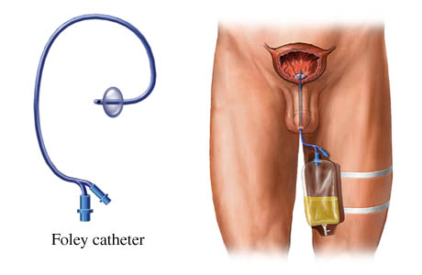
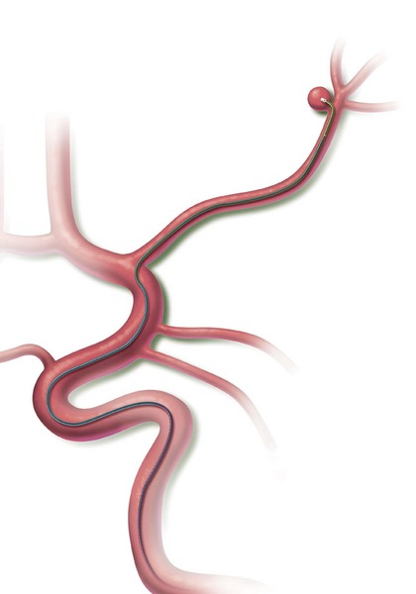
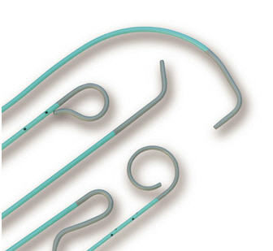
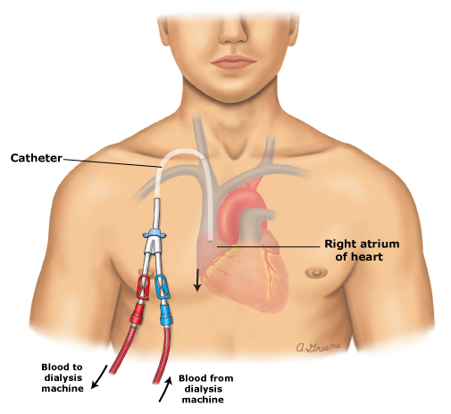
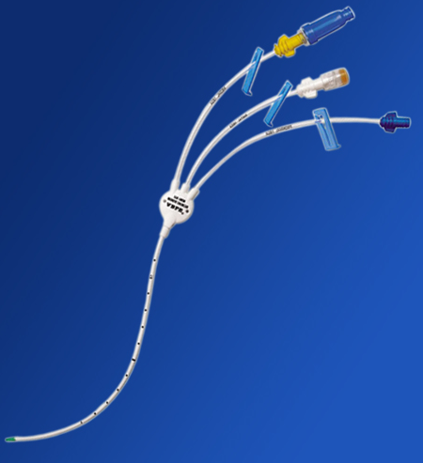
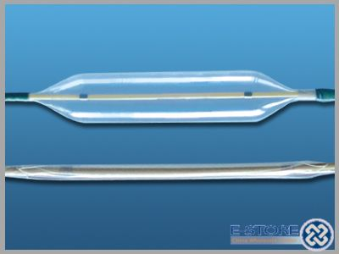
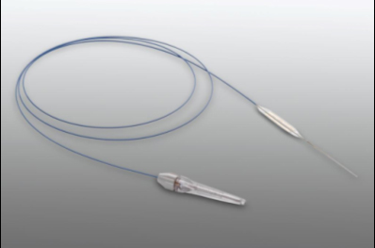
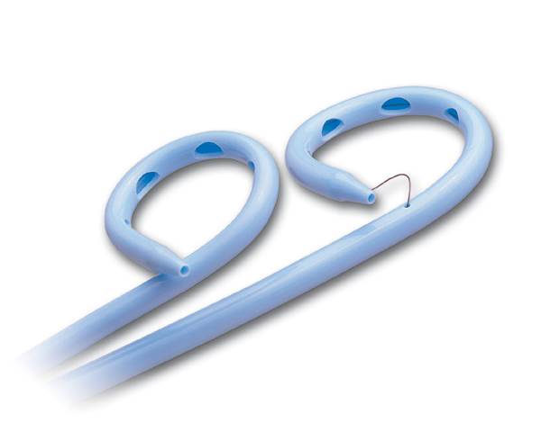
CLASSIFICATION
CENTREL VENOUS CATHETERS
BALLOON CATHETERS
MICROCATHETERS
DRAINAGE CATHTERS
DIAGNOSTIC ANGIOGRAPHIC

Slide 12
CATHETER TYPES
CEREBRAL
VISCERAL
CORONARY

Slide 13
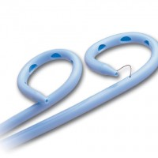
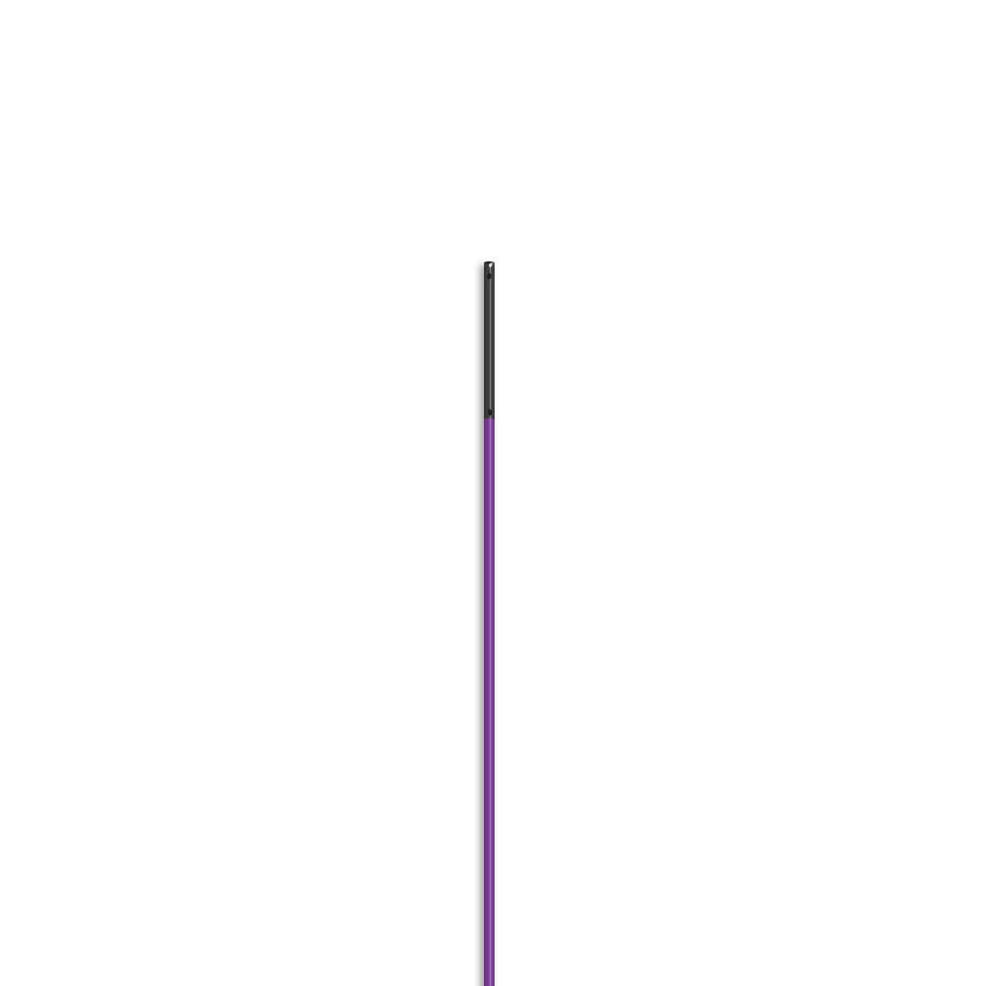
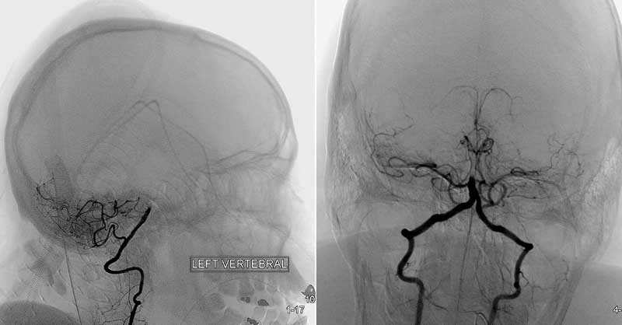
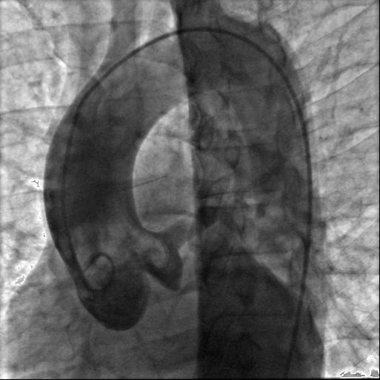
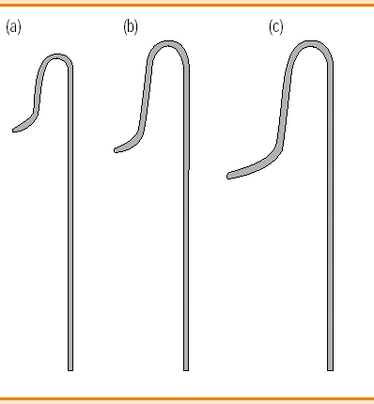
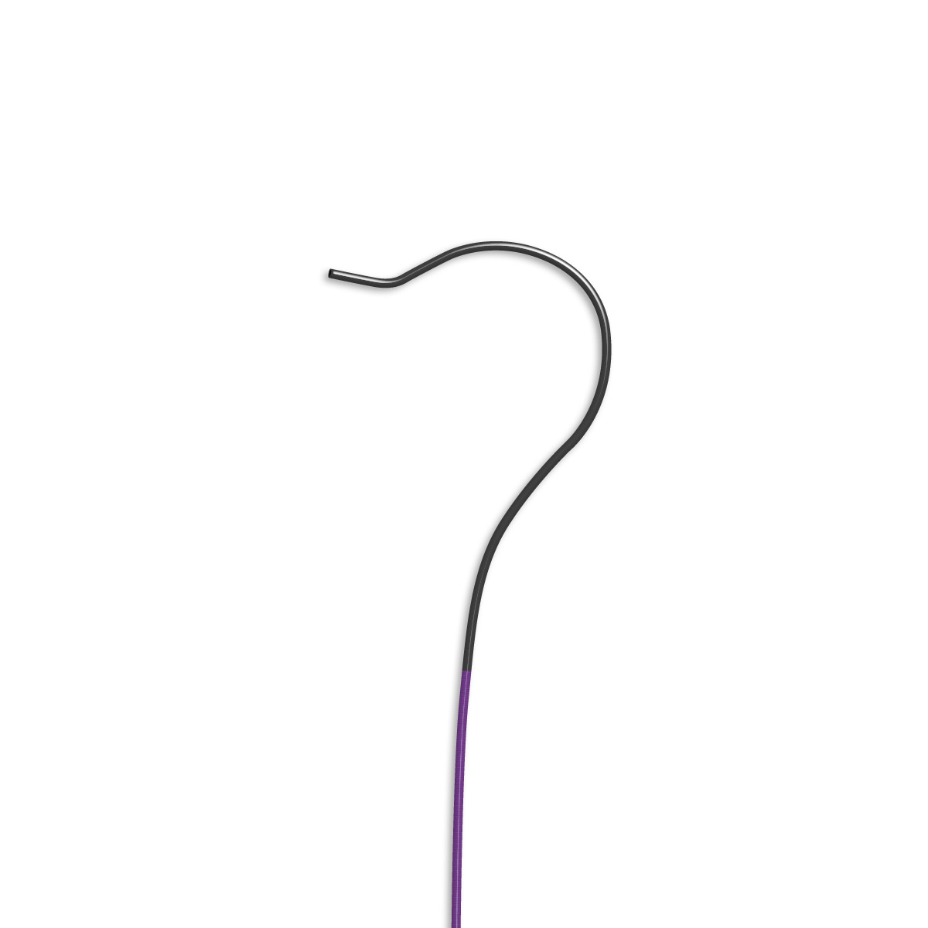
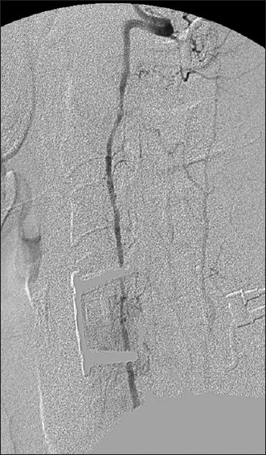


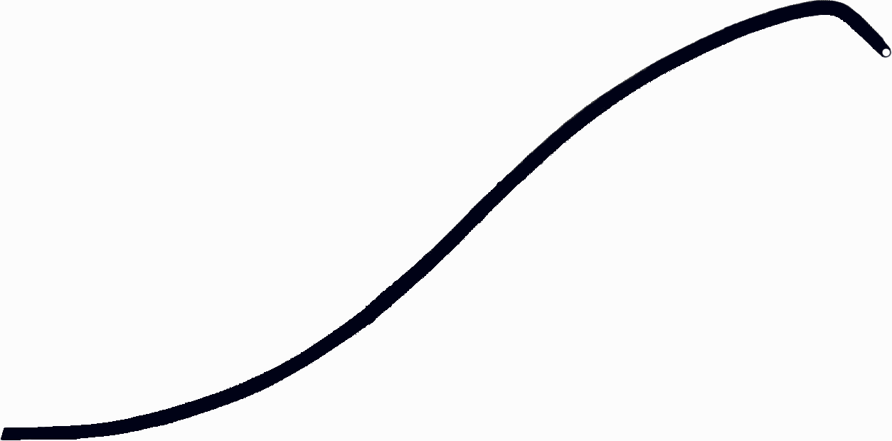
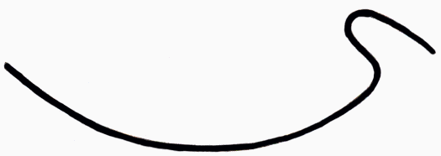
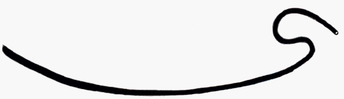
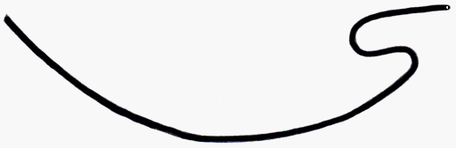
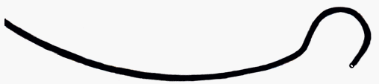

STRAIGHT AND PIGTAIL CATHETERS WITH MULTIPLE SIDE HOLES
Injecting large amount of contrast
Straight(catheter whipping), so pigtail is used
Aortogram
Ventricles, arch of aorta
CEREBRAL CATHETERS:
Head hunter catheter- 4 vessel angio
FOR MORE TORTOUS VESSEL:
Bentson hanafee wilson (JB2,JB3)
Simmons
newton
Newton 1, 2, 3,4,5
Bentson hanafee wilson (JB1,JB2,JB3)

Slide 14
CEREBRAL

Slide 15

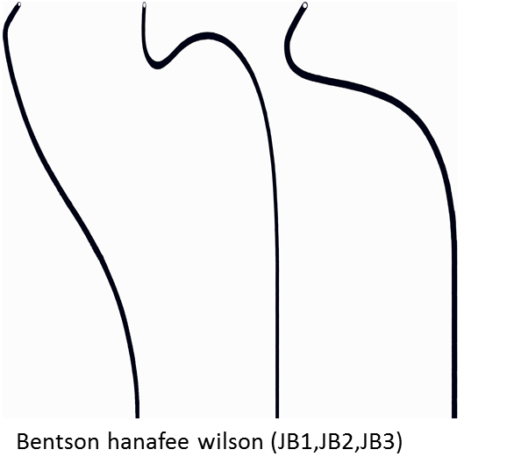
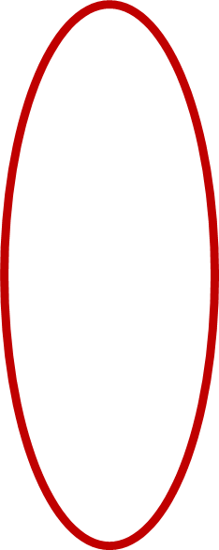
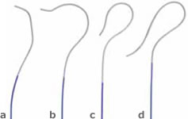


HEAD HUNTER

Slide 16





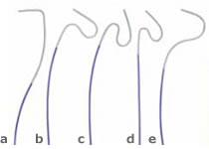
MANI
HOCKEY
NEWTON

Slide 17
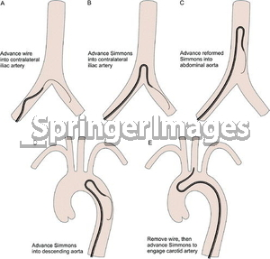
Advance reformed simmons into the abdominal aorta
Advance simmons into the collateral iliac artery
Advance wire into the collateral iliac artery
Advance simmons into the carotid
Advance Simmons into descending aorta

Slide 18
VISCERAL

Slide 19
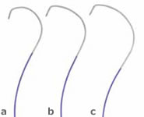



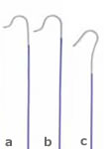

COBRA CATHETER
RENAL DOUBLE CURVE
SHEPERD HOOK

Slide 20
CORONARY

Slide 21





AMPLATZ LEFT 1,2,3,4
AMPLATZ RIGHT 1,2,3,4

Slide 22
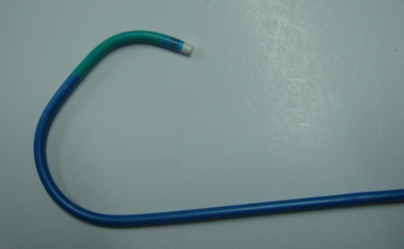
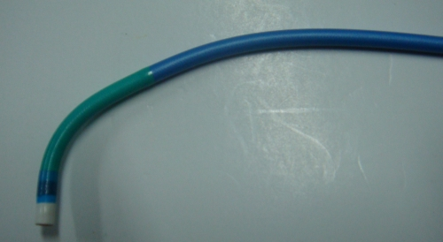
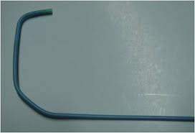

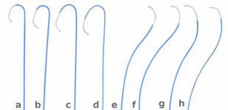
SONES
JUDKINS LEFT
JUDKINS RIGHT
TIGER

Slide 23
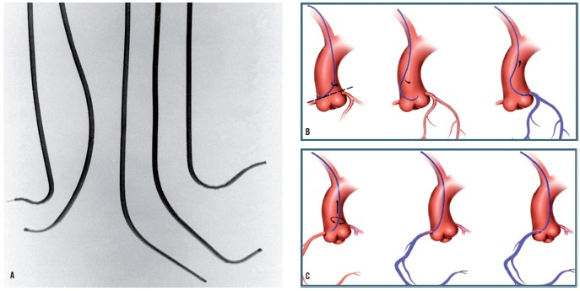

Slide 25
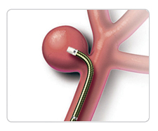
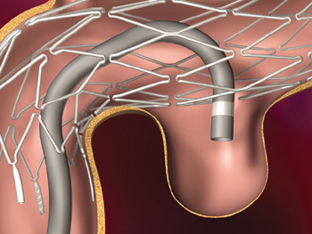
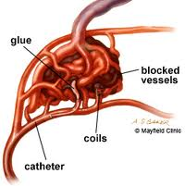
Micro catheters
3F or smaller
Designed for distal catheterization
0.010-0.018” guide wire
Neuro-intervention
Helpful in peripheral intervention to select smaller vessel
Platinum marker, not very radio opaque

Slide 26
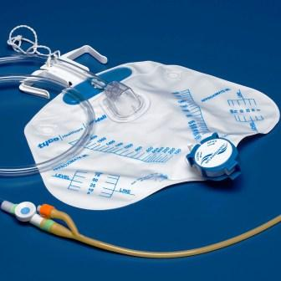
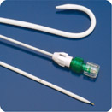
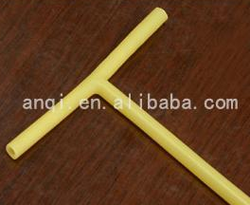
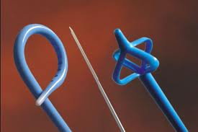
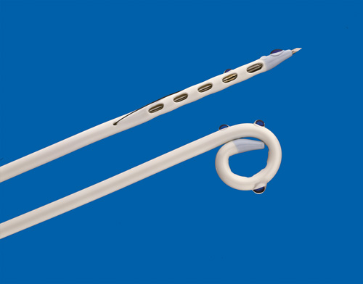
Drainage Catheter
Used Mainly For Draining Of Fluid
Nephrostomy
Abscesses
Biliary Gall Bladder
Pleural Fluid
Ascitis
Lymphoceles- Tenckoff catheter

Slide 27
Balloon catheters
Occlusion balloon
SOFT AND PLIABLE
Rigid
Porst mann’s korsett’s balloon catheter
Dotter’s coaxial catheter
Caged balloon catheter
PVC balloon catheter
TO CLEAR thrombosis
Forgarty balloon
Dialatation-angioplasty
FATHER OF INTERVENTIONAL PROCEDURE
Charles Dotter
Julio Palmaz with
his balloon-expandable stent

Slide 28
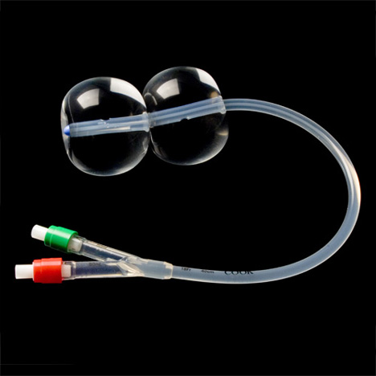


Slide 29




Slide 30

What to see when you purchase a catheter?
Catheter Length- E.g.: 180 cm
French /Guage
Recommended guide wire
For which procedures it can be used
For Balloon Catheters:
Balloon Inflated Diameter- E.g. :4 mm/12 Fr
Balloon Length- E.g. :3 cm
Balloon Recommended Pressure- E.g. :150 psi/10 atm
Recommended Wire Guide - .E.g.: 035" Tracer® Metro Direct™

Slide 31


Guide wire

Slide 32

Help in placement of catheters
Made of stainless steel
Two types:
    Solid
    Wrapped
One end is rigid while other end is flexible
The flexible end is introduced into the vessel

Slide 33

SOLID GUIDE WIRE
Advantage:
    reduces catheter tip flaring
    Blood clotting on the guidewire
    Abrasion of the blood vessel
WRAPPED GUIDE WIRE
Advantage
    Versatility is there
To avoid damage to vessel they coat it with Heparin And Teflon

Slide 34

Cores
Fixed :
    Used for normal vascular structures
    Keep the guide wire in original shape
Movable :
    Has a handle (mandril)- that helps to adjust position of core within guide wire
    Making it more flexible

Slide 35


TIPS OF GUIDE WIRE
Straight
J-shaped
In wrapped guide wire both type of configuration can be used
Length of flexible tip measured in cm
straight have 3cm
Movable has 10-15cm

Slide 36

Measurement
Length 30-260
30-50cm for percutaneous or direct vascular puncture
100-150cm for selective angio
260cm for interchanging vascular catheter
Diameter
mm/inches
0.014”- 0.052”
0.035” and 0.038” used commonly

Slide 37

HOW TO SELECT GUIDE WIRE?....
Size Needle Gauge
Vessel Size
Size Lumen Of Vascular Catheter

Slide 38
SAFETY TIPS
Flexibility : bend the tip 180⁰
Visual inspection
Check for the core
No force should be applied while advancing a guide wire
needle bevel-end position
Do not clean guide wire with too much saline- chances for rusting
EXAMPLE
EXAMPLE

Slide 39

MR GUIDE WIRES
They Use Fibre Optic Material
For Tracking The Tip Contains A Parmagnetic Substance- Dysporsium Oxide Rings

Slide 40

Sterilization
First catheters should be washed in water and with air jets
Polyethylene Catheters are sterilized in solutions of quaternary ammonium compounds or by gas.
Teflon nylon catheters are autoclaved maximum temp:121°C , Pressure:15 pounds for 15 min

Slide 41
THANK YOU

Slide 42
EMBOLI
BACK

Slide 43
BACK

Slide 44


Types of catheter and how to select???

