Slide 1
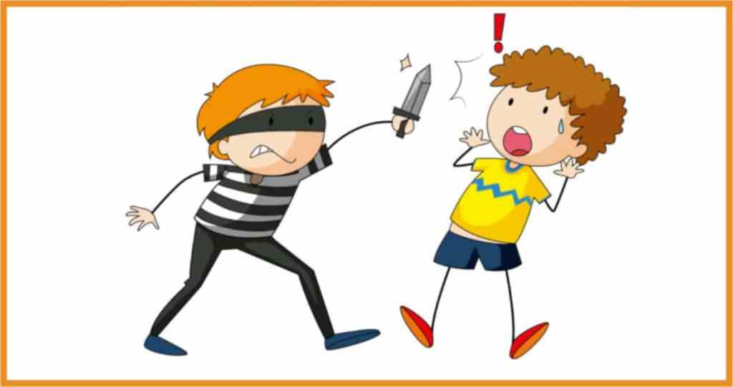
Nutrition and DELIQUENT behaviour
DR. SHEETAL CHHAYA RD
Associate Professor
Clinical Nutrition and Dietetics
SBKS Medical Institute and Research Centre
Sumandeep Vidyapeeth

Slide 2
INTRODUCTION
There are certain nutritional problems that can pose greater risk on juvenile behavior.
Because, it is a proven fact that poor nutrition can lead to poor brain function.
The adolescent cannot make good decisions with poor nutrition.
Also, negativity is the obvious result of poor diet and nutrition.
A good behavior is the outcome of the healthy brain, heart, and body.

Slide 3
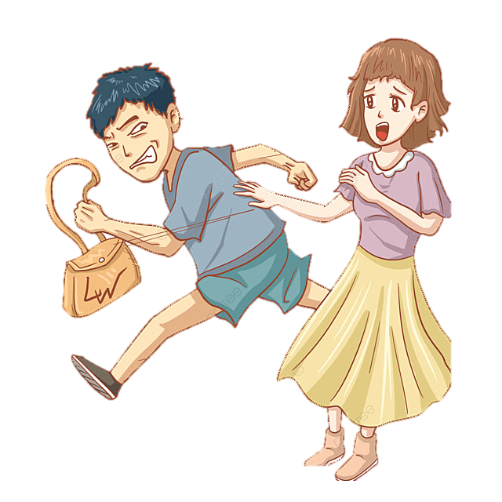
INTRODUCTION
Violence is one major outcome of poor nutrition in juvenile.
One study (Gesch 2013) suggested that 26% of the subjects showed less violent behavior after they received a diet that fulfilled their recommended dietary allowance.
Other studies also proved that a significant number of subjects (48%) showed less violent and antisocial behavior who received balanced diet.

Slide 4
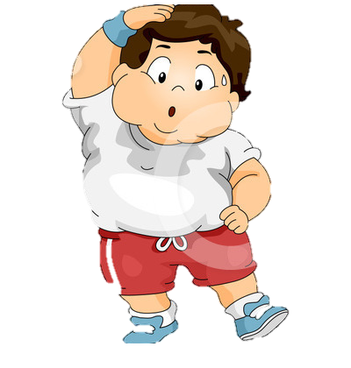
Malnutrition
Malnutrition is the lack of proper nutrition. It may mean taking less nutrients that does not fulfill the daily recommended intake. Malnutrition also means poor nutritional choice that can cause obesity.
Undernourishment
Undernourishment is one major concern around the world in many countries. Many nutrients like protein and iodine deficiency mean poor brain growth and function.
Obesity
The rate of obesity is increasing around the world and if you see closely it is higher among teenagers. The consumption of fatty and sugary junk foods is one most obvious cause of this.
Some of the recent research links the intake of high caloric diet to memory problems in adolescents.

Slide 5

Problems associated with obesity and consumption of junk food
Learning inability and disruption
Dementia and short term memory problems
Cognitive decline
Behavioral problems
Attention and decision making problems

Slide 6
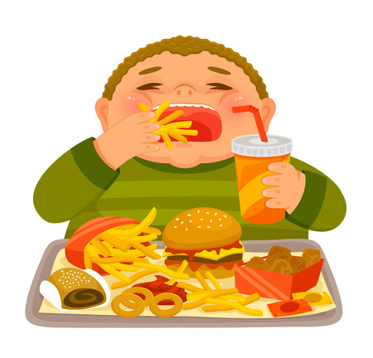
OBESITY
One study suggests that poor brain control and behavioral problems arise from obesity.
As a result of this the adolescent might indulge in other unhealthy activities like excessive drinking, smoking, and drugs use.
Also, it can lead to risk-taking behavior in adolescents. For example, driving dangerously, smoking just for fun and so on.
There are many reasons why teenagers prefer to eat junk food.
One such reason is that teenagers’ brain look for immediate enjoyment and fun that they receive from any activity.
The consumption of junk food gives them immediate satisfaction. On the other hand adults’ brain think more about the later outcomes of their choices.
This makes it really difficult for the adolescents to make right choices that have long term health benefits.
A good company can help an adolescent engage in eating healthy food. While, poor company can lead to encouragement to eat unhealthy.

Slide 7
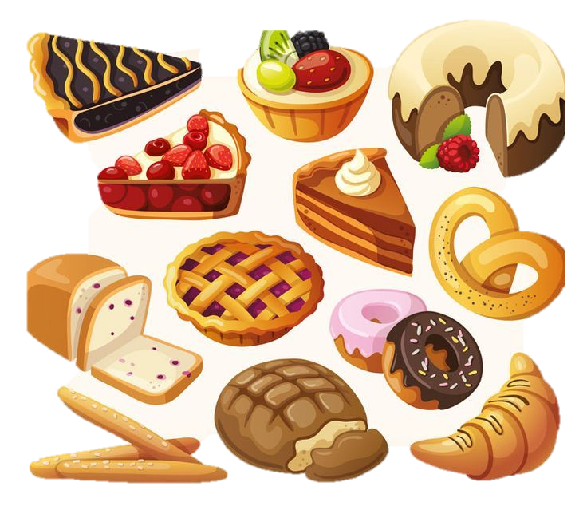
SPECIFIC DIETARY CONSTITUENTS
Sugar
Sugar and other sweet components of food trigger poor brain function.
Scientists explain that excessive sugar intake can result in poor function of the hippocampus region of the brain.
This region of brain is responsible for learning function and memory.
So, taking too much sugar may result in poor performance of the teenagers in school/ colleges.
It may also result in aggression, lethargy, memory issues, low self esteem and dangerous risky behaviors.
One fact about the consumption of sugary food is that it fills the stomach leaving behind no place for healthy food.
For example, food rich in protein may be low in sugar and fats. As a result the adolescent will miss on the good nutrients that can help boost good mental development.
Another fact about the high sugar diet is that it can boost the release of dopamine in the brain.

Slide 8

Caffeine
Caffeine is an important dietary constituent that teenager consume that may cause negative impact on brain.
It is important to understand that the negative impact of opiates, and cocaine are so important to gauge that caffeine becomes a secondary source of addiction in adolescents.
When talking about the benefits of caffeine we already know that it can do the following:
improve alertness, arousal etc
Improve motor activities
Reduce feelings of fatigue
What we miss here is that all of the above mentioned benefits are temporary and on the expense of caffeine addiction.

Slide 9
Caffeine
Secondly, when caffeine reduces night time sleep we need more caffeine in day to improve our alertness.
Some other studies suggest increase in anxiety, hypertension, agitation, and irritability due to excessive use of caffeine.
Mental health is at risk because many caffeinated drinks are also high in sugar. So, the adolescent is getting addicted to both caffeine and sugar.
Some adolescents who are already going through behavioral problems will start taking more caffeine.
These behavioral problems include anger, aggression and substance abuse. It is complex and difficult to understand that whether behavioral problems lead to excessive caffeine intake or vice versa.

Slide 10
Alcohol consumption
Underage alcohol consumption can lead to several behavioral and societal problems causing can cause memory and motor impairments.
Drinking for underage is punishable by law because of it severe worse outcomes.
Binge drinking is one major cause of teenage crimes and behavioral problems.
Heavy drinking can lead to several car crashes, criminal assaults and so on.

Slide 11
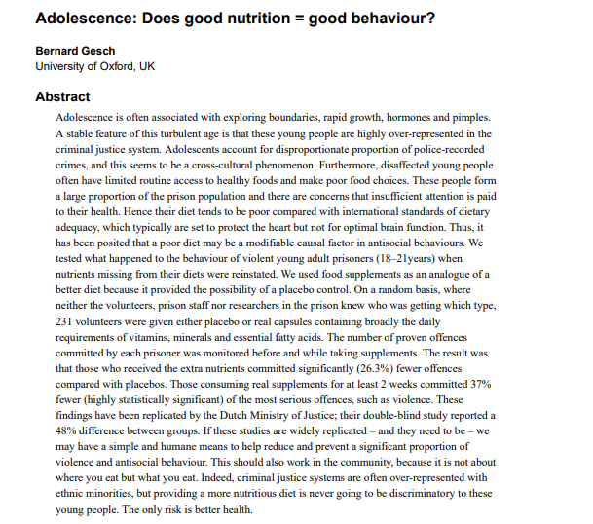


Slide 12

CONCLUSION
Good nutritional habits and a balanced diet aren't developed in one day, nor are they destroyed in one unbalanced meal.
Healthful eating means a lifestyle of making choices and decisions, planning, and knowing how to make quick and wise choices when you haven't planned.
Eating nutritious and healthful food while maintaining your proper body weight will contribute to a better performance in life.
In contrast, a poor diet can lead to insidious health problems that can interfere with success in academic and social performance and may eventually mean confronting a serious long-term illness, such as heart disease or diabetes.
DON’T EAT LESS,
EAT RIGHT

Slide 13
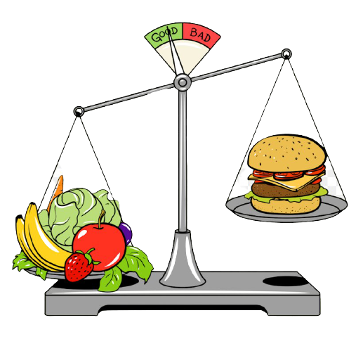
“To eat is a necessity,
but to eat intelligently is an art.”
~ La Rochefoucauld
For more, Visit Diet Clinic, OPD -1, Dhiraj Hospital

