Slide 1
Compression only life support
Dr. Pooja Shah
Associate Professor
Dept. of Emergency Medicine
SBKSMIRC

Slide 2
Introduction
The cardiopulmonary resuscitation (CPR) guidelines of compression-only life support (COLS) for management of the victim with cardiopulmonary arrest in adults provide a stepwise algorithmic approach for optimal outcome of the victim outside the hospital by untrained laypersons.
Compression-only CPR is giving continuous chest compressions of approximately 100 compressions per minute, without giving rescue breaths

Slide 3


Slide 4
AIM
Doctors and paramedics cannot always reach the victim in time and hence, guidelines have been developed that recommend practical, uniform and acceptable resuscitation algorithms across India.
The AIM is to keep the steps simple so that even an uneducated person can understand and perform it easily.

Slide 5
When you see any person suddenly collapsed or comatose
The patient should be shifted to a safe place.
After the patient has been shifted to a safe place, tap the shoulders and look for response.
If the patient is responsive, observe and shift to the nearest medical facility.
If the patient is not responsive, call for emergency help.

Slide 6
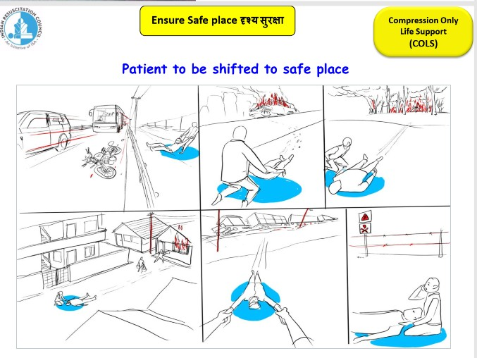

Slide 7
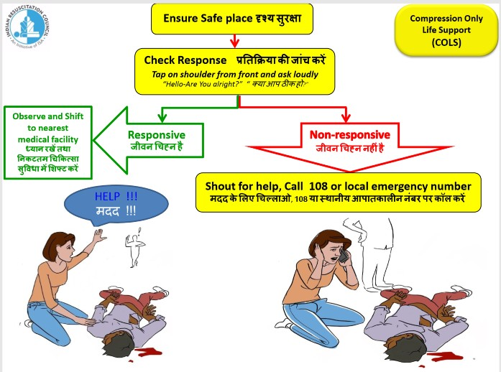

Slide 8
Chest compressions
If the patient is not responsive and emergency help is yet to arrive, start chest compressions immediately.
5 cycles of 30 chest compressions are given.
Effectively knowing how to give chest compressions can save a life in any surrounding!

Slide 9
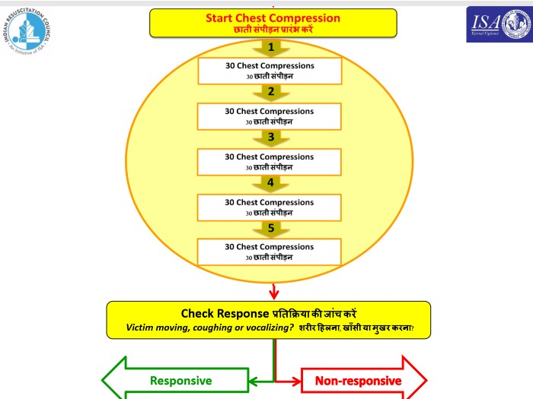

Slide 10
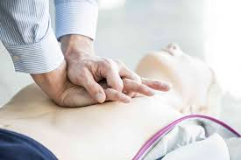
How to perform?
Place the heel of one hand on the lower half of the sternum. (sterno xiphoid junction)
Place the other hand on the top.
Interlock your fingers
Keep your arms straight and lock your elbows so that compressions can be provided using full weight while conserving energy.

Slide 11
Chest compressions
The rate should be at least 100/min
Depth – 5-6cm (1/3rd AP diameter of the chest)
Allow chest recoil
Whenever possible, change the operator after 5 cycles to avoid exertion.
Lean forward while providing chest compressions until shoulders are directly over midline at patient’s chest.

Slide 12
Duration
Continue chest compressions for 5 consecutive cycles.
If there is more than one rescuer, they should exchange hands every 5 cycles.
The aim of COLS is to provide continuous uninterrupted chest compressions to improve the survival and neurological outcome.
It should be continued till a trained rescuer arrives, till the victim is revived, till the rescuer is exhausted and cannot do any more compressions or if the scene becomes unsafe.

Slide 13
If the victim is revived or there is return of spontaneous circulation, he/she should be placed in either left or right lateral position.

Slide 14
Complications
Rib and sternum fracture
Pneumothorax
Bleeding (hemopericardium, hemothorax and anterior mediastinal bleeding)
Contusion of heart and lung
Laceration of liver or spleen

Slide 15
EVERY CITIZEN IS A LIFE SAVER!

Slide 16

Learn how to save a life today!

