Slide 1
Arrythmias
Dr. Anuja Agrawal
Associate Professor
Dept. of Emergency Medicine
SBKSMIRC

Slide 2
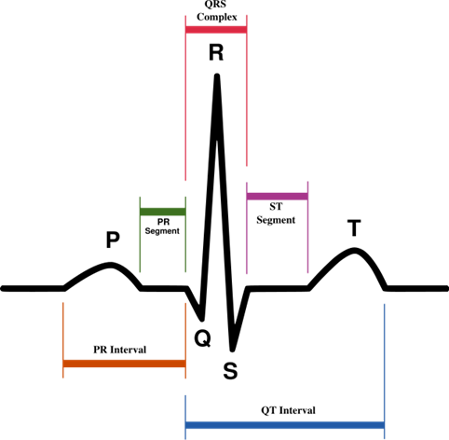
Elements of the trace
medics.cc

Slide 3
Rate
If the rhythm is irregular (see next slide on rhythm to check whether your rhythm is regular or not) it may be better to estimate the rate using the rhythm strip at the bottom of the ECG (usually lead II)
The rhythm strip is usually 25cm long (250mm i.e.
10 seconds)
If you count the number of R waves on that strip and multiple by 6 you will get the rate
medics.cc

Slide 4
Rhythm
Sinus Rhythm
Definition
Cardiac impulse originates from the sinus node. Every QRS must be preceded by a P wave.
(This does not mean that every P wave must be followed by a QRS – such as in 2nd degree heart block where some P waves are not followed by a QRS, however every QRS is preceded by a P wave and the rhythm originates in the sinus node, hence it is a sinus rhythm. It could be said that it is not a normal sinus rhythm)
medics.cc

Slide 5
Rhythm
Sinus arrhythmia
There is a change in heart rate depending on the phase of respiration
Q. If a person with sinus arrhythmia inspires, what happens to their heart rate?
A. The heart rate speeds up. This is because on inspiration there is a decrease in intrathoracic pressure, this leads to an increased venous return to the right atrium. Increased stretching of the right atrium sets off a brainstem reflex (Bainbridge’s reflex) that leads to sympathetic activation of the heart, hence it speeds up)
This physiological phenomenon is more apparent in children and young adults
medics.cc

Slide 6
Rhythm
Sinus bradycardia
Rhythm originates in the sinus node
Rate of less than 60 beats per minute
Sinus tachycardia
Rhythm originates in the sinus node
Rate of greater than 100 beats per minute
medics.cc

Slide 7
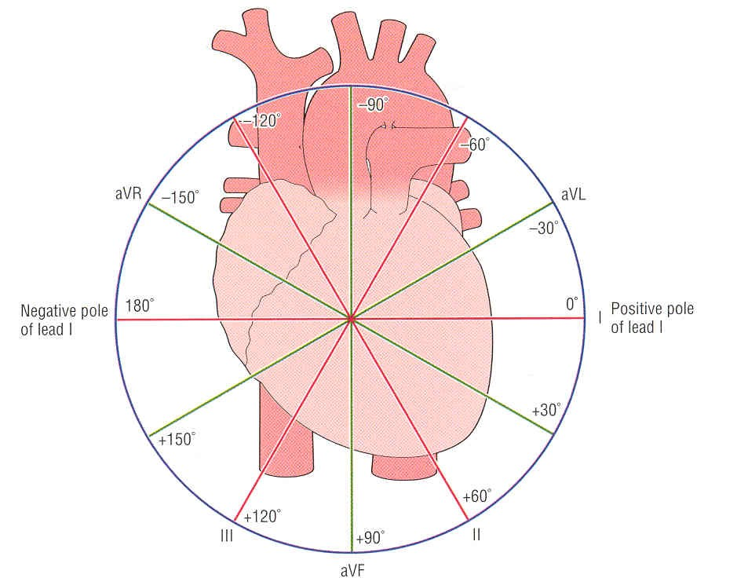

Axis
An axis falling outside the normal range can be left axis deviation
or extreme axis deviation
A normal axis
can lie
anywhe
re
between -30
and +90 degrees
or +120 degrees according to some
right axis deviation

Slide 8
Axis deviation - Causes
Wolff-Parkinson-White syndrome can cause both Left and Right axis deviation
A useful mnemonic:
“RAD RALPH the LAD from VILLA”
Right Axis Deviation
Left Axis Deviation
Ventricular tachycardia
Inferior MI
Left ventricular hypertrophy
Left Anterior hemiblock
Right ventricular hypertrophy
Anterolateral MI
Left Posterior Hemiblock
medics.cc

Slide 9


The P wave
Height
A tall P wave (over 2.5mm) can be called P pulmonale
Occurs due to R atrial hypertrophy
normal
P pulmonale
>2.5mm
Causes include:
pulmonary hypertension,
pulmonary stenosis
tricuspid stenosis
medics.cc

Slide 10


The P wave
Length
A P wave with a length
>0.08 seconds (2 small squares) and a bifid shape is called P mitrale
It is caused by left atrial hypertrophy and delayed left atrial depolarisation
normal
P mitrale
Causes include:
  Mitral valve disease
  LVH
medics.cc

Slide 11
The PR interval
If the PR interval is short (less than 3 small squares) it may signify that there is an accessory electrical pathway between the atria and the ventricles, hence the ventricles depolarise early giving a short PR interval.
One example of this is Wolff-Parkinson-White syndrome where the accessory pathway is called the bundle of Kent. See next slide for an animation to explain this
medics.cc

Slide 12
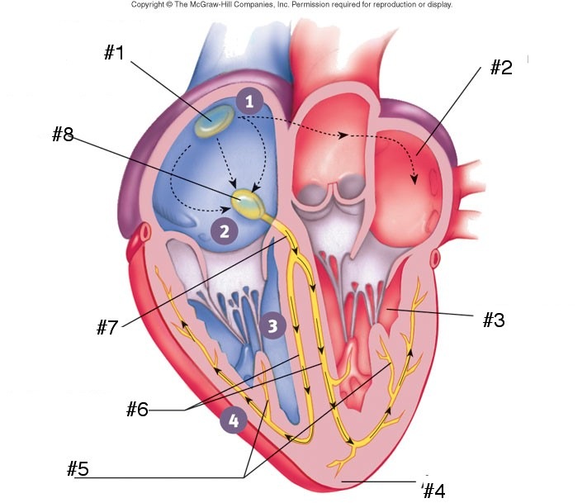





Depolarisation begins at the SA node
The wave of depolarisation spreads across the atria
It reaches the AV node and the accessory bundle
Conduction is delayed as usual by the in-built delay in the AV node
However, the accessory bundle has no such delay and depolarisation begins early in the part of the ventricle served by the bundle
As the depolarisation in this part of the ventricle does not travel in the high speed conduction pathway, the spread of depolarisation across the ventricle is slow, causing a slow rising delta wave
Until rapid depolarisation resumes via the normal pathway and a more normal complex follows
medics.ccmedics.ccmedics.ccmedics.ccmedics.ccmedics.cc

Slide 13
The PR interval
If the PR interval is long (>5 small squares or 0.2s):
If there is a constant long PR interval 1st degree heart block is present
First degree heart block is a longer than normal delay in conduction at the AV node
medics.cc

Slide 14
The PR interval
If the PR interval looks as though it is widening every beat and then a QRS complex is missing, there is 2nd degree heart block, Mobitz type I. The lengthening of the PR interval in subsequent beats is known as the Wenckebach phenomenon
(remember (w)one, Wenckebach, widens)
If the PR interval is constant but then there is a missed QRS complex then there is 2nd degree heart block, Mobitz type II
medics.cc

Slide 15
The PR interval
If there is no discernable relationship between the P waves and the QRS complexes, then 3rd degree heart block is present
medics.cc

Slide 16
Heart block (AV node block)
Summary
1st degree
  constant PR, >0.2 seconds
2nd degree type 1 (Wenckebach)
  PR widens over subsequent beats then a QRS is dropped
2nd degree type 2
  PR is constant then a QRS is dropped
3rd degree
  No discernable relationship between p waves and QRS complexes
medics.cc

Slide 17
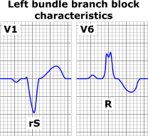
LBBB
If left bundle branch block is present, the QRS complex may look like a ‘W’ in V₁ and/or an ‘M’ shape in V_{6.}
New onset LBBB with chest pain consider Myocardial infarction
Not possible to interpret the ST segment.
medics.cc

Slide 18
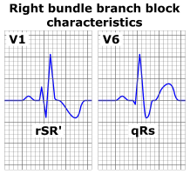
RBBB
It is also called RSR pattern
If right bundle branch block is present, there may be an ‘M’ in V1 and/or a ‘W’ in V6.
Can occur in healthy people with normal QRS width – partial RBBB
medics.cc

Slide 19
QRS width
It is useful to look at leads V₁ and V₆
LBBB and RBBB can be remembered by the mnemonic:
WiLLiaM MaRRoW
Bundle branch block is caused either by infarction or fibrosis (related to the ageing process)
medics.cc

Slide 20
The ST segment
The ST segment should sit on the isoelectric line
It is abnormal if there is planar (i.e. flat) elevation or depression of the ST segment
Planar ST elevation can represent an MI or Prinzmetal’s (vasospastic) angina
Planar ST depression can represent ischaemia
medics.cc

Slide 21
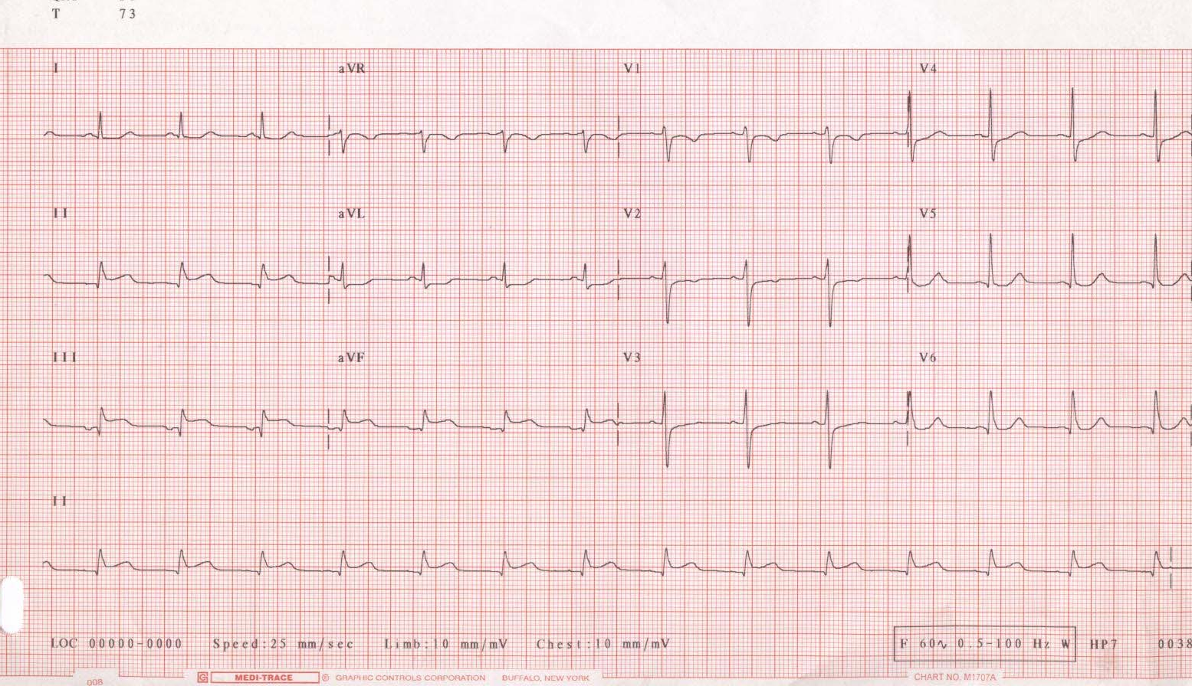
Inferior MI
ST elevation
medics.ccmedics.ccmedics.ccmedics.ccmedics.ccmedics.cc

Slide 22

The T wave
Are the T waves too tall?
  No definite rule for height
  T wave generally shouldn’t be taller than half the size of the preceding QRS
  Causes:
    Hyperkalaemia
    Acute myocardial infarction
medics.cc

Slide 23
The T wave
If the T wave is flat, it may indicate hypokalaemia
If the T wave is inverted it may indicate ischaemia
medics.cc

Slide 24
Supraventricular tachycardias
These are tachycardias where the impulse is initiated in the atria (sinoatrial node, atrial wall or atrioventricular node)
If there is a normal conduction pathway when the impulse reaches the ventricles, a narrow QRS complex is formed, hence they are narrow complex tachycardias
However if there is a conduction problem in the ventricles such as LBBB, then a broad QRS complex is formed. This would result in a form of broad complex tachycardia
medics.cc

Slide 25
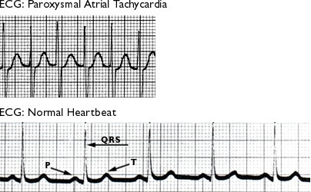
medics.cc

Slide 26
Atrial Fibrillation
Features:
There maybe tachycardia
The rhythm is usually irregularly irregular
No P waves are discernible – instead there is a shaky baseline
  This is because there is no order to atrial depolarisation, different areas of atrium depolarise at will
medics.cc

Slide 27
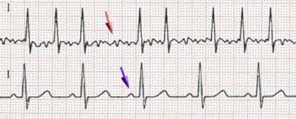
Atrial Fibrillation
medics.cc

Slide 28
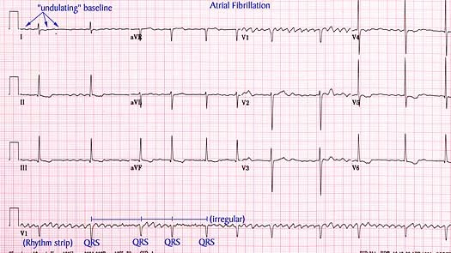
medics.cc

Slide 29
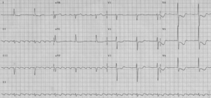
Atrial flutter
There is a saw-tooth baseline which rises above and dips below the isoelectric line.
Atrial rate 250/min
This is created by circular circuits of depolarisation set up in the atria
medics.cc

Slide 30
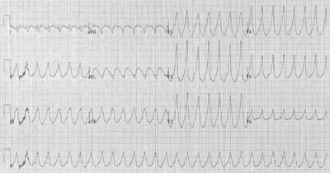
Ventricular Tachycardia
medics.cc

Slide 31
Ventricular Tachycardia
QRS complexes are wide and irregular in shape
Usually secondary to infarction
Circuits of depolarisation are set up in damaged myocardium
This leads to recurrent early repolarisation of the ventricle leading to tachycardia
As the rhythm originates in the ventricles, there is a broad QRS complex
Hence it is one of the causes of a broad complex tachycardia
Need to differentiate with supraventricular tachycardia with aberrant conduction
medics.cc

Slide 32

Ventricular Fibrillation
medics.cc

Slide 33
Ventricular fibrillation
Completely disordered ventricular depolarisation
Not compatible with a cardiac output
Results in a completely irregular trace consisting of broad QRS complexes of varying widths, heights and rates
medics.cc

Slide 34
THANK YOU

