Slide 1
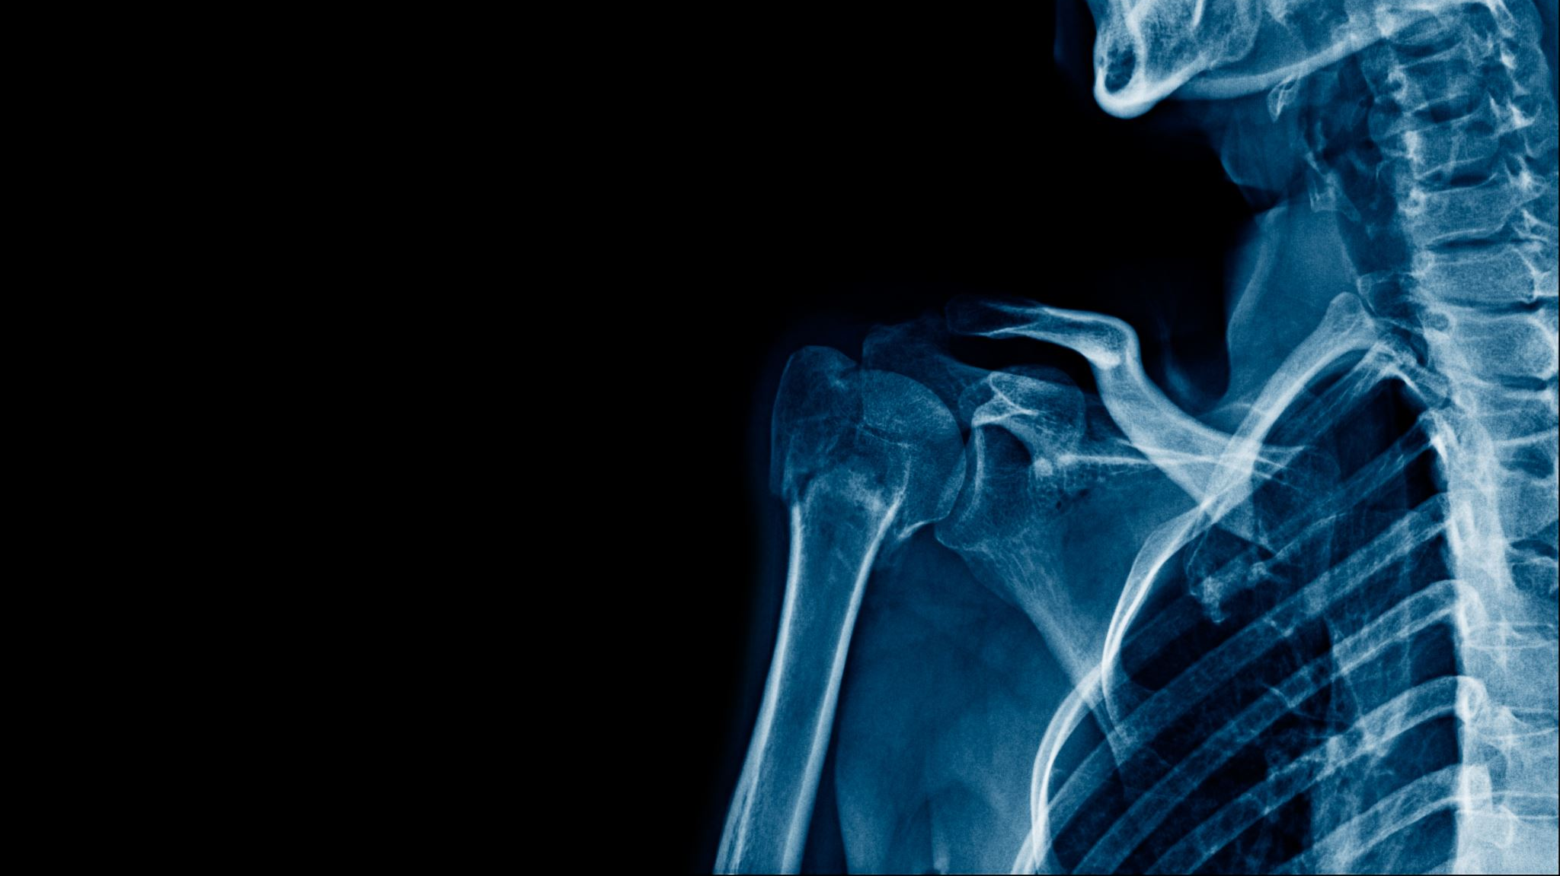
ACUTE CORONARY SYNDROME
Dr. Malini Mehta
Professor and Head
Dept. of Emergency Medicine
SBKSMIRC

Slide 2
Definition
Acute coronary syndrome (ACS) refers to a spectrum of clinical presentations ranging from those for ST-segment elevation myocardial infarction (STEMI) to presentations found in non–ST-segment elevation myocardial infarction (NSTEMI) or in unstable angina. It is almost always associated with rupture of an atherosclerotic plaque and partial or complete thrombosis of the infarct-related artery.

Slide 3
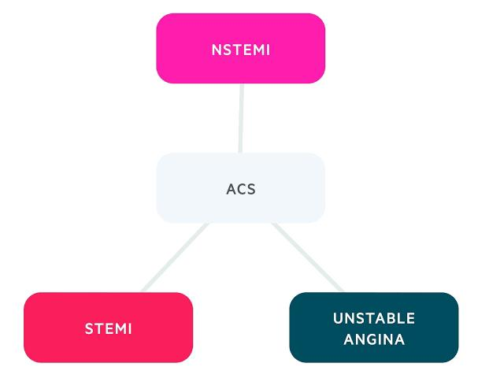

Slide 4
STEMI : ST SEGMENT ELEVATION MI
ST segment elevation myocardial infarction most commonly occurs when thrombus formation results in complete occlusion of a major epicardial coronary vessel.
Unlike during unstable angina and non-ST segment elevation myocardial infarction, the 12-lead ECG will show significant ST segment elevation during STEMI.
The Killip Classification is frequently used to predict mortality during STEMI.

Slide 5
Killip’s classification of MI
Class I: No evidence of HF (mortality 6%)
Class II: Findings of mild to moderate HF (S3 gallop, rales < halfway up lung fields or elevated jugular venous pressure (mortality 17%)
Class III: Pulmonary edema (mortality 38%)
Class IV: Cardiogenic shock defined as systolic blood pressure < 90 mm Hg and signs of hypoperfusion such as oliguria, cyanosis and sweating (mortality 67%)

Slide 6
Pathophysiology
The “vulnerable” plaque that formed from the atherosclerotic process is responsible for acute coronary syndromes and, ultimately, coronary artery thrombosis.
A substance known as “tissue factor” is located within the necrotic core of the plaque. When exposed to the bloodstream, tissue factor activates the clotting cascade, and thrombosis occurs. Tissue factor is exposed when the fibrous cap that covers the plaque becomes disrupted or ulcerated. This disruption of the fibrous cap is called “plaque rupture” or “plaque erosion.”
Plaque rupture and plaque erosion (ulceration) can result in coronary thrombosis. STEMI is most often from coronary thrombosis after plaque rupture and less often from fixed obstruction.

Slide 7
PHYSICAL FINDINGS
The physical examination findings during STEMI are similar to those of stable angina, unstable angina and non-STEMI, but they are frequently more severe due to the larger amount of myocardium experiencing ischemia.
Physical examination findings are relatively non-specific. The heart rate and BP may be elevated due to increased sympathetic tone, or the BP can be low due to cardiogenic shock depending on the extent of the STEMI.
A S4 heart sound may be present.
During inferior ischemia, posteromedial papillary muscle dysfunction can cause mitral regurgitation resulting in a holosystolic murmur at the cardiac apex radiating to the axilla.

Slide 8
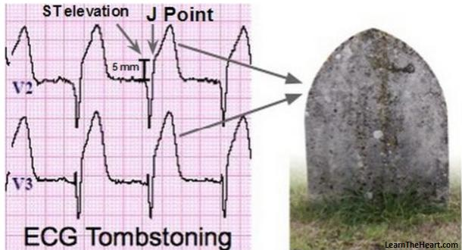
When the left ventricular end-diastolic pressure, or LVEDP, increases during myocardial ischemia, that pressure can be transmitted backward to the pulmonary veins and into the pulmonary vasculature causing transient pulmonary edema that results in dyspnea and rales on lung examination

Slide 9
NSTEMI
Anginal symptoms at rest that result in myocardial necrosis, as identified by elevated cardiac biomarkers with no ST segment elevation on the 12-lead ECG.

Slide 10
UNSTABLE ANGINA
Three different presentations of unstable angina exist:
1. Exertional angina of new onset (even if relieved with rest and requiring a consistent amount of exertion to procedure symptoms, angina is considered unstable when it first occurs)
2. Exertional angina that was previously stable and now occurs with less physical exertion
3. Anginal symptoms at rest without physical exertion
In unstable angina, the cardiac enzymes remain normal or are only very minimally elevated.

Slide 11
Diagnosis of ACS
The diagnosis of STEMI is made predominantly using the 12-lead ECG and cardiac enzymes. There is significant myocardial necrosis occurring in the setting of STEMI, resulting in elevation of the cardiac enzymes.
Cardiac enzymes — also known as cardiac biomarkers — include myoglobin, troponin and creatine kinase. Historically, lactate dehydrogenase, or LDH, was also used but is nonspecific. Cardiac enzymes are released into the circulation when myocardial necrosis occurs, as seen in MI.

Slide 12
Myoglobin
Myoglobin is released into circulation with any damage to muscle tissue, including myocardial necrosis. Because skeletal muscle contains myoglobin, this measurement is quite nonspecific for MIs. The benefit is in the fact that a detectable increase is seen only 30 minutes after injury occurs, unlike troponin and creatine kinase, which can take 3 to 4 hours.
Troponin
The enzymes troponin I and troponin T are normal proteins important in the contractile apparatus of the cardiac myocyte. They are released into the circulation about 3 to 4 hours after MI and are still detectable for 10 days afterwards. The long half-life allows for the late diagnosis of MI but makes it difficult to detect re-infarction as can occur in acute stent thrombosis after PCI. Although, there are a number causes for troponin elevation unrelated to MI, troponin elevation is much more sensitive and specific than myoglobin and even CK.

Slide 13
Creatine Kinase
Creatine kinase — also known as creatine phosphokinase, or CPK — is a muscle enzyme that exists as isoenzymes. The MB type is specific to myocardial cells, whereas MM and BB are specific to skeletal muscle and brain tissue, respectively. The CK level will increase approximately 3 to 4 hours after a MI and stays elevated for 3 to 4 days. This makes it useful for the detection of re-infarction in the 4- to 10-day window of time after the initial insult compared with troponin, which remains elevated for 10 days and is less useful for this purpose.

Slide 14
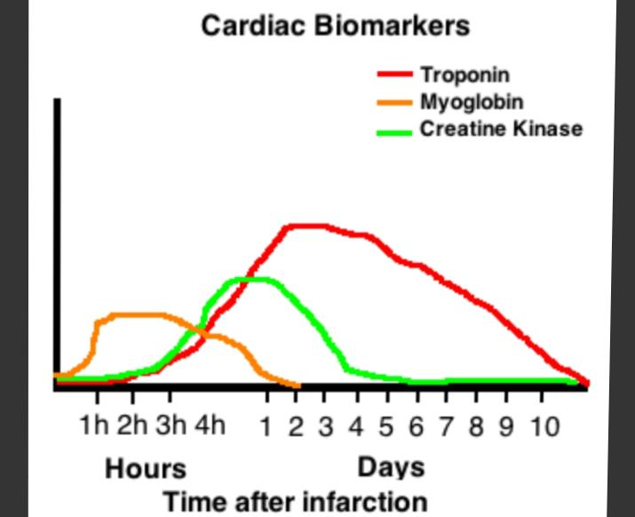

Slide 15
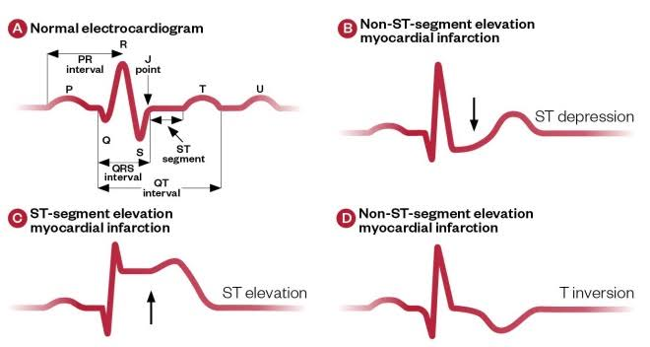

Slide 16
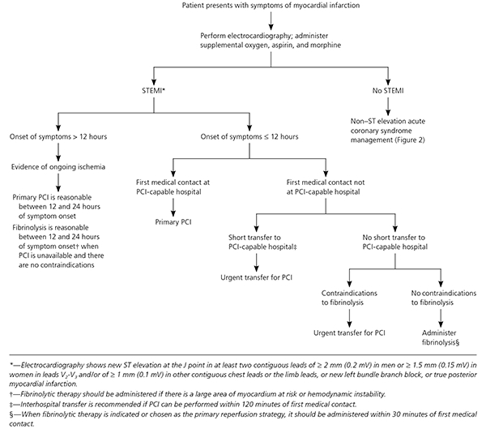

Slide 17


