Slide 1
Emergency Drugs
Dr. Pooja Shah
Associate Professor
Dept. of Emergency Medicine
SBKSMIRC

Slide 2
EMERGENCY DRUGS LIST
OXYGEN
DRUGS FOR CARDIAC CONDITIONS
DRUGS FOR POISONING
DRUGS FOR SHOCK
DRUGS FOR HYPERTENSIVE CRISIS AND PULMONARY EDEMA

Slide 3
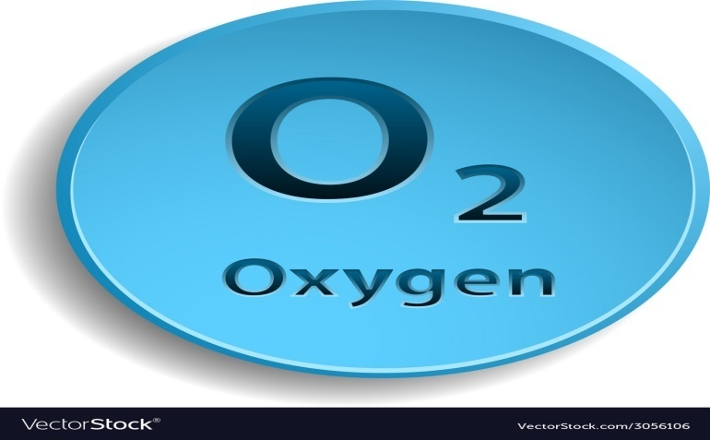
OXYGEN
w/o OXYGEN - Brain death within 6 min
Pulse oximeter – measures oxygen saturation
WHAT’S THE IDEAL O2 SAT? 95%

Slide 4
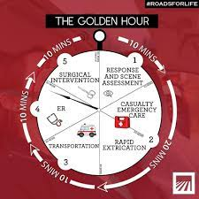
THE GOLDEN PERIOD

Slide 5
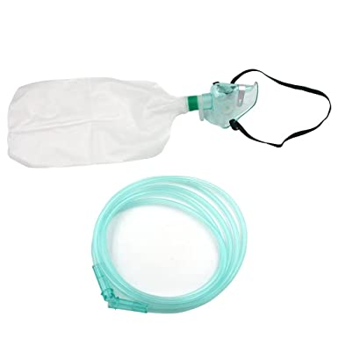
OXYGEN DEVICE: non- re breather mask with O2 reservoir
Breathing spontaneously:
non- rebreather mask with O2 reservoir 10-15L/min
For those who needs ventillation Bag-valve mask – 15L/min

Slide 6

CAUTION IN COPD PATIENTS
OXYGEN
CAUTION IN COPD PATIENTS
May lose their hypoxic respiratory drive

Slide 7
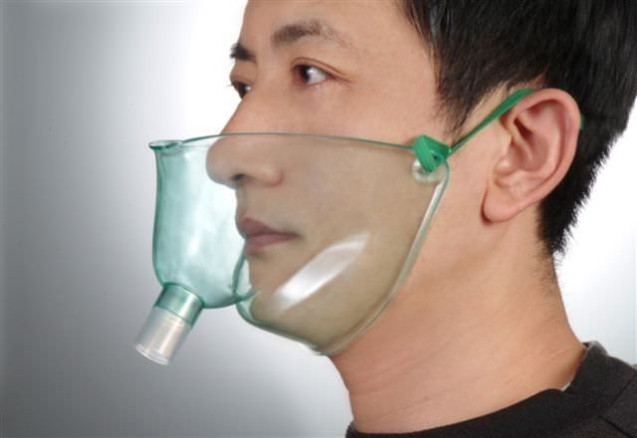
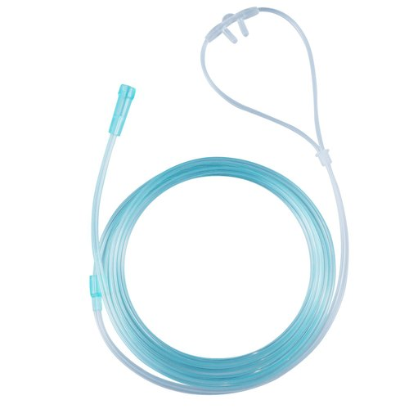
Emergency but no severe stress (angina, arrhythmia)
OXYGEN
Emergency but no severe stress (angina, arrhythmia)
Nasal cannula – 1-6L/min
Face tent (high O2 flow) - children
FACE TENT
NASAL CANNULA

Slide 8
DRUGS FOR CARDIAC DISORDERS
NITROGLYCERIN – vasodilator
ANGINA -MYOCARDIAL INFARCTION
SUBLINGUAL – 0.4 mg to be repeated after 5 min (max: 3 doses)
Translingual aerosol spray – 0.4mg

Slide 9
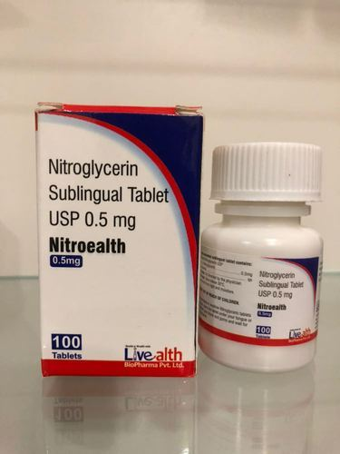
DRUGS FOR CARDIAC DISORDERS
NITROGLYCERIN – vasodilator
Should not be use along with Sildenafil (VIAGRA)

Slide 10
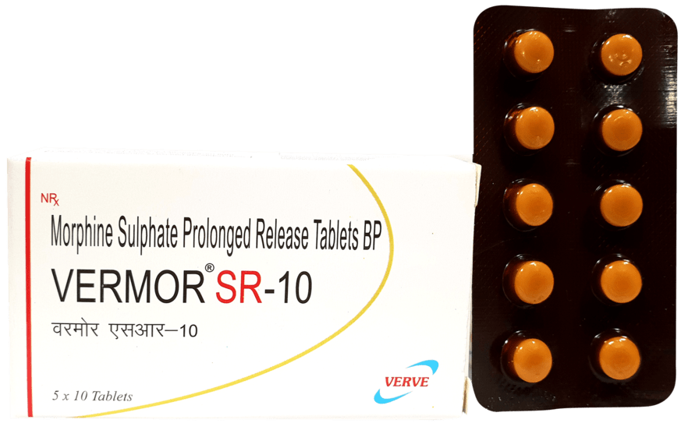
DRUGS FOR CARDIAC DISORDERS
MORPHINE SULFATE
Narcotic analgesic
given for chest pain associated with MI
Dose: 1-4mg IV over 1-5min to be repeated q 5-30’ until chest pain is relieved
Adverse effects: respiratory depression and hypotension
NALOXONE (NARCAN)Reverses the action of morphine

Slide 11
1)ATROPINE SULFATE
Inhibits action of VAGUS nerve for treatment of bradycardia, asystole and AV block dose: 0.5-1mg q 3-5 min
2)ISOPROTERENOL beta adrenergic drug – increase heart rate – for HYPOTENSION monitor heart rate
3)EPINEPHRINE Improves perfusion of the heart and brain, bronchodilation
“E” drug for hypotension, pulseless V-tach, V fibrillation, status asthmaticus. monitor cardiac and hemodynamics
4)SODIUM BICARBONATEFor metabolic/respiratory acidotic state dose: 1meq/kg IV, maybe repeated at 0.5meq/Kg every 10 min.
DRUGS FOR CARDIAC DISORDERS

Slide 12
DRUGS FOR CARDIAC DISORDERS – ANTI ARRYTHMICS
1)ADENOSINE
2)VERAPAMIL
3)DILTIAZEM
4)LIDOCAINE
5)AMIODARONE
6)PROCAINAMIDE

Slide 13
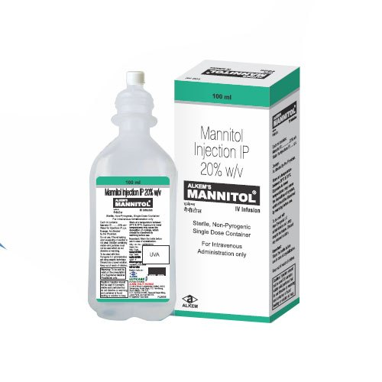
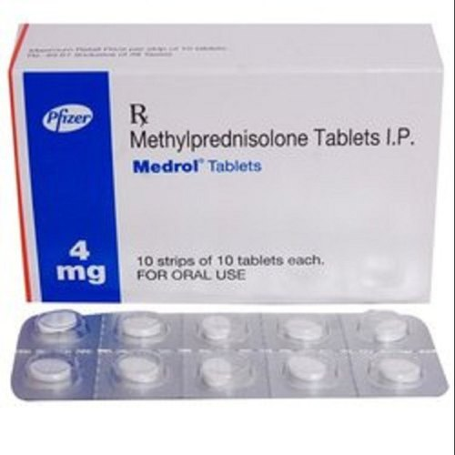
DRUGS FOR NEURO-SURGICAL DISORDERS –Increase ICP
1)MANNITOL
Osmotic diuretic – for cerebral edema
may inc ICP initial dose – 0.5-1g/kg IV of 25% solution
Note: highly irritating to the veins forms crystals
2)METHYLPREDNISOLONE
Indication: spinal cord injury/cerebral edema
Contraindications : HIV infection
Pregnancy
Uncontrolled diabetes

Slide 14
Poisoning: Ingested Poisons
May be corrosive (alkaline and acid agents that cause tissue destruction)Alkaline products: Lye, drain and toilet bowl cleaners, bleach, non-phosphate detergents, button batteries Acid products: toilet bowl and metal cleaners, battery acid

Slide 15
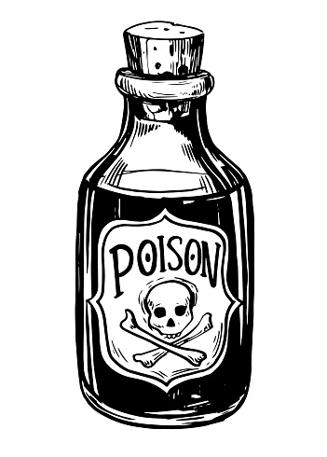
Poisoning Management
Control the airway, ventilation and oxygenation
ECG, VS, and neurologic status
monitored for changes.
Note for amount
time since ingestion
signs and symptoms
age and weight
health history are determined
Insert Foley catheter - to monitor renal function
blood examinations - test for poison concentration
Treat SHOCK

Slide 16
Poisoning management
Ingestion of corrosive poison
give water or milk - for dilution
not attempted if patient has acute airway obstruction, or if with evidence of gastric or esophageal burn or perforation.
Ipecac syrup - induce vomiting in the alert patient
Gastric lavage for the obtunded patient
aspirate is tested
Activated charcoal administration if poison can be absorbed by it
Cathartic - when appropriate

Slide 17
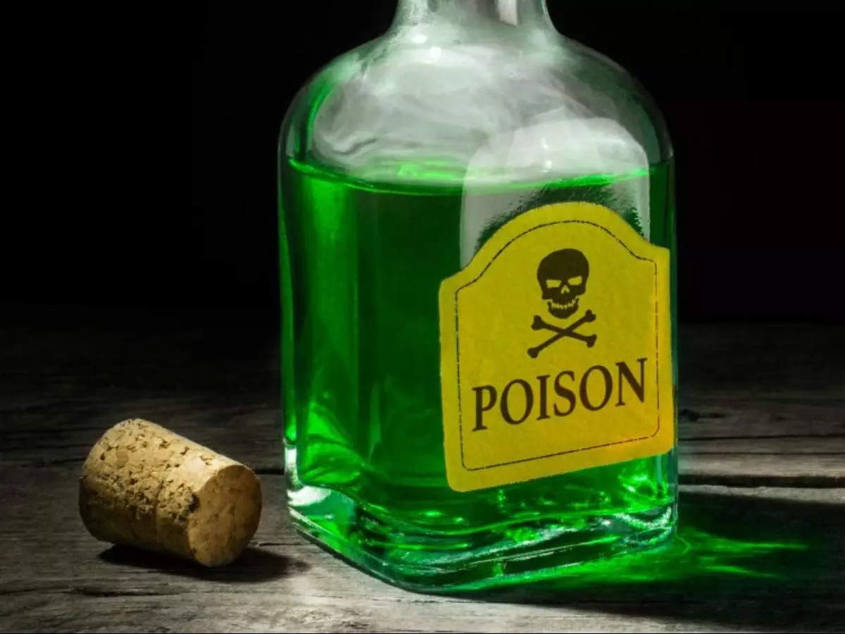
Ingested Poison Warnings!!!
Poisoning Management
Vomiting is NEVER induced after ingestion of caustic substances or petroleum distillates.
Contact poison control center – PGH
if an unknown toxic agent has been taken
if it is necessary to identify an antidote for a known toxic agent.

Slide 18
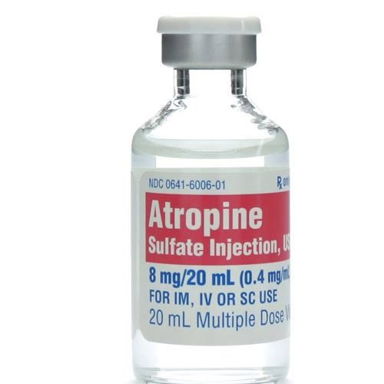
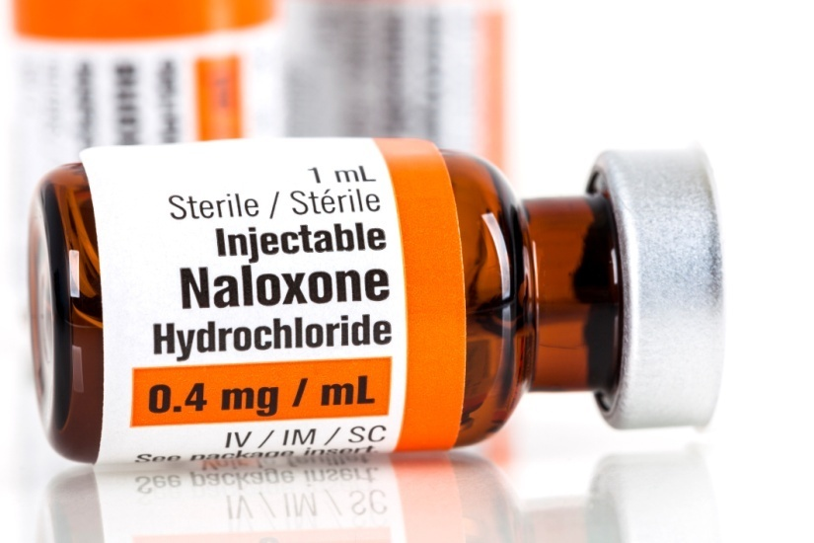
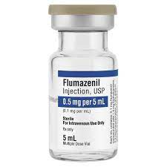
Poisoning management
NALOXONE – anti-dote for opiates overdose
FLUMAZENIL – reverses respiratory depression secondary to benzodiazepines
ATROPINE - reverses organophosphate poisoning

Slide 19
DRUGS FOR SHOCK
DOPAMINE
Sympathomimetic
For hypotension (shock)It can increase heart rate when atropine has not been effective
Dose: 1-20mcg/kg/min (in 250ml D5W)
Wean patient gradually – can result to severe hypotension if abruptly stopped
Assess IV site q1 hr
Extravasation can lead to tissue necrosis
DOBUTAMINE
sympathomimetic with beta 1 effects (inc. heart rate)
no vasoconstriction, only increase cardiac output
dose: mg in 250ml D5W or NSS
NOREPINEPHRINE
AN EXTREMELY POTENT VASOCONSTRICTOR GIVEN WHEN DOPAMINE AND DOBUTAMINE HAVE FAILED
DOSE: 4-8mg to 250ml D5W or NSS and infused at mcg/min

Slide 20
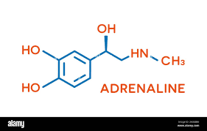
ANAPHYLACTIC SHOCK
ADRENALINE
ALBUTEROL
Reverses bronchoconstriction
administered via nebulizer
side effects: tremors, tachycardia, dysrhythmia, hypertension
DIPHENHYDRAMINE
Anti – histaminic
Reduce histamine induced tissue swelling and pruritus25-50mg IV or deep IM

Slide 21
DRUGS FOR HYPERTENSIVE CRISIS
Diastolic pressure that exceeds mmHg and pulmonary edema
LABETALOL
Beta blocker Lowers heart rate, BP, myocardial contractility, and myocardial O2 consumption
Dose: 10mg IV push for 1-2 min(max dose: 150mg)Contraindicated in patients with Asthma
SODIUM NITROPRUSSIDE
Reduces arterial BP Effect: immediate vasodilatation and BP goes down but immediately goes up once the drug is stopped
inactivated by light – wrap in aluminum foil
Blue or brown discoloration – means drug is degraded
prolonged use – can lead to cyanide poisoning
FUROSEMIDE
loop diuretic
For acute pulmonary edema due to left ventricular dysfunction or hypertensive crisis diuresis may start within 20 mins

Slide 22
THANK YOU

