Slide 1
Department of Emergency Medicine
“Training On Triage”
Dr. Anuja Agrawal
Associate Professor
Dept. of Emergency Medicine
SBKSMIRC

Slide 2
TRIAGE
Dr. POOJA SHAH
Associate Professor
Dept. of Emergency Medicine
S.B.K.S.M.I.R.C
PIPARIA

Slide 3
What is triage?

Slide 4
French word ‘ trier’ means ‘to sort’
the sorting of patients depending upon the priority of the condition of the patients.

Slide 5
WHERE:
Emergency departments (EDs) and in mass casuality , disasters, and battlefield settings.
WHY:
To provide the greatest benefit to the largest number of emergency patients to decrease morbidity and mortality.

Slide 6
Patients are classified according to type and conditions of their general status
Our AIM is
Right patient to the
Right place at the
Right time with the
Right care provider

Slide 7
In-hospital triage aims to rapidly identify the most injured/serious patient and ensure timely and appropriate treatment according to the patient’s clinical urgency
identify the most urgent (or potentially most serious) cases to ensure that they receive priority treatment, followed by the less urgent cases.

Slide 8
AIMS
To ensure that the patients are treated in the ORDER of their clinical urgency
To ensure TREATMENT is appropriate and timely.
Avoid CONGESTION of the patients
To provide ONGOING assessment of patients
To provide INFORMATION to patients and relatives about expected care and waiting time.

Slide 9
Who can do this?

Slide 10
Medical officer
Clinician
Nurses
Para medical staff
Degree of medical urgency is assessed by a care team this is called team triage.

Slide 11
Objective
Immediate patient assessment to avoid any possible harmful delay.
Triage aims to ensure that timing of care and resource allocation is according to the degree of illness or injury.

Slide 12
Effective triage scale
- increase the quality and prognosis of
patient care,
- shorten patients' length of stay
- waiting time by optimizing time of
medical assessment and intervention.

Slide 13
TRIAGE CATEGORIES
Red- danger zone
Yellow- warning zone
Green – goal zone
Black- Dead zone
Need for ICU admission

Slide 14
4 categories

Slide 15
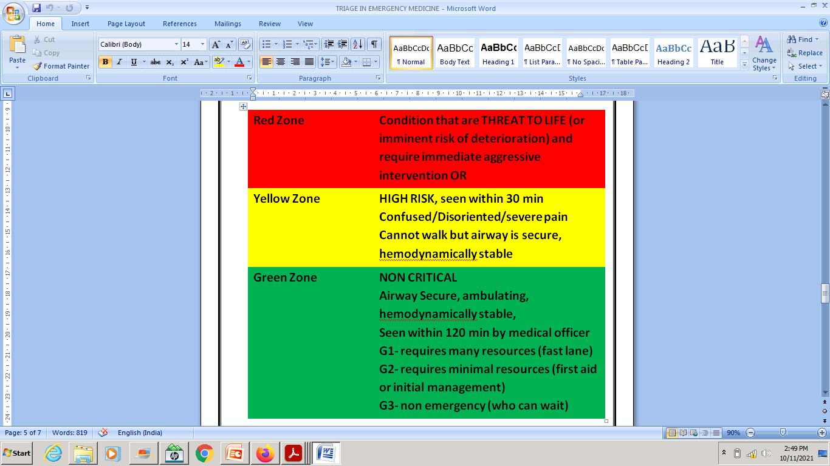

Slide 16
RED ZONE
Airway compromise,
Open chest wounds,
Tension pneumothorax,
Sepsis and septic shock
Arrythmias
Acute respiratory failure
Poisoning
Unconsciousness with focal signs,
Severe hypotension,
Active external hemorrhage,
Severe burns
Acute ST elevation MI
Acute LVF, pulmonary edema
Cardiac arrest
Unstable AF/SVT
Cerebro vascular Stroke

Slide 17
YELLOW ZONE
Haemodynamically stable NSTEMI, AF, SVT
open and closed extremity fractures,
Intestinal obstruction
Visceral injuries
Peritonitis, acute abdomen (unstable)
unconsciousness without airway compromise
pelvic fractures,
Spinal fractures with or without spinal cord injury,
Extremity vascular injuries,
soft tissue wounds
Febrile conditions

Slide 18
GREEN ZONE
Minor injuries, cuts, abrasions, minor burns and normal mental status, require no treatment beyond first aid, and do not require hospitalization.
They are identified by their ability to walk under their own power.

Slide 19
Black category
Important to recognize dead patients
to segregate them from all others
to minimize inappropriate attempts at resuscitation and intervention.
No resuscitation or care should be initiated.

Slide 20
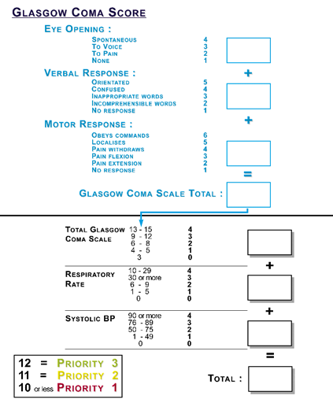

Slide 21
GCS score
SEVERE – 3-8
MODERATE - 9-12
MILD – 13-15

Slide 22
Case # 1
36 year male patient with road traffic accident having fracture in lower limb
pulse: 84/min
BP: 114/80 mmHg

Slide 23
GREEN ZONE
STABILIZE THE FRACTURE AND SHIFT TO WARD

Slide 24
CASE # 2
60 year old patient h/o chest pain, palpitation
Pulse: 110/min
Bp: 160/90 mmHg
ECG: ST elevation MI

Slide 25
RED ZONE
Give O2 via nasal cannula.
Give Aspirin/clopidogrel/ sublingual nitroglycerin, send laboratory investigations.

Slide 26
CASE # 3
40 year patient having c/o abdominal pain and vomiting since 3 days
Pulse: 110/min
Bp: 100/70 mmHg

Slide 27
YELLOW ZONE
Suspect acute abdomen/ perforation/ obstruction

Slide 28
Case # 4
65 year old patient came to casuality
Uncouncious
Pulse feeble
SPo2- 90% on room air
BP- 80/60 mmHg
RBS- 36 mg/dl

Slide 29
RED ZONE
START DNS, MAINTAIN AIRWAY, BREATHING AND IF NECCESARRY START CPR

Slide 30
CASE # 5
70 year old patient h/o RTA, having minor abrasions in lower limb, walking without support
Haemodynamically stable

Slide 31
GREEN ZONE
Clean the wound/ suturing if needed, basic work up. Shift to ward

Slide 32
Case # 6
25 year old patient h/o fall from height, not able to sit, restless
spO2: 96% on room air
Pulse: 104/min
BP : 100/70mmHg
Mental status: follows verbal command

Slide 33
YELLOW ZONE
Polytrauma patient. Work up for the same

Slide 34
CASE # 7
45 year male h/o brain tumour,
Pulse- 62/ min
BP- 140/70 mmHg
Mental status- unconscious
GCS- 5/15

Slide 35
RED ZONE
MAINTAIN AIRWAY, BREATHING , CIRCULATION.
Further work up for brain tumour

Slide 36
Case # 8
67 year old patient k/c/o IHD came with h/o gabharaman
Hemodymically stable
ECG- NSTEMI

Slide 37
ICU
NEED MONITORING OF THE PATIENT .

Slide 38
CASE # 9
50 year old man having k/c/o DM with painful ulcer on lower limb, not able to walk by himself
Hemodynamically stable
May require surgery/ debridement

Slide 39
GREEN ZONE
Pain management + further work up for ulcer mangement

Slide 40
Case # 10
50 year old patient H/O RTA , having
difficulty in breathing, multiple injuries,
SpO2: 88 % on RA
Pulse: 130/min
BP: 70 systolic, feeble
Mental status- disoriented

Slide 41
RED ZONE
STABILISE, AIRWAY, BREATHING, CIRCULATION. WORK UP

Slide 42
CASE # 11
Pt with H/O burns by hot water having 20% superficial burns
Patient walking
Hemodynamically stable
Mental status- oriented

Slide 43
GREEN ZONE
Stable pt, routine burns management

Slide 44
CASE # 12
  Patient with H/O fall in bathroom having pain in hip and not able to walk
  H/O LOC present
  SpO2- 95% on RA
  Pulse- 104/min
  BP- 100/70 mmHg
  Mental status- oriented/ follows command

Slide 45
YELLOW ZONE
Monitoring and stabilise the hip joint

Slide 46
CASE # 13
Patient with H/O injury with knife , having cut wound over left palm
Hemodynamically stable
Mental status- oriented

Slide 47
GREEN ZONE
May need minor suturing

Slide 48
CASE # 14
Patient with severe blast injury having 80 % burns
Breathing – gasping
Hemodynamically not stable

Slide 49
RED ZONE
IMMIDIATE INTUBATE AND RESUSCITATE IF NECESSARY

Slide 50
CASE # 15
Patient with acid ingestion
Breathing- poor efforts
SpO2 - 85% on RA
Pulse – 120/min
Bp - 90/60 mmHg
Mental status- restless

Slide 51
RED ZONE
Airway is compromised, intubation and resuscitation.

Slide 52
CASE # 16
Patient with status epilepticus having continuous seizures.
Hemodynamically stable
SpO2 -97% on RA
Mental status- disoriented

Slide 53
RED ZONE
LOAD THE PATIENT WITH INJ. PHENYTOIN AND STABILISE HIM

Slide 54
THANK YOU

