Slide 1
GLASGOW COMA SCALE AND MODIFIED GLASCOW COMA SCALE
Dr. Malini Mehta
Professor and Head
Dept. of Emergency Medicine
SBKSMIRC

Slide 2
CONTENTS:
1. INTRODUCTION
2. HISTORY
3. GCS SCALE
4. MODIFIED GCS
5. PEDIATRIC GCS

Slide 3
INTRODUCTION
The Glasgow Coma Scale (GCS) is used to objectively describe the extent of impaired consciousness in all types of acute medical and trauma patients. The scale assesses patients according to three aspects of responsiveness:
eye-opening,
motor, and
verbal responses.

Slide 4
The levels of response in the components of the Glasgow Coma Scale are ‘scored’ from 1, for no response, up to normal values of 4 (Eye-opening response) 5 ( Verbal response) and 6 (Motor response)
The total Coma Score thus has values between three and 15, three being the worst and 15 being the highest.
The score is the sum of the scores as well as the individual elements.
For example, a score of 10 might be expressed as GCS10 = E3V4M3.

Slide 5
HISTORY
The Glasgow Coma Scale was first published in 1974 at the University of Glasgow by neurosurgery professors Graham Teasdale and Bryan Jennett.
The original scale involved three exam components (eye movement, motor control, and verbal control). These components were scored based on clearly defined behavioral responses.

Slide 6
In 1976, Teasdale updated the motor component of the Glasgow Coma Scale to differentiate flexion movements.
Widespread adoption of the GCS was attributed to two events in 1978 :
1. First, Tom Langfitt, a leading figure in neurological trauma, wrote an editorial in Journal of Neurosurgery strongly encouraging neurosurgical units to adopt the GCS score.
2. Second, the GCS was included in the first version of Advanced Trauma Life Support (ATLS), which expanded the number of centers where staff were trained in performing the GCS.

Slide 7
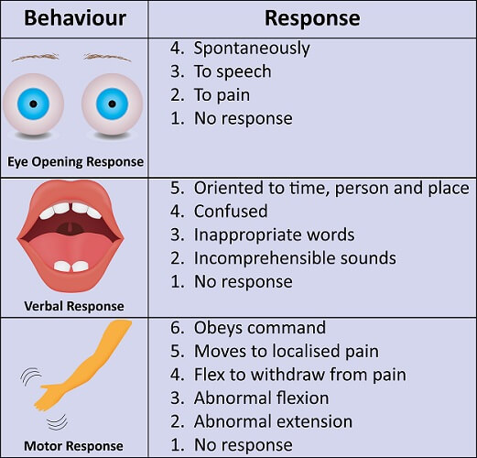

Slide 8
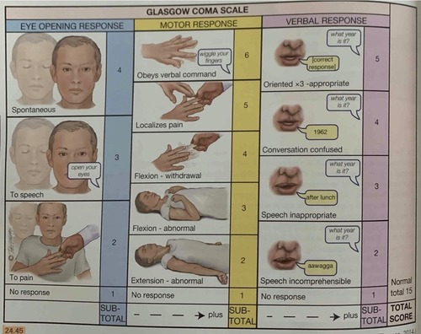

Slide 9
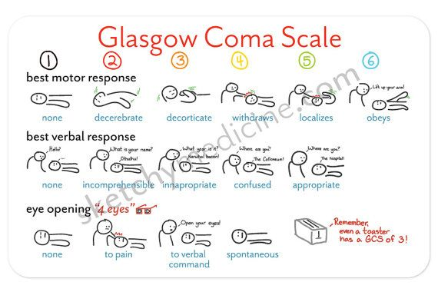

Slide 10
INTERPRETATION
1. Vegetative state -<3
2. Severe brain inury - score 3-8
3. Moderate injury – Score 9-12
4. Minor – 13 or >13

Slide 11
CONDITIONS WHERE SCORE IS NOT CALCULATED OR IS MISCALCULATED:
1. Eye (ocular response) - severe trauma to the eyes, enucleation
2. Verbal (oral response) - intubation,
non-oral language disability, linguistic barrier, dysphagia
3. Motor (motoric response)- paralysis/ hemiparesis (acquired causes such as post-stroke, post-neurological injury;
congenital/innate such as cerebral palsy)

Slide 12
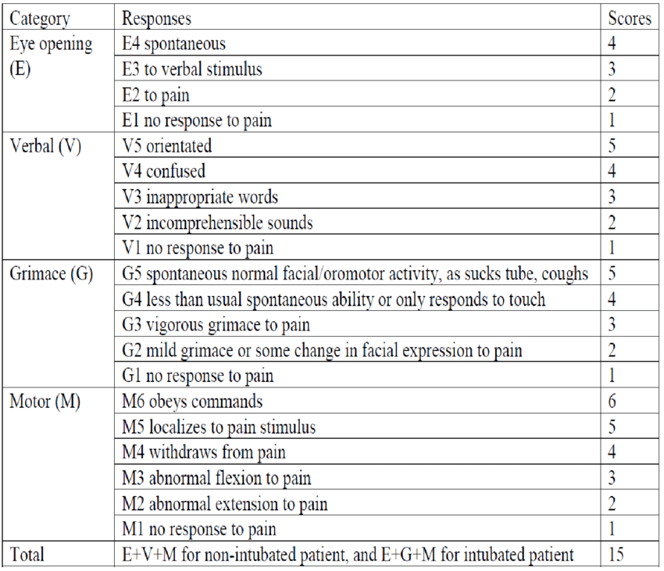
MODIFIED GCS SCORE:

Slide 13
PEDIATRIC GCS
The Pediatric Glasgow Coma Scale is the equivalent of the Glasgow coma scale (GCS) used to assess the level of consciousness of child patients.
PGCS comprises three tests: eye, verbal and motor responses. The three values separately as well as their sum are considered. The lowest possible PGCS (the sum) is 3 (deep coma or death) whilst the highest is 15 (fully awake and aware person). The pediatric GCS is commonly used in emergency medical services.

Slide 14
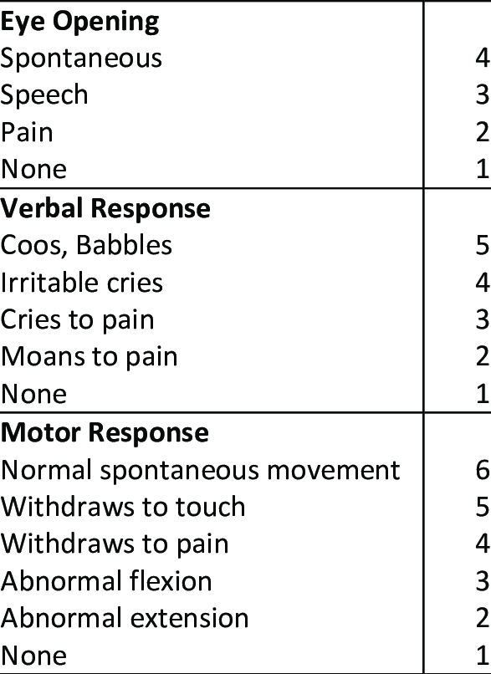

Slide 15


