Slide 1
DYNAMIC
AUSCULTATION
Dr Kashyap patel
Md, dnb cardiology
Assistant professor
Sbks mi & rc

Slide 2
DYNAMIC AUSCULTATION
Dynamic auscultation is a technique of altering circulatory dynamics by means of physiological and pharmacological manoeuvres and determining their effects on heart sounds and murmurs; in short, “auscultation by altering hemodynamics”.

Slide 3
AIMS
Differentiate right-sided events from left side events
Systolic murmurs (SMs) of obstruction from regurgitant SMs
Increasing or precipitating regurgitation/obstruction (in ambiguous situation)
Differentiating dynamic obstruction from fixed obstruction.

Slide 4
TYPES OF BEDSIDE MANEUVERS
Physical changes: –
– Postural/positional changes: Sitting, standing, squatting and transient arterial occlusion
– Respiration
– Isometric exercises
– Valsalva maneuver
– Müllers maneuver.

Slide 5
Changes in cardiac rhythm:
– Postventricular premature complex (VPC) response
– Long cycle lengths: Atrial fibrillation, carotid sinus massage, heart block.
Pharmacological changes:
– Amyl nitrate
– Vasopressors: Methoxamine, phenylephrine
– Nitroglycerin.

Slide 6
POSTURAL/POSITIONAL CHANGES
Sudden lying down from standing or sitting posture or passive elevation of both the legs
Squatting
Sitting up and leaning forward
Lying on left side (left lateral decubitus)
Knee-elbow position

Slide 7
Sudden lying down from standing or sitting posture or passive elevation of both the legs
It leads to
increased venous return
increases right ventricular (RV) stroke volume (SV)
later on increases left ventricular (LV) SV and LV size after several cardiac cycles.
These changes cause widening of S2 split in both phases of respiration (wide split), with further increase in split during inspiration (variable).

Slide 8
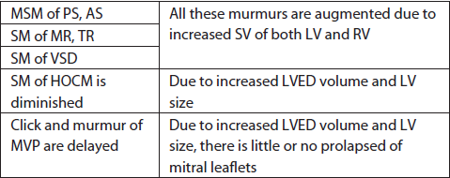
Effects on Murmurs

Slide 9
Head up position (standing up) during stabilized phase (30 seconds to two minutes)
The hemodynamic responses are
An average increase in HR (15–30%)
Diastolic pressure of (10–15%)
Total vascular resistance (VR) of (35–40%)
Decrease in thoracic blood volume (25–30%)
Cardiac output (CO) (15–30%)
Pulse pressure (5–10%).
Notes:
These changes are blunted with increasing age and are mediated by pooling of blood in lower half of body and a reflex increase in autonomic nervous system.

Slide 10
Effects on Heart Sounds
The A2-P2 interval narrows due to decreased venous return to right side of heart
S2-os interval widens, due to fall in left atrial (LA) pressure, consequent to decreased venous return to LA.

Slide 11
Effects on Murmurs
All the murmurs will have reduced intensity except for murmurs of mitral valve prolapse (MVP) and hypertrophic obstructive cardiomyopathy (HOCM).
HOCM: Murmurs increases in intensity
MVP: Click and SM occurs earlier.

Slide 12
squatting
Squatting results in
increase in venous return
systemic arterial blood pressure (BP)
decrease in HR
decrease in forearm VR.

Slide 13
REASON:
The increase in CO and decrease in HR are due to increase in venous return from compressed leg veins
the decrease in HR is baroreceptor reflex-mediated consequent to the rise in aortic pressure.
Rise in aortic pressure during squatting is consequence of exaggerated aortic wave reflection due to kinking of femoral arteries.

Slide 14
In patients who cannot perform squatting, the same hemodynamic effect can be achieved by pushing knees of patient into abdomen in supine posture (jack-knife effect).
Similar hemodynamic effect is elicited by simultaneous compression of brachial arteries.

Slide 15
Transient arterial occlusion
Transient external compression of both brachial arteries by bilateral cuff inflation to 20–40 mm Hg greater than peak systolic pressure for 20 seconds and results in increase of aortic pressure, similar to squatting.

Slide 16
Effects on Heart Sounds
S3 and S4 of both ventricles are accentuated due to increased SV and venous return.

Slide 17
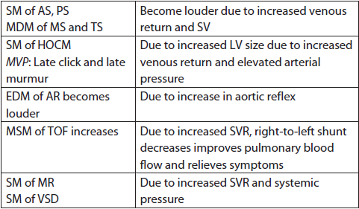
Effects on Murmurs

Slide 18
Sitting up and leaning forward
Brings cardiac mass nearer to chest wall
Loud P2 and split S2 are more clearly audible.
DM of AR and PR are more readily audible.

Slide 19
Left lateral recumbent position
Closeness of heart to the chest wall and a transient increase in heart rate.
Accentuates S1, LV S3 and S4, and mitral OS.
Accentuates MDM of MS, AFM of AR and SM of MR.
Accentuation and early occurrence of mid systolic click and late SM in MVP as a result of increased prolapse due to increase heart rate and ionotropism.

Slide 20
Knee–elbow position
Brings closeness of heart to the chest wall.
Pericardial rub becomes more prominent due to increased friction between parietal and visceral pericardial layers.

Slide 21
HEMODYNAMICS OF RESPIRATION
During inspiration
venous return to the right side of heart increases
pulmonary impedance decreases due to expansion of lungs and pressures on right side decreases (even though flow is increased) as a consequence of transmission of negative held intrathoracic pressures to intrapericardial structures.

Slide 22
The pressures on left heart also decreases during inspiration, consequent to decreased preload (blood is held back in expanded pulmonary vasculature).
Inspiration increases venous return, which augments RA and RV preload.
Resistance to RV outflow also decreases as a result of dilatation of the pulmonary vasculature.
The net effect is increased RV-SV and decreased pulmonary impedance

Slide 23
During expiration
pulmonary venous flow into the LA increases as a result of increased intrathoracic pressure transmitted to the pulmonary capillary bed that augments the flow out of the pulmonary bed into the LA and LV.
Right-sided events are louder on inspiration and left-sided events are best heard during expiration.

Slide 24
Heart sounds
Expiration
LVS3 and LVS4
mitral OS
Accentuated during
Inspiration
RVS3 and RVS4
Tricuspid OS

Slide 25
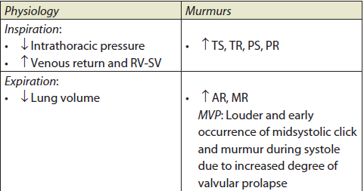
Effect on Murmurs

Slide 26
Pulmonary valvular ES is best heard during expiration - Inspiratory increase of venous return and RV stroke volume leads to elevation of RVEDP beyond the PADP causing premature opening of the pulm valve in diastole itself and less upward motion of valve leaflets resulting in the decreases intensity of ES.
pulmonary vascular ES may increase with inspiration.
NO CHANGE
Patients complicated with RVF.
Aortic valvular ES - LVEDP does not vary with respiration and it is never higher than the aortic diastolic pressure.
Notes:
Aortic ES –

Slide 27
ISOMETRIC EXERCISES
Sustained handgrip for 20–30 seconds results in increase SVR, arterial pressure, CO, LV volumes and increase in HR.
It is important to make sure that patients are not straining (Valsalva maneuvers) during the handgrip.
useful in differentiating aortic stenosis (AS) murmur from that of MR which generally increases
differentiates dynamic left ventricular outflow tract (LVOT) obstruction from fixed obstruction.

Slide 28
Methods
By using calibrated handgrip device simultaneously by both hands
By pressing handball simultaneously with both hands
By making handgrip with both hands simultaneously. It should be done for 20–30 seconds.
It should be avoided in patients with ventricular arrhythmias and myocardial ischemia.

Slide 29
Effects on Heart Sounds
LV S3 and S4 sounds are accentuated

Slide 30
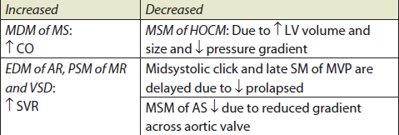
Effects on the Murmurs

Slide 31
VALSALVA MANEUVER
It consists of relatively deep inspiration followed by forced expiration against closed glottis .

Slide 32
Methods
Manometer method: Patient blows into the mercury manometer and maintains 40 mm Hg for 15 seconds.
Valsalva equivalent: Patient pushes back against examiner’s hand which is pressed downward on mid abdomen.
The Valsalva maneuver strain phase decreases the intensity or duration of all left-sided murmurs, except MVP and HOCM

Slide 33
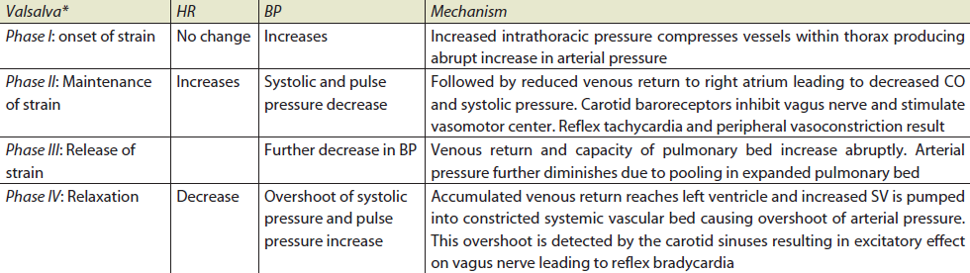

Slide 34
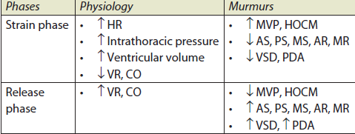
Effects on the Murmurs

Slide 35
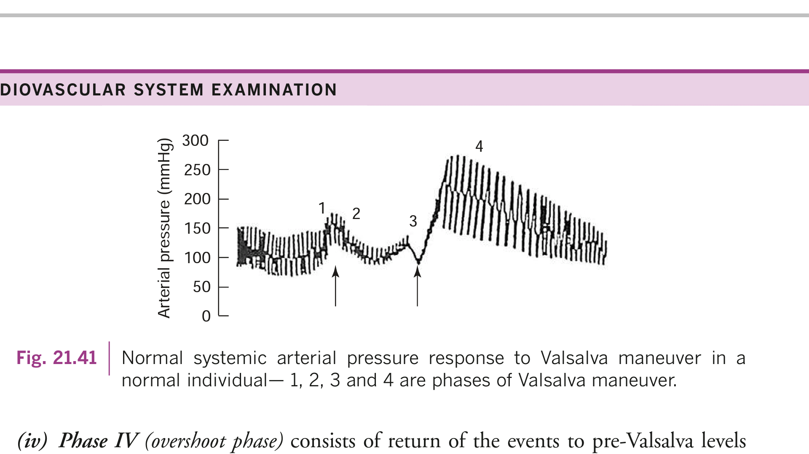
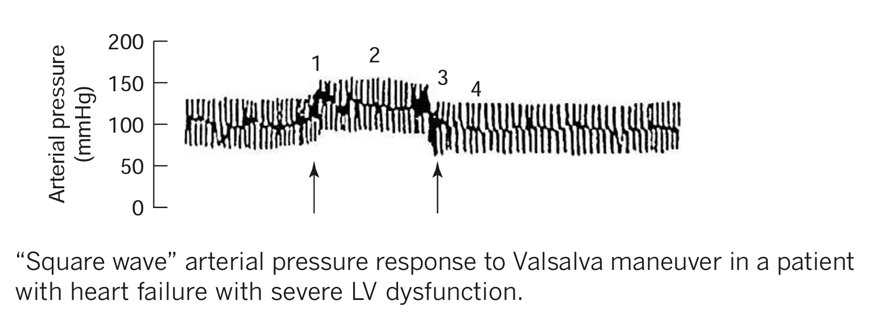

Slide 36
MÜLLER’S MANEUVER
This is a converse of the Valsalva maneuver.
The patient forcefully inspires—with nose and mouth firmly sealed for 10 seconds.
It markedly increases the venous return to right side of heart.
Effect on Heart Sounds and Murmurs All right-sided events are markedly increased in intensity and duration of events including wide split of S2.

Slide 37
Post premature Ventricular Complex Response
During the compensatory pause after premature ventricular complex (PVC)
RV and LV filling increases
aortic and pulmonary diastolic pressure decreases
enhances SV and forward blood flow.
Ventricular function is augmented after PVC because of increase in end-diastolic ventricular volume and increased contractility (postectopic potentiation).

Slide 38
Murmurs originating at normal or stenotic valves increase in intensity during the cardiac cycle after PVC
REASONS:
enhanced LV filling
post-extra-systolic potentiation of contractile function.
Result is forward flow accelerates, causing an increase in the gradient and a louder murmur.

Slide 39
SMs of valvular regurgitation do not change, diminish, or become softer after PVC as there is relatively little further increase in valvular flow or change in the ventricular atrial gradient.

Slide 40
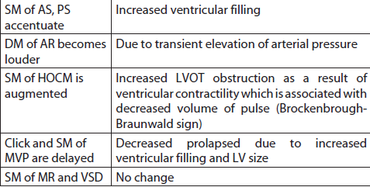
Effects on Murmurs

Slide 41
Pharmacologic Maneuvers
Amyl nitrate inhalation: It is a potent vasodilator, not used nowadays.
Method: Place amyl nitrate on a piece of gauze and ask the patient to take 3 or 4 deep breaths over 10–15 seconds.

Slide 42
Hemodynamic changes:
Initial vasodilatation: Decrease SVR, decreases SBP in first 30 seconds
Reflex tachycardia after 30 seconds, increase CO and velocity of blood flow.

Slide 43
Effects on Heart Sounds
S1 is augmented
Mitral and tricuspid OS becomes louder
A2-OS interval shortens as arterial pressure falls
S3 of both ventricles is augmented due to rapid ventricular filling but S3 of MR diminishes.

Slide 44
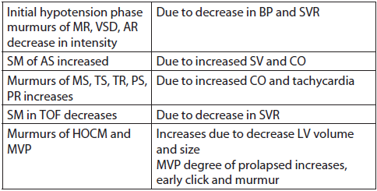
Effect on Murmurs

Slide 45
Methoxamine and phenylephrine
Vasopressor agents are less commonly used.
Methods :
3–5 mg of methoxamine intravenously (IV) is administered which elevates arterial pressure by 20–40 mm Hg for 10–20 minutes
0.3–0.5 mg of phenylephrine IV elevates arterial pressure by 30 mm Hg in 3–5 minutes.

Slide 46
Hemodynamic Changes
Increases arterial pressure
Reflex bradycardia and decreased contractility and CO.

Slide 47
Effects on Heart Sounds and Murmurs
Opposite to that of amyl nitrate
Useful to elicit low-intensity murmur of AR and also verify murmurs of VSD and Austin Flint murmur (AFM) – augmented.
No change in murmurs of AS, pulmonary stenosis (PS), pulmonary regurgitation (PR) and tricuspid stenosis (TS)

Slide 48
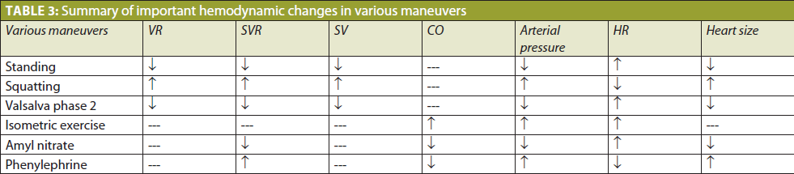
summary

Slide 49
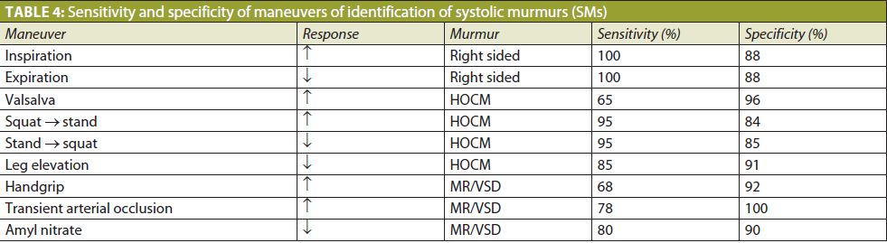

Slide 50
Dynamic auscultation helpful in
AS X HOCM squatting (^/v)
valsalva/standing (v/^)
AS x MR handgrip (v/^)
phenylephrine (v/^)
post pvc (^/v)
amyl nitrate (^/v)

Slide 51
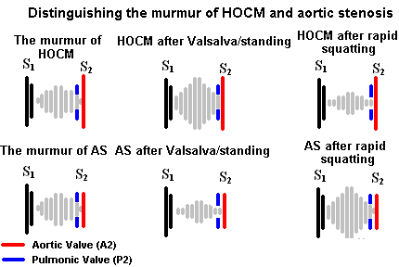

Slide 52
MS X TS respiration
MR X TR respiration
MS X AUSTIN FLINT amyl nitrate(^/v)
PS X AS respiration
PS X Small VSD amyl nitrate (^/v)
phenylephrine (v/^)
respiration
PR X AR squatting (_/^)
sust handgrip (-/^)

Slide 53
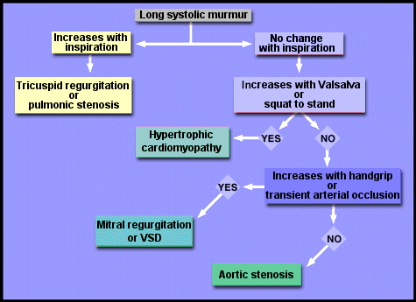

Slide 54
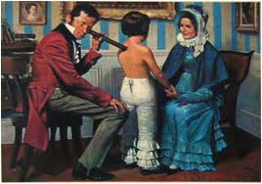
THANK U

