Slide 1
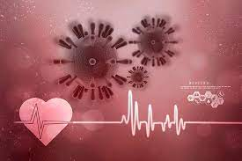
Cardiovascular disease and covid 19
Dr. Viral gandhi
MD, DNB. Assistant Prof
SBKS MI & RC

Slide 2
introduction
Emergence of the novel SARS coronavirus 2 (SARS-CoV-2), the causative agent of coronavirus disease 2019 (COVID-19),
has resulted in an unprecedented pandemic
accompanied by a global health crisis.
Although the lungs are the main organs involved in COVID-19.
One of the major systems affected by this virus is the cardiovascular system.

Slide 3
presence of preexisting cardiovascular disease increases mortality in patients with COVID-19,
cardiovascular injuries, including myocarditis, cardiac rhythm abnormalities,
endothelial cell injury, thrombotic events, and myocardial interstitial fibrosis, are
observed

Slide 4
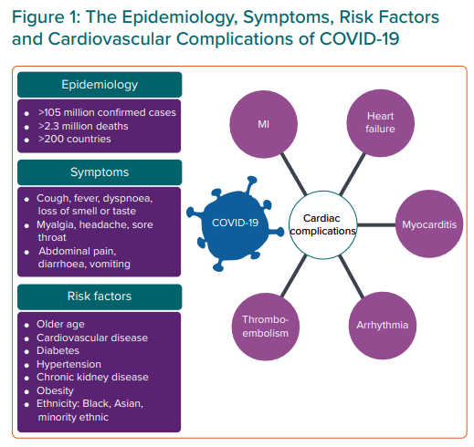

Slide 5
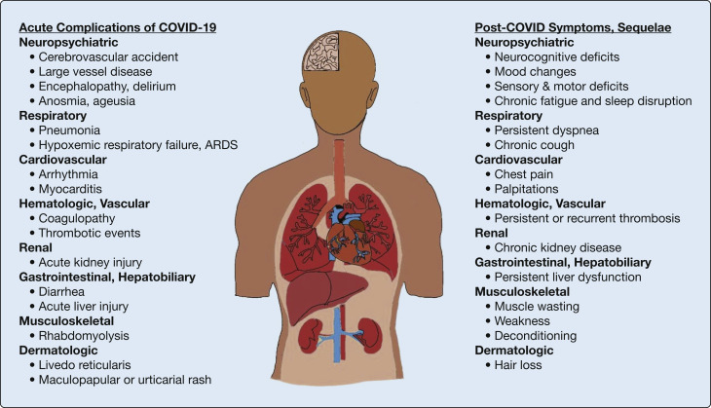

Slide 6
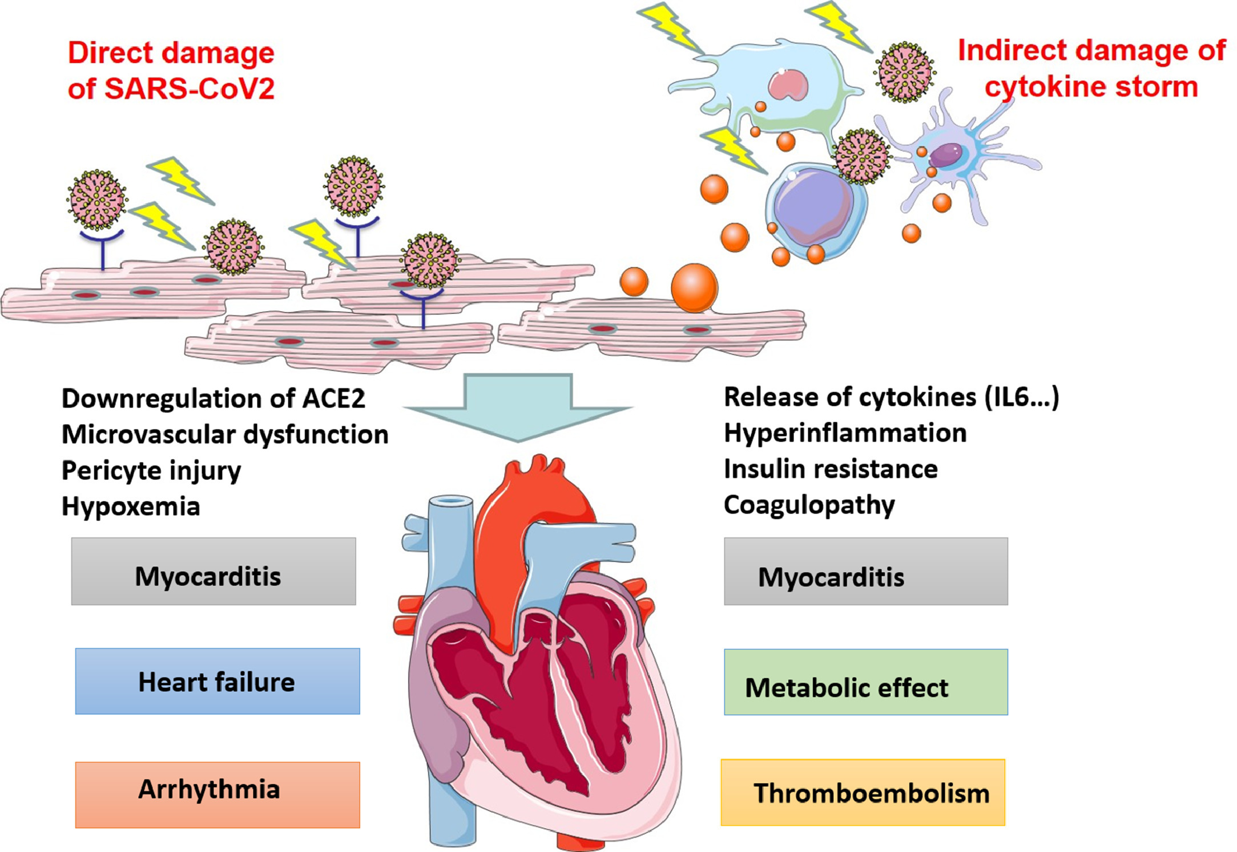

Slide 7
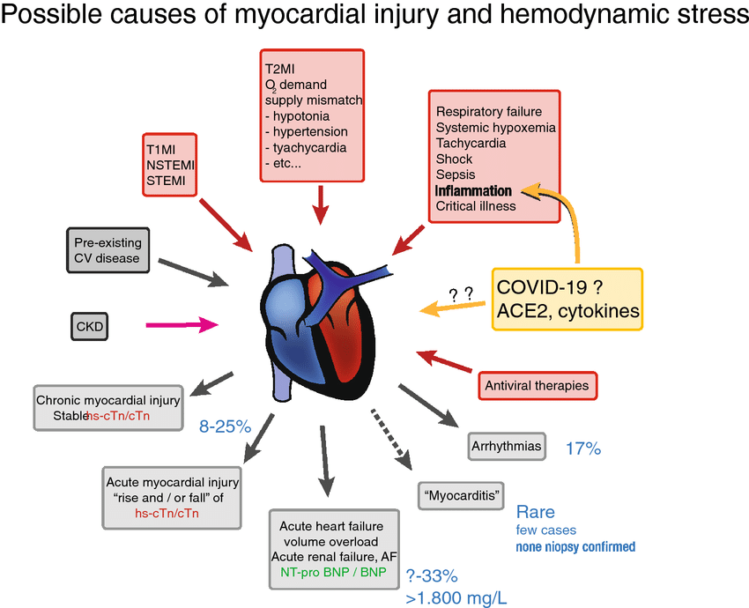

Slide 8
test
ECG
ECHO
TROPONIN I
BNP , NT-PROBNP

Slide 9
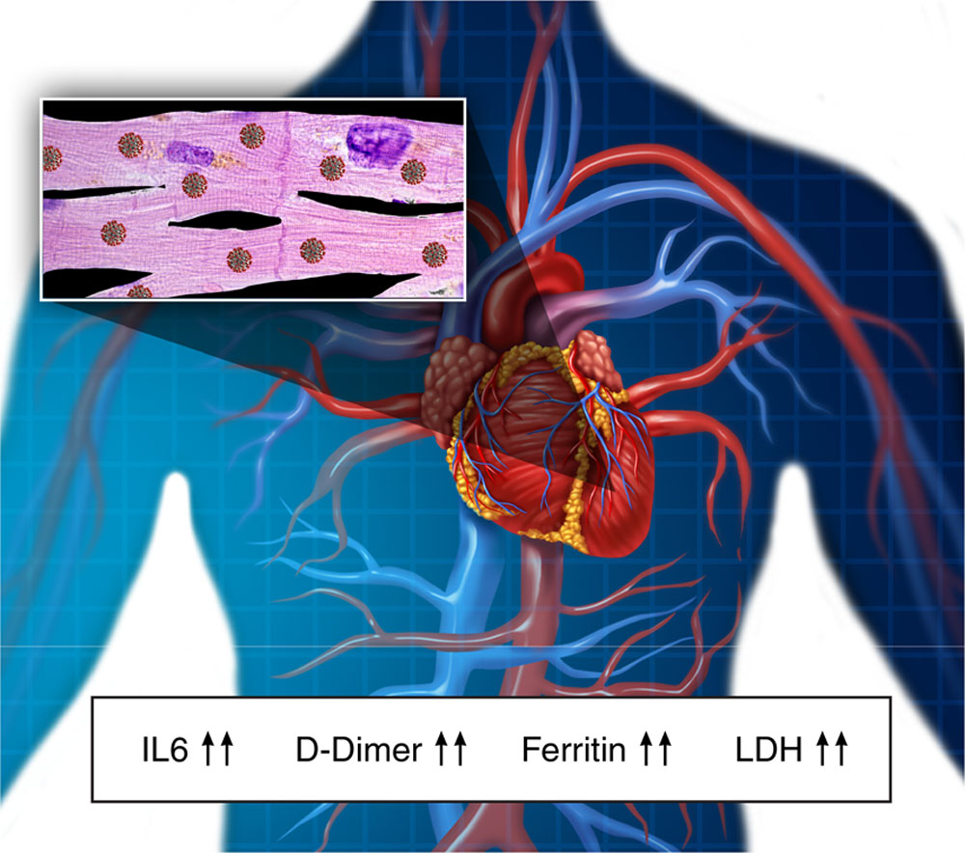

Slide 10
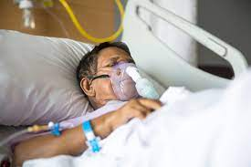
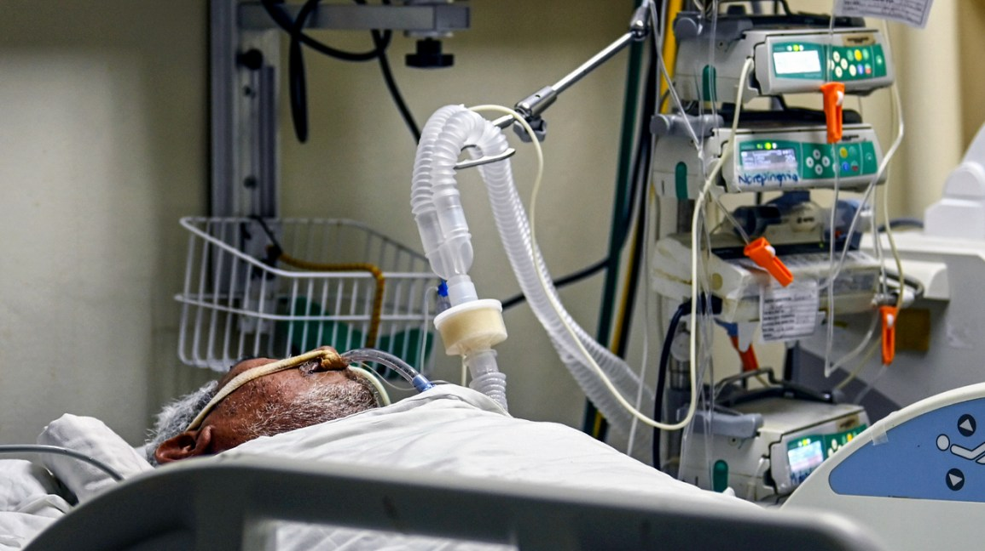

Slide 11
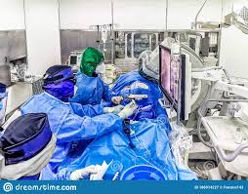
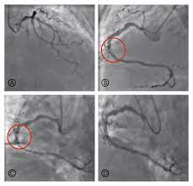
MANAGEMENT
MEDICAL MANAGEMENT
INVASIVE PROCEDURE

Slide 12
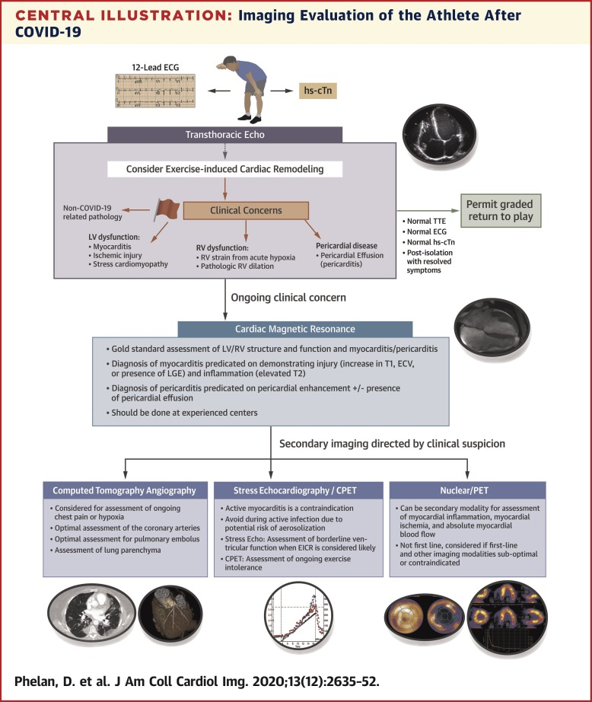

Slide 13
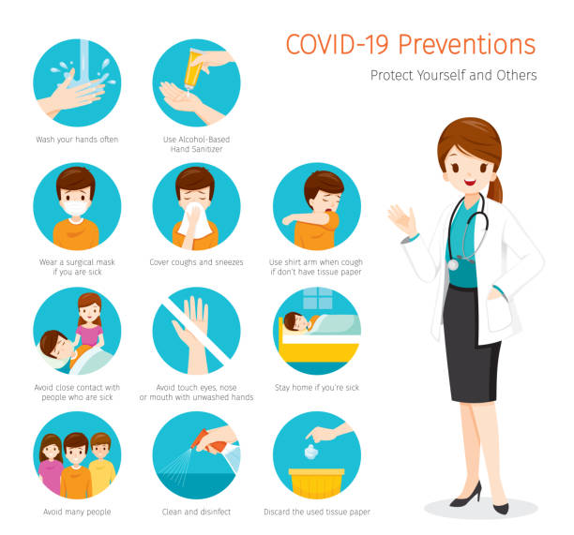

Slide 14
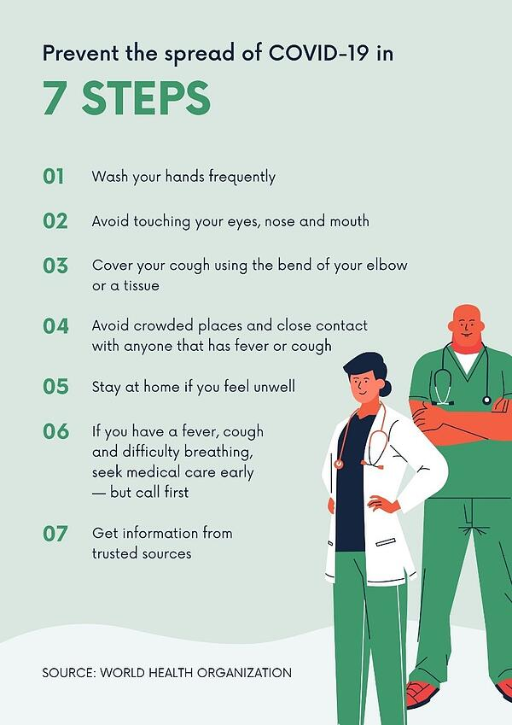

Slide 15
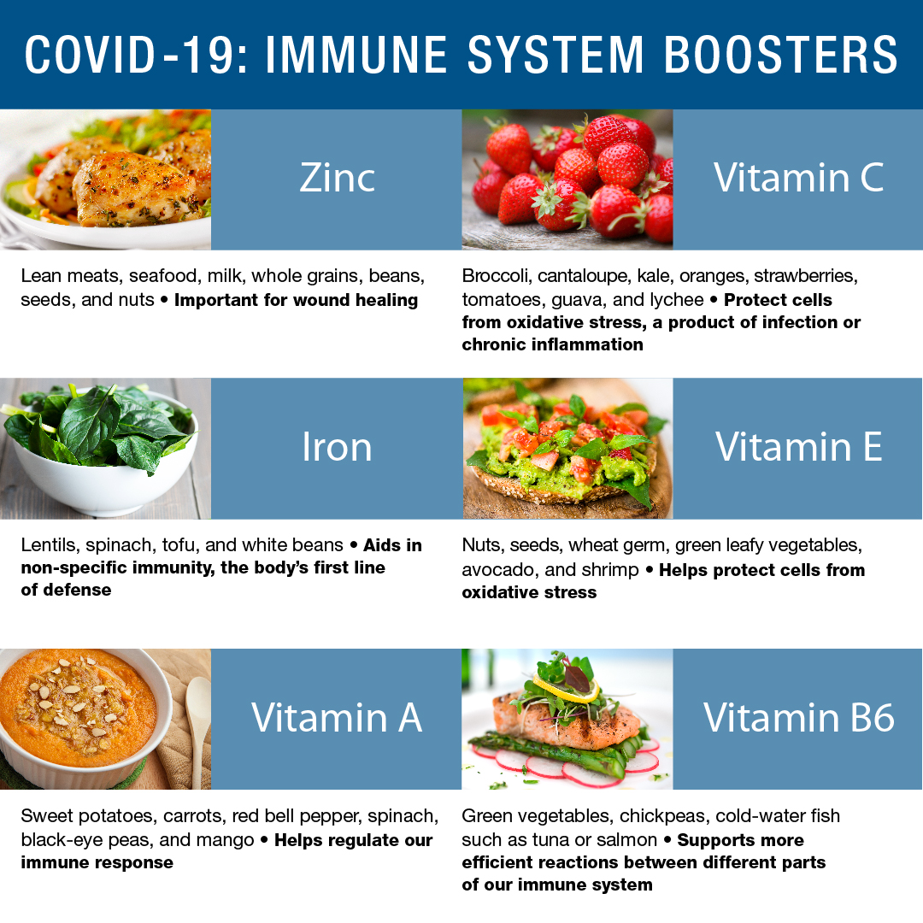

Slide 16
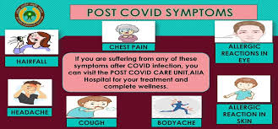

Slide 17
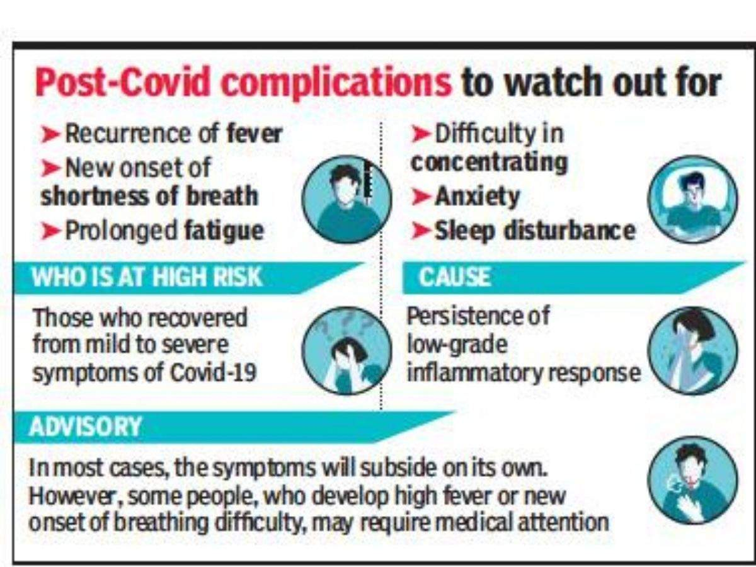

Slide 18
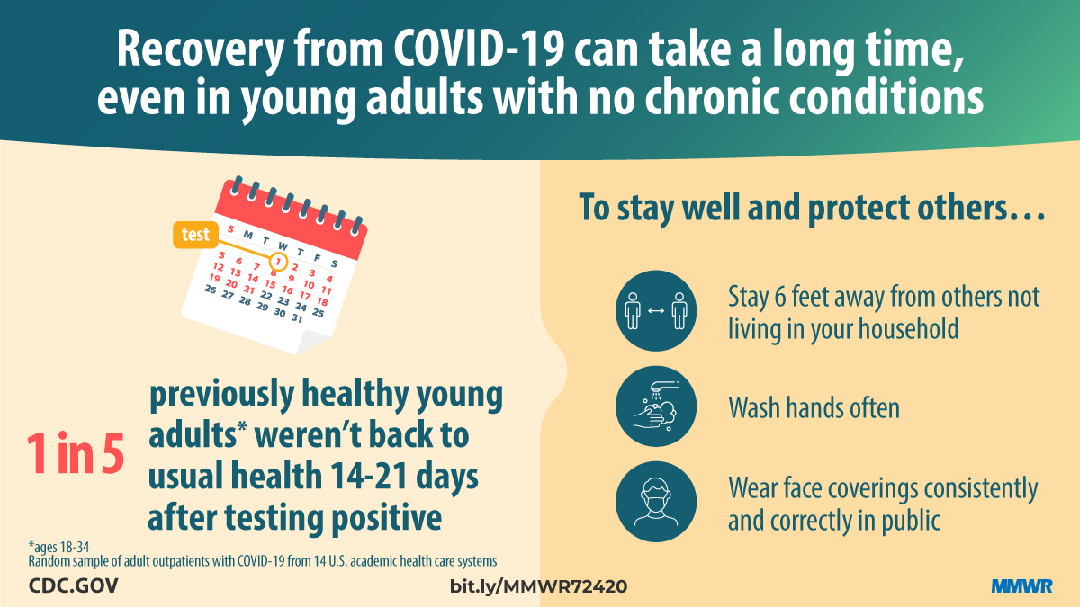

Slide 19
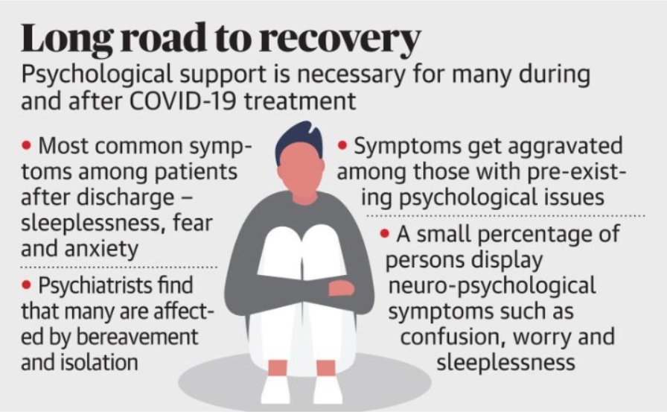

Slide 20
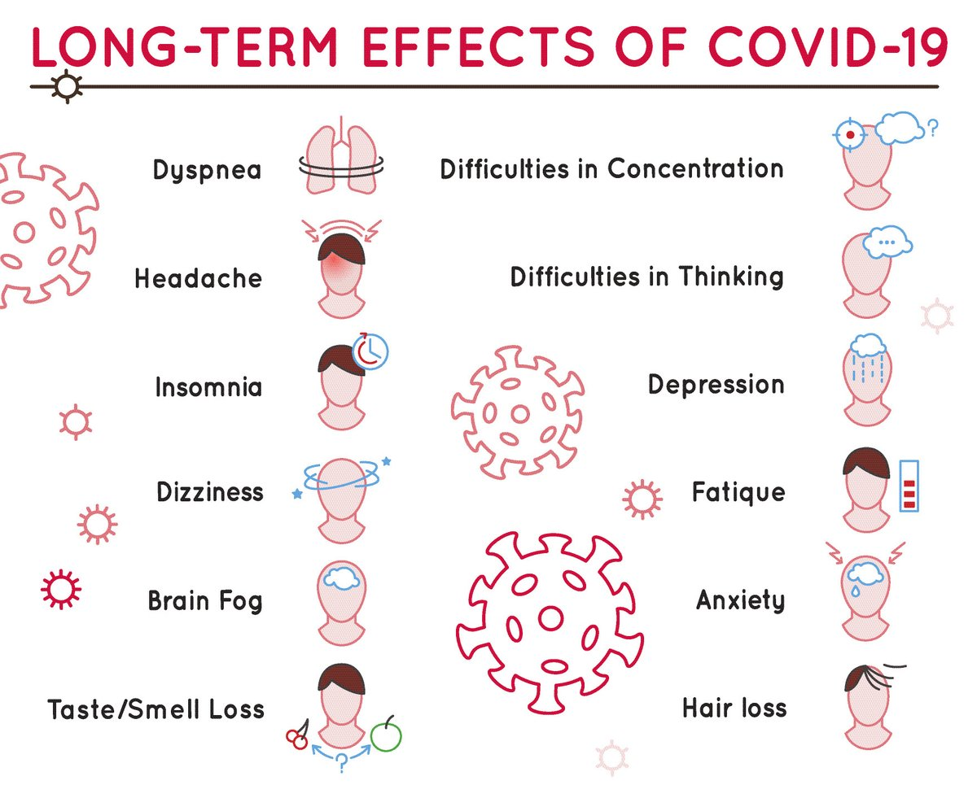

Slide 21
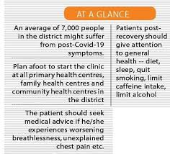

Slide 22

Thanking you

