Slide 1
Out of office BP measurement
Dr Tejas shah
MB,MD,DNB(Cardiology),FACC
Interventional cardiologist
Dept of Cardiology
SBKS MI & RC

Slide 2

Introduction
Hypertension is one of the leading causes of the global burden of disease
Hypertension doubles the risk of cardiovascular diseases (CVD), including coronary heart disease (CHD), congestive heart failure (CHF), ischemic and hemorrhagic stroke, renal failure, and peripheral arterial disease
It often is associated with additional CVD risk factors, and the risk of CVD increases with the total burden of risk factors
Although antihypertensive therapy clearly reduces the risks of cardiovascular and renal disease, large segments of the hypertensive population are either untreated or inadequately treated
Harrison’s Principles of Internal Medicine, 18th Edition
Harrison’s Principles of Internal Medicine, 18th Edition

Slide 3
Prevalence of Hypertension in India
Prevalence of hypertension in India are high across all geographical settings and socioeconomic groups in middle and old age.
The crude prevalence of hypertension is 25.3% .
The unexpectedly high prevalence of hypertension among young adults in India which—if ineffectively treated—will likely result in longer lifetime exposure to this risk factor and thus higher CVD rates in the future.
Hypertension in India; A Nationally Representative Study of 1.3 Million Adults
JAMA Intern Med. January 29, 2018.

Slide 4
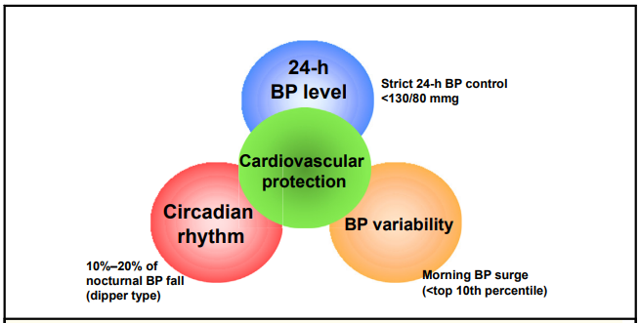
Triad of perfect 24-hour BP control
What are the challenges in achieving this Triad ???
Kario et al Annals of Global Health, VOL. 82, NO. 2, 2016. March April 2016: 254 – 273

Slide 5
Important factors affecting B.P measurement
The inherent variability of blood pressure
The defense reaction
The limitations of the device being used
The accuracy of the device
Blood pressure is not as easily measured in some groups, such as elderly people
BMJ. 2001;322(7292):981-985.

Slide 6
ASPECTS COMMON TO ALL B.P MEASUREMENT TECHNIQUES
Accuracy of BP measuring devices
Selecting reliable devices
Cuffs for BP measuring devices
White-coat hypertension and masked hypertension
BP variability
Journal of Hypertension: July 2021 - Volume 39 - Issue 7 - p 1293-1302

Slide 7
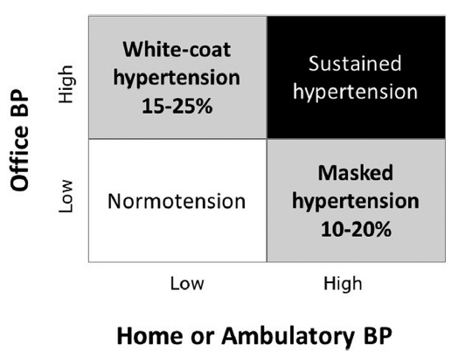
White-coat hypertension and masked hypertension
When BP is evaluated using both office and out-of-office measurements (HBPM or ABPM), patients are classified into four categories:
Journal of Hypertension: July 2021 - Volume 39 - Issue 7 - p 1293-1302

Slide 8
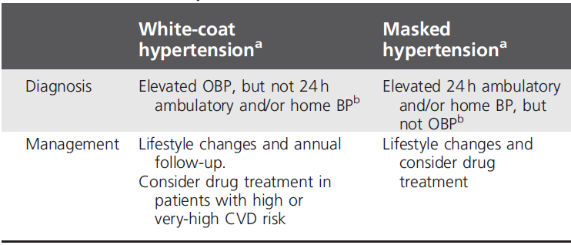
Diagnosis and management of white-coat and masked hypertension phenomena
The diagnoses of WCH and MH require confirmation with a second set of out-of-office BP measurements, as their reproducibility is limited
Journal of Hypertension: July 2021 - Volume 39 - Issue 7 - p 1293-1302

Slide 9
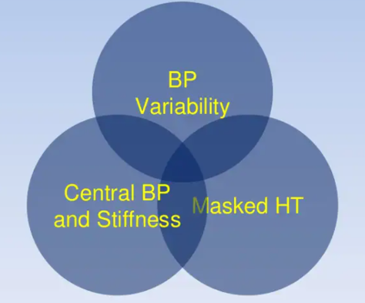
Blood Pressure measurement beyond Office

Slide 10
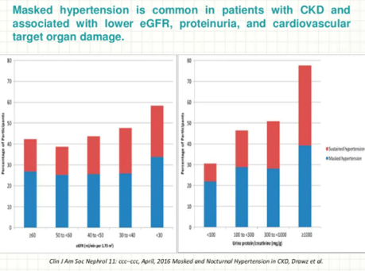
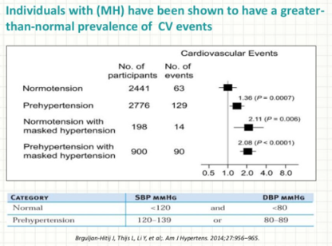
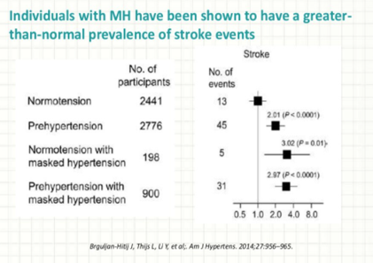
Clinical Implications of Masked Hypertension

Slide 11
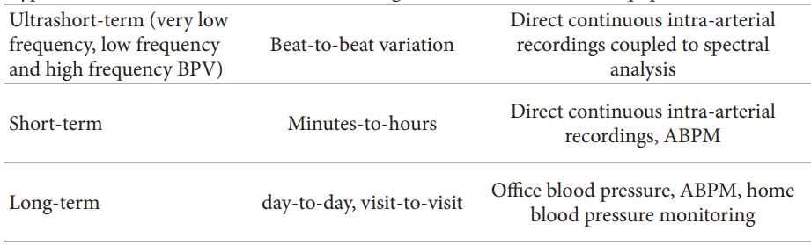
Blood Pressure Variability
Blood pressure variability (BPV) is considered nowadays a novel risk factor for cardiovascular disease
Classification of blood pressure variability and its clinical implication
Estimation of neuro humoral systems involved in blood pressure regulation
Increased variability in daytime, nighttime, and whole 24 h period associated with increased TOD
Large visit-to-visit BPV independently associated with increased incidence of stroke
https://downloads.hindawi.com/archive/2013/398485.pdf accessed on 23rd sep 2021 13:40

Slide 12
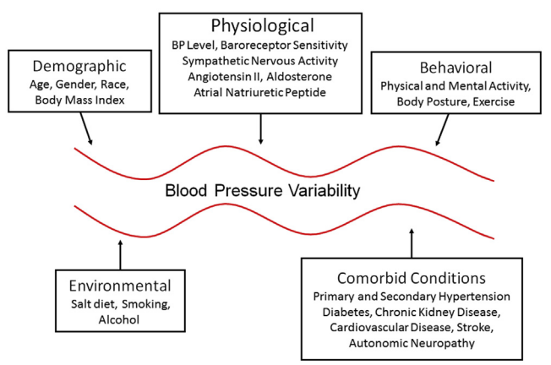
Factors affecting the overall blood pressure variability
Kidney International Reports (2016) 1, 94–104

Slide 13
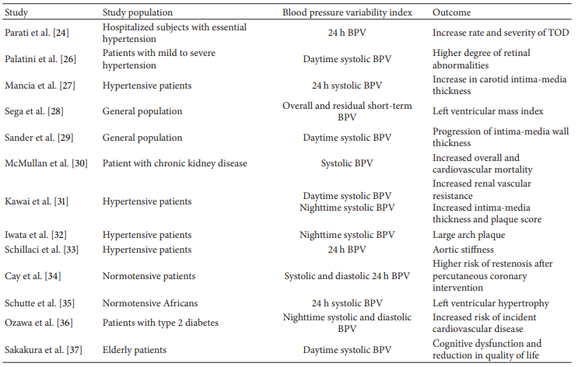
Short-term blood pressure variability and target organ damage and cardiovascular events in patients
Expanding evidence has clearly demonstrated the influence of short-term and long-term BPV on target organ damage and cardiovascular events in hypertensive patients
https://downloads.hindawi.com/archive/2013/398485.pdf accessed on 23rd sep 2021 13:40

Slide 14



Different Prognostic Impact of Nocturnal BP Fall and Short Term BPV
24h Intra-Arterial BP
Protective
Damaging
mmHg
200
100
0
19
22
1
4
7
10
13
19
Hours
Mancia G, Parati G 1983

Slide 15
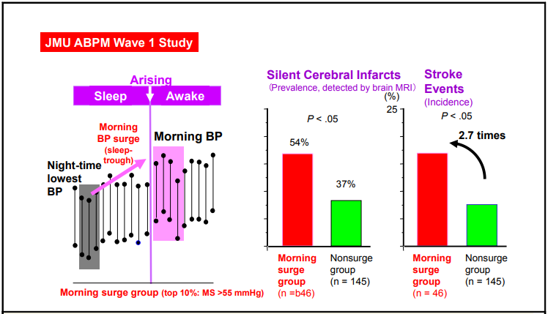
Morning BP surge and stroke risk in hypertension
Kario et al Annals of Global Health, VOL. 82, NO. 2, 2016. March April 2016: 254 – 273

Slide 16
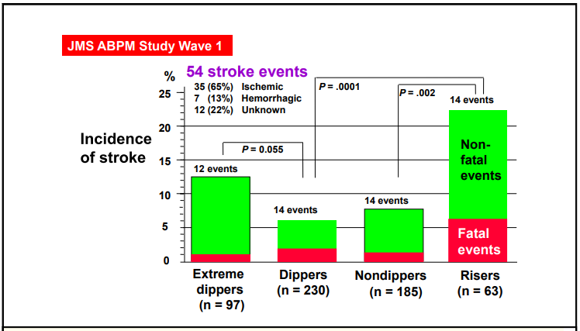
Nocturnal blood pressure dipping status and stroke prognosis in older sustained hypertensives
Kario et al Annals of Global Health, VOL. 82, NO. 2, 2016. March April 2016: 254 – 273

Slide 17
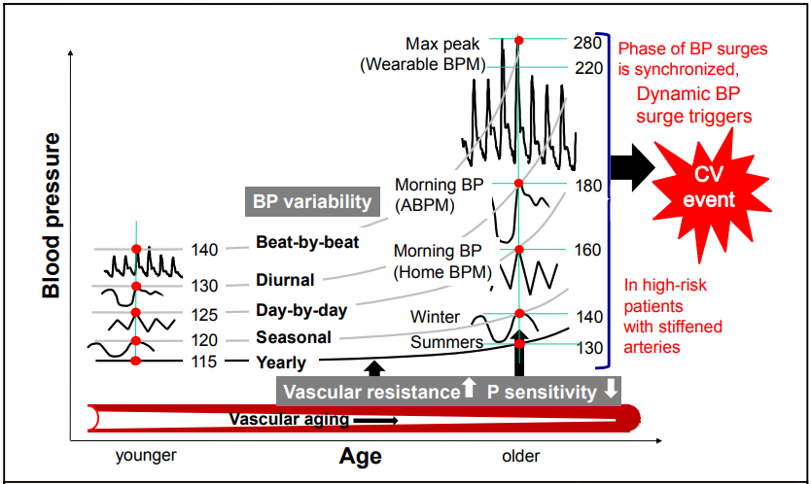
Synergistic resonance of BP variability
Kario et al Annals of Global Health, VOL. 82, NO. 2, 2016. March April 2016: 254 – 273

Slide 18

What should we do ??

Slide 19
Out of office B.P. measurement
Acknowledging that office BP measures are inherently problematic, for a variety of reasons, many BP guideline groups around the globe have recommended out-of-office BP measurements to confirm a diagnosis of hypertension
There are many out-of-office methods available. These include ambulatory BP monitoring (ABPM), self monitoring (or self measurement or home based) BP which is usually done by the patient at home, at work, or in any conducive environment.
Hypertension. 2020;76:1667-1673

Slide 20
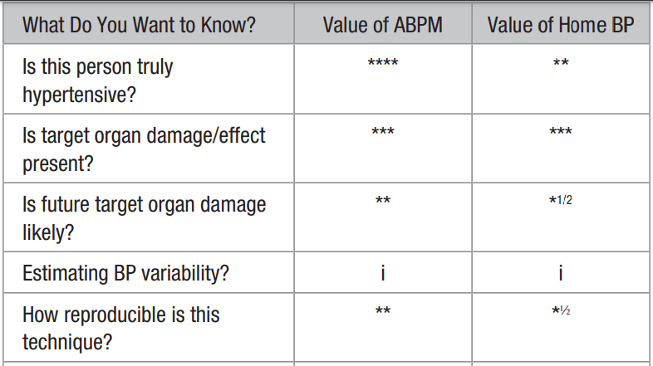
Out-of-Office Queries
Hypertension. 2020;76:1667-1673

Slide 21

Out-of-office BP measurements (by patients at home or with 24-hour ambulatory blood pressure monitoring [ABPM]) are more reproducible than office measurements, more closely associated with hypertension-induced organ damage and the risk of cardiovascular events and identify the white coat and masked hypertension phenomena
Out-of-office BP measurement is often necessary for the accurate diagnosis of hypertension and for treatment decisions.

Slide 22
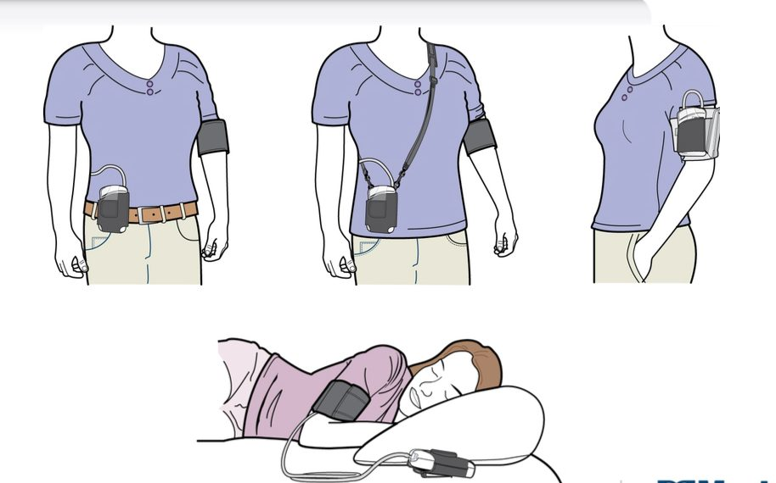
24 H AMBULATORY BP MONITORING (ABPM)

Slide 23
Background
Provides multiple BP readings away from the office, in the usual environment of each individual.
Provides BP readings during routine daytime activities and night-time sleep.
Identifies WCH and MH.
Provides an evaluation of the 24 h BP control with antihypertensive drug treatment.
Recommended in several guidelines as the best method for diagnosing hypertension.
Journal of Hypertension: July 2021 - Volume 39 - Issue 7 - p 1293-13

Slide 24
Advantages and limitations of ABPM
Not widely available in primary care settings.
Rather expensive and time-consuming for healthcare provider.
May cause discomfort particularly during sleep.
Reluctance of some patients to use, especially when repeated.
Imperfect reproducibility for diagnosis within 24 h (superior to OBP).
Asleep BP often not calculated using the individuals’ sleeping times.
Limitations
Advantages
Objective results over 24 h.
Detects WCH and MH.
Confirms uncontrolled and resistant hypertension.
Assesses BP during usual daily activities.
Detects nocturnal hypertension and non-dippers.
Detects excessive BP lowering by drug treatment.

Slide 25
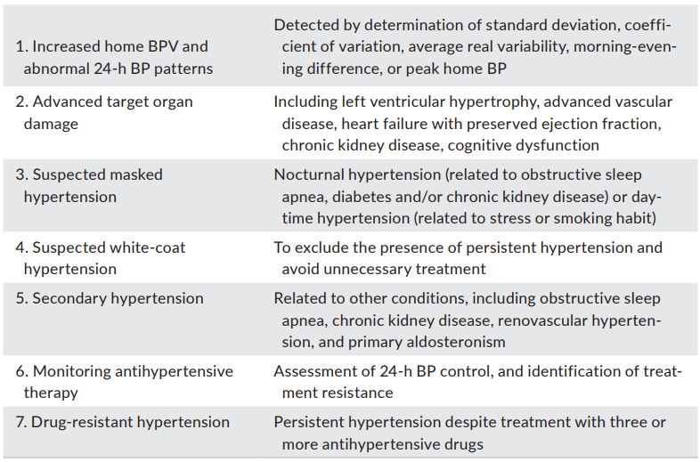
Clinical indications for ABPM
J Clin Hypertens. 2019;21:1250–1283

Slide 26
ABPM implementation
Fitting the monitor
Frequency of measurement 20–30 min during day and night.
Cuff size according to the individual’s arm circumference.
Fit cuff on bare non-dominant arm. Centre bladder over the brachial artery.
Take a test measurement.
Provide instructions to patient
Removing the monitor
Remove the monitor after 24 h.
Determine day and night-time periods only according to patient’s report.
Repeat ABPM if <20 valid awake or <7 asleep BP readings.
Interpretation of ABPM results
Basic requirements
Perform ABPM preferably on a routine working day.
10–15 min needed to initialize and fit the device.
Journal of Hypertension: July 2021 - Volume 39 - Issue 7 - p 1293-1302

Slide 27
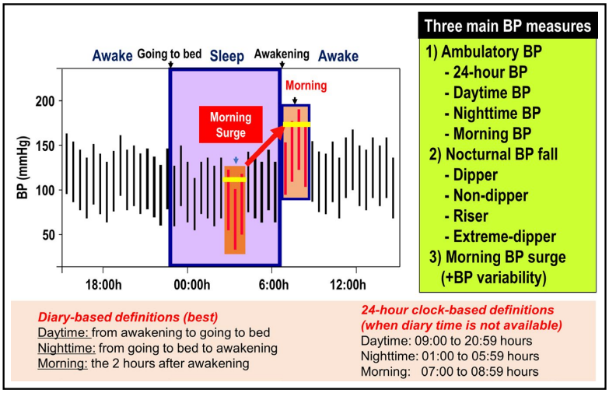
Blood pressure measures evaluated by ambulatory blood pressure monitoring
J Clin Hypertens. 2019;21:1250–1283.

Slide 28
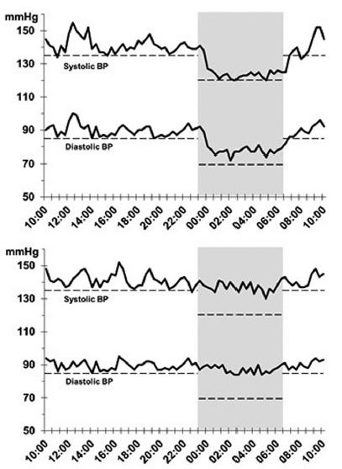
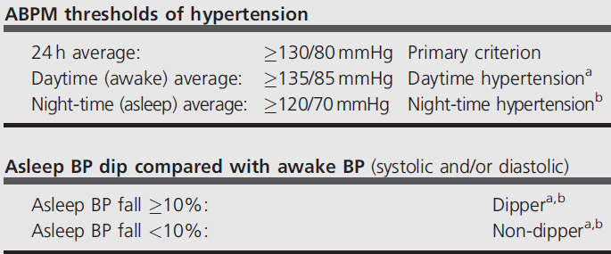
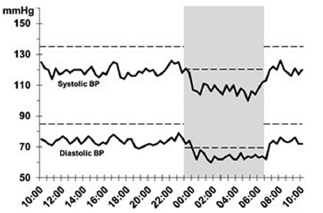
ABPM INTERPRETATION
Hypertensive dipper
Normal
Hypertensive non-dipper

Slide 29
When to repeat ABPM?
In severe HTN patients with organ damage, BP lowering is necessary and in the initial stages of treatment may require frequent ABPM as different drug combination are prescribed and dosages are often altered depending on the condition of patients.
In patients with mild HTN and no organ damage, ABPM repetition depends upon patient need or preference and physicians discretion
J Indian Coll Cardiol 2020;10:56-74.

Slide 30
ABPM : Indian Perspective
The prevalence of HTN (including high morning BP surge and nocturnal HTN) and HTN‑related CV diseases (CVDs) is higher in Asian populations than in Western populations
In addition to the growing burden of HTN, clinicians face several challenges in diagnosis and management of hypertensive patients in India:
Lack of understanding/awareness regarding the condition among patients and caregivers
Contemporary diagnostic techniques such as ABPM are not widely available or utilized
There is a paucity of studies evaluating the prevalence and impact of various abnormal ambulatory BP patterns
J Indian Coll Cardiol 2020;10:56-74.

Slide 31
Contd….
Although ABPM has become a standard procedure for hypertension management in developed countries, it is not yet the case for low- and middle-income countries (LMIC)
A recent survey among 260 physicians in India revealed that most physicians (72%) perform ABPM in >5% of their patients
However, as 24-h ABPM can address major issues, such as reliably diagnosing night-time hypertension, masked hypertension (MH) and white coat hypertension (WCH), its use may lead to improved diagnosis of hypertension and reduced healthcare costs for the long-term
J Indian Coll Cardiol 2020;10:56-74.

Slide 32

HOME B.P. MONITORING (HBPM)

Slide 33
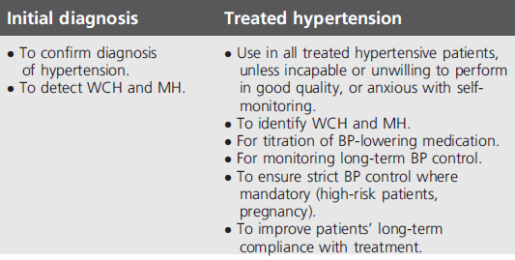
Background
Widely used in many countries.
Provides multiple BP readings away from the office, in the usual environment of each individual.
Identifies WCH and MH.
Recommended as the best method for long-term follow-up of treated hypertension
Clinical indications for HBPM

Slide 34
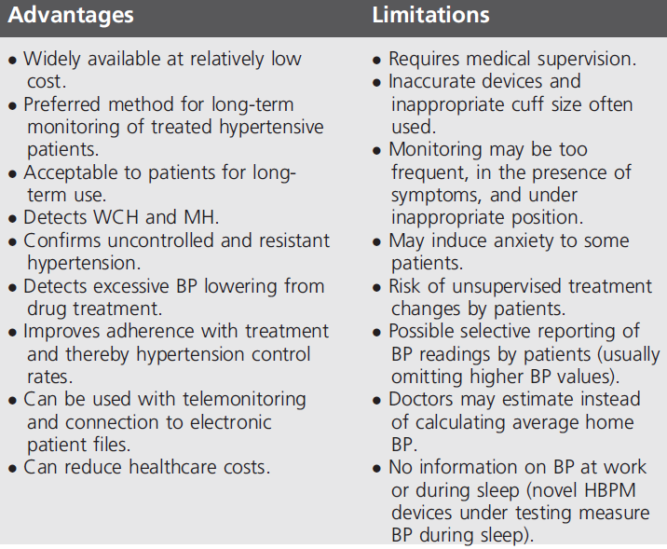
Advantages and limitations of HBPM
Journal of Hypertension: July 2021 - Volume 39 - Issue 7 - p 1293-1302

Slide 35
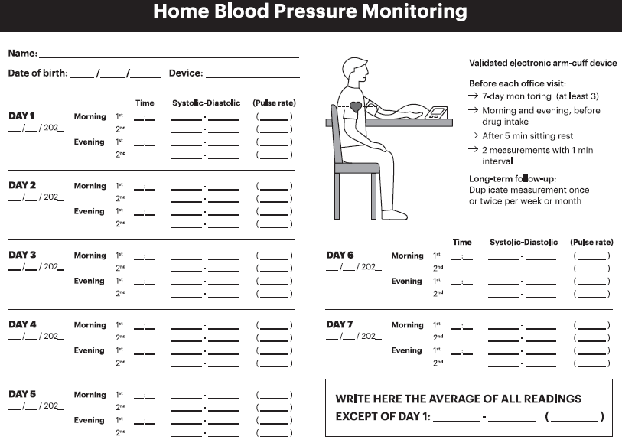
Form for reporting 7-day HBPM

Slide 36
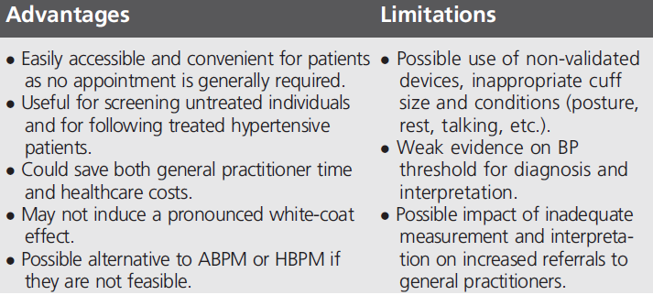
BP MEASUREMENT IN PHARMACIES
Background
Widely used in several countries.
Its validity and applicability for management have not been adequately investigated.
24 h ABPM may be performed in pharmacies.

Slide 37
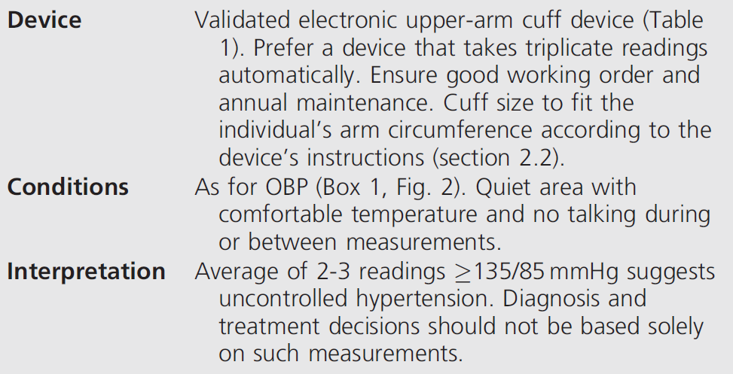
CLINICAL IMPLEMENTATION
Journal of Hypertension: July 2021 - Volume 39 - Issue 7 - p 1293-1302

Slide 38
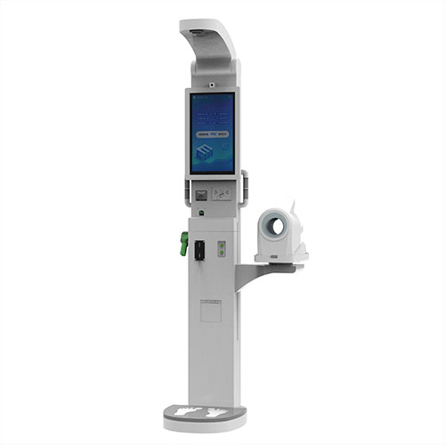
BP MEASUREMENT IN PUBLIC SPACES (KIOSKS)
Background
Kiosks are stations in public spaces where BP is measured with an automatic device triggered by the user.
Very little studied, but useful for screening in the general population.
Journal of Hypertension: July 2021 - Volume 39 - Issue 7 - p 1293-1302

Slide 39
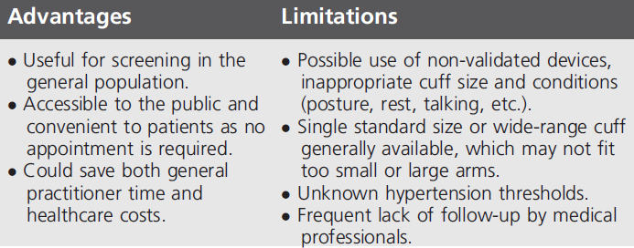
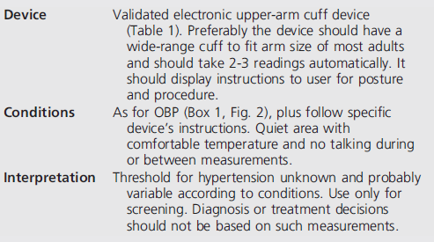
Advantages and limitations & CLINICAL IMPLEMENTATION

Slide 40
CUFFLESS WEARABLE BP MONITORS
Cuff less wearable devices have great potential as they can obtain multiple or even continuous BP measurements for days or weeks
The assessment of the accuracy of cuff less devices requires the use of a validation protocol, which is specific for these Devices
At present, the accuracy and usefulness of cuff less devices are uncertain. Therefore, they should not be used for diagnostic or treatment decisions
MOBILE TECHNOLOGIES – APPS
Recently, impressive expansion of mobile devices has led to the development of mobile health (mHealth) technologies, identified by the WHO
However, despite good results in clinical studies, BP tele monitoring based on services by professional providers is not regularly implemented in daily practice, mainly because of high installation
Journal of Hypertension: July 2021 - Volume 39 - Issue 7 - p 1293-1302

Slide 41
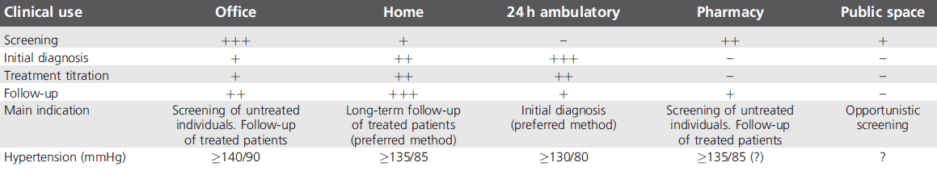
Clinical utility of office and out-of-office BP measurement methods
Journal of Hypertension: July 2021 - Volume 39 - Issue 7 - p 1293-1302

Slide 42
Thank you

