Slide 1
LVOT Obstruction
Dr Cinosh Mathew
MD,DM,FACC
Professor, Cardiology
SBKS MI & RC

Slide 2
Aortic valve stenosis
Morphologically diverse condition
Varies in severity
Asymptomatic to critically ill
Age at presentation – Neonatal life to 6-7th decades

Slide 3
Neonatal presentation
6-10 days old neonate
Presentation with shock
Near normal O2 sats in upper limbs
Cardiomegaly on X- ray chest
Feeble all limb pulses
S1S2N LVS3 ESM
Critical AS

Slide 4
AS in Neonates
Complex disorder
Varying degrees of LV Hypoplasia
Functional & structural abnormalities of mitral & aortic valves
Presence of EFE

Slide 5
Suitability of biventricular repair
Dimensions of LV inflow
LV size- Mass & volume
LV outflow- Aortic annulus
Rhode’s score

Slide 6
Aortic stenosis in children
CHF less common
Neonates – Immaturity of myocardium, cant handle the pressure overload
Neonates – More associated lesions

Slide 7
Balloon aortic valvotomy in neonates
Critical AS – Arterial duct dependent systemic circulation
Asymptomatic with PG of 60mm or more
Impaired valve mobility on echo
Impaired LV function with less gradients

Slide 8
Auscultation
Normal S1
Normally split S2
A2- not diminished in intensity unless the valve is immobile due to calcification
Paradoxical splitting in severe AS
Delay in the A2 component is roughly proportional to the severity of AS
Audible S4

Slide 9
Clinical presentation AS- children
Asymptomatic
Fatigue, exertional dyspnea- stenosis is moderately severe
Exertional syncope- Critical stenosis- inability of LV to increase cardiac output
Sudden death – Not uncommon

Slide 10
Aortic ejection click
Confirms the diagnosis of structural heart disease
Localizes the abnormality of aortic valve
Valve is pliable
LV function is preserved

Slide 11
Aortic Ejection Click
Constant sharp sounds
Heard best at the apex
S1- click interval does not decrease with increasing severity unlike PS
Can occur even with dilated ascending aorta

Slide 12
Ejection Systolic Murmur
Starts after 1st HS, preceded by a click
Ends before second heart sound
Murmur – transmitted to the neck
Peak of the murmur gets delayed with increasing severity

Slide 13
Indications for valvotomies in infants & children
PG > 60mm Hg irrespective of symptomatic status
Symptomatic heart failure with borderline gradients
Gradient of >50mm Hg with symptoms or ST- T changes on ECG

Slide 14
AS in adults
50% have congenital bicuspid valve
Pts with valve clicks – better prognosis
Progressive stenosis
Infective endocarditis
Calcification

Slide 15
AS in adults
50% have congenital bicuspid valve
Pts with valve clicks – better prognosis
Progressive stenosis
Infective endocarditis
Calcification

Slide 16
Arterial pulse
Pulsus Parvus et tardus
Small volume
Slow rising, reduced amplitude , sustained contour , more gradual drop off , palpable thrill
Rapid rate of rise & normal pulse contour without sustained peak excludes significant valvar AS

Slide 17
Pitfalls in evaluation
Normalization of arterial pulse High cardiac output Associated AR Low stroke volume with heart failure
Exaggerate the severity Associated mitral inflow abnormalities

Slide 18
Supravalvar Aortic Stenosis
Associated with Williams Syndrome
Autosomal Dominant
Obstructive arterial disease – systemic and often pulmonary circulation
Potential for involving conducting arteries
Pulmonary artery stenosis- improve spontaneosuly
Supra AS- static , may progress

Slide 20
Coronary Artery pattern

Slide 21
Characteristics of murmur in supravalvar AS
Selected jet streaming of blood into rt innominate vessels
Greater pulse amplitude – rt subclavian, brachial & carotid arteries
Systolic BP rt arm- higher than left arm

Slide 22
Supravalvar AS
Facial features of William’s syndrome
Absence of ejection click
Disparity in pulses- tendency of the jet stream to adhere to the vessel wall
Transmission of thrill & murmur to jugular notch & carotids
Continuous murmur- peripheral PS
Higher systolic BP in right arm

Slide 23
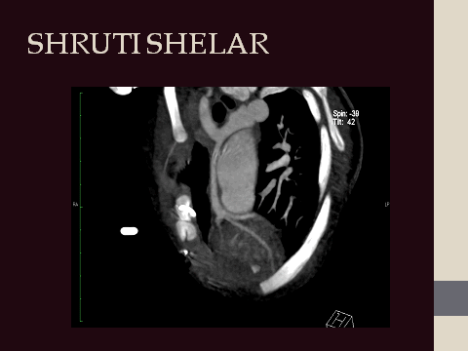

Slide 24
Subaortic stenosis
Absence of systolic ejection click
Diastolic murmur more common
Absence of valve calcification
Dilatation of ascending aorta – may be present

Slide 25
Fixed forms
Discrete
Fibrous/ membranous
Fibromuscular
Tunnel type
May evolve from from less diffuse to more diffuse & extensive form

Slide 26
Characteristics of the AV
Adequacy of lt heart structures is not a issue
Well formed left ventricle with LV hypertrophy
Usually bicuspid aortic valve with varying degrees of fusion
Calcification is uncommon
Dilated ascending aorta

Slide 27
Anatomical substrates for developing sub AS

Slide 28
Types of Sub AS

Slide 29
Clinical scenarios
Congenital & acquired features
Male predominance
Associated with VSD, bicuspid aortic valve
Recurrence common

Slide 30
Hypertrophic Cardiomyopathy
Complex inherited myocardial disorder
Inappropriate myocardial hypertrophy in the absence of structural heart disease, hypertension
Causes subaortic obstruction
Association with syndromes – Noonans

Slide 31
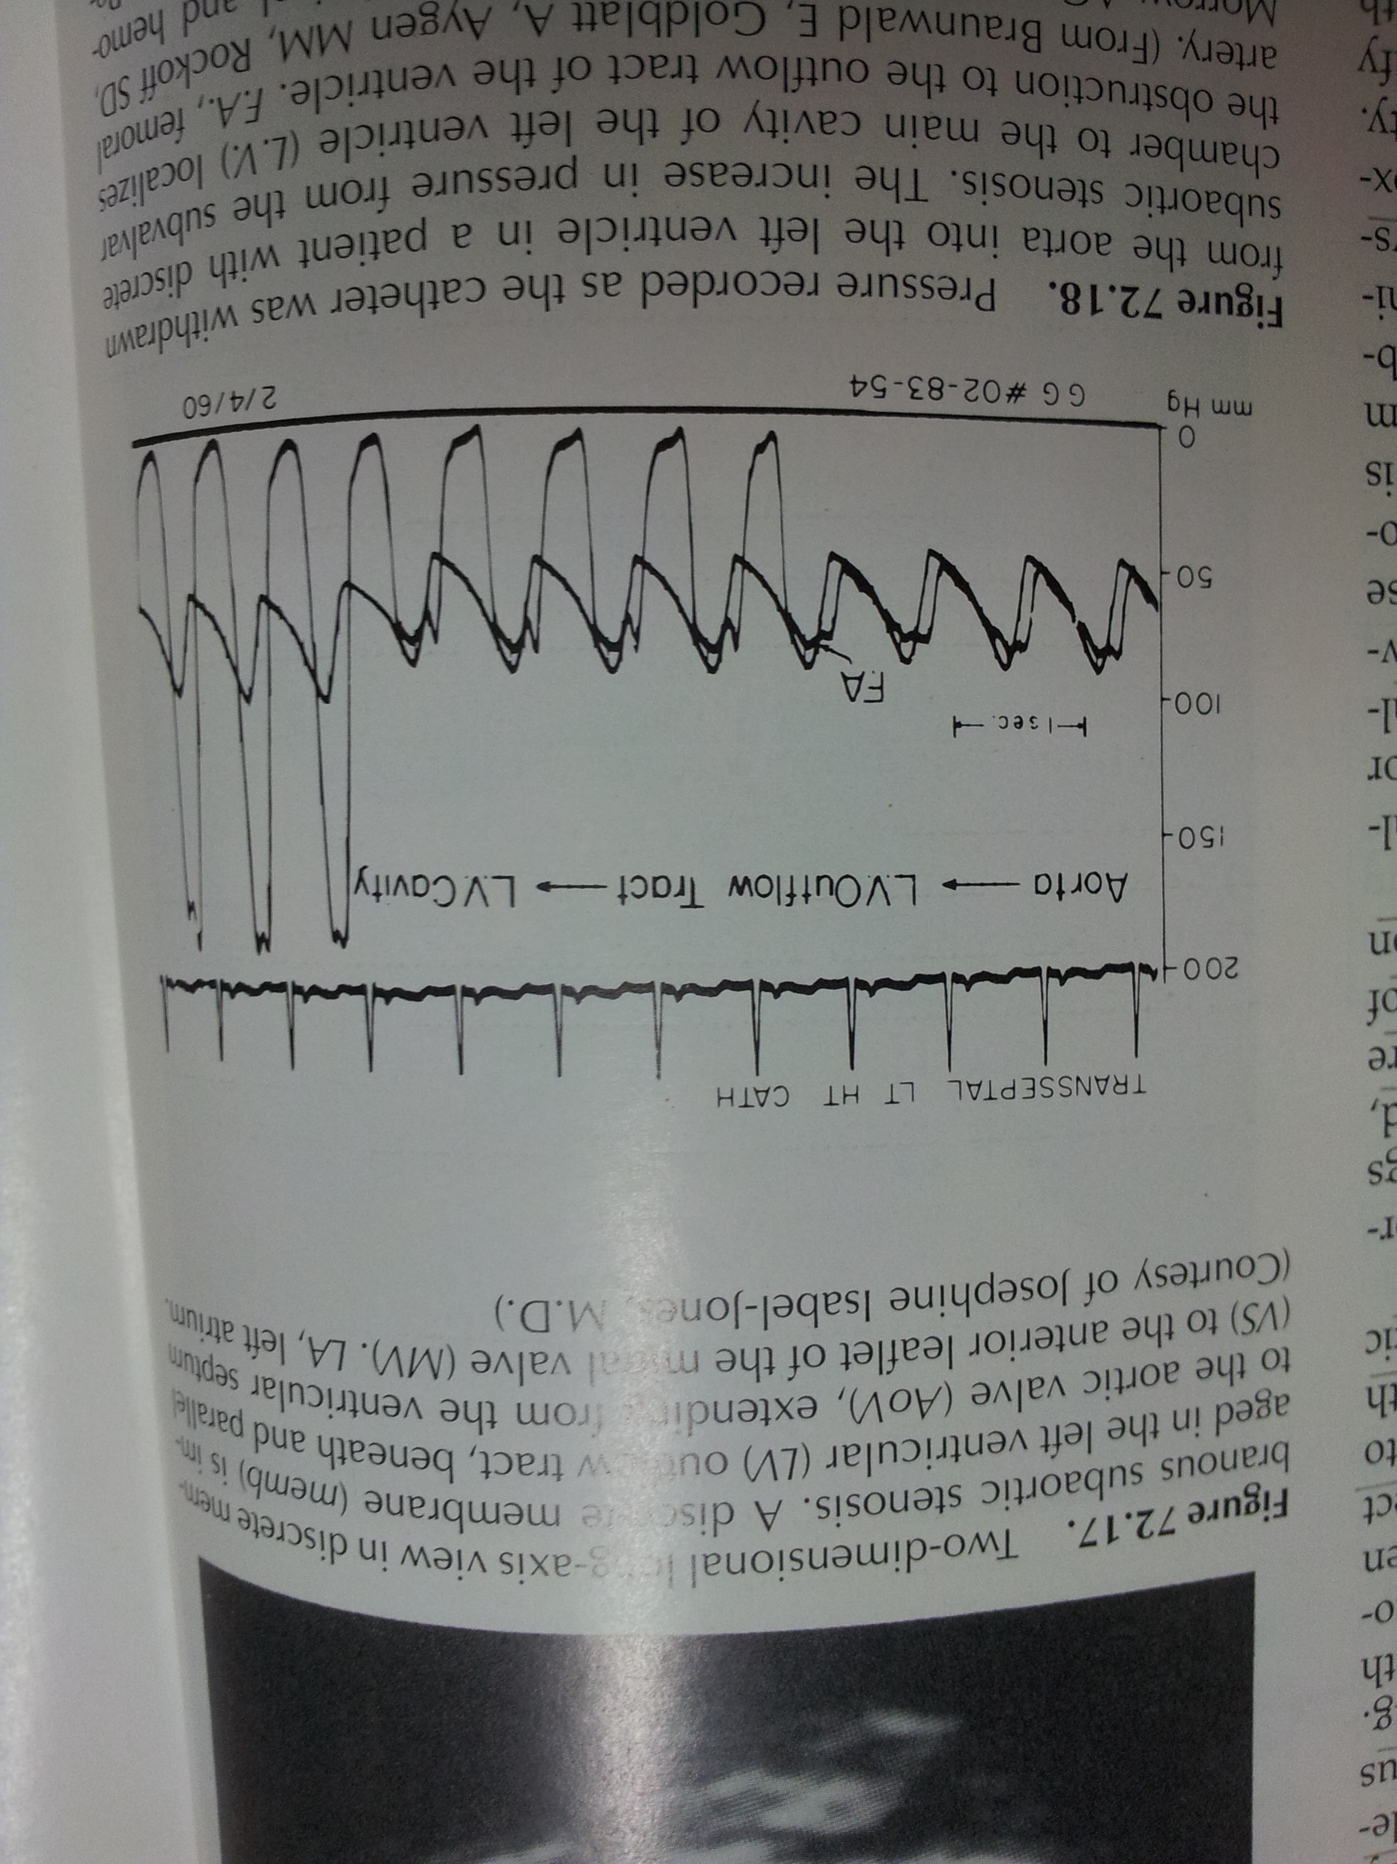

Slide 32
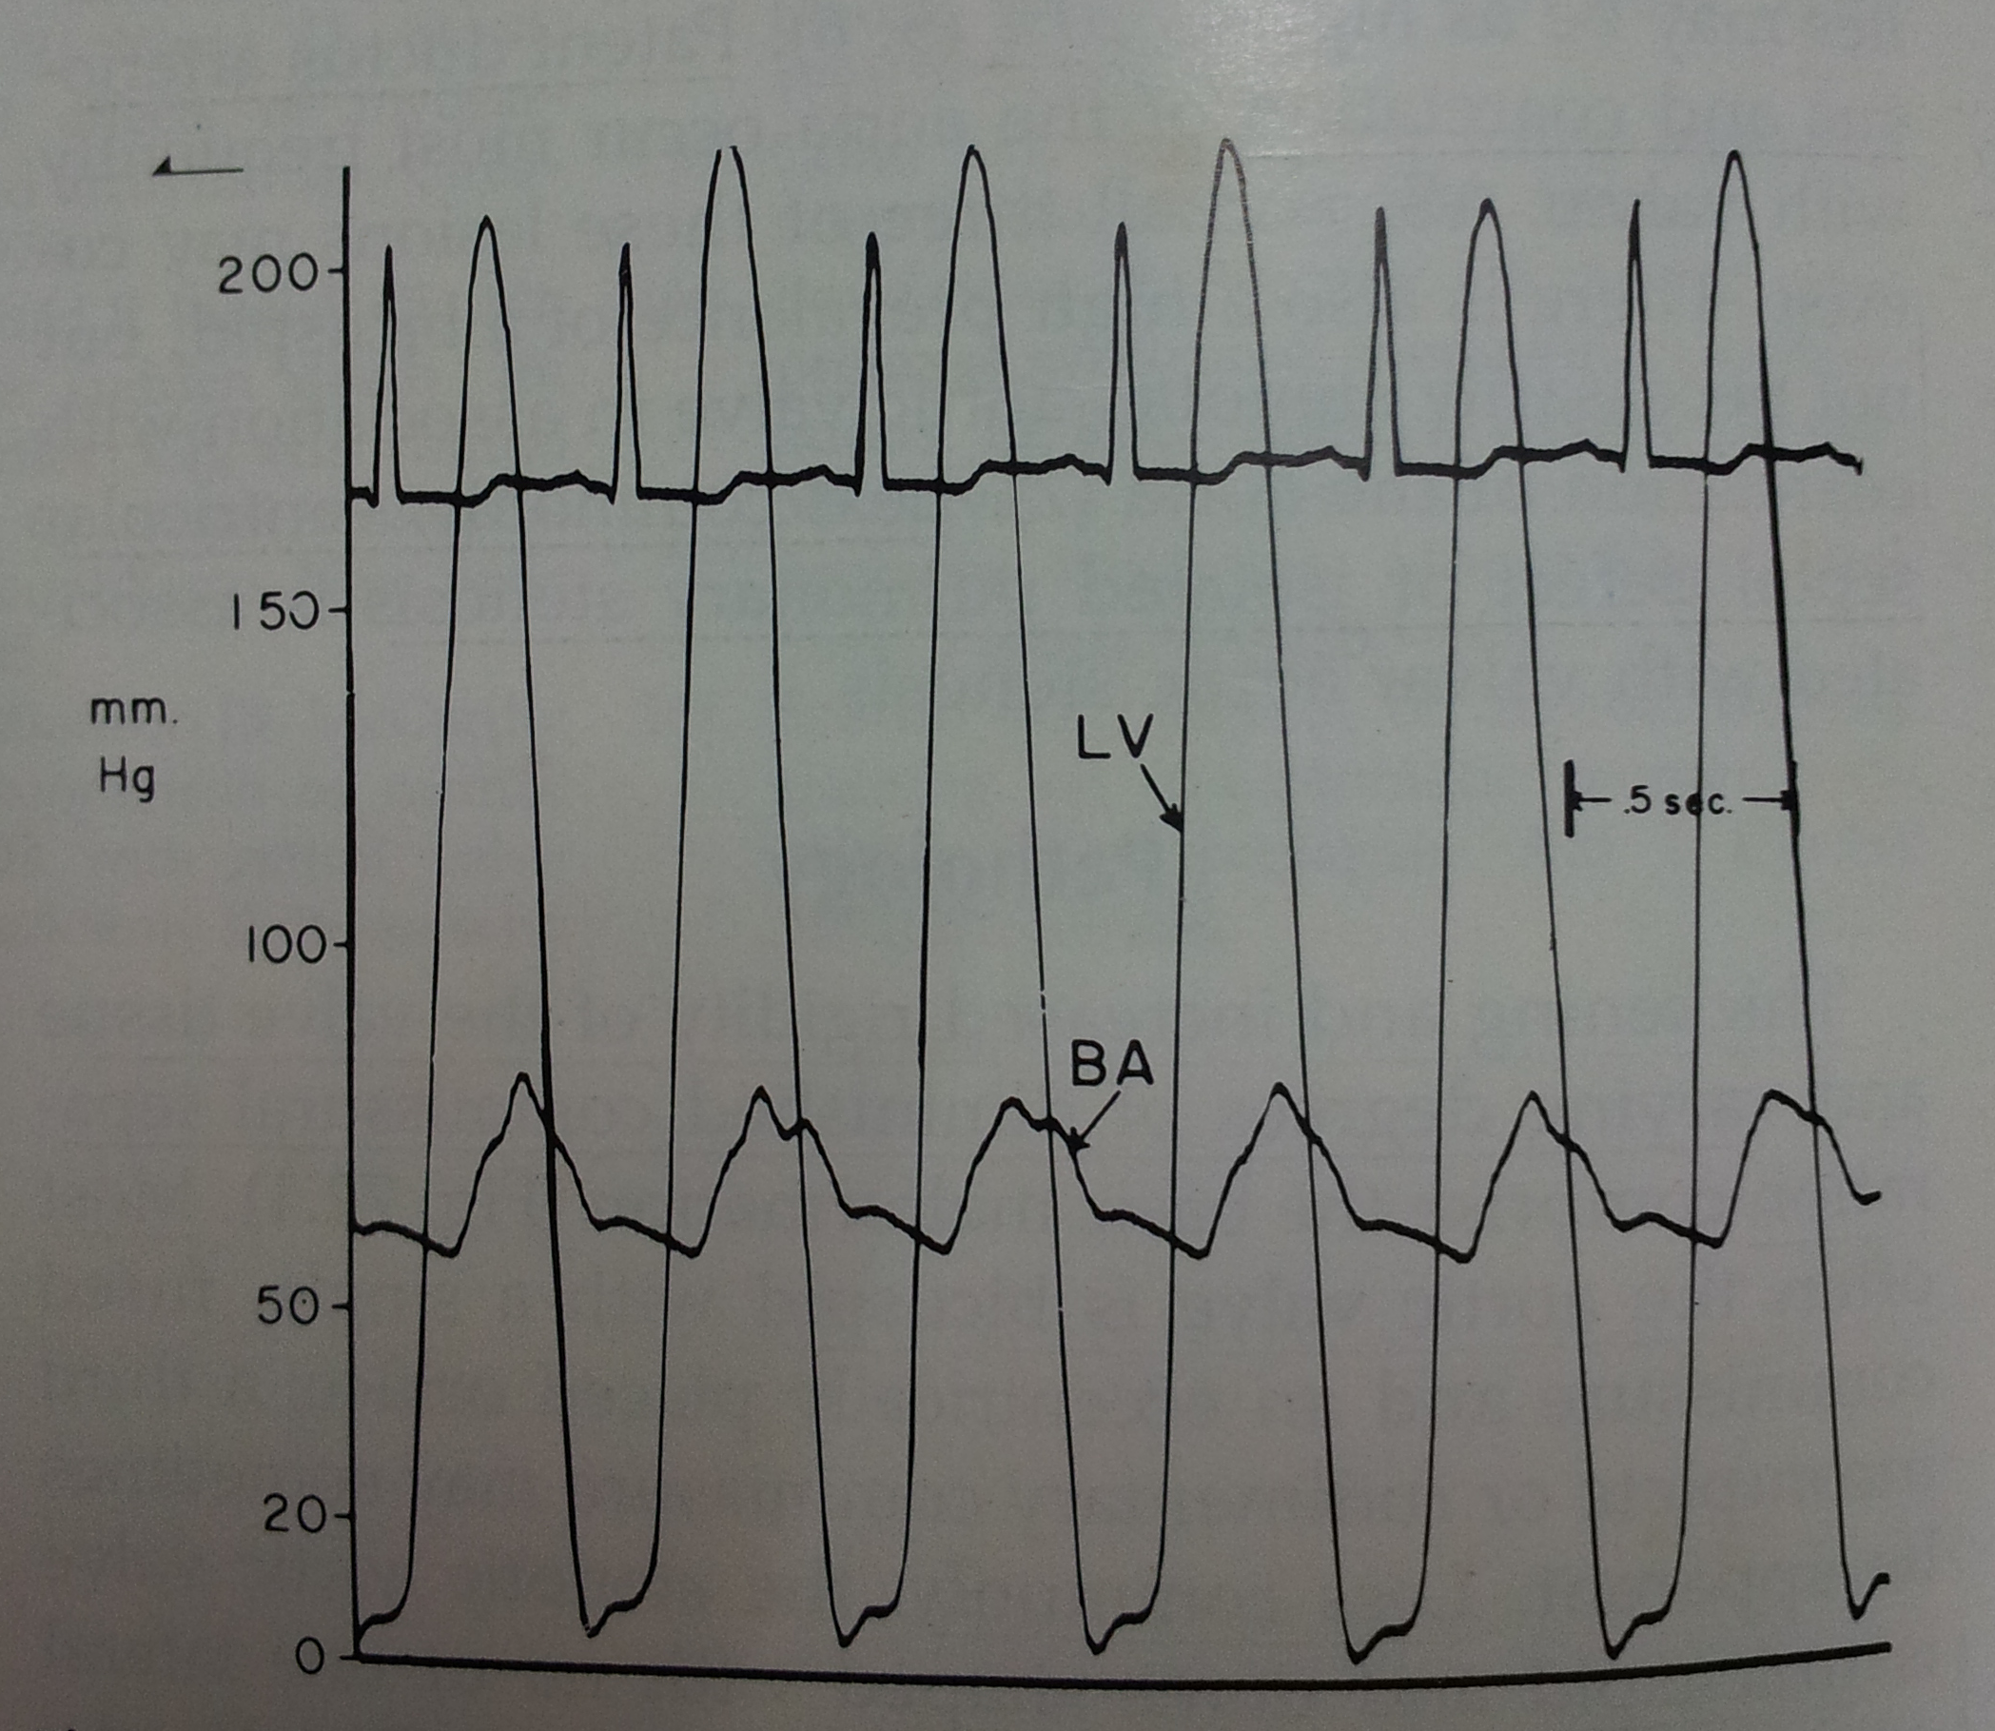

Slide 33
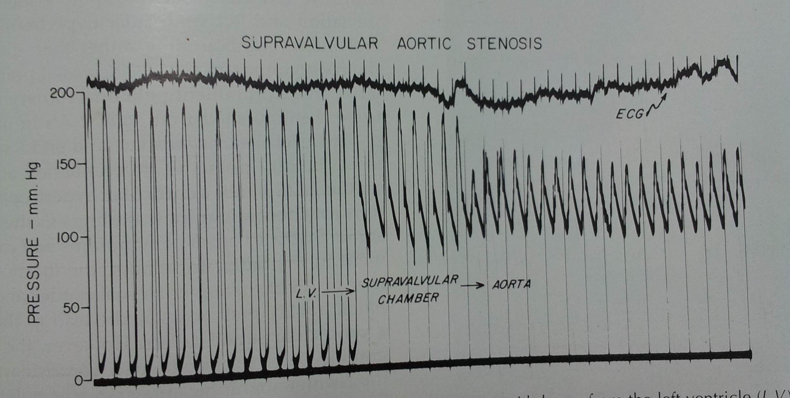

Slide 34
Coarctation of aorta
Complex anatomy, pathophysiology, clinical presentation
Associated intracardiac lesions
Murmur in the asymptomatic hypetensive child to neonate in shock

Slide 35
Patterns of presentation of coarctation
Infant with CHF
Child or adolescent with systemic hypertension
Child with heart murmur

Slide 36
Neonate in shock
Earlier neonatal presentation
Presentation with collapse
Normal upper limb O2 sats
Lower limb O2
Good upper limb pulses
Lower limb not paplpable
Critical corcatation.

Slide 37
Clinical findings
Discrepancy in arterial pulses
Abnormal subclavian common – alter findings
Upper limb hypertension
Ejection click with systolic murmur
ESM across the coarct segment
Continuous murmur of collaterals

Slide 38
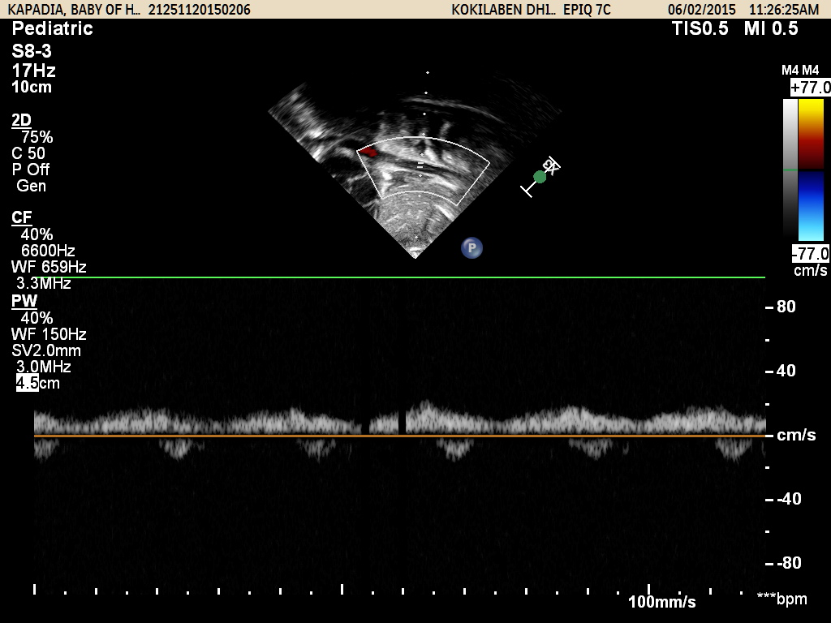

Slide 40
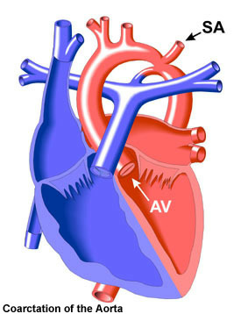
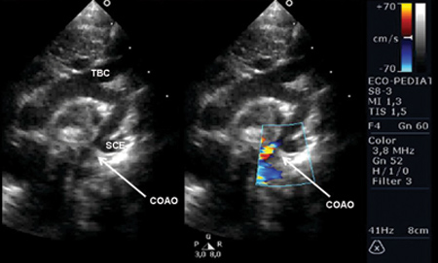
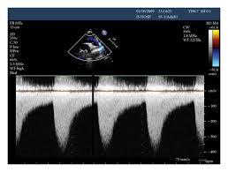
ECHO

Slide 41
Common associations
Turners Syndrome 45 XO
Common in females
Webbing of neck

Slide 42
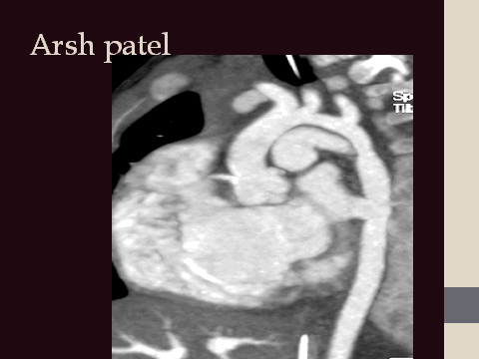

Slide 43
Associated abnormalities
Common in infants
Bicuspid aortic valve 80%
VSD
Mitral valve abnormalities
TGA
DORV

Slide 45
Interruption of aortic arch
Uncommon anomaly
Rarely occurs in isolation
Complete lack of anatomic continuity between transverse arch or isthmus and descending aorta
Commonly associated with Di George syndrome

Slide 46
Clinical prsentation
Extremely sick neonate
Present with collapse
Severe PAH
Differential O2 sats – due to PDA dependent systemic circulation

Slide 48
Mitral Valve Abnormalities
Part of Shone’s complex
Mitral inflow abnormalities associated with LV outflow or aortic arch abnormalities

Slide 49
Supramitral ring VS Cor triatratum

Slide 50
THANK YOU

