Slide 1
Dr Cinosh mathew MD DM
Professor of Cardiology
SBKS MI & RC
Right Ventricular Infarction

Slide 2
INTRODUCTION
Cohn et al.4 in 1974 gave the initial description of the clinical syndrome of right ventricular failure in patients of RVI.
Acute myocardial infarction (MI) involving only the right ventricle is a rare event.
Right ventricular involvement in the setting of an acute inferior wall MI is much more common.
Recognition of the syndrome of RVI is important as it identifies a significant clinical entity, which is associated with considerable immediate morbidity and mortality and has a well-delineated set of priorities for its management.

Slide 3
Its presence defines a high-risk subgroup of patients with acute inferior left ventricular infarction who should be considered high-priority candidates for reperfusion.
Ischemia or infarction of the right ventricle results in decreased right ventricular compliance, reduced filling, and decreased right ventricular stroke volume.
In turn, these changes lead to diminished left ventricular filling and drop in cardiac output that could result in systemic hypotension and shock.
Frequent accompaniments may include atrial infarction, sinus bradycardia, atrial fibrillation, and atrio ventricular block.
Acute occlusion of the right coronary artery, proximal to the right ventricular branches, results in right ventricular dysfunction.

Slide 4
Advantage to RV Myocardium During Ischemia
Variables | Right Ventricle | Left Ventricle
Systolic Pressure | Lower | Higher
Wall Stress | Low | Higher
Wall Thickness | Less | More
Sub endocardial Resistance to Perfusion | Less | More
Coronary Perfusion | Diastoloc and systolic | Diastolic only
Oygen Consumption | Less | More

Slide 5
Many right coronary artery occlusions do not result in significant right ventricular necrosis.
This may be due to lesser right ventricular myocardial oxygen demands(the right ventricle has much smaller muscle mass than the left ventricle); coronary perfusion of the right ventricle occurs both in systole and diastole; and dual coronary arterial circulation and the presence of more extensive collateral vessels from left to right.
Right ventricular hypertrophy may predispose a patient to RVI when coronary
artery disease is present.(COPD,PHT)

Slide 6
Incidence
The incidence of RVI is variable depending on the criteria used for detection. Autopsy studies suggest that right ventricular infarction accompanies fatal inferior left ventricular infarction in 24 to 34 percent of cases.
Noninvasive studies suggest that RVI occurs in more than 30 percent of patients with acute inferior-posterior left ventricular MI.

Slide 7
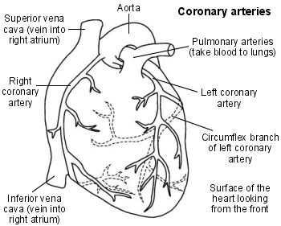

Slide 8
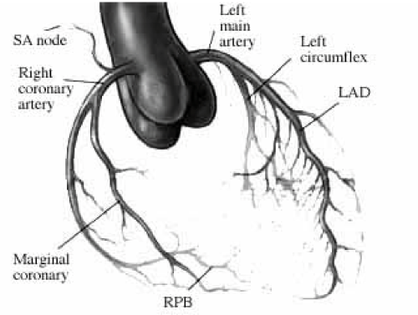

Slide 9
Major sections of RCA and corresponding regions of perfusion
Segment | Branch | Region | Findings
Proximal | SA nodal Artery Right Atrial Branch | SA Node | Sinus Bradycardia Atrial Infarction Atrial Fibrillation
Middle | Lateral RV branches Marginal RV branch | Lateral RV free wall Inferior & RV free wall | ST segment elevation in V3R-V6R STE in LII,LIII aVF
Distal | AV nodal Postero lateral branch PDA branch | AV node Posterior LV Inferior septum and Inferior Free wall | AV block ST segment elevation and q in LII,LIII and aVF

Slide 10
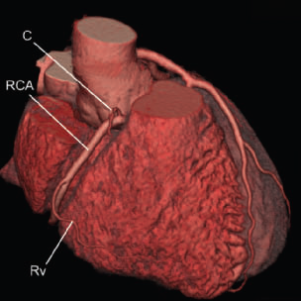
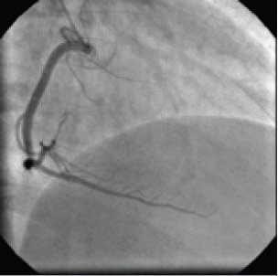
Proximal RCA anatomy
Cardiac CT imaging
Coronary angiography

Slide 11
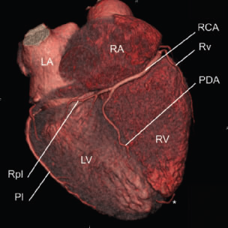
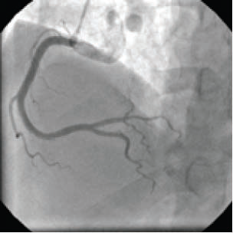
Distal RCA anatomy
Cardiac CT imaging
Coronary angiography

Slide 12
Pathophysiology
RV is a thin-walled chamber that functions at low O2 demands.
RV is a low-volume pressure pump, its contractility is highly dependent on diastolic pressure.
It is perfused throughout the cardiac cycle in both systole and diastole
Its ability to extract O2 is increased during hemodynamic stress
Thinness of RV wall allows some nutrition extraction from the blood within the LV cavity
All of these factors make the RV less susceptible to infarction than the LV

Slide 13
Pathophysiology contd…
Mostly arteriosclerotic occlusion of proximal RCA
Direct correlation between anatomic site of RCA occlusion and extent of RV Infarction.
More proximal occlusion causes a larger RVI
Proximal RCA occlusion causes:
→RV free wall injury→ compromises blood supply to SA node, atrium and AV node → sinus brady, atrial infarction, AF, AV block.

Slide 14
Pathophysiology contd…
With RV infarction, RV dysfuncion sets in & right ventricular output can decrease dramatically
The only driving force remaining is elevated right atrial pressure.
In such a circumstance, the right ventricle serves as a poorly functioning conduit between the right atrium and the pulmonary artery.
Elevation of right atrial pressure serves as a stimulus for secretion of atrial natriuretic factor (ANF).

Slide 15
Pathophysiology contd…
Increased levels of this polypeptide can be detrimental to normal left ventricular filling pressures.
This occurs by virtue of the potent vasodilating, natriuretic, diuretic, and aldosterone-inhibiting properties of ANF.
Inappropriately elevated levels of ANF may worsen the clinical syndrome of right ventricular infarction.

Slide 16
Pathophysiology contd…
Interestingly, right ventricular infarction noted at necropsy usually involves the posterior septum and posterior wall rather than the right free wall
The relative sparing of the right ventricular anterior wall apparently arises from a high degree of collateralization.
This collateral blood flow is thought to be derived from the thebesian veins and diffusion of oxygen directly from the ventricular cavity

Slide 17
CLINICAL PRESENTATION
Right ventricular infarction should be suspected in any patient with acute inferior wall MI. Even in patients who do not present with hypotension, the potential of RVI should be recognized to avoid therapy that will further lower right heart preload.
Ischemia or infarction of the right ventricle results in decreased right ventricular compliance, reduced filling, and decreased right ventricular stroke volume. These changes lead to diminished left ventricular filling and drop in cardiac output.
In addition, acute right ventricular dilatation causes a leftward shift of interventricular septum, increasing left ventricular end-diastolic pressure with a decrease of left ventricular compliance and cardiac output.

Slide 18
These changes in left ventricular compliance are further aggravated by increased intra pericardial pressure as a result of right ventricular dilatation.
The symptoms of RVI may be more pronounced in the presence of combined right atrial infarction with associated rate and rhythm disturbances.
Whent he culprit coronary artery lesion is distal to the right atrial branches, augmented right atrial contractility enhances right ventricular performance and offsets some of the hemodynamic consequences of RVI.

Slide 19
The triad of hypotension, elevated jugular venous pressure(JVP), and clear lung fields has been recognized as marker of RVI in acute inferior-posterior wall MI.
Pulsus paradoxus(decrease in size, or even momentary disappearance of the pulse during inspiration) and Kussmaul’s sign (an inspiratory increase in JVP) .
The presence of elevated JVP and Kussmaul’s sign in the setting of an acute inferior wall infarction indicate a hemodynamically significant RVI (sensitivity = 88% and specificity= 100%), particularly when it is associated with significant damage to the left ventricle and/or inter ventricular septum.
Elevated JVP alone was found to be more sensitive (88%) but less specific (69%) in the same study in detecting a hemodynamically significant RVI.

Slide 20
Patients with intact right atrial perfusion manifest augmented atrial contraction resulting in enhanced A wave and X descent, but diminished Y descent in the jugular venous pulsations.
In contrast, patients with depressed right atrial function have higher right atrial and systemic venous pressures, but depressed A wave, X descent, and Y descent.
Finding of diminished A wave in patients with hemodynamically important RVI, signifying right atrial infarction, has been proven to be a bad prognostic indicator even in the presence of preserved left ventricular function.

Slide 21
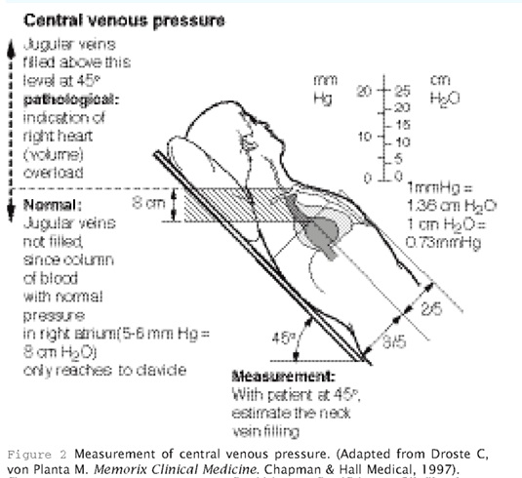

Slide 22
Auscultation may reveal a right-sided S3 and S4.
Tricuspid regurgitation may be identified because of dilatation of right ventricular chamber, which may be severe when related to papillary muscle dysfunction.
Right ventricular infarction occasionally may be accompanied by ventricular septal defect.
It is important to recognize that findings of RVI may be masked by global left ventricular systolic dysfunction with hypotension and pulmonary congestion.
Finally, high grade atrioventricular blocks may occur and result in loss of atrial ventricular synchrony with exacerbation of hypotension and shock.

Slide 23
Noninvasive Diagnosis of Right Ventricular Infarction
Various non invasive methods have been used for diagnosis of right ventricular infarction, including chest x-ray, electrocardiogram,two-dimensional echocardiogram, radionuclide ventriculogram,and technetium-99m pyrophosphate myocardial scintigram.
Chest Roentgenogram
The suggested radiographic findings of right atrial and ventricular enlargement have a very low sensitivity and specificity for right ventricular infarction.
Electrocardiogram
The right ventricular involvement can be diagnosed with a predictive accuracy well above
80% by the presence of ST-segment elevation of ≥1 mm in the right-sided precordial lead, V4R, in the presence of an acute inferior or inferioposterior MI.
The ST-segment elevation in V4R is a strong independent predictor of major complications
and in-hospital mortality.Zehender et al.,48

Slide 24
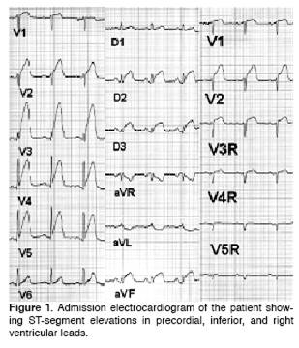
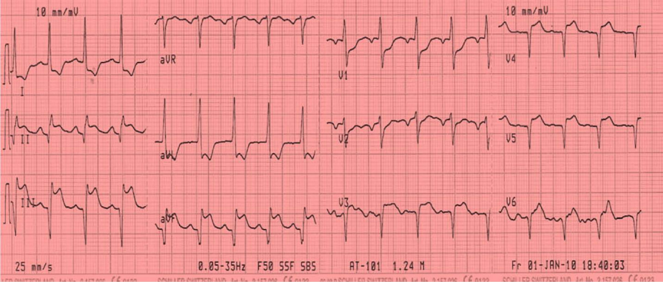

Slide 25
Leads | Sensitivity (%) | Specificity (%)
V1 | 28 | 92
V3R | 69 | 97
V4R | 93 | 95

Slide 26
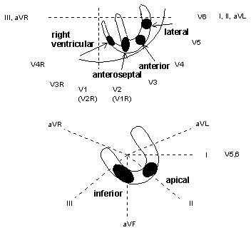
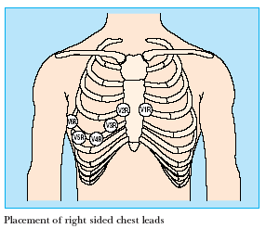

Slide 27
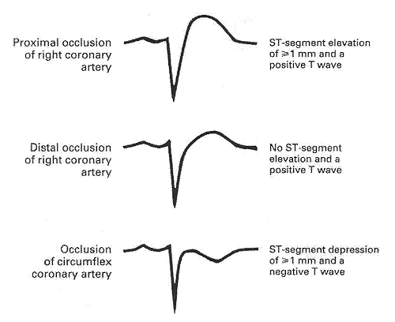
Lead V4R

Slide 28
ST-segment elevation in right precordial leads is transient and may be absent in one half of patients with RVI after 12 h of onset of chest pain.
Furthermore, conditions other than RVI may produce ST-segment elevation in lead V4R, including acute pulmonary embolism, left ventricular hypertrophy, acute anteriorseptal myocardial infarction, pericarditis, and previous anterior myocardial infarction with aneurysm formation.
There are reports of RVI presenting as ST-segment elevation in leads V1–V5 mimicking anterior wall MI.
It is of note that the distribution of ST-segment elevation in the anterior leads is greater in leads V1–V2 and decreased toward V5–V6 in RVI compared with anterior wall MI.

Slide 29
As explained in a recent article by Hurst, in the case of RVI the ST-segment vector is directed anteriorly and is more than + 90° to the right (producing a downward displacement of the ST-segment in lead I),
while in the case of anteroseptal left ventricular infarction the vector is also anterior, but is usually located from 30° to 90° to the left in the frontal plane (producing an elevation of the ST segment in lead I).
Right bundle-branch block and complete atrioventricular block are the most frequent conduction abnormalities associated with RVI.
Disturbances of rhythm such as atrial fibrillation and sinus bradycardia may be present.

Slide 30
Echocardiogram
Abnormal findings include right ventricular dilatation, right ventricular wall akinesis or dyskinesis, reversed septal curvature caused by the reversal of the transseptal pressure due to increased right ventricular end-diastolic pressure, and the presence of severe right atrial enlargement.
The presence of interatrial septal bowing indicating a concomitant right atrial infarction is an important prognostic marker and is predictive of more hypotension,atrioventricular blocks, and higher mortality in RVI.

Slide 31
This reduced specificity may be due to a superior sensitivity of echocardiography in detecting right ventricular ischemia or infarction may or may not be associated with hemodynamic derangement.
The addition of Doppler echocardiography has increased the diagnostic utility of this technique by detecting complications of RVI such as tricuspid regurgitation, ventricular septaldefect, and shunt flow across a patent foramen ovale.
Doppler echocardiography can also detect premature opening of thepulmonic valve, indicating a noncompliant right ventricle.

Slide 32
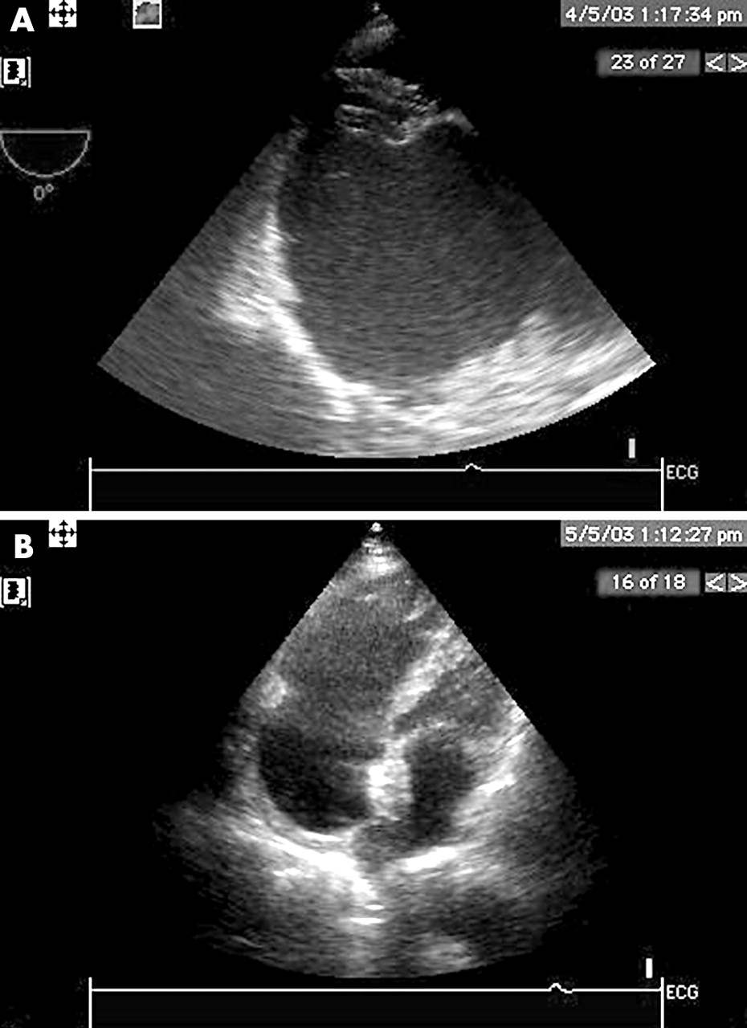

Slide 33
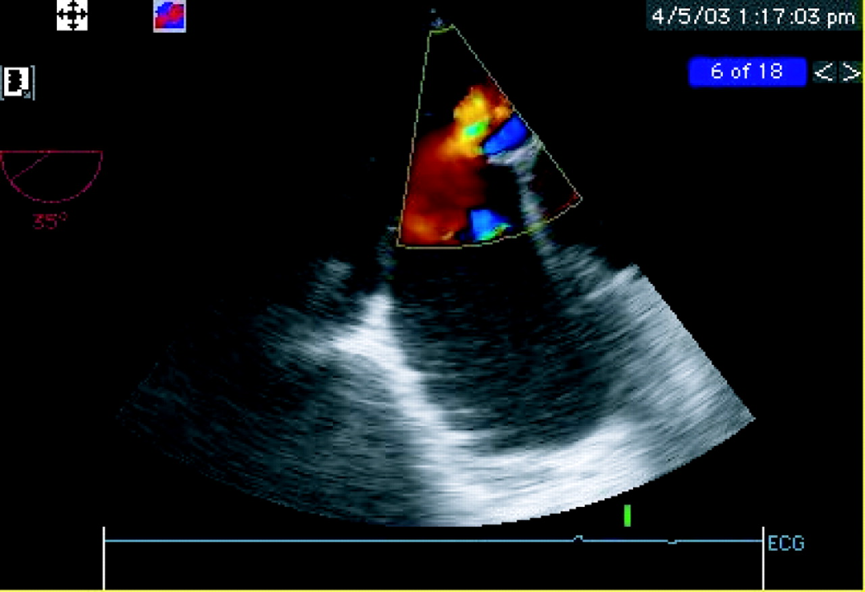

Slide 34
RADIONUCLIDE ANGIOGRAM
Radionuclide angiography is a useful technique for determination of right ventricular ejection fraction.
Right ventricular dilatation or right ventricular ejection fraction of < 45% has been demonstrated in 40 to 50% of patients with inferior wall MI using both first pass and gated equilibrium technique.
When low ejection fraction is combined with right ventricular wall motion abnormalities, together they had a sensitivity of 92% and a specificity of 82% in detecting hemodynamically important RVI.

Slide 35
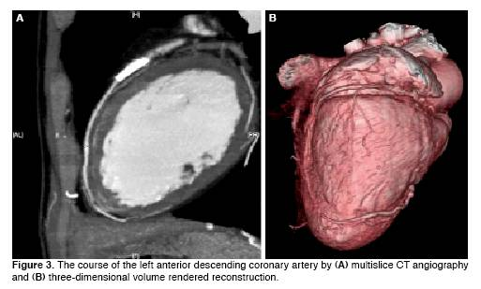

Slide 36
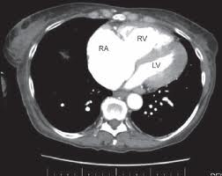

Slide 37
TECHNETIUM-99M PYROPHOSPHATE SCINTIGRAM
In various studies using this technique, the incidence of RVIassociated with acute inferior wall MI is variable, ranging from 20 to 40%.
Although highly specific, technetium-99mpyrophosphate scintigraphy is not very sensitive, especially for detecting hemodynamically important RVI.
The sensitivityof this method to detect this clinically important presentation
of RVI approaches 25%.
Also, application of this techniqueis limited in the acute setting because scans should be obtained 24 to 36 h after the onset of the infarct.

Slide 38
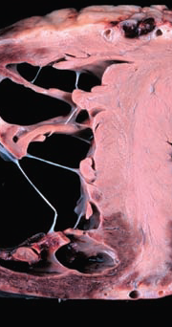
Acute RV infarct with RV dilatation
Mayo Clinic Cardiology, Concise Textbook. Third edition

Slide 39
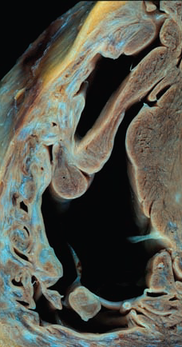
Healed RV infarct with RV wall fibrosis
Mayo Clinic Cardiology, Concise Textbook. Third edition

Slide 40
HEMODYNAMIC MEASUREMENTS
The diagnosis of RVI can be confirmed by hemodynamic data when the right atrial pressure exceeds 10 mmHg and the ratio of right atrial pressure to pulmonary capillary wedge pressure exceeds 0.8 (normal value < 0.6).
Lopez-Sendon et al. reported that right atrial pressure > 10 mmHg and within 1–5 mmHg of pulmonary artery wedge pressure had a sensitivity of 73% and a specificity of 100% in identifying hemodynamically important RVI.
A prominent X descent and blunted Y descent in the right atrial waveform was considered a hallmark of RVI in earlier studies.
But, in co existing right Atrial Infarction ,there will be blunted a wave , x descent and y descent
RV pressure tracings will show a dip and plateau pattern

Slide 41
Complications
Electrical
Mechanical
Severe Sinus Bradycardia
Sinus arrest
Atrial fibrillation
High degree AV block(CHB is more common than with isolated IWMI)
VT
VF
Asystole
Ventricular Septal Rupture with right to left shunt
Patent Foramen Ovale with Right to Left shunt
Severe Tricuspid Regurgitation

Slide 42
Management .... 5R’S
Reloading
Restoraton of Hemodynamics
Reperfusion
Restoration of Rhythm
Rate(Chronotropic agents/Pacing)

Slide 43
TREATMENT
In 1974, Guiha et al.,working on a canine model of RVI,demonstrated an increase in right heart filling pressures and a decrease in cardiac output in experimentally induced right ventricular damage, and that progressive volume loading produced an increment in right heart filling pressures, as well as an increase in systolic arterial pressure and cardiac output.
This study provided the rationale behind volume loading in the treatment of RVI.
In the absence of any other pathogenic mechanisms, volume loading, by restoring left ventricular filling pressures, should improve the cardiac output.
However clinical studies failed to show uniform benefits with volume loading, indicating that other mechanisms might be responsible for the hemodynamic alterations in RVI.

Slide 44
In 1983, Goldstein et al.27 demonstrated that in anima studies ,RV infarction caused a fall in cardiac output which could be improved by volume loading and further augmented by pericardiotomy, highlighting the role of an intact pericardium in hemodynamic changes of RVI.
In addition, acute right ventricular dilatation causes a leftward shift of interventricular septum, increasing left ventricular end-diastolic pressure with a decrease of left side output

Slide 45
Brookes et al. showed that the alteration of septal curvature as a result of acute right ventricular dilatation in RVI changes the left ventricular geometry and that this has a direct impact on left ventricular contractile function, which is independent of the effects of left ventricular inferior wall ischemia or left ventricular compliance.
Therefore, volume loading in the context of right ventricular dilatation may not improve cardiac function.

Slide 46
Volume loading may further dilate the right ventricle, causing a further decrease in left ventricular compliance and systolic function.
The discrepancy in responding to fluid therapy may reflect a spectrum of initial volume status in patients with acute RVI with hypovolemic right heart infarcts who are definitely benefiting from fluid therapy.
As a result, the therapeutic options for RVI differ from those in a patient with isolated or predominant left ventricular infarction .

Slide 47
OPTIMIZATION OF VENTRICULAR PRELOAD
The initial therapy of a patient with RVI, who has hypotension and no pulmonary congestion, should start with volume expansion, often by infusion of isotonic saline to increase the filling of the right ventricle which in turn will increase the filling of the underfilled left ventricle and increase cardiac output.
For patients who are unresponsive to initial trial of fluids, hemodynamic monitoring may be necessary, and subsequent volume challenge may be appropriate if the estimated central venous pressure is < 15 mmHg.

Slide 48
Treatment of RVI includes early maintenance of right ventricular preload with intravenous fluid administration and avoidance of diuretics, nitrates, and ACE inhibitor.
When RVI is accompanied by severe left ventricular dysfunction and pulmonary congestion, the right ventricle is further compromised by increased afterload.
In this circumstance, the use of afterload-reducing agents such as sodium-nitroprusside or an intra-aortic counterpulsation device is often necessary to unload the left and subsequently the right ventricle.

Slide 49
IONOTROPIC STIMULATION
Parenteral ionotropic stimulation has been shown to improve both right and left ventricular function in the setting ofan acute RVI.
Dell’Italia et al.studied the effect of dobutamine in nine patients with RVI after volume loading with normal saline and found that dobutamine produced an increase in cardiac index and right ventricular stroke volume.
It was thought that ionotropic stimulation enhances right ventricular performance by increasing ventricular septal contraction.This acts in a piston like fashion and contributes to right ventricular systolic pressure generation and an increase in cardiac output.

Slide 50
Recent experiments by Brookes et al. showed that dobutamine also acts by enhancing left ventricular systolic pressure, exaggerates septal movement toward the right ventricle in systole, reducing right ventricular cavity dilatation,thus maintaining left ventricular cavity geometry and enhancing its contractile performance.
Dobutamine also can diminish pulmonary vascular resistance and therefore reduce right ventricular afterload.
Thus, ionotropic support with dobutamine should be initiated if the cardiac output fails to improve after 1–2 litres of fluid administration.
Although dobutamine is the preferred initial drug of choice, patients with severe hypotension may require agents with pressor effects such as dopamine for restoration of adequate coronary pressure.

Slide 51
OPTIMIZATION OF RHYTHM
Even in the absence of right ventricular infarction, patients with inferior wall MI are prone to develop bradycardia, thought to be mediated by Bezold-Jarisch reflex.
Brady arrhythmias may precipitate severe hemodynamic compromise in patients with RVI.
Bradyarrhythmias resulting in atrioventricular dyssynchrony and loss of right atrial contribution may also lead to severe hemodynamic compromise.
The development of high-degree atrioventricular block has been reported to occur in as many as 48% of patients with RVI.

Slide 52
Although atropine may restore physiologic rhythm in some patients, atrioventricular sequential pacing may be necessary for increasing the cardiac output and reversing the
shock associated with atrioventricular dyssynchrony in RVI.
There are reports that aminophylline may restore sinus rhythm in patients with acute atrioventricular block, suggesting the role of ischemia-induced adenosine.
This pharmacologic maneuver may restore atrioventricular synchrony and thereby
obviate the need for transvenous pacing.
In patients with atrialfibrillation, prompt cardioversion and restoration of atrioventricular synchrony should be considered at the earliest sign of hemodynamic compromise.

Slide 53
REPERFUSION
The salutary effects of reperfusion in patients with inferiorwall MI have been less impressive than in patients with anteriorwall MI.Whether the presence of RVI in patients with inferiorwall MI is an indication for reperfusion is less clear.
Some studies suggest that right ventricular function recovers only after successful reperfusion,whereas others report improvement even in the absence of a patent infarct-related vessel.
Zehender et al.,studied 107 patients with RVI, identified by the presence of ST-segment elevation in the right precordial lead V4R. They found that both mortality and major in-hospital complications were lower in patients who received thrombolytics than in those who did not.

Slide 54
In the second phase of the Thrombolysis in Myocardial Infarction trial,there was a reduction in the incidence of RVI(identified by wall motion abnormality on a predischarge radionuclideangiogram) among patients with inferior MIs who had patent infarct-related arteries, compared with those whose arteries remained occluded (14 vs. 48%).
This finding suggeststhat successful thrombolysis may prevent RVI.In another related study, Bowers et al. studied the role of primary angioplasty in 53 patients with RVI (identified byechocardiographic evidence of a combination of right ventricular dilatation, depressed right ventricular global function, andwall motion abnormalities).
They found that patients with right ventricular dysfunction who had incomplete reperfusion had higher mortality (58%) and a higher rate of untoward inhospitalevents (83%).

Slide 55
In a recent study, Zeymer et al. studied the prognostic impacto f RVI in streptokinase-treated patients with acute inferiorwall MI. They found that patients with inferior wall MI and“small ST” (sum of ST-segment elevations of ≤0.8 mm on standard 12-lead ECG) had a very low cardiac mortality regardless of whether RVI (identified by the presence of ST-segment elevation in right precordial lead V4R) was present or not.
The authors concluded that reperfusion therapy in patients with acute inferior wall MI and “small ST,” indicating a small infarction, is not indicated irrespective of the presence of RVI,unless advanced heart block or hemodynamic instability indicates a large infarct.

Slide 56
O’Rourke, in a recent editorial, states that since different methods are used to diagnose RVI and failure to randomize patients with RVI to thrombolytic or primary angioplasty versus nonreperfusion therapy, it would be difficult to determine which patients with inferior wall MI and RVI are likely to do better with reperfusion therapy.
O’Rourke recommends that patients with evidence of RVI by ECG criteria or by other noninvasive methods, who have clinical evidence of depressed right ventricular function, are candidates for coronary angioplasty(if available), thrombolytic therapy (if not contraindicated),or volume and dobutamine infusion (if necessary)when reperfusion therapy is unavailable or contraindicated.

Slide 57
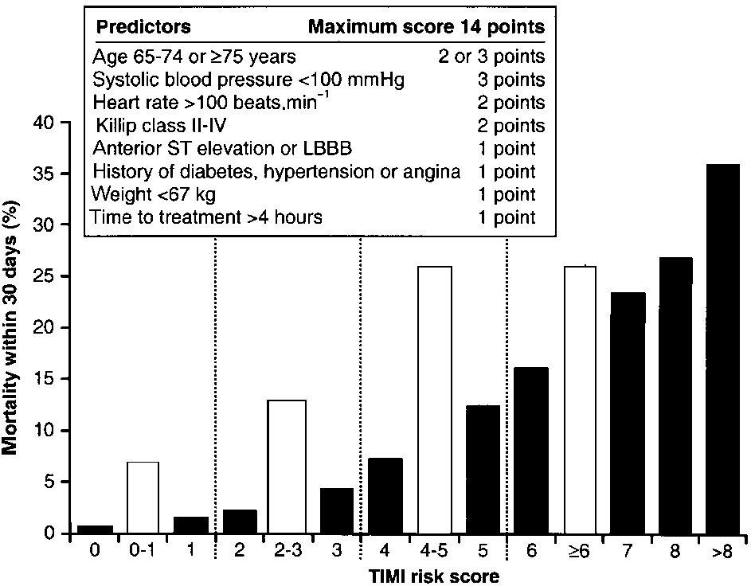
Figure 1 Associations between TIMI risk scores and
30-day mortality in the InTIME-II trial of 14 114
patients[1] ( ) and in-hospital mortality in the Gumina
study ( ) of 102 patients with right ventricular
infarction[2]. LBBB=left bundle branch block.

Slide 58
CONCLUSION
Right ventricular infarction occurs in more than one-third of patients with acute inferior wall MI.
A spectrum of disease from asymptomatic mild right ventricular dysfunction to cardiogenic shock has been recognized.
Frequent accompaniments may include atrial infarction, sinus bradycardia, atrialfibrillation, and atrioventricular block.
Only 10 to 15% of patientsshow hemodynamic abnormalities.
Patients with hemodynamically significant RVI usually present with hypotension,elevated JVP, and occasionally shock, all in the presence of clear lung fields.

Slide 59
All patients with inferior wall MI should have right-sided precordial leads recorded for evidence of RVI.
Patients with RVI who are hemodynamically unstable should be managed with volume loading to maintain adequate right ventricular preload.
Early recognition and prompt reperfusion with thrombolytic therapy or coronary angioplasty, rate and rhythm control, and ionotropic support with dobutamine may also be warranted.
Patients who survive the acute phase have no long-term consequences, and complete recovery over a period of weeks to months is the rule in a majority of patients,suggesting right ventricular “stunning” rather than irreversible necrosis has occurred.

