Slide 1
Achalasia Cardia
By dr jagdish karia

Slide 2
HISTORY:
Annual incidence is about 6 per 100,000 populations
M:F :: 2:3
Usually affect people of 30-40 years age
It was first seen by Thomas willis in 1672

Slide 3
Failure of relaxation of cardia due to disorganised peristalsis of esophagus.
It is due to failure of integration of vagal impulses and cause functional obstruction.
It was first seen by Thomas willis in 1672

Slide 4
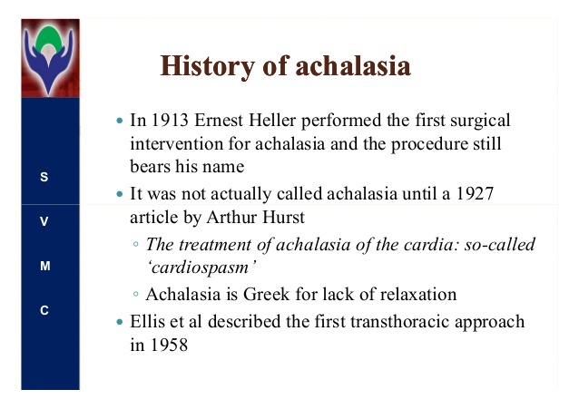
Achalasia = failure to relax

Slide 5
Innervation of oesophagus
SHOWING ARRANGEMENTS OF NERVES OF ESPHAGUS I.E. INTRINSIC NERVE PLEXUSES

Slide 6
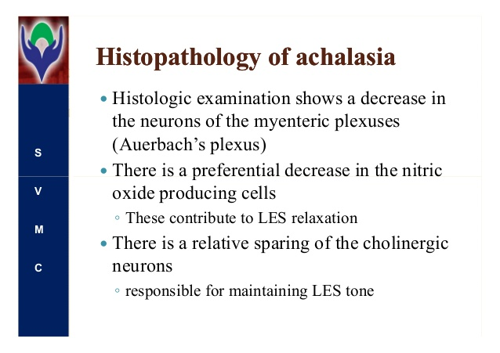

Slide 7
Types
Idiopathic :There is either degeneration or absence of Inhibitory ganglions (Nitric Oxide) in the myenteric (aurbech’s plexus) plexus in the esophagus. Thus imbalance of Ach. and nitric oxide, cause more resting tone of LOS
As a result the esophagus gets dilated and tortuous and hypertrophic. It fails to relax At lower end when bolus reaches lower end .

Slide 8
Types of achalasia
Acquired achalasia: this is more seen in South America, caused by TRYPANOSOMA CRUZI (sleeping sickness).
The parasite destroys ganglion cells of the auerbach’s plexus
Pseudo achalasia: its really a case of tumour at cardia which presents early with dysphagia. Endoscopy will confirm the diagnosis.

Slide 9
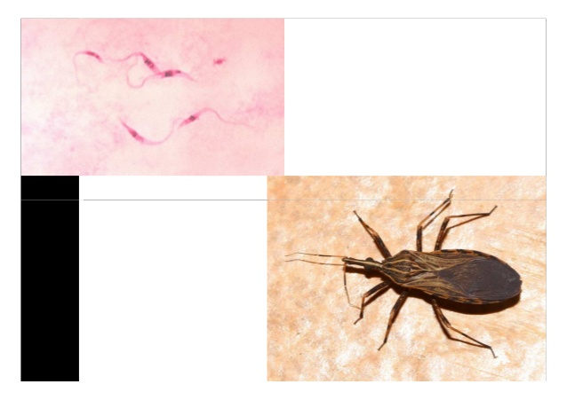
Trypanosome cruzi

Slide 10
pathophysiology
Myenteric plexus damaged or inflamed
Loss of inhibitory ganglion cells in plexus
Neurotransmitter inhibition decreased( NO)
Imbalance of Ach. And nitric oxide (NO)
Achalasia cardia

Slide 11
Also following points are responsible in many cases as Aetiology
Stress
Vitamin B1 deficiency
Diffuse esopgageal spasm-cork screw esophagus
It’s a pre cancerous condition…7 times more prone for squamous cell ca. esophagus.

Slide 12
Pathology of Achalasia cardia
Thickening of circular muscle fibres in distal esophagus
Reduced or depletion of ganglion cells more so of nitric oxide (NO) producing cells
Neural fibrosis
Absence of peristalsis and
Raised LES pressure with functional obstruction of LES
Dilatation of proximal esophagus

Slide 13
The symptom complex in achalasia or cardiospasm is very pathognomonic.
It can be divided into 3 stages
1 : cardiospasm without food regurgitation
2 ; Cardiospsm with immediate food regurgitation
3 : cardiospasm with dilated esophagus. The retention of food is in dilated esophagus which comes out at irregular interval

Slide 14
Clinical presentation
Incidence : 6 :: 100,000 population
Common in females of 20-40 years age
Retrosternal chest pain may be there
Dysphagia (difficulty in swallowing): slowly & progressive and more for liquids than solids.
- Regurgitation of liquid / food in mouth.
-malnutrition with ill health
-Bad smell from mouth i.e. halitosis

Slide 15
Weight loss
Recurrent respiratory infection due spillage of food in R.S.
Features of anaemia, glossitis, stomatitis, bald tongue
Inhalation of Amyl nitrate will release sphincter which can help to differentiate from pseudo achalasia

Slide 16
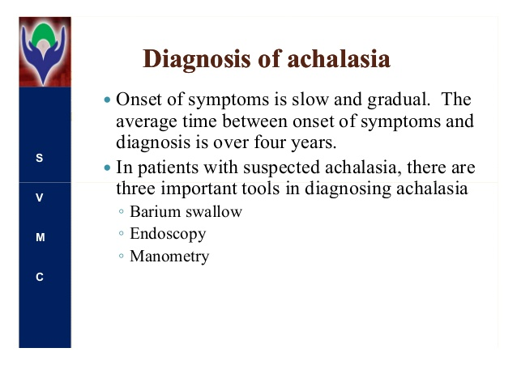
Investigations

Slide 17
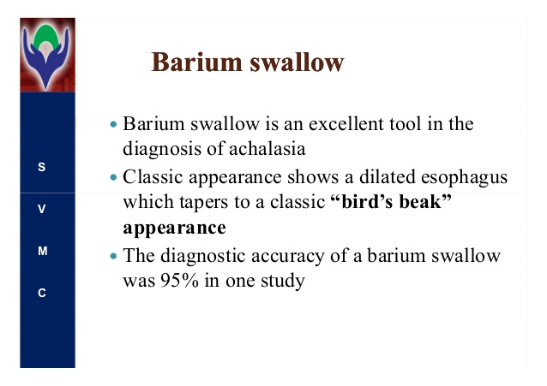

Slide 18
Ba. Bolus
Pencil tip like smooth narrowing of lower end of esophagus
Esophagus is dilated proximal to narrowing….called cucumber esopgagus
Absence of fundic gas bubble
Lateral view of chest may show air and fluid level in esophagus in the posterior mediastinum behind the cardiac shadow.

Slide 19
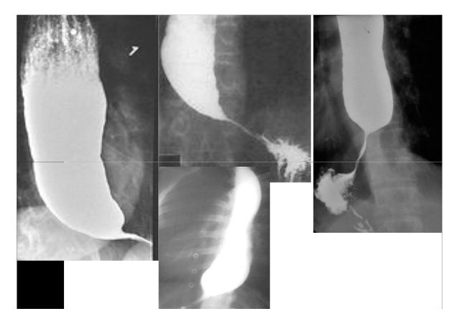

Slide 20
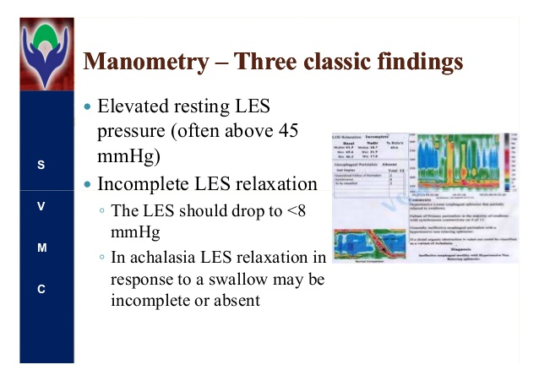

Slide 21
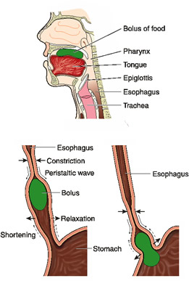
Esophageal peristalsis

Slide 22
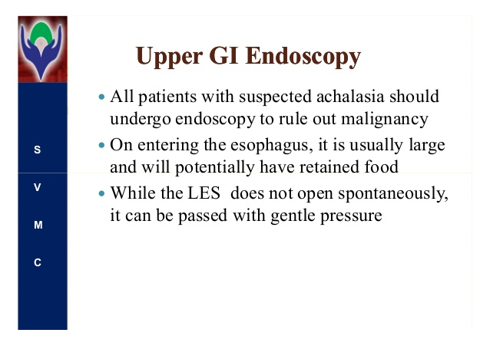

Slide 23
During endoscopy biopsy of mucosa should be done to rule out carcinoma in doubtful cases
Endoscopic ultrasound (EUS) can help to rule out malignancy.
CT scan can also help in doubtful cases

Slide 24

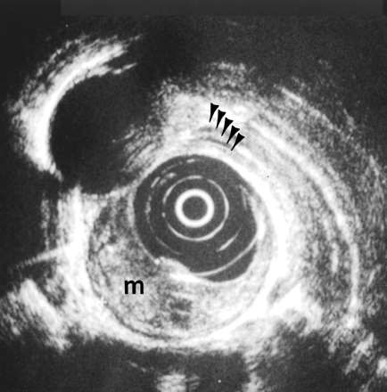
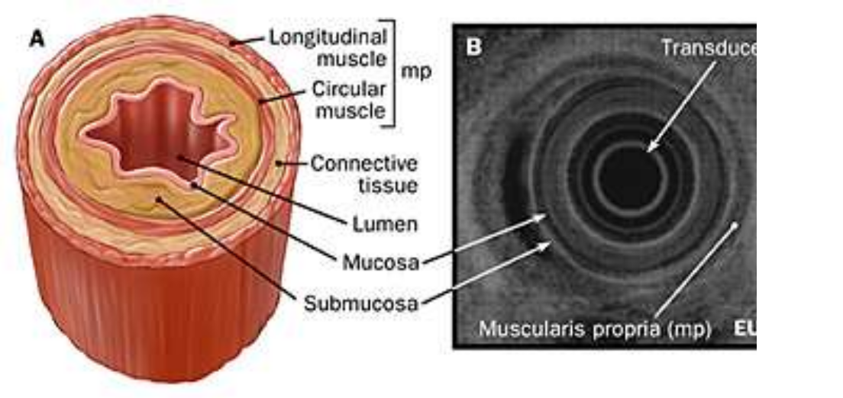

Slide 25
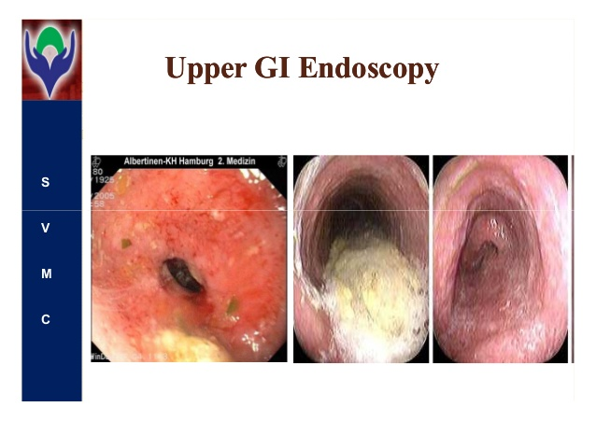

Slide 26
D.D.
Carcinoma esophagus
Stricture esophagus
Scleroderma

Slide 27
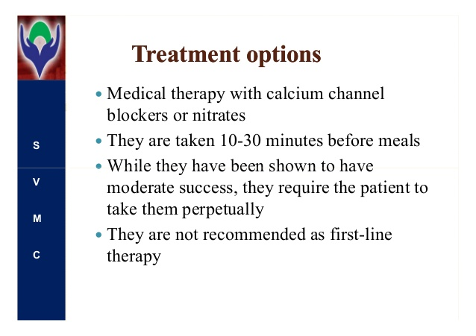

Slide 28
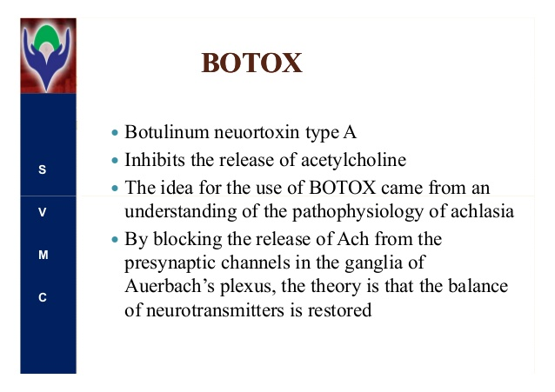
Botulinum neurotoxin

Slide 29
Tab. Nifedipine 10 mg s/l is used
Nitroglycerine sub lingual
Amyl nitrate inhalation will cause sphincter relaxation in achalasia but not in pseudo achalasia ( seen in carcinoma esophagus)

Slide 30
BOTOX
Botulin toxin is neurotoxic and derived from clostridium botulin bacteria.
It blocks the cholinergic nerve endings and cause flaccid paralysis of muscle.
The effect may reduce to half in 6-12 months and may need inject again. So its used now only if pt. is unfit for other interventions

Slide 31
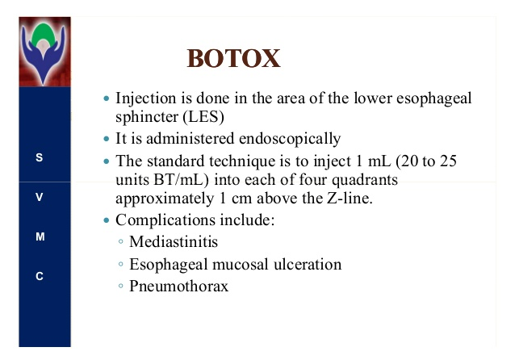

Slide 32
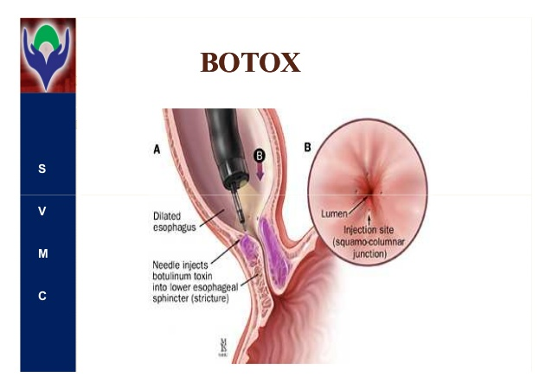

Slide 33
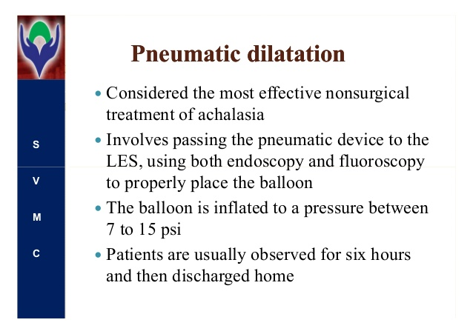

Slide 34
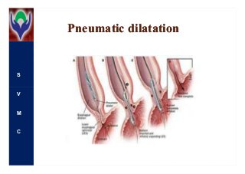

Slide 35
Balloon dilatation
Now a days plastic balloons are preferred to rubber balloons with diameter of 30 mm to 40 mm.
These are made such that they will not get size more than 30 mm and by chance inflated more than that, then it will breakdown vertically and not cause damage to oesophageal wall
Rubber balloon can inflate more and may burst transversely and cause perforation of oesophagus

Slide 36
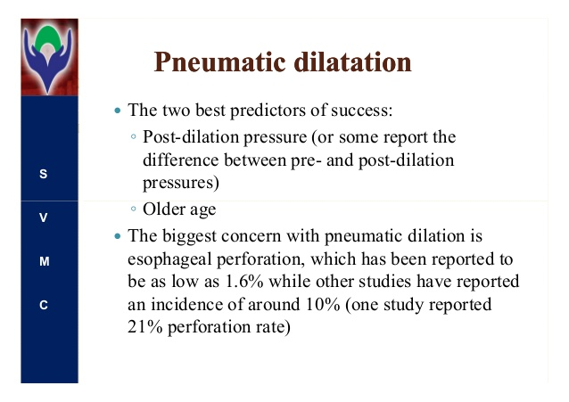

Slide 37
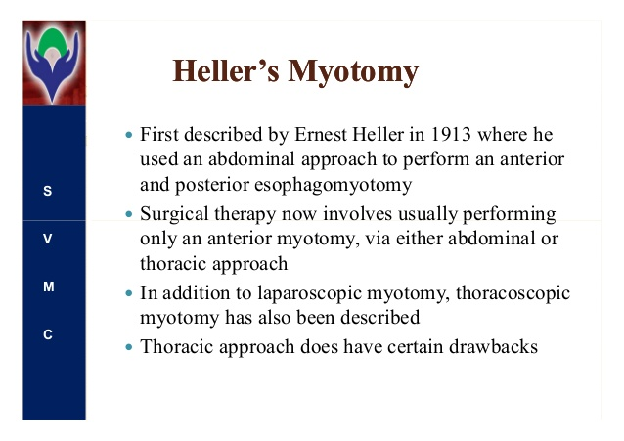

Slide 38
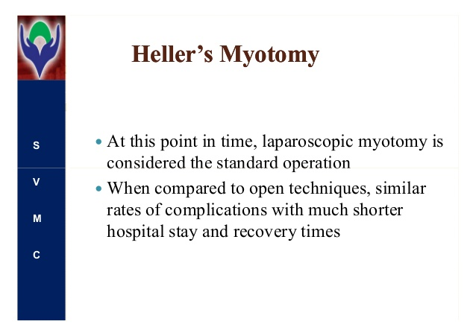

Slide 39
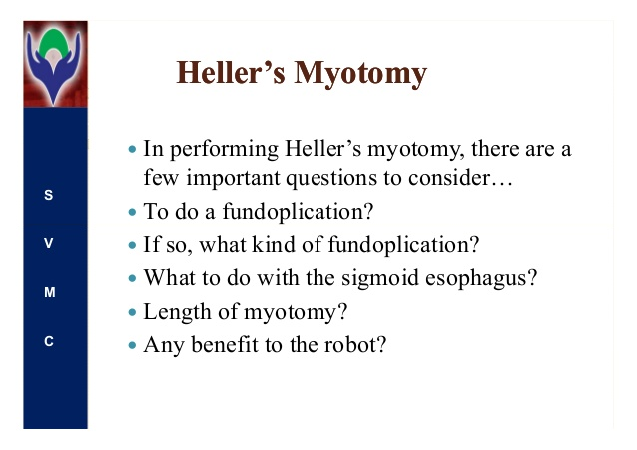

Slide 40
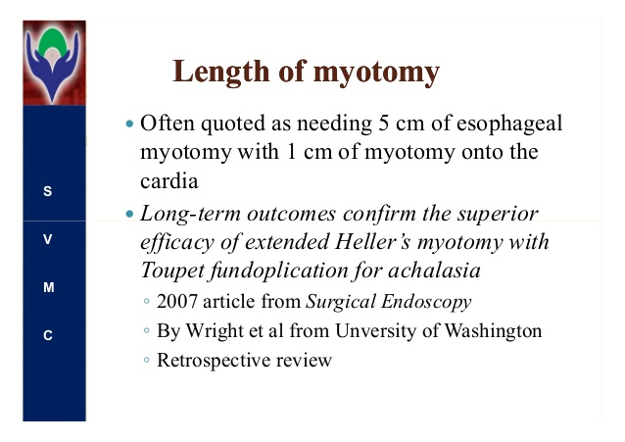

Slide 41
Usually a longitudinal cut made 2 cm proximal to thickened muscle and 1 cm distal to the Gastro oesophageal junction .
Usually totally 6 cm is sifficient.

Slide 42
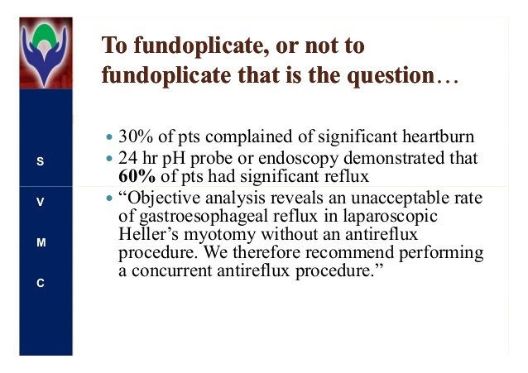

Slide 43
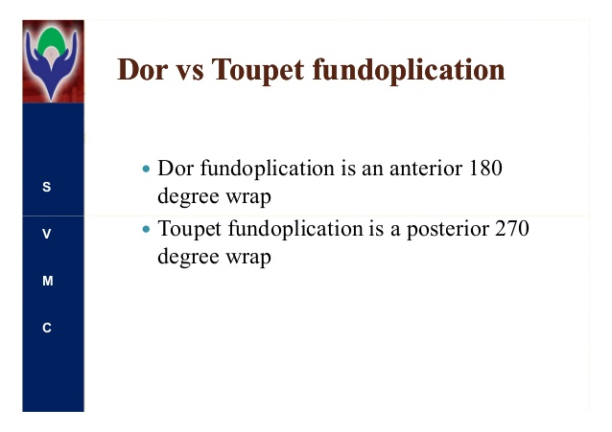
Fundoplication

Slide 44
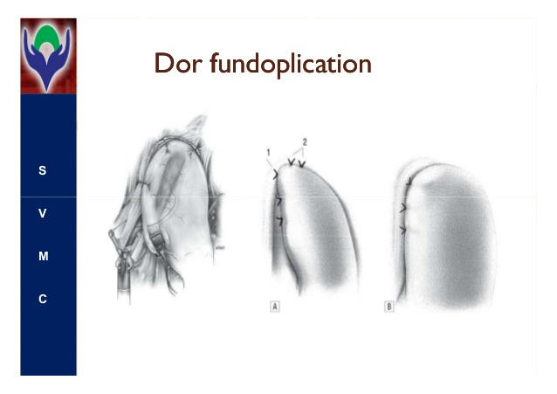

Slide 45
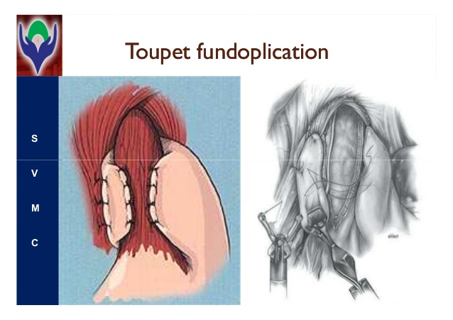
Toupet fundoplication 270 degree

Slide 46
Nissen fundoplication is 360 degree wrapping of fundus from behind the esophagus with 3 stiches.
This sometimes cause more narrowing of OG junction and requires reversal operation also. So now not popular 3 stitches but 2 stiches is most sufficient to serve the purpose without causing more narrowing.

Slide 47
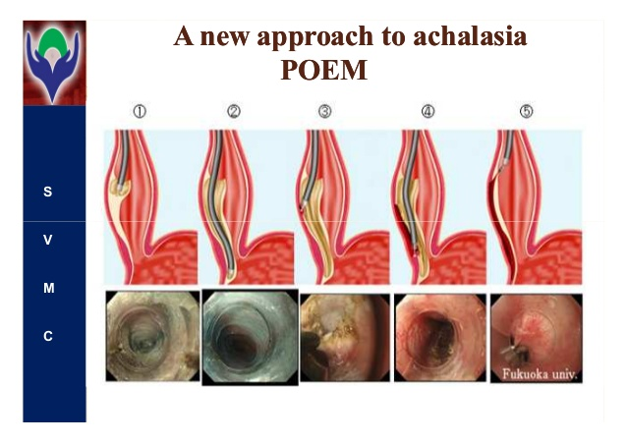
Per oral endoscopic myotomy-POEM

Slide 48
POEM
Heusing endoscope , methylene blue dye is diluted by saline and injected in the submucosa of esophagus 15 cm above the ES junction.
2 cm incision in mucosa is made proximally to enter submucosal space. Adequate tunnel in this space is created and with endoscopic knife lower oesophageal sphincter is cut.
Mucosa is closed with clips.

Slide 49
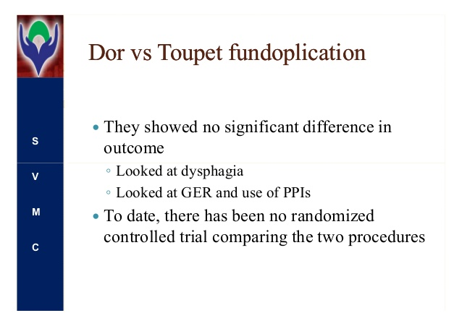

Slide 50
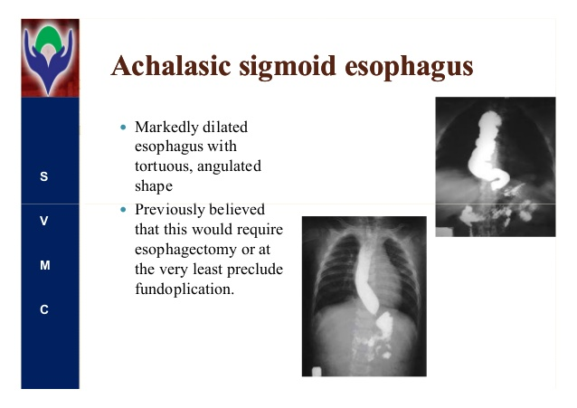

Slide 51
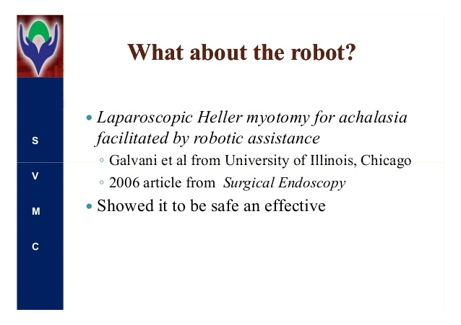

Slide 52
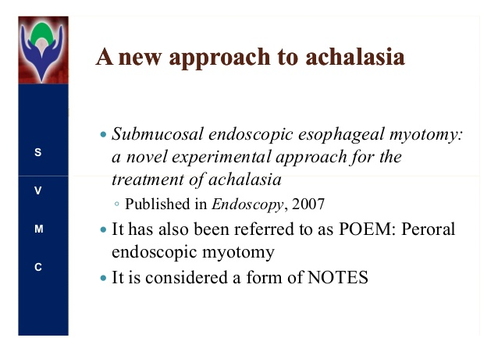

Slide 53
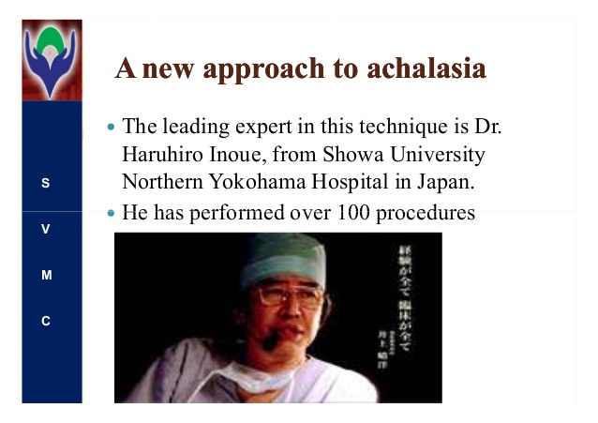

Slide 54
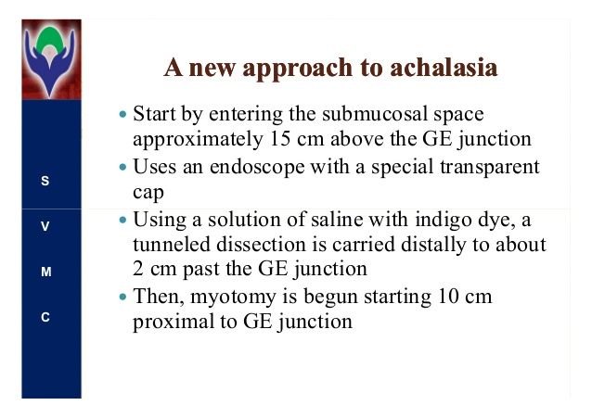

Slide 55
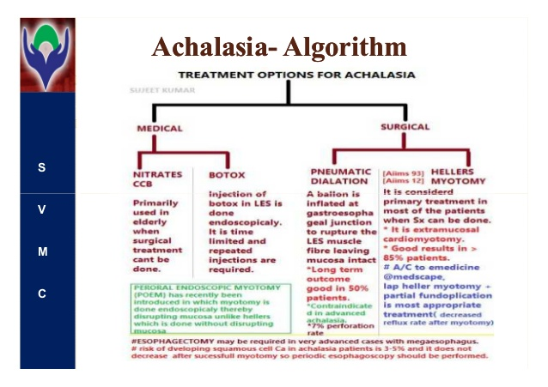

Slide 56
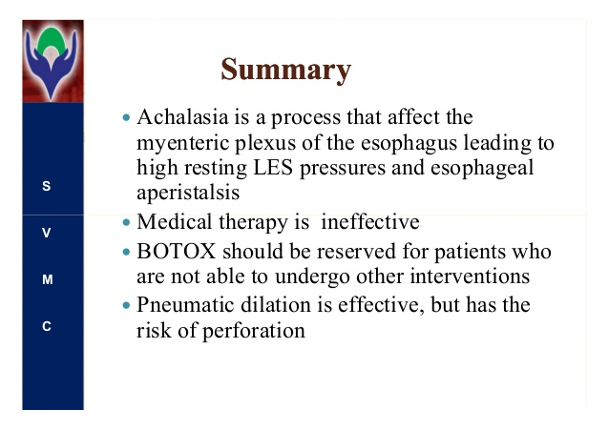

Slide 57
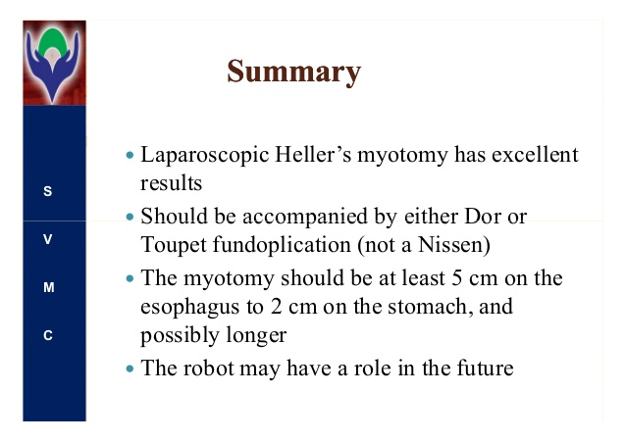

Slide 58
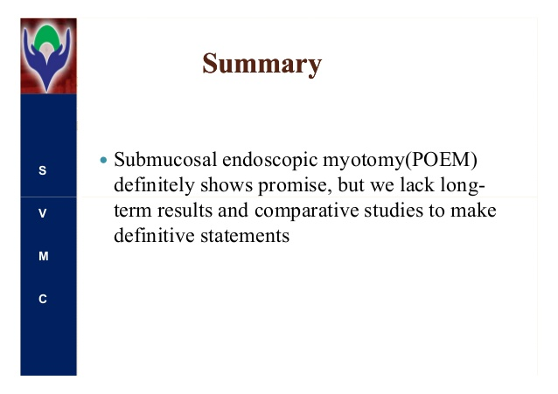

Slide 59
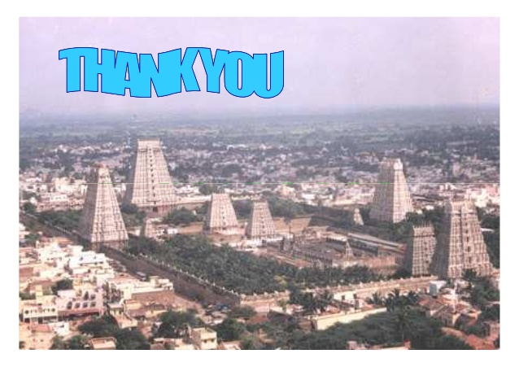

Slide 60
M.C.Q. 1
Achalasia cardia means……….
A: lack of contraction
B: lack of relaxation
C: lack of nerve supply
D: lack of blood supply

Slide 61
M.C.Q. 2
Surgical operation for achalasia cardia called
A : Heller’s operation
B: lord’s plication
C : esophagectomy
D: esophagotomy

Slide 62
M.C.Q. 3
Barium bolus picture of Achalasia cardia is like …….
A : tail of bird
B : eye of bird
C: beak of bird
D: feather of bird

Slide 63
M.C.Q. 4
Achalasia cardia produces dilatation of ……
A stomach
B: esophagus
C: lower esophageal sphincter
D: upper esophageal sphincter

Slide 64
M.C.Q. 5
Chaga’s disease is produced by parasite….
A: plasmodium vivax
B ; Entamoeba hystolytica
C: trypenosoma cruzi
D: ancylostoma duodenale

