Slide 1
Lumbar canal stenosis
-Dr. Malkesh Shah M.S.(Ortho.)
Associate Professor
Dept. of Orthopaedics, SBKS MI&RC,
Piparia, Waghodia, Vadodara

Slide 2
Lumbar canal stenosis is a cauda equina compression in which the lateral or anteroposterior diameter of the spine canal is narrow with or without change in cross-sectional area. It is defined as Narrowing of spinal canal ,nerve root canal or vertebral foramina
Lumbar canal stenosis is common cause of back pain.

Slide 3
CLASSIFICATION OF SPINAL CANAL STENOSIS-
GENERALISED/LOCALISED
SEGMENTAL
  Central
  Lateral
  Foraminal
  Farout
ANATOMICAL
  Cervical –seen
  Thoracic –rare
  Lumbar – most common

Slide 4
PATHOLOGICAL(ARNOLD’S 1976)
  CONGENITAL STENOSIS- eq. Achondroplasia
  ACQUIRED STENOSIS - 1) Degenerative
    Combined congenital and degenerative
    Spondylolisthetic
    Spondylitic
    Post traumatic
MISCELLANEOUS
Paget disease
Fluorosis
Kyphosis
Scoliosis
Fracture spine
Diffuse idiopathic skeletal hyperost-
-osis syndrome

Slide 5
IATROGENIC CAUSES –
eq- Hypertrophy of posterior bone graft.
- Incomplete treatment of stenotic
condition.
CLINICAL FEATURE –
Low Back pain.
Pain, paraesthesia and cramping of lower extremities .
cauda equina claudication is common symptom.
Pain exacerbated by standing and walking.
Parasthesia, hypoesthesia and heaviness in lower limb.
Pain radiates to buttocks and lower extremities.
Pain releaved by forward flexion.
Pain relieved by sitting or lying down and increase by
standing or walking.

Slide 6
CAUDA EQUINA CLAUDICATION
-Pain in the buttocks and lower extrem Ities after walking.
ISCHAEMIC CLAUDICATION
- Pain in legs appears on walking
- Relieved by sitting forward for 20 min. - Appears and disappear fast
-Hypoaesthesia, parasthesia precipitate by walking uphills and cycling
-Pulses are felt
- No trophic changes
- No neurological deficit
Absent pulses
Trophic changes in foot and toes

Slide 7
INVESTIGATION –
Radiograph – Reduce interpedicle distance.
Anteroposterior or transverse diameter of affected vertebral absolute midsaggital diameter of canal is decreased.
Hypertrophy and sclerosis of the facet joint.
Reduced interlaminar space and short, stout spinous process.
Normal diameter
Anteroposterior = 15mm Transverse = 20mm
Myelographic finding- Narrowing of the dural sac at the level of
facet joints and indentation of the dural tube due to disc prolapsed.

Slide 8
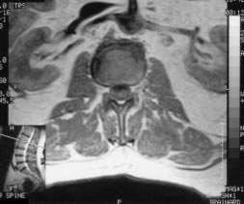
MRI and CT SCAN-
Helps to diagnose lateral recess stenosis, facet hypertrophy, mid sagittal distance etc.
Lumbar canal
stenosis
Magnetic resonance imaging (MRI scans in a 75-year-old man. minimal degenerative changes at the L1-L2 level.

Slide 9
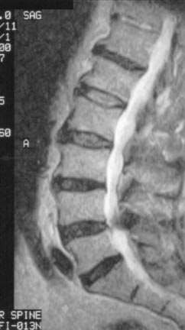
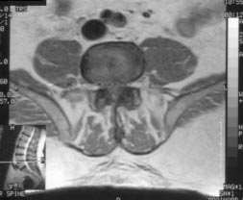
Note the stenosis at L4- L5 (arrow).
severe lumbar canal stenosis at the L4-L5 level due to (1) disc degeneration, (2) facet hypertrophy, and (3) ligamentum flavum hypertrophy.

Slide 10
Physical examination –
Reduced spinal mobility.
Extension is more usually limited than flexion.
Lumbar, paraspinal and gluteal tenderness.
Hip, and knee slightly flexed and trunk stooped forward.
Hamstring tightness is often present.
Neurologic examination typically normal
or reveals only such a mild weakness, sensory changes and difficulty in walking.

Slide 11
Special test –
1) Stoop test-
Ask patient to walk --- pain develop--- continue to walk---
---- patient assumes a stooped posture--- symptom disappear—
---- the pain decreases by forward bending because the canal length increase by 2.2 mm.
2) Lumbar extension test –(Katz et al)
Ask the standing patient to hyperextend the lumbar spine for 30 to 60 second. A positive test is reproduction of the buttock or leg pain.

Slide 12
Different diagnosis –
Back pain
Malignancy
infection
Vascular claudication
Peripheral neuropathy
Hip disease

Slide 13
Treatment –
Conerservative-
NSAIDS(non steroidal anti-inflammatory drug) and analgesics.
Epidural injection
lumbar corset should be used.
Calcitonin has also be used in patient with intermittent claudication.
Physiotherapy treatment –
Improve strength, endurance and tone of abdominal muscle.
Back ergonomics avoiding extension attitude are taught.
Lumbar corset should be used provide back support.
Emphasis on flexion exercise and generalized flexion attitude
avoiding extension.

Slide 14
Gentle passive manipulation technique.
Lumbar traction to releave spasm.
Walking on inclined treadmill. Harness supported treadmill ambulation.
Strong isometric exercise for abdomen.
Single Knee to chest exercise.
Spinal flexion exercise.
Hamstring stretching performed by extending the knee with hip flexed 90*.
Hip flexor stretching is performed by maintains posterior pelvic tilt while in a half kneeling posture.
Mini squats for general lower extremity strengthing exercises.

Slide 15
Surgical treatment-
✓
Surgical treatment is indicated in patient with moderate or
marked compression of the nerve root or severe cauda equina
syndrome.
The aim of surgery is to decompress the cord.
For central canal stenosis
LAMINECTOMY - Decompression laminectomy is useful. It is mostly
done in central canal stenosis.
DISCECTOMY -
Discetomy and osteotomy of inferior articular
process helps to remove the hypertrophic element.

Slide 16
For lateral canal stenosis
LAMINECTOMY
DISC EXCISION
PARTIAL MEDIAL FACETECTOMY
FORAMINOTOMY
➢
Spinal fusion to stabilise the lumbar spine is usually not required as instability is less commonly seen in lumbar canal stenosis.
The neurogenic claudication respond poorly to the conservative treatment but respond well to surgical decompression.

Slide 17
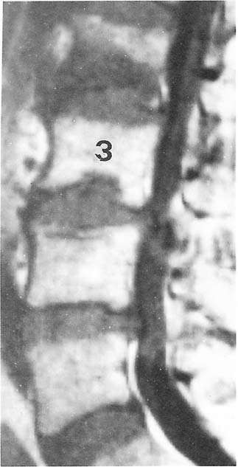
A patient with constitutional stenosis at L3-L4 and L4-L5. Figure 5a – T1-weighted MRI showing narrowing of the thecal sac at L3 to L5 and constriction of the sac at L3-L4. The third and fourth lumbar discs protrude posteriorly.

Slide 18
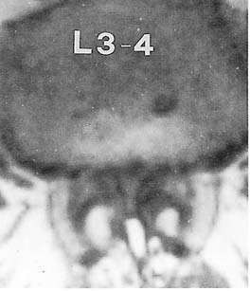
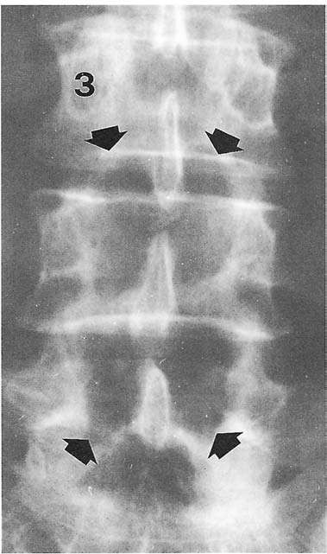
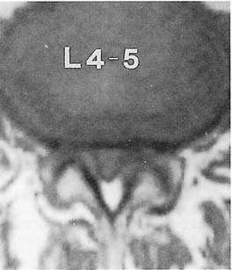
figure 5b – MRI showing transverse narrowing of the spina canal causing compression of the nervous structures
Figure 5c – AP radiograph after bilateral laminectomy at the stenotic levels.

Slide 19
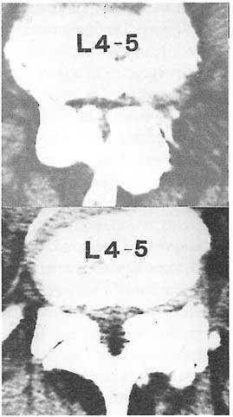
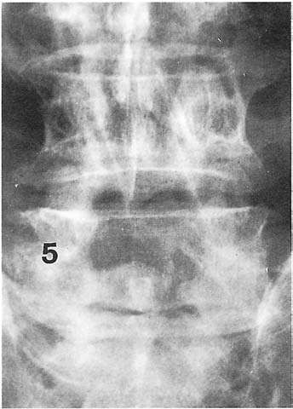
CT of a patient with severe degenerative stenosis at L4-L5 level. The central portion of the spinal canal and the nerve-root canals are narrowed by degenerative changes of both superior and inferior articular processes
AP radiograph
after total laminectomy and undercutting facetectomy at L4-L5.

Slide 20
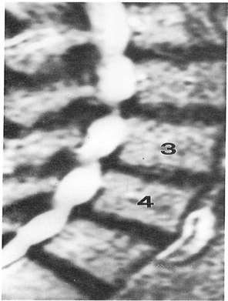
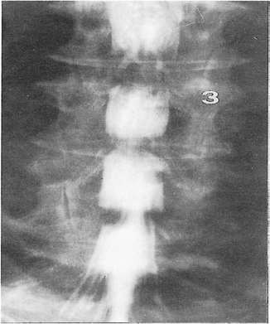
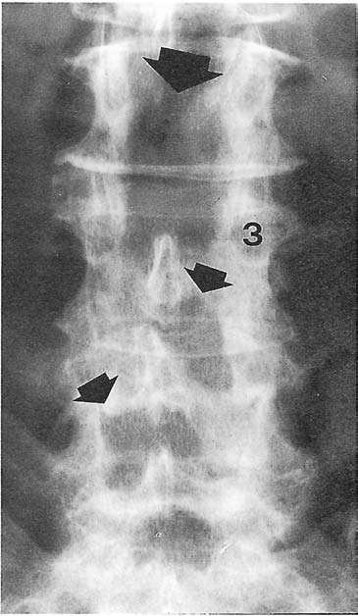
A patient with marked spinal canal stenosis at L2-L3 and severe root- canal stenosis at L3-L4 and L4-L5, who had total laminectomy at L2- L3 and laminotomy at L3-L4 on the left and L4-L5 on the right. Figure 7a – Preoperative MRI.
Preoperative
myelogram
Postoperative
radiograph.

Slide 21
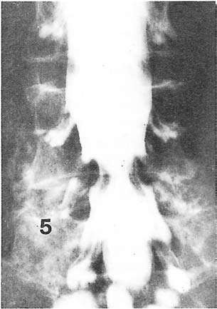
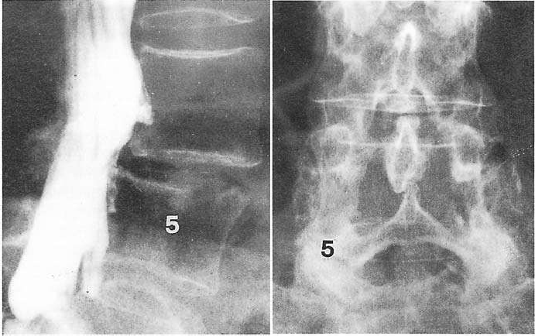
A patient with mild degenerative spondylolisthesis of L4 and nerve-root canal stenosis at the L4-L5 levels in whom a bilateral laminotomy (c) was carried out.

Slide 22
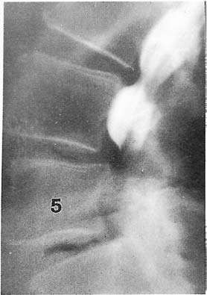
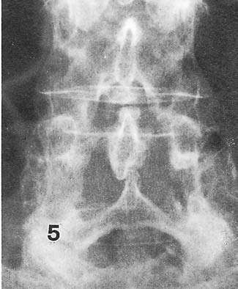
patient with degenerative spondylolisthesis of L4 and L5 causing a complete myelographic block at L4-L5 (a) who had total laminectomy at L3 to L5
intertransverse process
fusion at L4-S1.

Slide 23
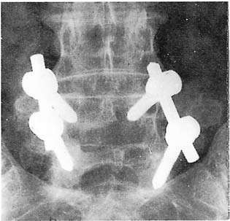
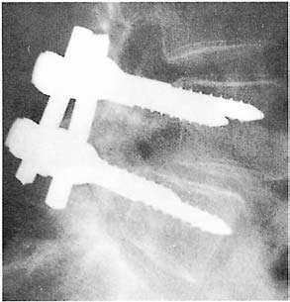
Total laminectomy and bilateral intertransverse process fusion with internal fixation (compact CD system) for degenerative spondylolisthesis of L4 and spinal canal stenosis at L4-L5 level

Slide 24
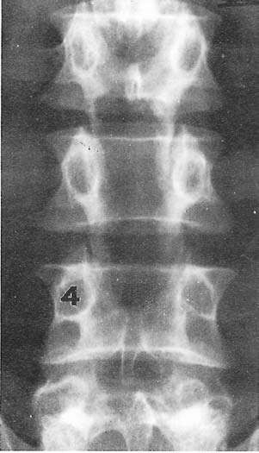
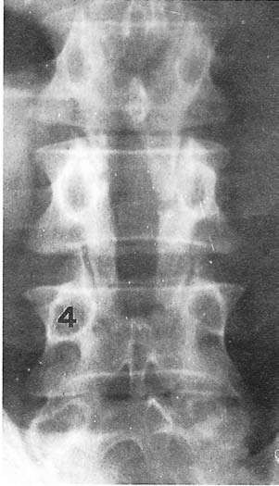
Radiographs showing regrowth of the posterior
vertebral arch after central laminectomy at L3 to L5 immediately after surgery

Slide 25
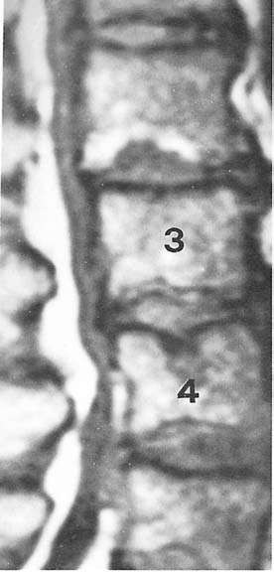
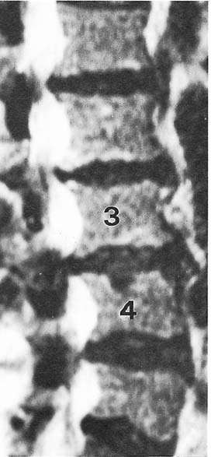
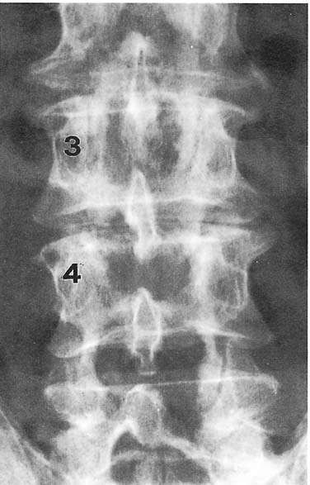
A patient who had a combined spinal canal stenosis at L1 to L5. Preoperative MRI showed compression of the nervous structures at the first four
lumbar levels (a and b), but compression at L1-L2 was considered relatively mild. Bilateral laminotomy was performed at L2-L3 to L4-L5 (c). One year after surgery radicular symptoms recurred.

Slide 26
A NON SURGICAL TREATMENT APPROACH FOR PATIENT
WITH LUMBAR STENOSIS

Slide 27
Case description-
The two patient selected for this case report had pathology and clinical presentation consistent with a diagnosis of lumbar spinal stenosis.
PATIENT 1
58
female
152 cm
55
9 yr. after kidney transplant. 2 yr. after left tibial plateau #
Non-insulin dependent diabe-
-tes mellitus.
PATIENT 2
76
male
190 cm
99
Left knee osteoarthritis Hypertension
AGE GENDER HEIGHT WEIGHT MED./H/S
Hypertension.
MEDICA. Immunosuppressive medication prednisone, Tylenol, codeine
Altace

Slide 28
PAST H/S
10 ys. History of low back pain 25 ys. History of low back pain and 6 month history of right and a 7 months history of left leg pain exacerbated by walk anterior leg pain exacerbated by
-ing. Onset of the lower extr walking.
-emity symptom was gradual.
No spinal trauma was report
No spinal trauma was reported
DIAGNOSTIC
IMAGING
Right facet OA at L3-4, L4-5, Mild central stenosis at L2-3.
L5-S1.
Degenerative disc disease at L3-4, L5-S1.
Mild central stenosis at L2-3.
Moderate central stenosis at
L3-4, L4-5.
Central disk herniations at L3-4, L5-S1.
Severe central stenosis at L3-4, L4-5.
Right lateral stenosis at L4-5.

Slide 29
Inter physical therapy evaluation-
Visual analog pain scale (0-10)
Modified oswestry low back pain questionnaire
(10 areas of daily living and expresses the degree of disability as a percentage)
The Roland-Morris disability questionnaire
(It contain 24 items selected from the 136 item sickness impact profile and reports a score from 0 – 24, with a score of reflecting the greatest
limitation.)
Physical examination
Neurological examination (Lower extremity reflexes, sensation, and
manual muscle testing and assessment of SLR)

Slide 30
Assessment of bony land mark
Active spinal range of motion
Treadmill walking
(Patient ambulate on a level treadmill and a treadmill with a 15* incline. The patient were asked ambulate to walk at a comfortable pace without handrails. The walking time till until the symptom of low back pain or lower extremity pain increased over the level
recorded before the test began, and the maximal walking time limited by either fatigue or symptoms were recorded. Patient walk maximum of 15 min.)
Outcome measure-
  VAS
  Modified oswestry low back pain questionnaire
  Roland- Morris disability evaluation
  Two stage treadmill test

Slide 31
Finding of initial physical therapy evaluation-
Patient 1- Had a leg length discrepancy, with a long right leg. Peripherali- zation of symptoms with lumbar extension. Patient had a positive findings on neurological assessment in the form of reflex, sensory, and motor changes as well as positive SLR test. The result of the two stage treadmill test showed a longer walking time on the incli- ned treadmill, an earlier onset of symptoms on the level treadmill and a longer recovery after level treadmill.
Patient 2 - Peripheralization of symptoms with lumbar extension. The two stage treadmill test result as earlier onset of symptoms and a longer recovery time with level treadmill ambulation than with inclined treadmill ambulation.
Treatment plan-
Both patients received physical therapy for LSS over 6 week period and a 4 weeks follow- up.

Slide 32
Patient 1-
Seen eight visit. The treatmentment approach had two compnent s; 1) an exercise program of and 2)a program of harness supported treadmill.
He received at a 1.27 cm(0.5-in) heel lift in the left shoe to correct
a leg length discrepancy of 1.27cm.
Spinal flexion increases the spinal canal dimensions. Flexion exer cise may help to decrease symptoms.
Exercise – Spinal flexion exercise including posterior pelvic tilts, quadruped spinal flexion, single- knee-to –chest exercise, hamstring muscle stretching,mini squats for general lower extremity strengthening, hip flexor stretching. Lower extremity strengthening exercise focus ing on gluteus medius muscle.
Harness supported treadmill- Harness supported treadmill ambula tion In which a vertical traction force can be applied to reduce the compressive loading on the spine and allow for pain free gait training. Sufficient traction was applied to completely relieve the patient’s symptoms of low back and lower extremity pain during ambulation.

Slide 33
Patient 2-
Seen eleven visit. The treatment has approach had two
component ; 1) An exercise program and 2) A program of harness- supported treadmill.
  Exercise - Quadruped spinal flexion, hamstring stretching, mini squad for general lower-extremity strengthing SLR in flexion,extension,abduction and adduction and terminal knee extension exercise. Hip flexor stretching.
  Harness supported treadmill-Harness supported treadmill in which a vertical traction force can be applied to reduce the compressive loading on the spine
and allow for pain free gait training. Sufficient tra- ction was applied to completely relieve the patient’s symptoms of low back and lower extremity pain during ambulation. He was tolerated treadmill exer- cise better than 1.

Slide 34
Treatment outcome-
As the completion of 6 weeks of treatment , the patient impairments were reassessed and the self report measu- re and the two stage treadmill test were repeated
Patient 1- Improvement in lumbar range of motion.
Improvement in neurological status.
Sensation as well as improved.
Improvement in SLR test.
Improvement in muscle force production particularly in gluteus medius muscle.
Patient 2- Improvement in lumbar range of motion.
  Improvement in muscle force production particularly in quadriceps femoris muscle.
Patient 1 & Patient 2 –Both patients were found improvement in self
report out come measure.
    VAS
    Modified oswestry low back pain questionnaire.
    Roland- Morris disability evaluation.
    Two stage treadmill test.

Slide 35
Both patients were able to ambulate the full 15 minutes during the 6 weeks
reassessment.
Both patients were instructed to continue their home exercise program daily after discharge form physical therapy .
Both patients perform at least 15 to 20 minutes of symptom free walking daily ,If symptom occurred the patient were instructed to stop walking and sit until the symptoms diminished.
Both patients returned for follow-up assessment 4 weeks after discharge
form physical therapy.
The self report measure and the two stage treadmill test were readministered
The result indicate indicated that the improvements in limitations and disab- ility noted at the conclusion of physical therapy were maintained over a 4 weeks period following discharge.
Both patients reported doing their home exercise programs, and neither pat- ient reported using any pain medication following discharge.

Slide 36
MEASURE
PATIENT 1
initial eval. After 6 weeks
6/10 1/10
PATIENT 2
4 wk. fo. initial eval after 6 wk 4 wk.
1/10 5/10 0/10 0/10
VAS
Modified low
Back pain osw 48 Estry question naire
Rolandmorris Disability que 17 stionnaire
16
12
53
0
0
2
3
19
1
1

Slide 37
Measure
inclined treadmill level treadmill
initial eval. after 6 wk. 4 wk. foll.up initial eva. After 6 wk. 4 wk. f 1.5 2.5 2.5 1.5 2.5 2.5
Walking
Speed(mph
Time to in Crease in 2 Symptoms (min.)
Max. walki
-ng time 5 (min.)
no increase noted
no increase 1 noted
no increase no incr
noted
ease noted
15
15
5
15
15
Symptoms Lt. anterior none noted
none notedLt. Anterior none noted none
leg pain noted
Of comple leg pain
Tion
Recovery Time(min.)
4
not assessed
not assess
-ed
5
not assess-not as-
-ed sesed

Slide 38


Slide 39
MCQ 1
The vertebrae has the following parts:
a) Outer anulus fibrosus
b) Inner anulus fibrosus
c) Nucleus pulposus
d) Vertebral end plates
e) All of the above

Slide 40
MCQ 2
The features of Degenerative disease of spine include
a) NARROW CANAL
b) DECREASED DISK HEIGHT
c) POSTERIOR OSTEOPHYTES
d) DISK PROTRUSIONS
e) All of the above

Slide 41
MCQ 3
Indications for surgery in degenerative spine disease include
a) Failure of conservative therapy
b) Increasing neurologic deficit
c) Cervical myelopathy that is progressive
d) All of the above
e) None of the above

Slide 42
MCQ 4
Investigations for degenerative disease of cervical spine include:
a) X-rays
b) Cervical myelography
c) CT scan
d) MRI
e) All of the above

Slide 43
MCQ 5
Conservative treatment for degenerative disease of spine include
Rest
Ice application
Physiotherapy
Belt
All of the above

