Slide 1
PROLPASED INTERVERTEBRAL DISC (PIVD)
Dr.Malkesh Shah
Assistant Professor
Dept. Of Orthopaedics
SBKSMIRC, SUMANDEEP VIDYAPEETH

Slide 2
DEFINITION
• Herniation OR Prolapse - Rupture or protrusion of all or part of an organ through a tear or abnormal opening in the wall of the containing cavity
Outpouching of the disc nucleus pulposus through an annulus tear - "prolapsed", "ruptured", "herniated" or "slipped" disc

Slide 3
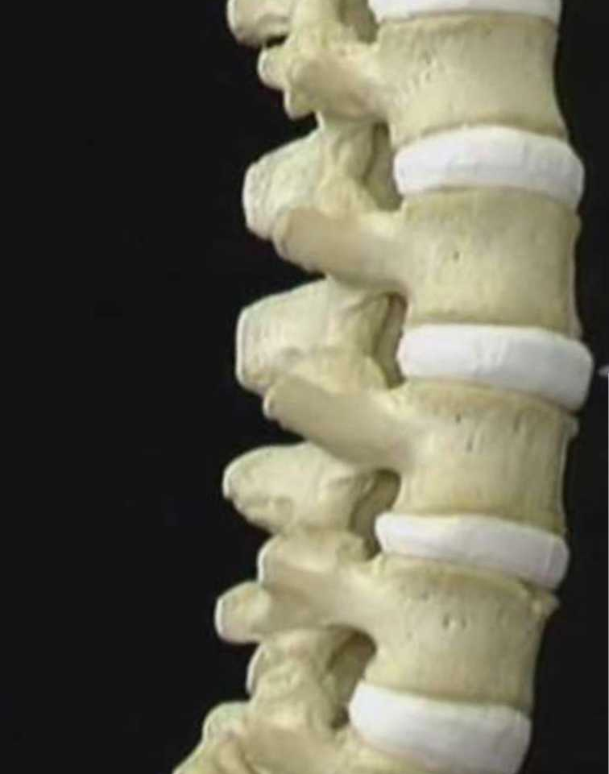
Intervertebral disc

Slide 4
THE INTERVERTEBRAL DISC
• Makes up 33% of lumbar vertebral height. (24% of cervical and 20% of thoracic)
• Thicker anteriorly in the cervical and lumbar regions - contributing to anterior convexity.

Slide 5
THE INTERVERTEBRAL DISC
VITAL FUNCTIONS
• Restricted intervertebral joint motion
• Contribution to stability
• Resistance to axial, rotational, and bending load
• Preservation of anatomic relationship

Slide 6
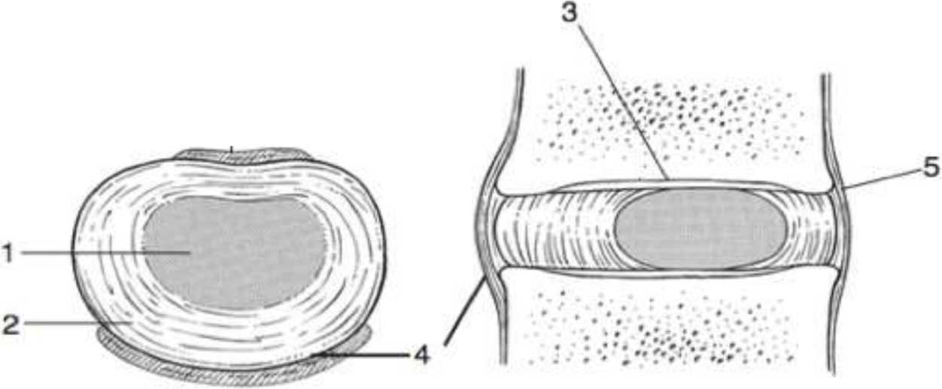
THE INTERVERTEBRAL DISC
The intervertebral disc: 1, nucleus; 2, annulus; 3, cartilaginous endplate; 4, anterior longitudinal ligament; 5, posterior longitudinal ligament.

Slide 8
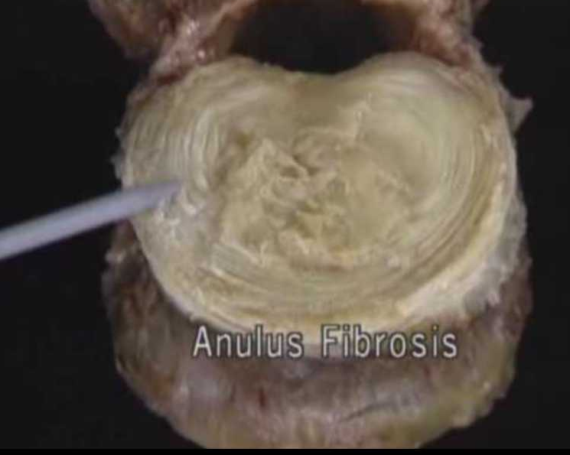
THE INTERVERTEBRAL DISC
Disc is made up of 3 parts:
1. Nucleus Pulposus

Slide 9
NUCLEUS PULPOSUS
• Whitish, glistening, mucoid, semi fluid mass occupying 40% of the disc
• Consists of water(70-90%), glycosaminoglycans and salts with a network of chondrocytes and fibrocytes.
• Type II collagen strand + hydrophilic proteoglycan.

Slide 10
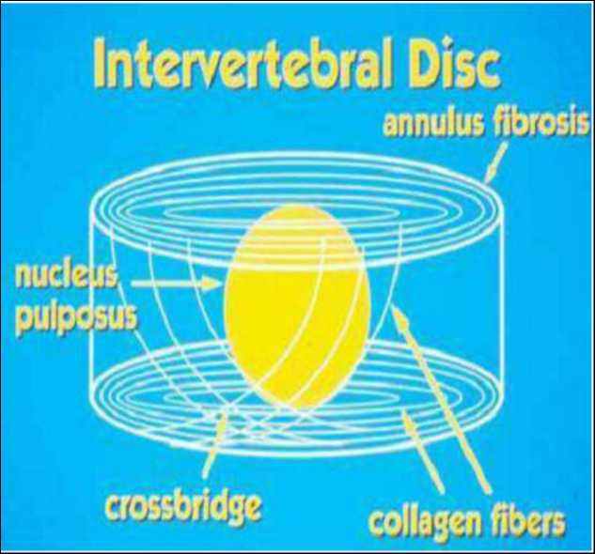
NUCLEUS PULPOSUS
• In lower lumbar spine, it is placed eccentrically near the posterior margin.
• Water binding capacity and elasticity - property of protein content.
• With aging - water binding capacity with progressive
dessication of the disc.

Slide 11
NUCLEUS PULPOSUS
FUNCTIONS:
• Fulcrum for movement (ball bearing)
• Equalization of stresses (even distribution of pressure)
• Dynamic hydraulic shock absorber
• Fluid exchange between vertebrae and disc

Slide 12
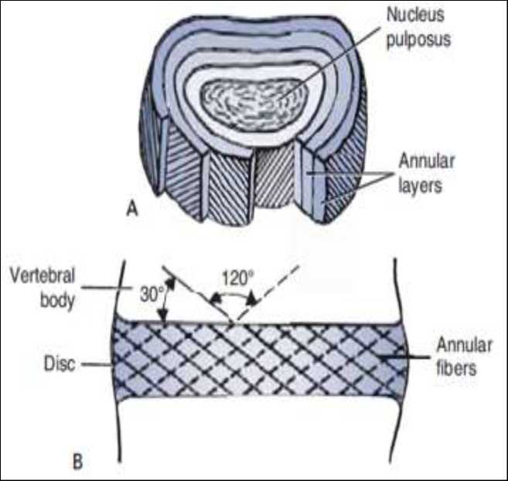
ANNULUS FIBROSIS
• Narrow outer cartilaginous zone and wider inner fibrocartilaginous zone.
• Composed of numerous concentric rings of fibrocartilaginous tissues
• Fibres in each rings cross radially
• Fibres are oriented 30° angle to the disc space.
• Attached to the cartilaginous and bony end-plate at the periphery of the vertebra.

Slide 13
ANNULUS FIBROSIS
FUNCTIONS:
• Stability: Binds vertebral bodies together so that spinal column moves.
• Shock absorber
• Check ligament
• Resist tensile, torsional, and radial stress

Slide 14
BLOOD SUPPLY
• In adults, it is AVASCULAR.
• Sustain by diffusion of nutrients into disc through porous central concavity of end plate.
• Diffusion is maintained by- Motion and weight bearing.

Slide 15
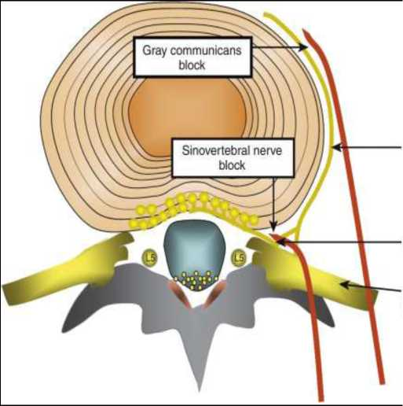
NERVE SUPPLY
• Sinu-vertebral nerve (recurrent branch of vertebral nerve)
• Supply periosteum, post. longitudinal ligament and OUTERMOST layers of annulus fibrosus.
• Nucleus pulposus and innermost layers of annulus fibrosus have NO nerve supply
Gray ramus commumcans
Sinovertebral nerve
L4 spinal nerve dorsal root ganglion

Slide 16
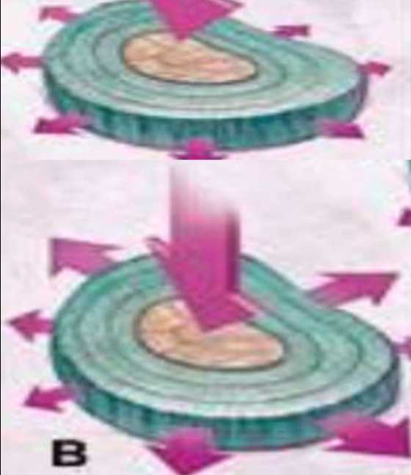
DISTRIBUTION OF LOAD
A. In the normal, healthy disc, the nucleus distributes the load equally throughout the annulus.
B. As the disc undergoes degeneration, the nucleus loses some of its cushioning ability and transmits the load unequally to the annulus.

Slide 17
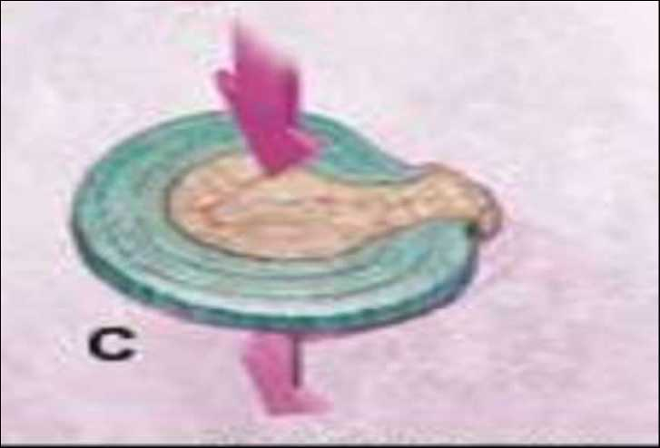
DISTRIBUTION OF LOAD
C. In the severely degenerated disc, the nucleus has lost all of its ability to cushion the load, which can lead to disc herniation

Slide 18
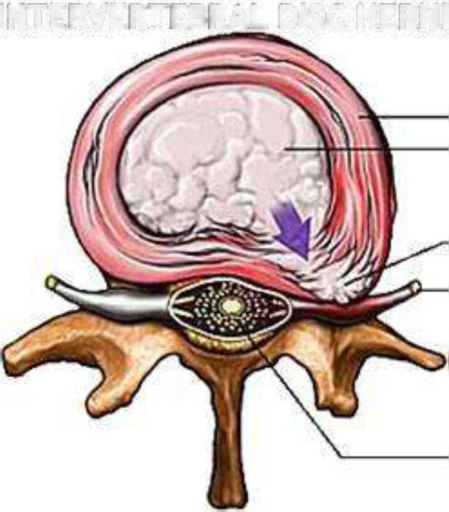
DISC HERNIATION
INTERVERTEBRAL DISC HERNIATION
Annulus fibrosus Nucleus pulposus
Disc Herniation -Nerve root
Spinal cord

Slide 19
BIOMECHANICS
• Supine patient weighing 70kg has a load of 20kg on his L3 spine.
• This increases to
100kg on standing with 20kg in his hand and to 270kg when sitting and leaning forward with 20kg weight in his hands.
• Young adults- IVD are strong and it's impossible to damage a healthy disc, except by forcible flexion.

Slide 20
BIOMECHANICS
• After 2nd decade- degenerative changes may result in:
Necrosis, sequestration of nucleus pulposus. Softening and weakening of the annulus fibrosus.
• Comparatively minor strains may cause either internal derangement with eccentric displacement of nucleus OR external derangement

Slide 21
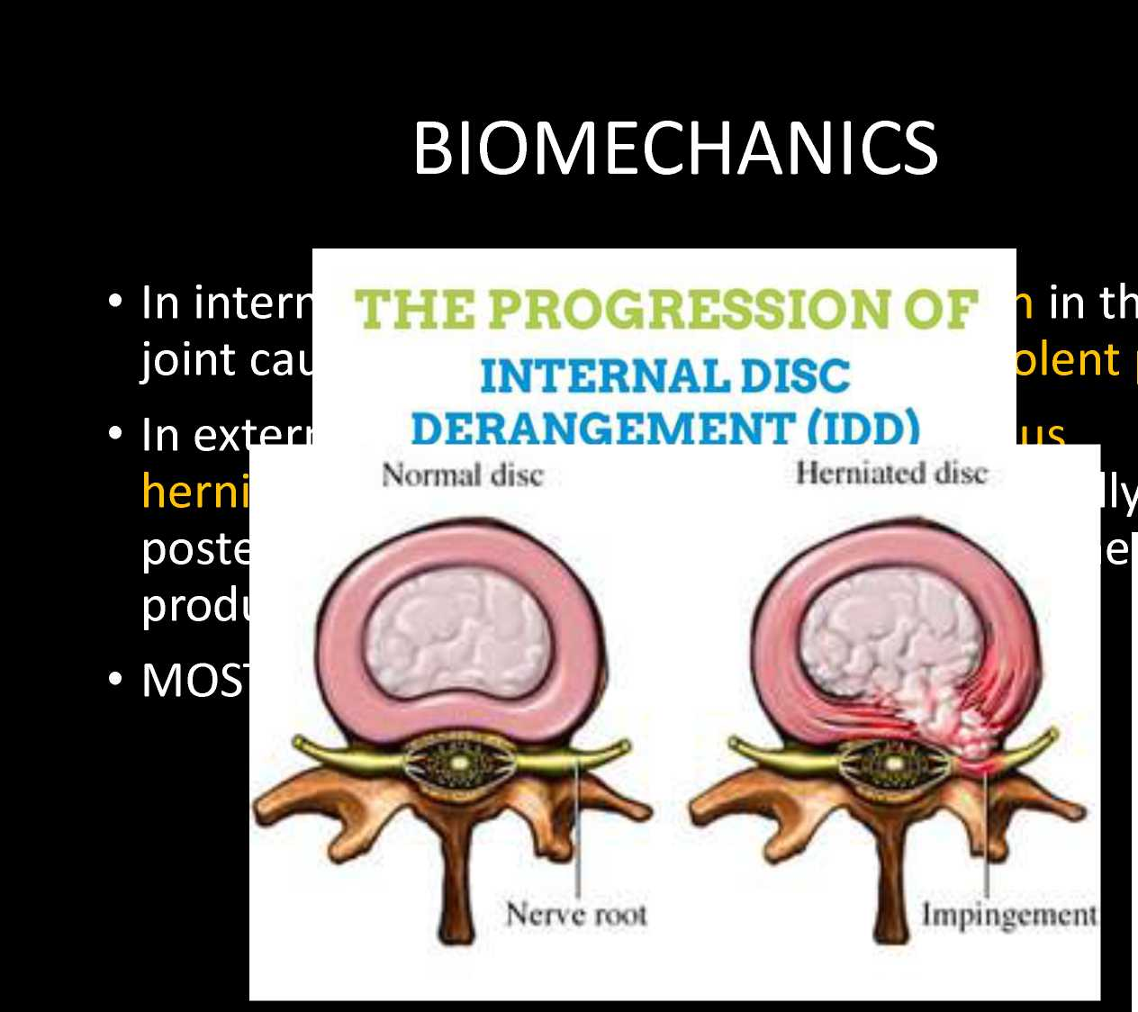
e
ain.
ere it

Slide 22
BIOMECHANICS
• A large central rupture may produce pressure on cauda equina
• Intra-discal pressures, myoelectric activity and intra-abdominal pressure measurements have shown that distance between the weight and body influences stress on the back.
• Disc pressures and myoelectric activity are highest in anterior unsupported sitting and lowest when sitting straight

Slide 23
e
a 225
e
200 175 150 125 100 75 50 25 0
a
%
5
£
© 1996 Scott Bod ell
DISC LOAD IN DIFFERENT BODY POSTURE

Slide 24
NATURAL HISTORY OF DISC
DISEASE
• Recurrent strains produce small, circumferential tears in the annulus fibrosus.
• Later, they enlarge and coalesce to form radial tears that run from annulus to nucleus pulposus.
• Still later, these tears increase further in size until disc is completely disrupted internally.

Slide 25
NATURAL HISTORY OF DISC
DISEASE
• The normal disc height is reduced because of loss of proteoglycans and water from nucleus.
• Annulus become lax and bulge around circumference of disc.
• This bulge must be distinguished from disc herniation, which is a "local protrusion"
• With further loss of disc content, disc space is represented by a "thin slit" filled with fibrous tissue.

Slide 26
NATURAL HISTORY OF DISC
DISEASE
• Vertebral body on either side of the disc is dense and sclerotic- called 'disc resorption'
• Finally disc is anchored by peripheral osteophytes that pass around its circumference.
• End result is bony ankylosis

Slide 27
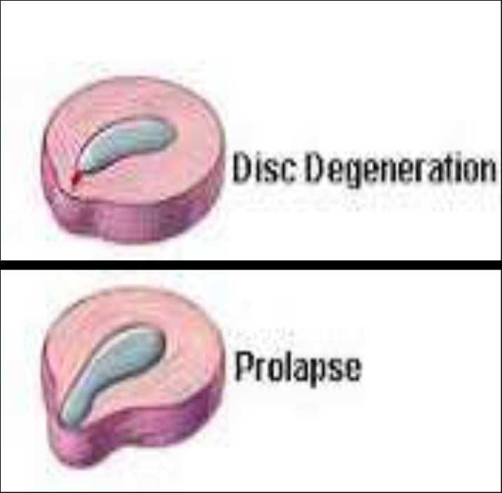
STAGES OF DISC HERNIATION
1. DISC DEGENERATION:
Chemical changes associated with aging causes discs to weaken, without herniation.
2. PROTRUSION:
When nuclear material causes bulging of outermost annular fibres (prolapsed disc)

Slide 28
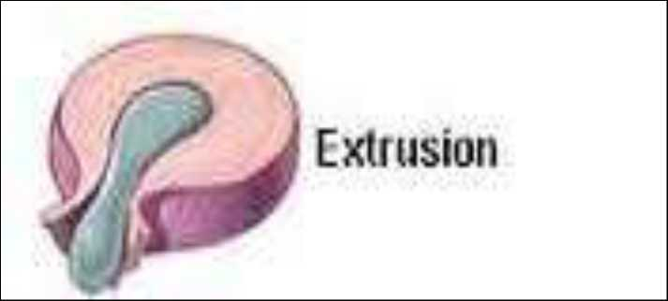
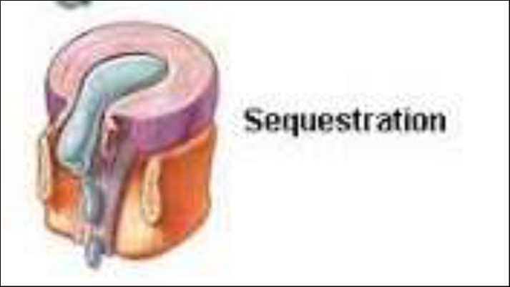
STAGES OF DISC HERNIATION
3. EXTRUSION:
IVD rupture occurs when nuclear material escapes through annular fibres but still remains connected within the disc.
4. SEQUESTRATION:
Nucleus pulposus breaks through the annulus fibrosus and lies outside the disc in the spinal canal.

Slide 29
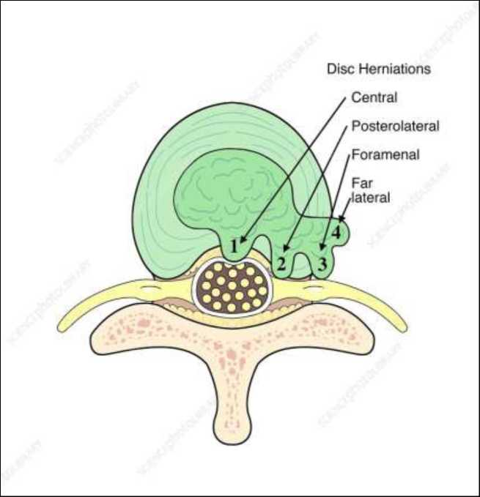
VARIETIES OF DISC HERNIATION
1. POSTEROLATERAL DISC HERNIATION - Protrusion is usually posterolateral into vertebral canal and compress the roots of a spinal nerve.
Protruded disc usually compresses the lower nerve as that nerve crosses level of disc in its path to its foramen.
(eg. protrusion of L5 disc usually affects S1 instead)

Slide 30
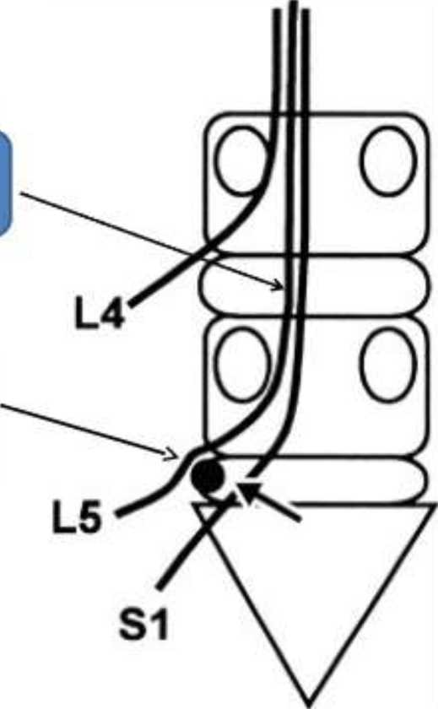
DISC & NERVE ROOT RELATION
L5 is
TRAVERSING NERVE ROOT
L5 is EXITING NERVE ROOT

Slide 31
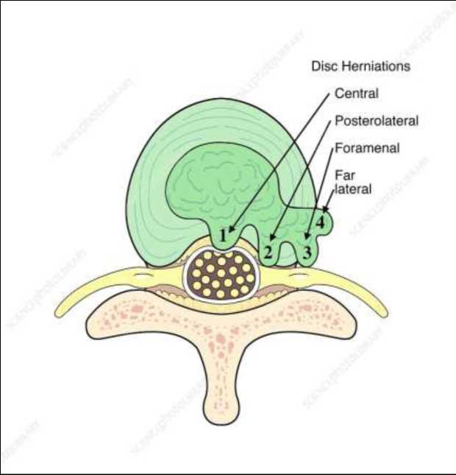
VARIETIES OF DISC HERNIATION
2. CENTRAL (POSTERIOR) HERNIATION:
When nuclear material is extruded through central portion of annulus but contained by post. longitudinal ligament.
Complete rupture- Rare
May rupture when spine is subjected to violent flexion forces.
Nerve roots not commonly involved, but post. ligament may be stretched causing severe back pain without radicular pain

Slide 32
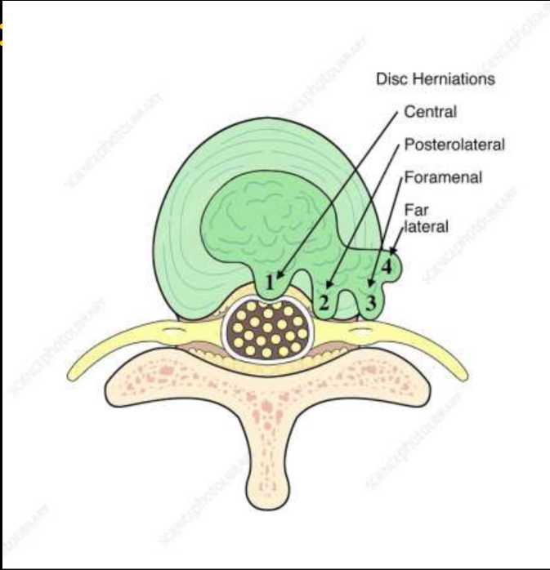
VARIETIES OF DISC HERNIATION
3. LATERAL DISC HERNIATION
May compress the nerve root above the level of the herniation
L4 nerve root is most often involved & patients typically have intense radicular pain.

Slide 33
FREQUENCY
TWO MOST COMMON FORMS
• Lumbar disc herniation
• Cervical disc herniation
Most disc herniations occur in the age group of 30-40 years (when nucleus is still gelatin like)
With age nucleus dries out and risk of herniation is greatly reduced.
At 50-60, spondylosis or spinal stenosis are more likely causes of low back pain/leg pain

Slide 34
FREQUENCY
• Lumbar disc herniation:
15 times more common than cervical disc herniation.
LEVEL | PERCENTAGE
L5-S1 | 40
L4-L5 | 49
L3-L4 | 7.5
L2-L3 | 3
L1-L2 | 0.5

Slide 35
FREQUENCY
• Cervical disc herniation:
Most often between C5-C6 and C6-C7.
Symptoms can affect the back of the skull, neck, shoulder girdle, scapula, shoulder, arm and hand

Slide 36
CAUSES
• Repetitive mechanical activities:
Frequent bending, twisting, lifting, and other similar activities without breaks and proper stretching can leave the discs damaged.
• Living a sedentary lifestyle:
Individuals who rarely if ever engage in physical activity are more prone to herniated discs because the muscles that support the back and neck weaken, which increases strain on the spine.
• Traumatic injury to lumbar discs commonly occurs when lifting while bent at the waist, rather than lifting with the legs while the back is straight.

Slide 37
CAUSES
• Obesity:
Spinal degeneration can be quickened as a result of the burden of supporting excess body fat.
• Practicing poor posture:
Improper spinal alignment while sitting, standing, or lying down strains the back and neck.
• Tobacco abuse:
The chemicals commonly found in cigarettes can interfere with the disc's ability to absorb nutrients, which results in the weakening of the disc.

Slide 38
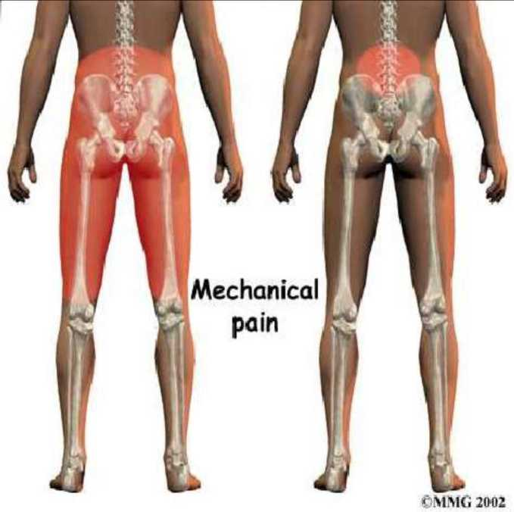
CLINICAL FEATURES
1. LOW BACK PAIN:
At least 4 types are associated.
a) Typical ligamentous or deep pain. Dull aching, poorly localised, varies in intensity.
Due to degenerative changes in nucleus
b) Deep pain due to stretching of the post. interspinous ligament.

Slide 39
CLINICAL FEATURES
c) Direct irritation of nerve root by posterior
protrusion produces pain referred to cutaneous distribution of affected root.
Patient is suddenly seized with an acute and agonising pain in lumbar region due to locking of joint by a nuclear sequesterum.
Relief of symptoms- when there is shrinkage of sequesterum
d) Last stages of disc lesion, is when affected
. oint is undergoing arthritic changes, it
becomes a source of pain associated with degenerative arthritis

Slide 40
CLINICAL FEATURES
• REFERRED PAIN:
Begins in lower back and is referred to SI region and buttocks or posterior thigh.
Can be elicited from many areas of spine- Facet joints, longitudinal ligaments and periosteum
These are mesodermal structures which when irritated give rise to referred pain.

Slide 41
CLINICAL FEATURES
• RADICULAR PAIN:
Extends below knee and follows dermatome of involved nerve root. Pressure on root produces pain and motor and/or sensory signs.
• SCIATICA:
Pathognomic of disc herniation.
Pain- Gradual or sudden in onset.
Gnawing or burning- continuously present or occurs paroxysmally.
Worse at night and while sitting.
Pain starts in back and spreads downwards.
Generally worse at he back of thigh and hip.
/

Slide 42
CLINICAL FEATURES
2. MUSCLE SPASM:
Reflex spasm of the erector spinae muscle- to protect and immobilize affected joint.
3. ABNORMALITIES OF POSTURE:
Flattening of lumbar lordosis- due to joint derangement.

Slide 43
CLINICAL FEATURES
4. DISORDERS OF MOVEMENT:
IVDP produces limitation and pain on movement of lumbar spine. Forward flexion and extension- more affected.
5. LOCAL TENDERNESS:
Deep tenderness present- about 2 inches from midline at level of lesion.

Slide 44
CLINICAL FEATURES
6. MOTOR CHANGES:
Muscle weakness and wasting occurs with prolonged and severe root irritation by increased tension.
7. REFLEX CHANGES:
There is associated diminution or complete loss of reflex tendon jerks in the affected root.
Alteration of these reflexes is an early and reliable sign of root involvement.

Slide 45
CLINICAL FEATURES
REFLEX CHANGES (contd)
Once reflex has been lost- recovery is slow even if nerve root is completely freed by operating.
Classically, ankle jerk- absent, knee jerk- present with herniation of lower lumbar discs.

Slide 46
CLINICAL FEATURES
8. SENSORY CHANGES:
Involvement of nerve root associated with sensory changes in skin area which it supplies.
Tingling/ pins and needles/ blunting/ loss of sensation.
Due to overlap of dermatomes- difficult to identify specific root involved.
Sensory finding below ankle- more reliable.
Loss of proprioception

Slide 47
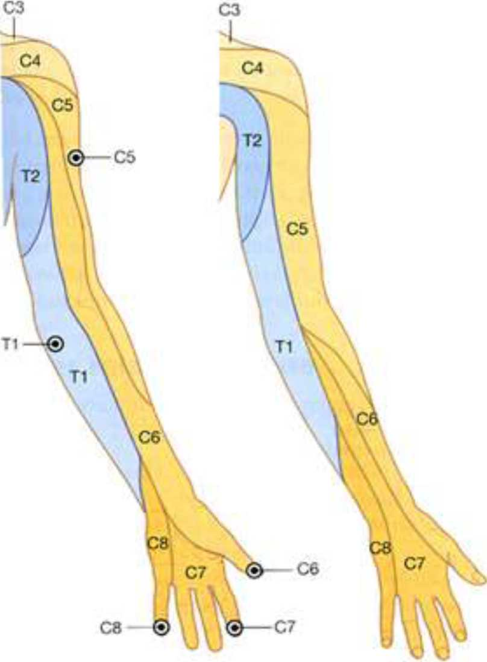
L4

Slide 48
Malli

Slide 49
CLINICAL FEATURES
9. BLADDER CHANGES: 4 syndromes described:
• Total urinary retention
• Chronic, long standing, partial retention
• Vesicular irritability
• Loss of desire to void, associated with unawareness of the necessity to void

Slide 50
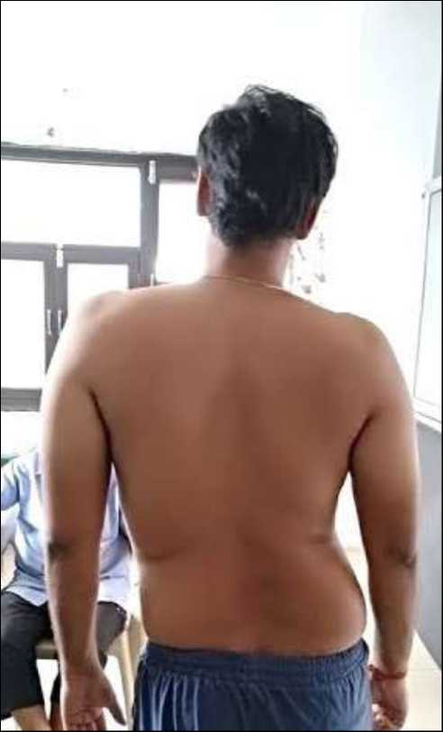
PHYSICAL EXAMINATION
INSPECTION:
Patient holds painful leg in flexed position and reluctant to place ,:oot flat on floor.
Antalgic gait.
Loss of lumbar lordosis.
In acute cases- Patient may tilt away from side of sciatica (sciatic scoliosis)- in an attempt to decompress nerve root

Slide 51
PHYSICAL EXAMINATION
PALPATION:
Tenderness on palpation- at level of symptomatic degenerative disc.
Paraspinal muscle spasm +
Patients with radiculopathy have tender motor points corresponding to probable segmental level of nerve root.

Slide 52
PHYSICAL EXAMINATION
NEUROLOGICAL EXAMINATION:
Weakness or paralysis of muscle group Loss of tone Wasting or atrophy Reflexes- Diminished or lost.

Slide 53
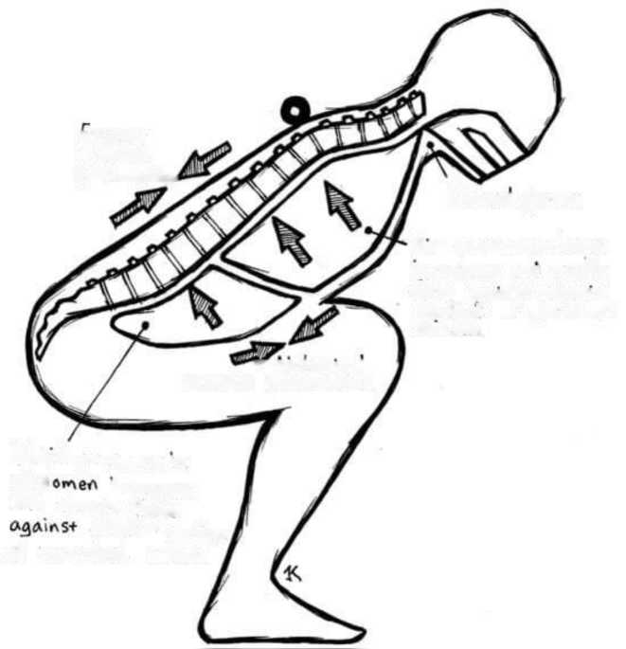
PHYSICAL EXAMINATION
SCIATIC TENSION SIGNS:
1. Valsalva manoeuvre: Coughing, sneezing and straining may produce sudden increase in intra discal pressure and thus- stretch pain
erector
Muscle
Contraction'
Closed glottis
A»< pressure in
lorv
3^{s}
increases and exerts
force
aja*
r\st on-tenor
Sarfac* of vertebral
Cola
m.rs
^{w} Abdominal fr\\ASCl« Contraction
F llA»<l
pressure in
ab d
increases
and
exerts force
on+#f'iof suffice
of veirfeloral
CtUlOA

Slide 54
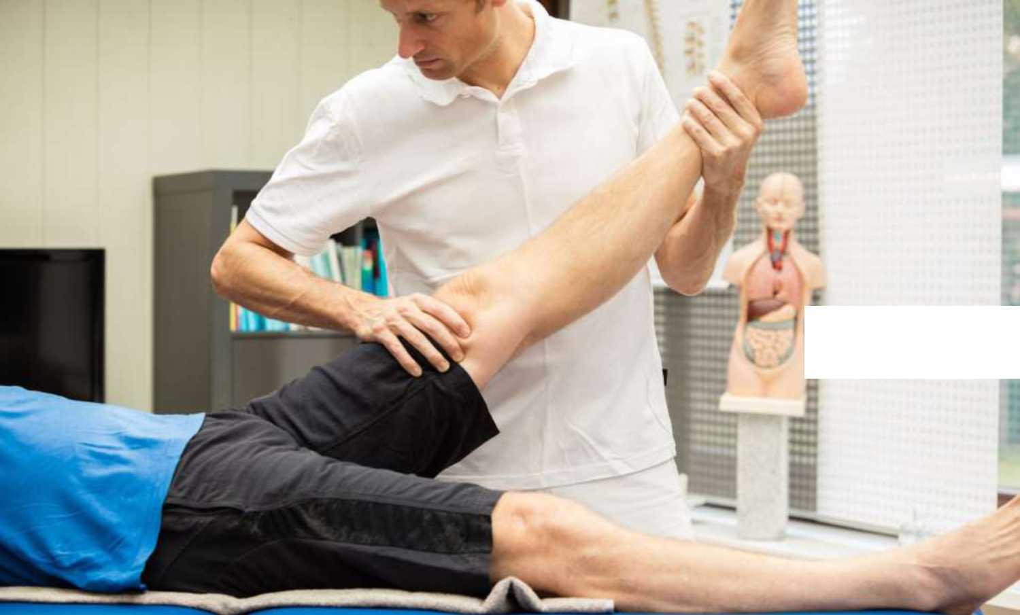
PHYSICAL EXAMINATION

Slide 55
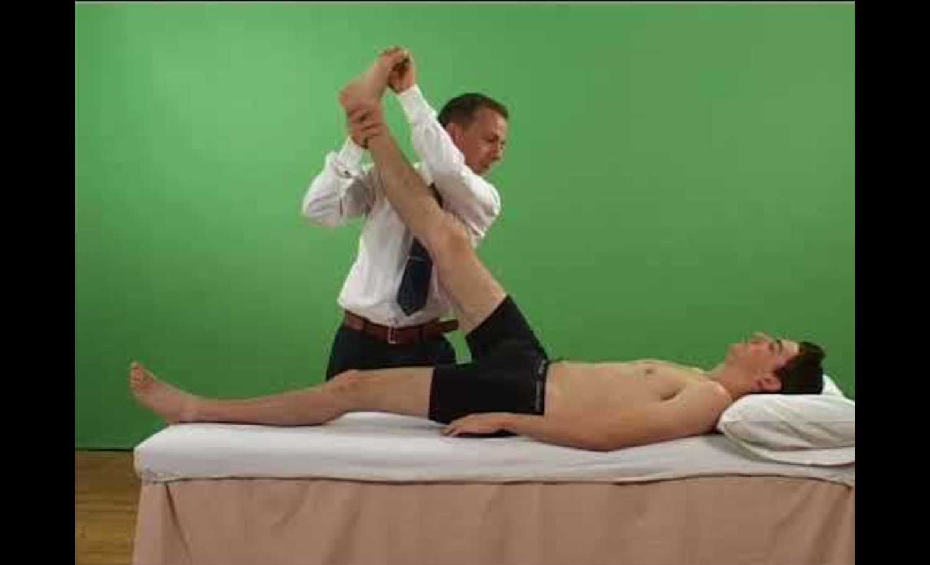
PHYSICAL EXAMINATION

Slide 56
PHYSICAL EXAMINATION
3. Contralateral SLRT
Performed in same manner as SLRT
Except- non painful leg is raised
If sciatica produced in opposite limb- positive
Suggestive of herniated disc.

Slide 57
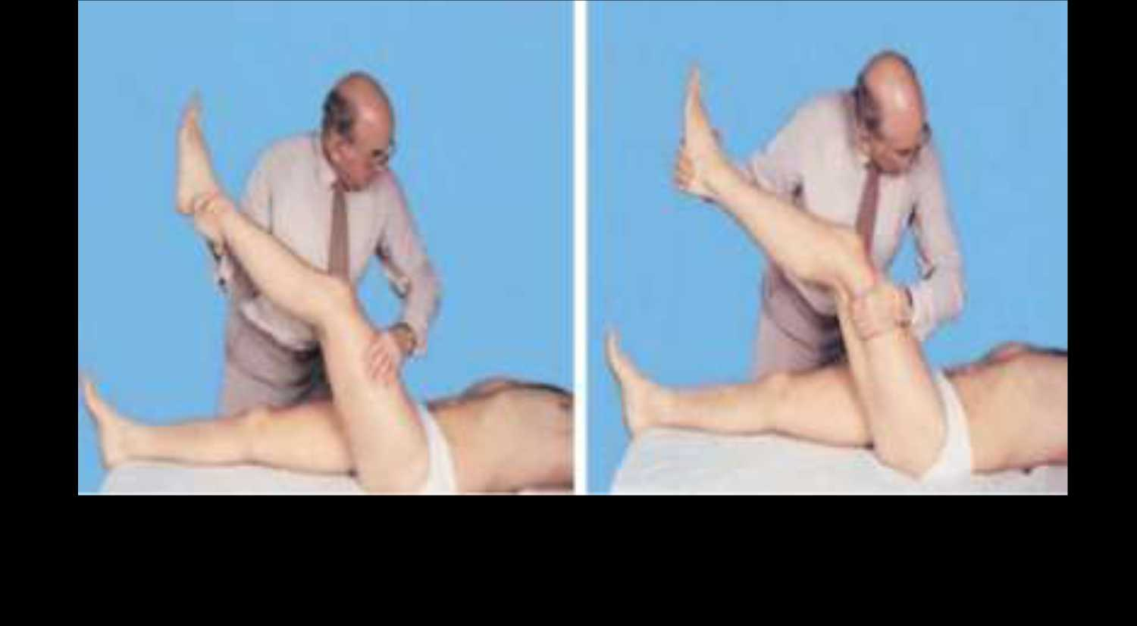
PHYSICAL EXAMINATION

Slide 58
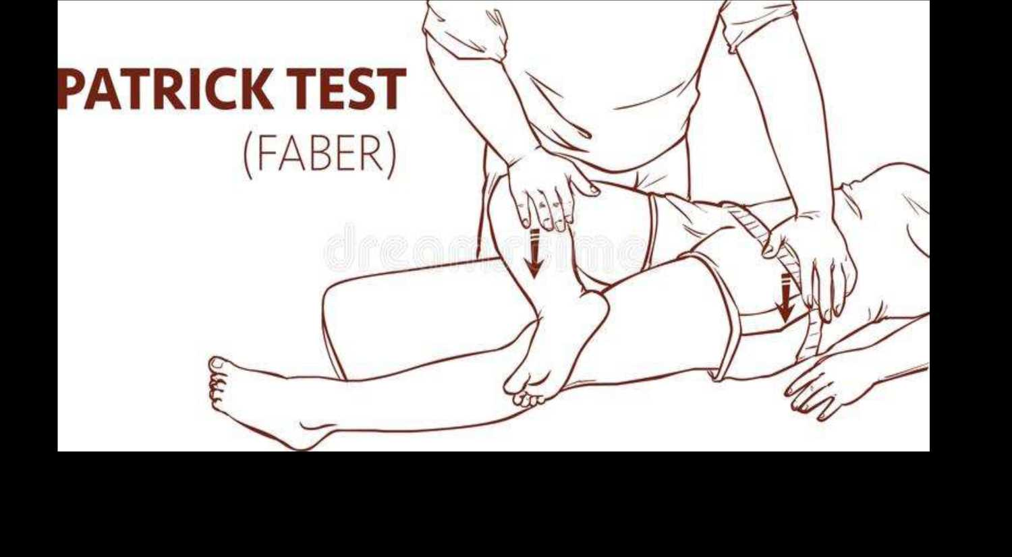
PHYSICAL EXAMINATION

Slide 59
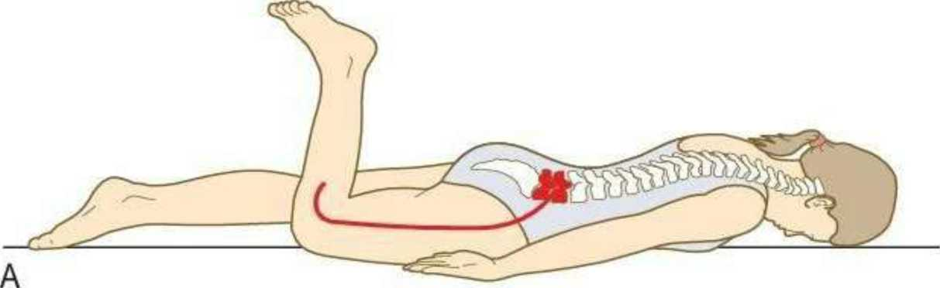
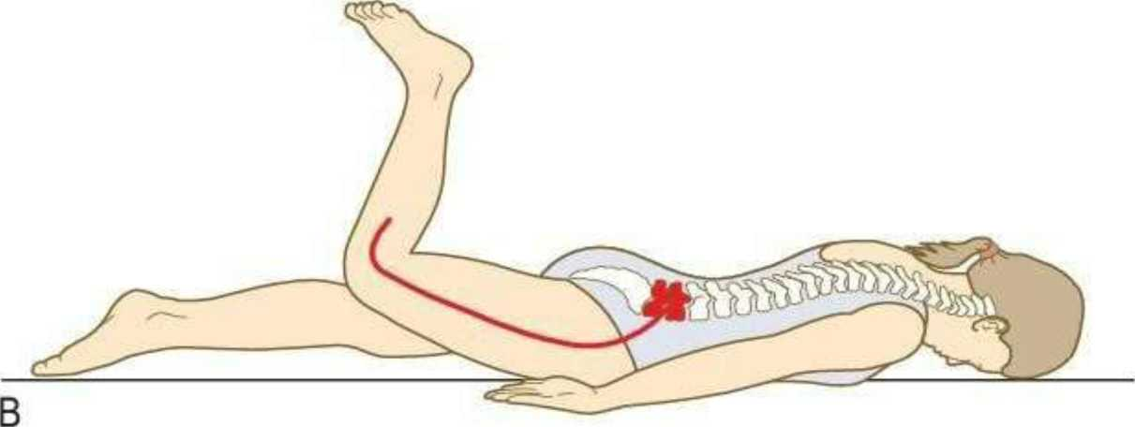
PHYSICAL EXAMINATION

Slide 60
PHYSICAL EXAMINATION
7. Cross-over test:
Determinant of compression of lumbosacral roots.
Raise the affected leg and this produces symptoms down asymptomatic contralateral extremity- positive
Indicates- large central disc protrusion.

Slide 62
INVESTIGATIONS
3. OBLIQUE LS SPINE (tube-45 degrees)
• Neural foramina narrowing
• Pars interarticularis defects
• Facet hypertrophy
• Spondylosis
• Spondylolysis
• Spondylolisthesis
4. FLEXION AND EXTENSION VIEWS

Slide 64
INVESTIGATIONS
CT SCAN
Lumbar disc herniation found to be- Focal, asymmetric and dorsolateral
ADVANTAGE:
Ability to see beyond dural sac and root sleeves and size of spinal canal
LIMITATION:
Cannot differentiate between-
• Scar tissue and disc herniation
• Annulus and nucleus

Slide 65
INVESTIGATIONS
MRI
• Clearly superior in the detection of disc degeneration.
• Allow evaluation of complete spinal group
• Shows:
• Intervertebral disc protrusion.
• Compression of nerve root

Slide 66
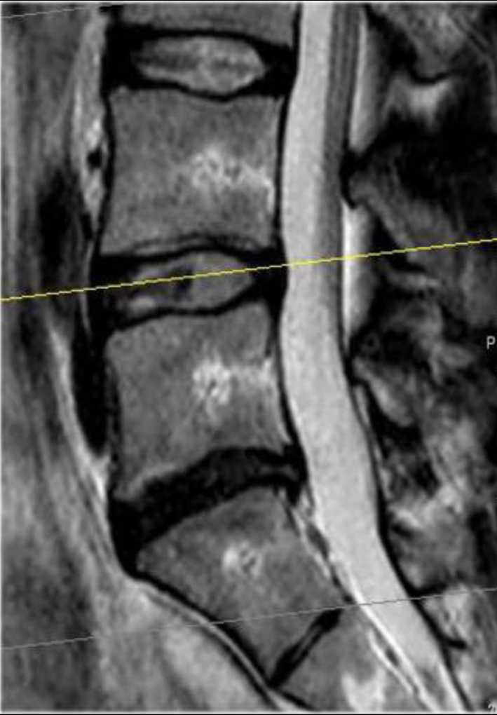
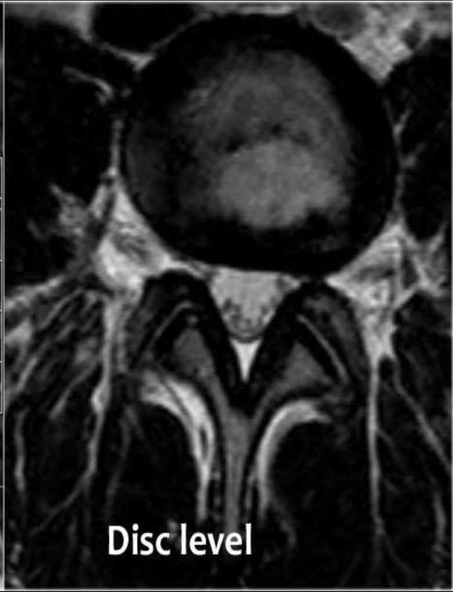

Slide 67
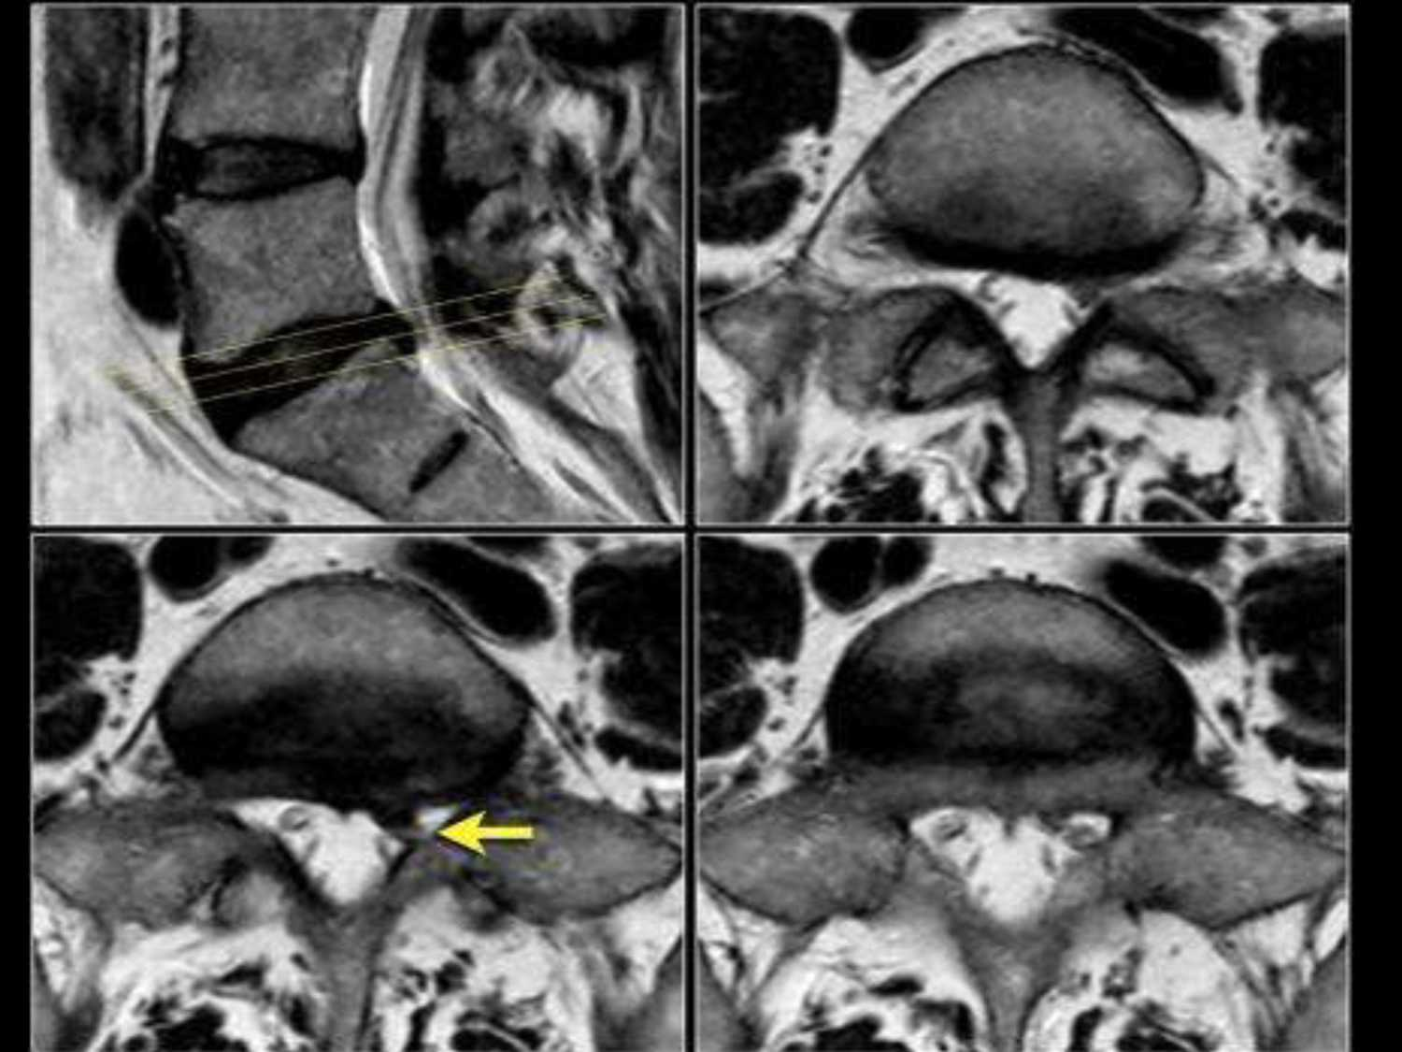

Slide 68
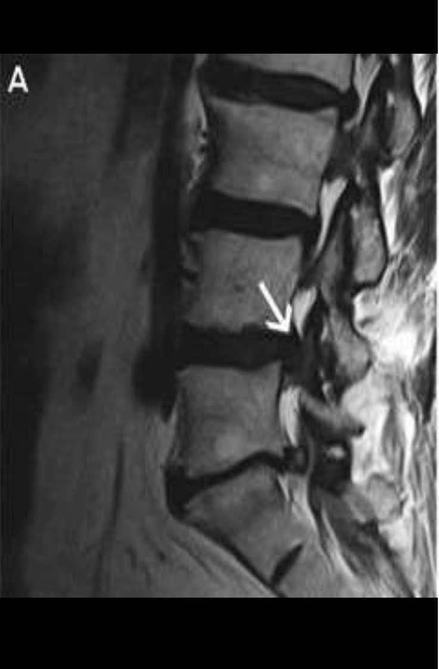
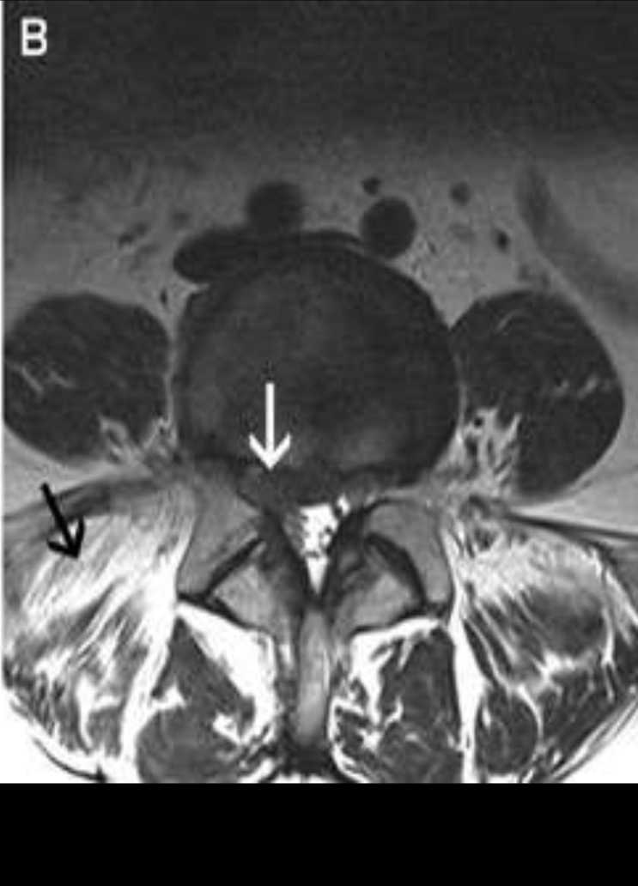

Slide 69
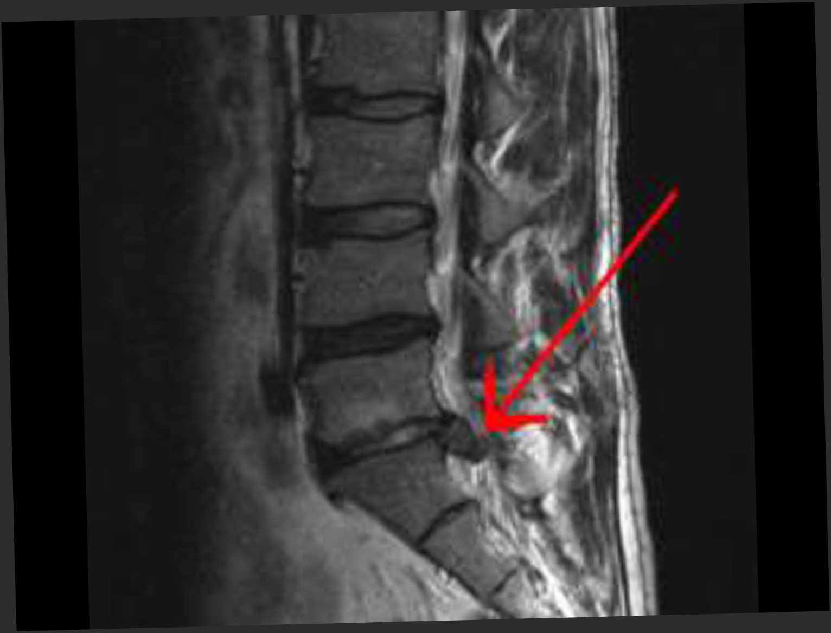

Slide 70
TREATMENT
CONSERVATIVE MANAGEMENT
Majority of patients respond well to conservative management
1. BED REST:
Strict bed rest- minimum 3 weeks
Mobilization- gradually started after pain and muscle spasm has reduced

Slide 71
TREATMENT

Slide 72
TREATMENT
2. DRUG THERAPY:
Bed rest supplemented by- NSAIDS, Muscle relaxants, night sedation
3. PHYSIOTHERAPY:
• Patients with acute back pain eased by passive extension of spine can benefit with extension exercises.
• Should not be forced in extreme pain.
• Education should be given regarding posture and biomechanics.

Slide 73
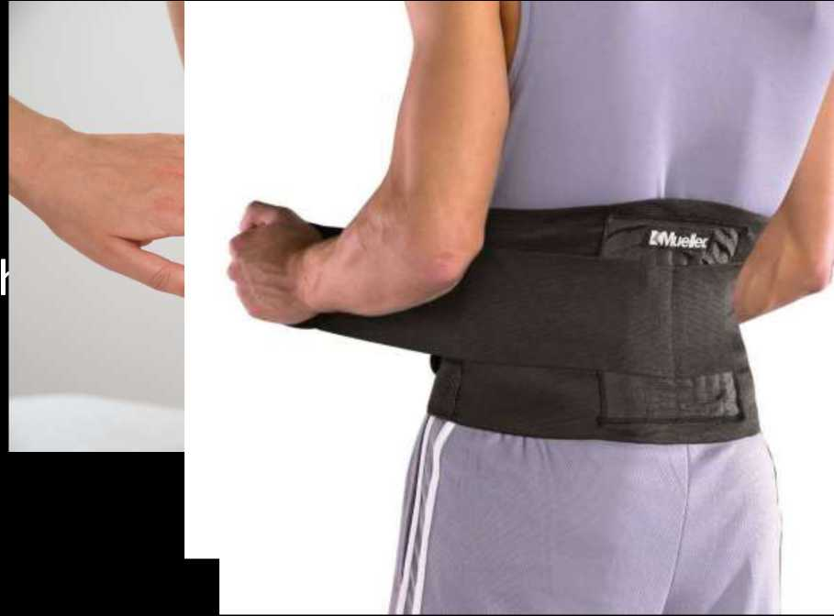
TREATMENT
• Some patients respond to-
TENS
Skin/pelvic traction Back braces/corsets Ultrasound and diat

Slide 74
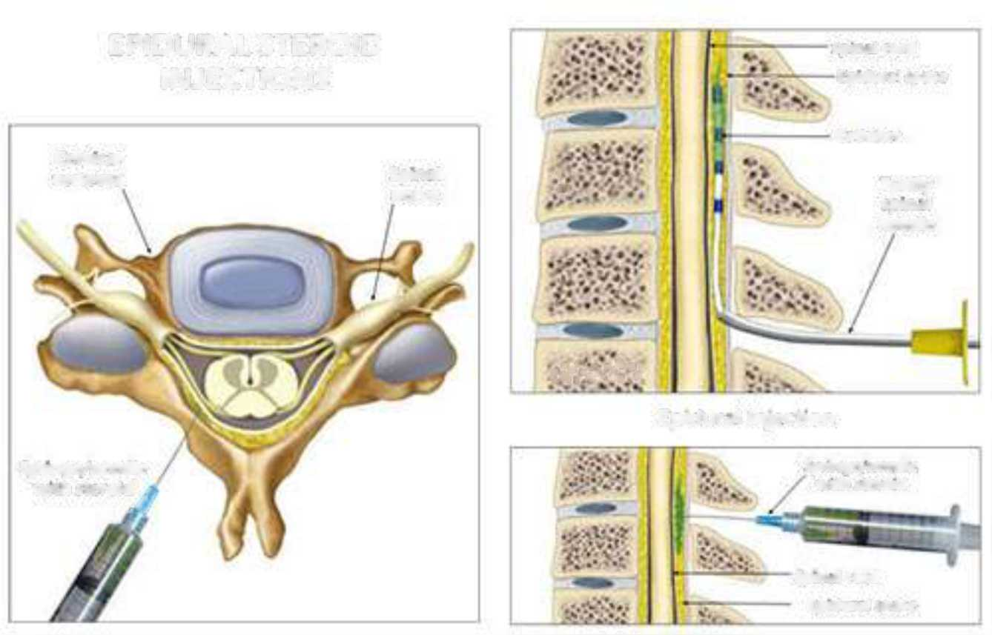
TREATMENT
EPIDURAL STEROID INJECTIONS
Spin.*I cord £p*durM ip,Kc
* -
Ciitlwtn
CcrvK^I
vertebra
Spwi.il
nerve
• •
Tuotiy
spm.il
nccdJc
tSSsKi?
Epidural Injection
Syringc/nccdlc with steroid a
J
Syringe/needle with steroid
Spwi.it cord CpKhirrl Sp.KC

Slide 75
TREATMENT
INDICATIONS:
• Painful SLRT
• Patients with neurological deficit
• Patient with acute on chronic symptoms, with different level of disc pathology
CONTRAINDICATIONS:
• Infection
• Haemorrhagic and bleeding diasthases
• Neurological diseases
COMPLICATIONS:
• Bacterial meningitis
• Transient hypotension
• Headache

Slide 76
TREATMENT
5. CHEMONUCLEOSIS
Enzymatic dissolution of disc.
Various substances used are- chymopapain, collagenase, apoprotein, chondroitinase.
Limited to lumbar disc preferably at one level. Confirmed by MRI/CT

Slide 77
TREATMENT
SURGICAL MANAGEMENT
INDICATIONS:
• Paraplegia or acute bladder paralysis due to cauda equina- an absolute indication.
• Neurological impairment- which is progressing
• Failure of conservative management
• Recurrent sciatica

Slide 78
TREATMENT
Options available are:
1. Posterior approach
-Standard laminectomy and discectomy -Fenestration operation -Microsurgical laminotomy with disc fragment excision.
2. Anterior approach with or interbody fusion
3. Percutaneous approach- suction, laser or arthroscopic discectomy

Slide 79
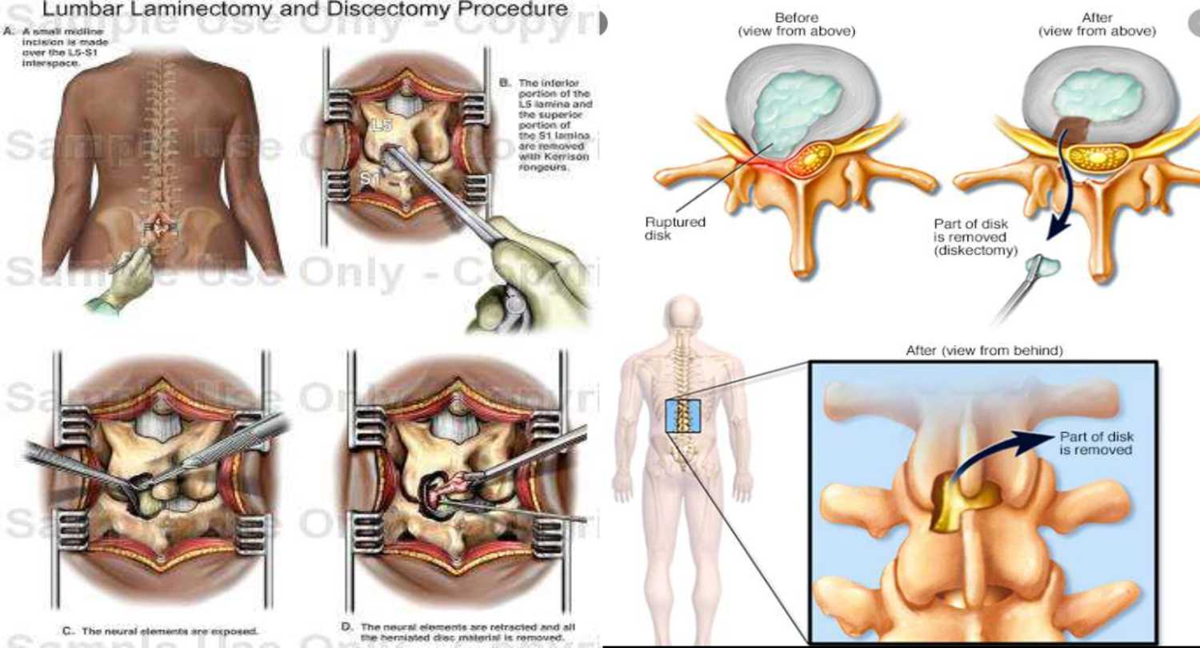
TREATMENT
LAMINECTOMY AND DISCECTOMY

Slide 80
TREATMENT
LAMINOTOMY
Partial removal (or by making a larger opening) of the lamina.
Less invasive than LAMINECTOMY

Slide 81
TREATMENT
SPINAL FUSION INDICATIONS:
• Young patients with signs of spondylolisthesis
• Post laminectomy who show instability
• Advanced intervertebral arthritis
• Need to return back to heavy manual work.

Slide 82
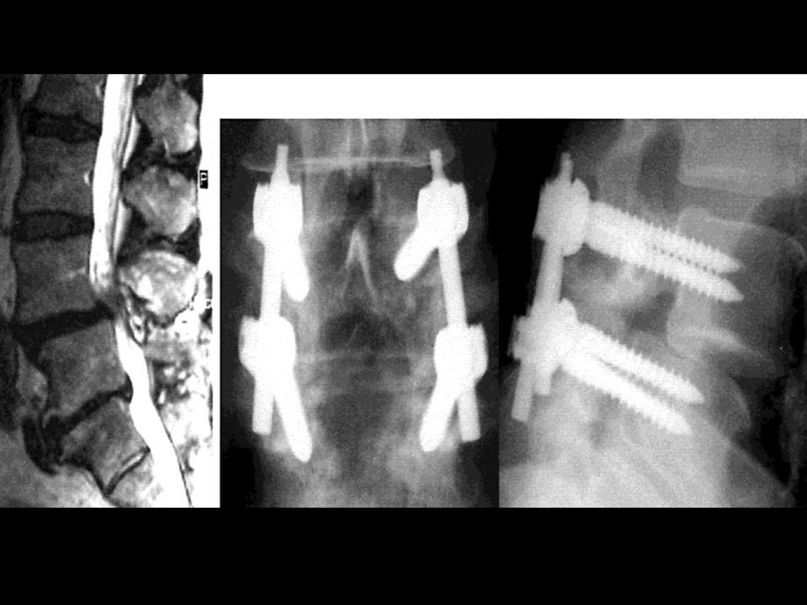

Slide 84
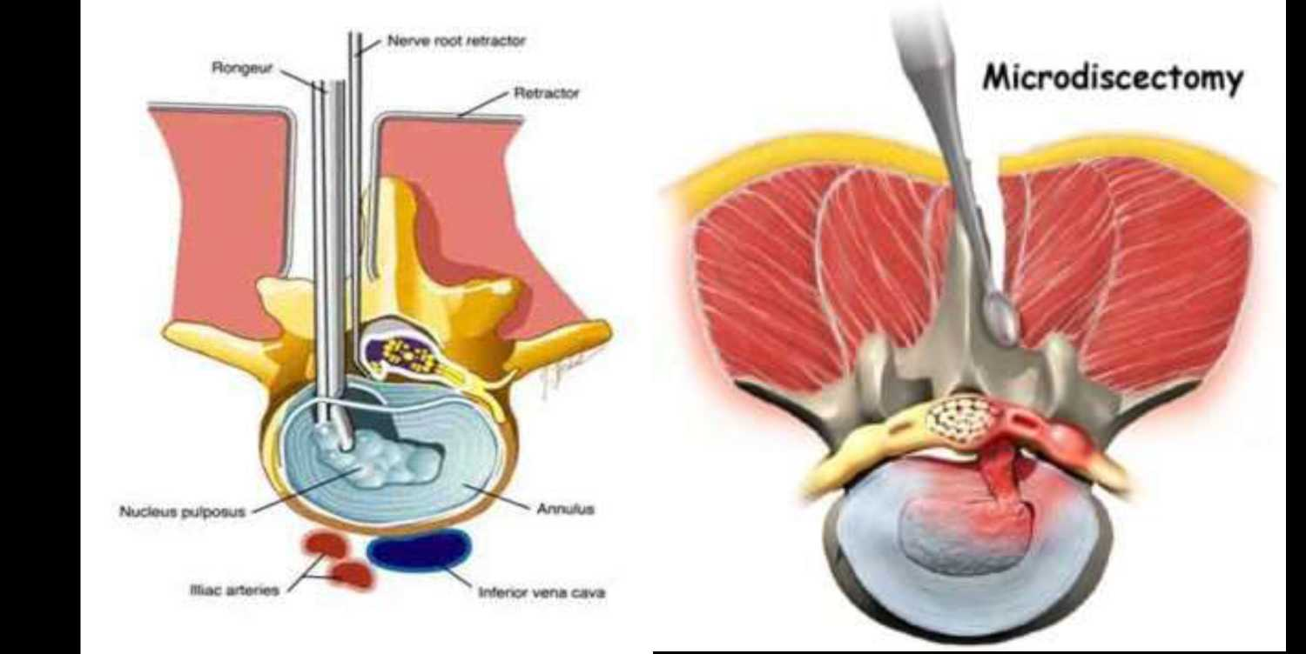
TREATMENT
RECENT ADVANCEMENTS

Slide 85
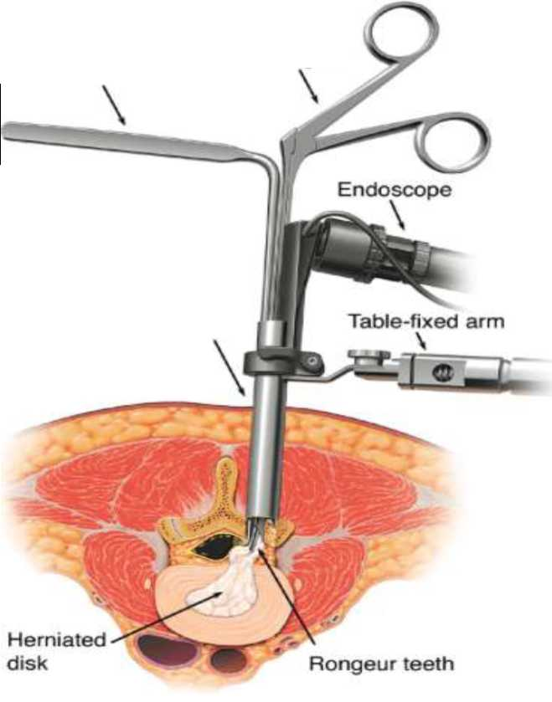
TREATMENT
2. MICROENDOSCOPIC DISCECTOMY
Blends percutaneous procedures with best of microdiscectomy.
Allows minimum tissue injury.
Direct observation of nerve root maximizes success.
Surgical outcomes match that of microdiscectomy.
Root retractor
Rongeur
Retractor tube

Slide 86
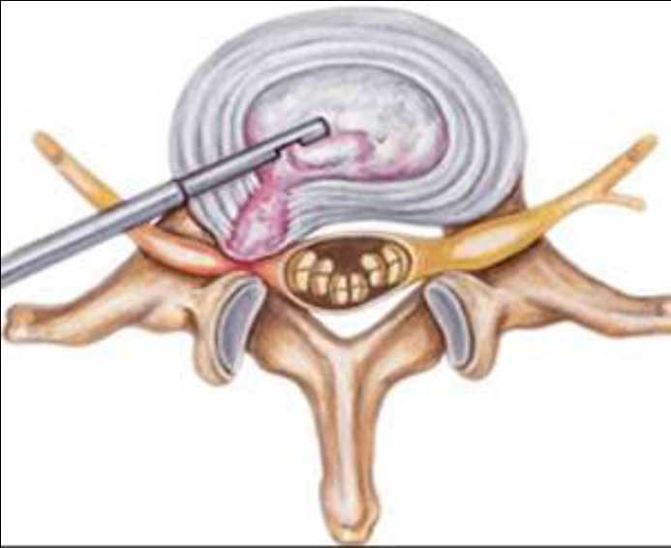
TREATMENT
3. PERCUTANEOUS LUMBAR DISCECTOMY
Operates only within confines of disc space, so abnormality must be restricted to area within annulus or contiguous post. longitudinal ligament
Percutaneous Endoscopic Lumbar Discectomy (PELD)

Slide 87
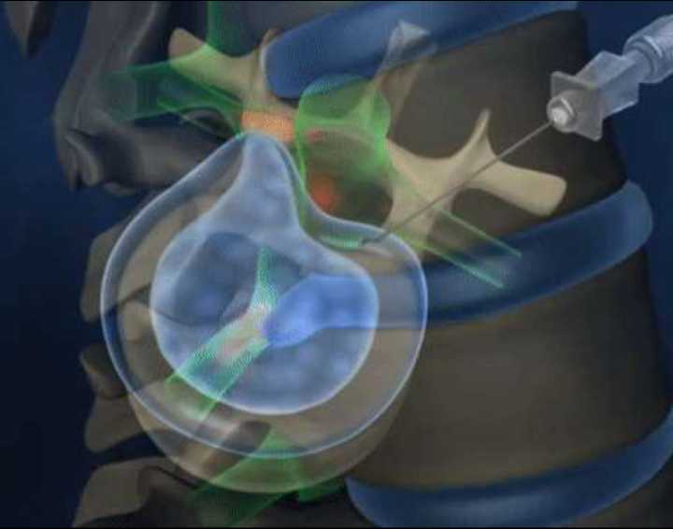
TREATMENT
4. PERCUTANEOUS LASER DISECTOMY:
A thin cannula is inserted through the back
Laser catheter is then inserted
Pulses of laser light will shrink the disc wall.
Because no muscles or bone is cut, recovery is faster

Slide 88
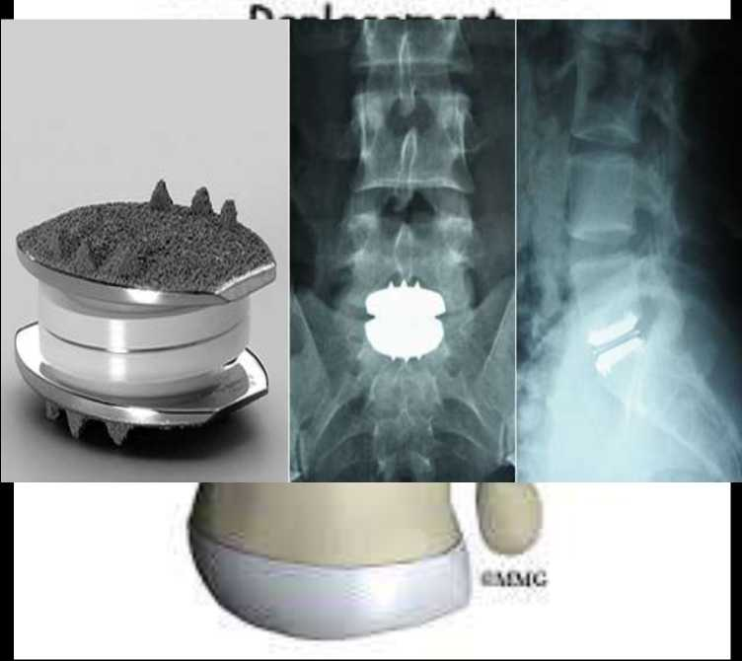
TREATMENT
5. LUMBAR ARTIFICIAL DISC REPLACEMENT
These replace entire disc unit (annulus and nucleus).
Less invasive- Only nucleus pulposus is replaced
Implant is designed to bear load through spine and prevent collapse.
Lumbar Artifical Disc

Slide 89
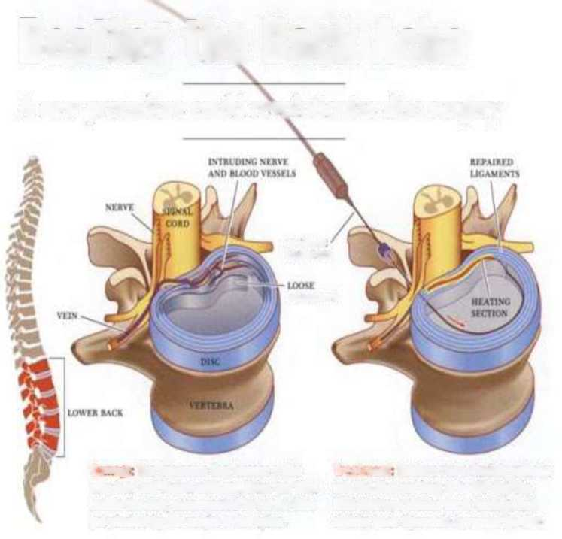
TREATMENT
6. INTRADISCAL ELECTROTHERMIC THERAPY (IDET)
Advanced procedure by electrothermal catheters that allow for careful and accurate temperature control.
The procedure works by cauterizing the nerve endings within the disc wall to help block the pain signals
Minimally invasive outpatient surgical procedure
Beating tin Back Ache
A new procedure could revolutionize disc surgery
nrxiau * cAmma
UGAMIXn
Damage: The ligaments that encase a disc may tear and loosen with age. Veins can then Invade the disc, accompanied by nerves that get pinched by the weight of the spine.
Treatment Doctors run a flexible catheter into the disc and heat It to 194 degrees. Heat destroys painful nerve endings and shrinks loose ligaments to reseat the disc.

Slide 90
COMPLICATIONS
1. Infection
2. Thrombophlebitis/ DVT
3. Pulmonary embolism
4. Dural tears resulting in: Pseudomeningocele, CSF leak, meningitis.
5. Post-op cauda equina lesions
6. Nerve-root injury
7. Urinary retention

Slide 91
CAUDA EQUINA SYNDROME
• Seen post-operatively after lumbar disc excision OR in a large midline/higher disc herniation.
CLINICAL FEATURES:
• Difficulty in walking for a specified distance associated with p ns and needles.
• Difficulty with urination, frequency or overflow incontinence
• Paraesthesia in gluteal region, perineum and urethra
• Loss of anal reflex

Slide 92
CAUDA EQUINA SYNDROME
• Symptoms relieved after 30 sec to 3 minutes by standing or lying down.
• Neurologic signs:
Depressed patellar and ankle reflex.
B/L muscle wasting in glutei, hamstring and calf.
• Hypoalgesia and hypoesthesia in all sacral segments.
• Absolute indication for surgery.

Slide 93
MCQ
•A young rower complains of sudden onset of low back pain when weight-lifting. There is no radiation of the pain and there is no neurological deficit. There is considerable lordosis of the lumbar spine with a step palpable at L5/S1. What is the most likely diagnosis ?
Prolapsed intervertebral disc
B. Spondylolisthesis
C. Collapsed vertebra
D. Muscle strain.

Slide 94
THANK YOU

