Slide 1

Lecture 7
AMPUTATIONS - GENERAL PRINCIPLES & UPPER LIMB AMPUTATIONS
Dr Aditya Agrawal
Associate Professor
Dept of Orthopaedics, Dhiraj Hospital
SBKS MIRC, Sumandeep Vidyapeeth
Vadodara

Slide 2
INTRODUCTION
Amputation is the most ancient of surgical procedure.
Amputation is no longer a crude ablational surgery but a refined reconstructive procedure to prepare the stump for its motor functions ,sensory feed back and cosmesis.
Early surgical amputation was a crude procedure by which a limb was rapidly severed from an unanesthetized patient.
The open stump was crushed or dipped in boiling oil to obtain hemostasis.

Slide 3
In 1674 Morels introduced use of tourniquet.
In 1867 Lister's introduced the antiseptic technique.
With the use of chloroform and ether general anesthesia in the late 19th century, surgeons for the first time could fashion reasonable sturdy and functional stumps.
In the past 3 decades there has been increased interest in improving surgical techniques, after care and post surgical prosthetic fitting.

Slide 4
DEFINITION
Amputation is defined as surgical ablation of a part or whole of limb through one or more bones.
DISARTICULATION is removal of a part through a joint
INCIDENCE
Age: Common in 50 to 75 years age group
Sex: 75% men and 25% women
Limbs: 85% is through the lower limbs, 15% is through upper limbs

Slide 5
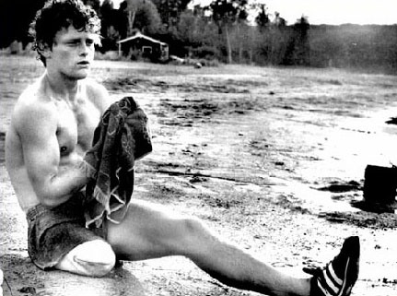
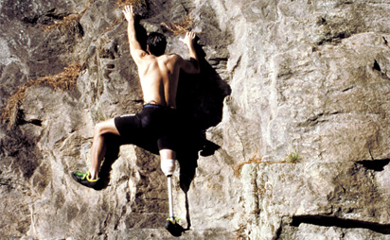
What is an Amputation?
Amputation: the surgical removal of a part of the body, a limb or part of a limb
Notes:
Amputation is the surgical removal of a part of the body, a limb or part of a limb to treat recurrent infection, gangrene in peripheral vascular disease; to remove malignant tumors; or to treat severe trauma. Amputation is used to relieve symptoms, improve function and save or improve the patients quality of life.

Slide 6
Classification of Amputations
Primary amputation (within first 24 hours)
Secondary amputation (7-8 days after injury)
Re-amputation (repeated amputation)

Slide 7
Steps of Amputation
I. Cutting of soft tissue
II. Treatment of periosteum and cutting of bone
III. Stump treatment

Slide 8
INDICATIONS
Amputation should be considered only if limb is
  Dead (gangrenous),
  Dying (ischaemic),
  Dangerous (malignancy) or
  Dud (useless)
The only ABSOLUTE indication is Irreversible ischaemia of a diseased or injured limb

Slide 9
Amputation: Etiology
Trauma
Burns
Peripheral Vascular Disease
Malignant Tumors
Neurologic Conditions
Infections
Congenital Deformities

Slide 10
Etiology: Trauma
90% of Upper Extremity Amputation
Male:Female = 4:1
Most Amputations at level of Digit
Major Limb Amputations less common

Slide 11
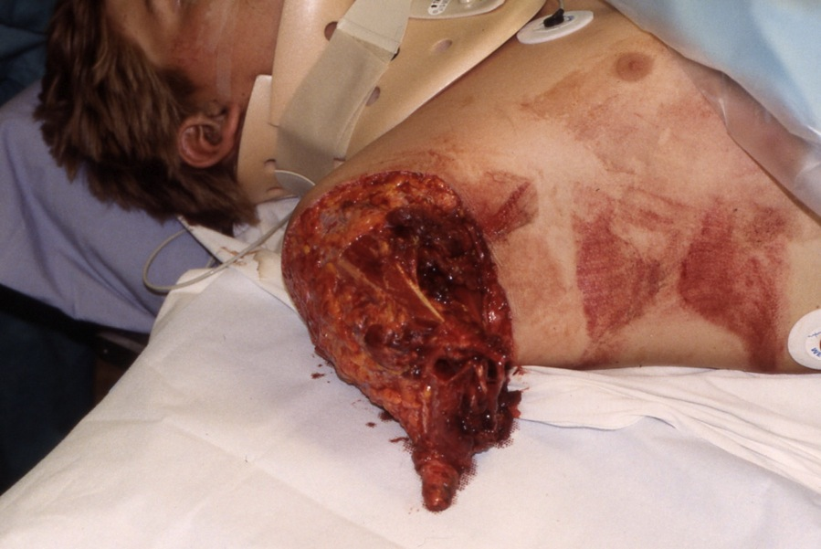
Etiology: Trauma

Slide 12
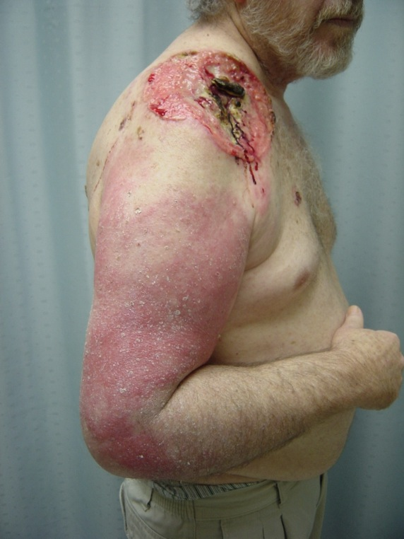
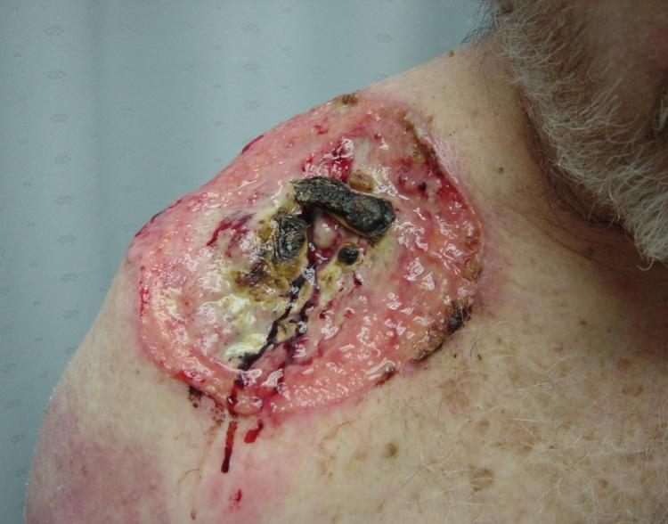
Etiology: Tumor

Slide 13
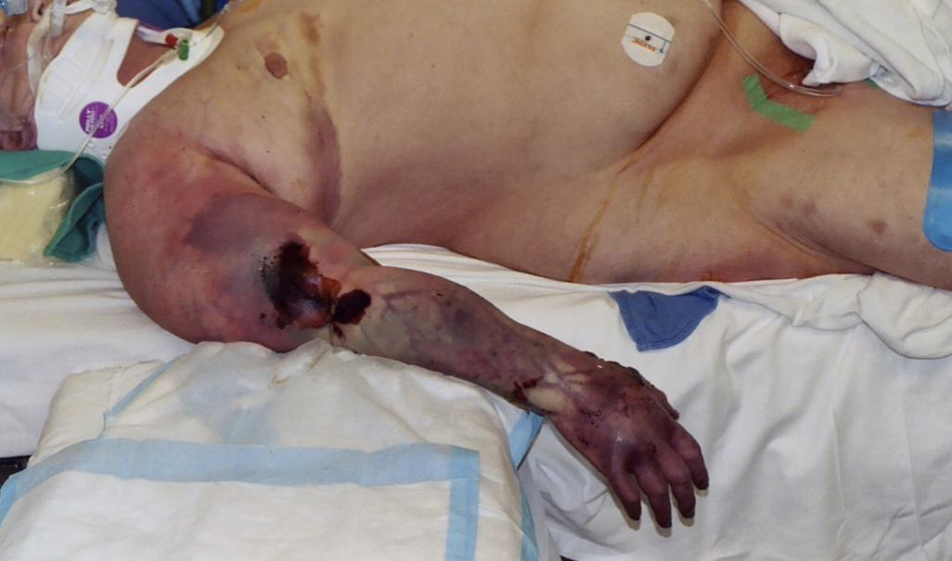
Etiology: Infection

Slide 14
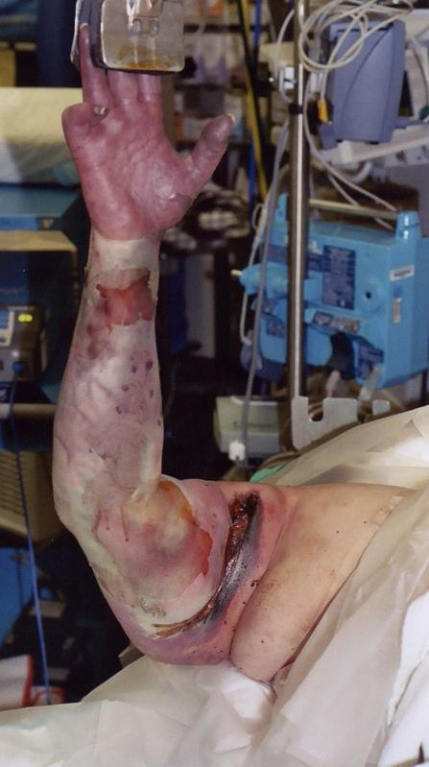
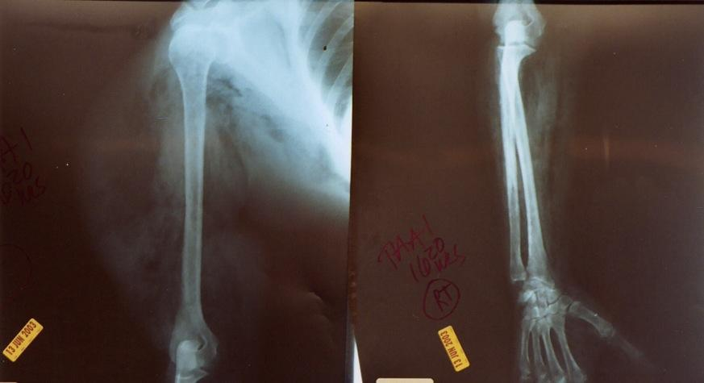
Etiology: Gangrene/Necrotizing Fasciitis
Radiograph:
Subcutaneous air throughout arm

Slide 15
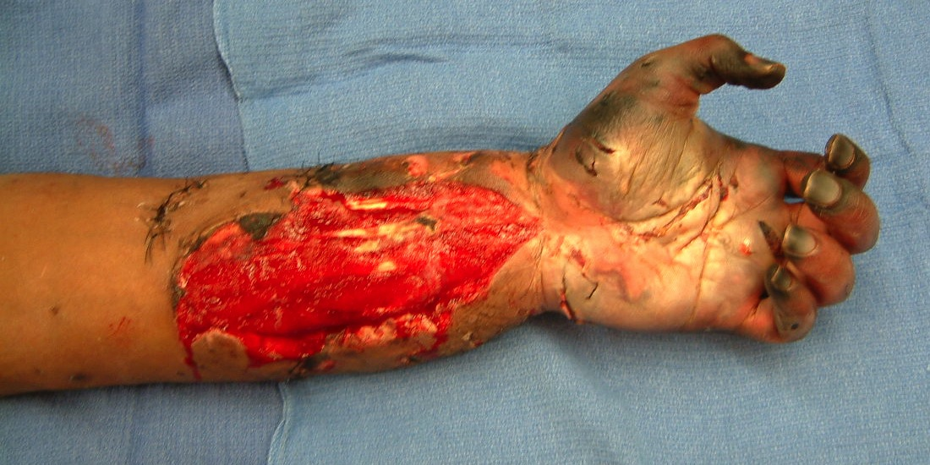
Etiology:Failed Forearm Vascular Repair after trauma

Slide 16
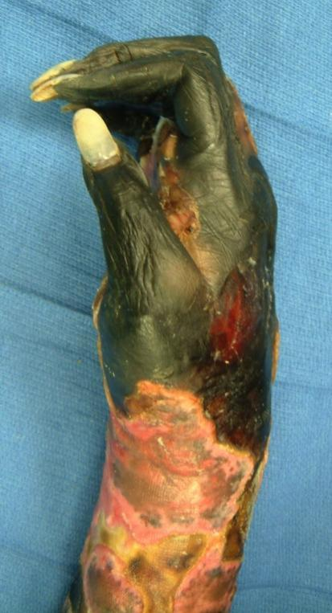
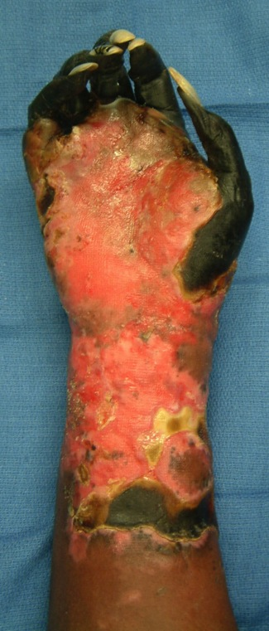
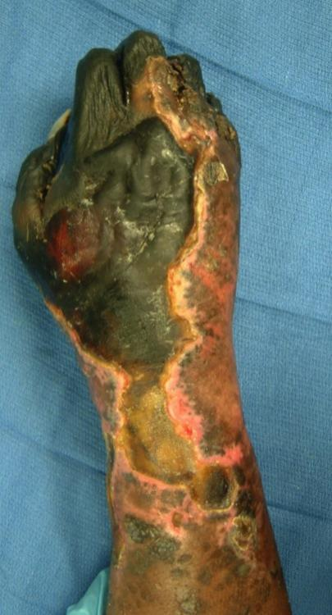
Etiology: Vascular Disease
Ischemia after AV Fistula Procedure

Slide 17
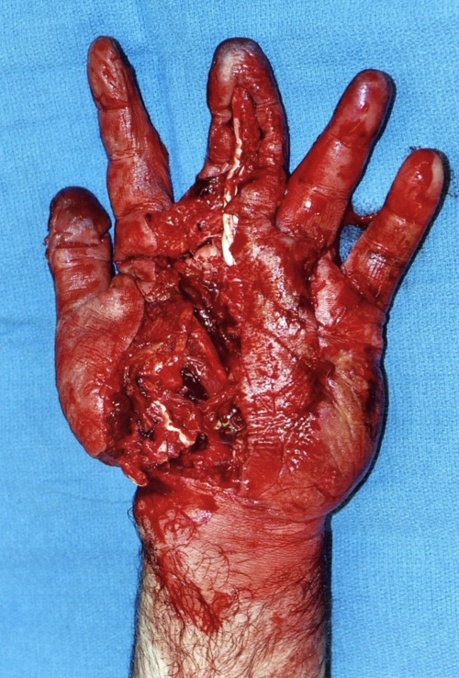
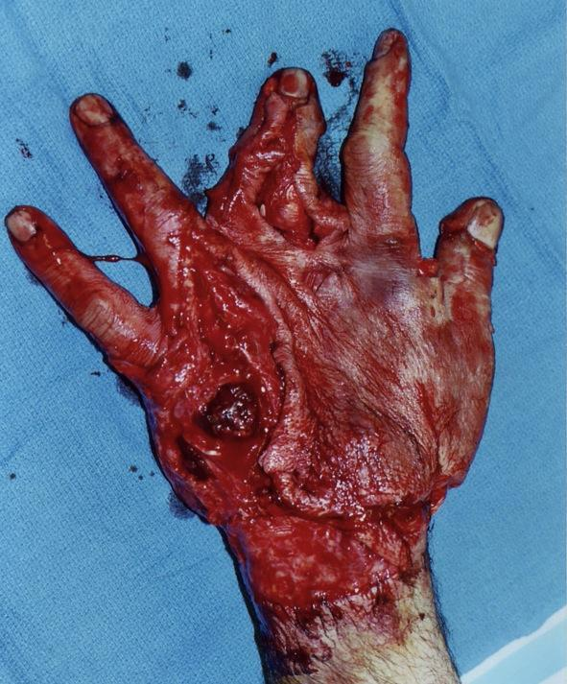
Etiology: Crush

Slide 18
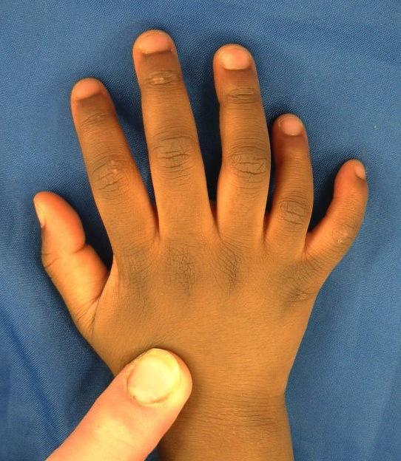
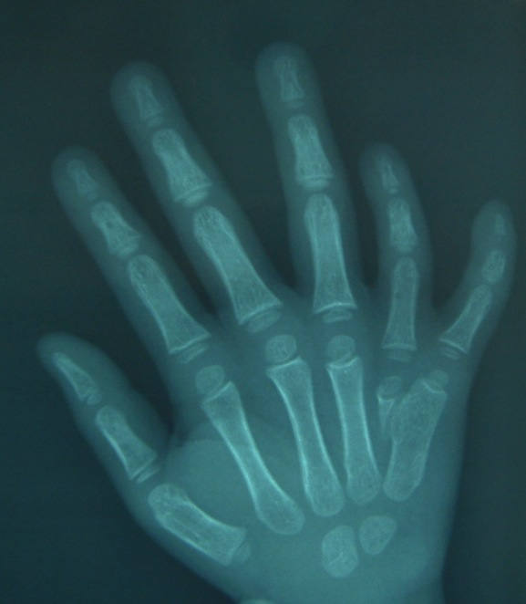
Etiology: Congenital
polydactyly

Slide 19
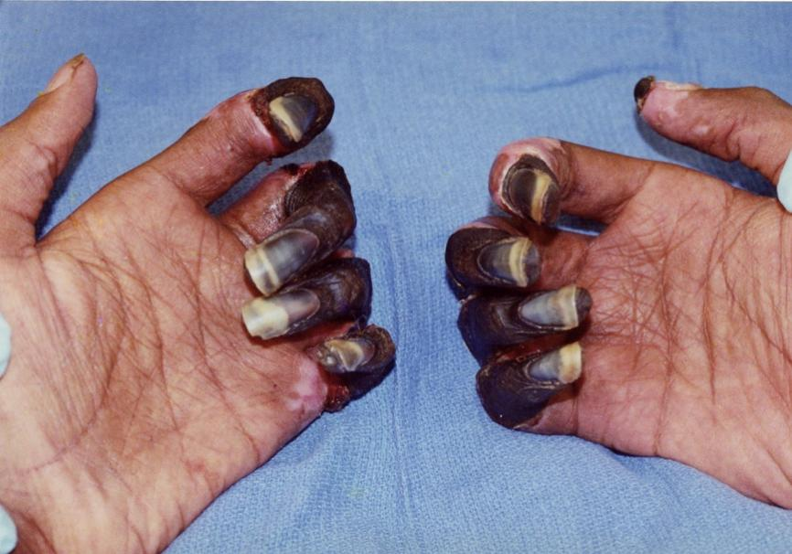
Etiology: Infarction associated with IV Drug Abuse

Slide 20
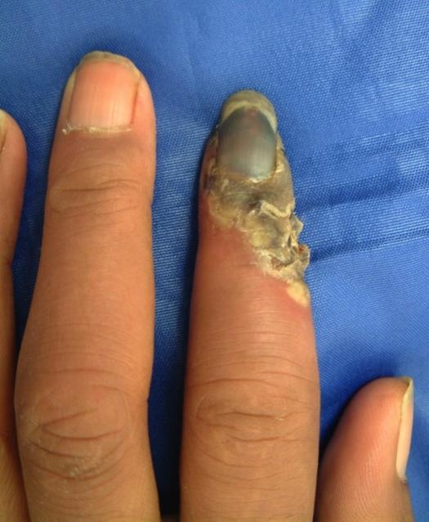
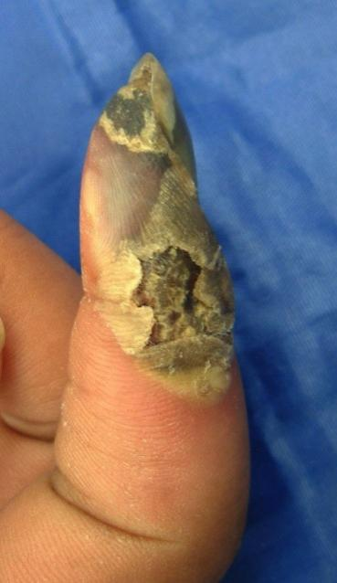
Etiology: Scleroderma

Slide 21
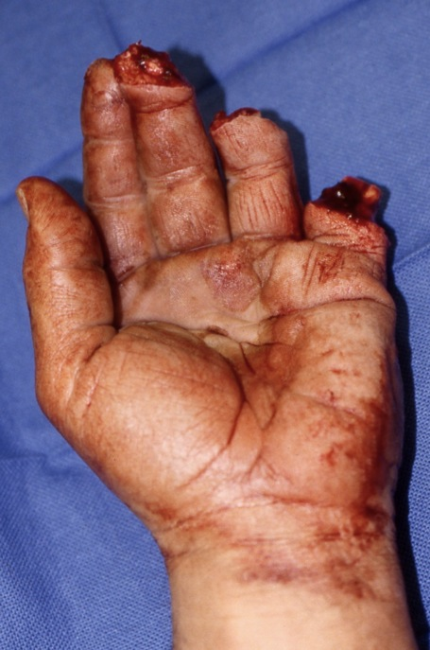
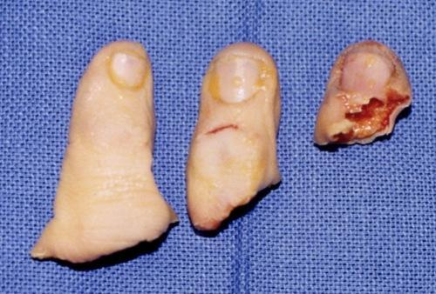
Replantation: Multiple Digits

Slide 22
Amputation: Replantation
Poor Candidates for Replantation
  1. Severely crushed or mangled parts
  2. Multiple levels
  3. Other serious injuries or diseases
  4. Atherosclerotic vessels
  5. Mentally unstable
  6. > 6 hours ischemic time
  7. Severe contamination

Slide 23
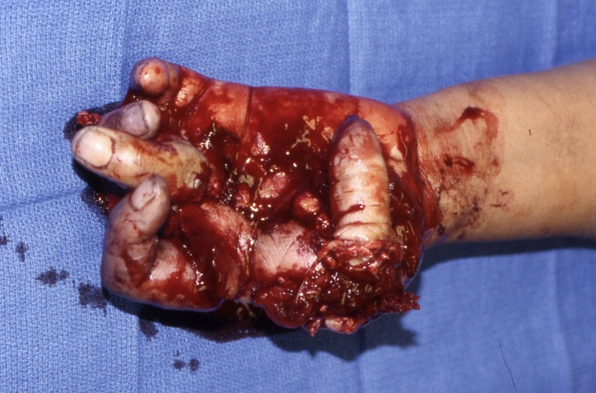
Amputation: Replantation
Mangled and Crushed – Poor Candidate

Slide 24
Ectopic “banking” of amputated parts
Indicated for extensive injuries with adequate amputated part in setting of contaminated or absent support structures.
Recipient sites described- anterior thorax, contralateral arm/leg, groin. High complication rate.
Largest and original series described by Marko Godina 1986.

Slide 25
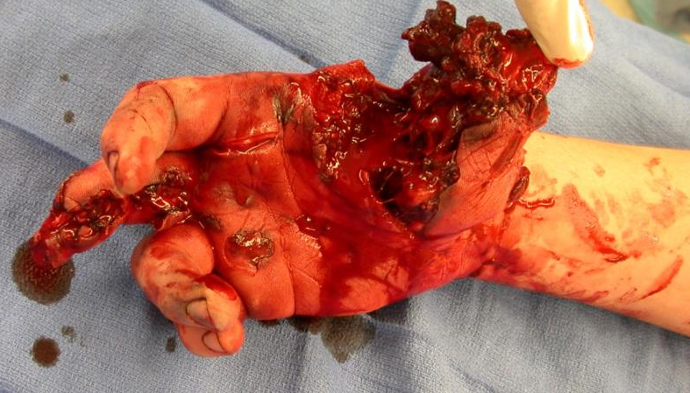
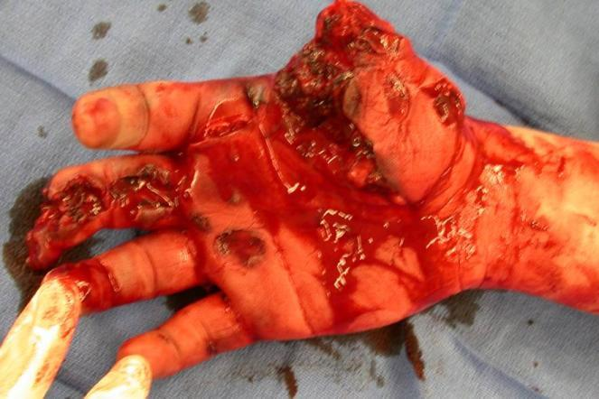
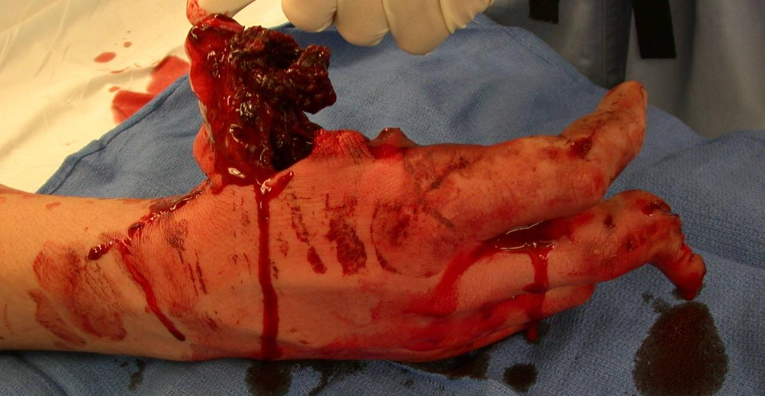
Courtesy: J. Higgins

Slide 26
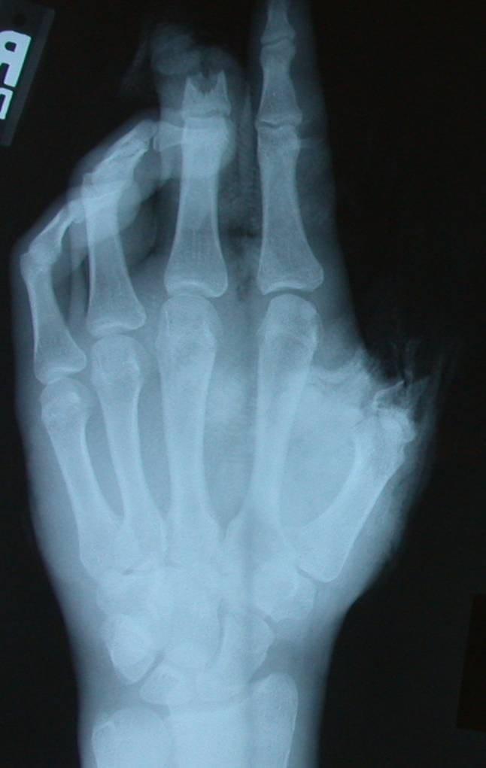
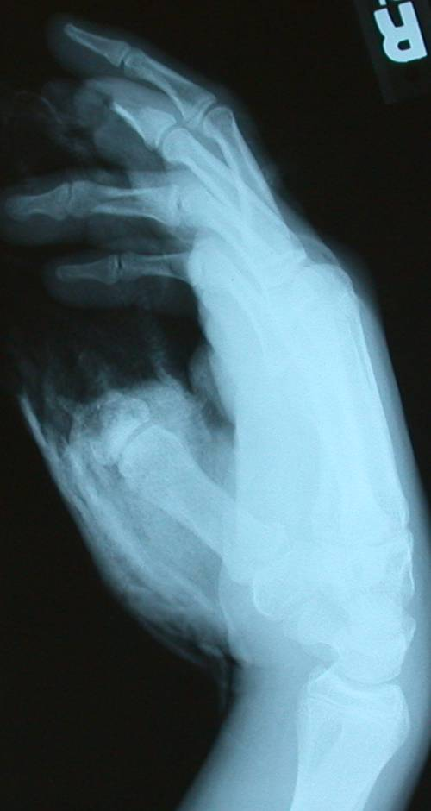
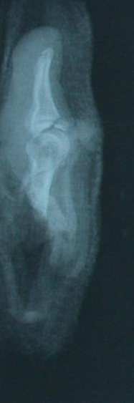


Slide 27
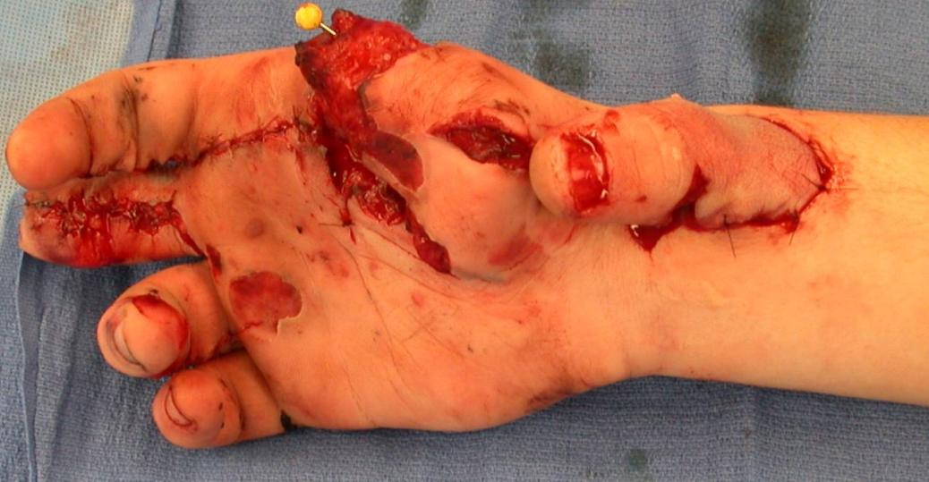
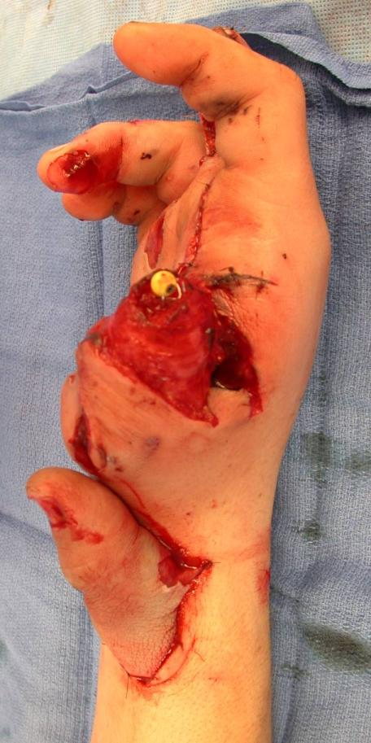
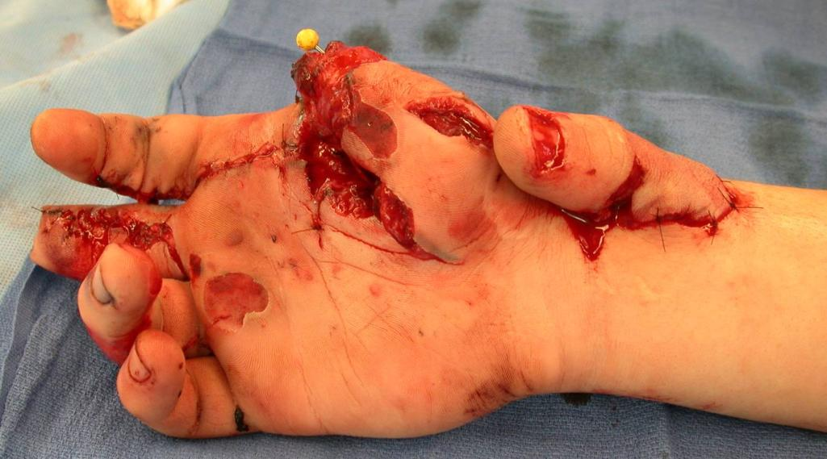

Slide 28
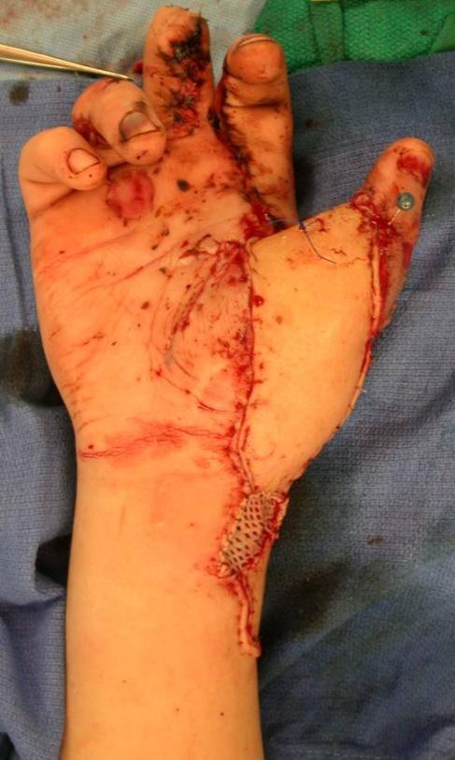
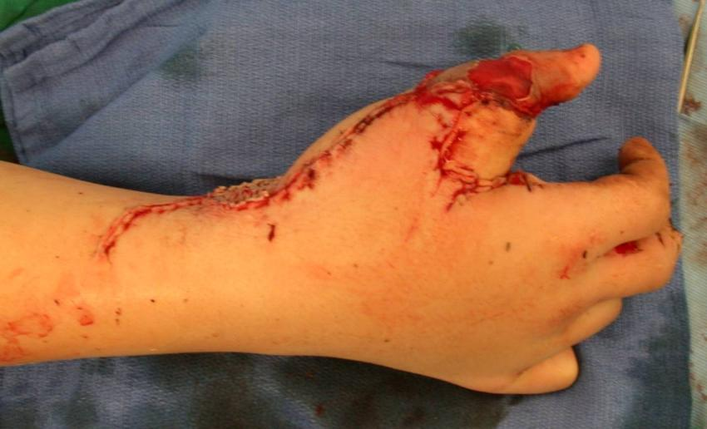
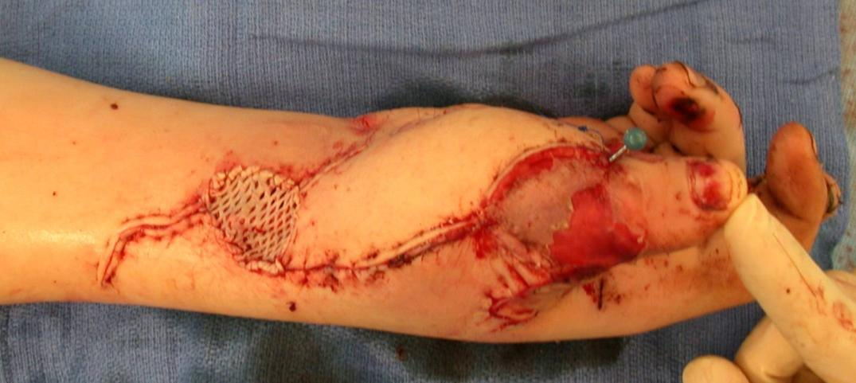

Slide 29
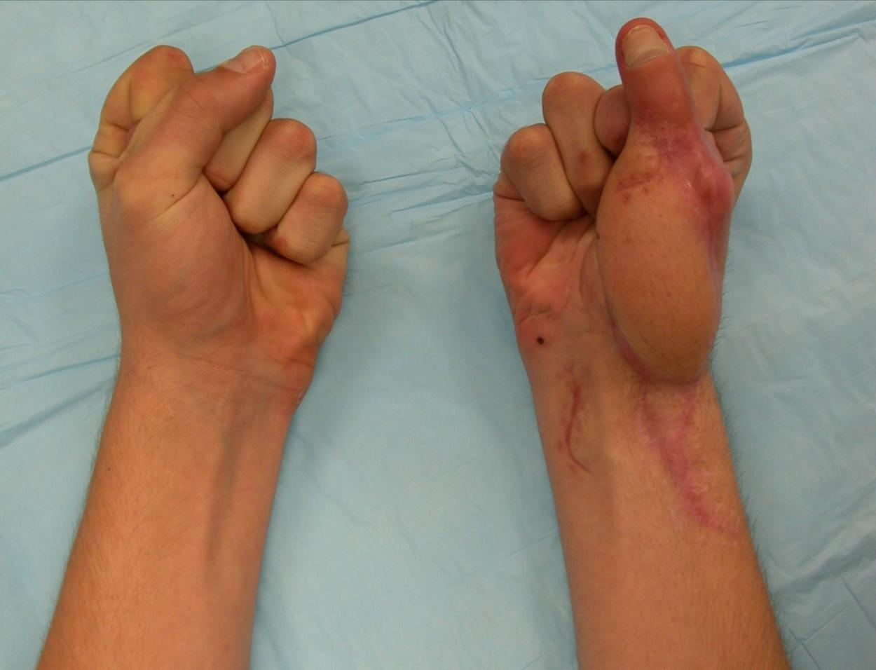
Grip strength 80 # (unaffected side 100#)
Injured right hand has remained dominant hand

Slide 30
Upper vs Lower Limb
Upper extremity nonweightbearing
  Less durable skin acceptable
  Decreased sensation better tolerated
  Joint deformity better tolerated
  Late amputations rare
  Transplants now being performed

Slide 31
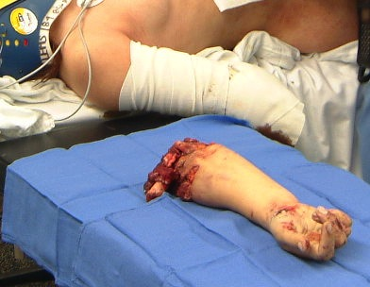
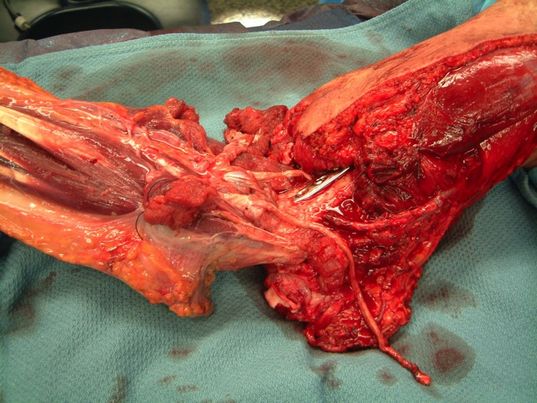
Major Limb Replantation
Include Surgical Prep of Legs
for vascular and nerve grafts
Rapid Bone Stabilization
Ready for Anastomosis

Slide 32
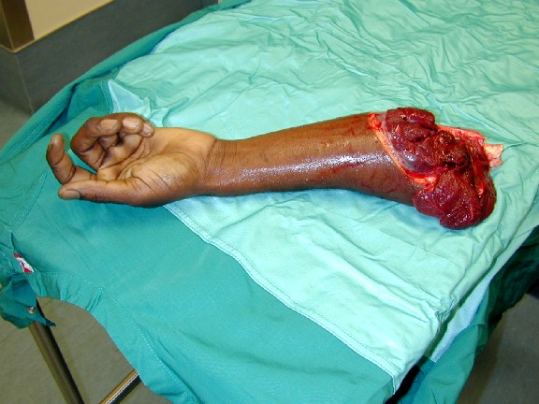
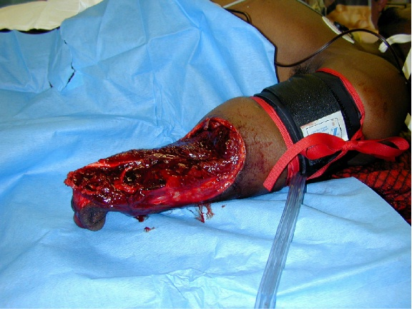
UE traumatic amputation may be associated with life threatening hemorrhage
Courtesy of T. Higgins, M. Dietch

Slide 33
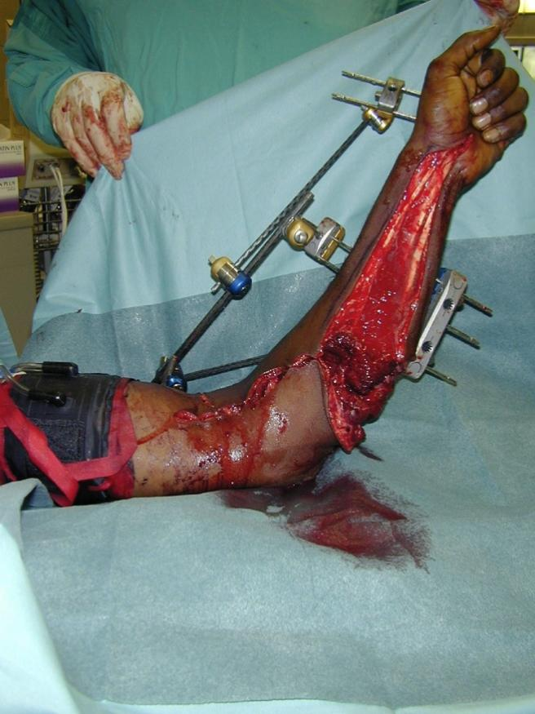
Aggressive resuscitation and limb repair
Courtesy of T. Higgins, M. Dietch

Slide 34
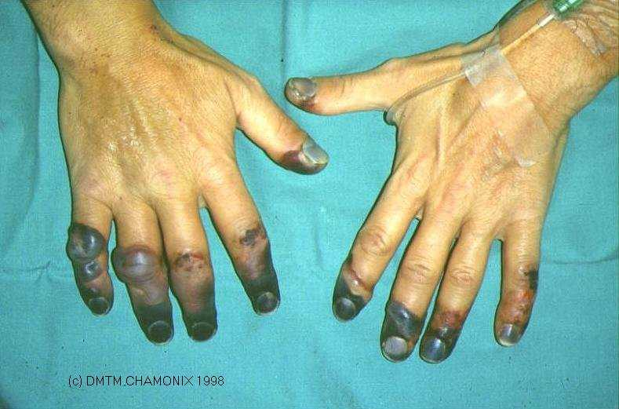
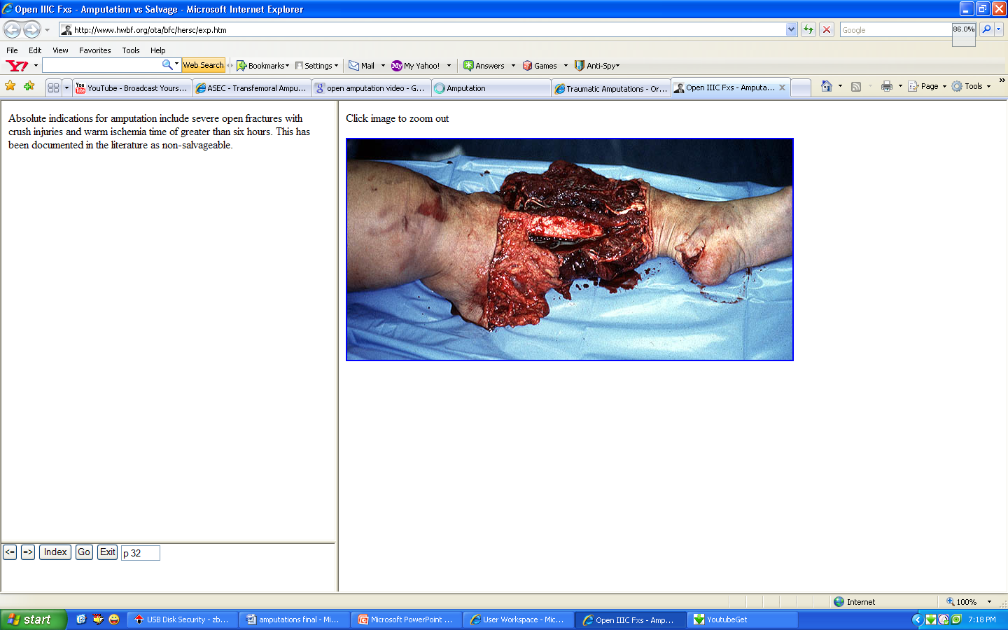
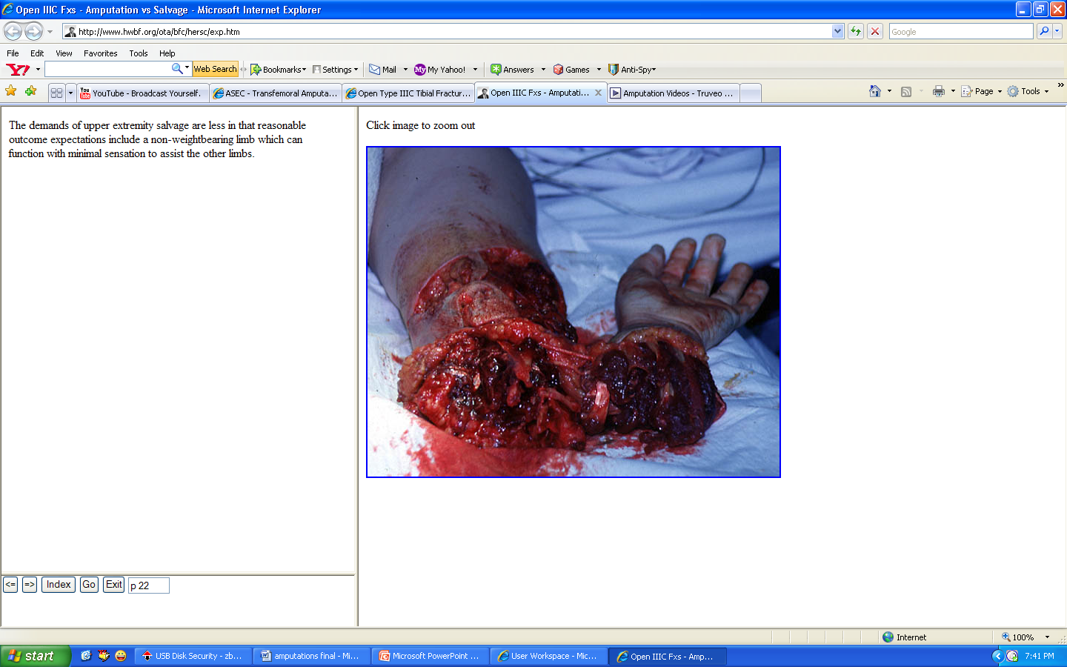
Vascular
  TAO
  Atherosclerosis
  Arteriosclerosis
  Gangrene
Traumatic
  Crush injuries
  Burns
  Frostbite
Infective
  Gas gangrene
  Leprosy
  Actinomycosis
  Filariasis
Neoplastic
Congenital anomalies

Slide 35
TYPES OF AMPUTATION
Open or Guillotine amputation
Closed
Closed Amputations are classical planned amputations where regular skin and muscle flaps are raised and wound is closed to get an ideal stump.

Slide 36
Types of Amputations
(according to soft tissues cutting)
1. Flap amputations:
- single-flap amputation
- double-flap amputation
2. Circular amputations:
- one-step (guillotine) amputation
- two-step amputation (variety – “cuff” method of forearm amputation)
- three-step (conical-circular) amputation

Slide 37
Open or Guillotine amputation
It is an emergency amputation done as a life saving measure.
The purpose is to prevent or eliminate infection.
It is indicated in
  Infections and
  Severe traumatic wounds with extensive destruction of tissue and gross contamination by foreign material.

Slide 38
Incision is circular around limb and all tissues including bone are cut at same level.
The wound is left open for free drainage.
When all infection is controlled and patient condition is stabilized, a revision amputation is done.

Slide 39
Two types
Open amputation with inverted skin flaps
Circular open amputation

Slide 40
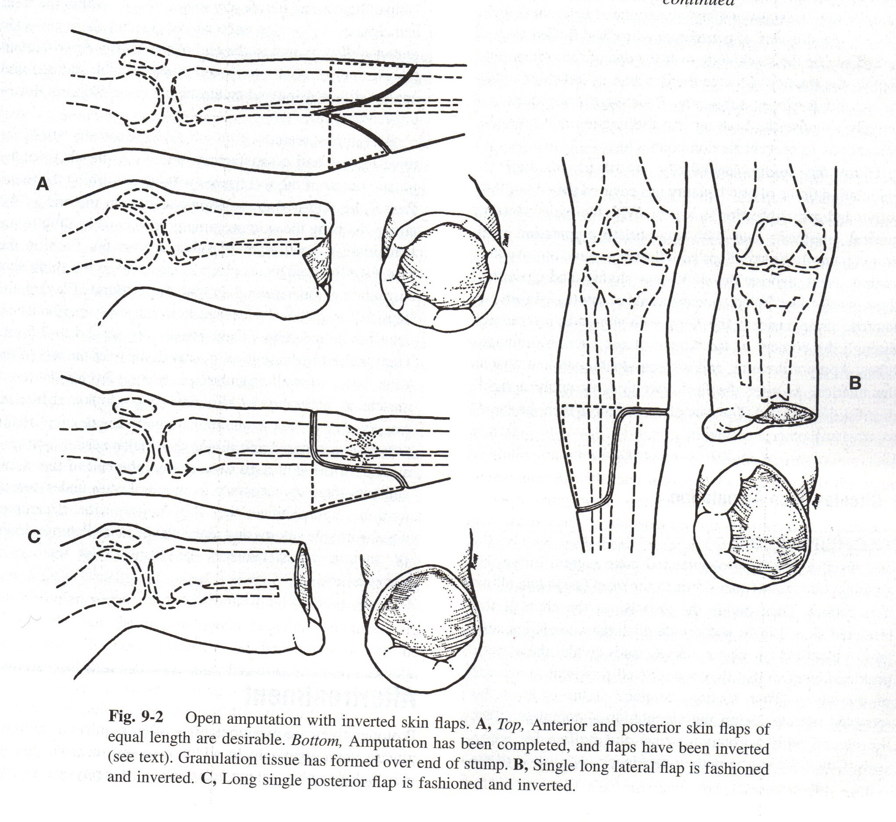
Open amputation with inverted skin flaps
Advantages:
    Requires no revision
Disadvantages:
    Skin traction is difficult to maintain and
    Maceration of skin flap.

Slide 41
Circular open amputation
Healing is prolonged, bone ends become covered with granulation tissues and skin margins become closed by scar contracture.
Disadvantages
    It needs constant skin traction that helps to pull all of the soft tissue over the end of the stump.
    Convoluted scar that results, is difficult to manage prosthetically.
    Often it is treated by reamputation at a more proximal level.

Slide 42
PREOPERATIVE PREPARATION
Patient should be brought to best possible condition to withstand and survive surgical trauma.
Tissue status evaluation by
    Transcutaneous oxygen tension PO₂ >35 mm Hg
    Ankle/ brachial pressure index > 0.45
    Arteriogram
Immune competence
    Serum albumin level should be >3.5 gm/dl and
    Total lymphocyte count should be >1500 cells/ml.

Slide 43
Systemic - To control diabetes, infection, dehydration, anemia, shock and cardiac insufficiency.
Psychological support by pre-operative counseling and through amputee support group.
Pre-operative pain control

Slide 44
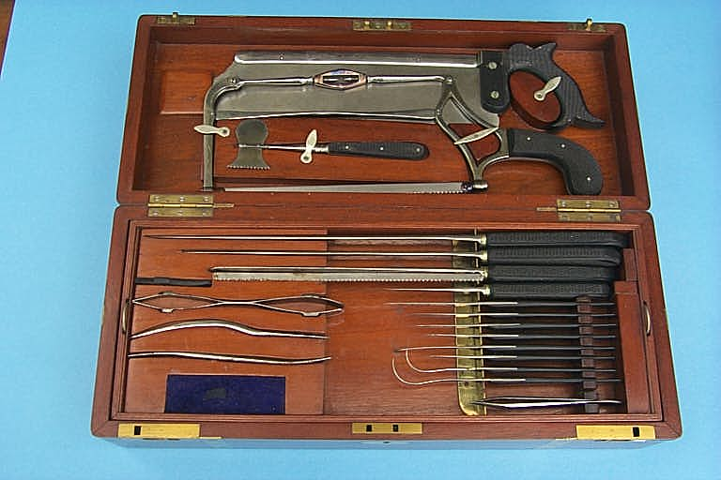
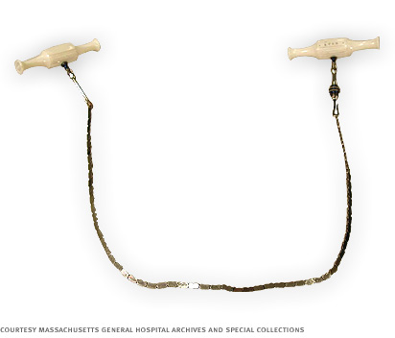
BASIC PRINCIPLES OF AMPUTATION
Tourniquet
Except in ischaemic limbs, the use of tourniquet is highly desirable and makes the amputation easier.
Usually the limb should be exsanguinated except in cases of infection and malignant growths.

Slide 45
Level of amputation
Any well healed, non tender and properly constructed amputation stump can now be satisfactorily fitted with a prosthesis.
CARDINAL RULE – To preserve all possible length consistent with good surgical judgement

Slide 46
Levels of Amputation
Wrist Disarticulation vs. Transradial
  Disarticulation offers potential of better active pronation and suppination of forearm
  Transradial often difficult to transmit rotation through prosthesis
  Disarticulation poor aesthetically
  Disarticulation more difficult to fit prosthetic
  Transradial needs to be done 2 cm or more proximal to joint to allow prosthetic fitting
  Transradial usually favored

Slide 47
Levels of Amputation
Transhumeral vs. Elbow Disarticulation
  Adults: Elbow disarticulation allows enhanced suspension and rotation control of prosthesis however retention of full length precludes use of prosthetic elbow. Long transhumeral favored
  Pediatrics: Transhumeral amputation results in high incidence of bony overgrowth. Elbow disarticulation is level of choice. Humeral growth slowed after trauma.

Slide 48
Levels of Amputation
Preservation of Elbow function is a priority
  Consider replantation/salvage of parts to maintain elbow function
  4-5 cm of proximal ulna necessary for elbow function
  For very proximal amputations, it may be necessary to attach bicep tendon to ulna

Slide 49
Ideal Stump
Firm and Smooth somewhat tapering segment with full range of movement and whose muscles are well developed
Rounded or conical in shape
Skin is free of scars, healthy and with good circulation.
No dog ears, folds or puckers
No redundant flaps
Linear and mobile operative scar

Slide 50
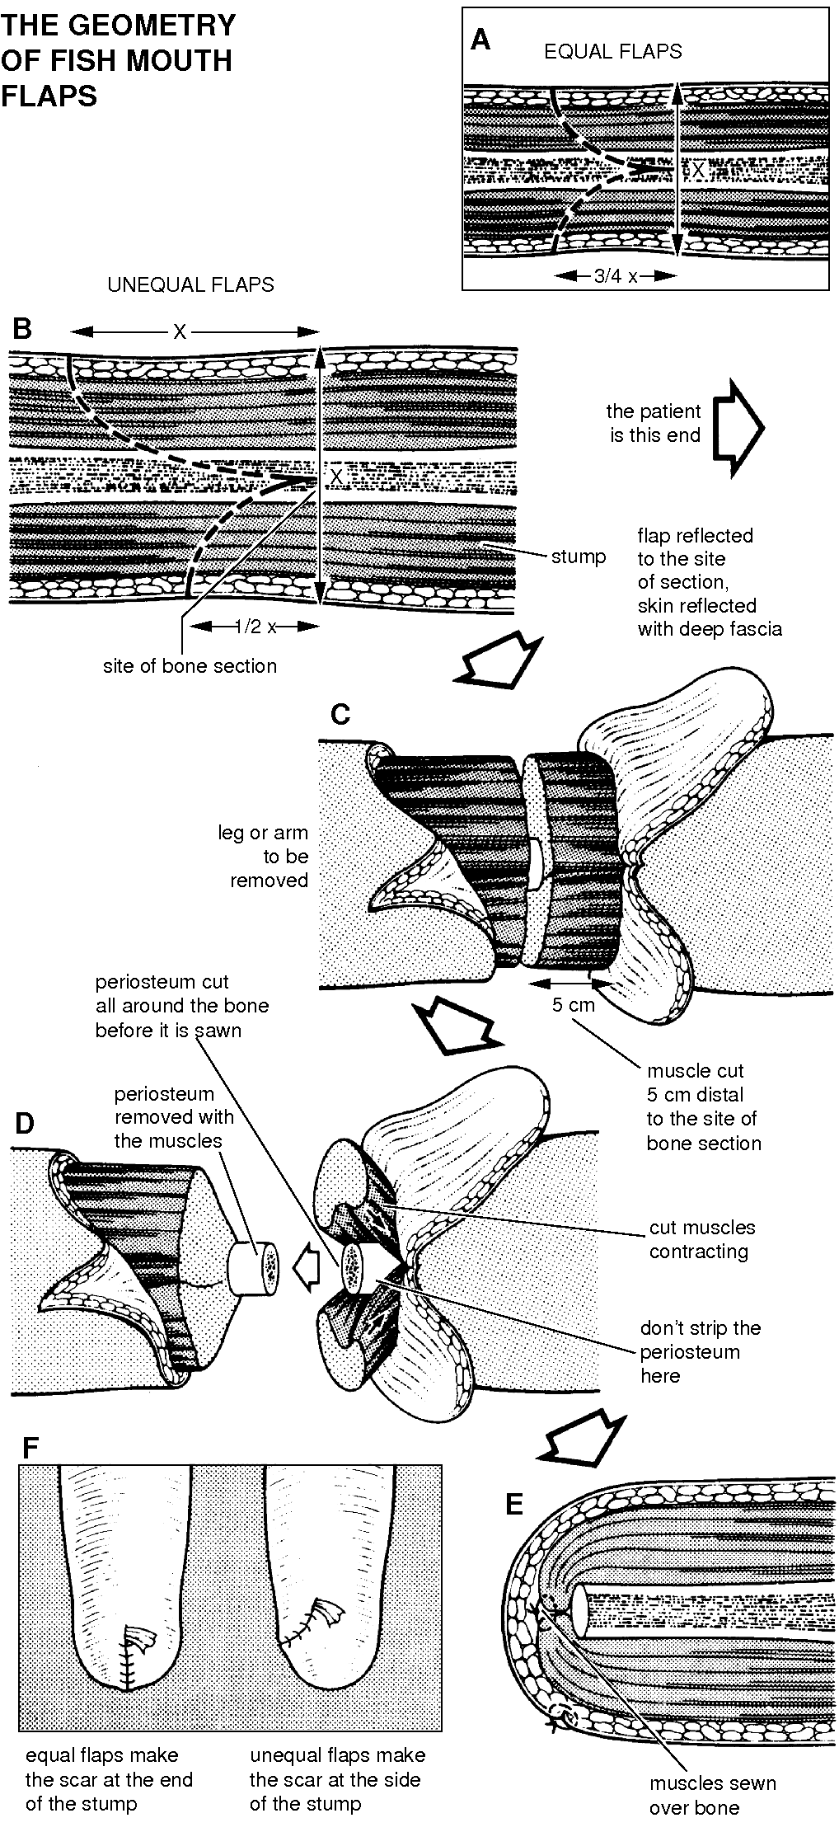
Skin Flaps
Skin at the end should be mobile and normally sensate.
Scar should not be adherent to underlying bone.
The location of scar should be either anteriorly or posteriorly
Redundant soft tissue or large dog ear should be prevented.

Slide 51
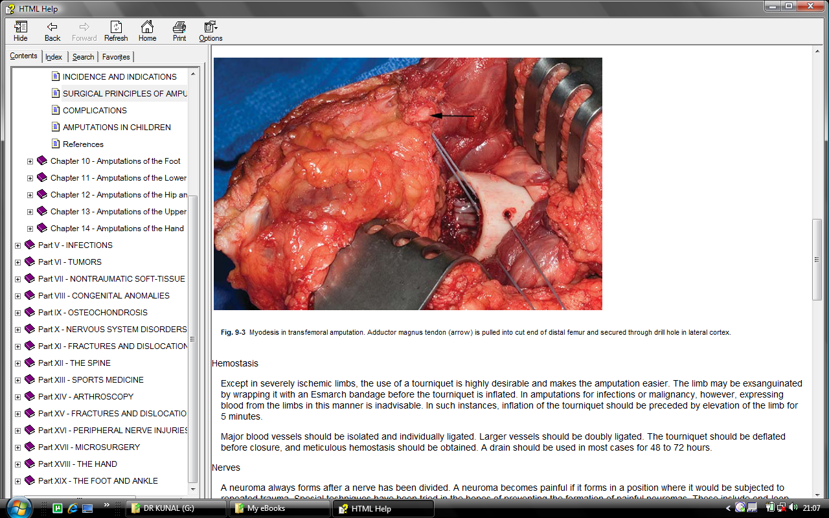
Muscles
Myodesis is contraindicated in peripheral vascular disease.
Advantages of Myoplasty
    Improves the functions of muscles
    Increases the circulation of the stump
    Prevents phantom pain

Slide 52
Nerves
Nerves are isolated, pulled down gently and divided with a sharp knife and allowed to retract above the saw line.
Large nerves such as sciatic nerve contains arteries and should be ligated before division.
Strong tension should be avoided.

Slide 53
Blood vessels
Major blood vessels should be doubly ligated with absorbable or nonabsorbable suture before division.
Before the skin is closed tourniquet is released and all bleeding points should be clamped and ligated.

Slide 54
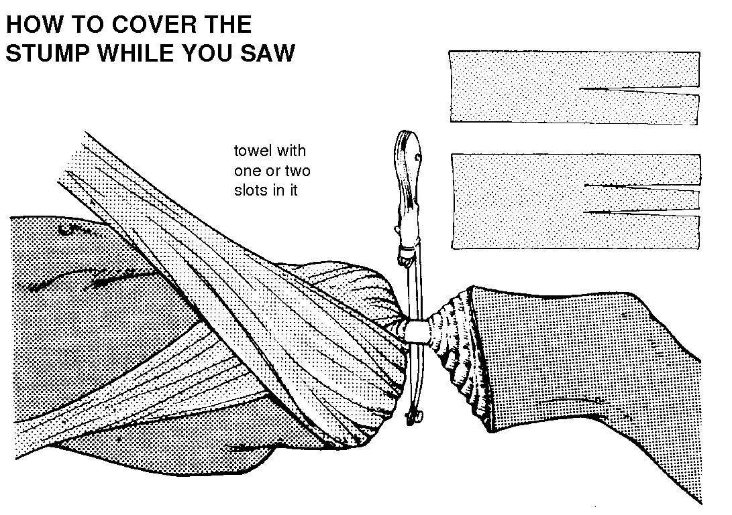
Bone
Excessive periosteal stripping is contraindicated and may result in formation of ring sequestrum.
Bone ends are rasped to form a smooth contour.
Some surgeons have advised closing the medullary canal at the end of the bone by osteoperiosteal flap to maintain the normal pressure gradient within the canal.

Slide 55
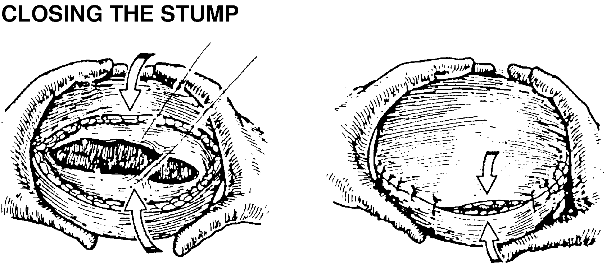

Slide 56




Dressings
Soft dressings
These are applied snugly and elastic bandage applied over it, with care to avoid constriction of stump proximally.
The stump is elevated by raising the foot end of bed.
Pillows should not be used as this may cause flexion contractures of hip and knee.

Slide 57
Rigid dressings
This method employs use of POP cast, applied to the stump in the OT at the end of surgery.
If weight bearing ambulation is anticipated in the early post operative period, a true prosthetic cast should be applied.
A metal Pylon with prosthetic foot is attached to the stump and properly aligned for ambulation.

Slide 58
Advantages
Prevents edema at surgical site
Decreases post operative pain
Physiological benefits of erect posture
Psychological benefits
Shorter stay in hospital and earlier fitting of definitive prosthesis
Disadvantages
Excessive pressure and constriction proximally can cause necrosis of the stump end
Early detection of infection is not possible

Slide 59
Immediate postsurgical prosthetic fittings
Following application of rigid dressing, ambulation on attached pylon and prosthetic foot may be initiated
  Immediately after surgery.
  Promptly, when good stump healing is evidenced (7-10 days)
  Early after stump has healed (2-3 weeks) or
  Later after stump is mature and there is no chance of stump break down.
The choice of optimal time to begin prosthetic ambulation depends on factors including age, strength and agility of patient and his ability to protect stump from injury by excess weight bearing.

Slide 60
Amputation: Major Limb Replantation Outcomes
>2/3 survival rate
Can be a life threatening undertaking
Multiple Surgeries often required
  Late Nerve, Bone, Tendon Surgeries
Function of major upper extremity replantations even though poor can be superior to prosthetic function

Slide 61
Outcomes: Major Limb Replantation
Comparison of functional results of replantation versus prosthesis in a patient with bilateral arm amputation
Peacock, Tsai, CORR, 1987
Major amputation of the UE: Functional Results after replantation/revascularization in 47 cases
Daoutix et al, Acta Orthop Scand, 1995
Major Replantation versus revision amputation and prosthetic fitting in the upper extremity: a late functional outcome study
Graham et al, J Hand Surg, 1998

Slide 62
Amputation: Technique
Preservation of functional residual limb length
balanced with
Soft tissue reconstruction to provide a well-healed, nontender, physiologic residual limb

Slide 63
Technique: Determination of Level
Zone of Injury (trauma)
Adequate margins (tumor)
Adequate circulation (vascular disease)
Soft tissue envelope
Bone and joint condition
Control of infection
Nutritional status

Slide 64
Techniques
Debridement of all Nonviable tissue and foreign material
Several debridements may be required
Primary wound closure often contraindicated
High voltage, electrical burn injuries require careful evaluation because necrosis of deep muscle may be present while superficial muscles can remain viable

Slide 65
Techniques
Nerve: Prevent neuroma formation
  Draw nerve distally, section it, allow it to retract proximally
Skin:
  Opportunistic flaps
  Rotation flaps
  Tension free
  Skin grafts

Slide 66
Techniques
Bone:
  Choose appropriate level
  Smooth edges of bone
  Narrow metaphyseal flare for some disarticulations
Postoperative Dressing:
  Soft
  Rigid

Slide 67
Techniques
Goals of Postoperative Management
  Prompt, uncomplicated wound healing
  Control of edema
  Control of Postoperative pain
  Prevention of joint contractures
  Rapid rehabilitation

Slide 68



Technique: Example
30 yo male, assault

Slide 69



Technique: Example
ray amputation
Be sure to identify all injuries and treat

Slide 70



Technique: Example
1 year postop

Slide 71


Technique: Example
debridement and preservation of viable structure

Slide 72


Technique:Example
Late reconstruction after
initial amputation surgery

Slide 73


The use of pylon in the immediate post-operative period is of valuable psychological importance.
It makes the patient ambulant at an early stage which is good for his morale.
It also improves his muscle strength and mobility of his joints thus preparing him for the more compact permanent prosthesis of future.

Slide 74
AMPUTATION IN CHILDREN
Congenital :
  60% secondary to congenital limb deficiencies.
Acquired :
  40% secondary to trauma followed by neoplasm and infection.

Slide 75
General principles -
Preserve length
Preserve important growth plates
Perform disarticulation rather than amputation
Preserve the knee joint whenever possible
Preserve stump shape
Be creative with soft-tissue coverage
Stabilize and normalize the proximal portion of limb
Be prepared to deal with issues in addition to limb deficiency

Slide 76
Disarticulation can provide a children with a well balanced sturdy stump capable of end weight bearing.
Length and physis are preserved without the risk of terminal overgrowth.
Additionally prosthetic suspension is improved with a disarticulation secondary to preservation of the metaphyseal flares.

Slide 77
Terminal overgrowth
The over growth is results from distal apposition of bone by the active periosteum and is unrelated to the growth of the physis.
Most severe before 6 years of age, and several revisions (three or more) may be required during the growing years.
Overgrowth is not seen after about 12 years of age.
The bones most likely to exhibit overgrowth are the humerus, fibula, and tibia.

Slide 78


It may cause swelling,edema, pain and bursa formation and in severe cases may penetrate the skin.
Terminal overgrowth is treated with surgical resection of the excess bone and its bursa.
Improved results have been obtained by CAPPING the bone with an epiphyseal graft harvested from the amputated limb at the index procedure or by capping with cortical iliac crest graft at a revision amputation.

Slide 79
COMPLICATIONS
Immediate postoperative bleeding
Gradual oozing or massive haemorrhage due to loosening of ligature may cause collection of blood within the wound.
If minimal, aspiration and application of compression bandage helps.
If it is massive, the wound is to be opened and bleeders ligated.
Accumulation of blood leads to infection and scaring which results in a poor stump.

Slide 80

Infection
Treated by hot packs, elevation of stump and antibiotics.
Any deep wound infection should be treated with immediate debridement and irrigation
For this the central one third of the wound is closed, and the remainder of the wound is packed open

Slide 81

Ulceration
Due to improper skin approximation, infection or haemorrhage.
Necrosis of skin flaps - Due to insufficient circulation.
If <1 cm - treated conservatively with open wound management.
In cases of severe necrosis with poor coverage of the bone end, wedge resection may be indicated.
Basic principle of wedge resection is to regard the end of the amputation stump as a hemisphere.
Hyperbaric oxygen therapy and transcutaneous electrical nerve stimulation have been shown to promote wound healing.

Slide 82
Stump oedema
Due to inadequate elastic bandaging in the postoperative period.
Bandage should be applied with even pressure throughout and care should be taken to avoid excessive pressure and constricting turns.
Stump contractures
Particularly in flexion is due to abnormal position and lack of physiotherapy

Slide 83
Phantom limb
Shortly after amputation most patients perceive a sensation as the lost portion of limb is still present.
Sometimes the sensation becomes painful and annoying.
Use of morphine, sympathectomy, procaine block, psychotherapy and early use of prosthesis may help.

Slide 84
Neuroma
Forms on the cut end of the nerve.
Pain results due to traction on a nerve when neuroma is bound down by scar tissue.
Treated by
    Alterations in prosthetic socket &
    Excision of neuroma with division at a more proximal level.
Jactitation
Painful contraction of the amputated stump.

Slide 85

Common Amputation Levels in the Upper Extremity
Shoulder Disarticulation
Above elbow (Trans-humeral)
Elbow Disarticulation
Below Elbow (Trans-radioulnar)
Wrist Disarticulation
Partial hand amputation and Amputation of Fingers

Slide 86

Common Amputation Levels
In the Lower Extremity

Slide 87
FOREQUARTER AMPUTATION
Forequarter amputation removes the entire upper extremity in the interval between the scapula and the chest wall.
Usually it is indicated for malignant tumors that cannot be adequately removed by limb-sparing resections. Extension of the operation to include resection of the chest wall occasionally is required.
Two approaches for amputation :
  Anterior approach of Berger
  Posterior approach of Littlewood (most commonly used)

Slide 88


Posterior approach of Littlewood

Slide 89

SHOULDER DISARTICULATION (DUPUYTREN’S)
This procedure is for nonsalvageable proximal arm injuries or for severe brachial plexopathies and malignant tumours.

Slide 90

ARM AMPUTATIONS
Amputation through the arm, or transhumeral amputation, is defined as amputation at any level from the supracondylar region of the humerus distally to the level of the axillary fold proximally.

Slide 91
ELBOW DISARTICULATION
Fashion equal anterior and posterior skin flaps
  Beginning proximally at the level of the humeral epicondyles,
  Extend the posterior flap distally to a point about 2.5 cm distal to the tip of the olecranon and
  The anterior flap distally to a point just distal to the insertion of the biceps tendon on the radius.

Slide 92
Expose the neurovascular bundle that lies against the medial aspect of the biceps tendon.
Ligate the brachial artery. Sharply divide the radial, ulnar, and median nerves proximally.
Disarticulate the elbow by dividing the insertion of the biceps and the insertion of the brachialis anteriorly and by dividing the triceps tendon at its olecranon insertion.

Slide 93
Release the medial flexor mass from the medial epicondyle, and divide the extensors from the lateral humeral epicondyle.
Perform an anterior capsulotomy, and remove the forearm, leaving the articular surface of the distal humerus intact.
Close the wound over drain without tension.

Slide 94
FOREARM AMPUTATIONS
When circulation in the upper extremity is severely impaired, amputations through the distal third of the forearm are less likely to heal satisfactorily than those at a more proximal level because distally the skin is often thin, and the subcutaneous tissue is scant.
The underlying soft tissues distally consist primarily of relatively avascular structures, such as fascia and tendons.
In these exceptional circumstances, an amputation at the junction of the middle and distal thirds of the forearm is preferable.

Slide 95

In amputations through the proximal third of the forearm, even a short below-elbow stump 3.8 to 5 cm long is preferable to an amputation through or above the elbow.
From a functional standpoint, preserving the patient's own elbow joint is crucial.
By using improved prosthetic fitting techniques, such as the Münster or a split socket with step-up hinges, a skilled prosthetist can provide an excellent prosthetic device for even a short below-elbow stump.

Slide 96

WRIST AMPUTATIONS
Transcarpal amputation or disarticulation of the wrist is definitely preferable to amputation through the forearm because, provided that the distal radioulnar joint remains normal, pronation and supination are preserved.

Slide 97
AMPUTATION OF HAND
Surgical amputation through the fingers or metacarpals is a slavage procedure.
Goal of surgery
  Restoration of a hand of acceptable appearance, capable of the highest degree of function consistent with its remaining musculoskeletal elements.
In amputations of several digits pinch and grasp are the chief functions to be preserved.

Slide 98
General principles
When out of 5 tissue areas (skin, tendon, nerve, bone and joint), three or more disrupted, amputation should be considered.
The volar skin flap should be semicircular at its end and it must be long enough to cover the volar surface and tip of the stump.
Skin closure should not be under tension and soft tissue covers over the bony stump is desirable.

Slide 99
Whenever possible amputation through the middle or distal phalanx is preferable to disarticulation at the IP joint.
In disarticulation of joint the flares of the Condyles should be resected to avoid clubbing of the stump.
Preservation or restoration of the thumb is of paramount importance.

Slide 100
When the radial fingers are compromised, precision prehension is impaired, while loss of the ulnar digits reduces effective power grip.
Preservation of length and sensibility is vital to radial digits, whereas preservation of joint mobility is more important to ulnar digits.

Slide 101
Index Ray Amputation
When the index finger is amputated at its PIP joint or at a more proximal level, the remaining stump is useless and can hinder pinch between the thumb and middle finger.
When a primary amputation must be at such a proximal level, any secondary amputation should be through the base of second Metacarpal.
This index ray amputation is especially desirable in women for cosmetic reasons.
Can cause stiffness of other fingers and may be contraindicated in arthritic hands.

Slide 102

After treatment
The hand is elevated immediately after surgery for 48hours.
At 24 hrs the drain is removed.
Digital motion initiated at 5 to 7 days post operatively.

Slide 103
MIDDLE / RING RAY AMPUTATION
In contrast to the proximal phalanx of the index finger, the proximal phalanx of the middle finger is important functionally.
Its absence in either finger makes a hole through which small objects can pass when the hand is used as cup or in a scooping maneuver.
The 3rd and 4th metacarpal heads are important because they help to stabilize the metacarpal arch

Slide 104

When the middle finger has been amputated proximal to the PIP joint or metacarpal head transposing the fifth ray radialward to replace the fourth rarely is indicated.
This operation is more favourable in children and women.
But contraindicated in heavy manual labourers.

Slide 105
Amputation of Thumb
In partial amputation of the thumb, reamputation at a more proximal level to obtain closure should not be considered because the thumb rarely should be shortened.
Wound should be closed primarily by a free graft, advancement pedical flap, or a local or distant flap.

Slide 106

Advancement pedical flap
After treatement :
The joints should maintained in flexion for 3 weeks.

Slide 107
Reconstruction of thumb
INDICATION
  Amputation at MCP joint or more proximal level.
The reconstruction of thumb must meet five requirements :-
  Sensibility : Sufficient for recognition of objects and painless.
  Stability : Should have sufficient stability so that pinch pressure
  does not cause the thumb joints to deviate and collapse.
  Mobility : To enable the hand to flatten and the thumb to oppose
  for pinch.
  Length : Should be sufficient to enable the opposing digital tips to touch it.
  Consemitically acceptable

Slide 108
LENGTHENING OF METACARPAL
Gillies and Millard technique - Iliac bone graft has been fixed to the distal end with the help of 'K' wires.
Osteoplastic reconstruction and transfer of Neurovascular Island graft technique
Pollicization - Transposition of a finger to replace an absent thumb

Slide 109


Krukenberg & Swanson
Amputation of both hands is extremely disabling.
It converts the forearm to forceps in which the radial ray act against the ulnar ray.
Swanson compares function of the reconstructed limb as chop sticks.

Slide 110

After Treatment
The limb is constatntly elevated for 3 to 4 days.
After 2 to 3 weeks rehabilitation is begun to develop abduction and adduction of the rays.

Slide 111



Complication of Amputations
Joint contractures
Energy issues
Phantom limb pain
Bony growth
Skin Breakdown
Blistering
Necrosis

Slide 112
The most common complications of amputation are:
massive haemorrhage that occurs when a suture becomes loose
infection
rash, blisters, and skin breakdown caused by immobility, pressure, and other sources of irritation
pneumonia, blood clots, and breathing problems associated with immobility
formation of nerve cell tumors (neuromas) at severed nerve endings

Slide 113
Complications of Amputation
Mistakes of I step of amputation:
1. conical stump
2. mace-shaped stump
Mistakes of II step of amputation:
3. terminal necrosis of bone
4. forming of large osteophytes
Mistakes of III step of amputation:
5. forming of trophic ulcers
6. phantom pain
7. Chronic osteomyelitis caused by secondary
infection inside a wound

Slide 114
Phantom Limb Pain: Coping Techniques
Acupuncture
Anaesthetics
Biofeedback
Chiropractic
Cold
Cranial Sacral Therapy
Desensitization
Dietary and Herbal Supplements
Electrical Stimulation
Exercise
Heat
Magnetic Therapy
Massage
Medications
Psychotherapy
Shrinker Socks
Wearing Your Artificial Limb

Slide 115
Complications specific to hand amputation
QUADRIGA or FLEXOR DIGITORUM PROFUNDUS BLOCKAGE
Occurs when the free distal end of a transected profundus tendon becomes fixed distally and cannot move to the proximal extent of its normal excursion.
Patients may experience limitation of active distal joint flexion in adjacent digits and may complain of palmar or flexor forearm pain with attempted forceful flexion.
Avoided by early active motion of digits.
Treatment - release of the adherent profundus tendon in the palm proximal to the lumbrical origin

Slide 116
THE LUMBRICAL PLUS
When amputation occurs through a finger proximal to the insertion of the profundus tendon, the proximal pull of the profundus is transmitted through the lumbrical into the dorsal hood apparatus, increasing the force of PIP joint extension.
As the patient tries to grip forcefully, the proximal movement of the profundus results in a posture of PIP joint extension.
This may be eliminated either by sectioning the profundus proximal to the lumbrical origin or by releasing the radial lateral band.

Slide 117
REHABILITATION AND TRAINING
Institute occupational therapy as soon as possible –
  To maintain body symmetry
  Prevent flexion contractures
  Reduce surgical edema
  Prepare the residual limb for the prosthesis
Early fitting of a prosthesis and promotion of two-handed function reduce the rejection rate.

Slide 118
Strengthening exercises help to counteract the pendulum effect of the terminal device.
Computer programs are used to aid in training patients.
Activities of daily living must be taught early.

Slide 119
Lower Limb Amputations
Ray amputation
Trans-metatarsal
Mid-tarsal
Syme’s
Below-knee
Gritti-stokes
Above knee

Slide 120

What are the lower limb amputations you know of?

Slide 121


Slide 122
Differentiation of neuropathic and neuroischaemic ulcers
Neuropathic ulcer
Painless
Normal arterial pulses
Plantar location
Presence of callus
Loss of small fibre sensation
(pain, temperature) before
loss of large fibre sensation
Increase in skin blood flow
Red and hot
Increase in total blood flow
Neuroischaemic ulcer
Painful
Reduction or absence of arterial pulses
Toes and border location
No callus
Loss of large fibre sensation
(touch, vibration) before loss of small
fibre sensation
Skin blood flow greatly reduced
Pale and cold
Decrease in total blood flow

Slide 123

B

Slide 124


Slide 125


Slide 126

Rehabilitation and Prosthetics

Slide 127
Rehabilitation
1. Residual Limb Shrinkage and Shaping
2. Limb Desensitization
3. Maintain joint range of motion
4. Strengthen residual limb
5. Maximize Self reliance
6. Patient education: Future goals and prosthetic options

Slide 128
Psychological Adaptation
Amputation represents loss of function, sensation and body image
Psychological response is determined by many variables
  Psychosocial/Age
  Personality
  Coping Strategies
  Economic/Vocational
  Health
  Reason for amputation

Slide 129
Psychological Adaptation
Up to 2/3 of amputees will manifest postoperative psychiatric symptoms
  Depression
  Anxiety
  Crying spells
  Insomnia
  Loss of appetite
  Suicidal ideation

Slide 130
Psychological Adaptation: Stages
1. Preoperative
  Tumor, Vascular Disease, Chronic Infection
  Support Groups
2. Immediate Postoperative
  Hours to days
  Safety, Pain, Disfigurement
3. In-Hospital Rehabilitation
4. At-Home Rehabilitation

Slide 131
In-Hospital Rehabilitation
Initial: concerns about safety, pain, disfigurement
Later: emphasis shifts to social reintegration and vocational adjustments
Grief Response:
  1. “numbness” or denial
  2. yearning for what is lost
  3. Disorganization: all hope is lost for recovery of lost part
  4. Reorganization

Slide 132
Management of Amputee
Preparation
Good Surgical Technique
Rehabilitation
Early Prosthetic Fitting
Team Approach
Vocational and Activity Rehabilitation

Slide 133
Prosthetics
Passive
  Cosmetic
Body Powered
  Harnesses and cables
Myoelectric
  Surface EMG
  Activation delay
Neuroprosthetics
  Investigational at this time

Slide 134
Rehabilitation
Suggested timeline for transradial amputation
1-14 days: immediate postop prosthesis
2-4 weeks: training body powered prosthesis
6-12 weeks: definitive body powered prosthesis
6-12 weeks: training electronic prosthesis
4-6 months: definitive electronic prosthesis

Slide 135
UPPER LIMB PROSTHESIS
In the upper limb, cosmetic requirements take precedence over functions in unilateral amputations as amputee tend to perform most of functions with the remaining limb.

Slide 136
GOALS OF PREPROSTHETIC CARE
 | WITH RESIDUAL LIMB | WITHOUT RESIDUAL LIMB
1 | Promote wound healing | Promote wound healing
2 | Reduce postsurgical oedema | Reduce postsurgical oedema
3 | Mould residual limb | Maintain muscle strength in unaffected limb
4 | Prevent flexion contractures of surrounding joints | Maintain body symmetry
5 | Maintain muscle strength in both limbs
6 | Maintain body symmetry

Slide 137
Length, condition, strength, and range of motion of the residual limb are the determining factors in the choice of a prosthetic system.
Types
  Passive in which the position of the terminal device or more proximal components is changed with a contralateral hand
  Body-powered in which gross body movements activate cables for function
  Myoelectric which is battery-powered and computer-driven
  Hybrid system which is a combination of body-powered and myoelectric

Slide 138





Slide 139
COMPLICATIONS DUE TO PROSTHESIS
Contact dermatitis
Failure to rinse detergents from stump socks thoroughly
Treatment - removal of the irritant & steroid cream
Bacterial folliculitis
Occur in areas of hairy, oily skin.
Treatment consists of improved hygiene and socket modifications.
Epidermoid cysts
may develop at the socket brim.
Best treated with socket modification.

Slide 140
Choke syndrome
Proximal restriction in the socket with lack of total contact can lead to edema in the stump
Can lead to hemosiderin deposition and the eventual development of verrucous hyperplasia.
This problem is preventable through good prosthetic fitting that achieves total contact in the socket.
Psychosocial maladjustment
Amputee support groups and peer counseling

Slide 141
PROSTHESIS AND ORTHOSIS
Prosthesis is a device or on artificial substitute designed to replace as much as possible the function or appearance of a missing limb or body or part both anatomically and functionally

Slide 142
Prerequisites for fitting of prosthesis
Stump must be well heeled
Skin should be of good thickness and texture
Circulation should be adequate
Scars should be away from points of pressure
Length of stump must be adequate
Nearly should be ideal stump
No dog ears

Slide 143
Prosthesis is classified into two types:
External prosthesis: device which replaces a body part externally
e.g. artificial limb, teeth, contact lenses, etc.
Internal prosthesis: device which replaces a body part internally
e.g. artificial hip joint, A.M. prosthesis, heart valve, etc.
The external prosthesis is classified into 3 main groups
Endoskeletal
Exoskeletal
Temporary pylon

Slide 144
Orthotics is the unit of rehabilitation which deals with improving function of body parts.
Uses of orthosis:
Immobilization
Prevention and correction of deformity
Assisting the movements
Relieve weight bearing
Support to limb

Slide 145
Commonly used orthosis
AFO – ANKLE FOOT
KAFO – KNEE ANKLE FOOT
HKAFO – HIP KNEE ANKLE FOOT
KO – KNEE ORTHOSIS
CO – CERVICAL ORTHOSIS
WHO – WRIST HAND
CTLSO – CERVICAL THORACIC LUMBAR SACRAL
FO – FOOT ORTHOSIS

Slide 146
REFERENCES
Campbell’s Operative orthopaedic Surgery
Rockwood and Green textbook Orthopaedics
Chapman’s orthopaedic surgery
Mercer’s orthopaedic surgery
Orthopaedics principles and their application –Samuel L. Turek
Oxford textbook of surgery
Atlas of hand surgery - by Chase
Internet

Slide 147
Author/year | Study design | Level | Results | Outcome
Aulivola B, Hile CN, Hamdan AD, Sheahan MG, Veraldi JR, Skillman JJ, Campbell DR, Scovell SD, LoGerfo FW, Pomposelli FB Jr. 2004 Apr | Retrospective study | Ii | Overall survival was 69.7% and 34.7% at 1 and 5 years, respectively. Survival was significantly worse for AKAs (50.6% and 22.5%) than BKAs (74.5% and 37.8%) (P<.001). Survival in patients with diabetes mellitus (DM) was 69.4% and 30.9% vs 70.8% and 51.0% in patients without DM at 1 and 5 years, respectively (P =.002). Survival in end-stage renal disease patients was 51.9% and 14.4% vs 75.4% and 42.2% in patients without renal failure at 1 and 5 years, respectively (P<.001). | Major amputation continues to result in significant morbidity and mortality. Survivors with BKA require revision or conversion to AKA infrequently. Long-term survival is dismal for patients with DM and end-stage renal disease and those undergoing AKA.

Slide 148
MCQ 1
DISARTICULATION is
Ablation of the articulating surfaces
removal of a part through a joint
Removal of cartilage
Removal of bone, nerves, vessels
None of the above

Slide 149
MCQ 2
Amputations are common in:
Men
Elderly
Lower limb
All of the above

Slide 150
MCQ 3
The only ABSOLUTE indication for amputation is:
Irreversible ischaemia of a diseased or injured limb
Dead (gangrenous),
Dying (ischaemic),
Dangerous (malignancy) or
Dud (useless)

Slide 151
MCQ 4
All of the statements given below are true except:
Equal flaps make scar at the end of the stump
Unequal flaps make scar at the side of the stump
Pylon helps to reduce edema post-operatively
All of the above
None of the above

Slide 152
MCQ 5
Orthotics help in
a) Immobilization
b) Prevention and correction of deformity
c) Assisting the movements
d) All of the above

Slide 153


Thank you

