Slide 1
MRCP vs ERCP
DR. KALPESH PATEL
PROFESSOR
RADIOLOGY DEPARTMENT

Slide 2
INTRODUCTION
Endoscopic retrograde cholangiopancreatography (ERCP) is one of several invasive direct cholangiography techniques. However, it is an imperfect diagnostic tool and other procedures may be more appropriate gold standards for diagnosis in the future . Magnetic resonance cholangiopancreatography (MRCP) is an alternative to diagnostic ERCP for imaging the biliary tree and investigating biliary obstruction. MRCP was developed in 1991 and techniques are continuing to improve. A major feature of MRCP is that it is not a therapeutic procedure, while in contrast ERCP is used for both diagnosis and treatment. MRCP also does not have the small but definite morbidity and mortality associated with ERCP. The use of MRCP in diagnosing biliary obstruction may avoid the use of unnecessary invasive procedures such as ERCP.

Slide 3
MRCP is comparable with invasive endoscopic retrograde cholangiopancreatography (ERCP) for diagnosis of extra hepatic bile duct and pancreatic duct abnormalities such as
choledocholithiasis
malignant obstruction of the bile and pancreatic ducts
congenital anomalies
chronic pancreatitis.
In some institutions, MRCP is becoming the initial imaging tool for the biliary system, with ERCP reserved for therapeutic indications.

Slide 4
Why is MRCP preferred over ERCP?
It is non-invasive.
It is cheaper.
It uses no radiation.
It is less operator dependent.
It allows better visualization of ducts proximal to an obstruction.
6. When it is combined with conventional T1- and T2-weighted sequences, allows detection of extraductal disease.

Slide 5
INDICATIONS FOR PERFORMING MRCP
1.Unsuccessful ERCP
2. Contraindication to ERCP
3. Presence of biliary-enteric anastomoses (eg, choledochojejunostomy, Billroth II anastomosis).

Slide 6
DISADVANTAGES OF MRCP
Decreased spatial resolution, making MRCP less sensitive to abnormalities of the peripheral intrahepatic ducts (eg.sclerosing cholangitis) and pancreatic ductal side branches (eg. chronic pancreatitis);
Imaging in the physiologic, nondistended state, which decreases the sensitivity to subtle ductal abnormalities.
Appropriate care is delayed in patients who need therapeutic endoscopic or percutaneous intervention
In patients with high clinical suspicion for bile duct obstruction, ERCP should be the initial imaging modality to provide timely intervention.

Slide 7
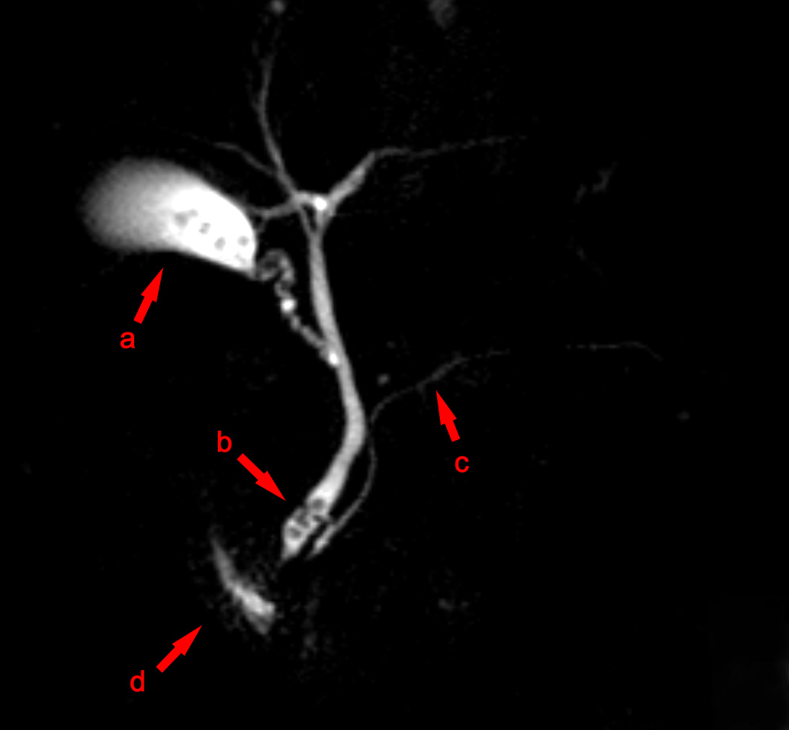
CASE :1
MRCP image showing stones in the distal common bile duct: (a) Gallbladder with stones (b) Stone in bile duct (c) Pancreatic duct (d) Duodenum.

Slide 8
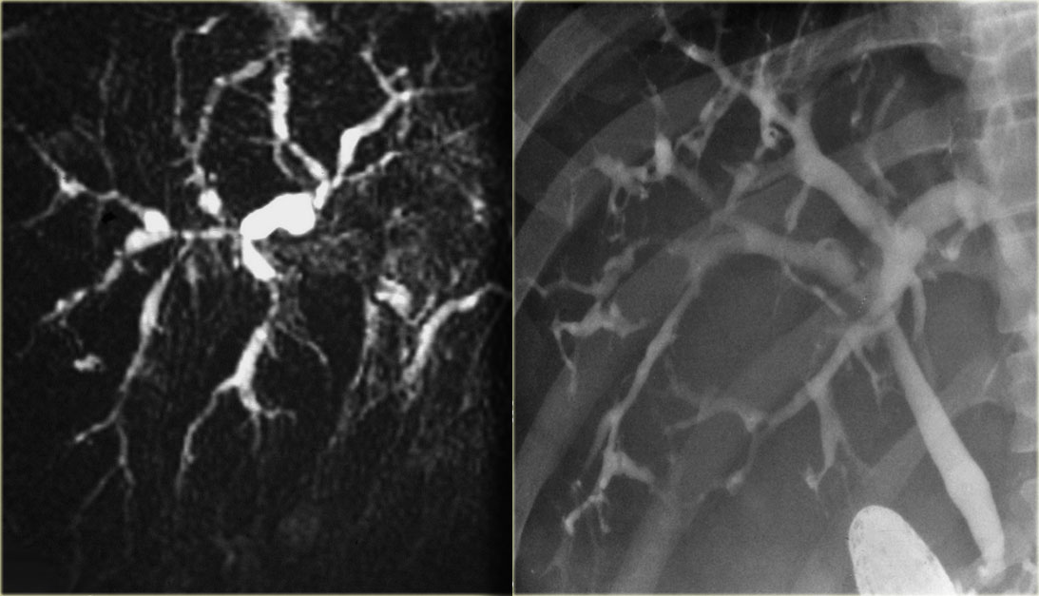
CASE :2
Primary sclerosis cholangitis
MRCP
ERCP

Slide 9
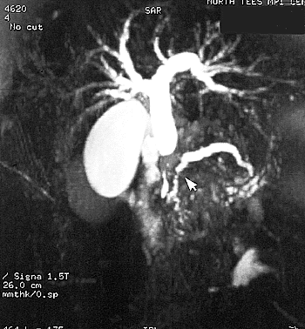
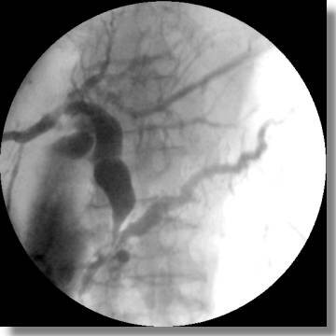
CASE : 3
PANCREATIC DUCT IRREGULARITIES AND PSEUDOCYST
MRCP
ERCP

Slide 10
AUTHOR | STUDY DESIGN | LEVEL | RESULT | CONCLUSION
J Dig Dis. 2008 Aug;9(3):162-9. Hekimoglu K¹, Ustundag Y, Dusak A, Erdem Z, Karademir B, Aydemir S, Gundogdu S. | CASE SERIES | LEVEL 4 | MRCP had a 88.9% sensitivity and a 100% specificity for diagnosing biliary stone.
AUTHOR | STUDY DESIGN | LEVEL | RESULT | CONCLUSION
J Dig Dis. 2008 Aug;9(3):162-9. Hekimoglu K¹, Ustundag Y, Dusak A, Erdem Z, Karademir B, Aydemir S, Gundogdu S. | CASE SERIES | LEVEL 4 | MRCP had a 88.9% sensitivity and a 100% specificity for diagnosing biliary stone. | MRCP is used with increasing frequency as a non-invasive alternative to ERCP and the diagnostic results of MRCP with a heavily T2-weighted TSE MR sequence and ERCP are comparable with high accuracy in various hepatobiliary pathologies.

Slide 11
AUTHOR | STUDY DESIGN | LEVEL | RESULT | CONCLUSION
Radiology. 2006 Mar;238(3):920-8. Epub 2006 Jan 19. Tamura R¹, Ishibashi T, Takahashi S. | CASE SERIES | LEVEL 4 | Overall sensitivity, specificity, and accuracy values of MRCP for delineating pathologic pancreatic changes were 88% (87 of 99), 98% (44 of 45), and 91% (131 of 144), respectively. | MRCP can enable accurate evaluation of the condition of the pancreatic duct and its changes in patients with chronic pancreatitis.

Slide 12
CONCLUSION
Studies show patients prefer MRCP to diagnostic ERCP. MRCP is particularly useful where ERCP is difficult, hazardous or impossible. It’s also an important option for patients with failed ERCPs. With the higher spatial resolution of these invasive methods, visualization of bile duct morphology with MRCP exceeds that of ERCP without the associated morbidity or mortality.
40% to 70% of patients who undergo ERCP have negative findings. If MRCP were performed before ERCP, mortality, morbidity and costs could be reduced by limiting ERCP only to those individuals who would benefit from this more invasive procedure.
MRCP can evaluate the biliary tract proximal and distal to a duct lacerated at cholecystectomy where ERCP may result in incomplete visualization, showing only a cut-off sign of the distal bile duct.
MRCP is excellent for diagnosing pancreas divisum because this technique can show the ventral and dorsal ducts simultaneously without need for cannulation of the major and minor papillae.

Slide 13
Thank you

