Slide 1
PERIPHERAL VASCULAR DISEASE
Dr Rajeshkumar Rathore
Professor, Radiology

Slide 2
Introduction
PVD is a generic term that encompasses vascular insufficiencies such as arteriosclerosis, arterial stenosis, Raynaud’s phenomenon.
Peripheral arteriosclerosis is common in the elderly and is often associated with hypertension and hyperlipidemia.
  PVD is frequently observed in patients with CAD, diabetes, and a long-term history of smoking.

Slide 3
Two types of PVD
Functional
Organic
Symptoms of PVD
Leg or hip pain during walking (intermittent claudication).
The pain stops when you rest.
Numbness, tingling or weakness in the legs.
Burning or aching pain in feet or toes when resting.
Sore on leg or foot that won’t heal.
Cold legs or feet.

Slide 4
The 5 P’s
Peripheral signs of PVD are the classic 5 P’s
  Pulselessness
  Paralysis
  Paraesthesia
  Pain
  Pallor

Slide 5
Who is at risk for PVD?
Over the age of 50
Smokers
Diabetics
Overweight (especially with syndrome X or hyperinsulinism)
Male sex
Sedentary people
People who have hypertension or high cholesterol
Family history of heart or vascular disease

Slide 6
Duplex Ultrasonography and Doppler Color-Flow Imaging
Technical advances in ultrasonography have allowed reproducible measurements of blood vessels and blood flow as well as standardization of criteria for assessment of PVD.
Doppler color-flow imaging are useful in localizing diseased segments, and spectral imaging can assess lesion severity.

Slide 7
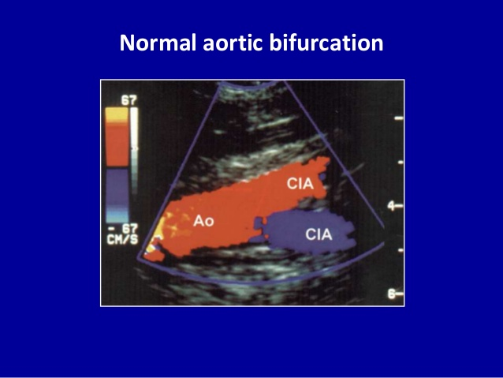
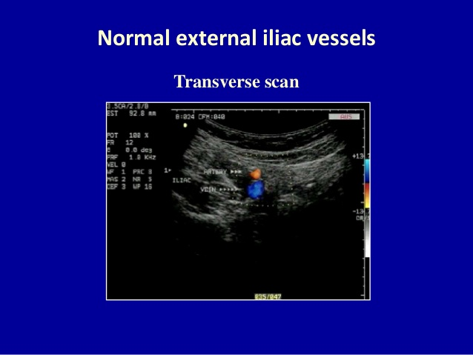
Normal appearances of vessels on Colour Doppler

Slide 8
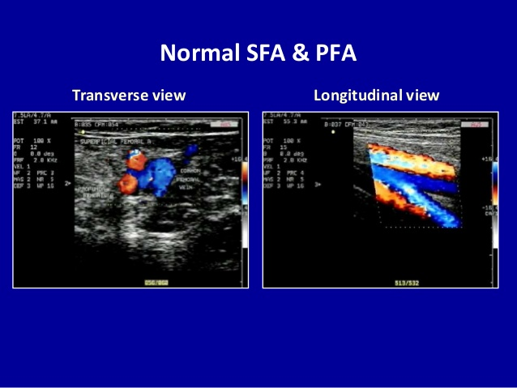
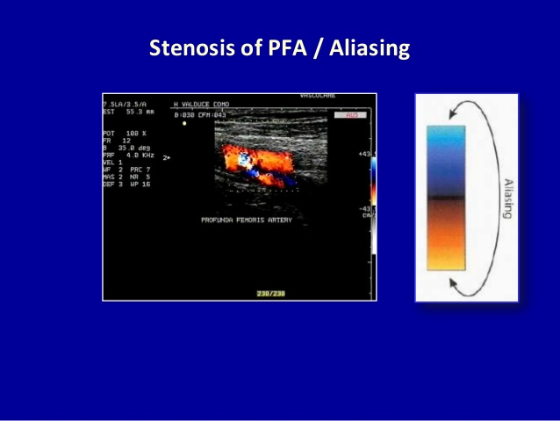

Slide 9
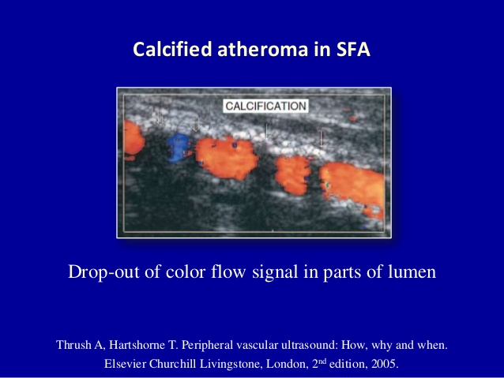

Slide 10
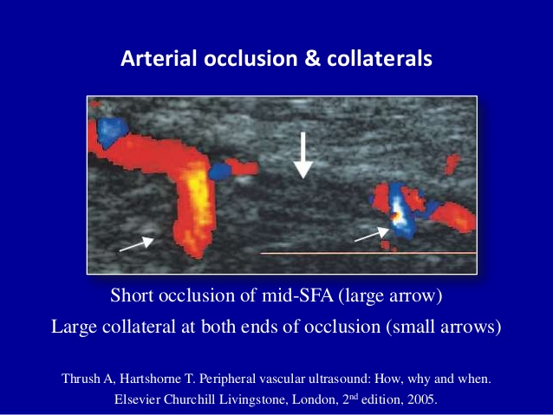

Slide 11
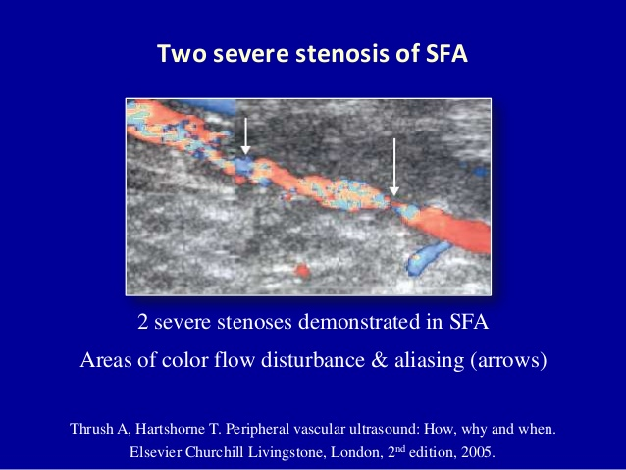
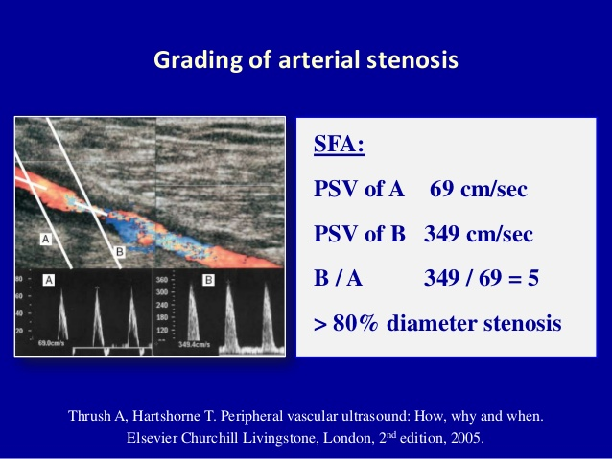

Slide 12
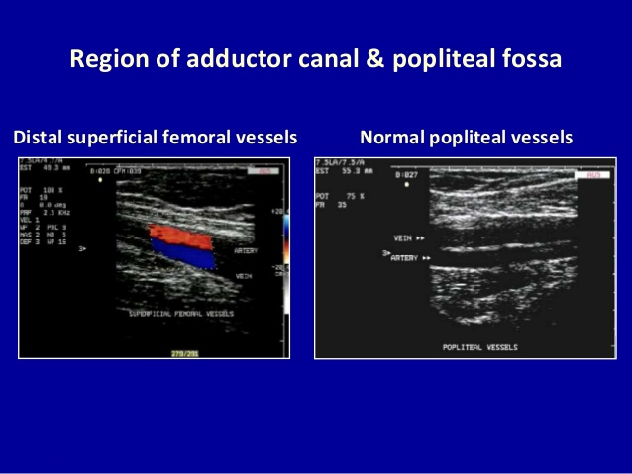

Slide 13
CT Angiography
CT angiography is a type of medical exam that combines a CT scan with an injection of a special dye called contrast material to produce pictures of blood vessels and tissues in a part of your body. The contrast is injected through an intravenous (IV) line started in your arm or hand.
A computerized tomography scan, or CT scan, is a type of X-ray that uses a computer to make cross-sectional images of your body. The dye injected to perform CT angiography is called a contrast material because it "lights up" blood vessels and tissues that are being studied.

Slide 14
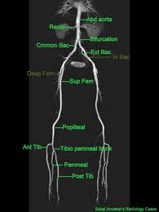
Normal appearance of vessels on CT angiography

Slide 15
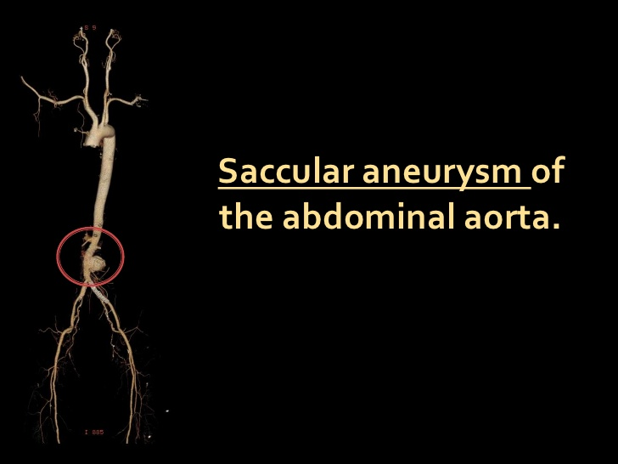

Slide 16
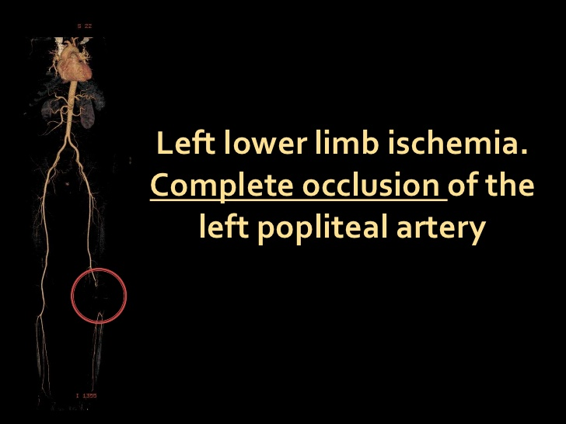

Slide 17
Author Arterial Sonography: Efficacy for the Diagnosis of Arterial Disease of the Lower Extremity Joseph F. Polak, AJR 1993;1 61:235-243 0361 -803X/93/1 612-0235 | Study design Case study | Level-4 | Results CT Angiography is a better modality for segmental length assessment, collateral circulation along with providing a road map reproduction of the arterial system. | Outcome CT angiography is a better modality for assesement of peripheral vascular disease as compared to colour doppler

Slide 18
Author Imaging in Lower-Extremity Atheroscler-otic Arterial Disease: Chadi Chahin, MD emedicine.medscape.com/article/423649-overview | Study design Case study | Level-4 | Results CT angiography is a better modality for confirm diagnosis of peripheral vascular disease | Outcome CT angiography is a better modality for assesement of peripheral vascular disease as compared to colour doppler

Slide 19
Conclusion
CDUSG is the initial modality of choice in any case of peripheral arterial disease.
CT Angiography is a better modality for segmental length assessment, collateral circulation along with providing a road map reproduction of the arterial system.

