Slide 1
DIAGNOSIS OF APPENDICITIS
USG VS CT SCAN
Dr Pradeep Jhala
Professor and HOD, Radiology

Slide 2
INTRODUCTION
Acute appendicitis is the most common surgical emergency of the abdomen, and there are about 250, 000 new cases a year in the United States. The lifetime risk of appendicitis is approximately 8.6% in males and 6.7% in females . Despite the frequency of the disease, the clinical diagnosis of appendicitis remains a diagnostic challenge. Historically, classic physical findings such as pain at McBurney's point or the psoas sign have been used to make the diagnosis, though the discriminative power of classic clinical and even laboratory findings remains low . The presence of these signs increases the likelihood of appendicitis, though no physical exam finding can effectively diagnose appendicitis.
An imaging study allows an objective confirmation of the diagnosis before an invasive procedure is performed. The two most common modalities in use are abdominal helical computed tomography (CT) and abdominal ultrasound (US). Both are considered to have acceptable sensitivities, specificities, and positive and negative predictive values, though CT has been shown to be superior in numerous studies. The introduction of CT has led to a marked decrease in the rate of negative appendectomy, as much as 48% in one institution. Compared with clinical and laboratory findings alone, the addition of CT increased diagnostic sensitivity from 91.6% to 98.3%.

Slide 3
ULTRASOUND FINDINGS OF APPENDICITIS
Thickened wall >3 mm
Diameter >6 or 7 mm
Blind-ended tubular structure
Noncompressible
Appendolith
Circumferential color flow
Echogenic mesentery
Free fluid
Abscess

Slide 4
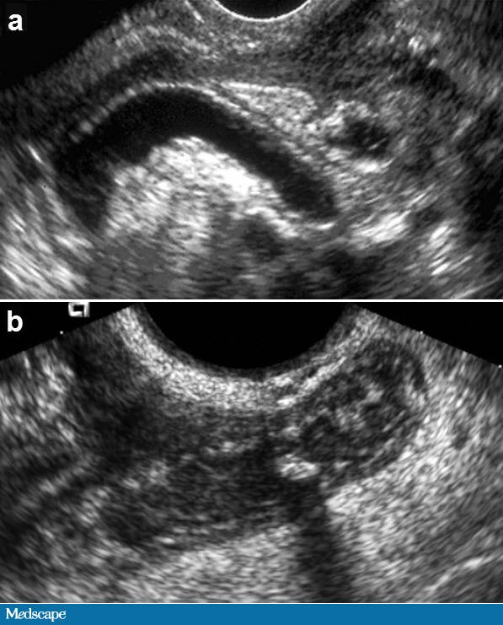
Classic acute appendicitis in 2 patients, both with a large distended appendix, diameter greater than 6 mm, and a blind-ended tip. a. A fluid distended lumen is seen. b. A thick wall; debris in the lumen; and an appendicolith, with an acoustic shadow, are seen

Slide 5
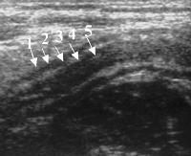
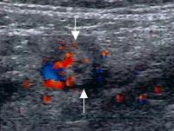
Suppurative appendicitis in a 15-year-old boy; longitudinal ultrasonogram. An aperistaltic, noncompressible, blind-ended, fluid-filled, tubular appendiceal structure is shown, and distinct wall layers (arrows) arising from the base of the cecum are observed
Suppurative appendicitis; transverse view, color Doppler ultrasound image. Circumferential colors are observed in the wall of the inflamed appendix (arrows), a strong indicator of acute appendicitis

Slide 6
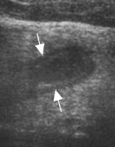
Gangrenous appendicitis; longitudinal ultrasonogram. A markedly distended appendix (arrows), loss of mucosa and submucosal layers, and prominent echogenic pericecal fat are shown.

Slide 7
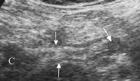
Perforated appendix; longitudinal ultrasonogram. A defect on the tip (large arrow, right side) of the enlarged appendix (short arrows, left side) is observed. c = cecum

Slide 8
CT SCAN FINDINGS OF APPENDICITIS
Typically on CT, the normal appendix is 1 to 2 mm in thickness with an overall diameter of 6 mm. The lumen is usually collapsed and the mesentery around the appendix exhibits a uniform fat density with crossing linear vessels. The abnormal appendix will show a thickened wall >3 mm and a distended lumen ≥ 6 to 7 mm. There may be an associated appendolith, mesenteric fat infiltration or fluid, and there may be associated adjacent adenopathy . More complex appendicitis may be associated with abscess formation and cecal thickening, the so-called "arrowhead sign" . In a recent report on the CT diagnosis of appendicitis, the most common signs of acute appendicitis included fat stranding (100%), an enlarged appendix >6 mm in lumen width (97%), adenopathy (63%), and an appendolith (43%). ^{[17]}

Slide 9
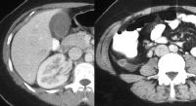
Atypical presentation of appendicitis in a young woman; computed tomography scan. The patient presented with an elevated white blood cell count and right upper quadrant pain. Left, there is pericholecystic fluid and free fluid in the right paracolic gutter, which is caused by retrocecal appendicitis. Right, the appendix, observed in axial section, has an increased diameter and an enhancing thickened wall.

Slide 10
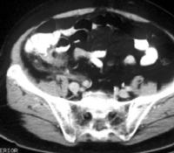
Arrowhead sign; computed tomography scan. The presence of this sign indicates contrast outlining the cecum and funneling into the origin of the appendix, with obstruction of the lumen preventing retrograde flow of barium into the distal appendix

Slide 11
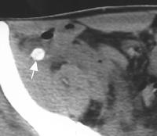
Acute gangrenous appendicitis with calcified appendicolith; computed tomography (CT) scan. A calcified appendicolith in the lumen of an enlarged inflamed appendix is shown

Slide 12

Distal appendicitis; computed tomography scan. The appendiceal lumen may be normal proximally (left, arrow), but distension and inflammatory changes are noted distally (right, open arrow)

Slide 13
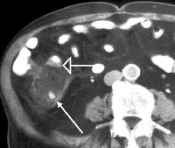
Perforated appendicitis with abscess; computed tomography scan. Note the appendicolith (arrow) and air within the abscess. The terminal ileum lies anterior to the appendiceal abscess, and inflammatory change is noted in its wall, which appears thickened (open arrow)

Slide 14
COMPARISON OF USG AND CT IN SUSPECTED APPENDICITIS
CATEGORY | ULTRASONOGRAPHY(USG) | CT
Accuracy | 71% to 97% | 93% to 98%
Sensitivity | 85% to 90% | 87% to 100%
Specificity | 47% to 96% | 95% to 99%
Negative predictive value | 76% | 95%
Patient types | Pregnant women and women of childbearing age, children | All types; avoid in pregnant women

Slide 15
Author | Study design | Level | Results | Outcome
Weston AR, Jackson TJ, Blamey S. Health Technology Analysts Pty Ltd., Balmain, New South Wales, Australia. aweston@htanalysts.com | Systemic review of surveys | I | Meta-analysis of eligible studies shows CT to have better sensitivity and specificity than ultrasound in both clinical situations. | Application of these findings in clinical practice and/or policy would need to evaluate the better diagnostic performance of CT against its cost and availability. In addition, it is imperative that future studies be conducted in patient populations that are well-defined with respect to prior investigations. Sequelae of false-negative and false-positive diagnoses should also be evaluated.

Slide 16
Author | Study design | Level | Results | Outcome
Health Technology Analysts Pty Ltd., Balmain, New South Wales, Australia. aweston@htanalysts.com | Systemic review of surveys | I | Meta-analysis of eligible studies shows CT to have better sensitivity and specificity than ultrasound in both clinical situations. | Application of these findings in clinical practice and/or policy would need to evaluate the better diagnostic performance of CT against its cost and availability. In addition, it is imperative that future studies be conducted in patient populations that are well-defined with respect to prior investigations. Sequelae of false-negative and false-positive diagnoses should also be evaluated.

Slide 17
Author | Study design | Level | Results | Outcome
Terasawa T, Blackmore CC, Bent S, Kohlwes RJ. San Francisco Veterans Affairs Medical Center and University of California, San Francisco, San Francisco, California, USA. terasawa@nnh.hosp.go.jp | Systemic review of surveys | I | Twelve computed tomography studies and 14 ultrasonography studies met inclusion criteria. Computed tomography had an overall sensitivity of 0.94 (95% CI, 0.91 to 0.95), a specificity of 0.95 (CI, 0.93 to 0.96), a positive likelihood ratio of 13.3 (CI, 9.9 to 17.9), and a negative likelihood ratio of 0.09 (CI, 0.07 to 0.12). Ultrasonography had an overall sensitivity of 0.86 (CI, 0.83 to 0.88), a specificity of 0.81 (CI, 0.78 to 0.84), a positive likelihood ratio of 5.8 (CI, 3.5 to 9.5), and a negative likelihood ratio of 0.19 (CI, 0.13 to 0.27). Verification bias and inappropriate blinding of reference standards were noted in all of the included studies. | Computed tomography is probably more accurate than ultrasonography for diagnosing appendicitis in adults and adolescents. Prospective studies that apply gold standard diagnostic testing to all study participants would more reliably estimate the true diagnostic accuracy of these tests.

Slide 18
CONCLUSION
Recent investigation indicates that abdominopelvic CT is an appropriate initial approach to imaging patients for acute appendicitis. Use of intravenous and oral/rectal contrast media and thin cuts optimizes the study.
Disadvantages of CT include possible iodinated-contrast-media allergy, patient discomfort from administration of contrast media (especially if rectal contrast media is used), exposure to ionizing radiation, and cost.

Slide 19
Thank You

