Slide 1
Imaging modalities for pediatric intussusceptions
Dr Jayesh Shah
Professor , Radiology

Slide 2
Introduction
Intussusceptions is a process in which a segment of intestine invaginates into the adjoining intestinal lumen, causing bowel obstruction.
With early diagnosis, appropriate fluid resuscitation, and therapy, the mortality rate from intussusception in children is less than 1%. If left untreated, however, this condition is uniformly fatal in 2-5 days.
A common cause of abdominal pain in children, intussusceptions is suggested readily in pediatric practice based on a classic triad of signs and symptoms: vomiting, abdominal pain, and passage of blood per rectum.
Intussusceptions presents in 2 variants: idiopathic intussusceptions, which usually starts at the ileocolic junction and affects infants and toddlers, and enteroenteral intussusception (jejunojejunal, jejunoileal, ileoileal), which occurs in older children. The latter is associated with special medical situations (eg, Henoch-Schonlein purpura [HSP], cystic fibrosis, hematologic dyscrasias) or may be secondary to a lead point and occasionally occur in the postoperative period. Intussusception is demonstrated in the images below.

Slide 3
History Presentation
The patient with intussusception is usually an infant, often one who has had an upper respiratory infection, who presents with the following symptoms :
Vomiting: Initially, vomiting is nonbilious and reflexive, but when the intestinal obstruction occurs, vomiting becomes bilious
Abdominal pain: Pain in intussusception is colicky, severe, and intermittent
Passage of blood and mucus: Parents report the passage of stools, by affected children, that look like currant jelly; this is a mixture of mucus, sloughed mucosa, and shed blood; diarrhea can also be an early sign of intussusception
Lethargy: This can be the sole presenting symptom of intussusception, which makes the condition’s diagnosis challenging
Palpable abdominal mass

Slide 4
Lead points
In approximately 2-12% of children with intussusception, a surgical lead point is found. Occurrence of surgical lead points increases with age and indicates that the probability of nonoperative reduction is highly unlikely. Examples of lead points are as follows:
Meckel diverticulum
Enlarged mesenteric lymph node
Benign or malignant tumors of the mesentery or of the intestine, including lymphoma, polyps, ganglioneuroma, and hamartomas associated with Peutz-Jeghers syndrome
Mesenteric or duplication cysts
Submucosal hematomas, which can occur in patients with HSP and coagulation dyscrasias
Ectopic pancreatic and gastric rests
Inverted appendiceal stumps
Sutures and staples along an anastomosis
Intestinal hematomas secondary to abdominal trauma
Foreign body
Hemangioma
Kaposi sarcoma
Post-transplantation lymphoproliferative disorder (PTLD)

Slide 5
Prognosis
The prognosis in patients with intussusception is excellent if the condition is diagnosed and treated early; otherwise, severe complications and death may occur.
The recurrence rate of intussusception after nonoperative reduction is usually less than 10% but has been reported to be as high as 15%.Most intussusceptions recur within 72 hours of the initial event; however, recurrences have been reported as long as 36 months later. More than 1 recurrence suggests the presence of a lead point. A recurrence is usually heralded by the onset of the same symptoms as appeared during the initial event. Provide similar treatment for a recurrence unless the suggestion of a lead point is very strong (in which case, surgical exploration should be contemplated).
The recurrence rates after air enema and barium enema are 4% and 10%, respectively. Recurrences respond to nonoperative reduction in almost 95% of cases.

Slide 6
Complications associated with intussusception, which rarely occur when the diagnosis is prompt, include the following :
Perforation during nonoperative reduction
Wound infection
Internal hernias and adhesions causing intestinal obstruction
Sepsis from undetected peritonitis (major complication from a missed diagnosis)
Intestinal hemorrhage
Necrosis and bowel perforation
Recurrence
With early diagnosis, appropriate fluid resuscitation, and therapy, the mortality rate from intussusception in children is less than 1%. If left untreated, this condition is uniformly fatal in 2-5 days.

Slide 7
Diagnosis
Imaging studies used in the diagnosis of intussusception include the following :
Radiography: Plain abdominal radiography reveals signs that suggest intussusception in only 60% of cases
Ultrasonography: Hallmarks of ultrasonography include the target and pseudokidney signs
Contrast enema: This is the traditional and most reliable way to make the diagnosis of intussusception in children

Slide 8
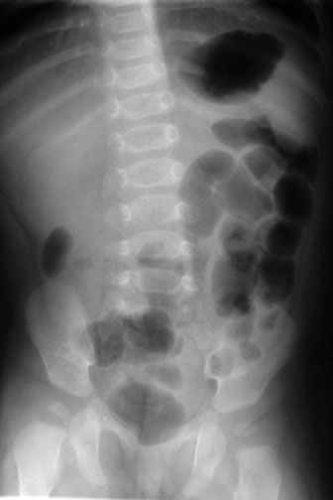
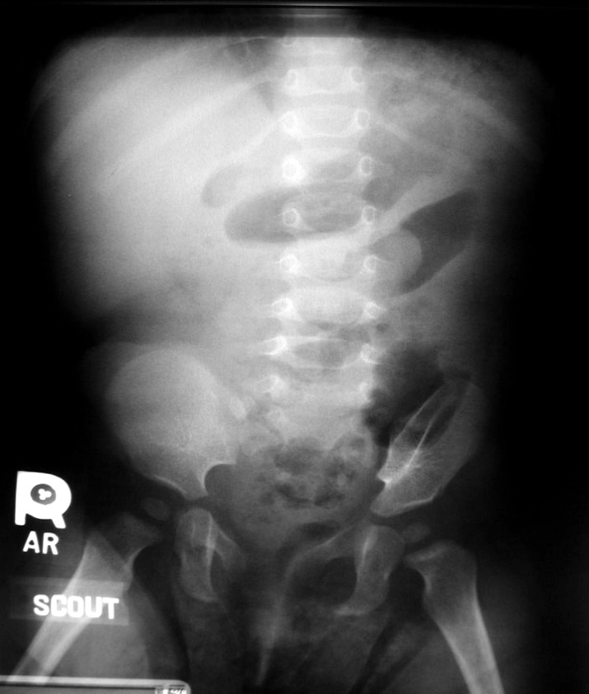
After obtaining a thorough history and performing a careful physical examination, obtain plain radiographs of the abdomen with the patient in the supine and upright positions.
Plain abdominal radiography reveals signs that suggest intussusception in only 60% of cases. (See the images below.) Plain radiograph findings may be normal early in the course of intussusception.^{[17]} As the disease progresses, the earliest radiographic evidence includes an absence of air in the right lower and upper quadrants and a right upper quadrant soft tissue density present in 25-60% of patients.
Abdominal radiograph
shows small bowel
dilatation and paucity
of gas in the right
lower and upper
quadrants.
Note intussusception
in the left upper
quadrant on this
plain film of an
infant with pain
vomiting.

Slide 9
These findings are followed by an obvious pattern of small bowel obstruction, with dilatation and air-fluid levels in the small bowel only. If the distention is generalized and the air-fluid levels are also present in the colon, the findings more likely represent acute gastroenteritis than intussusception.
A left lateral decubitus view is also helpful. If the view exhibits air in the cecum, the presence of ileocecal intussusception is highly unlikely.
Limitations of radiography
Morrison et al concluded that, when interpreted by pediatric emergency physicians, abdominal radiographs have a low sensitivity and specificity for diagnosing intussusception. In a prospective experimental study, 14 pediatric emergency physicians interpreted radiographs of 50 cases of intussusception and 50 matched controls; these interpretations showed a sensitivity of 48% and a specificity of 21%. In 11% of cases, the abdominal radiographs were incorrectly interpreted as reassuring.

Slide 10
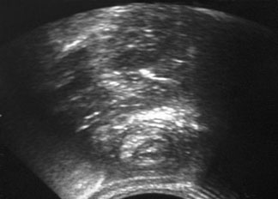
Ultrasound and CT scan imaging
Abdominal ultrasonography reveals
the classic target sign of an
intussusceptum inside
an intussuscipiens.
One study reported that the overall sensitivity and specificity of ultrasonography for detecting ileocolic intussusception was 97.9% and 97.8%, respectively. The authors concluded that ultrasonography should be used as a first-line examination for the assessment of possible pediatric intussusception.
Ultrasonography eliminates the risk of exposure to ionizing radiation and can help to depict lead points and residual intussusceptions. It also helps to rule out other possible causes of abdominal pain. Even so, ultrasonography is highly operator dependent; therefore, interpret results with caution.

Slide 11
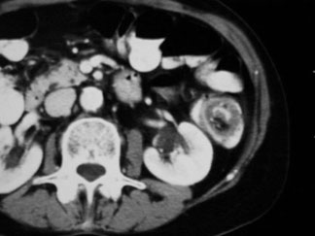
The presence of ascites and long segments of intussusception can be used as sonographic predictors of failure for nonoperative management. Sonographic detection of ascites, air, and absence of blood flow in the intestinal wall strongly suggest bowel gangrene.
Computed tomography (CT) scanning has also been proposed as a useful tool to diagnose intussusception (see the image below); however, CT scan findings are unreliable, and CT scanning carries risks associated with intravenous contrast administration, radiation exposure, and sedation.
CT scan reveals the classic ying-yang sign of an intussusceptum inside an intussuscipiens

Slide 12
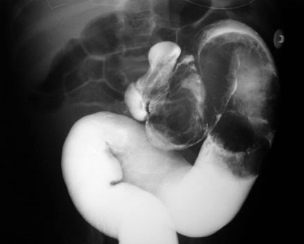
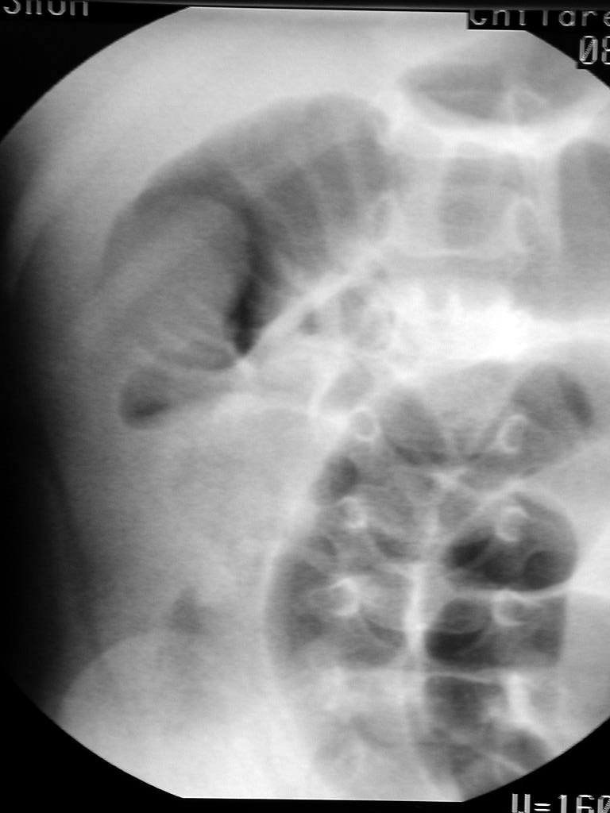
The traditional and most reliable way to make the diagnosis of intussusception in children is to obtain a contrast enema (either barium or air). Contrast enema is quick and reliable and has the potential to be therapeutic.
Barium enema shows intussusception in the descending colon.
Intussusception evident during air contrast enema prior to reduction.

Slide 13
Exercise caution when performing contrast enema in children older than 3 years, because most of these patients have a surgical lead point, usually in the small bowel. The diagnostic and therapeutic yield of the enema is lower in these patients. Enema is contraindicated in patients in whom bowel gangrene or perforation is suspected.

Slide 14
Author/Year | Study Design | Level | Result | Outcome
An institutional analysis and systematic review with meta-analysis of pneumatic versus hydrostatic reduction for pediatric intussusception. Beres AL, Baird R | Non Randomized Studies scale for observational studies, Jadad score for randomized trials. | 1 | Institutional data revealed a failed reduction rate of 20.4% (20/98) with air and 29.6% (8/27) with contrast reduction. Nineteen studies were included in the systematic review. The cumulative failure rate favored pneumatic reduction (odds ratio [OR] 0.45; 95% confidence interval [95% CI] 0.34-0.60); sensitivity analysis of prospective studies demonstrated similar results (OR 0.39; 95% CI 0.24-0.63). The number needed to treat to eliminate one failed reduction was nine pneumatic reductions. No difference was noted in reported perforations (OR 0.98; 95% CI 0.48-2.03). | Pneumatic reduction is more likely to successfully reduce intussusception in children without evidence of increased morbidity. In the context of available expertise, pneumatic reduction should be the method of choice for the treatment of intussusception barring an indication for immediate operative intervention.

Slide 15
Author/Year | Study Design | Level | Result | Outcome
Intussusception in Early Childhood: A Cohort Study of 1.7 Million Children Thea Kølsen Fischer, MD, DMSc, Kristine Bihrmann, MSc, Michael Perch, MD, Anders Koch, MD, PhD, Jan Wohlfahrt, MSc, Mølbak Kåre, MD, DMSc‖ Mads Melbye, MD, DMSc | Cohort study | 3 | A total of 1814 cases of intussusception among children who were younger than 5 years were reported from 1980 to 2001. The incidence rate remained fairly constant during 1980 to 1990 but decreased by 55% (95% confidence interval: 43%–65%) from 1990 to 2001. The reduction was most pronounced among children aged 3 to 5 months. | The incidence of intussusception among Danish children declined significantly during the 1990s, particularly among infants 3 to 5 months of age.

Slide 16
One important point to be noted that Intussusception among Infants Given an Oral Rotavirus Vaccine - study findings given as below :
Author/Year | Study Design | Level | Result | Outcome
Intussusception among Infants Given an Oral Rotavirus Vaccine Trudy V. Murphy, M.D., Paul M. Gargiullo, Ph.D., Mehran S. Massoudi, Ph.D., M.P.H., David B. Nelson, B.S., Aisha O. Jumaan, Ph.D., M.P.H., Catherine A. Okoro, M.S., Lynn R. Zanardi, M.D., M.P.H., Sabeena Setia, M.P.H., Elizabeth Fair, M.P.H., Charles W. LeBaron, M.D., Benjamin Schwartz, M.D., Melinda Wharton, M.D., M.P.H., | CASE SERIES | 4 | Data were analyzed for 429 infants with intussusception and 1763 matched controls in a case–control analysis as well as for 432 infants with intussusception in a case-series analysis. Seventy-four of the 429 infants with intussusception (17.2 percent) and 226 of the 1763 controls (12.8 percent) had received RRV-TV (P=0.02). An increased risk of intussusception 3 to 14 days after the first dose of RRV-TV was found in the case–control analysis (adjusted odds ratio, 21.7; 95 percent confidence interval, 9.6 to 48.9). In the case-series analysis, the incidence-rate ratio was 29.4 (95 percent confidence interval, 16.1 to 53.6) for days 3 through 14 after a first dose. There was also an increase in the risk of intussusception after the second dose of the vaccine, but it was smaller than the increase in risk after the first dose. Assuming full implementation of a national program of vaccination with RRV-TV, we estimated that 1 case of intussusception attributable to the vaccine would occur for every 4670 to 9474 infants vaccinated. | The strong association between vaccination with RRV-TV and intussusception among otherwise healthy infants supports the existence of a causal relation. Rotavirus vaccines with an improved safety profile are urgently needed.

Slide 17
Management
Nonoperative reduction
Therapeutic enemas include the following:
Hydrostatic: With barium or water-soluble contrast
Pneumatic: With air insufflation; this is the treatment of choice in many institutions, and the risk of major complications with this technique is small
Surgical reduction
Traditional entry into the abdomen is through a right paraumbilical incision. The intussusception is delivered into the wound, and manual reduction is attempted. It is important that the intussusception be milked out of the intussuscipiens.
If manual reduction is not possible or perforation is present, a segmental resection with an end-to-end anastomosis is performed.
Laparoscopy has been added to the surgical armamentarium for intussusception and can be performed in all cases of intussusception.

Slide 18
Thank you

