Slide 1
MRI VERSUS ARTHROSCOPY IN THE DIAGNOSIS OF KNEE PATHOLOGY
Dr Mayur Khadendia
Professor, Radiology

Slide 2
MRI KNEE
MRI of the knee provides detailed images of structures within the knee joint, including bones, cartilage, tendons, ligaments, muscles and blood vessels, from many angles.
Magnetic resonance imaging (MRI) is a noninvasive medical test that helps physicians diagnose and treat medical conditions.

Slide 3
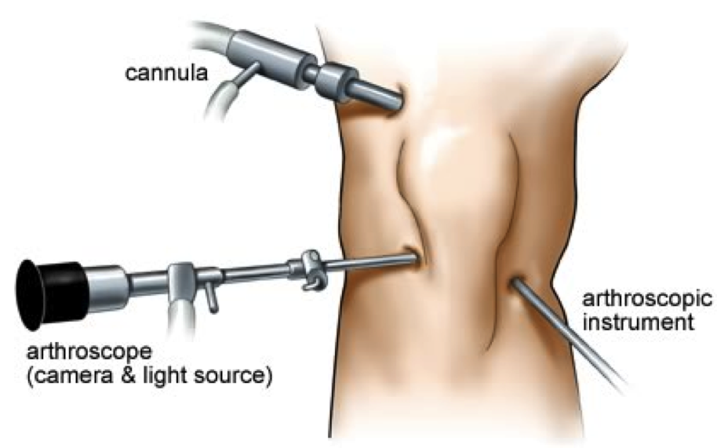
Knee Arthroscopy
Arthroscopy is a common surgical procedure in which a joint(arthro-) is viewed (-scopy) using a small camera. Arthroscopy gives doctors a clear view of the inside of the knee. This helps them diagnose and treat knee problems.

Slide 4
Anterior Cruciate Ligament (ACL) tear
The anterior cruciate ligament is one of four major ligaments that provide stability to the knee joint. In particular, it prevents anterior translation and rotation of the tibia in relation to the femur. ACL tear occurs when the forces that tend to displace the tibia can not be absorbed by the ligament. ACL tear is common in sports (football, basketball) and could be accompanied by meniscal tear, osteochondral lesion and other ligaments rupture. Cutting maneuvers, incorrect landing after a jamb, sudden deceleration and direct knee blow could be the mechanism of ACL tear.

Slide 5
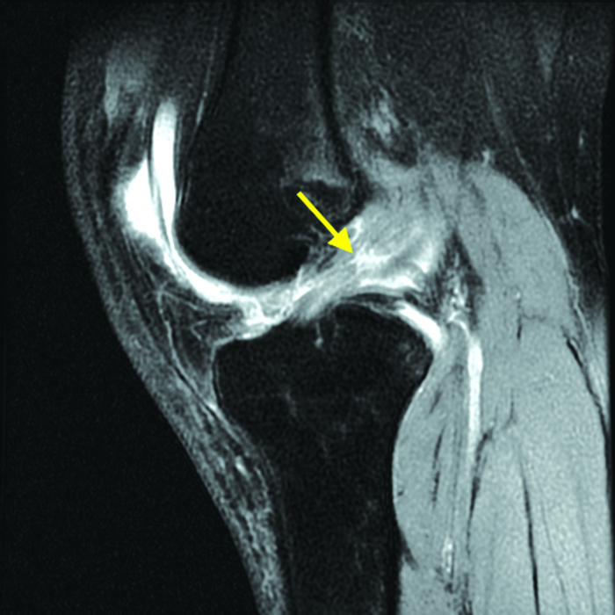
Sagital T2-weighted MRI shows ACL tear (yellow arrow).

Slide 6
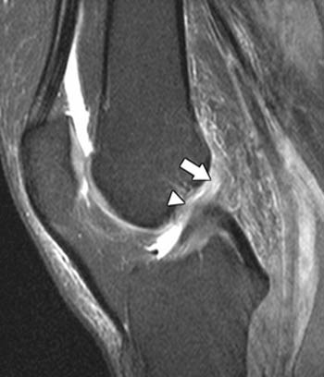
Subtle focal hyperintensity in the substance of the proximal anterior cruciate ligament (arrow) and a slightly wavy contour of its anterior margin (arrowhead) are demonstrated

Slide 7
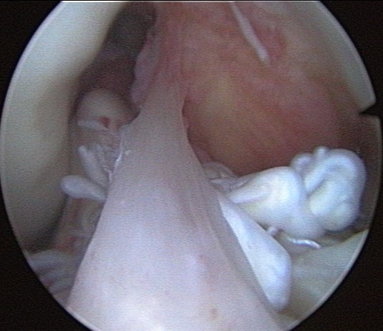
Arthroscopic picture of torn ACL

Slide 8
Meniscal lesions
The patient with meniscal pathology typically presents with symptoms referable to the joint line, either medially or laterally. In traumatic cases, an injury is brought on with the knee in flexion, weight bearing, followed by rotation. A pop may or may not be felt. Symptoms are frequently worsened by flexing and loading the knee, and activities such as squatting and kneeling are poorly tolerated. Patients will frequently complain of a "pop" or "clunk" sensation as the knee is brought through the range of motion.

Slide 9
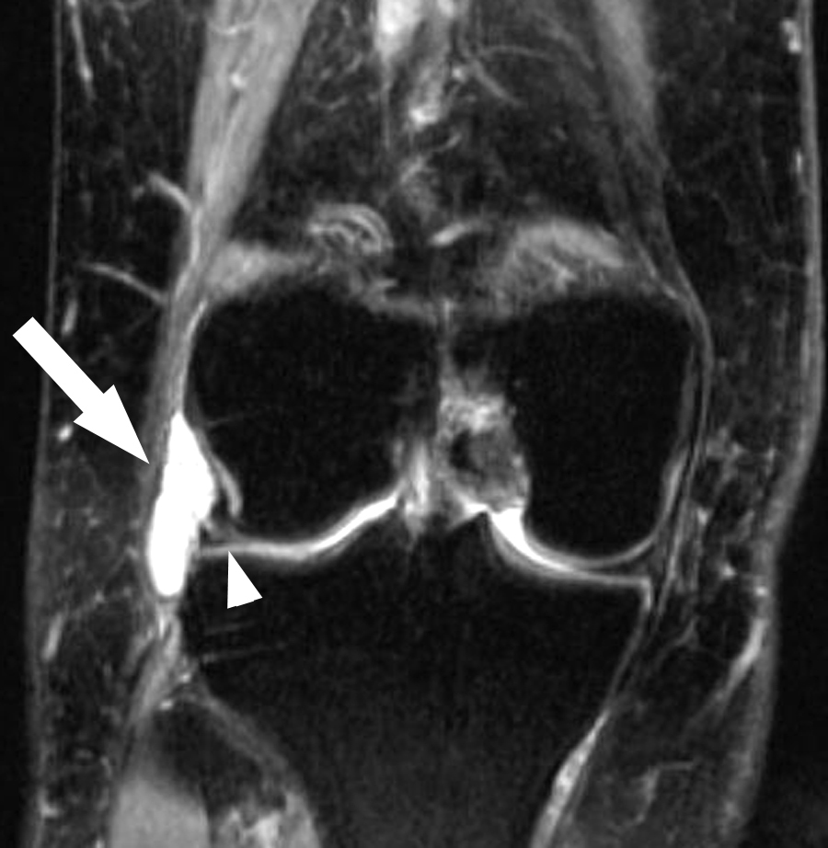
Coronal T2-weighted magnetic resonance image shows a cyst (arrow) adjacent to the lateral meniscus (arrowhead) and also demonstrates a tear communicating with the cyst.

Slide 10
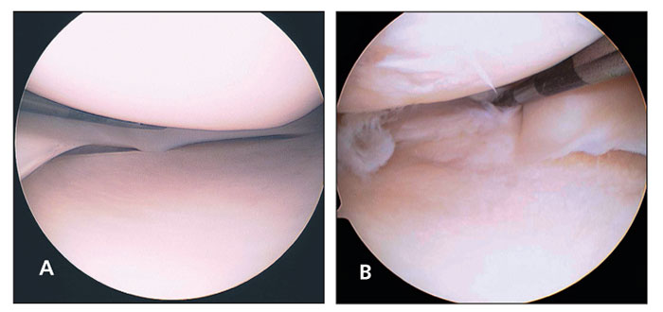
The normal arthroscopic appearance of the meniscus is shown here (A). This arthroscopic visualization (B) shows a complex medial meniscus tear with radial and horizontal patterns.

Slide 11
Advantages of MRI
MRI is a noninvasive imaging technique that does not involve exposure to ionizing radiation.
MRI has proven valuable in diagnosing a broad range of conditions, including tendon, ligament, muscle, cartilage and bone abnormalities.
MRI can help determine which patients with knee injuries require surgery.
MRI may help diagnose a bone fracture when x-rays and other tests are inconclusive.
MRI enables the discovery of abnormalities that might be obscured by bone with other imaging methods.
MRI provides a non-invasive alternative to x-ray, angiography and CT for diagnosing problems of the blood vessels.

Slide 12
Disadvantages of MRI
If sedation is used, there are risks of excessive sedation. The technologist or nurse monitors your vital signs to minimize this risk.
Although the strong magnetic field is not harmful in itself, implanted medical devices that contain metal may malfunction or cause problems during an MRI exam.
There is a very slight risk of an allergic reaction if contrast material is injected. Such reactions usually are mild and easily controlled by medication. If you experience allergic symptoms, a radiologist or other physician will be available for immediate assistance.
Nephrogenic systemic fibrosis is currently a recognized, but rare, complication of MRI believed to be caused by the injection of high doses of gadolinium-based contrast material in patients with very poor kidney function. Careful assessment of kidney function before considering a contrast injection minimizes the risk of this very rare complication.

Slide 13
ADVANTAGES OF ARTHROSCOPY
less pain following the operation
faster healing time
lower risk of infection
it can be performed as a day case procedure
you may be able to resume normal activities more quickly
DISADVANTAGES OF ARTHROSCOPY
Bruising around the knee, the back of the leg, lower leg, or thigh can occur and responds well to ice and elevation.
Swelling is common after surgery. Icing your knee and elevating your leg are extremely helpful.
Portal discomfort/fluid leak - Soon after surgery the small arthroscopic skin incisions may leak watery fluid used during the procedure. This is normal. The portal scar may feel nodular as the incisions heal; this generally resolves over time.
Anterior knee pain ("patellofemoral syndrome"). Some patients may develop new symptoms or exacerbation of current symptoms during the course of their rehabilitation.

Slide 14
TITLE/AUTHORS | STUDY TYPE | LEVEL | RESULT | CONCLUSION
Ruth Crawford, Gayle Walley, Stephen Bridgman and Nicola Maffulli Br Med Bull (2007) 84 (1): 5-23. doi: 10.1093/bmb/ldm022 | Systematic review | 1 | MRI is highly accurate in diagnosing meniscal and anterior cruciate ligament (ACL) tears. It is the most appropriate screening tool before therapeutic arthroscopy. It is preferable to diagnostic arthroscopy in most patients because it avoids the surgical risks of arthroscopy. The results of MRI differ for medial and lateral meniscus and ACL, with only 85% accuracy. | Diagnostic performance results of MRI differ for the medial and lateral meniscus and the ACL, although all were above 85% accuracy. Study design characteristics should also be taken in account whenever a study on MRI assessing its diagnostic performance is designed or reviewed.

Slide 15
TITLE/AUTHORS | STUDY TYPE | LEVEL | RESULT | CONCLUSION
von Engelhardt LV1, Schmitz A, Burian B, Pennekamp PH, Schild HH, Kraft CN, von Falkenhausen M. 008 Sep;37(9):914, 916-22. doi: 10.1007/s00132-008-1313-6. | Systematic review | 1 | Thirty-six percent of the examined cartilage surfaces demonstrated no agreement between MRI and arthroscopic grading. In most of these cases, grades II and III cartilage lesions were confounded with each other. Regarding the positive predictive values, the probability that a positive finding in MRI would be exactly confirmed by arthroscopy was 39-72%. In contrast, specificities and negative predictive values of different grades of cartilage diseases were 85-95%. | MRI is a supportive, noninvasive method for clinical decision making regarding conservative or operative treatment possibilities. The value of diagnostic arthroscopy for a definitive assessment of the articular surfaces and for therapeutic planning currently cannot be replaced by MRI.

Slide 16
CONCLUSION
MRI is highly accurate in diagnosing meniscal and ACL tears. It is the most appropriate screening tool for therapeutic arthroscopy. It is preferable to diagnostic arthroscopy in most patients because it is faster and avoids surgical risks. An area of future research is the use of specific MRI sequences to identify problems in each of the various tissues in and around the knee (ligaments, menisci, tendons, articular surface and bone), while keeping the investigation within acceptable times and costs.
From the present study, it is clear that the diagnostic performance results of MRI differ for the medial and lateral meniscus and the ACL, although all were above 85% accuracy. Study design characteristics should also be taken in account whenever a study on MRI assessing its diagnostic performance is designed or reviewed. There is scope for more research in this area, particularly on knee pathology other than menisci and ACL.

Slide 17
THANK YOU

