Slide 1
CT ANGIOGRAPHY IN PULMONARY EMBOLISM
Dr Tushar Vaishnav
Professor, Radiology

Slide 2
Pulmonary Embolism
Pulmonary embolism (PE) is a blockage of the main artery of the lung or one of its branches by a substance that has travelled from elsewhere in the body through the bloodstream (embolism).
PE most commonly results from deep vein thrombosis (a blood clot in the deep veins of the legs or pelvis) that breaks off and migrates to the lung, a process termed venous thromboembolism (VTE).
A small proportion of cases are caused by the embolization of air, fat, or talc in drugs of intravenous drug abusers or amniotic fluid.
The obstruction of the blood flow through the lungs and the resultant pressure on the right ventricle of the heart lead to the symptoms and signs of PE.

Slide 3
RISK FACTORS
The most common sources of embolism are proximal leg deep venous thrombosis (DVTs) or pelvic vein thromboses. Any risk factor for DVT also increases the risk that the venous clot will dislodge and migrate to the lung circulation, which may happen in as many as 15% of all DVTs. The conditions are generally regarded as a continuum termed venous thromboembolism (VTE).
Alterations in blood flow: immobilization (after surgery, injury, pregnancy (also procoagulant), obesity (also procoagulant), cancer (also procoagulant)
Factors in the vessel wall: surgery, catheterizations causing direct injury ("endothelial injury")
Factors affecting the properties of the blood (procoagulant state):
  Estrogen containing hormonal contraception
  Genetic thrombophilia (factor V Leiden, prothrombin mutation G20210A, protein C deficiency, deficiency of protein S , antithrombin deficiency, hyperhomocysteinemia and plasminogen/fibrinolysis disorders)
  Acquired thrombophilia (antiphospholipid syndrome, nephrotic syndrome, paroxysmal nocturnal hemoglobinuria)
  Cancer (due to secretion of pro-coagulants)

Slide 4
CT Angiography
CT angiography is a type of medical exam that combines a CT scan with an injection of a special dye called contrast material to produce pictures of blood vessels and tissues in a part of your body. The contrast is injected through an intravenous (IV) line started in your arm or hand.
A computerized tomography scan, or CT scan, is a type of X-ray that uses a computer to make cross-sectional images of your body. The dye injected to perform CT angiography is called a contrast material because it "lights up" blood vessels and tissues that are being studied.

Slide 5
USES
Examine the pulmonary arteries in the lungs to rule out pulmonary embolism, a serious but treatable condition. This is called a CTPA.
Visualize blood flow in the renal arteries (those supplying the kidneys) in patients with high blood pressure and those suspected of having kidney disorders. Narrowing (stenosis) of a renal artery is a cause of high blood pressure (hypertension) in some patients and can be corrected. A special computerized method of viewing the images makes renal CT angiography a very accurate examination. Also done in prospective kidney donors.
Identify aneurysms in the aorta or in other major blood vessels. Aneurysms are diseased areas of a weakened blood vessel wall that bulges out—like a bulge in a tire. Aneurysms are life-threatening because they can rupture.
Identify dissection in the aorta or its major branches. Dissection means that the layers of the artery wall peel away from each other—like the layers of an onion. Dissection can cause pain and can be life-threatening.
Identify a small aneurysm or arteriovenous malformation inside the brain that can be life-threatening.
Detect atherosclerotic disease that has narrowed the arteries to the legs.

Slide 6
RISKS
There is always a slight risk for cancer from repeated exposure to radiation, but the benefits of getting an accurate diagnosis generally outweigh the risks. The amount of radiation used during CT angiography is considered minimal, so the risk for radiation exposure is low.
Allergic reactions. Always let your radiologist know if you have any history of allergies or an allergy to contrast material. Reactions to contrast are uncommon. If you have any history of allergic reactions, you may be given medication to lessen the risk for an allergic reaction before the test.
Tissue damage. If a large amount of contrast material leaks around your IV site, it can irritate your skin or the blood vessels and nerves just under your skin. It is important to tell your radiologist or radiology technician if you have any pain when the contrast material is injected through your IV.
Angiography contrast material can damage your kidneys, so you may not be able to have this test if you have severe kidney disease or diabetes.

Slide 7
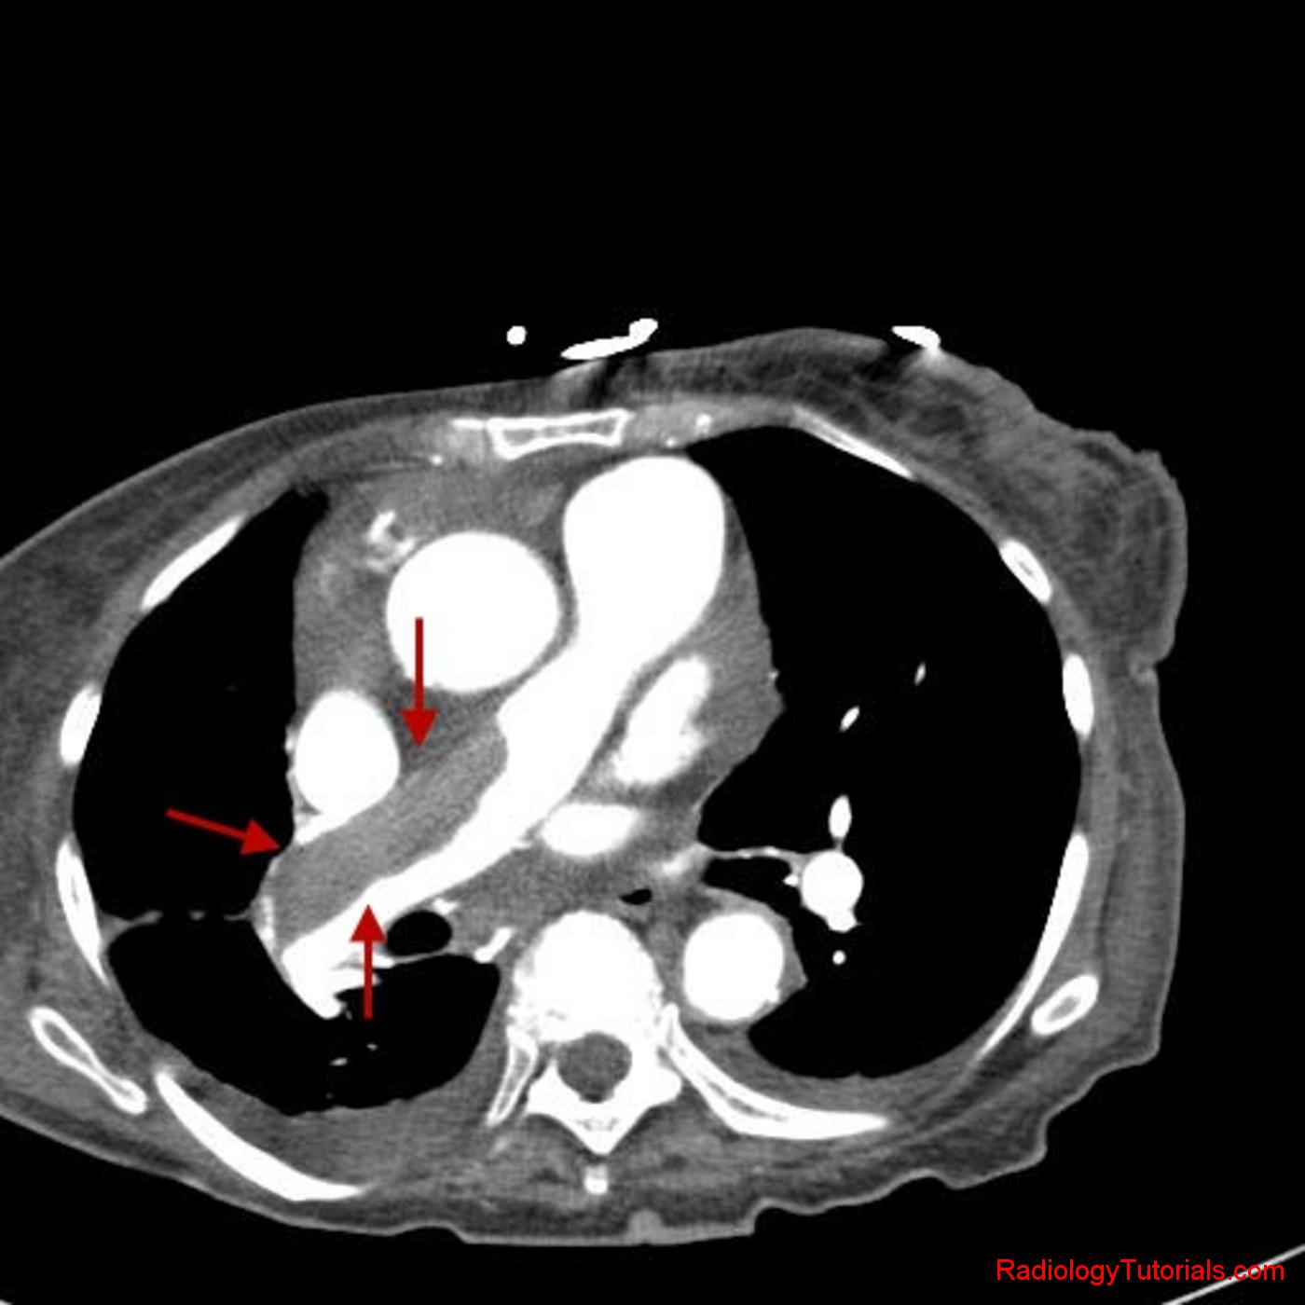
Pulmonary embolus in right pulmonary artery
This pulmonary embolus has a more chronic appearance, since it is wall adherent

Slide 8
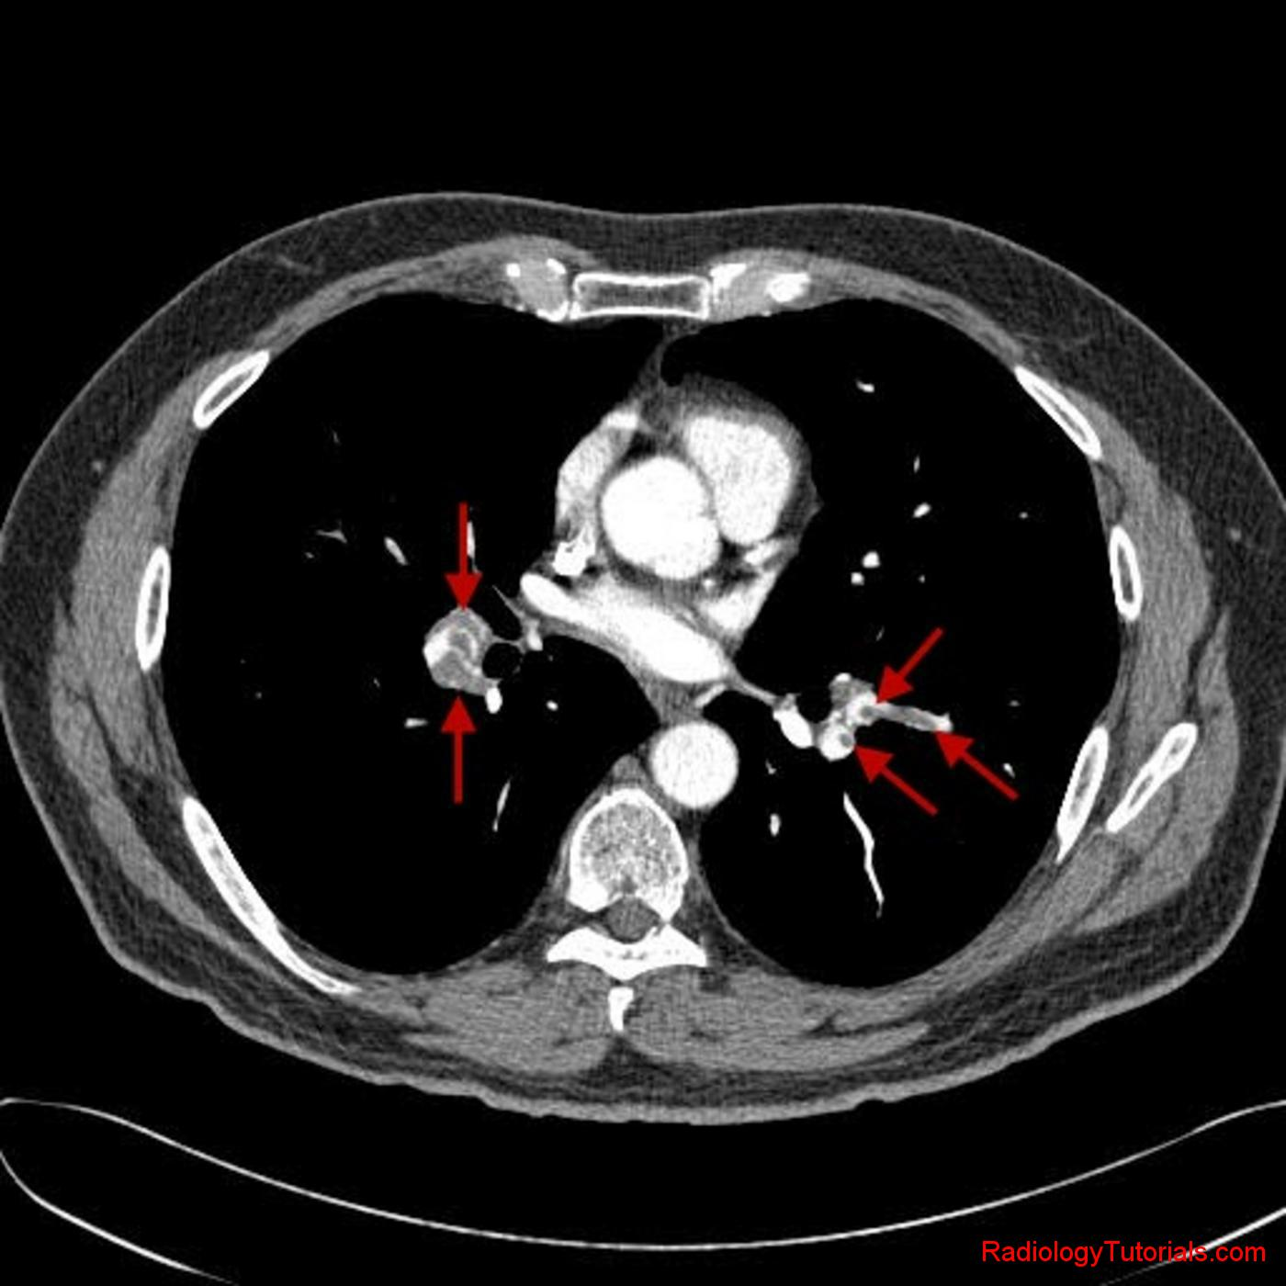
Multiple luminal filling defects are seen in the segmental and subsegmental branches of bilateral pulmonary arteries (arrows), consistent with a shower of acute pulmonary emboli

Slide 9
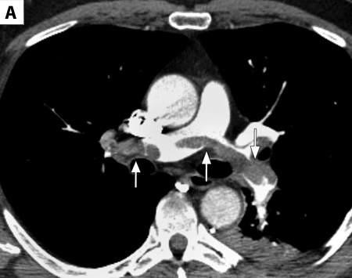
axial contrast-enhanced image obtained at the level of the main pulmonary artery shows low density material (arrows) within the left and right main pulmonary arteries, crossing the bifurcation of the main PA. This is consistent with a saddle embolus.

Slide 10
TITLE/AUTHORS | STUDY TYPE | LEVEL | RESULT | CONCLUSION
Hogg K1, Brown G, Dunning J, Wright J, Carley S, Foex B, Mackway-Jones K 2006 Mar;23(3):172-8 | Systematic review | 1 | Thirteen diagnostic and 11 follow up studies were identified. Studies varied in prevalence of pulmonary embolism (19-79%), patient groups, and method quality. Few studies recruited unselected emergency department patients. There was heterogeneity in the analysis of sensitivity (53 to 100%), specificity (79 to 100%), and false negative rate (1.0 to 10.7%). The pooled false negative rate of combined negative CT pulmonary angiography and negative deep vein thrombosis testing was 1.5% (95% CI 1.0 to 1.9%) | Diagnostic studies give conflicting results for the diagnostic accuracy of CT pulmonary angiography. Follow up studies show that CT pulmonary angiography can be used in combination with investigation for deep vein thrombosis to exclude pulmonary embolism

Slide 11
TITLE/AUTHORS | STUDY TYPE | LEVEL | RESULT | CONCLUSION
Joshi R1, Wu K, Kaicker J, Choudur H. 2013 Oct 3 | Systematic review | 1 | Discrepancies were noted in 25 of the 215 studies (11.6%). These discrepancies consisted of three false-positive, four false-negative, and 18 equivocal cases. There was a decrease in the discrepancy rate from the second year to the fifth year of training by approximately 60%. | Our study suggests that it is reasonable to have on-call radiology residents perform the preliminary interpretations of CT for PE studies.

Slide 12
TITLE/AUTHORS | STUDY TYPE | LEVEL | RESULT | CONCLUSION
Adil Shujaat, Janet M. Shapiro and Edward Eden 2013; 2013: 915213 | Systematic review | 1 | Our study shows that CTPA revealed alternative findings in only 35% of such patients. The most common alternative findings were emphysema (7.6%), pneumonia (7.1%), atelectasis (5.5%), bronchiectasis (3.8%), air-trapping (3.3%), and pulmonary edema (3.3%). CTPA has replaced ventilation-perfusion scan as the imaging test of choice in patients suspected of PE | In patients with suspected PE, CT can be used safely as the primary diagnostic test to rule out PE. CT has an excellent sensitivity, specificity, PPV and NPV for the diagnosis of PE and it could be used as the first-line imaging modality in patients suspected of PE.

Slide 13
Other less specific modalities in diagnosing pulmonary embolism -
Chest X-rays to rule-out other causes.
Leg doppler, in search of deep venous thrombosis (DVT).
ECG to rule out other causes of chest pain.
D-dimer.
Echocardiography.
Arterial blood gas analysis.
Ventilation-perfusion scanning
Pulmonary angiogram.
Magnetic resonance imaging (MRI).

Slide 14
CONCLUSION
Computed tomographic pulmonary angiography (CT pulmonary angiography) is increasingly used in the diagnosis of pulmonary embolism. CT has the advantage of imaging the entire thorax, facilitating the diagnosis of conditions mistaken for pulmonary embolism, such as pneumonia, aortic dissection, and malignancy. UK and US guidelines have planted CT among the basic investigations for pulmonary embolism. Attempts to evaluate the clinical utility of CT pulmonary angiography have been complicated by rapid advances in CT scanning technology, acceptance that angiography may not be the most appropriate reference standard, and heterogeneous study populations.

Slide 15
THANK YOU

