Slide 1
GAS CYLINDERS
Dr JAYSHRI DESAI
(Prof., sbks mi & rc)

Slide 2
INTRODUCTION
The practice of anaesthesia involves the use of compressed gases day in and out. A well planned gas delivery system is an efficient, economic and highly dependable medical life support network that carries medical gases, vacuum and compressed air towards, operation theatres, intensive care units (ICUs), remote areas and allows better patient care in all the areas of the healthcare institutes.
The medical gases used in anaesthesia practice are supplied under high pressure either in the form of cylinders or as a piped gas supply

Slide 3
COMPRESSED GAS CYLINDERS
The cylinders are mounted on hanger yokes of anaesthesia machines as a primary source of gases or as backup for anaesthesia machine, should the central piping gas supply fail. However, they are the primary source supply for the central piping system.
The cylinders used in medical practice are either solid drawn or made from seamless steel tube and never welded at ends. After manufacturing, the cylinders are kept in a furnace at a temperature of 860-890ºC and then carefully removed and cooled at atmospheric pressure.

Slide 4
As the cylinders have to withstand a high gas pressure and rough handling during transport, they are subjected to mechanical testing before marketing for use.
The tensile test, flattening test, impact test and bend test are performed on one cylinder from a batch of every 100 finished cylinders. Hydraulic test or pressure test is performed on every finished cylinder from the batch before filling and marketing. This test confirms that the cylinder is leak proof. The manufacturer should regularly check cylinders for faults during the process of refilling of the cylinders. Cylinders must be tested atleast every 5 years.
The size and capacity of the cylinder may vary from country to country and with the manufacturer. Sizes vary from smallest (size A) to largest (size J), each cylinder contains a gas under specified pressure, which is known as service pressure. Service pressure is the maximum pressure at 70ºF to which the cylinder is ordinarily filled.

Slide 5
CYLINDER SIZES, COLOR, CAPACITY AND SERVICE PRESSURE
Used on anaesthesia machine with pin index valves
GAS | COLOR | PIN INDEX | SIZE | Free gas capacity at 15ºC and 1 atmospheric pressure | WATER CAPACITY | FULL WEIGHT (kg) | SERVICE PRESSURE
OXYGEN | Black body, White shoulder | 2:5 | C D E | 170 L/6 ft³ 340 L/12 ft³ 680L/24 ft³ | 1.2 L 2.32 L 4.68 L | 2.5 3.9 6.5 | 1987 psi/137 bar
NITROUS OXIDE | Blue body, Blue shoulder | 3:5 | C D E | 450L/16 ft³/100 gallons 900L/32 ft³/200 gallons 1800L/64 ft³/400 gallons | 1.2 L 2.32 L 4.68 L | 3 5 9 | 750 psi/51 bar
CARBON DIOXIDE | Grey body, Grey shoulder | 1:6 | C D E | 450L/16 ft³/100 gallons 900L/32 ft³/200 gallons 1800L/64 ft³/400 gallons | 1.2 L 2.32 L 4.68 L | 3 5 8.5 | 725 psi/50 bar

Slide 6
Attached to anaesthesia machine with flexible hoses/used in wards with flow meters or attached to central manifold
GAS | COLOR | PIN INDEX | SIZE | Free gas capacity at 15ºC and 1 atmospheric pressure | Water capacity | Full weight (kg) | Service pressure
OXYGEN | Black body, White shoulder | Bull-nosed valves OR Hand wheel | F G J | 1360 L/48 ft³ 3400 L/120 ft³ 6800 L/240 ft³ | 9.4 L 23.6 L 47.2 L | 17 39 78 | 725 psi/50 bar
NITROUS OXIDE | Blue body, Blue shoulder | Bull-nosed valves OR Hand wheel | F G J | 3600 L/128 ft³/800 gallons 9000 L/320 ft³/2000 gallons 18000 L/640 ft³/4000 gallons | 9.4 L 23.6 L 47.2 L | 22 52 105 | 750 psi/51 bar

Slide 7
Color coding of compressed gas cylinders intended for medical use in USA
GAS | U.S. COLOR
OXYGEN | GREEN
CARBON DIOXIDE | GRAY
NITROUS OXIDE | BLUE
CYCLOPROPANE | ORANGE
HELIUM | BROWN
NITROGEN | BLACK
AIR | YELLOW
MIXTURE OTHER THAN OXYGEN AND NITROGEN | A COMBINATION OF COLORS CORRESPONDING TO EACH COMPONENT GAS

Slide 8
GAS | U.S. COLOR
OXYGEN | GREEN
CARBON DIOXIDE | GRAY
NITROUS OXIDE | BLUE
CYCLOPROPANE | ORANGE
HELIUM | BROWN
NITROGEN | BLACK
AIR | YELLOW
MIXTURE OTHER THAN OXYGEN AND NITROGEN | A COMBINATION OF COLORS CORRESPONDING TO EACH COMPONENT GAS
Color coding of compressed gas cylinders intended for medical use in USA

Slide 9
Units of pressure used
psi = pounds per square inch
psig = pounds per square inch gauge (difference between measured pressure and surrounding atmospheric pressure)
psia = pounds per square inch absolute [based on a reference point of “0” pressure (vacuum)], i.e. psia = (psig + local atmospheric pressure)
1 atmospheric pressure = 760 mmHg = 14.7 psi = 1030 cm H₂O = 100 kPa = 1000 mbar.

Slide 10
Oxygen, N₂, Air and He are in the form of compressed gases in the cylinder at service pressure, but N₂O, CO₂ and cyclopropane are in the liquid form in the cylinders.
The cylinders are not fully filled with liquids otherwise a rise of temperature may cause a rise of pressure leading to bursting. They are filled upto the specified filling ratio which is different for each gas.
The filling ratio is the weight of gas with which the cylinder is filled, divided by the weight of water the cylinder could hold. Filling ratio for N₂O and CO₂ is 0.66, and that for cyclopropane is 0.48.

Slide 11
PARTS OF CYLINDER
BODY
Cylinders are made of molybdenum steel. Alloy containing molybdenum (0.15-0.25%) and/or chromium (0.8-1.1%) is used to increase strength and to minimize weight and wall thickness.
Walls of the cylinders are on an average 5/64 to 1/4 inch thick. Magnetic resonance imaging (MRI) compatible cylinders are made of aluminium. Cylinders that have marked “3AA” are manufactured by using steel. The marking “3AL” or “3ALM” indicates that the cylinders are made from aluminium.
Bodies of the cylinders have flat or concave bases. The other end taper into a neck with screw threads to which is fitted the cylinder valve. The body of the cylinders have a label and certain markings engraved on the body.

Slide 12
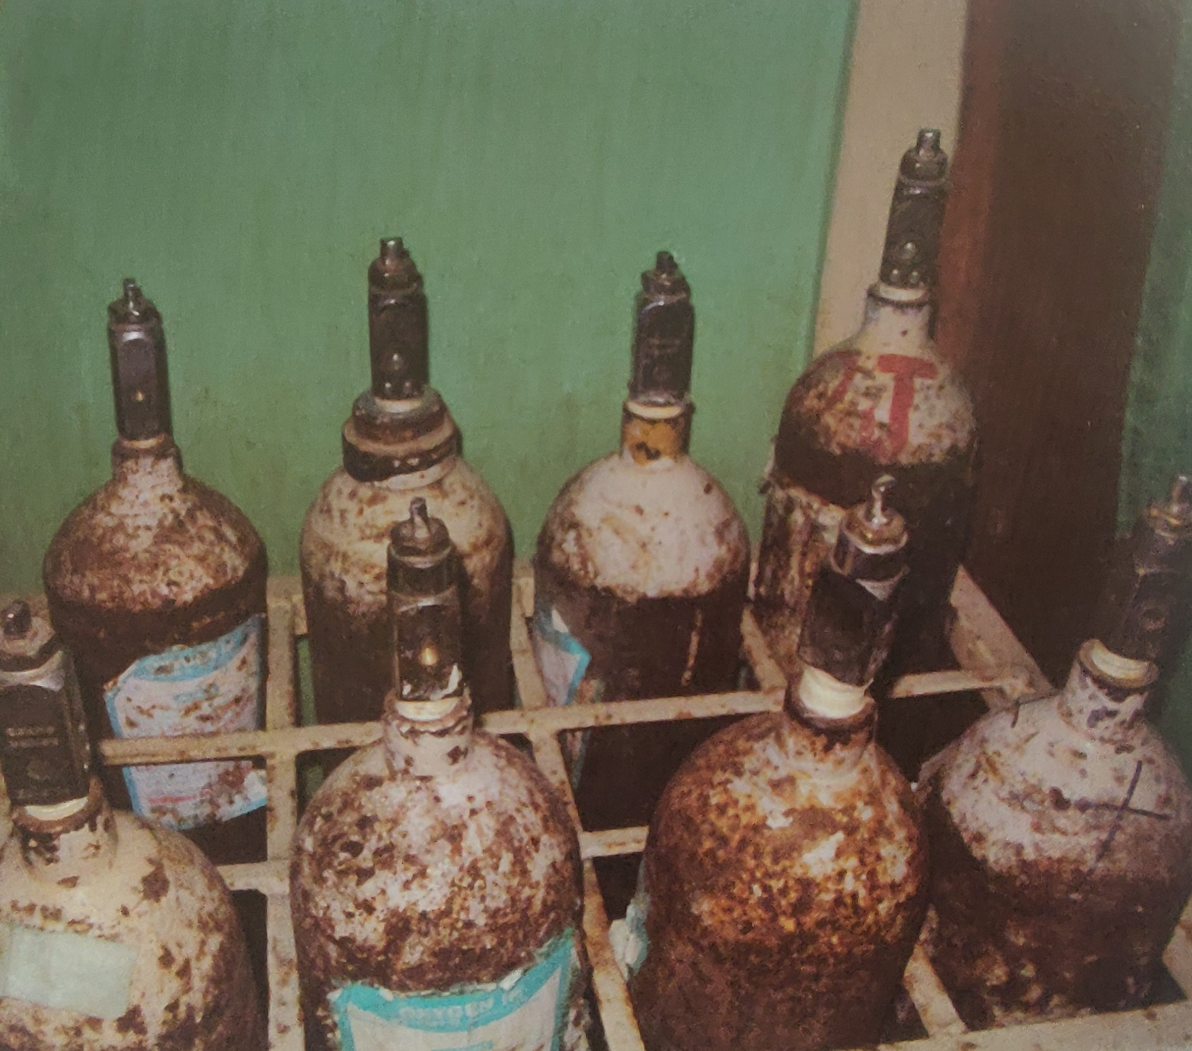
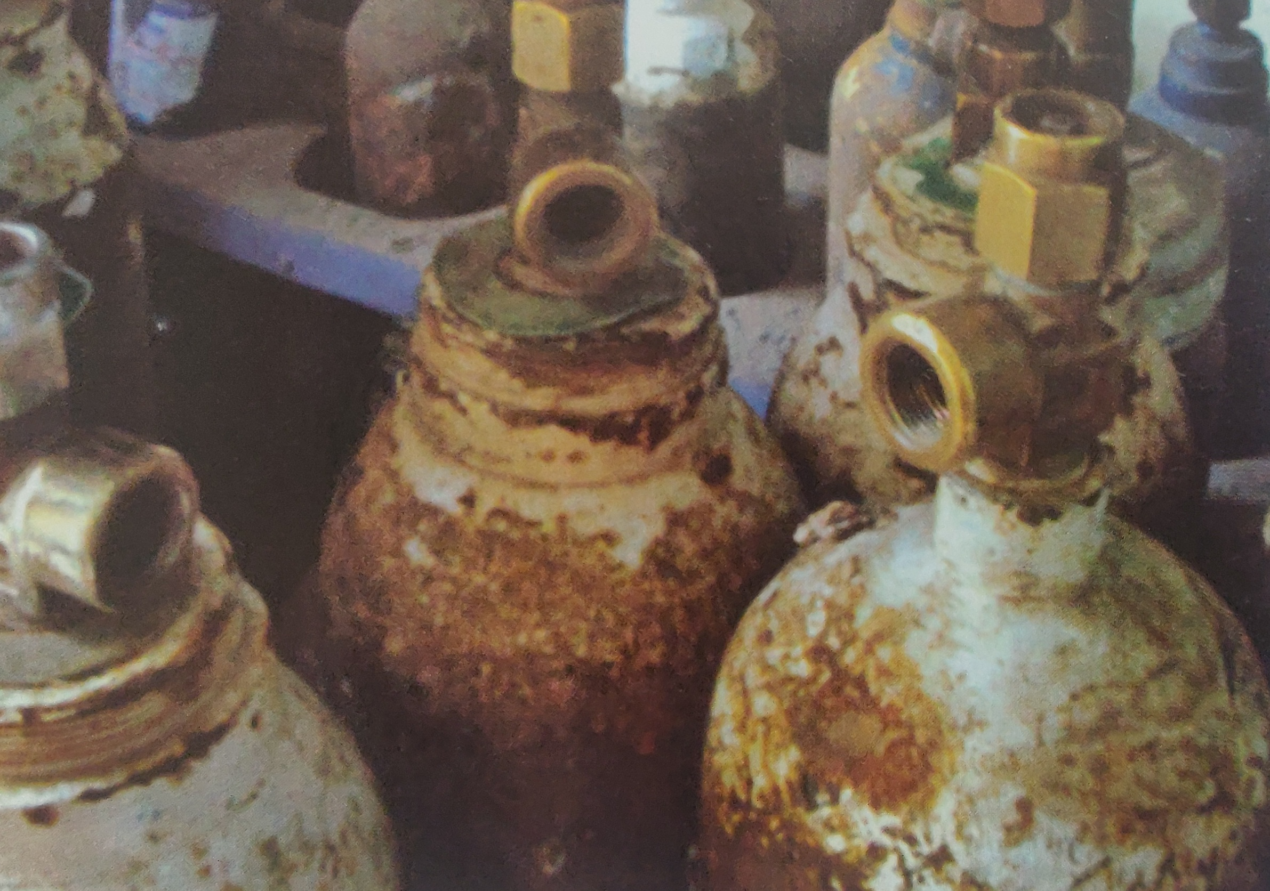
VALVE
The cylinder outlet valves are made of bronze or brass, which is heavily plated with nickel and chromium so as to allow a rapid dissipation of heat of compression. The end, which enters the neck of the cylinder, is threaded to fit a corresponding screw thread inside the neck itself.
FLUSH TYPE VALVES
BULL NOSE VALVES

Slide 13
A sleeve or washer of soft alloy ( containing a high proportion of lead)completes the gas-tight seal as the valve is screwed into the neck of a cylinder.
The spindle or screw-pin (stem) of the valve is made of very hard steel. The inner end is cone shaped and beds into a cone shaped hollow within the valve through which gas is admitted. Longitudinal spindle is set within a gland, which is screwed into the valve block. Turning the longitudinal spindle opens the valve.

Slide 14
Cylinders are filled and discharged through the cylinder valve. The valve is marked with the chemical symbol of gas that it contains, tare weight of the cylinder, pressure at the last hydraulic test, and a serial number. Leaks are prevented by the compression of a nylon ring around the spindle. A safety outlet is fitted between the cylinder neck and the valve block. This melts at relatively low temperatures to allow gas to escape in case of fire and minimize the risk of explosion.
Cylinder valves are of various types. Those to be used on anaesthesia machine are “flush” type which fits with the pin index system on the machine and for the medium and large capacity cylinders the valves are “bullnose” type. Valves have certain markings engraved on it.

Slide 15
Cylinder valve designs are of two types- packed and diaphragm type.
Packed type
This type of valve is capable of withstanding high pressures. This type of valve is also called direct acting valve. This is because turning the stem makes the seat also to turn. Here, stem is sealed by a resilient packing such as Teflon which prevents leak around the threads. It withstands high pressure. It is opened by two to three full turns. In a large cylinder valve, the force is transmitted by means of a driver square.
Diaphragm type
Here, the stem is separated from the seat. A disk or diaphragm separates upper and lower stems. The stem may be permanently attached to the diaphragms. The upper stem is actuated by a manual or automatic means whereas the lower stem shuts or permits flow through the valve. The advantage is that this type of valve can be opened fully using a one-half to three quarters turn, the seat doesnot turn and therefore, it is less likely to leak.

Slide 16
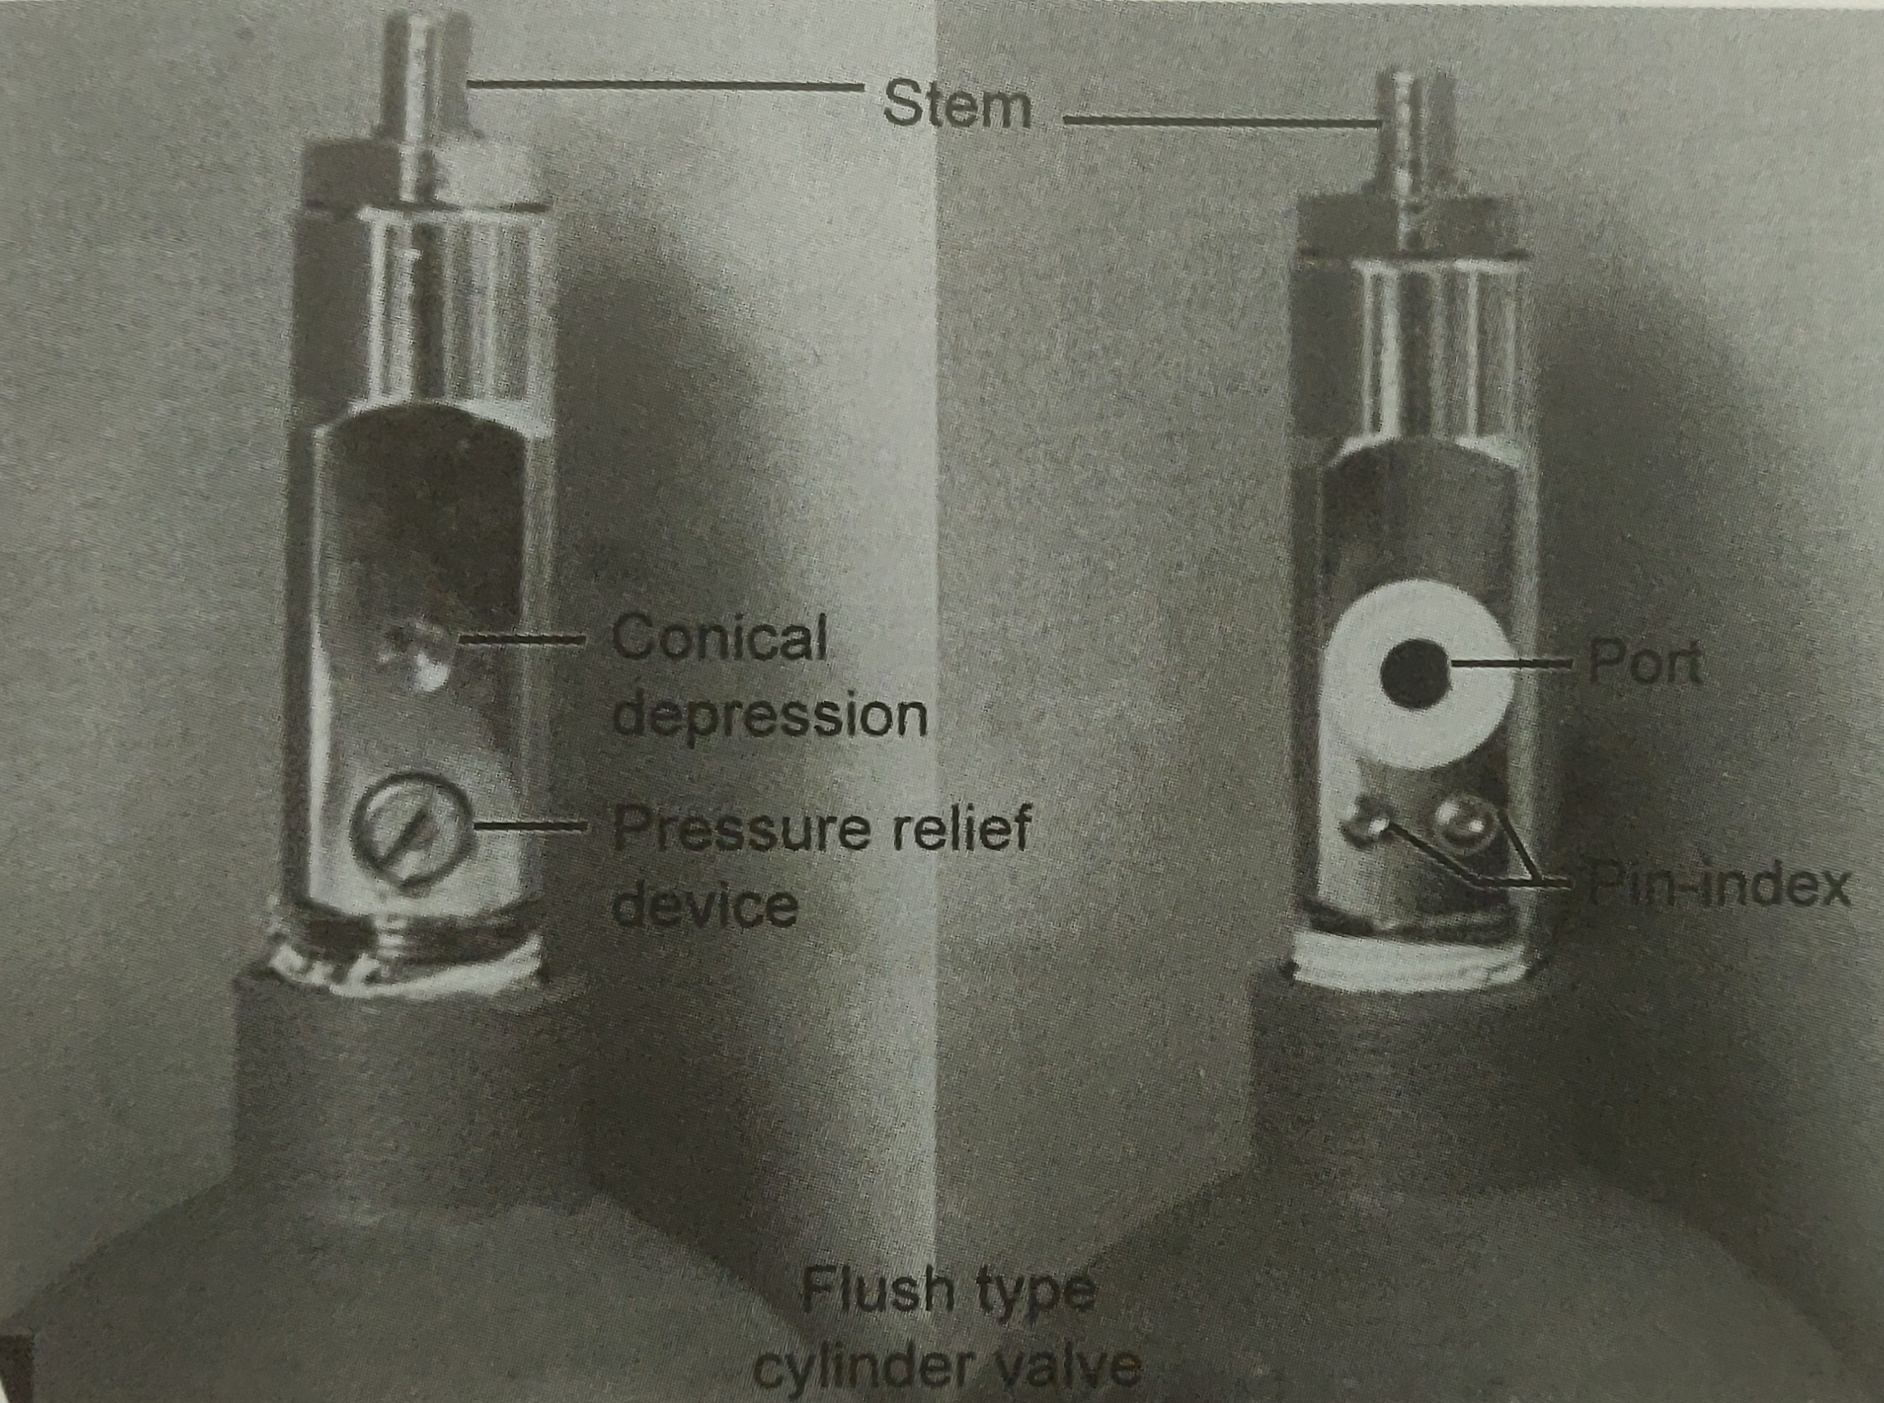
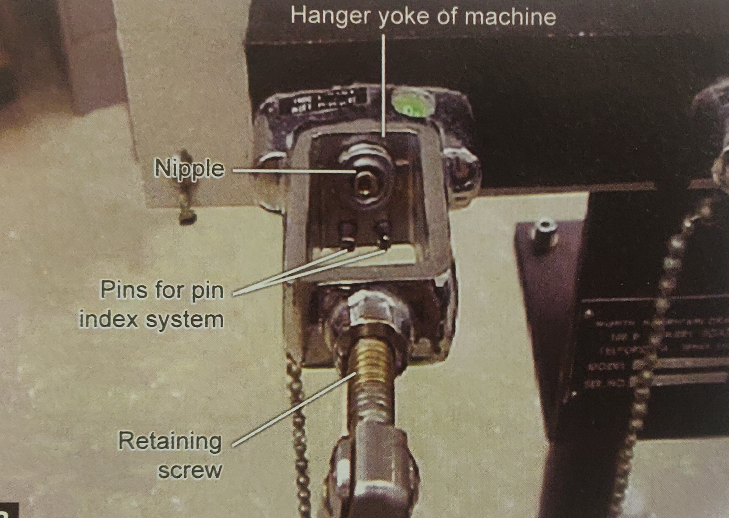
PORT
The port is the point of exit for the gas. It fits into the nipple on the hanger yoke of the anaesthesia machine. It should be protected in transit by a covering. When installing a cylinder on anaesthesia machine, it is important for the user not to mistake the port for the conical depression.
FLUSH TYPE CYLINDER VALVE
HANGER YOKE OF ANAESTHESIA MACHINE

Slide 17
Conical depression is situated on the opposite side of the port on the cylinder valve and is situated above the safety relief device. It is present on those cylinders which are designed to fit on anaesthesia machines. The conical depression is designed to receive the retaining screw on the yoke of the anaesthesia machine. Screwing the retaining screw into the port may damage the port and/or index pins.
STEM
Each valve contains a stem(spindle/screw pin) or shaft that is rotated to open or close the cylinder valve. It is made up of very hard steel. Stem closes the valve by sealing against the seat that is part of the valve body. When the valve is opened, the stem moves upwards and allows the gas to flow to the port.

Slide 18
PRESSURE RELIEF DEVICES
Every cylinder is fitted with pressure relief device. The whole purpose of this device is to vent the cylinder’s content to atmosphere rather than the cylinder bursting if the pressure of enclosed gas increases to dangerous level.
TYPES
Rupture disk
Fusible plug
Combination of both
Pressure relief valve (spring loaded)

Slide 19
Rupture disk: When predetermined pressure is reached, the disk ruptures and allows the cylinder content to be discharged. It is a non reclosing device held against an orifice. It protects against excess pressure as a result of high temperature or overfilling.
Fusible plug: The fusible plug is thermally operated. It is a non reclosing pressure relief device where the plug is held against the discharge channel. It does offer protection from excessive pressure caused by a high temperature (yield temperature), but it doesnot protect against excessive pressure from overfilling. The yield temperature is the temperature at which the fusible material becomes sufficiently soft to extrude from its holder so that cylinder contents are discharged.
Spring loaded pressure relief valve: It is a reclosing device. When the set pressure is exceeded, the pressure in the cylinder forces the spring to open the channel for letting out gases and gas flows around the safety valve seat to the discharge channel till the excess pressure is relieved.

Slide 20
SAFETY FEATURES OF CYLINDERS
Molybdenum steel alloy construction. This is stronger and lighter than its carbo steel predecessor.
Color coding for each gas or vapor
Pin index system
Bodok seals
Cylinder pressure indicator (gauge)

Slide 21
COLOR CODING
GAS | BODY | SHOULDER
O₂ | BLACK | WHITE
N₂O | BLUE | BLUE
CYCLOPROPANE | ORANGE | ORANGE
CO₂ | GRAY | GRAY
AIR | GRAY | WHITE/BLACK QUARTERS
NITROGEN | BLACK | BLACK
N₂O+O₂, 50:50 | BLUE | WHITE/BLUE QUARTERS

Slide 22
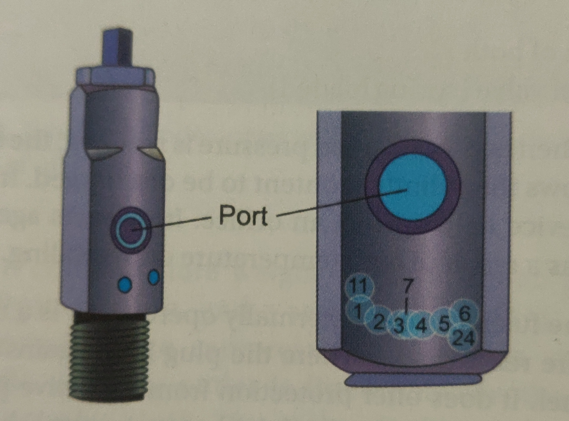
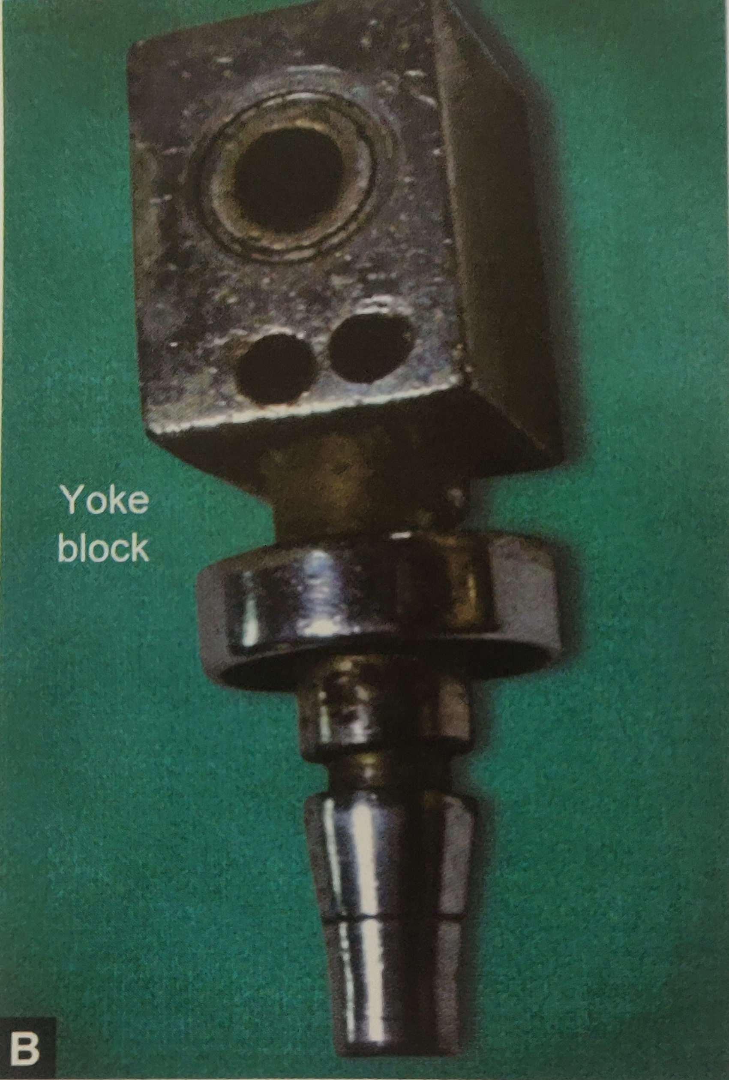
PIN INDEX SAFETY SYSTEM
In order to ensure that the correct cylinder or pipeline supply is attached to the appropriate hanger yoke of the anaesthesia machine/work station, a series of pins on the hanger yoke is made to fit into the corresponding indentations (pits/holes) drilled into the cylinder valve or yoke block. This pin index system is used on small cylinder (sizes A to E) valves and yoke blocks.
PIN INDEX SYSTEM
YOKE BLOCK

Slide 23
PIN INDEX FOR VARIOUS GASES
GAS | INDEX PINS | GAS | INDEX PINS
O₂ | 2,5 | O₂-CO₂(CO₂<7.5%) | 2,6
N₂O | 3,5 | O₂-CO₂(CO₂>7.5%) | 1,6
CYCLOPROPANE | 3,6 | O₂-He(He>80.5%) | 4,6
AIR | 1,5 | O₂-He(He<80.5%) | 2,4
N₂ | 1,4 | N₂O-O₂(N₂O 47.5-52.5%) | 7

Slide 24
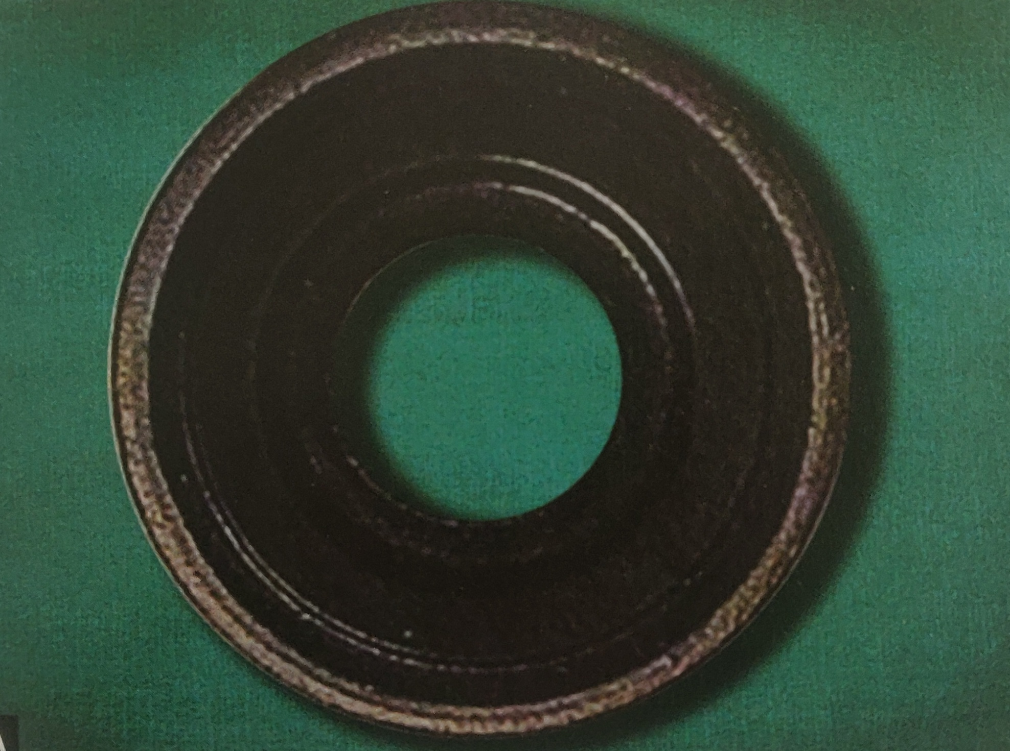
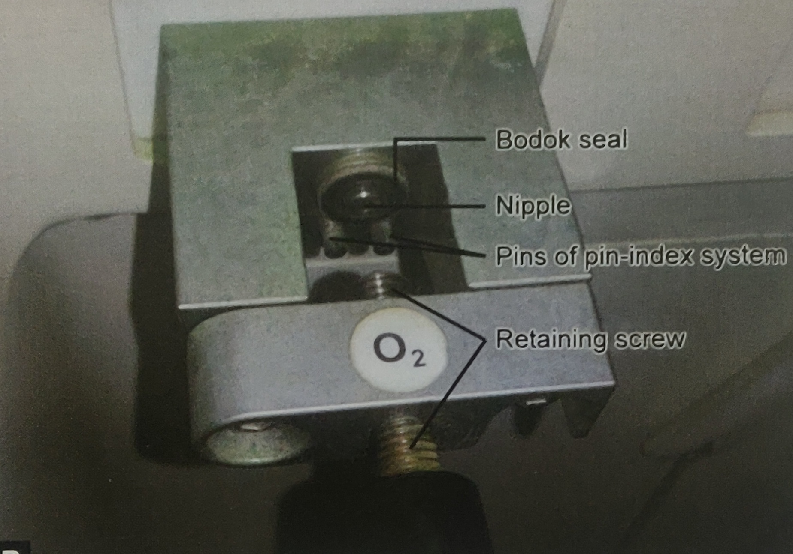
BODOK SEAL
A small disk of neoprene with metal periphery ensures a gas tight fit between the cylinder and anesthetic machine yoke in the form of seal.
Under no circumstances, may oil or grease be used as a seal; the pressurized gases give off heat as they are released from the cylinder and may cause explosions if oil is used. Before attaching a full cylinder to the machine briefly open and close the cylinder valve to clear any dirt from the port. This is called cracking the cylinder.
BODOK SEAL
BODOK SEAL IN SITU

Slide 25
Additional safety features are on the anaesthesia machine . Each gas entering the machine from the cylinder flows through a filter, one way check valve and pressure regulator. Non return valves prevent empty cylinders still attached to the machine from refilling from fresh cylinders. The pressure in anaesthetic gas pipeline is 4 bar. All anaesthetic machines, including those having pipeline gases, have provision to attach reserve gas cylinders. These cylinders should be turned off when pipeline pressure is sufficient.
Anaesthetic machines operate at 4 bar pressure and therefore the compressed medical gases in cylinders pass through reducing valves to bring a gas pressure to constant 4 bar. Nonreturn valves prevent empty cylinders still attached to the machine from refilling from fresh cylinders.

Slide 26
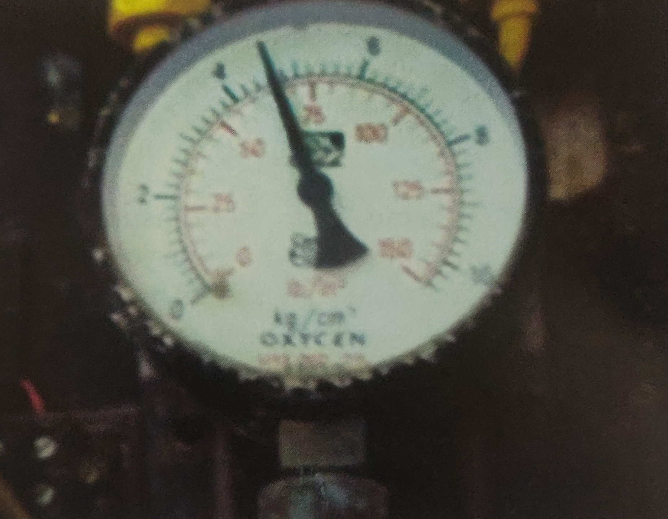
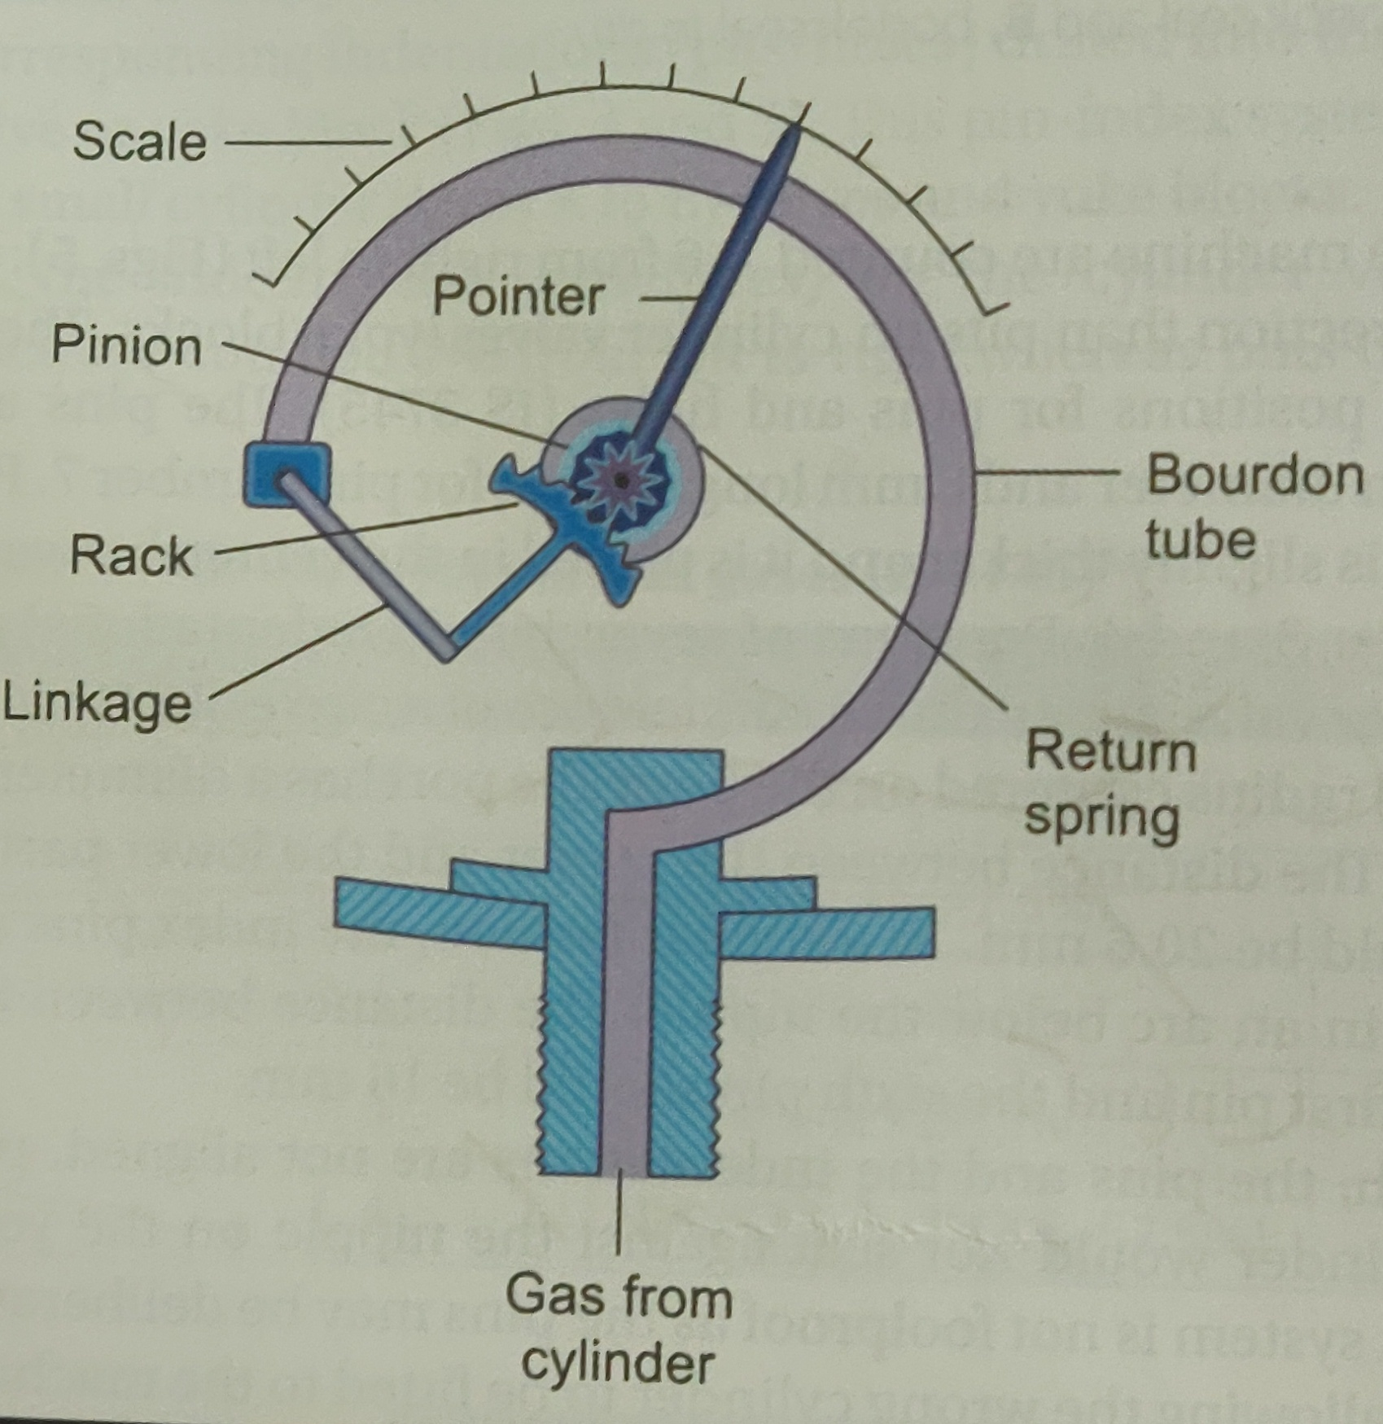
CYLINDER PRESSURE INDICATOR (GAUGE)
The anaesthesia work station standard requires that there be a pressure indicator to display the cylinder pressure for each gas supplied by cylinders. The indicator may be located near the cylinders or on a panel on the front of the machine. The sacle is 33% greater than the maximum filling pressure of the cylinder or the “full indication” position.
CYLINDER PRESSURE GAUGE
PRESSSURE GAUGE DIAGRAM

Slide 27
Many indicators are of the Bourdon tube (Bourdon spring, elastic element) type. A hollow metal tube is bent into a curve. One end is sealed and linked to a clocklike mechanism. The other end which is opened is connected to a gas source. An increase in gas pressure inside the tube mkes the curved tube to straighten out depending on the change in the pressure. As the pressure falls, the tube resumes its curved shape. The open end is fixed and the sealed end moves. Movement of the sealed end is transmitted to the indicator, which moves over a calibrated scale. Cylinder pressure gauges are calibrated in kg/cm², pounds/inch² or kilo Pascals (kPa).
Some electronic machines have light emitting diodes(LEDs) to indicate cylinder pressure. LED is green if the pressure is adequate when the cylinder valve is opened. But, if the pressure is inadequate when the cylinder valve is opened, LED will flash red. It will be dark if the cylinder valve is not open. These machines may also display the actual pressure for pipelines and cylinders on a screen during the checkout. The readings can be available on a continuous basis or on demand.

Slide 28
As the cylinder content gets empty, the pressure in the cylinder falls proportionately if the cylinder contents are in gaseous form. If half of the content is over, the pressure drops to half of the original and so on. The same is not true for the gases in the liquid form. The pressure in the cylinder containing gases in liquid form remains as full cylinder pressure until the last drop of liquid form of gas vaporizes. This is because the pressure gauge reads the saturated vapor pressure of the liquid gas. Once all the liquid has evaporated, the pressure drops much faster till all the gaseous contents are over.

Slide 29
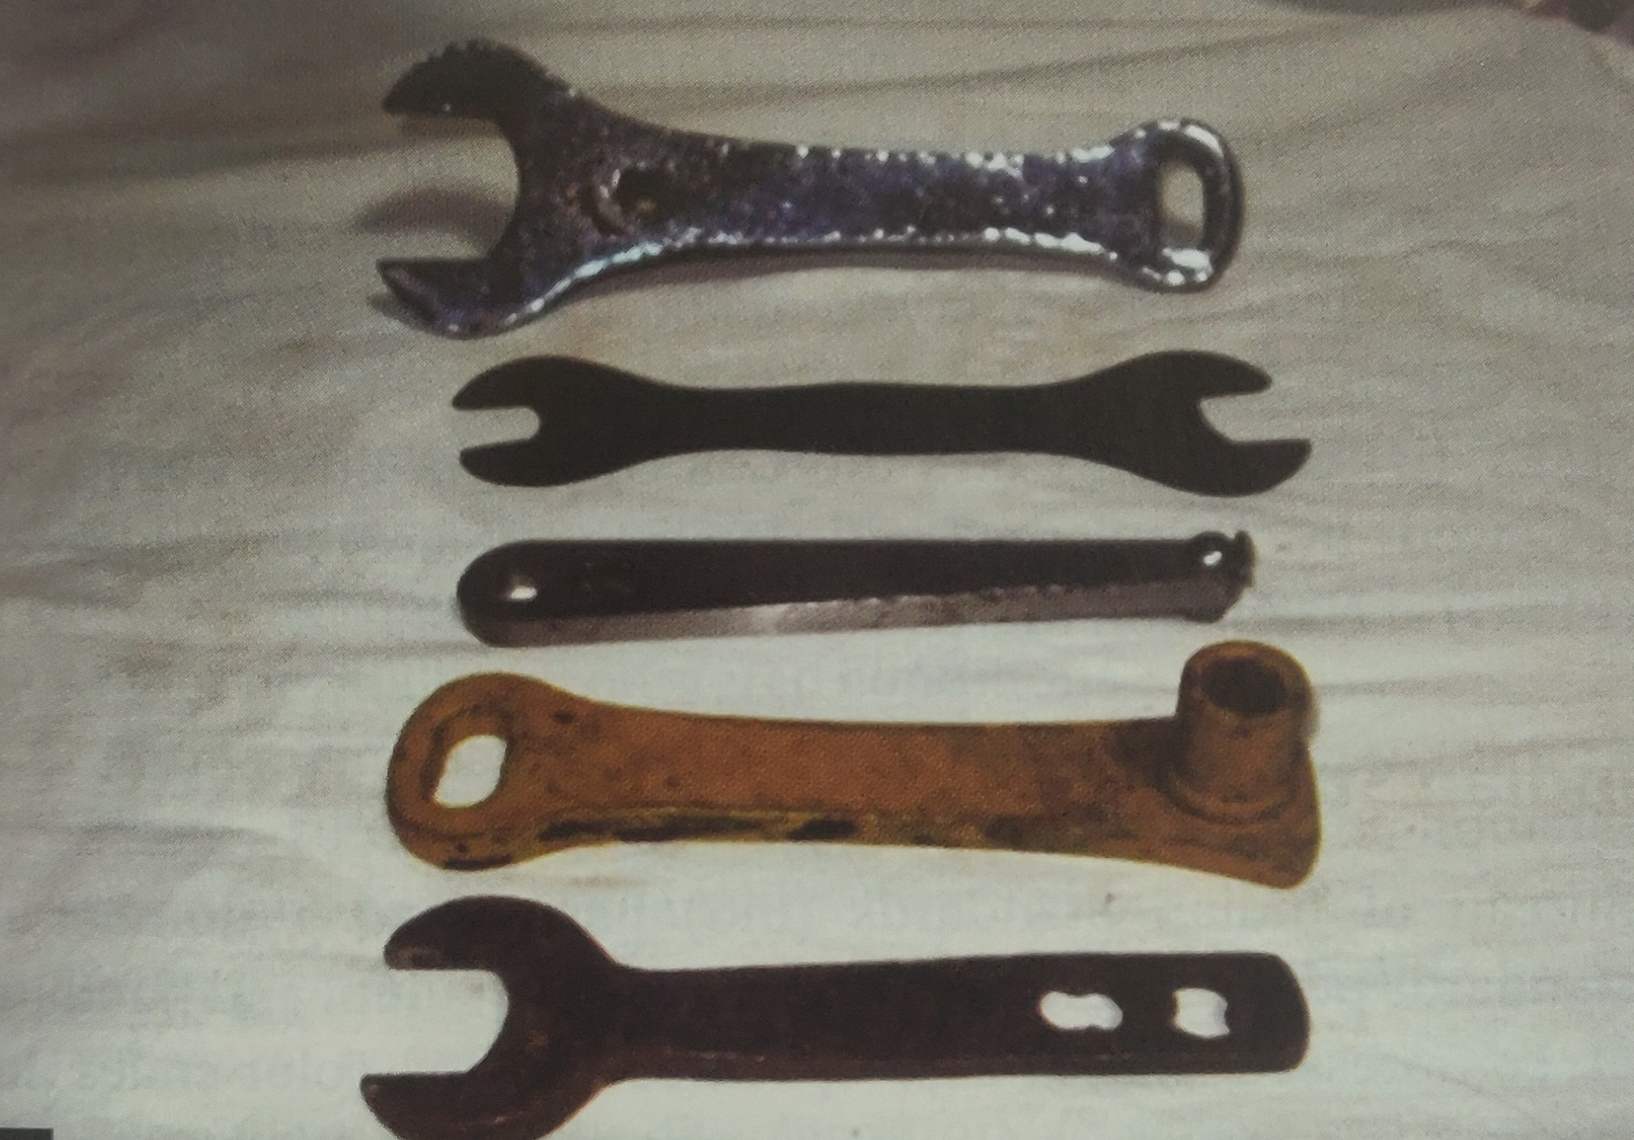
CYLINDER KEY (HANDLE) OR HANDWHEEL
A cylinder key (handle) or handwheel is used to open or close a cylinder valve. It is turned counterclockwise to open the valve and clockwise to close it. This causes the stem to turn. A cylinder key (handle) is used to open a small cylinder valve. They come in a variety of shapes.
VARIOUS CYLINDER KEYS

Slide 30
RULES FOR SAFE USE OF CYLINDERS
To be handled only by trained staff.
Store cylinders in a cool, clean room with adequate ventilation.
Do not drape cylinders with any material during storage.
Cylinders are best stored upright in a cylinder stand.
Should be grouped by contents or sizes.
Good segregation between empty and full cylinders.
To be kept away from oils, rubber, and other combustible substances.
Never to expose cylinders to heat or higher temperatures.
Never interchange parts of cylinder used for one gas with other.
Take care to avoid obstructions to discharge ports.

Slide 31
Keep the valves closed when not in use
Identify contents by label
Remove wrappings (protective cover) before using
Remove dust and foreign bodies before connecting
Cracking to be done to reduce possibility of flash fire.
A sealing washer in good condition should be used.
Flow control valve should be closed before the cylinder valve is opened.
While opening, stand to theb side; not in front or back.
Quick opening to be avoided as it can generate heat leading to flame.
Valve should be fully opened when in use.

Slide 32
Valve should be closed before removing from a regulator or yoke.
Lower part of the tag should be removed when cylinder is empty.
HAZARDS
Incorrect cylinder contents
Incorrect valve
Incorrect color, labelling
Inoperable valve, damaged valve
Suffocation, fires, explosion, and thermal injury
Contamination of contents
Overfilling

Slide 33
THANK YOU

