Slide 1

TURP
DR. AKSHAY JAIN
(2ND YEAR RESIDENT)
Under the guidance of
DR. DINESH CHAUHAN
(PROFFESOR AND HEAD, DEPT. OF ANAESTHESIOLOGY)

Slide 2





How to approach this case?
Geriatric concerns
•
74 year old male
Co-morbid conditions
Known history of hypertension
Procedure related concerns
•
Scheduled for TURP

Slide 3

Issues related to age…
•
Progressive loss of functional reserve in body systems
Arterial ageing→ secondary changes in heart, brain & kidney.
Cognitive decline
Autonomic nervous system changes→ ↓ ß receptor sensitivity
Respiratory changes→ VC ↓, paO2
↓
Normal mean PaO2
20-29 y | 94
30-39y | 91
40-49 y | 88
50-59 y | 84
60-69 y | 81
•
Sensitive to anaesthetic drugs
Less drug for same clinical effect
Prolonged drug effects
Exaggerated hemodynamic responses

Slide 4

Pre-op assessment
GOAL→ Decision making
I. Fitness for procedure/ Acceptance for anaesthesia
II. Anaesthesia plan

Slide 5

History and examination
Cardiovascular
HTN, IHD, arrhythmias
Respiratory
  ? ↓ in functional ability
  ? Ability to lie flat
•
Neurological
  Able to lie still Musculo-skeletal
  Degenerative changes in vertebral column→ positioning and SAB
•
difficult
Joint replacements or arthritis→ damage or dislocation Renal- ? Obstructive uropathy
•
•
Airway- assessment even if SAB is planned.

Slide 6
Drug history
Beta blockers→ suppress compensatory tachycardic
response→ to be continued peri-operatively
ACE inhibitors→ limits renin-angiotensin mediated response to hypovolemia- also impaired by SAB
– To omit 24 hours pre-op
Alpha blockers→ first line medical treatment for BPH→ may precipitate severe hypotension after SAB.

Slide 7
Investigations
Complete Blood count/ Hb
Blood sugar, creatinine and electrolytes
ECG and 2D-echo for symptomatic patients or > 45 yrs
Chest X-ray
Blood- group and save Other tests
Clotting studies- Prothrombin time
Blood gas and pulmonary function tests

Slide 8

On PAC:
•
74 year old male, scheduled for TURP
Known history of hypertension for 15 years
H/o smoking 5-10 cigarettes/ day for 30 years
Good effort tolerance, no symptoms of cardiac failure, BP- 136/80 mm Hg.
Blood results, EKG and CXR- unremarkable
•
•
•
Risk stratification ??

Slide 9
Anaesthetic plan?
•
Deciding factors:
Noxious stimuli→ depends on anatomy
Procedure related concerns- Intra-op and Post-op
Patient’s medical status
Informed consent

Slide 10
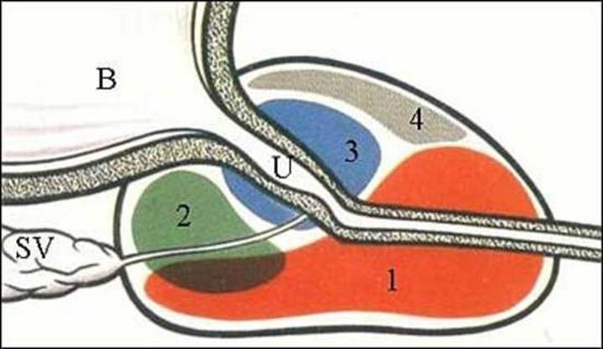
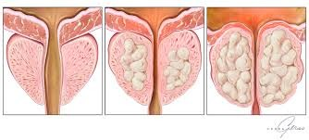
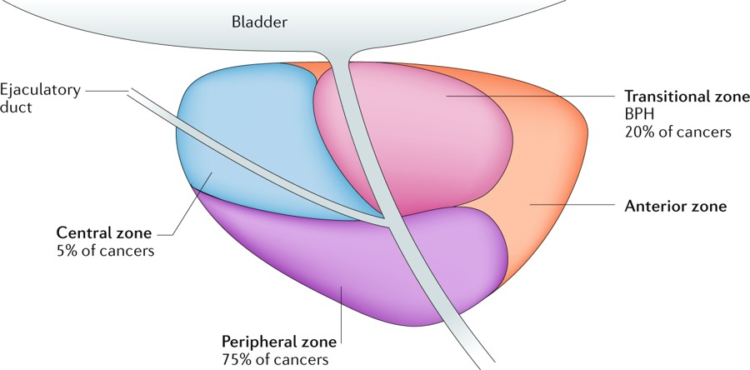
Anatomy
Normal Weight→ upto 20-30 g

Slide 11
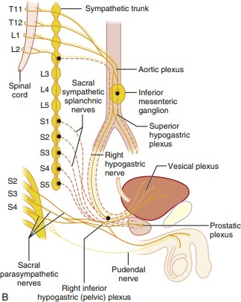

Nerve supply
Bladder
Prostate & Urethra
Sympath T11-L2
Afferents:
Stretch→ PS
Pain, touch, temp→ Symp
Parasympath S2-4
Sympath & Parasympath
Sensory

Slide 12

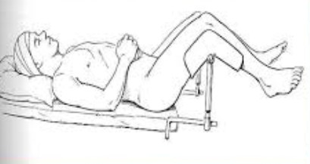
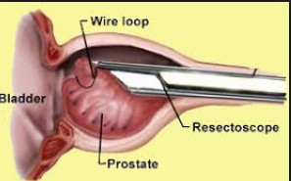
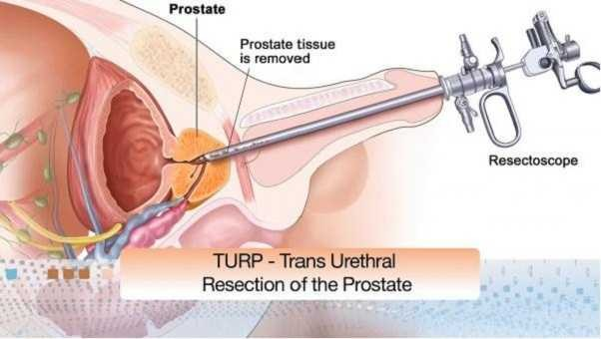
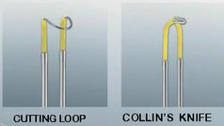

The procedure
Conventional TURP- Monopolar

Slide 13
Irrigation is a must for visualisation
Ideal solution
Isotonic
Electrically inert
Nontoxic
Transparent
Easy to sterilise
Inexpensive
Distilled water
× Isotonic
Electrically inert
Nontoxic
Transparent
Easy to sterilise
Inexpensive
Physiologic implication→ Systemic absorption

Slide 14
Irrigation fluids
Glycine 1.2%
Glycine 1.5%
Sorbitol 3.5%
Mannitol 5%
Glucose 2.5%
Cytal (Sorbitol 2.7% + Mannitol 0.54%)

Slide 15
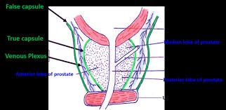
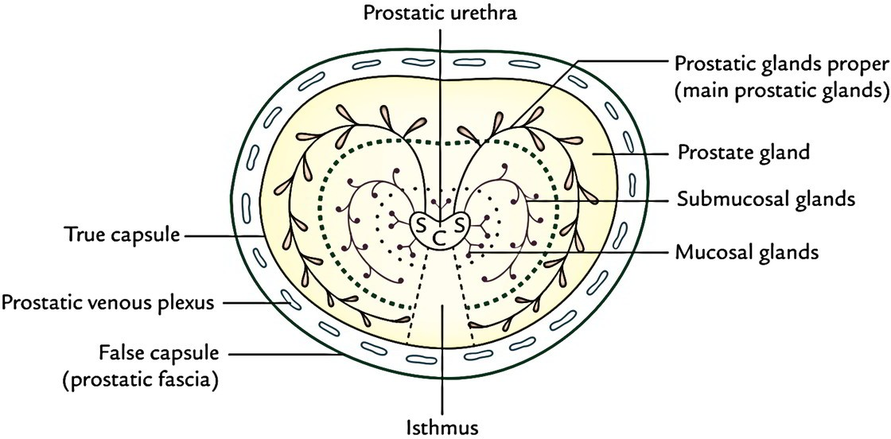
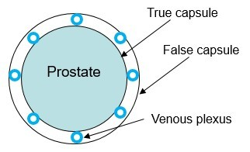
Factors determining the volume absorbed?
Duration of procedure (larger gland)
-10-30 ml absorbed /minute of resection time (1800 ml/hr)
Hydrostatic pressure→ Height of the irrigation fluid bag above pt.
Vascularity of diseased prostate

Slide 16

Consequences of systemic absorption?
•
Absorbed crystalloid→
enters interstitial space.
20-30% remains in intravascular, remaining
•
Average fall in serum Na+→
Excessive absorption
3.65-10 mEq/L
•
Hypervolemia
TURP syndrome.
  Upto 8% of cases in mild form
  Severe in 2%

Slide 17
Choice of anaesthetic technique?
•
Subarachnoid block- Advantages
Good relaxation of pelvic floor and perineum
Early detection of complications
  TUR syndrome→ Monitoring for change in mentation
  Bladder perforation→ Conscious pts experience symptoms of bladder perforation before it becomes manifest to surgeon
– Bradycardia, hypotension, restlessness, diaphoresis, nausea, abdominal pain, dyspnea, shoulder pain, hiccups.

Slide 18

Other advantages of SAB
Operative blood loss is reduced - ↓ transfusions
  ↓ in systemic BP due to sympathetic block
  ↓ in peripheral venous pressure
Sympathetic block ↑ venous capacitance→
operative fluid overload.
Good early postop analgesia
Reduced incidence of postop DVT/PE
  RA ↓ hypercoagulable tendency- maintains normal coagulation and platelet function.
Lower cost
mitigates intra-

Slide 19
What should be the level of SAB?
Sensory level of T10 required
  Eliminates discomfort caused by bladder distension.
  Obliterates visceral pain sensation from prostate and bladder neck.
Sensory level above T9 to be avoided
  For manifestation of capsular sign- should perforation occur.

Slide 20
Contraindications
Patient refusal
Infection- either localised or generalised
Raised intracranial pressure
Hypovolemia or shock of any cause
Coagulopathy-platelet count<80-100, 000 or INR<1.5
Pre-operative neurological disease-postoperative exacerbation of disease.

Slide 21
Can continuous epidural be given?
– Incomplete block of sacral roots
Can caudal block be considered?
•
When and what precautions?
For laser prostatecomy in high risk patients.
Avoid bladder distension→ continuous irrigation

Slide 22
General anaesthesia
•
Advantages
Less challenging hemodynamically than SAB in pts with AS or IHD
Patient preference.

Slide 23

Anaesthesia plan?
•
74 year old male, scheduled for TURP
Known history of hypertension for 15 yrs and hypercholesterolemia
H/o smoking 5-10 cigarettes/ day for 30 yrs
Good effort tolerance, no symptoms of cardiac failure, BP- 146/80 mm Hg.
Blood results, EKG and CXR- unremarkable
•
•
•
•
ASA II

Slide 24
Preparation for anesthesia?
•
Pre-medication
Anxiolytics
  Short acting BZDs- in elderly, can lead to postop confusion
Medications for HTN. Monitoring
  NIBP
  Pulse oximetry
  ECG
  Temperature IV cannula- large bore
In case of RA+ sedation Capnography
•
In case of GA: Capnography Volatile agent levels Airway pressure
•

Slide 25
Conduct of SAB
•
Fluid pre-load-200-300 ml of warmed 0.9% NaCl
– Dehydration due to fasting, use of diuretics Block to at least T10
•
If hypotension→ use vasopressors
– Ephedrine-3-6 mg/ Mephentermine-3-6 mg/ Phenylephrine 25-50 µg.
•
•
•
•
Intra-op sedation- sparingly
Prevent hypothermia→ Warming blanket/ Fluid warmer Supplementary oxygen +/-.

Slide 26
If WE choose GA….
•
Either spontaneously breathing- supraglottic airway or
relaxant technique.
Elderly susceptible to hypotensive effects of induction and maintenance drugs
Analgesic requirements→ Paracetamol/ NSAIDs/ Increments of opioid- fentanyl or morphine.
Consider renal function when choosing IV drugs.
•
•
•

Slide 27

During RA and GA…
•
IV Fluids to replace blood loss.
Maintenance fluids- not required as irrigation fluid is absorbed.
Antimicrobial prophylaxis→ gram negative bacteremia
•
•

Slide 28
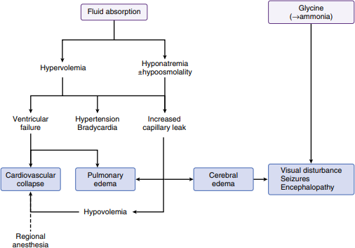

TURP syndrome-Mechanism
Problem of volume and solute

Slide 29
Signs and symptoms
Na+
•
Tachycardia
Nausea & vomiting
Confusion/ disorientation/ headche
Hypertension, then hypotension
Transient blindness
Angina
Dyspnoea and hypoxia→ pulmon edema QRS widening, ST segment elevation
120→
CNS
CVS
115→
•
•
100→
•
Cardiovascular collapse and arryhthmias-VF/
Collapse
VT
Convulsions/ Coma
•

Slide 30
Red flags
•
Prostate size > 60-100 g
Procedure duration> 1 hour Hydrostatic pressure > 60 cm H2O Inexperienced or slow surgeon
Reduced venous pressure (dehydration) Large volumes of hypotonic IV fluids-eg 5%D Pre-existing hyponatremia/ pulmonary edema
•
•
•
•
•
•

Slide 31

How to prevent TUR syndrome?
•
•
•
Bipolar TURP with normal saline irrigation
Use regional anaesthesia & monitor neurologic status. Limit the volume of irrigation fluid
– Monitor fluid absorption→ compare amount instilled and
amount removed → is difficult.
10-30 ml of absorption /min of resection time.
If >750-1000 mL→ Check serum Na+
– If >1500-2000 mL→ Stop surgery Keep surgical time < 1 hour
Limit the height of irrigation fluid to keep intravesical pressure < 15-25 mm Hg.
•
•

Slide 32
Management
•
ABC
Intubate and ventilate.
Atropine/ vasopressors as appropriate.
Inform surgeon, terminate surgery. Fluid overload and hyponatremia
Stop IV fluids
Promote diuresis
  IV frusemide
Fluid restriction
  800 ml/24 hrs→ achieve Na+ rise of 1.5 mmol/L/24 hrs
•
•

Slide 33
Hyponatremia causing encephalopathy
  Rapid correction →3% Hypertonic saline @ 1 ml/kg/hr for 3-4 h.
  Close monitoring →Check Na every few hrs
    Not >5-10 mmol/L in 24 hrs /Not > 20 mmol/L in 48 hrs
    Stop hypertonic saline when Na reaches 124-132 mol/L.
  Too rapid correction can cause central pontine myelinolysis.
  If pt has CRF→ Hemofiltration .
Convulsions
  Benzodiazepine- Diazepam 1-5 mg OR Thiopentone- 25-100 mg
  Intractable seizures→ Correct Na @ 8-10 mmol/L/hr for first 4 hrs.
In ICU- Invasive monitoring→ Arterial BP/ CVP

Slide 34
Other complications to prevent/ watch for during TURP??

Slide 35

1.Bladder perforation
1% of TURP
Why does it happen?
  Damage from cutting loop or knife electrode during difficult resection
  Overdistension of bladder with irrigation fluid.
When to suspect?
  Irregular return of irrigating fluid- noticed by surgeon
  Signs/ symptoms in awake patient
Extraperitoneal→
Intraperitoneal→
Suprapubic/ inguinal/ periumbilical pain
far less, but more serious
» Generalised abdominal pain, shoulder tip pain
» Pallor sweating, peritonism, nausea, vomiting, hypotension
Management→ Immediate laparotomy & correction of
» ↓GA→ unexpected hypotension
defect

Slide 36
2. Hypotension
•
Most common complication
Usually follows sympathetic block of SAB
Esp. if cardioaccelerator fibres-T1-4 are blocked.
Treatment
Fluid
Vasopressor
Inotropes if required
•

Slide 37
3. Haemorrhage
•
How to assess blood loss during TURP?
Clinical judgement
  Vital signs
  Observation of surgical field/ drain bucket
  Resection time- 2-5 mL/ min
  Size of mass excised- 20-50 mL/g
  Communication with surgeon
Serial hematocrit levels

Slide 38
Measures to minimise blood loss
  Antifibrinolytics
    IV tranexamic acid
  Foley catheter → balloon inflated and traction applied.
    Lateral pressure on the prostatic bed to reduce bleeding.
Blood transfusion required ~ 2.5% of TURP.
Measure Hb and electrolytes on POD1.
  To detect sub-clinical anemia and hyponatremia

Slide 39
4. Bacteremia and sepsis
Prostate harbours bacteria→ source of intraop and postop bacteremia through prostatic venous sinuses.
Indwelling urinary catheter ↑ the risk
6-7% may develop septicemia
Septic shock is rare but with 75% mortality
Prevention
  Antibiotic prophylaxis- Gentamicin 3-4 mg/kg single dose/ Cephalosporins.

Slide 40

5. Hypothermia
Prevention
  Warm IV fluids and irrigation fluids
  Forced air active warming
6. Shivering
Can increase myocardial oxygen requirement
Reduction in CO
Treatment
  Systemic/ Intrathecal opioids

Slide 41
Unlikely, yet known complications
Positioning
Lithotomy + Trendelenburg tilt
  Nerve compression-common peroneal nerve
  Dislocation of hip prosthesis
  Respiratory compromise in those with pre-existing lung disease-due to ↓ in FRC.
Erection
Usually due to surgical stimulation during inadequate plane of anaesthesia.
Subsides with deepening of anaesthesia
Low-dose ketamine helps if it persists.
•
•

Slide 42

TOXICITY
•
Glycine toxicity
–
–
Nonessential amino acid
Major inhibitory neurotransmitter in spinal cord and brainstem.
Normal plasma glycine levels- 13-17 mg/L
Glycine toxicity implicated in transient blindness- levels as high as 1029 mg/L measured.
No overall correlation between plasma glycine levels and CNS toxicity
Ammonia toxicity
  Formed by oxidative biotransformation of glycine.
  Delayed awakening→ elevated blood ammonia concn.
–
–
Deterioration of CNS function when ammonia levels> 150 M.
Glycine and ammonia levels did not correlate with each other
Case reports only……

Slide 43
To watch out after procedure
•
Lowering of legs from lithotomy
Check BP→ Hypovolemia manifests as hypotension. Hypothermia/ Hypotension/ Hemorrhage
S/S of TUR syndrome/ Septicemia
Clot retention→ Clot blocking urinary catheter
Bladder distension
Prevented by continuous bladder washouts. Bladder spasm
Indwelling catheter stimulates bladder neck to cause painful involuntary contraction of bladder
Irrigation fluid prevents bladder from draining completely and aggravates pain
Treatment:
  Low dose diazepam- 2.5-5 mg iv
  Hyoscine (Buscopan)- 20 mg iv slow
•
•
•
•

Slide 44
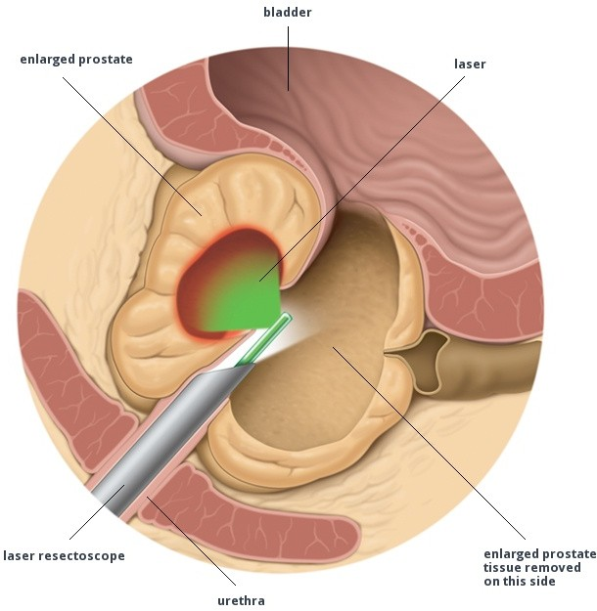
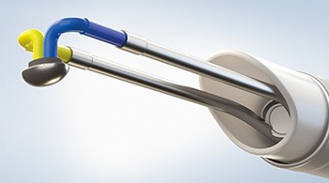
Recent advances in TURP….
Bipolar TURP
Laser TURP
Irrigating solution is Normal saline →
minimises TURP syndrom

Slide 45
Advantages
•
Bipolar TURP
Less fluid absorption → ↓
TURP syndrome
↓ in transfusion rate
Fewer postop readmissions
Faster postop recovery
Comparable urologic efficacy and equivalent long-lasting results as conventional TURP.
Laser-TURP
  Minimal irrigating fluid absorption- ↓ risk of TURP syndrome
  Minimal blood loss-50-70 ml→ Fewer transfusions
  In anticoagulated patients
  Outpatient procedure
  Fewer strictures
  Shorter hospitalizations

Slide 46
TAKE HOME POINTS…
Regional anaesthesia offers several advantages over GA for
conventional TURP.
Vigilant monitoring is the key for early detection of TURP syndrome.
ABC followed by controlled correction of hyponatremia to
manage TURP syndrome
TURP syndrome is rare with newer techniques of prostate removal-bipolar/ laser TURP
•

Slide 47
Thank you!!

