Slide 1
Anesthesia and Laproscopic Surgery
Under the guidance of Dr. JATIN PATEL

Slide 2
Introduction
Laparoscopy is a minimally invasive procedure allowing endoscopic access to the peritoneal or extraperitoneal cavity after insufflation of a gas to create space between anterior abdominal wall and the viscera.
Surgical procedures have evolved to reduce trauma to patient, morbidity, mortality and hospital stay. Laproscopic surgery is a step in this direction.
•
•

Slide 3
Advantages and Disadvantages of laproscopy
Advantages:
Small, non muscle spli ting incisions.
Decreased blood loss.
Less postoperative pain and ileus.
Shorter hospitalization.
Lesser wound complications like wound dehisence and infection.
Disadvantages:
Long learning curve for surgeon.
Narrowed two dimensional visual field.
High cost of equipment.
•
•

Slide 4
Contraindications to laproscopic surgery
Absolute:
Shock
Significantly raised ICP
Retinal detachment
Right to left shunts
Relative:
Coagulopathy.
Diaphragmatic hernia.
Severe cardiovascular or pulmonary disease.
Impending renal shutdown.
History of extensive surgery or adhesions.
Sickle cell disease.
Ventriculoperitoneal (VP) shunts without unidirectional valves.
•
•

Slide 5
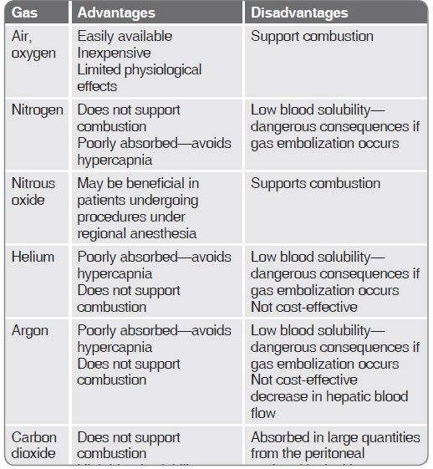
Advantages and disadvantages of various gases used to create pneumoperitoneum

Slide 6
Alternatives to CO2 Pneumoperitoneum
Gasless Laparoscopy: The peritoneal cavity is expanded using abdominal wall lift obtained with a fan retractor.
This technique avoids the hemodynamic and respiratory effects of increased IAP and the consequences of the use of CO2.
Renal and splanchnic perfusion is not altered.
Port site metastases after laparoscopic surgery for cancer are reduced after gasless laparoscopy.
This technique, therefore, is appealing for patients with severe cardiac or pulmonary disease.
However, it compromises surgical exposure and increases technical difficulty.

Slide 7
Ventilatory and Respiratory Changes
•
•
•
•
Thoracopulmonary compliance decreases by 30 to 50%. Reduction in functional residual capacity.
Atelectasis may develop due to elevation of diaphragm.
During uneventful CO2 pneumoperitoneum, the partial pressure of arterial carbon dioxide (PaCO2) progressively increases to reach a plateau 15 to 30 minutes after the beginning of CO2 insufflation.
During laparoscopy with local anesthesia, PaCO2 remains unchanged but minute ventilation significantly increases.
•

Slide 8
Ventilatory and Respiratory Changes
•
During CO2 pneumoperitoneum, the increase of Paco2 may be multifactorial:
Absorption of CO2 from the peritoneal cavity,
Impairment of pulmonary ventilation and perfusion by mechanical factors such as abdominal distention, patient position, and volume controlled mechanical ventilation.

Slide 9
Hemodynamic changes due to Pneumoperitoneum
Decreases in cardiac output(10-30%), increased arterial pressures, and elevation of systemic and pulmonary vascular resistances.
Heart rates remain unchanged or increased only slightly.
The increase in systemic vascular resistance is affected by patient position. The Trendelenburg position attenuates this increase; the head-up position aggravates it.

Slide 10
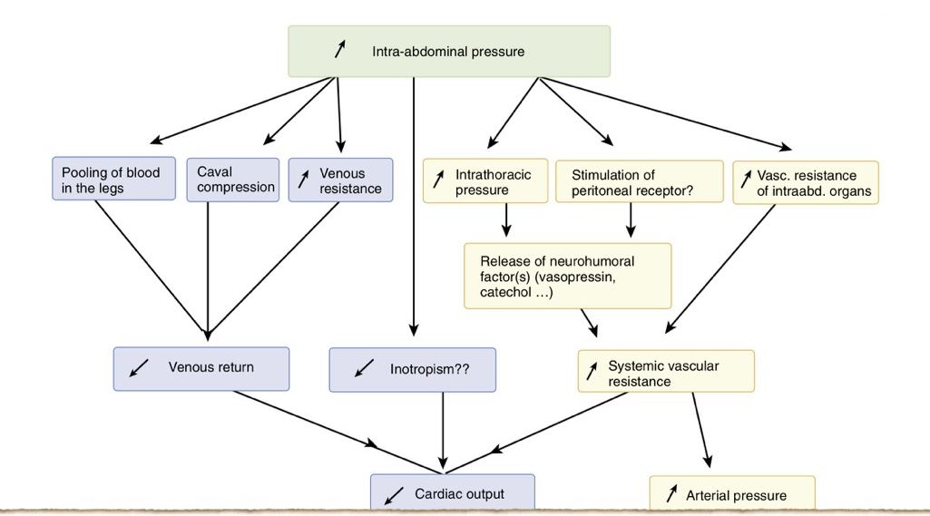
Different mechanisms of decreased cardiac output and increased arterial pressure during pneumoperitoneum

Slide 11
Effect of Pneumoperitoneum on regional Hemodynamics
Increased IAP and the head­up position result in lower limb venous stasis leading to thromboembolic complications.
Urine output, renal plasma flow, and glomerular filtration rate decrease to less than 50% of baseline values during laparoscopic cholecystectomy.
There is a reduction in splanchnic blood flow during air pneumoperitoneum but not during CO2 pneumoperitoneum. This may be due to direct splanchnic vasodilating effect of CO2 which counteracts the mechanical effect of increased IAP.
Cerebral blood flow velocity increases during CO2 pneumoperitoneum in response to the increased PaCO2. Intracranial pressure rises.

Slide 12
Preoperative Evaluation
CHG, ECG, Serum electrolytes.
Baseline renal function tests (BUN, creatinine).
Baseline chest x­ray.
Increased intracranial pressure( eg: tumour, hydrocephalus, head injury) and hypovolemia: Pneumoperitoneum is undesirable.
Ventricular peritoneal (VP) Shunt: Shunts having unidirectional valves resistant to IAP during Pneumoperitoneum.
Heart disease: Patients with congestive heart failure and terminal valvular insufficiency are more prone to develop cardiac complications.

Slide 13
Renal Failure: Increased IAP may adversely affect renal function, so hemodynamics should be optimised during Pneumoperitoneum. Nephrotoxic drugs should be avoided.
Respiratory disease: Laparoscopy appears preferable to laparotomy because of reduced postoperative respiratory dysfunction. But there is risk of pneumothorax during pneumoperitoneum and the risk of inadequate gas exchange from V/Q mismatching.
•
•

Slide 14
Anaesthetic Techniques for Laproscopic surgery
General Anesthesia: Technique of choice for laparoscopy is general anesthesia with a cuffed endotracheal tube and controlled positive pressure ventilation, because of the following reasons:
  Duration may be long.
  Patient may be anxious .
  The Trendelenburg position may cause respiratory compromise and dyspnea in the awake or in the spontaneously breathing patient with abdominal contents under pressure.
  Muscle relaxation and paralysis are necessary because the increase in intra­abdominal pressure and splinting of the diaphragm make spontaneous breathing difficult. It provides a quieter surgical field and better surgical exposure. Moreover, muscle relaxation is necessary to control and augment ventilation to compensate for the hypercarbia and respiratory acidosis that results from absorption of CO2.

Slide 15
Anaesthetic techniques
•
The laryngeal mask airway results in fewer cases of sorethroat and may be used as an alternative to endotracheal intubation. But it does not protect the airway from aspiration of gastric contents. It allows controlled ventilation and accurate monitoring of PetCO2. However, decreased thoracopulmonary compliance during pneumoperitoneum frequently results in airway pressures exceeding 20 cm H2O. The ProSeal laryngeal mask airway may be an alternative to guarantee an airway seal up to 30 cm H2O.
Under local anaesthesia:
CO2 may cause pain intraperitoneally, which is referred to the shoulder.
Rapid peritoneal distention causes nausea, which may be worsened without a nasogastric tube.
Because of patient discomfort, the surgeon may obtain suboptimal visualization of the surgical field.
Also the possibility, although remote, of having to open the abdomen speaks against local anesthesia.
•

Slide 16
Anaesthetic techniques
•
Regional anesthesia can be used for laparoscopy. However, it has serious drawbacks:
It requires a high level of sensory block, possibly causing dyspnea in the trendelenburg position.
A nasogastric tube may not be tolerated.
Hyperventilation in response to hypercarbia may cause too much movement in the surgical field.
Spontaneous ventilation may be inadequate to compensate for hypercarbia in the trendelenburg position.
Use of IV sedation during regional anesthesia may result in respiratory depression or obstruction, especially in steep Trendelenburg position. Hypoxia in the presence of hypercarbia may have serious cardiovascular consequences .

Slide 17
Patient Positioning and monitoring
Patient tilt should be reduced as much as possible and not exceed 15­20 degrees. Tilting must be slow and progressive to avoid sudden hemodynamic and respiratory changes.
The position of endotracheal tube must be checked after any change in patient position and after induction of Pneumoperitoneum.
During laparoscopy, arterial blood pressure, heart rate, electrocardiography, capnometry, and pulse oximetry must be continuously monitored.

Slide 18
Complications of Laparoscopy
Mortality rates have varied from 1 per 10,000 to 1 per 100,000 cases.
The number of serious complications requiring laparotomy
was 2 to 10 per 1000 cases:
  Intestinal injuries ­ 30% to 50%.
  Vascular complications ­ 30% to 50%.
– Burns ­ 15% to 20%.
During laparoscopic cholecystectomy conversion to laparotomy was necessary in approximately 1% of patients.
  Bowel perforation : 2 per 1000 cases.
  Common bile duct injury: 2 to 6 per 1000 cases.
  Significant hemorrhage: 2 to 9 per 1000 cases.

Slide 19
Respiratory complications
1. CO2 subcutaneous emphysema:
–
–
Accidental extraperitoneal insufflation. Intentional extraperitoneal insufflation:
•
•
•
Inguinal hernia repair. Renal Surgery.
Pelvic lymphadenectomy.
2. Pneumothorax, Pneumomediastinum, Pneumopericardium
•
•
•
Embryonic remnants.
Aortic and esophageal hiatus
Pleural tears during laparoscopic surgical procedures

Slide 20
Respiratory complications
3. Endobronchial intubation:
  Cephalad displacement of the diaphragm during pneumoperitoneum results in cephalad movement of the carina, potentially leading to an endobronchial intubation.
  Detected by: A decrease in the oxygen saturation as measured by pulse oximetry (Spo2) associated with an increase in plateau airway pressure.
4. Gas Embolism.
5. Aspiration of Gastric Contents.

Slide 21
4 Gas Embolism
Most feared and dangerous complication.
May follow trocar placement into a vessel or gas insufflation into an abdominal organ.
Develops usually during initiation of pneumoperitoneum but may occur anytime during surgery.
Patients with previous history of abdominal surgery are at increased risk.
CO2 used for laparoscopy increases the margin of safety as it is more soluble in blood than air, oxygen and nitrous oxide. Lethal dose of embolized CO2 is approximately five times than that of air.

Slide 22
The diagnosis of gas embolism depends on the detection of gas emboli in the right side of the heart or on recognition of the physiologic changes from embolization.
Early events, occurring with 0.5 mL/kg of air or less, include changes in Doppler sounds and increased mean pulmonary artery pressure.
With >2 mL/kg of air: tachycardia, cardiac arrhythmias, hypotension, increased central venous pressure, alteration in heart tones (i.e., millwheel murmur), cyanosis, pulmonary edema and electrocardiographic changes of right­sided heart strain can develop.
Pulse oximetry: Hypoxemia.
EtCO2: decreases in the case of embolism owing to the fall in cardiac output and the enlargement of the physiologic dead space.

Slide 23
Treatment of CO2 embolism
Immediate cessation of insufflation and release of the pneumoperitoneum.
Steep head­down and left lateral decubitus (Durant) position.
Discontinuing N2O will allow ventilation with 100% O2 to correct hypoxemia and reduce the size of the gas embolus.
Hyperventilation increases CO2 excretion and is made necessary by the increase in the physiologic dead space.
A central venous or pulmonary artery catheter may be introduced for aspiration of the gas.
Cardiopulmonary resuscitation must be initiated if necessary. External cardiac massage may be helpful in fragmenting CO2 emboli into small bubbles.
Cardiopulmonary bypass may be needed to treat massive CO2 embolism..

Slide 24
Cardiac Arrhythmias During Laparoscopy
Reflex increases of vagal tone may result from sudden stretching of the peritoneum and during electrocoagulation of the fallopian tubes.
Bradycardia, cardiac arrhythmias, and asystole can develop.
Vagal stimulation is accentuated if the level of anesthesia is too superficial or if the patient is taking β­blocking drugs.
Treatment consists of interruption of insufflation, atropine administration, and deepening of anesthesia after recovery of the heart rate.

Slide 25
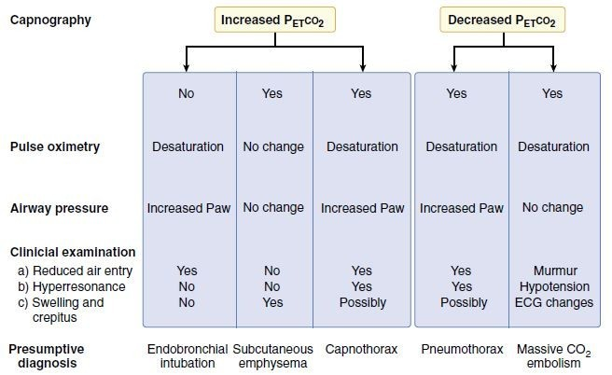
Diagnosis of respiratory complications during laparoscopy

Slide 26
Problems Related to Patient Position
Head­down or Trendelenburg position:
  Increase in central venous pressure and cardiac output.
  Decrease in the functional residual capacity, the total lung volume, and the pulmonary compliance. Atelectasis may also develop.
Head­up or Reverse Trendelenburg position:
  Decrease in cardiac output and mean arterial pressure results from the reduction in venous return.
  Venous stasis in the legs occurs during the head­up position and may be aggravated by the lithotomy position with knees flexed. Increased risk of venous thromboembolism.

Slide 27
Problems Related to Patient Position
Nerve compression is a potential complication during the head­ down position. Overextension of the arm must be avoided.
Shoulder braces should be used with great caution and must not impinge on the brachial plexus.
The common peroneal nerve is particularly vulnerable and must be protected when the patient is placed in the lithotomy position.
Prolonged lithotomy position, such as required for some operative laparoscopies, can result in lower extremity compartment syndrome.

Slide 28
Postoperative Benefits and Consequences of Laparoscopy

Slide 29
Stress Response
Improved and more rapid recovery.
There is a reduction in acute phase reactants reflected by lower levels of CRP and interleukin-6 after laparoscopy as compared to laparotomy.
The metabolic response (e.g., hyperglycemia, leukocytosis) is also reduced after laparoscopy. As a con-sequence, nitrogen balance and immune function might be better preserved.
Laparoscopy avoids prolonged exposure and manipulation of the intestines and decreases the need for peritoneal incision and trauma. Consequently, postoperative ileus and fasting, duration of intravenous infusion, and hospital stay are significantly reduced after laparoscopy.

Slide 30
Postoperative pain
The nature of pain varies depending on the surgical technique; after laparotomy, patients complain more of parietal pain (e.g., abdominal wall), whereas after laparoscopic cholecystectomy, patients report also visceral pain (e.g., biliary colic [cholecystectomy], pelvic spasm [tubal ligation]), and shouldertip pain resulting from diaphragmatic irritation.
Pain after laparoscopy is multifactorial, and different treatments have been proposed to provide pain relief.
–Local anesthetic infiltration.
–Careful evacuation of residual CO2 after desufflation.
–Nonsteroidal anti-inflammatory drugs (NSAIDs), cyclooxygenase-2 inhibitors and opoids.
–Dexamethasone is also effective in reducing postoperative pain.

Slide 31
Pulmonary dysfunction
Upper abdominal surgery results in postoperative changes in pulmonary function. Respiratory dysfunction is less severe and recovery is quicker after laparoscopy.
Postoperative pulmonary function is less impaired after gynecologic laparoscopy than after upper abdominal laparoscopic surgery.

Slide 32
Postoperative Nausea and Vomiting
•
PONV can persist upto 48 hours after laproscopic surgeries.
•
Intraoperative drainage of gastric contents reduces the incidence of PONV.
•
Periopertive opoids increase risk whereas propofol Anesthesia reduces risk.
•
Intraoperative administration of droperidol or 5HT3 antagonists helps in prevention and treatment of PONV.

Slide 33
Thank you

