Slide 1
OXYGEN –HAEMOGLOBIN DISSOCIATION CURVE
DR. SARA MARY THOMAS
PROF. DEPT OF ANAESTHESIOLOGY
SBKS MI & RC

Slide 2
Oxygen haemoglobin dissociation curve relates the saturation of Hb (Y AXIS) to partial pressure of O2 ( axis ). Hb is fully saturated ( 100 % ) by a PO2 of about 70 mm Hg. The normal arterial saturation of 95 -98% with oxygen occurs by a Pao2 of about 95-100 mm Hg

Slide 3
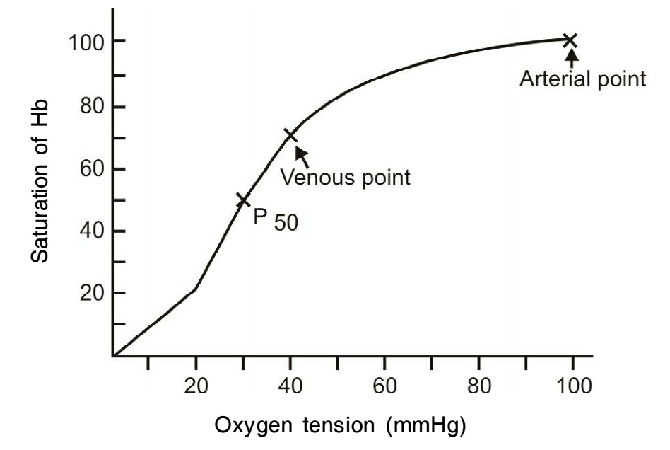

Slide 4
As blood passes by the alveolus , o2 diffuses into plasma, increasing the partial pressure of O2
( PaO2). As PaO2in blood increases , O2 diffuses into RBC combining with the ferrous iron in the haemoglobin. Each Hb molecule has 4
Fe ²⁺⁺ atoms.As each Fe²⁺ combines with O2, affinity of the Hb to Fe ²⁺⁺ increases, till it completely saturated.

Slide 5
Shape of ODC
The sigmoid shape of the curve reflects the physiological adaptation of Hb to take up oxygen at higher partial pressure ( i.e. in alveoli ) and release O2 at lower partial pressure ( in tissue ). When PO2 is less than 60 mm of Hg (90 % saturation ), the saturation falls steeply , so that for a given decrease in PO2 amount of Hb uncombined with O2 increases greatly. Mixed venous blood has a PO2 of about 40 mm Hg ( i.e . 75 % saturation)

Slide 6
Significance
Oxygen –Hb curve can relate oxygen content ( ml O2/ 0.1 L blood) to PO2.
Oxygen is carried in solution in plasma = 0.003 ml O2 mm of Hg PO2/0.1 L
Oxygen is combined with Hb – 1.39 ml O2/gm of Hb.
Therefore, O2 content = 1.39 % saturation+0.003 PO2
Arterial O2content in a patient with HB 15ml/0.1 L comes to 21.2ml of O2/ 0.1L

Slide 7
Cv O2 comes to 15.2 ml of O2 /0.1 L blood.
Normal arteriovenous O2 contentdifference= 5.5ml/ 0.1 L
Oxygen – Hb curve can also relate the oxygen transport to peripheral tissues to PO2
Oxygen transport = O2 content CO
Oxygen consumption amounts to250ml/ min.
Oxygen – Hb curve can relate O2 available to tissue as a function of P O2-of the 1000 ml of oxygen going to the tissues, 200 ml cannot be extracted because it will lower PO2 below the level at which brain can survive.So O2 available to tissues is 800 ml/min. With lower arterial O2 saturation, the important thing to be remembered is that tissue demand of O2 can bemet only by an increase in cardiac output or in long termby an increase in HB concentration.

Slide 8
SO2- consumable oxygen – defined as percentage saturation of Hb when oxygen tension is 20mm of Hg – lowest Pv O2 at which tissue oxygen tension is thought to be possible. Normally SO2 is 33% available.
The posistion of oxy- Hb is best described by P50- partial pressure of O2 at which Hb is half saturated with O2 at 37*C at Ph 7.4. The normal adult P50 -26.7 mm of Hg.

Slide 9
SHIFTS IN ODC
The effect of shift in the posistion of oxy- Hb curve on Hb saturation depends greatly on Po2. In the region of normal PaO2 (75-100 mm Hg) curve is relatively horizontal , so that shifts of the curve is relatively steep .

Slide 10
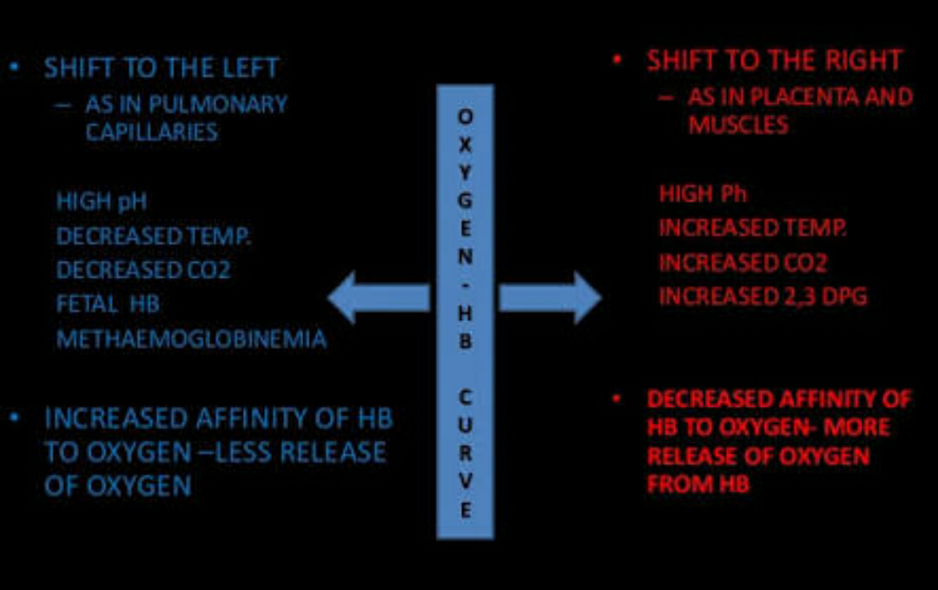

Slide 11
P50 less than 27mm Hg describes a left –shift of oxy – Hb curve meaning , at any given PO2, Hb has highest affinity for oxygen and therefore more satrurated that normal.i.e., shift of ODC to left. This require a highest tissue perfusion than normal to produce a normal oxygen delivery to tissues.
Causes are
Alkalosis ( metabolic and respiratory )
Hypothermia
Abnormal and foetal Hb
Carboxy Hb.

Slide 12
Met Hb.
Decrease in RBC 2,3 DPG content – occurs with transfusion of old acid citrate – dextrose stored blood ( > 6-7 days ).This persists for upto24 hr,after transfusion. Storageof blood DPG with time. Hence to minimise the effects:
-Should warm all blood.
Avoid excessive bicarbonate administration.
Use frozen blood if available.
Avoid infusing blood that is more than 5-7 days old.

Slide 13
P50 more then 27mm of Hg describes a right ward shift of oxy –Hb curve which means that at any given PO2, Hb has a affinity for oxygen and is less saturated than normal.
CAUSES
Acidosis
Hyperthermia
Increased RBC 2,3 DPG.
Anaemia
Exercise
Propranolol

Slide 14
Sickle cell anaemia
Deficiency of Pyruvate kinase
Drugs like digoxin, testosterone
FACTORS AFFECTING THE POSISTION OF THE OXY- HB DISSOCIATION CURVE
Temperature
Increase in temperature decreaseHb-O2 affinity and ODC is shifted to right. Conversely : when body is cooled , O2 demand decreases , P50 falls and ODC is shifted to left.

Slide 15
Hydrogen ions
P50 is inversely proportional to Ph . Acute alkalosis shifts the ODC curve to left . Acute changes in pH of 0.1 unit will change of P50 by approx. 3 mm of Hg. The effect of chronic Ph changes depends largely on compensatory change in organic phosphate synthesis
CO2
Modifies the posistion of ODC by altering Ph
( Bohr effect ). P50 is directly proportional to the partial pressure of CO2. Acute respiratory acidosis will shift the curve to the right : acute respiratory alkalosis will shift the curve to left.

Slide 16
Organic phosphate -2,3 DPG and ATP
These bind to the oxy – Hb – The normal intra eryrhrocytic concentration of 2,3 DPG is about 4m Mol/L of RBC. Increase in concentration of 2,3 DPG or ATP or both will shift ODC to the right, and decrease will shiftODC to the left. 2,3 DPG is produced in red cells by HMP shunt pathway of glycolysis.
The production of 2,3 DPG is potentiated through enzymatic response to anaemia, alkalosis and hypoxaemia. Alteration in 2,3 DPG requires several hours to become evident.In chronic acidosis2,3 DPG is diminished ( left shift ). In chronic alkalosis 2,3 DPG is increased ( Rt. Shift )

Slide 17
Congenital abnormalities of ODC
Haemoglobinopathies shift to right or left depending on the affinity of abnormal Hb to O2
Disorders of red cell metabolism- pyruvate kinase deficiency shifts the ODC to rightwith elevated2,3 DPG levels. Hexokinase deficiency shifts the ODC to left with low 2,3 DPG levels.

Slide 18
ODC and Environmental factors
Physiological adaptation to high altitudes. At high altitudes oxygen tension is markedly reduced.
Compensatory mechanisms are – Hyperventilation, polycythamia, increased breathing capacity and pulmonary vasoconstriction.
Hypoxaemia and hypocarbia stimulate 2,3 DPG production and results in a right ward shiftof ODC and improved oxygen extraction.

Slide 19
Carbon monoxide
CO has an affinity for Hb over 200 times greater than that of oxygen and readily displaces oxygen from Hb. It has direct effect on P50 and shifts the ODC top the ,left, further reducing available oxygen to tissues.
ODC and Chronic Disease States
Cardiopulmonary disease-compensatory increase in 2,3 DPG. In low cardiac output states as in CCF, tissue coimpensate by extracting more oxygen. Increase in de-oxy Hb

Slide 20
stimulates phosphofructokinase and 2,3 DPG production.
Anaemia – most imp. Compensatory mechanisms are :
  Increased CO nd O2 delivery.
  Right shift of ODC – mostly by increased 2,3 DPG levels
  Uraemia and cirrhosis and thyroid disease- increased2,3 DPG levels and right shift of ODC.

Slide 21
ODC in Acute Disease state
Hypophosphataemia – results in lowered P50 and increased Hb-O2 affinity. Causes are
Parenteral nutrition
Alkalosis
Starvation
Vomiting
Malabsorption
Antacids
Hyperphosphaturia
Hypokalemia
Haemodialysis.

Slide 22
Shock – effects on ODC involves interaction of pH,Paco2 , and temperature
Factors contributing to increased oxygen affinity in shock are massive blood transfusion,acute alkalosis, metabolic acidosis, hypophosphataemia and hypothermia
Acute MI
P50 was found to be elevatedand ODC shifted to right

Slide 23
ODC and Anaesthesiologist
Volatile anaesthetic agents – in general all inhalational agents including N2O causes a shift to right in the ODC.
Intravenous anaesthetic sgents –no demonstrable effect.
ODC and Cardiopulmonary Bypass
Influenced by the state of hypothermia, type of anticoagulated blood used for BT, etc.

Slide 24
Therapeutic manipulation of ODC
Infusion of inosine, pyruvate and phosphate – caused significant rise in 2,3DPG. But there was no difference in p50 or oxygen extraction.
Steroid therapy –Methylprednisilone was found to induce a transient moderate increase in cardiac indices and a sustained significant increase in P50. The use of steroids particularly in septic shock has been claimed to be beneficial, by causing membrane stability, haemodynamic improvements and improvement in tissue oxygenation.

Slide 25
Propranolol was found to decrease oxygen affinity- by releasing the bound 2,3 DPG in red cells. This effect is blocked by epinephrine . Its beneficial effect in angina may be in part due to increased myocardial oxygenation by causing a decreased Hb-C affinity

Slide 26
AUTHOR | TITLE | ABSTRACT | JOURNAL DETAILS | LEVEL OF EVIDENCE | CONCLUSION
Carole Hamilton et al | The oxygen dissociation curve: quantifying the shift | An oxyhaemoglobin dissociation curve (ODC) quantifies the most important function of red blood cells and that is the affinity for oxygen and its delivery to the tissues. Oxygen affinity for haemoglobin plays a critical role in the delivery of oxygen to the tissues and is changed by shifting to the left or right. | Sage journals First Published May 1, 2004 | 1 b

