Slide 1
capnography
DR. TEJASH SHARMA
ASSO. PROF. DEPT. OF ANAESTHESIOLOGY
SBKS MI & RC, SVDU

Slide 2
objectives
History
Definitions
Physiology
uses
SOURCES
Types
Components
Variations of waveforms

Slide 3
history
1943-
luft – developed the principles of capnography
Collier & colleagues – established the accuracy of rapid infra red (ir) co2 analysis
Ramwell – established the value of the end tidal sample
1978-
holland was the first country to adopt capnography as a standard monitoring during anaesthesia

Slide 4
definitions
Capnography –Technique by which the fluctuations of CO2 in the end tidal gas drawn from the alveoli is measured & monitored.
CAPNOGRAM – Tracing of the trend of CO2 fluctuation on recording paper/ monitor.
CAPNOGRAPH- machine or device which records CO2 fluctuations
CAPNOGRAM WAVEFORM + NUMERICAL VALUE
CAPNOMETER- device that performs the measurement & displays the readings in numerical forms

Slide 5
DEFINITIONS
ETCO2 – End Tidal CO2- The measurement of exhaled CO2 in the breath
Normal Range 35-45 mmHg
PaCO2 – Partial pressure of carbon dioxide in the alveoli.
PACO2 – Partial pressure of carbon dioxide in arterial blood.
PETCO2 – Partial pressure of carbon dioxide at the end of expiration.
P(a-ET)CO2 – The difference between PaCO2 and PETCO2 .
Sometimes called the “CO2 -diff”, or “CO2 gradient”.
In healthy lungs the normal a-ETCO₂ gradient is 2-5 mmHg
PVCO2 – Partial pressure of carbon dioxide in venous blood.

Slide 7
CAPNOGRAPHY refers to the noninvasive measurement of the partial pressure of carbon dioxide (CO2) in exhaled breath expressed as the CO2 concentration over time.
Relationship of CO2 concentration to time is graphically represented by the CO2 waveform, or CAPNOGRAM.

Slide 8
Oxygenation and Ventilation
The respiratory cycle consists of two components;
A- inspiration and B-expiration.
To understand capnography you must understand that “oxygenation” and “ventilation” are two entirely different mechanisms, but they both rely on the respiratory cycle.
Oxygenation relies on the inspiratory phase and refers to the amount of oxygen (O2) available and utilized.
Ventilation relies on the expiratory phase and refers to the amount of carbon dioxide (CO2) produced during the metabolic cycle of the cells, and exhaled from the body.
Oxygenation and ventilation are both needed, in proper proportion, to sustain an adequate and safe quality of life.

Slide 9
Oxygenation and Ventilation
Must be assessed in both intubated and spontaneously breathing patients.
Pulse oximetry provides instantaneous feedback about oxygenation
Capnography provides instantaneous informations
1. Ventilation (how effectively CO2 is being eliminated by the pulmonary system)
2. Perfusion (how effectively CO2 is being transported through the vascular system)
3. Metabolism (how effectively CO2 is being produced by cellular metabolism).
Metabolism
Transport
Ventilation
CO₂
CO₂
CO₂

Slide 10
Determination of Oxygenation Status:
Invasively an arterial blood gas (ABG) can be obtained which measures, among other things, the PAO2 (partial pressure of oxygen dissolved in the blood plasma of arterial blood).
Non-invasively a pulse oxymetry can be obtained which measures the amount of oxygen that is bound to the hemoglobin.

Slide 11
Determination of Ventilation Status:
Invasively the same arterial blood gas (ABG) sample that measures the PAO2 also measures the PaCO2 (partial pressure of carbon dioxide dissolved in blood plasma of arterial blood).
Non-invasively the PETCO2 (partial pressure of carbon dioxide in exhaled gas) can be measured. This is measured breath by breath at the end of the expiratory phase of respiration.

Slide 12
Uses of Capnography
1. Respiration
To confirm correct placement of EndoTrachealTube: presence of stable ETCO2 for > 3 successive breaths.
Determines if tip of fiberscope is in trachea.
Determines position of double lumen tube.
2. Metabolism
Diagnosis of malignant hyperthermia.
Rise is ETCO2 occurs before rise of body temperature in malignant hyperthermia.
3. Circulation
Assessment of effectiveness of CPR-better than ECG, pulse and BP
Detects pulmonary embolism.

Slide 13
4. Equipment function
Indicates:
–– Apnea/extubation
–– Disconnection of circuit
–– Ventilator malfunction
–– Leaking ETT cuff/circuit.
• Incompetent inspiratory/expiratory valve
Assessment of functioning of soda lime canister.
5. Others
Detection of tracheo-esophageal/broncho-esophageal fistula
Guides blind intubation
Detects tracheo-bronchial injury during thoracoscopy
Confirm placement of needle in cricothyroidotomy
.

Slide 14
Sources of monitoring
Various sources
1. Infrared analysis: Quantitative
–– Blackbody radiation technology
–– Microstream technology.
2. Chemical colorimetric analysis: Semi quantitative
–– Hygroscopic
–– Hydrophobic.
3. Mass spectroscopy.
4. Raman spectroscopy
5. Piezoelectric crystal (quartz) oscillation

Slide 15
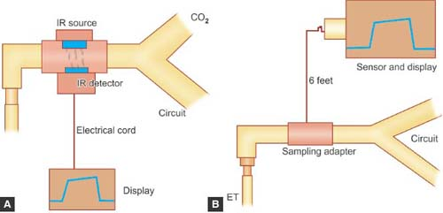
SAMPLING
Carbon dioxide (CO2) monitors measure gas concentration, or partial pressure, using one of two configurations:
1. Main stream
2. Side stream.

Slide 16
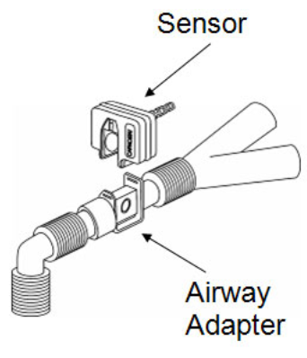
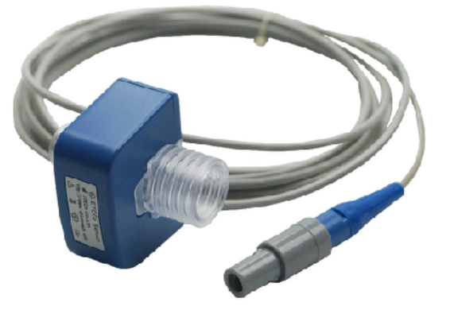
Main stream/ non diverting
Technique
Total volume of inspired and expired gas passes through sensing device
Sensing device is located at endotracheal tube (sensor)
Measuring chamber warmed to 40 ºC to prevent condensation of water vapor on sensor window, e.g ;- Siemens sirecrust 300 and FEF etco2 detector.

Slide 17
Advantage
Allows for analysis of multiple gases
Very accurate and stable
Avoids sampling system
No delay in response time
Reduces sample tubing dead space
Disadvantages
• Large and bulky
• Adds more dead space in pediatric patients
• Can cause kinking of ETT due to weight
• Requires frequent calibration
• Prone to soiling with mucus/saliva due to proximity to patient
• Leak/circuit disconnection can occur
• Difficult to use in intubated patients
• Siemens 300 sirecrust uses a heated sensor which
may cause thermal burns

Slide 18
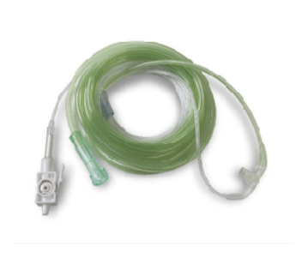
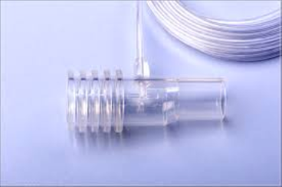
Side stream/ diverting
Technique
Sample is removed from circuit to be evaluated
Withdraws gas 50–150 ml/min via sampling tube near ETT
Sample transported to a distant device for evaluation
Sampled gas is then released into atmosphere/ returned to circuit through a second tube.

Slide 19
Sites of sampling
• Endotracheal tube
• Facemask (placed in patients nears/attached to Upper lip)
• LMA (can be inserted through elbow connector)
• Mask outlet in non-intubated patients
• Jet ventilator (connected to sampling lumen).

Slide 20
Advantages
• Allows for unobstructive sampling near patient
• Calibration usually automatic
• Patient interface is light
• Sampling port can be used to administer bronchodilators.

Slide 21
Disadvantages
• Prone to gas leak, sample tube obstruction and moisture problems
• Hypoventilation if sampling rate > fresh gas flow rate
• Error if sampling rate > expiratory flow rate: causes inspired gas to be sampled
Sources of error
• Water vapor condensation in sample tubing
• Liquids and particulate matter entering cell
• Delayed response time
• Multiple sites for damage/gas leakage
• CO2 can diffuse out of sample tube
• Longer tubing increases chances of error.

Slide 22
Influence of water vapour
1. Effect of condensed water:
Water vapor may condense on the window of the sensor cell and absorb IR light, thereby produce falsely high C02 readings
2. Effect of water vapor.
The temperature of the sampling gases may decrease during the passage from the patient to the unit, resulting in a decrease in the partial pressure of water vapor. This can cause an apparent increase in C02 concentration of about 1.5-2%
Fetco2=partial pressure(atmospheric pressure-water vapour pressure)*100

Slide 23
NO. | MAIN STREAM | SIDE STREAM
1. | SENSOR LOCATED BETWEEN BREATHING CIRCUIT & ETT | SENSOR LOCATED IN MAIN VENT
2. | NO SAMPLING REQUIRED | SAMPLE TUBING ASPIRATES GAS
3. | HAVE FAST RESPONSE TIME | SLOW RESPONSE TIME
4. | STANDARD GAS NOT REQUIRED FOR CALIBERATION | SUPPLY OF CALIBRATION GAS IS NEEDED
5. | FREQUENT CALIBARATION REQUIRED | AUTOMATICALLY CALIBERATED
6. | INCREASED DEAD SPACE DUE TO USE OF ADAPTOR | NO SUCH PROBLEM
7 | PATIENT INTERFACE HEAVY DUE TO WEIGHT OF ADAPTOR | PATIENT INTERFACE IS LIGHT
8. | ADAPTOR CAUSES KINK IN ETT / DISCONNECTION OF CIRCUIT | NO SUCH PROBLEM
9. | DIFFICULT TO USE IN UNINTUBATED PATIENTS | RELATIVELY EASY
10. | CANNOT BE USED AS SAMPLING PORT FOR BRONCHODIALATOR ADMINISTRATION | SAMPLING PORT PRESENT FOR BRONCHODIALATOR ADMINISTRATION
12. | WATER AND SECRETIONS ARE SELDOM A PROBLEM | SECRETIONS CAN OCCLUDE SAMPLE TUBING
13. | DAMAGED BY INHALED DRUGS LIKE INHALED BETA BLOCKERS | NOT SO
14. | MAY CAUSE THERMAL BURNS | NOT SO
15. | HYPERVENTILATION NOT POSSIBLE | HYPERVENTILATION : IF SAMPLING RATE > FGF

Slide 24
Infrared(IR) analysis
Introduction
Most common technology
Used most commonly with side stream sampling.
Principle
Gases with 2 or more dissimilar atoms in a molecule have specific IR light absorption spectra ( e.g : CO2, N2O)
Amount of IR absorbed is proportional to concentration of absorbing molecules.
It works on basic principle based on INFRARED & BEER LAMBERT LAW.

Slide 25
This technology is used in most CO2 monitors.
It works on the principal that carbon dioxide selectively absorbs infrared light of a specific wavelength (4.3 millimicrons).
The amount of light absorbed is directly proportional to the concentration of carbon dioxide molecules.
A predetermined amount of infrared light is sent from the emitting side of the sensor through a gas sample and collected on the receiving side of the sensor ( IR detector).
The infrared light received is compared to the infrared light transmitted.
The difference is then converted by calculations into the partial pressure that you see on the
Monitor.

Slide 26
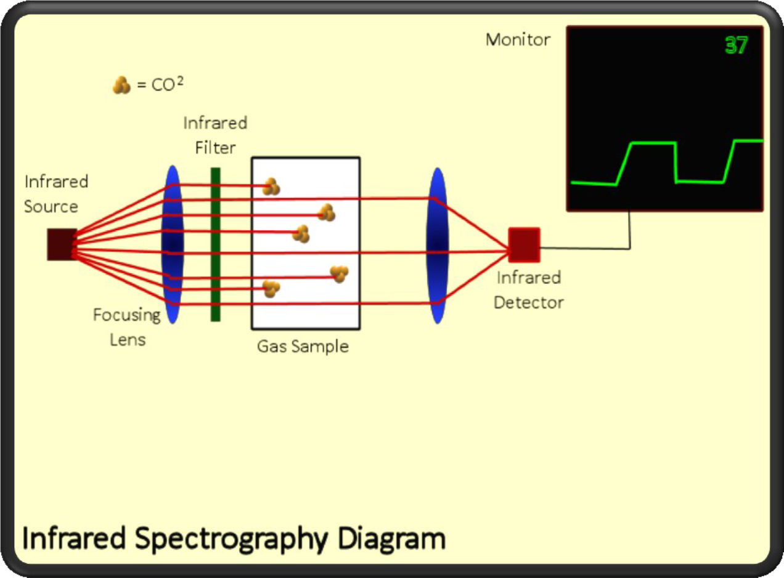

Slide 27
Blackbody Radiation Technology
Most commonly used
Heated element called blackbody emitter is source of IR
Filter present to block radiation which is outside the desired range
Analyzer selects appropriate IR wave length to maximize absorption by selected gas
Sensor detects transmitted IR light and converts it to electrical signals
Electrical signal is amplified and concentration is displayed.

Slide 28
Microstream Technology
Laser based technology to generate IR light uses smaller sample cell and low flow rates (50 ml/min)
IR light precisely matches absorption spectrum of CO2
Emitted electrons excite nitrogen molecules
These molecules collide with CO2 molecules and excite them
IR light of signature wavelength of CO2 is emitted as excited CO2 molecules drop back to ground state
Amplitude of signal depends on amount of IR radiation absorbed which is proportional to CO2 concentration.

Slide 29
Advantages
Rapid response time
Require low sample flow
Not affected by pressure of other gases
Provides a breath by breath waveform and measurement that can be used to help determine your patients airway and gas exchange condition.
Small sample volume required which is useful in:
–– Small patient
–– High respiratory rates
–– Low flow applications
–– Non intubated patient.

Slide 30
Disadvantages
Continuous withdrawal of gas from RS (if used with side stream)
Propensity to leak/occlude
Sensitive to water accumulation

Slide 31
CHEMICAL COLORIMETRIC ANALYSIS
Chemical colorimetric analysis uses a pH-sensitive chemical indicator inside a device that is placed between an endotracheal tube and a breathing circuit.
This indicator changes color breath by breath.
It turns yellow when it’s exposed to a carbon dioxide concentration of 4% or greater, and purple when it’s exposed to room air that contains almost no carbon dioxide.
These devices are good for quick determination of the presence of CO2 but are not sensitive to low concentrations of CO2, as is the case during CPR or other low cardiac output situations .
CO2 Present
CO2 Not Present

Slide 32
Technologies
1.Hygroscopic
Can detect CO2 concentration in range 0.25–0.6%
minimum CO2 concentration to produce color change is 0.54%
Life span of detector depends on humidity of expired gas
Reduced humidity prolongs detectors life
Color changes are:
–– Purple: low CO2 ( < 0.5% or < 2.3 mm Hg)
–– Biege: moderate CO2 (0.5–2% or 3.7–7.6 mm Hg)
–– Yellow: high CO2 (> 2% or > 15.2 mm hg)
–– Changes color back to purple after removal of CO2.

Slide 33
2. Hydrophobic
Color changes from blue to green to yellow as CO2 concentration increases
Faster response time
Less affected by humidity
Performs better at higher respiratory rate.

Slide 34
Advantages of chemical colorimeter analysis
Cheaper,
Easy to use,
Disposable
Small in size,
Portable
Useful in remote site resuscitative evaluation
Not affected by N2O or anesthetic vapor
Require no other equipment.

Slide 35
Disadvantages
May require several breaths before conclusion is drawn
Wait for six breaths with colorimetric methods
False positive results in:
–– Ingested carbonated drinks/antacids
–– Mask ventilation.
False negative results in:
–– Low tidal volume
–– Low ETCO2 concentration
–– Compromized lung perfusion.

Slide 36
MASS SPECTROMETRY
Gas withdrawn continuously through capillary lines
Sample directed into mass spectrometer
Sample is ionized and then exposed to magnetic field in a vacuum chamber
Ionized molecules separated by mass–charge ratio
Collectors in vacuum chamber determine concentration of each gas component.

Slide 37
Types of Capnographs
Time volume capnograph
Volume capnograph.

Slide 38
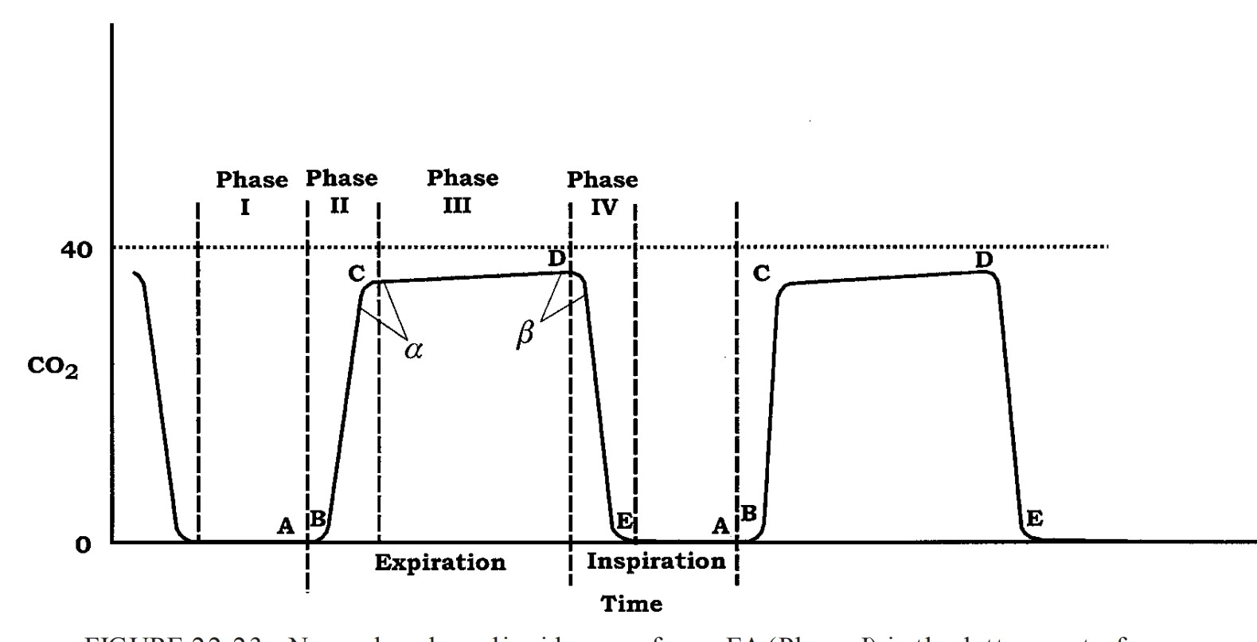
Notes:
Normal carbon dioxide waveform.
EA (Phase I) is the latter part of inspiration, during which the CO2 level remains at zero.
BC (Phase II) represents the emptying of connecting airways and the beginning of the emptying of alveoli. As exhalation continues, gas from alveoli in regions with relatively short conducting airways appears and mixes with dead space gas from regions with relatively long conducting airways, resulting in an increasing CO2 level.
CD (Phase III) shows the alveolar plateau. Because of uneven emptying of alveoli, the slope continues to rise gently.
Point D shows the best approximation of alveolar CO2 (end of expiration, beginning of inspiration).
In DE (Phase IV), as the patient inhales, CO2-free gas enters the patient’s airway, and the CO2 level abruptly falls to zero.
Characteristics of the normal capnogram include (a) rapid increase from B to C, (b) nearly horizontal plateau between C and D, (c) rapid decrease from D to E
to zero, and (d) a zero baseline (EA AB).
A good alveolar plateau greatly increases the chances that the end-tidal reading is a reliable estimate of the alveolar level.

Slide 39
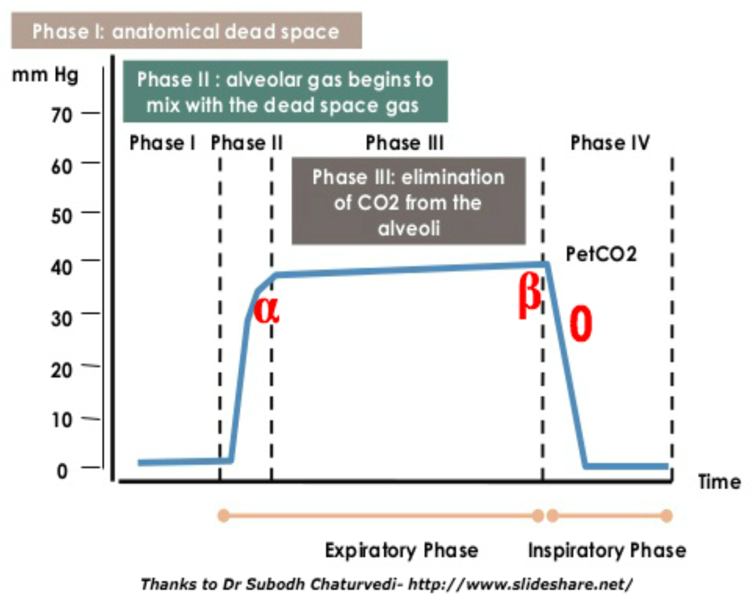
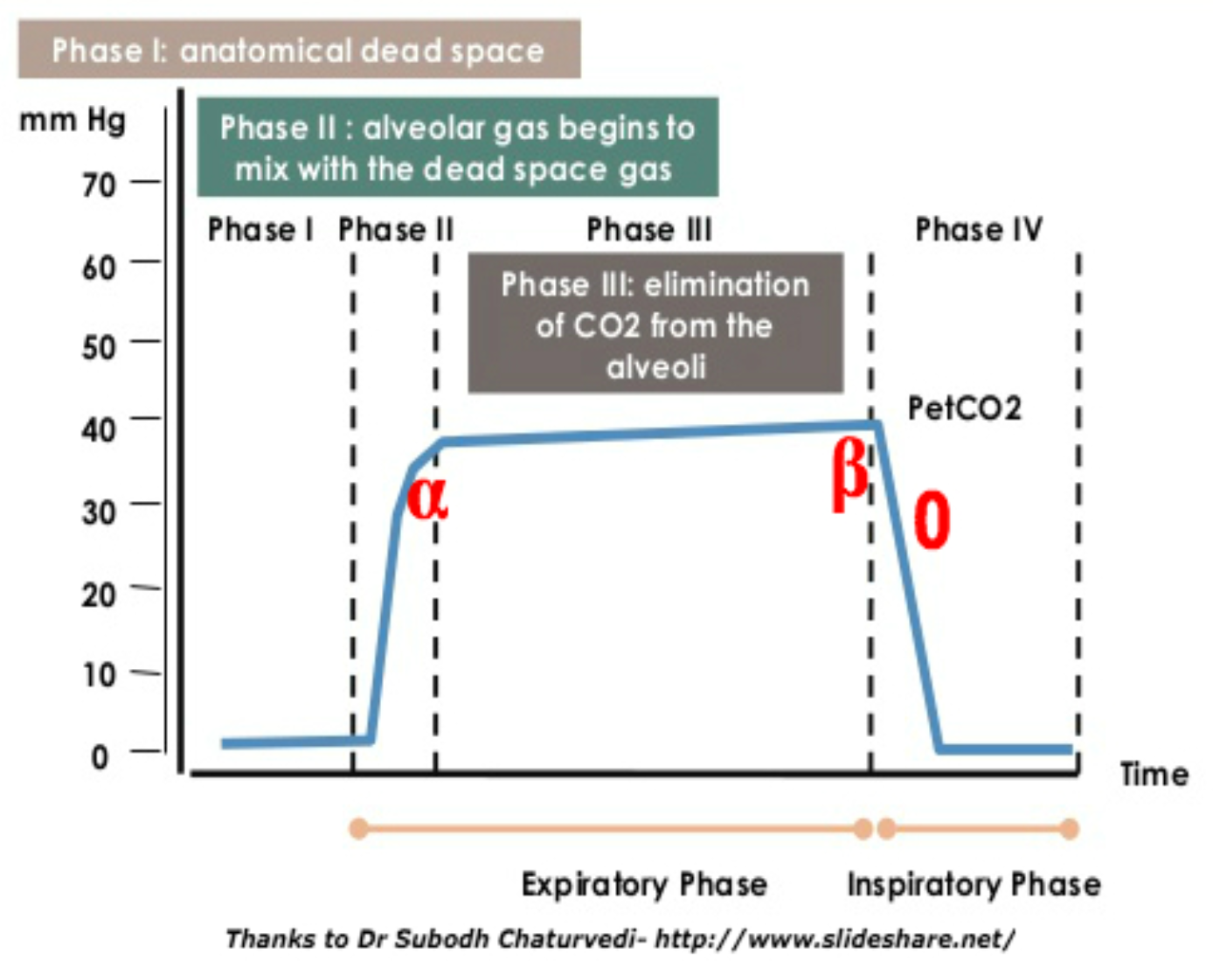
components
PHASE I:-
Inspiratory Baseline
• Usually is zero
• Reflects inspired gas devoid of CO2
PHASE III:_
Plateau phase
• Represents gas coming from alveoli
• End of phase III at point D is End tidal point
PHASE II:-
Expiratory upstroke
• Rapid S-shaped upswing
• Represents transition gas from anatomical dead
space
• Prolonged in:
–– Partial endotracheal tube obstruction
–– COPD, bronchospasm
–– Upper airway obstruction.
PHASE IV
• Inspiratory downstroke
• Represents patient inhalation
• CO2 levels abruptly falls to zero.

Slide 40
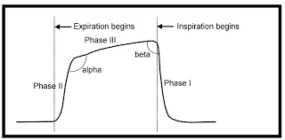
Angles of Capnograph
α Angle
β Angle
• Angle between phase III and descending limb of capnogram
• Normally around 90°
• Decreased in airway obstruction and PEEP
• Increased in rebreathing.–– PEEP.
Take off/elevation angle
Angle between phase II and phase III
Normally between 100–110°
Decreased in obstructive lung diseases
Increased in:
–– Airway obstruction
°

Slide 41
Five characteristics of capnogram should be evaluated
Height depends on ETCO2 concentration
Frequency depends on respiratory rate
Rhythm shows regularity of breathing
Normal shape is top hat/sine wave
Baseline is normally zero (EA).

Slide 42
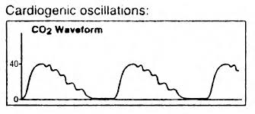
Variation of waveform
- Ripple effect
Cardiogenic oscillations
• Due to heart beating against lungs.
Also Seen during low frequency ventilation
Cardiogenic oscillations on capnograph

Slide 43
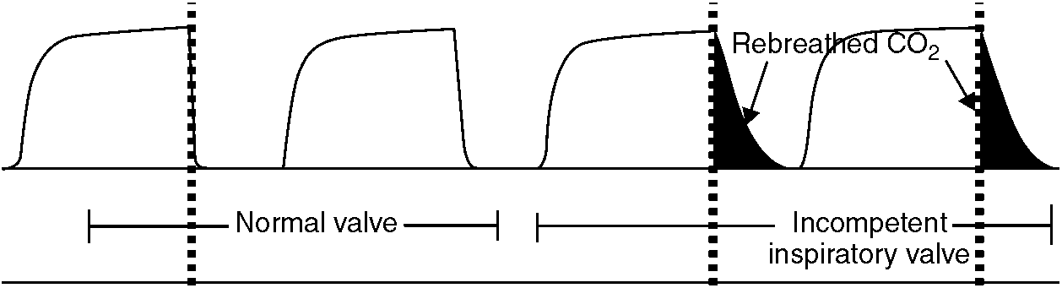
Incompetent inspiratory unidirectional valve
Prolonged plateau with slanting inspiratory downstroke.
The inspiratory phase is shortened, and the baseline may or may not reach zero,
depending on the fresh gas flow.
A similar pattern may be seen with suction applied to a chest tube.

Slide 44
Irregular plateau/baseline
• Displacement of ETT into upper larynx/lower pharynx with intermittent ventilation of stomach and lungs
• Pressure on chest.

Slide 45
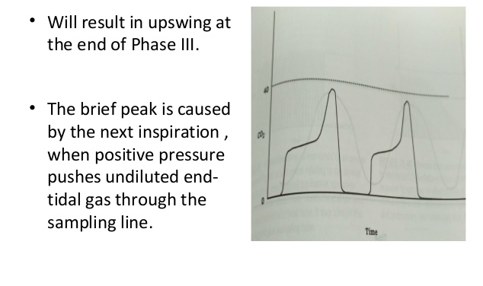
Leak in sample line during IPPV
• Also in obese and pregnant patients.
Rounded low rectangle
EtCO2 waveform
• A sharp increase in the angle of
phase 3 that looks like a small
uptick or "pig tail" on the
righthand side of the rectangle
• CO2 being squeezed out of the
alveoli by the poorly compliant lung
tissue, obese chest wall, or
pregnant belly
• Weight closes off the small bronchi.
• Patients are progressing quickly from
respiratory distress to respiratory
failure.

Slide 46
If the compliance, airway resistance, or
ventilation-perfusion ratios in one lung differ substantially
from the other lung, a biphasic expiratory plateaus may be
seen
• Biphasic expiratory plateau
• Severe kyphoscoliosis
• One lung ventilation
• Single lung transplantation
• Very high airway resistance.

Slide 47
Obstruction
The EtCO2 in patients
with lung disease is only
useful for assessing
trends in ventilatory
status over time

Slide 48
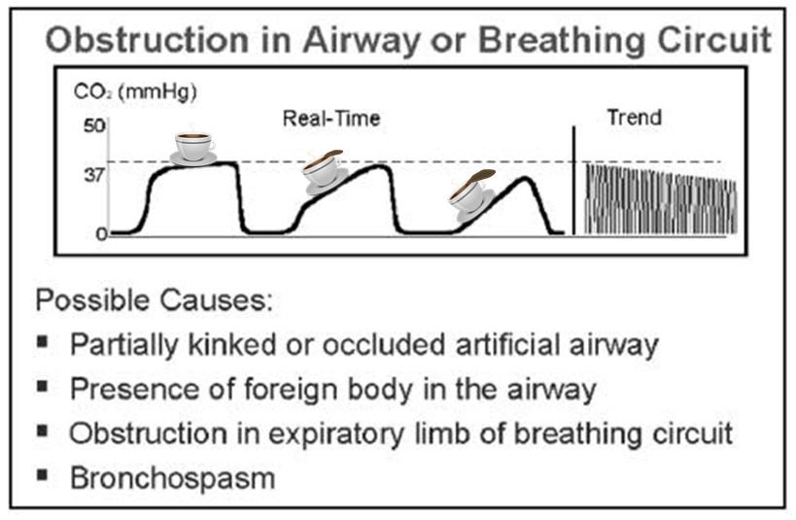
• Prolonged expiratory upstroke
• COPD
• Bronchospasm
• Upper airway obstruction.
curves show progressive slanting and prolongation of the expiratory
upstroke.
As expiration is progressively prolonged, inspiration may start before expiration is complete so that the end-tidal PCO2 reading is decreased.

Slide 49
ASTHAMA
The classic "shark's fin" shape is indicative of obstructive
diseases like asthma
Slow and uneven emptying of alveoli will cause the shape to slowly curve up resembling a shark's fin instead of the normal rectangle.
Early on the trend is likely to be a shark's fin shape with an increasing rate and lowering quantity.
• As hypoxia becomes severe and the patient begins to get exhausted, the shark's fin shape will continue, but the rate will slow and the quantity will rise as CO2 builds up.

Slide 50
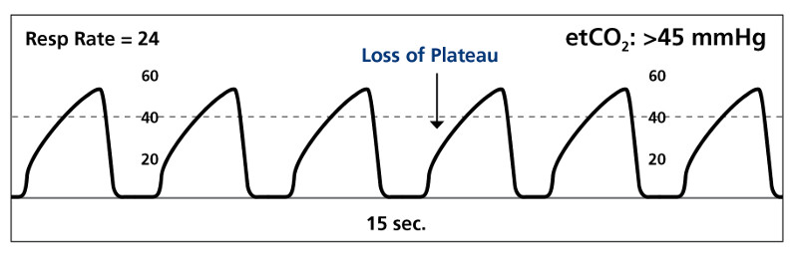
asthma

Slide 51
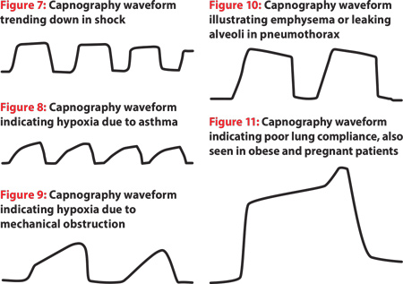
Emphysema may have so much damage to their lung tissue that the shape of their waveform may "lean in the wrong direction."
Pneumothorax won't be able to maintain the plateau of phase 3 of the EtCO2 wave. The shape will start high and then trail off as air leaks from the lung.
High on the left, lower on the right shape.

Slide 52
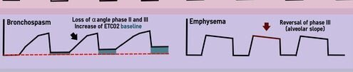

Slide 53
Contamination of sample with fresh gas or ambient air
• Occurs due to sampling site being too close to fresh gas flow inlet
• Leak in sample tube.

Slide 54
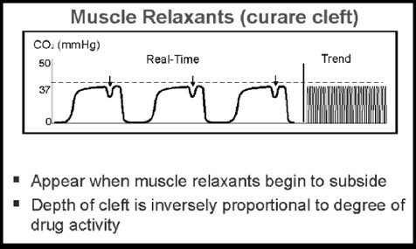
Curare cleft/notch
• Depression is last third of plateau
• Occurs if patient is spontaneously breathing
• Due to lack of synchronous action between intercostal
muscles and diaphragm
• Also seen in:
–– Flail chest
–– Hiccough
–– Pneumothorax
–– Spontaneous breaths in a patient on ventilator.

Slide 55
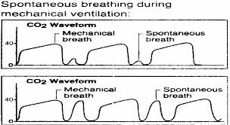
Spontaneous respiratory efforts during mechanical ventilation.
The capnogram shows small breaths at various places during expiration and inspiration.
Causes include maladjusted ventilator (hypoventilation), inadequate muscle paralysis,
severe hypoxia, or the patient waking up.
The end-tidal CO2 may rise slightly because of increasing metabolism of the contracting respiratory muscles.
This pattern may also be caused by pressure on the patient’s chest or ventilator malfunction.

Slide 56
Rebreathing with elevated base line.

Slide 57
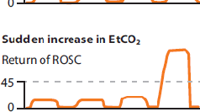
Return to spontaneous ventilation.
The first breath is typically of small volume.
Subsequent breaths show progressively higher peaks with gradual resumption of a normal waveform.

Slide 60
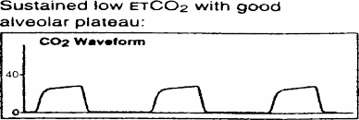
Low end-tidal CO2 with a good alveolar plateau may be the result of
hyperventilation or an increase in dead space ventilation.
Comparison of PetCO2 with PaCO2 is necessary to distinguish these two conditions

Slide 61
Oesophageal tube
A normal capnogram is the best evidence that the ETT is correctly positioned
With an esophageal tube little or no CO₂ is present

Slide 63
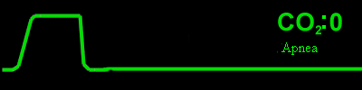
Sudden Loss of Waveform
Apnea
Airway Obstruction
Dislodged airway (esophageal)
Airway disconnection
Ventilator malfunction
Cardiac Arrest

