Slide 1
METHODS OF PAIN RELIEF
DR. DINESH CHAUHAN HEAD & Professor,
Dept.of Anaesthesia,
S.B.K.S.M.I.R.C.,Piparia

Slide 2
PAIN
Pain is an unpleasant sensory and emotional experience associated with actual and potential tissue damage, or described in terms of such damage.

Slide 3
ETIOLOGY
Physiological pain
  It is experienced when an intact, properly functioning nervous system sends signals that tissue is damaged requiring attention and proper care.
Somatic pain
  It originates in the skin, muscle, bones or connective tissue with sharp sensation.

Slide 4
Visceral pain
  It is poorly located and may have cramping, throbbing, pressing, or aching quality and is often associated with feeling sick
Neuropathic pain
  It is experienced by people with damaged or malfunctioning nerves which can be central or peripheral

Slide 5
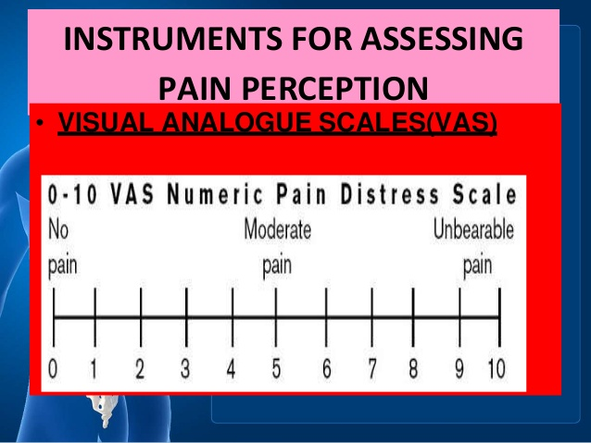

Slide 6
Classification of Pain
Acute or Chronic
Nociceptive or neuropathic

Slide 7
Effects of pain
Tachycardia
Diaphoresis
Increased blood sugar levels
Dilatation of pupils
Decreased GI motility
Increased muscle tension
Tachypnea

Slide 8
Management of pain
It is broadly divided into
  Acute pain management(primarily deals with patient recovering from surgery or with acute medical conditions mostly due to nociception)
  Chronic pain management (includes diverse group of patients always seen in out patient setup)

Slide 9
Acute pain management
Perioperative period
  Preoperative
  Intraoperative
  Postoperative

Slide 10
Modalities of Pain management
Systemic opioids
Nonopioid analgesics
Patient controlled analgesia
Regional analgesic techniques

Slide 11
Systemic opioids
Technique | Examples | Advantages | Disadvantages
Systemic opioidsª | Staff-administered intramuscular (IM) injections | None noted | Pain on injection Tissue damage
 | Staff-administered intravenous injections | Similar pain control to PCA | Peak / trough opioid adverse drug reactions (ADRs)
 | PCA without background infusion | Improved pain scores vs IM | None noted
 | PCA with background infusion | Improved pain scores vs IM | Increased analgesic use vs no background
Examples of opioids include morphine, fentanyl, hydromorphone

Slide 12
Nonopiod analgesics
Technique | Examples | Advantages | Disadvantages
Nonopioid systemic analgesics | Acetaminophen (oral, rectal, injectable) | Similar benefit to intravenous (IV) PCA opioid Fewer ADRs | None noted
 | Injectable NSAIDs | Improved pain scores Reduced analgesic use | NSAID risks / ADRs
 | Oral NSAIDs (both non- and selective | None noted | NSAID risks / ADRs
 | Gabapentinoids (both gabapentin and pregabalin) | When combined w/ opioids Improved pain scores Reduced analgesic use | None noted

Slide 13
Regional Analgesia
Technique | Examples | Advantages | Disadvantages
Central Regional Analgesia | Intrathecal or epidural opioidª | Improved pain relief | Increased frequency of pruritus
 | Epidural opioidª + local anesthetic^{b} | Improved pain scores | Increased motor weakness
 | Epidural opioidª + clonidine | None noted | None noted

Slide 14
Technique | Examples | Advantages | Disadvantages
Peripheral Regional Analgesia | Peripheral nerve blocks^{b} | Generally, improved pain relief and lower analgesic consumption compared with saline | None noted
 | Intra-articular blocks^{b} or opioidsª | None noted compared with saline | None noted
 | Infiltration of incisions^{b} | Generally, improved pain relief and lower analgesic consumption compared with saline | None noted
ª Examples of opioids include morphine, fentanyl, sufentanil
^{b} Examples of local anesthetics include bupivacaine, ropivacaine

Slide 15
Patient controlled analgesia
Patients are able to self administer precise dose of opioids intravenously or in epidural space on and as needed basis.
The physician programs the infusion pump to deliver a specific dose , the minimal interval between doses and maximum amount of opioids to be given in a period
It is a cost effective technique provides superior analgesia and drug consumption is less

Slide 16
Most adults require 2-3 mg/hr of iv morphine in first 24 -48 hrs and 1-2 mg/hr in following 36-72 hrs

Slide 17
Post operative pain management
It includes
  Epidural or intrathecal analgesia
  Single shot or peripheral nerve blockage
  Regional anaesthetic techniques like local wound infiltration
  Drugs – NSAIDS, opioids and acetaminophen

Slide 18
NSAIDS
They reduce post operative pain and decreases both opioid consumption and opioid related side effects
They act by inhibiting prostaglandin synthesis (COX)
Side effects include increase risk of GI and postoperative bleeding , decrease renal function increase risk of anastomotic leakage after colorectal surgery and impair wound healing. They also cause headache , diziness and drowsiness

Slide 19
Acetaminophen(PCM)-
There analgesic effect is 20-30% less than that of NSAIDs but its pharamacological profile is safer
Significantly reduces pain intensity and spares opioid consumption after orthopeadic and abdominal surgery

Slide 20
OPIOIDS
Opiod administration by patient control analgesia provides better pain control,greater patients satisfaction and fewer opioid side effects as compared to parentral administration
Tramadol ,a partial agonist has been assosiated with an increased incidence od PONV

Slide 21
EPIDURAL ANALGESIA
It provides excellent analgesia, blunts stress response associated with surgery , decreases post operative morbidity ,attenuates catabolism and accelerates post operative functional recovery
As compared to systemic opioid analgesia thoracic epidural analgesia provides better static and dynamic pain relief
High thoracic epidural analgesia has been introduced in patient undergoing cardiac surgery and showed an overall pulmonary complication and supraventricular arrytythmias

Slide 22
Challenges in the Management of Acute Pain
Variable response to analgesics
  Older age = more sensitivity to opioids
  Ethnicity
  Psychological issues
  Type of surgical procedure
  The use of pre-emptive analgesic techniques
  Intraoperative anesthetic techniques:
    Regional anesthetic procedures vs generaL

Slide 23
Inadequate Acute Pain Management Can Have Consequences
Chronic pain
may develop
after surgery
as a result
of complex biochemical and pathophysiological mechanisms
Clinically meaningful, severe acute postoperative
pain may be a
risk factor for the development of chronic pain
Up to 50%
of patients reportedly suffer from chronic
pain following common surgery
Effectively managing
acute pain can reduce the risk for pain progression

Slide 24
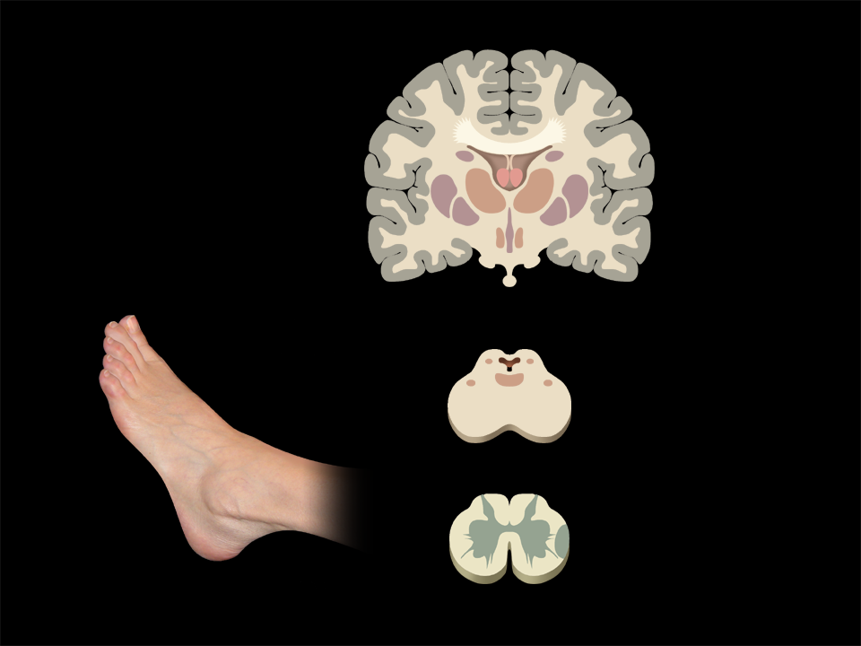




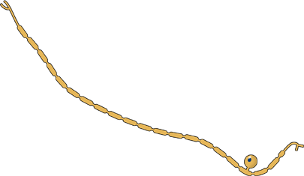

Dual Ascending Pathways
Limbic Cortex
Sensory Cortex
Thalamus
Peripheral
Nociceptor
Descending
Pathways
Ascending
Pathways
Mid Brain
Sensory
Fiber
Dorsal
Horn
Spinal Cord
Efferent
Fiber
Slide courtesy of Raymond Sinatra, MD

Slide 25




Physiological Pain
Limbic Cortex
Sensory Cortex
Thalamus
Nociceptor
Ascending
Pathways
Mid Brain
Sensory
Fiber
Dorsal
Horn
Spinal Cord
Efferent
Fiber
Slide courtesy of Raymond Sinatra, MD

Slide 26
Postoperative Pain
Treatment
Multimodal
Therapy
Opioids
α₂-Agonists
Acetaminophen
N-methyl-d-aspartate
(NMDA) antagonists
Local anesthetics (LA)
infiltration
Acetaminophen
Anti-inflammatory agents,
COX-2 inhibitor
LA via peripheral
nerve catheters
Local anesthetics
Opioids
α₂-Agonists
NMDA antagonists
COX-2 Inhibitors
Slide courtesy of Raymond Sinatra, MD and modified for educational purposes

Slide 27
Systemic Multimodal Medications – Common Adverse Drug Reactions
Class | Examples | ADR Risks | Comments
Opioids | Morphine Hydromorphone Fentanyl | Sedation Constipation Nausea / Vomiting Dizziness | Sedation may impair postoperative rehabilitation Constipation may affect time to discharge
NSAIDs (injectable) | Ketorolac Ibuprofen | GI bleeds Nephrotoxicity | May affect wound / bone healing
NSAIDs (oral, nonselective) | Ibuprofen Naproxen Diclofenac | GI bleeds Nephrotoxicity Nausea / Vomiting | May affect wound / bone healing
NSAIDs (oral, selective) | Celecoxib | Nephrotoxicity Nausea / Vomiting | May affect wound / bone healing
Acetaminophen | Acetaminophen (oral and injectable) | Hepatotoxicity at high doses | No effect on bleeding times Well tolerated
Gabapentinoids | Gabapentin Pregabalin | Dizziness Sedation | Helpful with neuropathic pain

Slide 28
Multimodal Pain Management:
Step Therapy
Step 3
Severe Postoperative Pain
Step 1 and Step 2 Strategies
AND
Local Anesthetic Peripheral Neural Blockade
(with or without catheter)
AND
Use of Sustained-release Opioid Analgesics
Step 2
Moderate Postoperative Pain
Step 1 Strategy
AND
Intermittent Doses of Opioid Analgesics
Mild Postoperative Pain
Step 1
Nonopioid Analgesic
Acetaminophen, NSAIDs, or COX-2 Selective Inhibitors
AND
Local Anesthetic Infiltration
Reprinted with permission. Copyright © 2002
American Medical Association. All rights reserved.
Crews JC. JAMA. 2002;288(5):629-632.

Slide 29
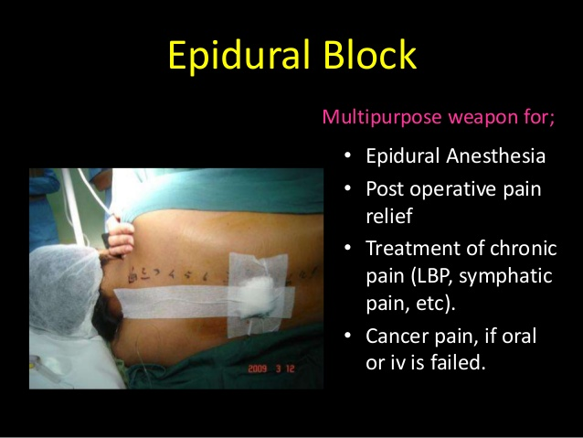

Slide 30
