Slide 1
Endotracheal tubes (ETT)
Under guidance of: Dr. Jayshri Desai
(Professor, Dept of Anaesthesia)
SBKS MI & RC, SVDU

Slide 2
Endotracheal tube (ETT)
ETT are either made of red rubber, polyvenyl chloride (PVC) or silicone.
PVC tubes are preferred as they are inexpensive, nontoxic, thermolabile transparent and are very smooth. These PVC tubes have a radio-opaque longitudinal line for visualization on the radiograph. They should be used as a use and throw device as boiling or autoclaving makes them opaque and they tend to adopt the shape in which they have been boiled of autoclaved.
ETT made of polymeric silicone are re-autoclaveble and hence reusable, They are not only expensive, but also have signifi-cantly less thermolabile property and are soft and floppy.
Red rubber tubes are seldom used today as their use is associated with more toxic reactions. Being opaque does not guarantee luminal patency and misting during exhalation cannot be observed during correct ETI. Rubber ETT is soft and springy. They can be sterilized and reused. Rubber fatigues over time and may kink.

Slide 3
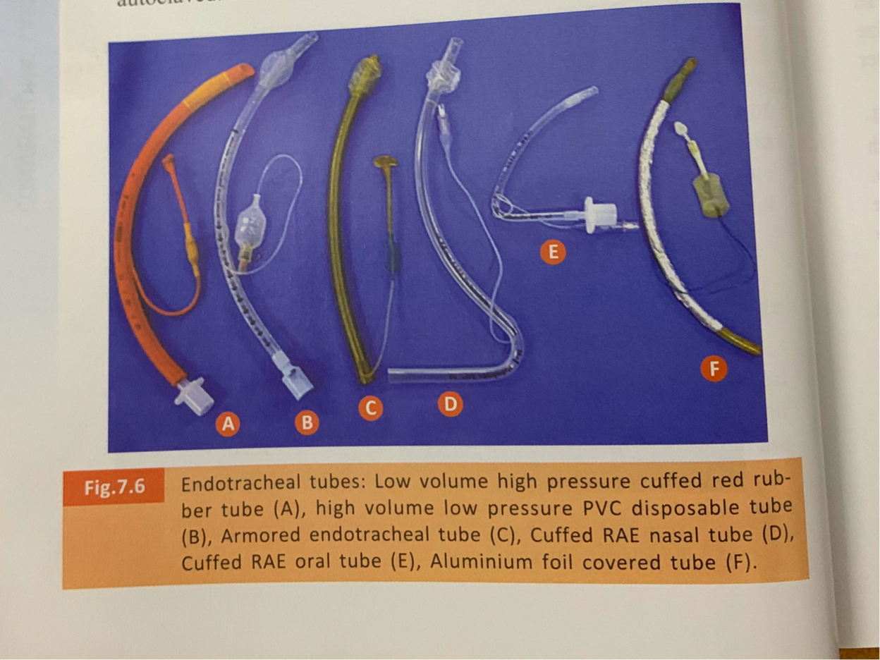

Slide 4
Special variety of ETT for use in special circumstances

Slide 5
Armored, anode, spiral embedded or re-enforced or flexometallic ETT :
These ETTs have a metal or nylon spiral wire running between inner and an outer layer of PVC, nylon or silicone. The spiral does not extend to its distal tip. The straight connector is usually bonded and is generally not removable.
These tubes generally require a stylet to give them appropriate curvature for easy tracheal intubation.
A few disadvantages of these ETTs include their inability to be shortened, absence of Murphy's eye in some of the tubes, difficult nasotracheal intubation and occasional separation of the two layers, especially if they are subjected to autoclaving.
They are available as paediatrie uncuffed version or the adult cuffed varieties. These armored tubes are easier to be placed than conventional PVC tubes during fiberoptic tracheal intubation. They are especially useful in patients having a tracheostomy or laryngectomy stoma. They are also indicated in patients undergoing cleft lip or palate repair, head and neck or neurosurgical procedures where kinking is possible with conventional ETT.

Slide 6
Ring, Adair & Elwyn (RAE) ETT
These are made of plastic and come in both plain and cuffed version.
Uncuffed RAE ETT is shorter than their cuffed version.
They have a preformed shape called either the preformed north-facing nasotracheal tube (RAE nasal) or the preformed south-facing orotracheal tube RAE oral).
These tubes are easy to secure and allow the breathing circuit to be away from the surgical field.
Some of the disadvantages of this tube are an increase in resistance to breathing, difficulty in suctioning and inability to correctly fit all patients because of their fixed lengths.

Slide 7
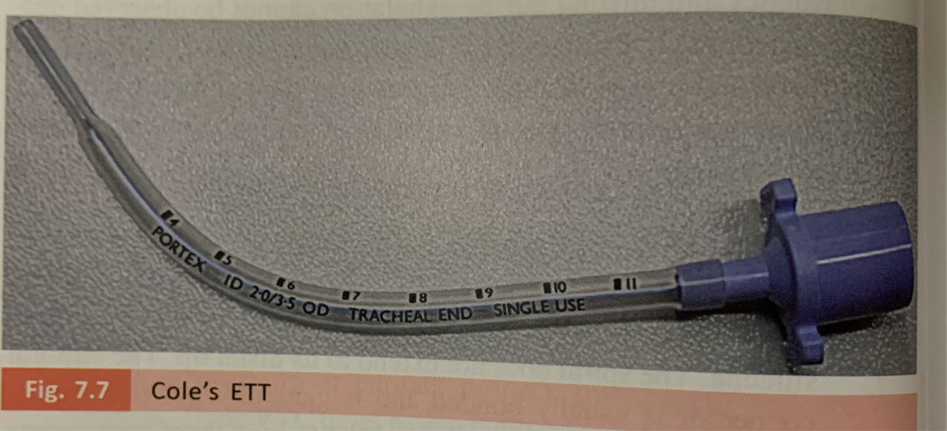
Cole’s ETT
This tube is sized by the French scale, according to the narrowed distal portion, which remains intratracheal.
This is basically used in paediatric patient.
Its use has declined in recent times.

Slide 8
ENDOTROL TRACHEAL TUBE:
These tubes have a mechanism, which enables the operator to displace the distal tip of the ETT anteriorly by pulling a loop at its proximal end. They are useful when a nasally placed ETT repeatedly enters the oesophagus and/of cervical movements are contraindicated. This ETT is available in 6. 0, 7. 0, 8. 0 and 9. 0 mm ID sizes.

Slide 9
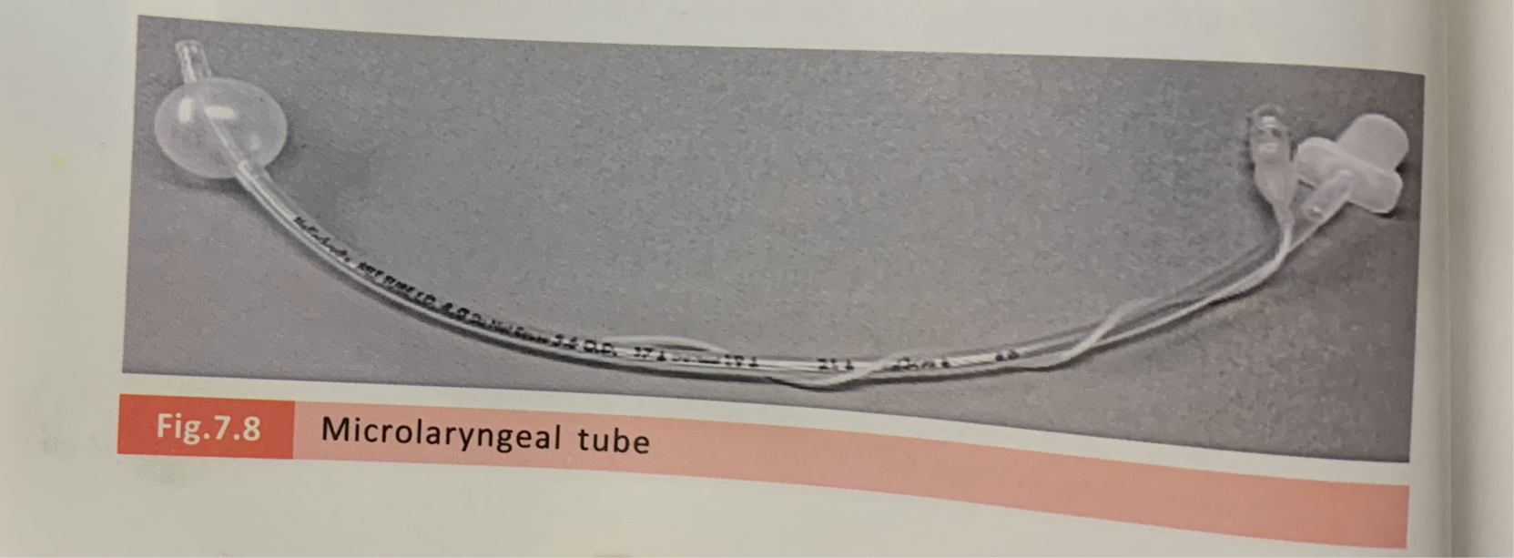
Microlaryngeal tube : This is a small tube with an internal diameter of approximately 5 mm. It has an adult size cuff. It is useful during laryngeal surgery. It permits a better surgical access to the operating surgeon.

Slide 10
Double lumen ETT:
Two varieties are currently available. The first is the older Robertshaw double-lumen tube, which is made of red rubber. It is re-usable. It is seldom used now.
The newer variant is called the Bronchocath double-lumen tube and is made of plastic. It is disposable and is more commonly used nowadays.
Their low pressure tracheal and bronchial cuff helps to minimize the risk of mucosal damage. Blue colour-coded bronchial cuff, bronchial proximal lumen and bronchial pilot balloon offers easy identification. X-ray opaque markers at the distal tip, above the bronchial cuff and at the tracheal opening aid location and verification of the tube position.
Double-lumen tubes permits selective deflation of one lung while maintaining effective ventilation of the other lung. They are mainly used during thoracic surgery.

Slide 11
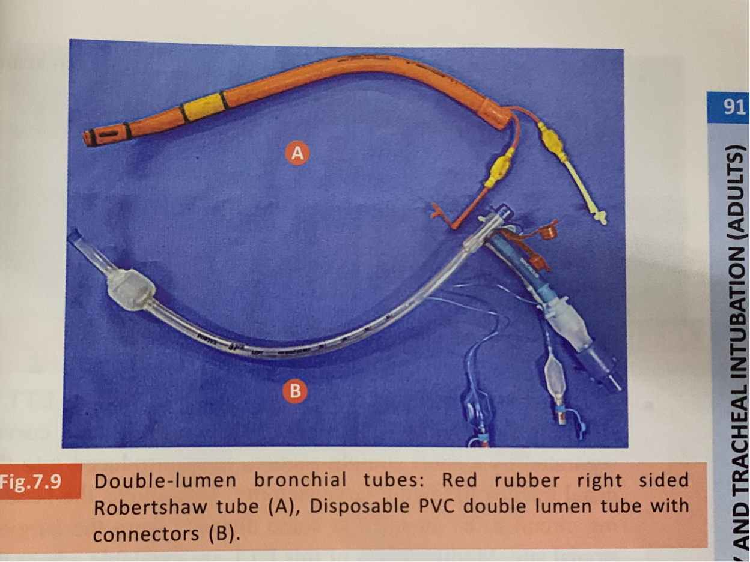

Slide 12
Laser-Flex tube:
It is a stainless steel tube with a smooth plastic surface and a matte finish. The surface of the Laser-Flex tube can reflect a laser beam. It is appropriate for use with CO2 and KTP lasers.
the wall of this tube is thicker than the regular ETT. The adult version has two pVC cuffs and a PVC tip. The tube has a Murphy eye. The two cuffs are inflated by using separate inflation tubes that run along the inside of the tube.
The pilot balloons with selFsealing valves are clearly marked "proximal“ and "distal." The advantage of two cuffs is that the distal cuff can be used if the proximal one is damaged by the laser.
Ideally, during laser surgery, both cuffs must be filled with isotonic saline. They have murphy eye as an added distal opening. Small uncuffed tubes are available.

Slide 13
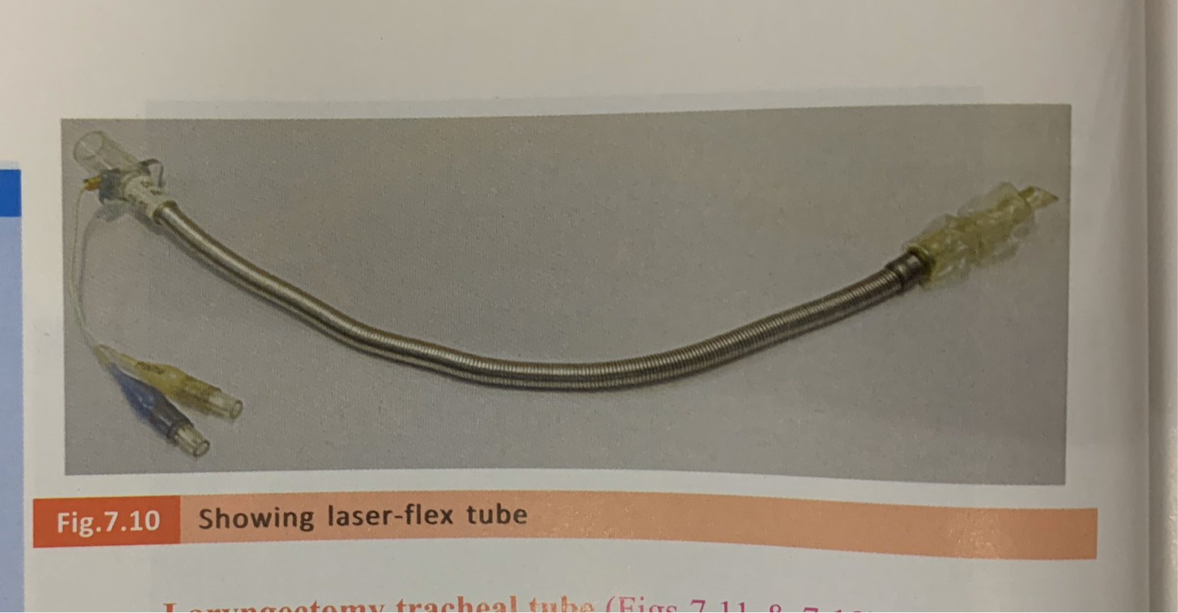

Slide 14
Laryngectomy tracheal tube
This ETT is specially designed as a J-shaped with two preformed curves separated by a short straight section.
It is introduced into the distal trachea following laryngectomy. This allows the breathing circuit to be attached at some distance from the surgical stomal site.
Modifications of this ETT are available where the laryngectomy tube has no bevel at all to prevent accidental endobronchial intubation. It is available in armored and PVCmaterial.

Slide 15
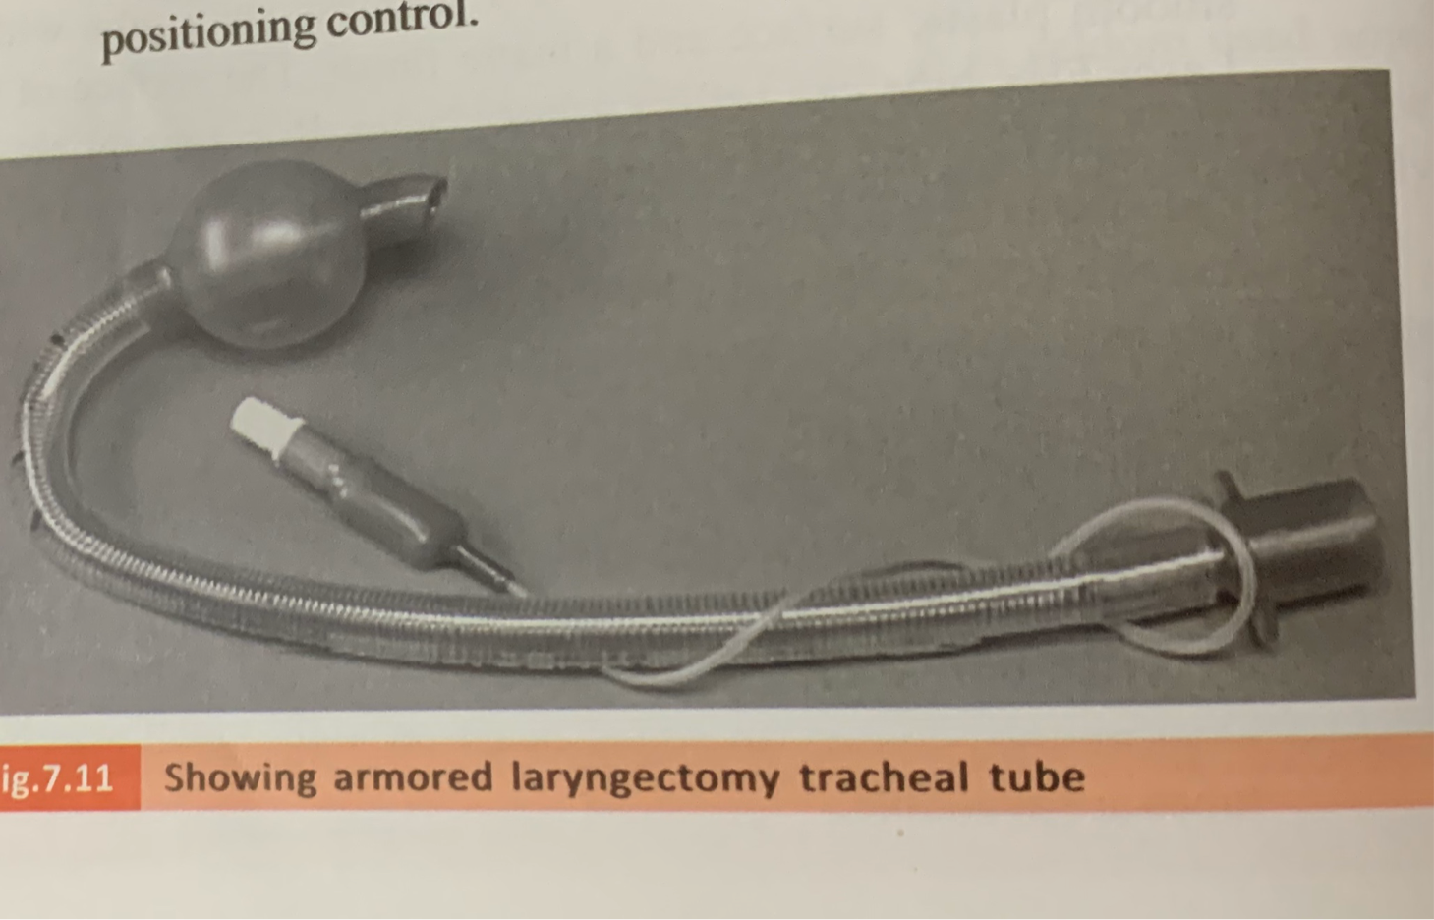
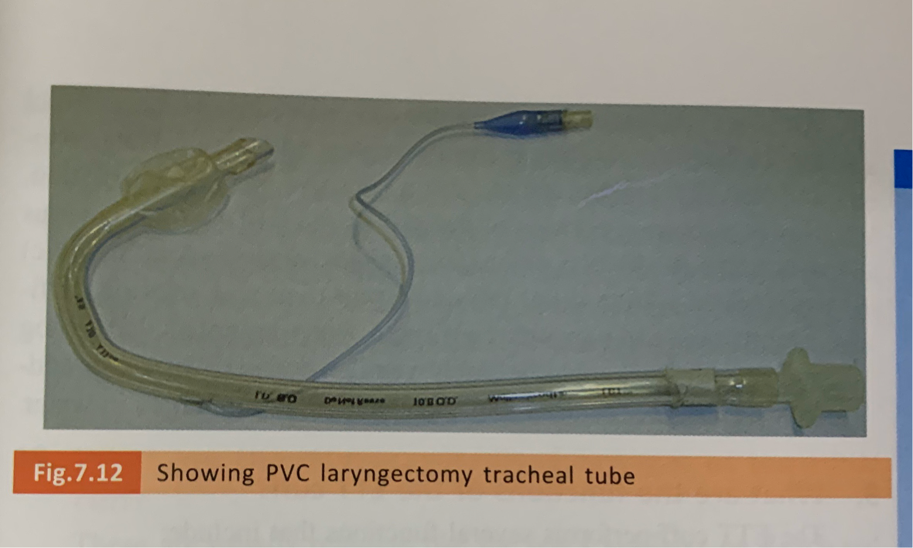

Slide 16
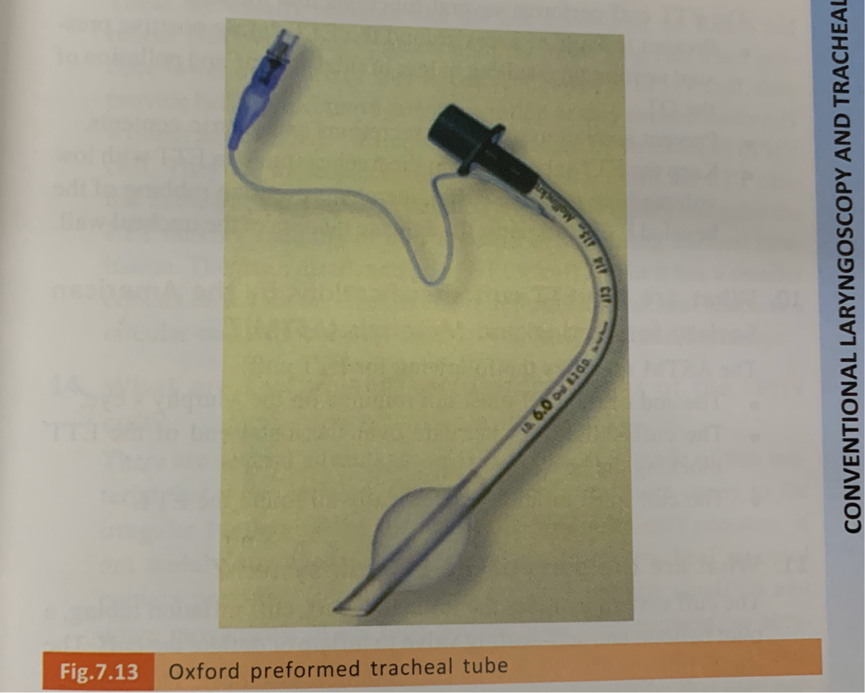
Oxford preformed tracheal tube
This is a right- angle shaped tracheal tube that reduces the risk of kinking in the oropharynx.
The beveled tip of this tracheal tube is aligned to the posterior tracheal wall, which facilitates rapid access to the trachea in emergency situation.
It is suitable for oral tracheal intubation. They have tip-to-tip X-ray line that allows for safe positioning control.

Slide 17
introduced the ETT cuff into actual clinical practice
It was Arthur Guedel who made the first ETT cuff.
However, correct position of the cuff on on the ETT was not obvious at that time & several positions (supraglottic, at glottis & infraglottic) were tested till the distal infraglottic position was selected.
Efficacy of this position was confirmed when he noted that a dog named"Airway"could be safely ventilated using Water's to-and-fro CO2 absorber canister while keeping the dog emerged in water.

Slide 18
functions of the ETT cuff
prevent leakage of gases around the ETT during positive pressure ventilation resulting in loss of tidal volume and pollution of the OT.
Prevent aspiration of blood, secretions and gastric contents.
Keep the ETT tube central in the trachea (more in ETT with low volume high pressure cuffs), thereby preventing rubbing of the beveled ETT tip against the delicate mucosa of the tracheal wall.

Slide 19
The ETT cuff specifications by the American
Society for Testing and Materials (ASTM)?
The end of the cuff must not impinge on the Murphy's eye.
The cuff should not herniate over the distal end of the ETT blocking the bevel.
The cufF must inflate symmetrically all round the ETT.

Slide 20
parts of the ETT cuff system
The cuff system includes the inflatable cuff, cuff inflation tubing, a pilot balloon and selFsealing valve to inflate or deflate the cuff. The whole thing is also known as cuff inflation assembly.
The function of the pilot balloon is to indicate whether the cuff is in an inflated or deflated state. It also gives a rough idea of pressure within the cuff.
The cuff inflation line travels partly in the wall of the ETT and portion of it is outside. The external inflation tubing should not have an outer diameter exceeding 2. 5 mm. The inflation tubing should extend at least 3 cm beyond the machine end of the ETT before a pilot balloon or inflation valve is attached.

Slide 21
conventional types of ETT cuffs
The two types of ETT cuffs are :
1)the high pressure low volume(HPLV) cuff and
2)the low pressure high volume cuff (LPHV).
The latter design is the more commonly used in clinical practice.
HPLV cuff is made of non-disposable silicone, while the LPHV cuff is made of tissue-compatible polyvinyl chloride or polyurethane.
Current example of HPLV cuff is the ETT that comes with the intubating LMA (FastrachTm).

Slide 22
advantages/disadvantages of the HPLVcuff
These are usually reusable like the one's available on Rusch red rubber ETT and hence more economical in the long run. They produce lower incidence of sore throat.
Compared to LPHV cuff, they provide better protection against aspiration as they expand uniformly without any channels created as that produced by wrinkles of LPHV cuff.
They are more successful in keeping the tip of the ETT central in the trachea. Finally, a deflated HPLV cuff tightly snuggles the ETT making visibility of ETT and cuff better during tracheal intubation.
The main disadvantage of HPLV cuff is that it has a smaller contact area with the trachea and it deforms the tracheal shape to a circular one with pressure areas, which may become ischaemic.

Slide 23
the advantages/disadvantages of the LpHV cuff
It is made of thin material that when inflated, adopts and conforms more easily to the irregular borders of the tracheal wall. The intra-cuff pressure, if not unduly stretched, usually correlates to the tracheal mucosa contact pressure.
Redundancy of the cuff permits small up and down movements of the tube without tube displacement, so abrasive movement of the cuff against the trachea is reduced.
Disadvantage includes the possibility of wrinkle formation that may permit some seepage of secretions past them and micro aspiration may take place.
In addition, the large, floppy cufF may also obscure the view at direct laryngoscopy increasing the likelihood of trauma on insertion.

Slide 24
intra-cuff pressure
we should keep the cuff-tracheal wall contact pressure below the capillary perfusion pressure.
This is possible when the intra-cuff pressure of the LpHV ETT is kept below 34 cmH20. Remember that total obstruction of the tracheal mucosal capillary blood flow occurs at a pressure of 50 cm H20.
The consensus regarding acceptable intra-cuff pressure is to keep it between 25-40 cm H20 in adults.
When using N20, one should check the cuff pressure at regular intervals as it diffuses across the cuff wall and may increase pressure with the greatest changes occurring after the first hour.

Slide 25
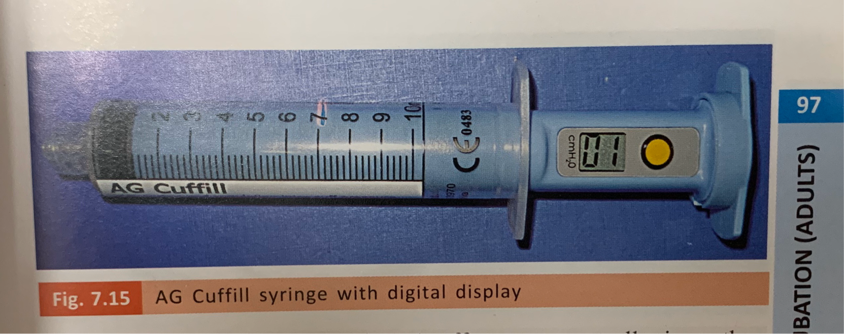
How should one assess the intracuff pressure???
tactile feel of the cuff. This can be fallacious and inaccurate.
Simpler devices are available such as the digital syringe called AG Cuffill that gives digital display of cuff pressure, They are recommended for 100 uses.
Other variants are the PressureEasy® Cuff Pressure controller that is designed to continuously monitor tracheal cuff pressure.
Intellicuff® integrated cuff pressure controller is another option that provides continuous real-time monitoring and control of optimal cuff pressure during the entire ventilation period in the ICUs and critical care areas, especially when cuffed tracheal tubes are used for longer duration.
They help to prevent ventilator associated pneumonia (VAP) and tracheal injuries.

Slide 26
strategies to prevent high ETT cuff pressure?
The most common method is to employ the manual cuff pressure gauge when inflating the cuff to maintain cuff pressure in the range of 25-40 cmH O.
In contrast to this method, one may employ ETT incorporated,with either the Lanz or Brandt system. In the ETT with Lanz pilot balloon, a syringe is used to fill the Lanz system pilot balloon with about 40 mL of air. This brings the cuff pressure between 30-34 cmH 2 0. After removing the syringe, the Lanz system pilot balloon automatically maintains cuff pressure below 34 cmH 2 0 due to the built-in control valve.
In contrast, the Brandt system limits the rise in intra-cuff pressure caused by the diffusion of nitrous oxide into the ETT cuff during general anaesthesia. The Brandt pilot balloon allows rediffusion of N20, which helps to maintain a low pressure cuff seal of the ETT.

Slide 27
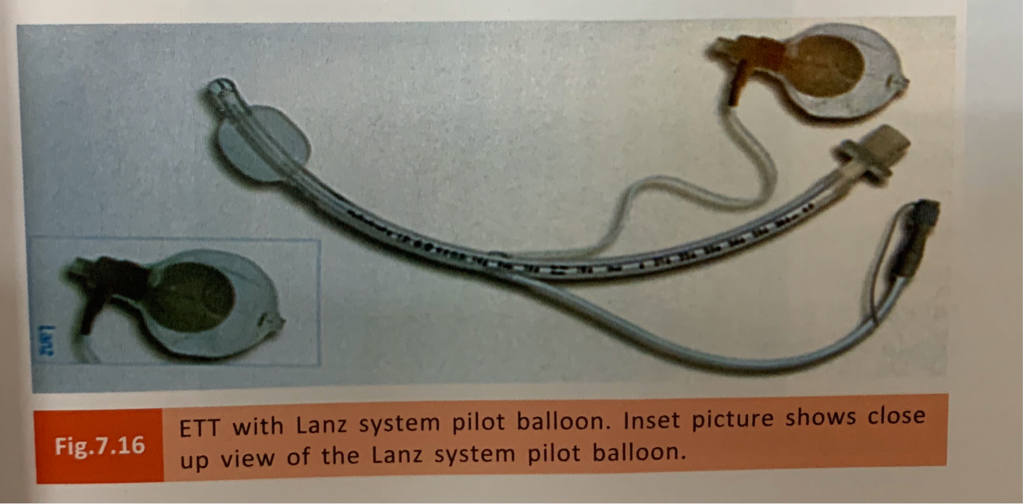
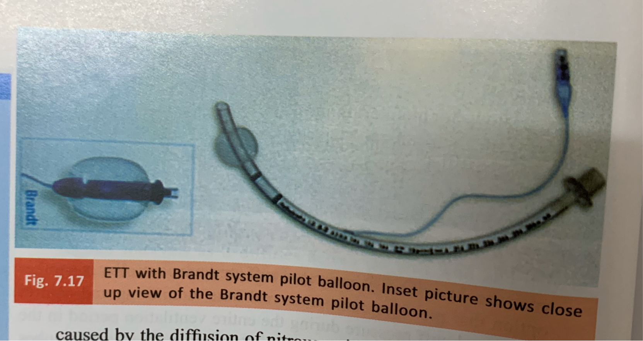

Slide 28
What is Vivasight-SL ETT?
Vivasight-SL incorporates a video camera and light source embedded in the tip of a single lumen ETT. The images from the Vivasight-SL can be viewed on its dedicated monitor or on other monitors/computers. This special tube offers several advantages over the conventional single lumen ETT.
This includes
Facilitates smooth possibly less traumatic intubation.
Ideal for simplifying endobronchial blocker placement and per-cutaneous tracheostomy.
Continuous visualization of the airway helps reduce the need for a bronchoscope.
Allows for monitoring and detection of accumulating secretions,
Gives complete airway visualization during lung isolation.
Facilitates easier detection of complications due to blocker displacement caused by patient repositioning.

Slide 29
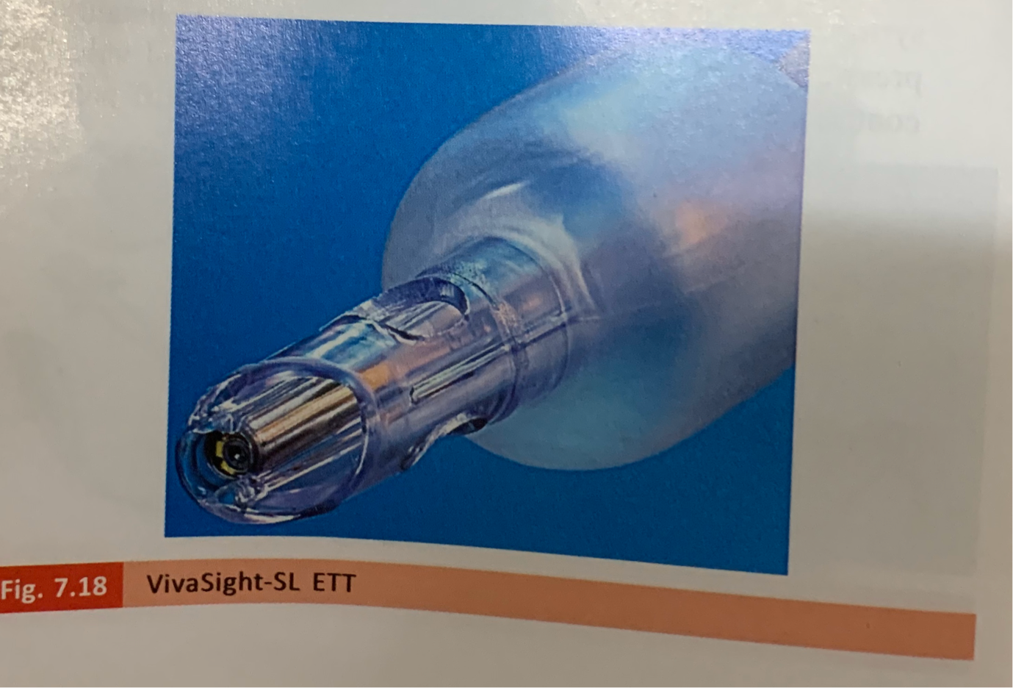

Slide 30
Thank you

