Slide 1
BREAST FEEDING
Dr. Manish Rasania
Head of Department , Paediatrics
SBKS MIRC
Vadodara

Slide 2
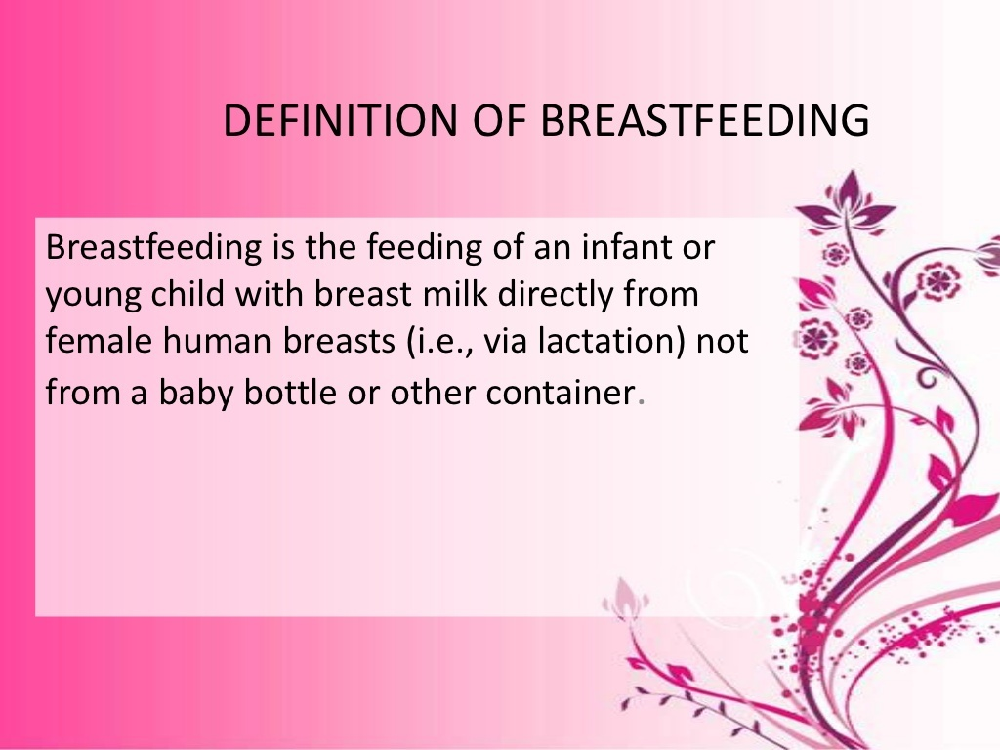

Slide 3
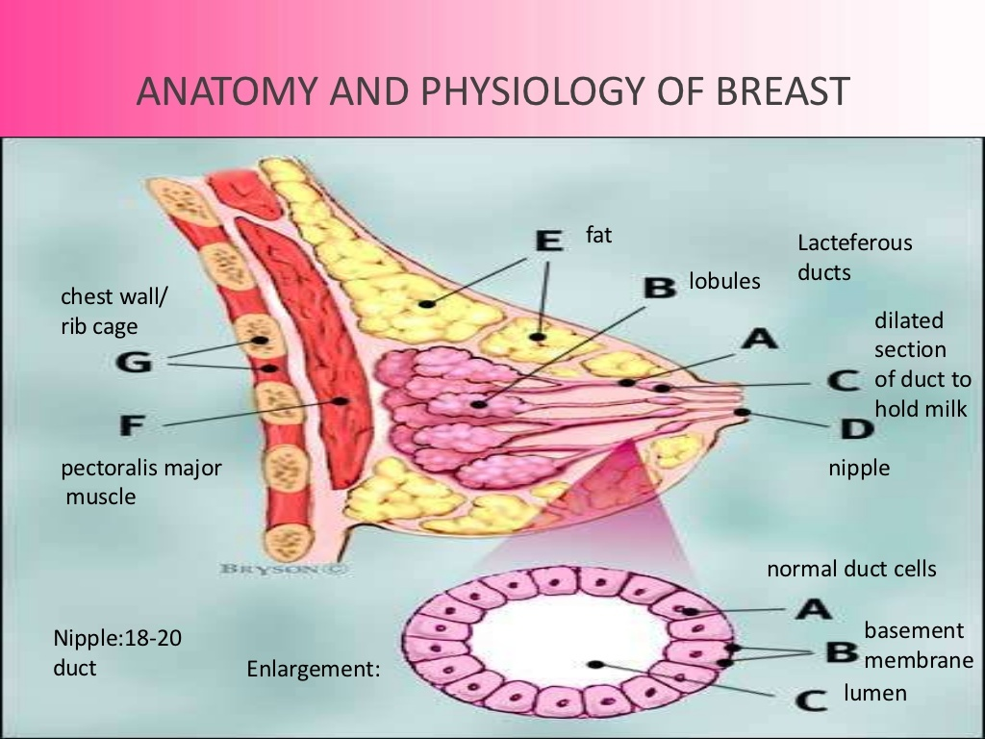

Slide 4
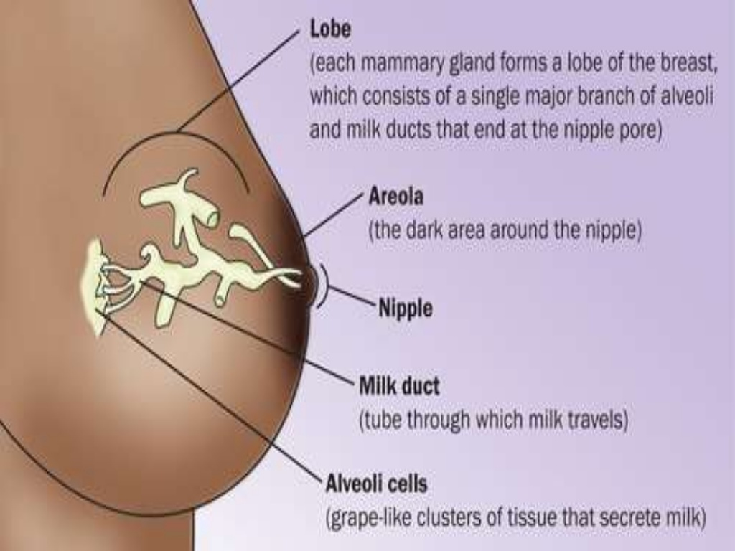

Slide 5
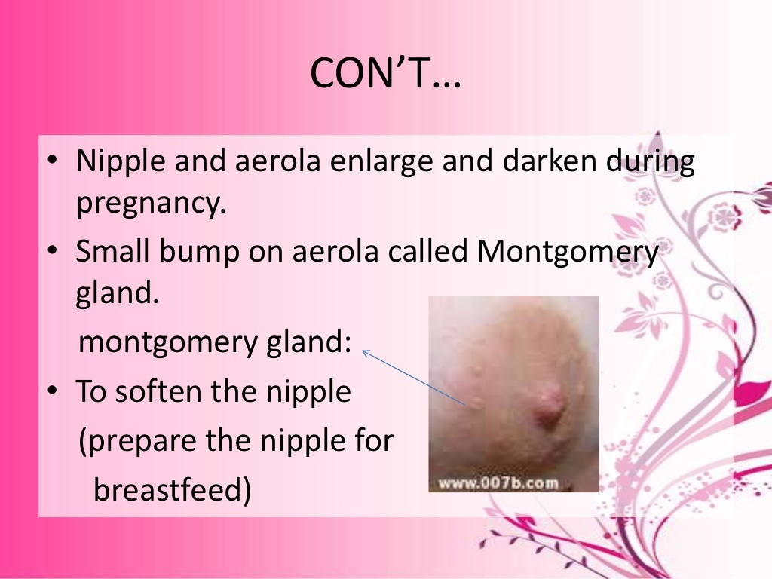

Slide 6
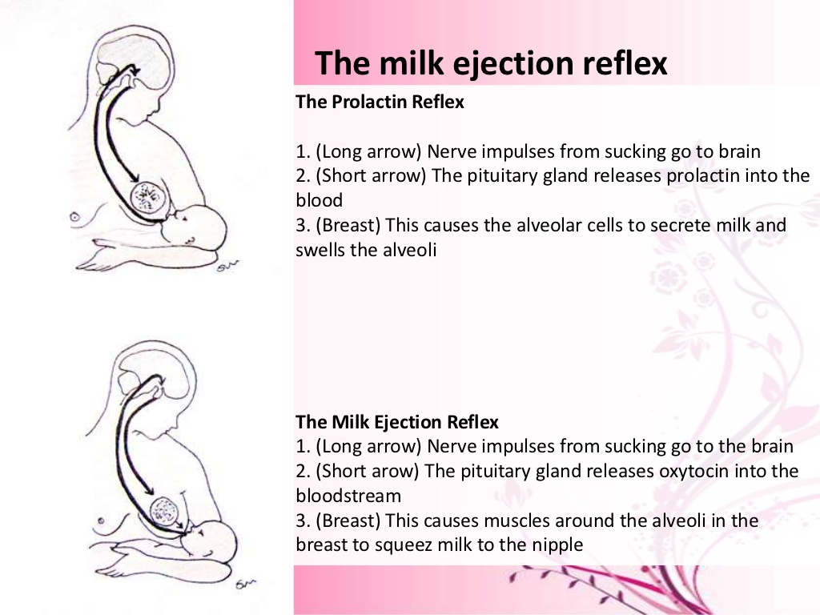

Slide 7
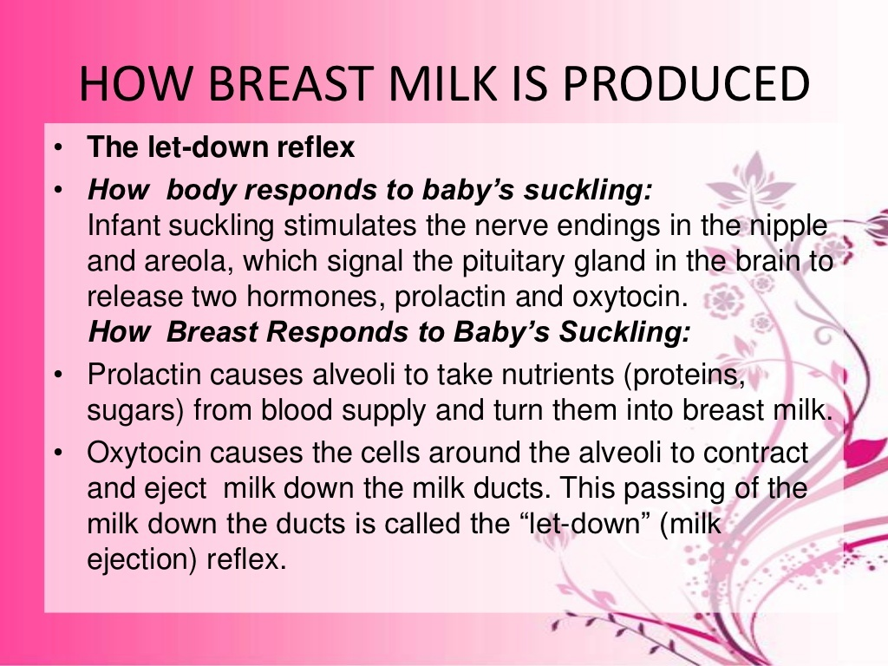

Slide 8
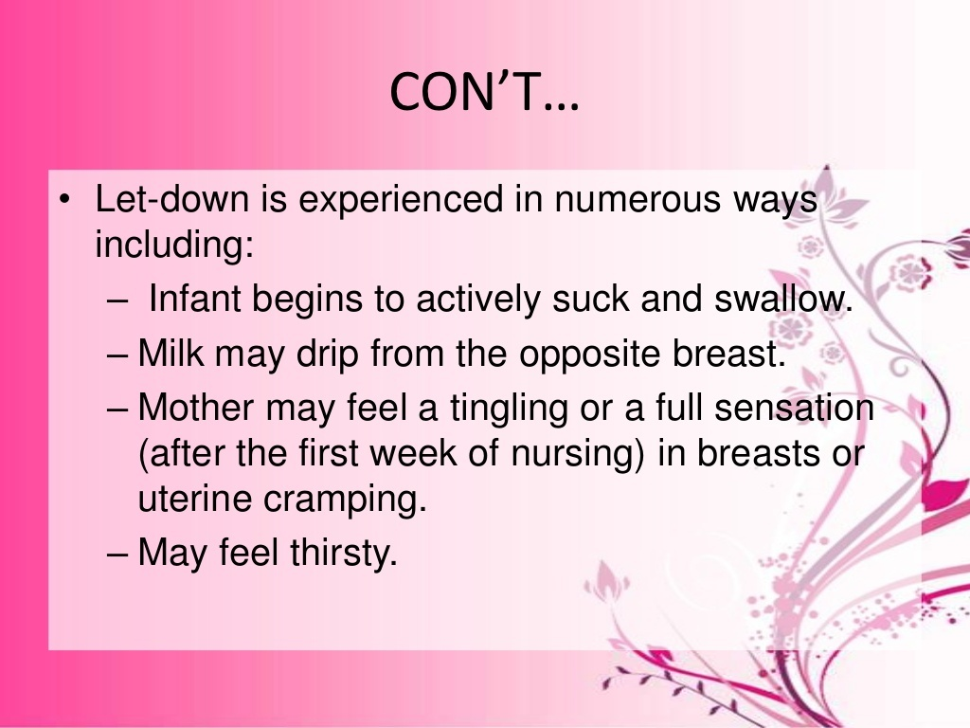

Slide 9
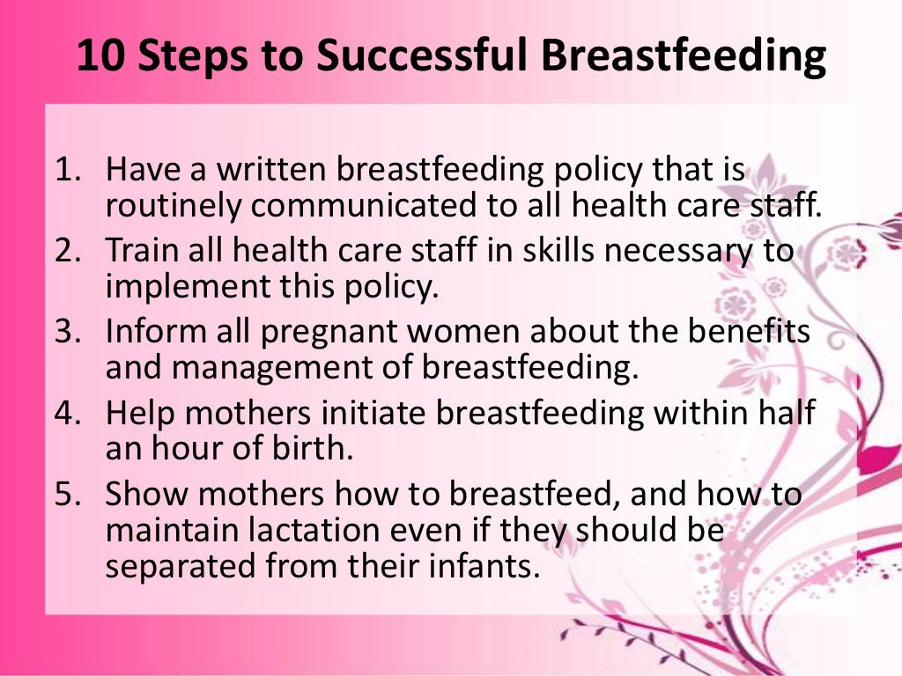

Slide 10
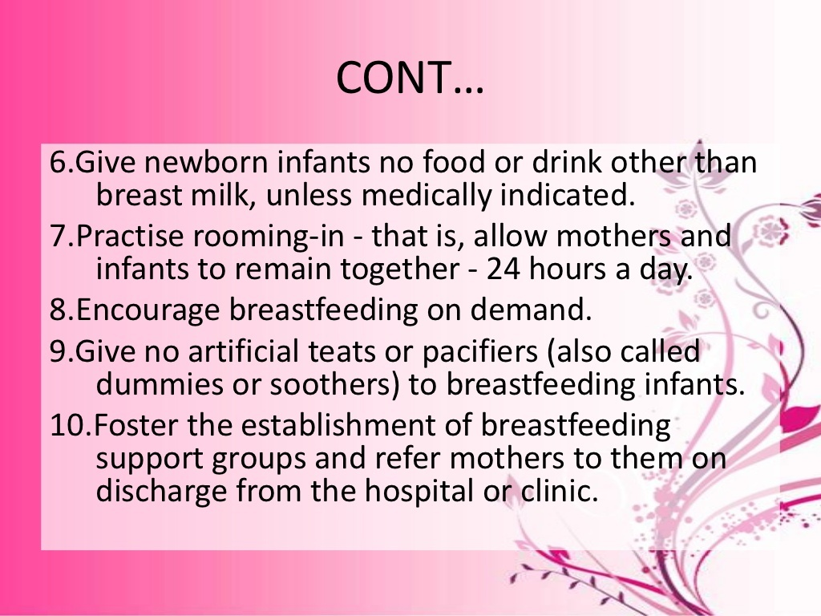

Slide 11
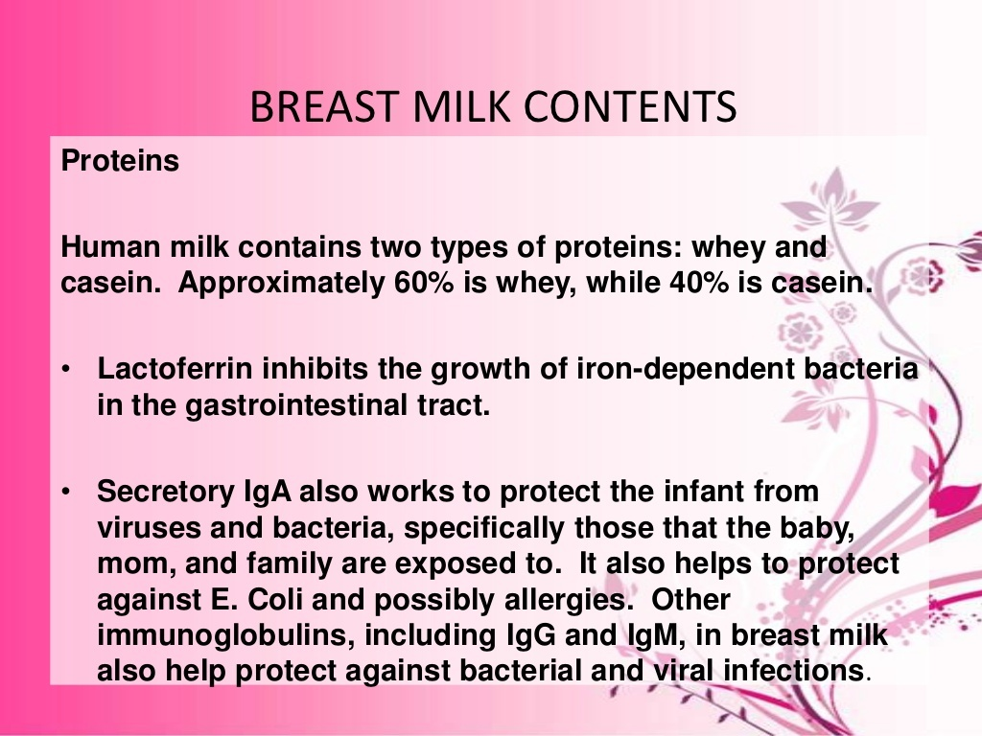

Slide 12
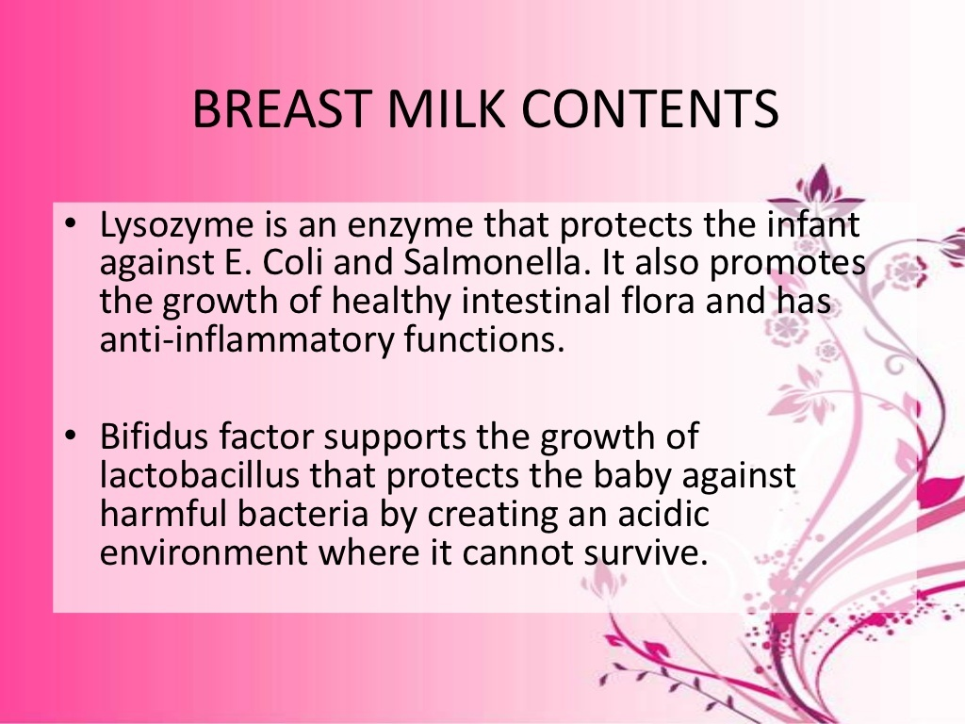

Slide 13
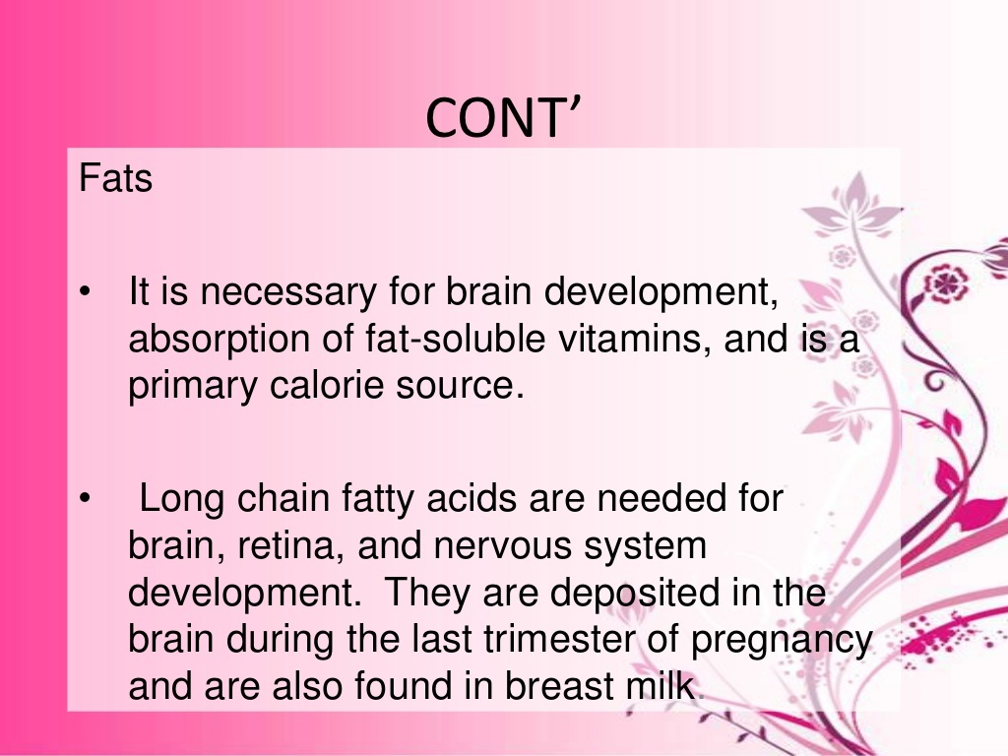

Slide 14
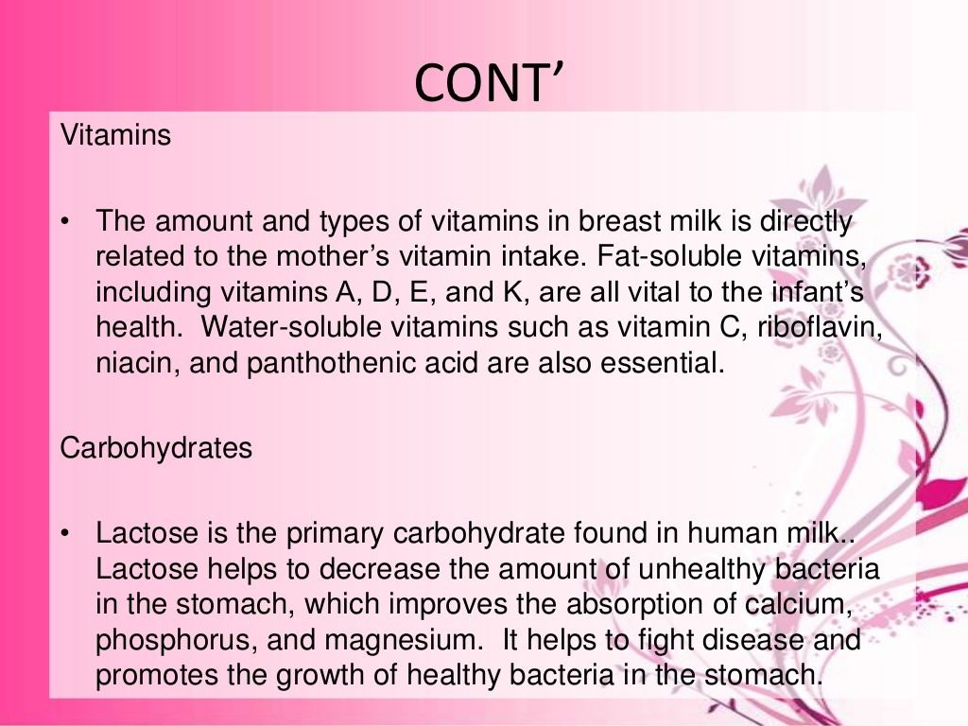

Slide 15
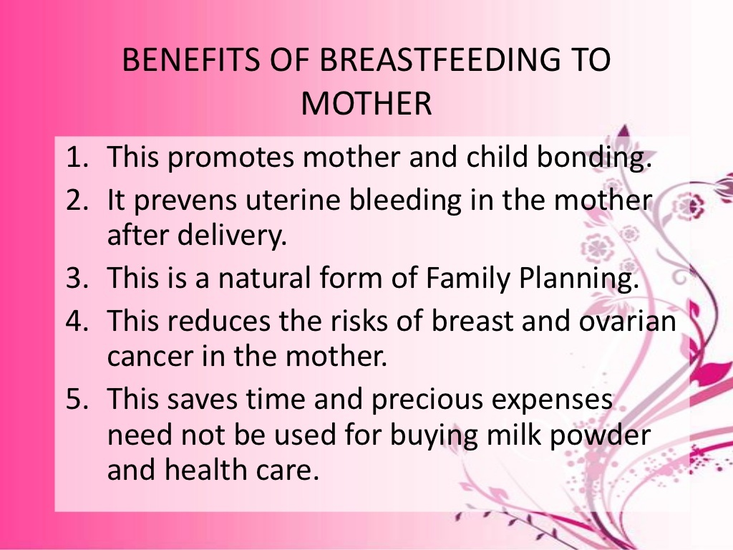

Slide 16
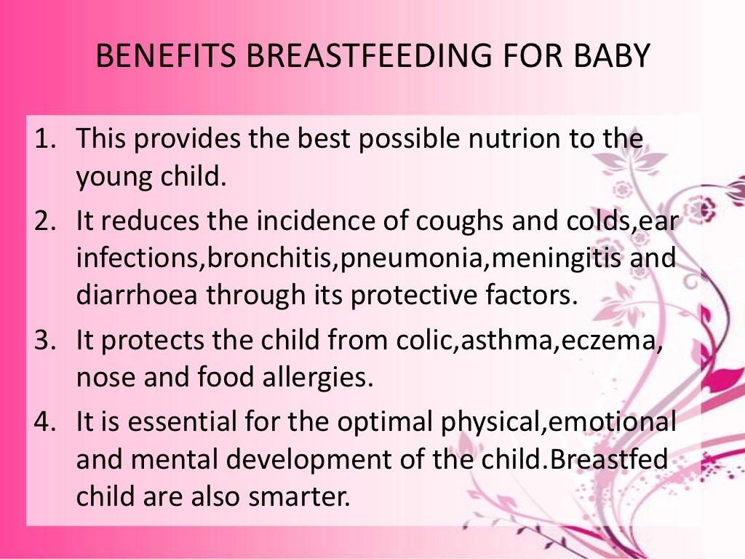

Slide 17
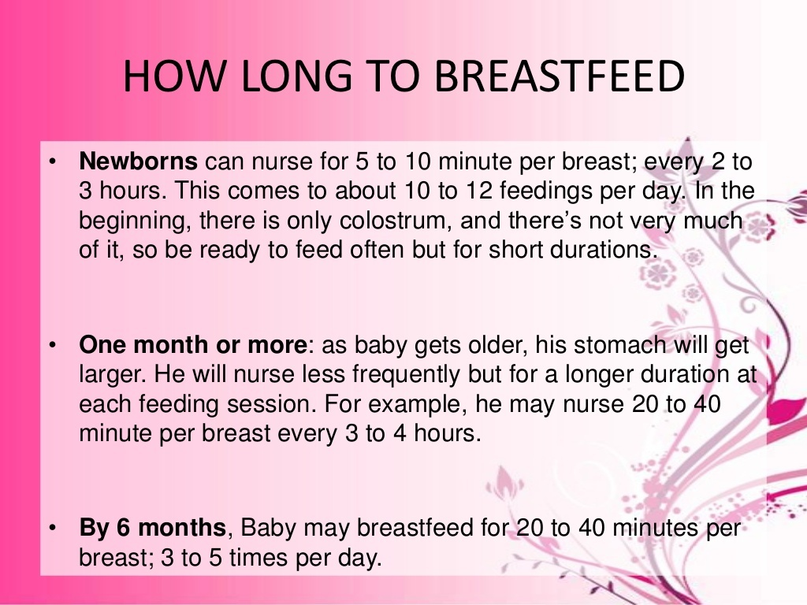

Slide 18
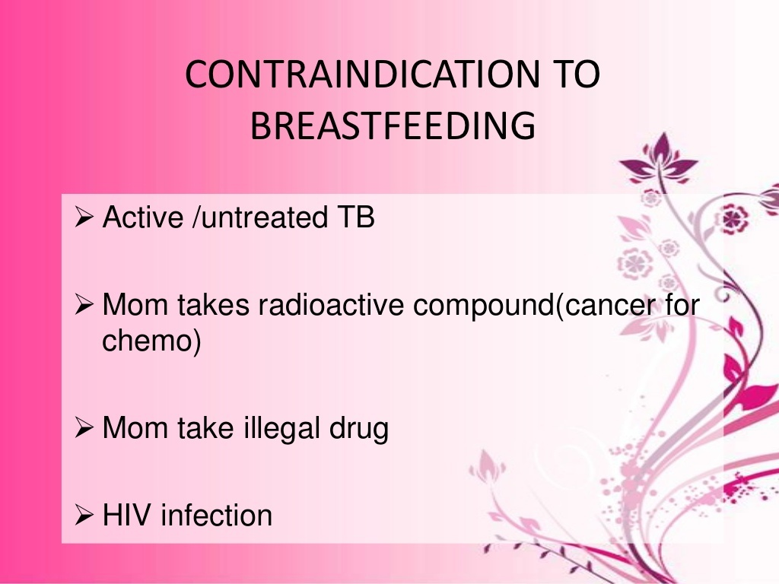

Slide 19
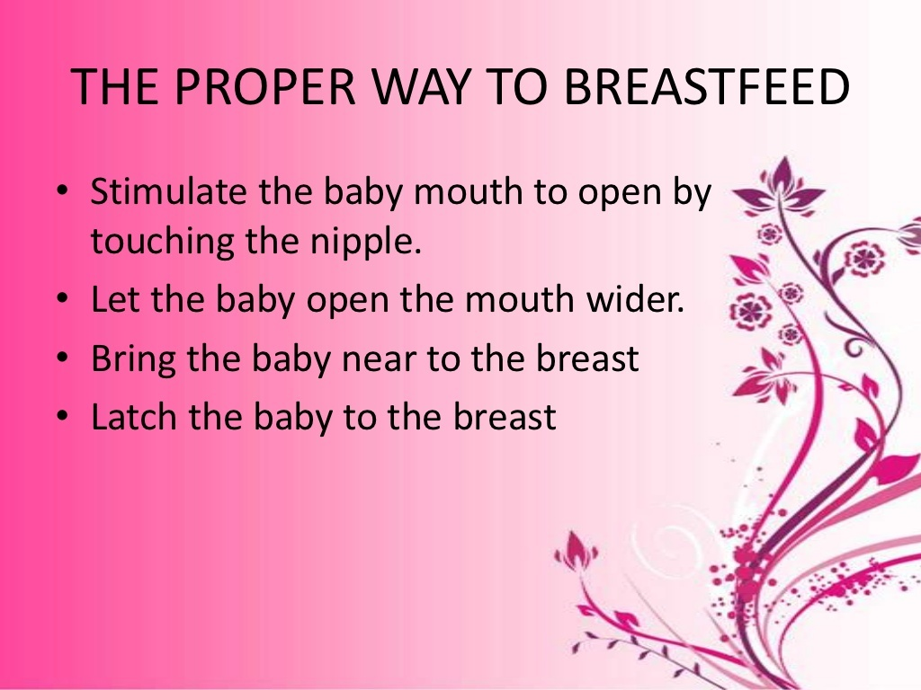

Slide 20
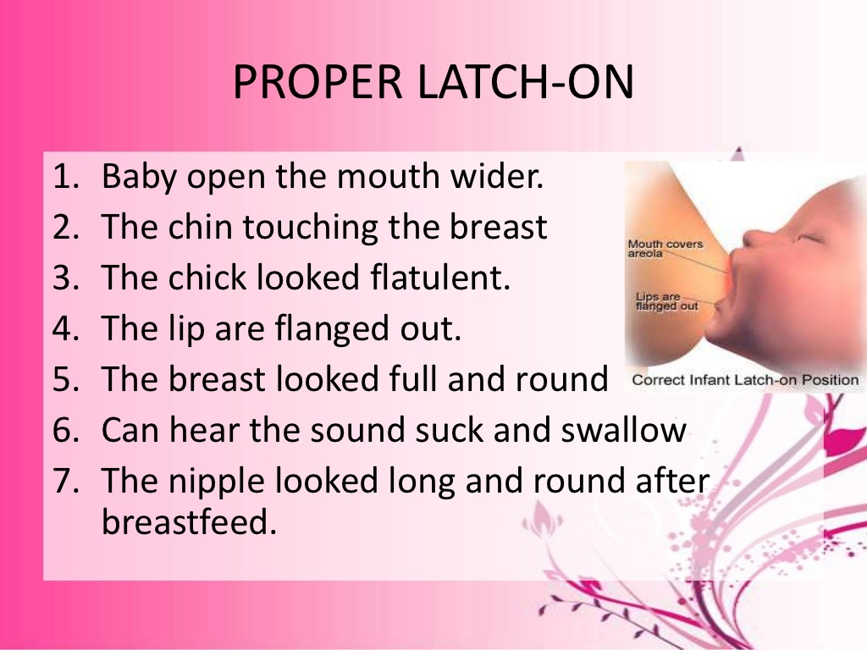

Slide 21
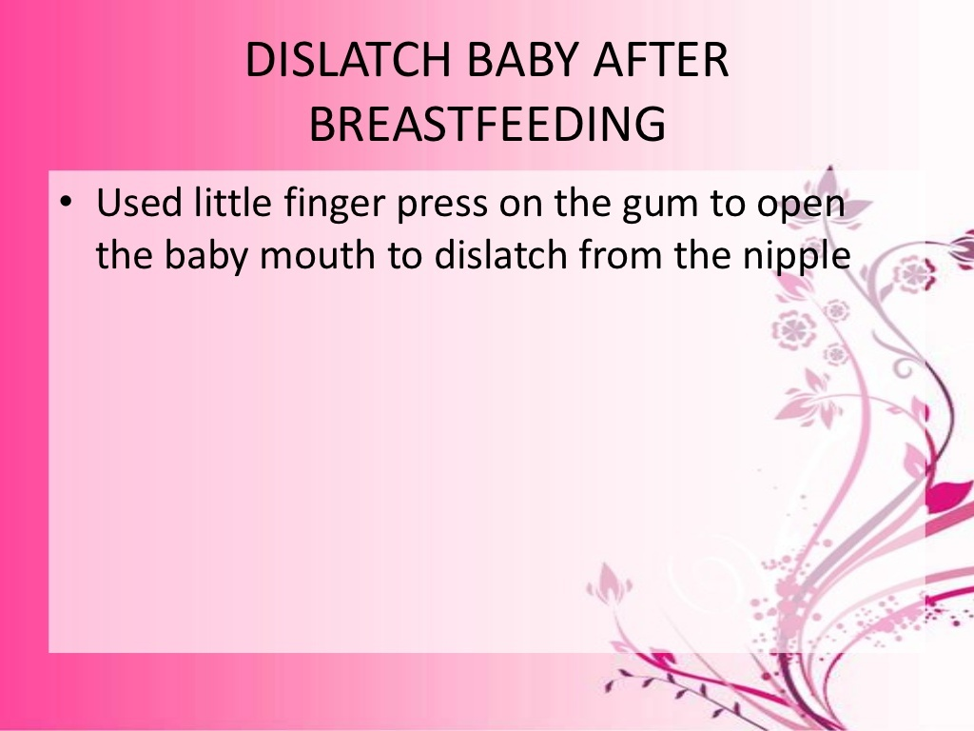

Slide 22


Slide 23
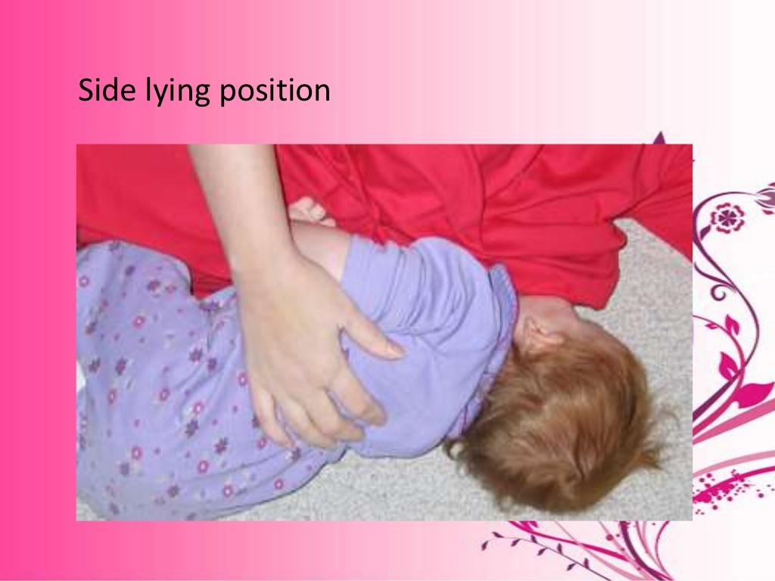

Slide 24
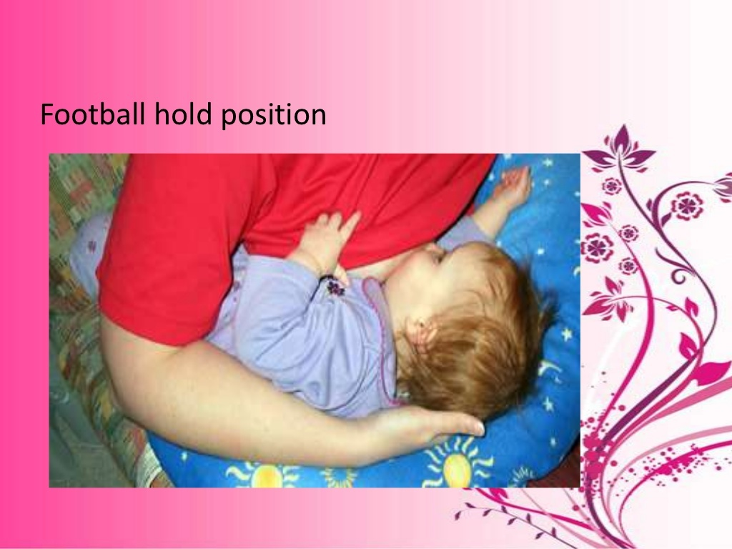

Slide 25


Slide 26
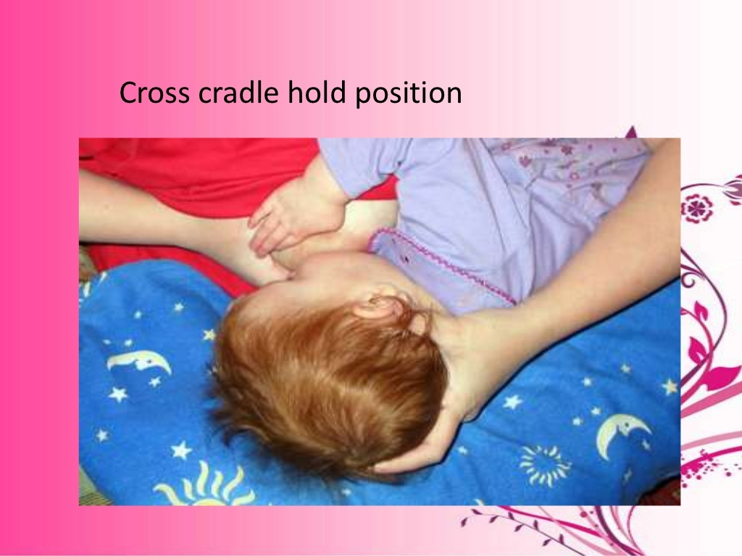

Slide 27


Slide 28


Slide 29
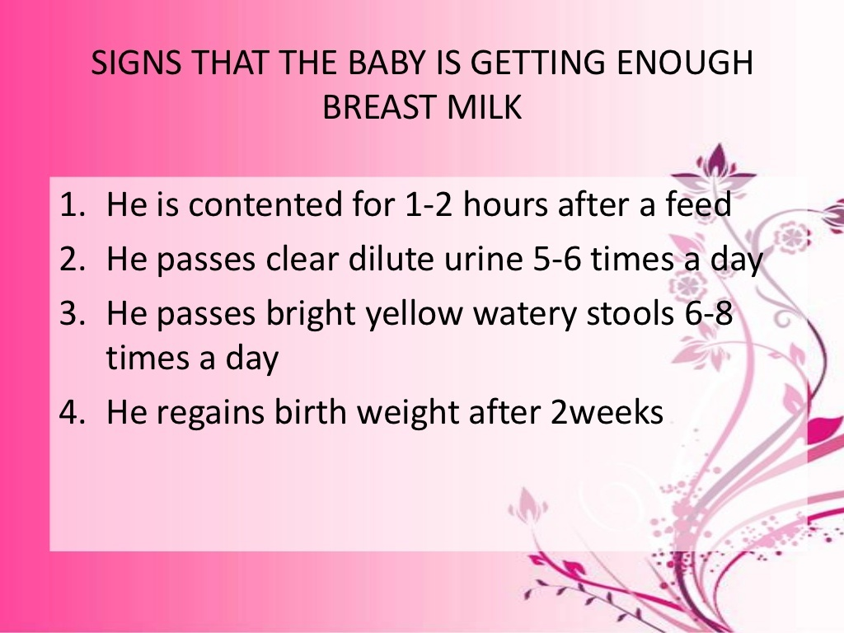

Slide 30
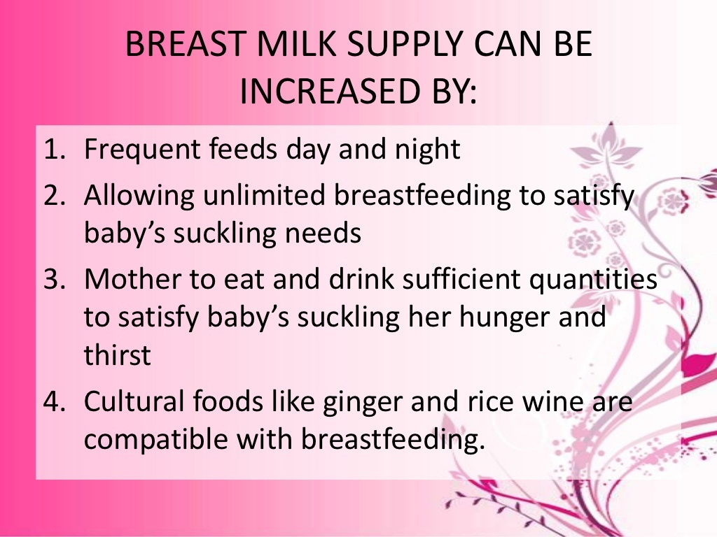

Slide 31
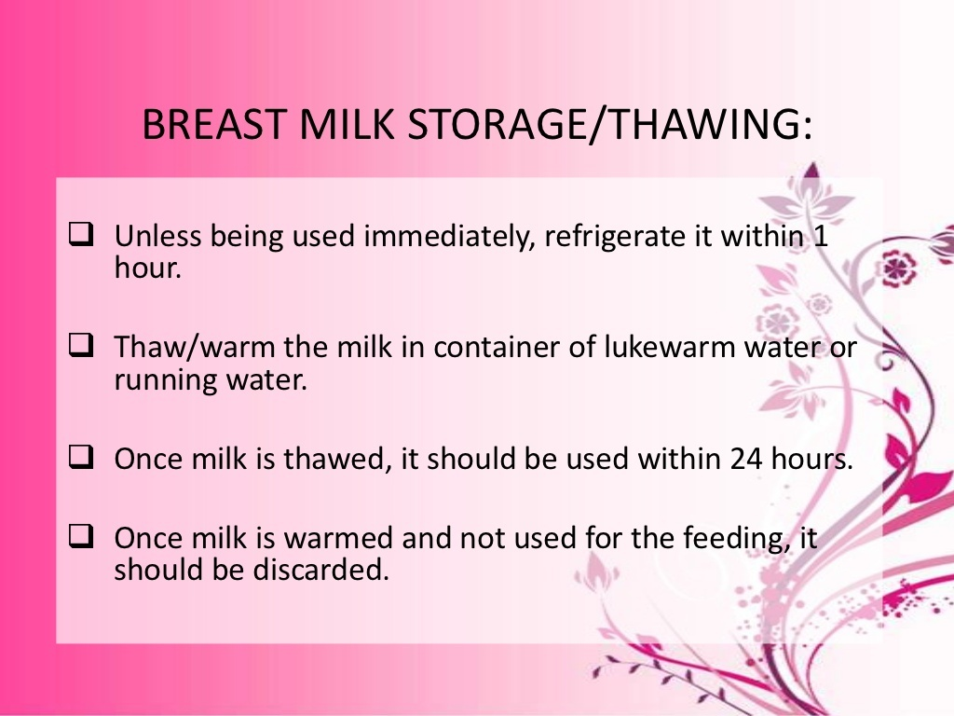

Slide 32
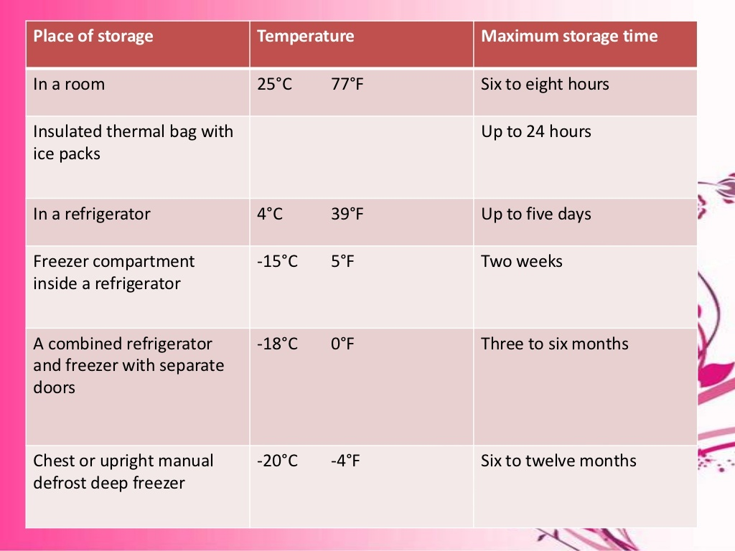

Slide 33
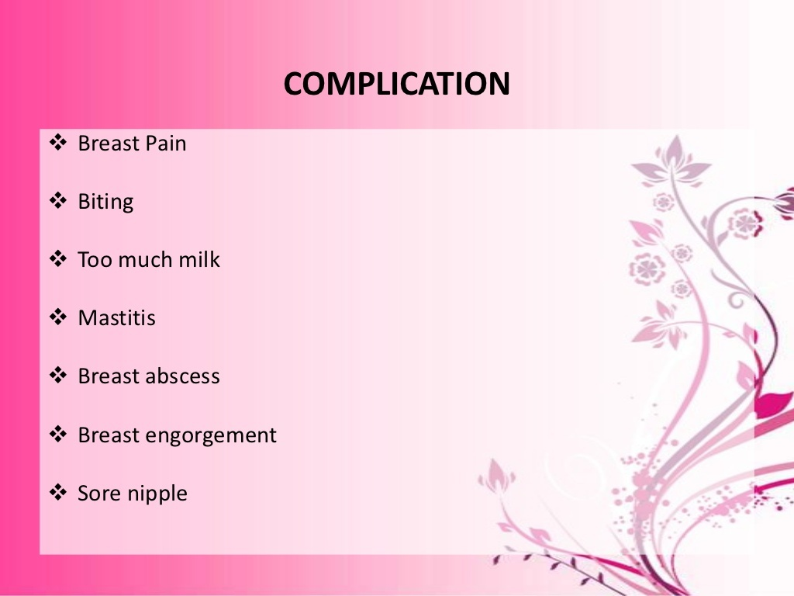

Slide 34
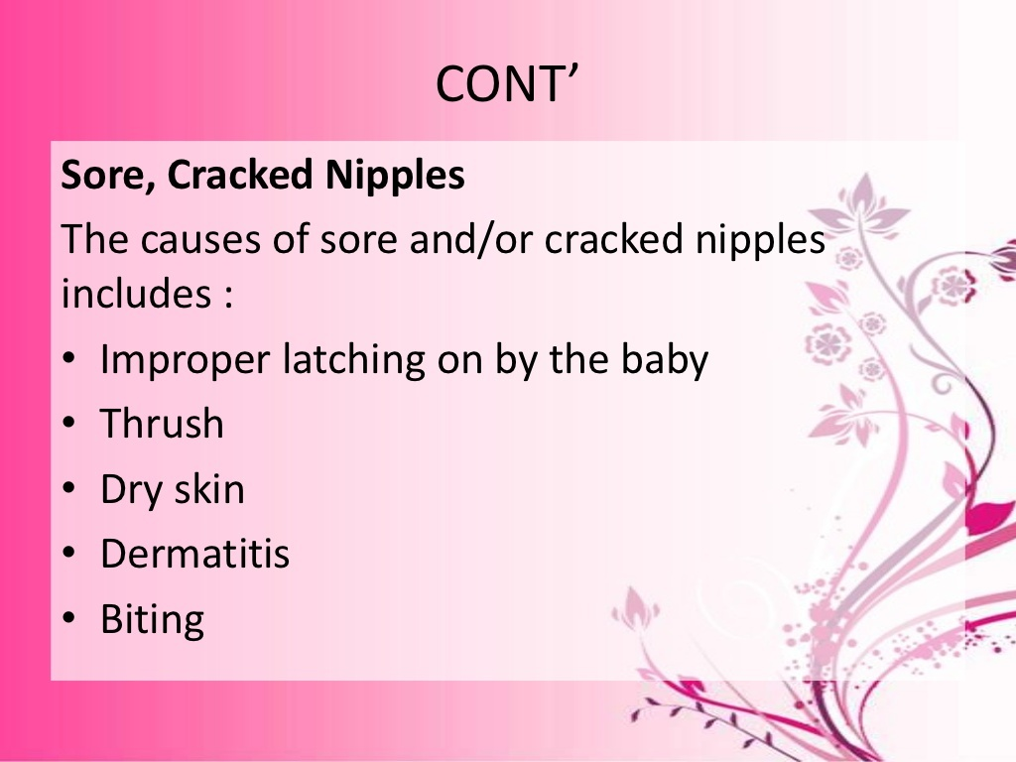

Slide 35
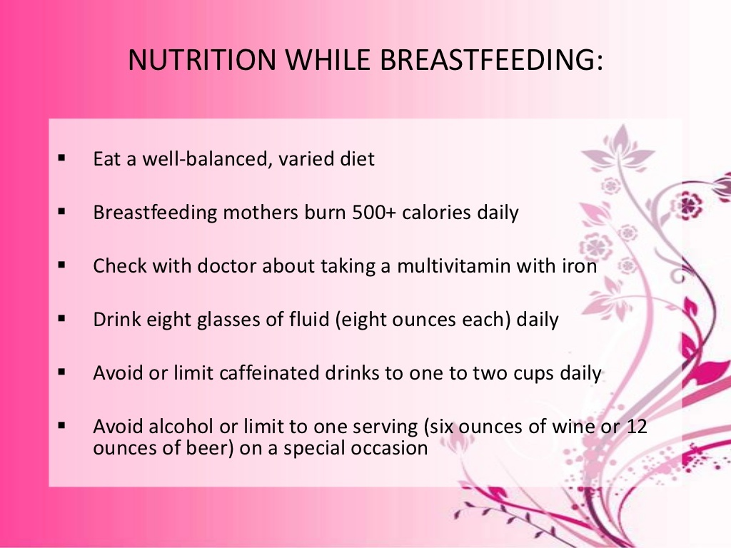

Slide 36
Author | Study design | Level | Result | outcome
Bernardo L Horta (blhorta@gmail.com), Christian Loret de Mola, Cesar G VictoraPostgraduate Program in Epidemiology, Universidade Federal de Pelotas, Pelotas, Brazil | META ANALYSIS Breastfeeding and intelligence: a systematic review and meta-analysis | 1 | We found no evidence of publication bias. Studies that controlled formaternal IQ showed a smaller benefit from breastfeeding [mean difference 2.62 points(95% confidence interval: 1.25; 3.98)]. In the meta-regression, none of the studycharacteristics explained the heterogeneity among the studies. | Breastfeeding is related to improved performance in intelligence tests. Apositive effect of breastfeeding on cognition was also observed in a randomised trial. Thissuggests that the association is causal.

Slide 37


