Slide 1
Vitamin B complex deficiency
By:
Dr .Pooja Patel
Dept of Paeditrics

Slide 2
Vitamin B complex functions as co-enzymes in several enzymatic reactions.
Lack of any one can interrupt many closely related problems and lead to diverse clinical manifestations.

Slide 3
Vitamin B1 ( Thiamine)

Slide 4
Functions
Thiamine diphosphate and pyrophosphate as cofactors for many enzymes in carbohydrate metabolism
Synthesis of neurotransmitter (GABA and Acetyl-choline)
For structure and functions of cellular membranes including neurons and neuroglia

Slide 5
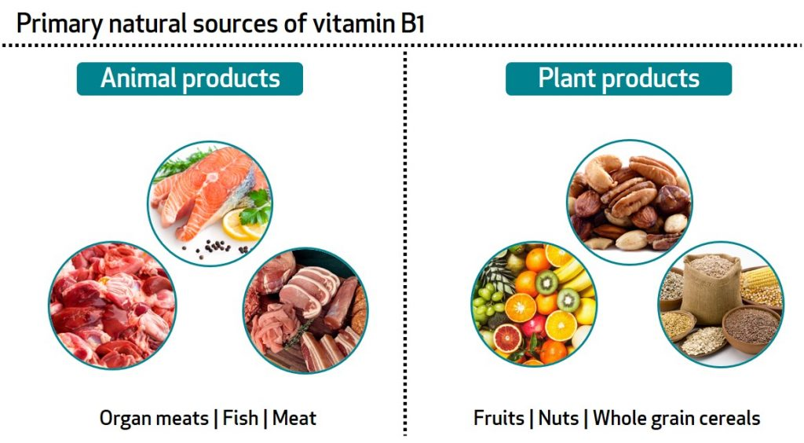
Dietary sources

Slide 6
Deficiency
Malnutrition
Consumption of diet
High contain of thiaminase (fresh water raw fish)
Anti-thiamine factors (tea, coffee)
Polished rice
Several chronic diseases (HIV, GI disease, alcoholism)

Slide 7
Clinical picture
Starts with non-specific signs
Anorexia
Nausea
Fatigue
Irritability
Apathy

Slide 8
BERI-BERI
3 types
Dry (nervous system)
Wet (cardiovascular)
infantile

Slide 9
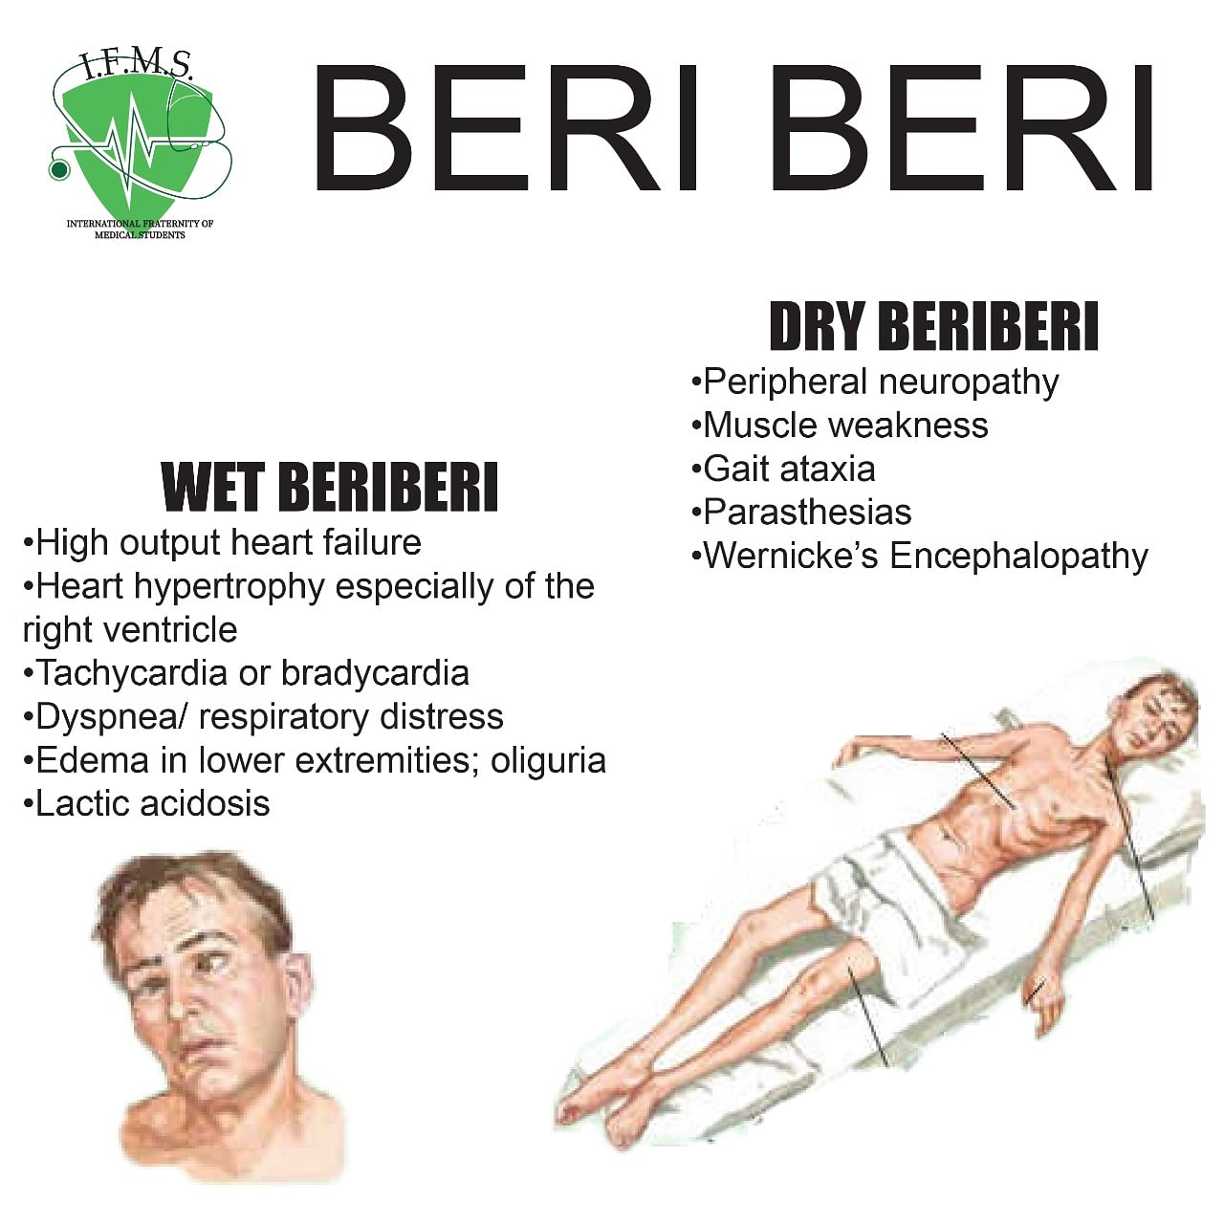

Slide 10
Infantile beri beri
Age group- 2-3 months
Fulminant cardiac failure
Cardiomegaly, tachycardia, cyanosis, dyspnoea
Aeptic meningitis
Vomiting, nystagmus, purposeless movements
Seizures with normal CSF

Slide 11
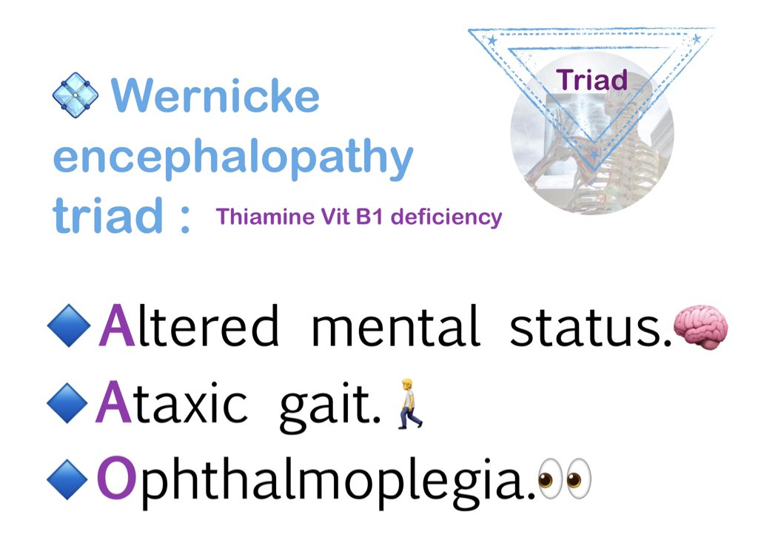
Wernicke encehalopathy

Slide 12
Treatment
Diagnosis: decreased level of RBC transketolase
Oral administration if no g.i. symptoms
In CNS/CVS involvement: 10 mg i.m. or i.v. for 1 week followed by 3-5 mg/day for 6 weeks.

Slide 13
Vitamin B2 (Riboflavin)

Slide 14
Function
Co-enzyme in many metabolic pathways and mitochondrial respiratory chain
Synthesis of all heme proteins including hemoglobin
Antioxidant

Slide 15
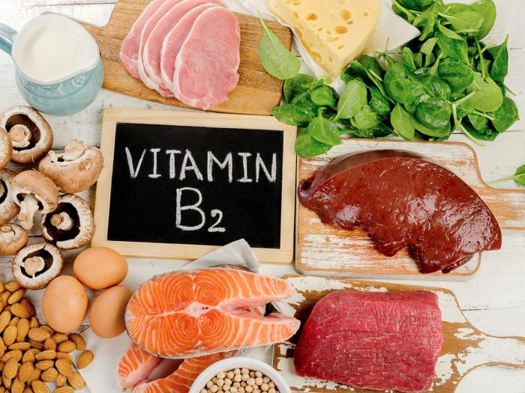
Dietary sources

Slide 16
Deficiency
Malnutrition
Malabsorption syndromes
Prolonged g.i. infections and diarrhoea
Drugs like phenothiazines , probenecid and oc pills

Slide 17
Cheilosis: starts as pallor, progresses to maceration and fissuring at angle of mouth
Glossitis
keratitis, conjunctivitis, photophobia, lacrimation
Seborrheic dermatitis
Loss of papillae leads to smooth tongue
Normochromic, normocytic anaemia

Slide 18
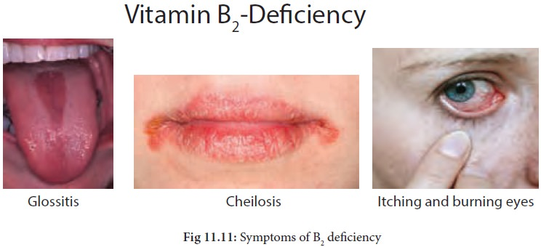

Slide 19
Treatment
Oral administration of 3-10 mg/day

Slide 20
Niacin (vitamin B3)

Slide 21
Constituent of 2 cofactors, NAD amd NADP, involved in REDOX reaction
Coenzymes for pyruvate, aminoacid, protein and fatty acid metabolism, for glycolysis, pentose biosynthesis
Role in modulation of inflammatory cascade
Functioning of skin, git and nervous system

Slide 22
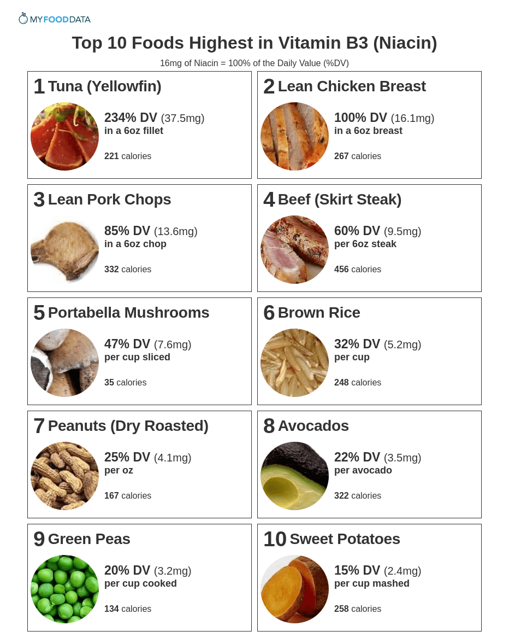
Dietary source

Slide 23
Deficiency
Anorexia
Weakness
Numbness
Dizziness

Slide 24
Pellagra
HISTORY
Pelle → skin , Agra → Sour
First discovered by Spanish Don Gasper Casal in 1735 as a disease of 3D
In 1937 discovered that pellagra is caused by niacin deficiency

Slide 25
TYPES
Primary:
results from inadequate niacin/tryptophan in the diet (when staple diet is maize)
Prolonged PN without appropriate niacin supplementation, anorexia nervosa and alcoholism
Secondary: interference with niacin absorption
Prolonged diarrhoea, ulcerative colitis, TB of GIT
HIV infection

Slide 26
The most common symptoms:
3 Ds
Diarrhoea
Dementia
dermatitis

Slide 27
Dermatits
Also known as eczema
Characterised by itching, red skin, rash
In initial stage, cutaneous lesions resembles sunburn.
Skin becomes red, blisters and blebs develop which leave dusky red-brown discolouration on healing.
In late stages, skin becomes dry, scaly and hyperkeratotic with yellow-brown hue.

Slide 28
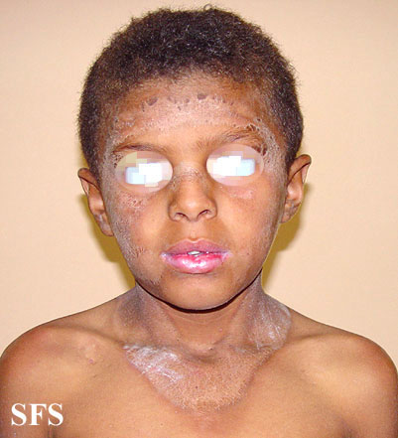
Distribution: dorsal surfaces of hand, face, neck, arms and feet.
In neck, characteristic distribution: Casal Necklace

Slide 29
Diarrhoea:
Associated with nausea, vomiting, abdominal pain and epigastric discomfort.
Dementia:
Apatheic and depressed
Later, neuropsychiatric symptoms: headache, irritability, fatigue, anxiety, confusion, delusions, hallucinations, tremors and disorientation
With progression, may become comatosed

Slide 30
Treatment
50-300 mg/day with balanced diet
Avoid sun exposure
Emolients

Slide 31
Vitamin B6 (Pyridoxine)

Slide 32
Cofactor in many enzymatic reactions related to amino acid biosynthesis and carbohydrate and fatty acid metabolism.
Pyridoxal-5-phosphate in metabolism of many neurotransmitters like dopamine, serotonin, adrenaline and GABA.
Direct effect on immune function
Role in glucose regulation

Slide 33
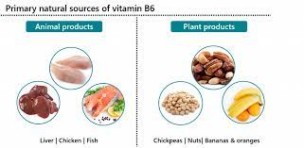
Dietary source

Slide 34
Deficiency
Irritability, apathy, seizures, vomiting and failure to thrive
Peripheral neuropathy
Cheilosis, ,glossitis and seborrheic dermatitis
Lymphopenia, hyperglycinemia, microcytic anaemia
Infections

Slide 35
Several vitamin B6 dependency syndromes occur duet o defects in enzyme structure or function like pyridoxine dependent seizures,
pyridoxine responsive anemia,
homocystinuria,
cystathioninuria.
In TB, on INH, peripheral neuropathy responds to B6

Slide 36
Treatment
100 mg once
Pyridoxine dependency, 10-100 mg daily PO or 2-10 mg I.M.

Slide 37
FOLIC ACID (vitamin B9)

Slide 38
Composed of Pterin ring connected to PABA, which is conjugated to 1 or more glutamate residues
Naturally occurring and structurally related compounds collectively referred as folates
Folic acid (Pteroly glutamic acid) is synthetic form
Tetrahydrofolate is biologically active form.

Slide 39
Function
Synthesis of DNA, purine and aminoacid interconversion
Converts homocysteine to methionine in conjunction with vitamin B12 and lowers risk of CVS disease
Synthesis of neurotransmitter like serotonin, regulation of mood and sleep

Slide 40
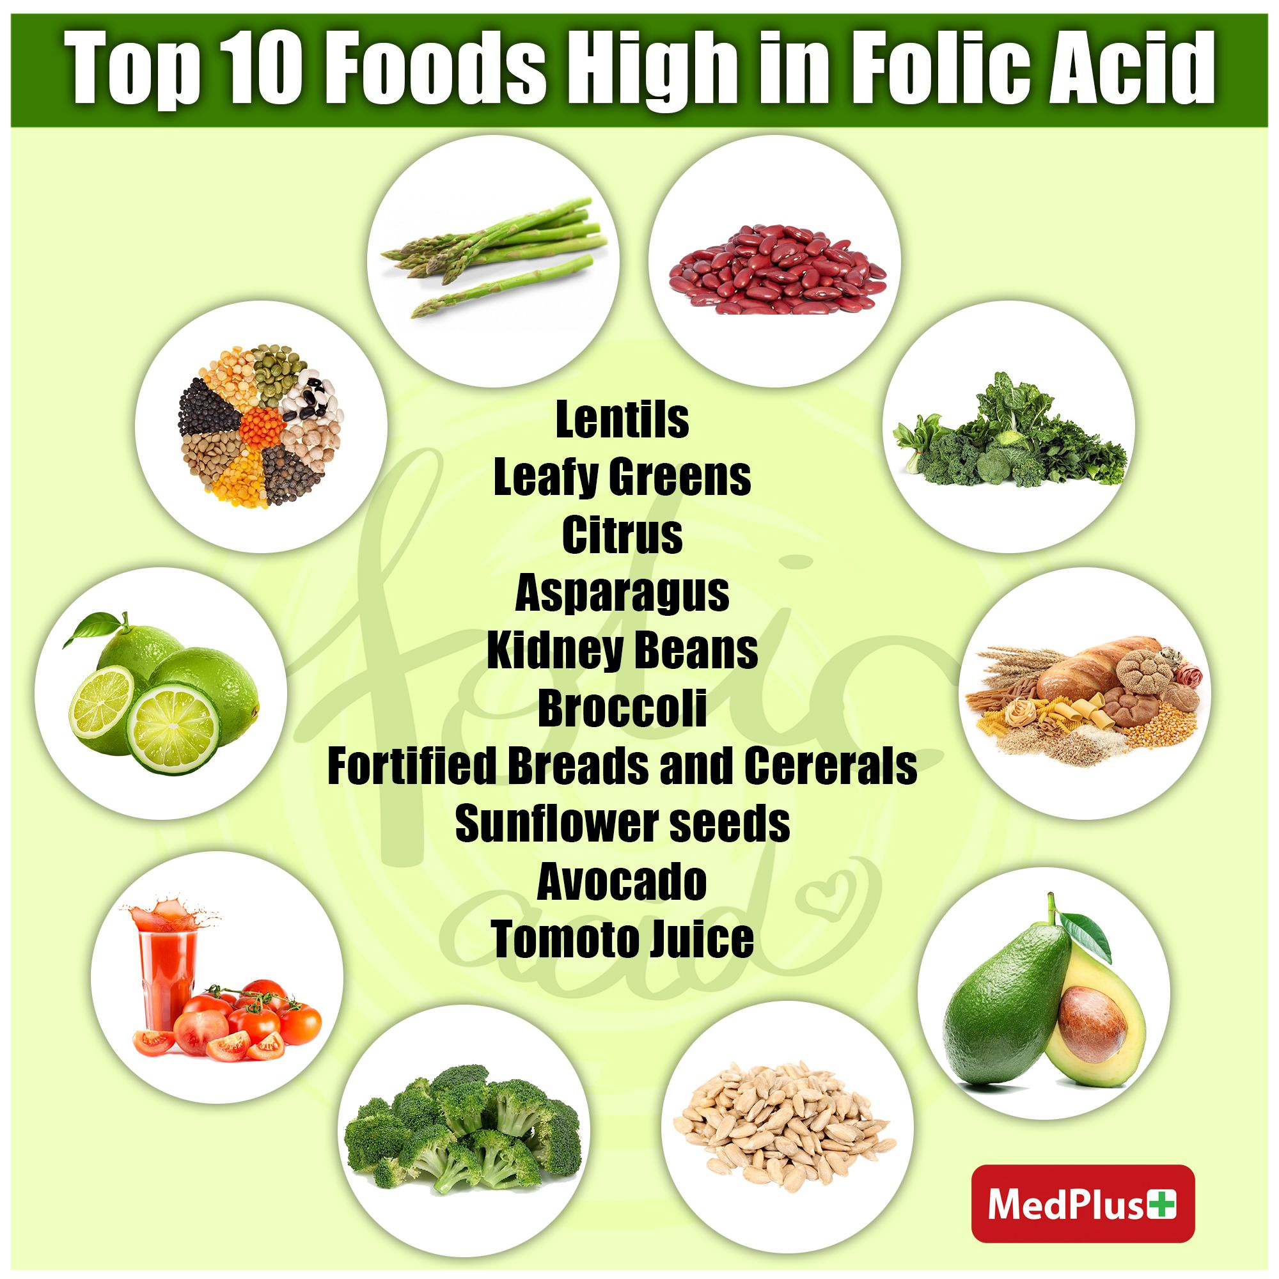
Dietary source

Slide 41
Deficiency
Poor nutritional state
Malabsorption (coeliac disease, IBD)
Chronic hemolytic anaemia (increased cell turnover)
Prolonged drug treatment (methotrexate, 6-mercaptopurine, azathioprine, phenytoin)
Inborn errors of folate metabolism (methylene tetrahydro folate reductase deficiency)

Slide 42
c/f
Megaloblastic anaemia
Accumulation of homocysteine leads to atherosclerotic changes causing CAD and stroke
Maternal folate deficiency can cause abortion, abruptio placentae and neural tube defects

Slide 43
Treatment
1-5 mg/day along with B12 supplementation for 3-4 weeks

Slide 44
Vitamin B12

Slide 45
Composed of 4 pyrrole rings, surrounding cobalt moiety
Active forms: methylcobalamine, 5-deoxyadenosyl
Commercially available: cyanocobalamine

Slide 46
Functions
Cofactor for enzymes involved in conversion of methylmalonyl coenzyme A to succinyl coenzyme A (important reaction required for carbohydrate and fat metabolism)
Conversion of homocysteine to methionine
Synthesis of purine and pyrimidine
Protein biosynthesis
Methylation reactions
Needed for general somatic cell metabolism

Slide 47
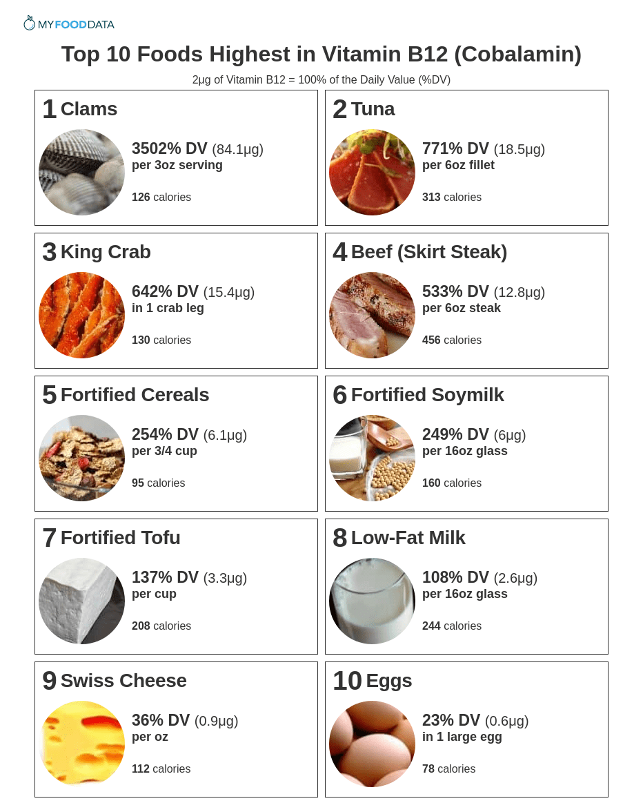
Dietary source

Slide 48
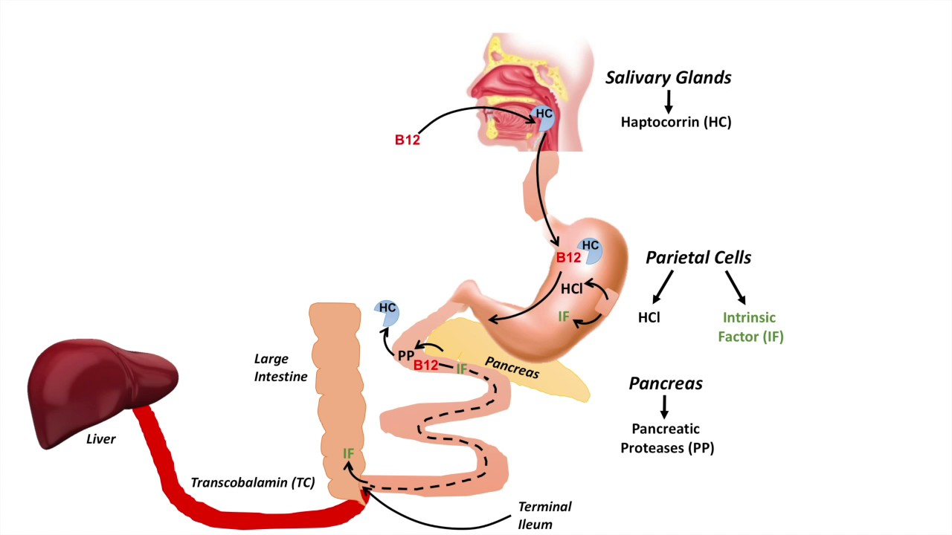
Absorption

Slide 49
Deficiency
Strict vegans/vegetarians
Impaired absorption
Deficiency of intrinsic factors
Atrophic gastritis/chronic gastritis
H.Pylori gastritis
Intestinal or liver disease
Drugs (anticonvulsants, aspirin, oc pills, HRT, H2 receptor antagonists)
Gastrectomy, gastric bypass
Medications suppressing stomach acid production (PPI)

Slide 50
MEGALOBLASTIC ANAEMIA
Characterised by macrocytes in PS and megaloblasts in bone marrow
More prevalent in South Asia, Africa, Mexico, Central and South America
Common age group:3-18 months (prolonged breastfeeding with deficient mother)

Slide 51
Clinical features
Glossitis
Anorexia/nausea/vomiting
Hyperpigmentation of skin (esp. knuckles) and abnormal pigmentation of hair (due to increased production of melatonin)
Pallor, easy fatiguability, irritability and lethargy
Infants may have ITS and regression of milestones
Pernicious anaemia presents as anaemia, diarrhoea, paresthesia, anorexia, recurrent glossitis, and neuropsychiatric symptoms

Slide 52
NEUROLOGIC MANIFESTATIONS
Subacute combined degeneration of cord manifested as diffuse demyelination of spinal cord, peripheral nerves and CNS
Frequently affect vibratory sensation in the extremities.
Bowel/bladder incontinence
Erectile dysfunction
Depression, delirium, psychosis
Coarse tremors
Apathy
Hypotonia
Regression of milestones

Slide 53
Approach to diagnosis
Detailed dietary history
Inquire for dietary faddism
A careful history of maternal diet including current diet, during and before pregnancy
Drug history/ history of any related surgery
Evaluate for causes

Slide 54
Investigation
PS:
anaemia with low retic count and macrocytosis
Macrocytosis amy get masked if associated IDA or thalassemia
Hypersegmented neutrophils
Leucopenia or normal WBC
Low platelets

Slide 55
Hypersegmented neutrophils: presence of I or more 6 lobbed neutrophils or
5 or more neutrophils with 5 separated lobes among 100 neutrophils

Slide 56
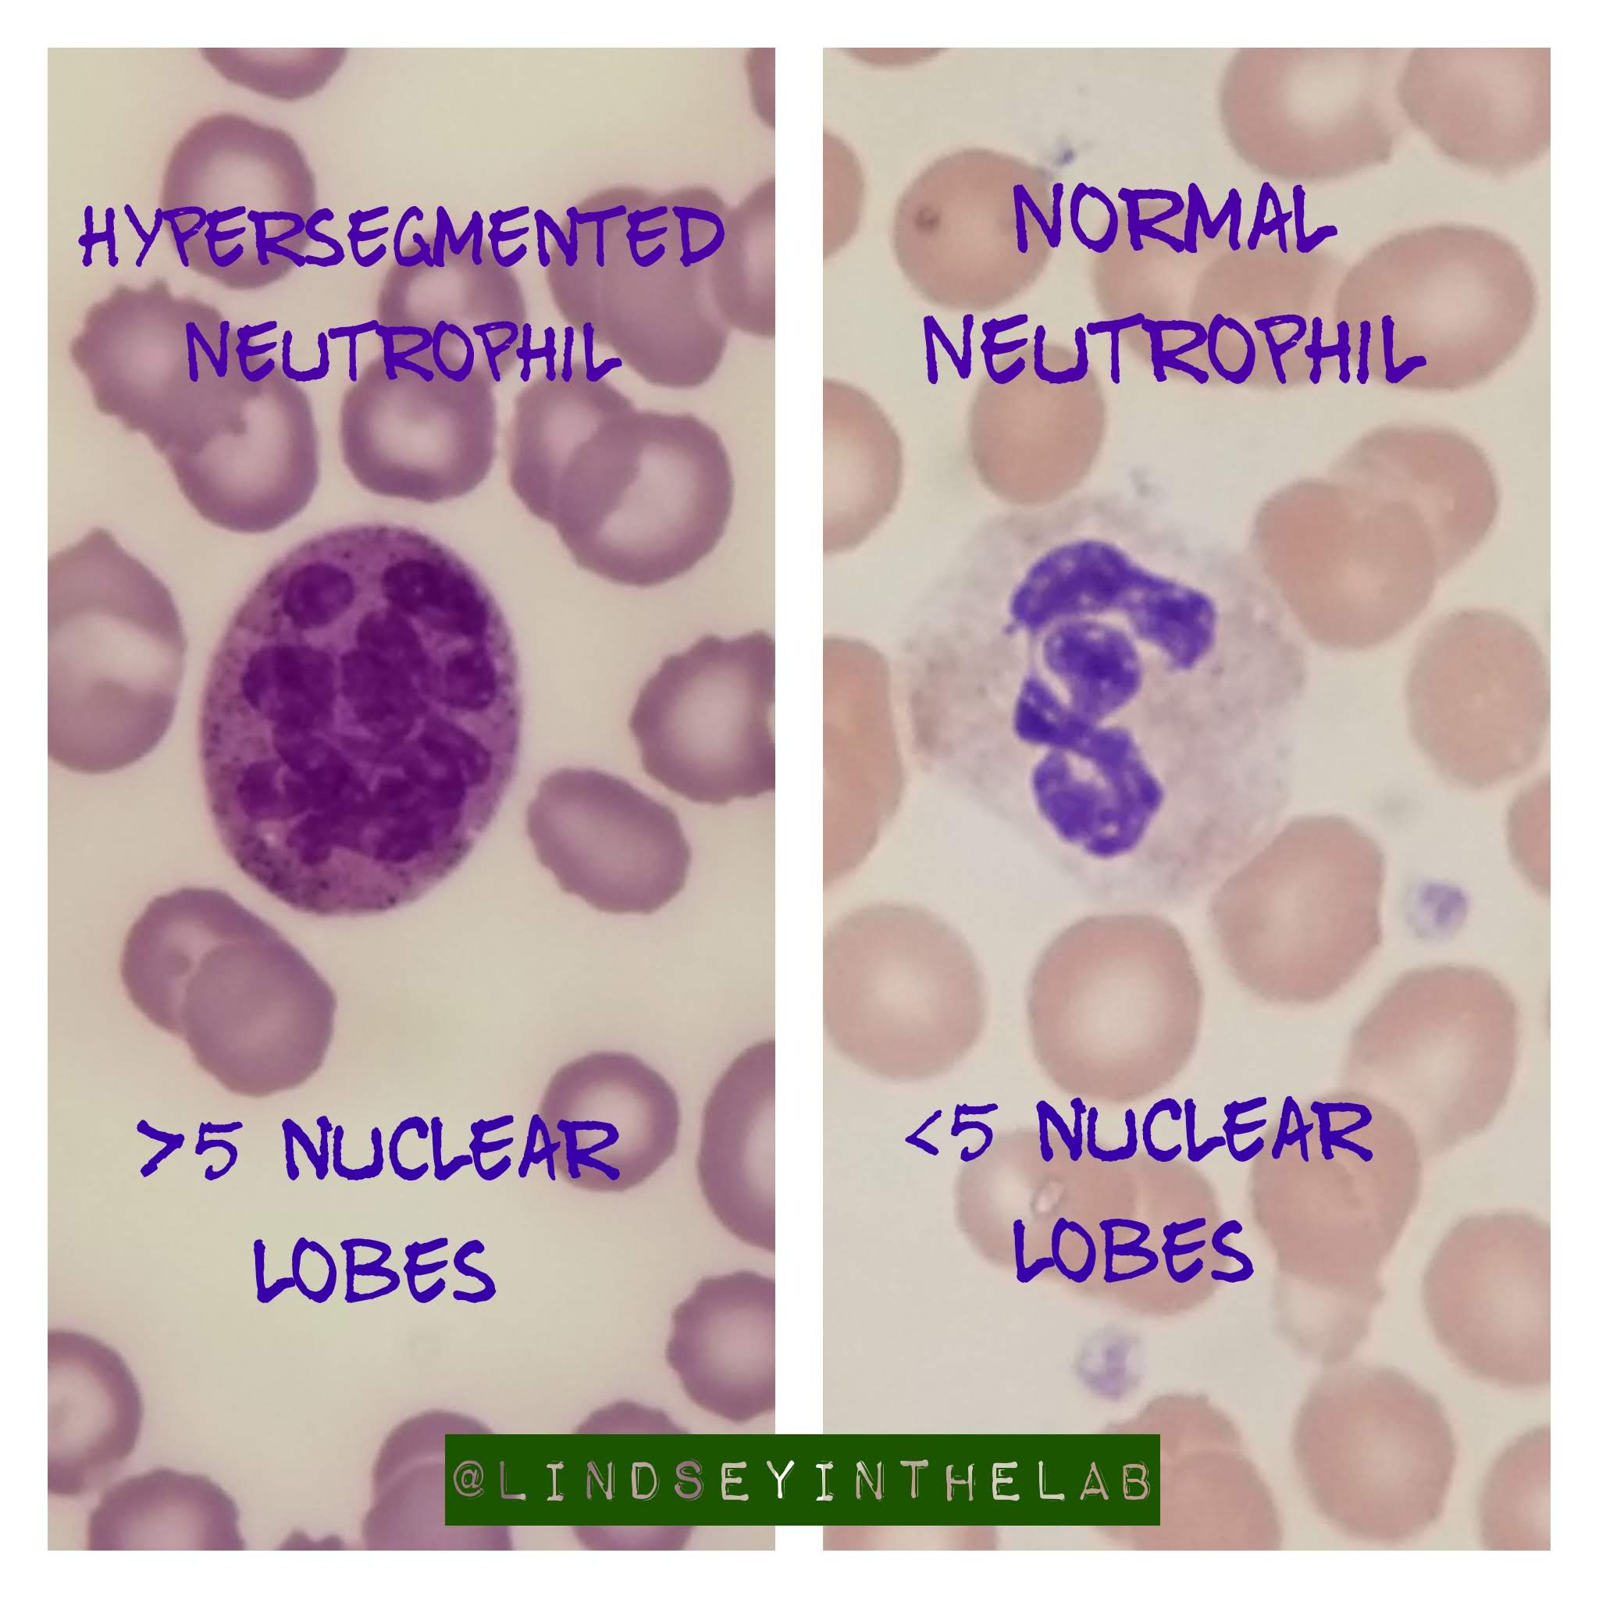

Slide 57
BONE MARROW EXAMINATION
Helps in ruling out aplastic anaemia, leukemia or myelodysplasia
Hypercellular marrow
Myeloid:erythroid ratio- changes from 3:1 to 1:1
Megaloblastic erythropoiesis: megaloblast with sieve like nucleus and hemoglobinised cytoplasm and mitotic features
Dyserythropoiesis: Howel-Jolly bodies, bi/trinucleated cells

Slide 58
S.VITAMIN B12 level
Serum and red cell folate levels (<3 ng/ml)
S.Homocysteine and S.methylmalonic levels
S.LDH

Slide 59
Treatment
Treatment of megaloblastic anaemia
Drug | Indication | Dose | Duration | Side effects
Cyanocobalamine or Hydroxocobalamine | MA due to vit.B12 deficiency | Adults or adolescent: 1000 mcg/dose im Children: 50-100 mcg/dose | 1-2 months weekly injection Or large oral doses | Hypokalemia, redness, pain at injection site Diarrhoea, joint pain or dizziness
Folic acid | MA due to folic acid deficiency | Adults or adolescent: 1 mg oral daily dose Infants: 10-50 mcg Children : 100-200 mcg | 1-3 months to replenish stores | Dyspnoea, dizziness, fever, weakness, rash

Slide 60
BIOTIN (VITAMIN B 7)

Slide 61
Cofactor in carboxylation reactions (gluconeogenesis, fatty acid metabolism and amino acid catabolism)
Insulin receptor transcription and pancreatic B-cell function
Deficiency can occur in
TPN without Biotin supplementation
Large quantities of raw egg consumption (avidin)

Slide 62
Presents with dermatitis, conjunctivitis, alopecia and CNS abnormalities
Treatment with 2-5 mg biotin daily for 2-3 weeks corrects deficiency

Slide 63
IRON

Slide 64
In 2011, WHO estimated that worldwide prevalence of anaemia was 42% in children
In 2013, iron deficiency was found to be one of the amjor cause of anaemia accounting for 27% of worldwide population
Prevalence of IDA is higher in developing countries than developed ones
As per NFHS-4, prevalence is highest in preschool children (>60%) followed by adolescents and young adults.

Slide 65
Functions
DNA synthesis, oxygen transport and cellular energy production
Component of various proteins (hemoglobin, myoglobin, cytochrome c and P-450, catalase, myeloperoxidase, cyclooxygenase and ferritin lipoxygenase
Iron dependent enzymes like NADP dehydrogenase, ribonucleide reductase, etc

Slide 66
Deficiency
AID: (absolute iron deficiency) state when total body iron stores with serum levels and saturation levels are low
FID: (functional iron deficiency) state of imbalance between iron demand and serum iron bioavailability (can occur despite normal stores)

Slide 67
Etiology
Increased iron demand: preschool, growth spurt, pregnancy
Decreased iron intake: poverty/malnutrition
Decreased iron absorption: high hepcidin levels
Surgical: gastrectomy, duodenal bypass
Medical: H.pylori infection, coeliac disease, atrophic gastritis
Drug-induced:PPI
Increase hemolysis:
PNH/autoimmune hemolytic anaemia
Enzymopathies, microangiopathic hemolytic anaemia

Slide 68
Chronic blood loss
GI: hookworm infection, esophagitis, peptic ulcer, diverticulitis, IBD
GU: heavy menstrual bleeding
Systemic: hemodialysis
Drugs: NSAID, corticosteroids, anticoagulants

Slide 69
IRIDA (iron refractory iron deficiency anaemia)
Rare recessive state caused by mutation of TMPRSS6 resulting in high hepcidin and reduced iron absorption from gut.
Refractory to iron therapy and erythropoeitin

Slide 70
Clinical features
Insiduous onset
Pallor noticed over tongue, lips , conjunctiva, palms, nails
Easy fatiguability, anorexia and irritability
Palpitation, dyspnoea, decreased exercise tolerance
Signs of CCF
Mild hepatosplenomegaly
Koilonychia/platynychia
Glossitis,stomatitis and angular cheilosis

Slide 71
Plummer-Vinson syndrome : triad of dysphagia duet o esophageal web, splenomegaly and koilonychia
Some studies show low IQ, lack of concentration, easy distractibility, short attention span, impaired mental and motor development
Scholastic backwardness

Slide 72
Investigation
COMPLETE BLOOD COUNT WITH PERIPHERAL SMEAR
low Hb with low hematocrit,
Low red blood cell count
Decreased MCV, MCH,MCHC and increased RDW
Anisopoikilocytosis with microcytic , hypochromic anaemia

Slide 73
SERUM IRON STUDIES: low (<40mcg/dl)\
TIBC: increased (>350 mcg/dl)
Transferrin saturation: decreased <16%
Serum ferritin: <12 ng/ml
Content of hemoglobin in reticulocyte: <27.5 pg

Slide 74
BONE MARROW EXAMINATION:
Not recommended for diagnosis of IDA
Increased cellularity with micronormoblastic erythroid hyperplasia
No or little stain with Prussian Blue dye

Slide 75
Treatment
Hospitalisation: CCF, Hb <5 g/dl
PCV: if CCF +
Medicinal therapy: 3-6 mg/kg/day for 3-6 months
Ferrous are better absorbed than ferric compounds
Sulphate (20%)<gluconate(30%)< fumarate(33%)

Slide 76
Parenteral iron therapy in severe GI intolerance, bleeding, malabsorption syndromes, GI surgical cases
Total dose calculated: weight (kg) x Hb deficit(g/dl) x 4

Slide 77
Response to therapy:
Positive response can be defined as daily increase in Hb of 0.1 g/dl (0.3% or 1% rise in Hct) from 4th day of therapy.
Retic response is seen in 7-10 days.

Slide 79
IODINE

Slide 80
Essential element required for normal human growth and development.
Also required for the synthesis of the thyroid hormones, thyroxine (T4) and triiodothyronine (T3)
Regulates cellular oxidation and, hence, affect calorigenesis, thermoregulation and intermediary metabolism
Iodine deficiency – the most prevalent and most common preventable cause of mental deficiency in the world
Serious iodine deficiency during pregnancy – stillbirth, spontaneous abortion and congenital abnormalities, such as cretinism (a grave, irreversible form of mental retardation)

Slide 81
RECOMMENDED DAILY INTAKE
90 µg for preschool children (0–59 months);
120 µg for schoolchildren (6–12 years);
150 µg for adolescents (above 12 years) and adults;
250 µg for pregnant and lactating women.

Slide 82
PATHOPHYSIOLOGY
Iodine is present in the superficial layers of the soil.
Consumption of crops and plants grown on iodine deficient soils leads to iodine deficiency.
Iodine deficiency in food and water leads to less availability of iodine to thyroid gland for synthesis of T3 and T4.
As a result, the thyroid gland becomes hyperactive to produce the requisite amounts of T3 and T4 thereby enlarging itself by hyperplasia. (Goiter)
In areas of iodine deficiency, where thyroid hormone levels are low, brain development is impaired.

Slide 83
Spectrum of iodine deficiency disorders
1. Fetus: Abortions, stillbirths, congenital abnormalities, neurological cretinism, mental deficiency, deaf mutism, spastic diplegia, squint myxedematous cretinism and dwarfism
2. Neonate: Neonatal hypothyroidism, mental deficiency
3. Childhood and adolescence: Goiter, hypothyroidism, dwarfism, impaired mental function, poor school performance

Slide 84
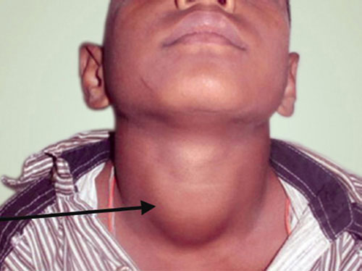
ASSESSMENT OF IODINE DEFICIENCY
Total Goiter Rate
Clinically, presence of goiter is considered a marker of iodine deficiency

Slide 85
Simplified classification of goiter by palpation
Grade 0 No palpable or visible goiter
Grade 1 A goiter that is palpable but not visible when the neck is in the normal position (i.e., the thyroid is not visibly enlarged). Thyroid nodules in a thyroid, which is otherwise not enlarged, fall into this category.
Grade 2 A swelling in the neck that is clearly visible when the neck is in a normal position and is consistent with an enlarged thyroid when the neck is palpated.

Slide 86
24-hour Urinary Iodine
Excretion in school-age children (≥ 6 years) is considered a good marker of recent dietary iodine intake.
Twenty-four-hours urinary iodine more than 100 µg/L is a valid indicator of iodine sufficiency.
Median urinary iodine less than 20, 20–49, 50–99 µg/L indicate severe, moderate or mild iodine deficiency in a given population.

Slide 87
Thyroid-stimulating Hormone
TSH in neonates – valuable indicator for assessing iodine deficiency.
The number of neonates with moderately elevated TSH concentrations (above 5 mIU/L whole blood) is proportional to the degree of iodine deficiency during pregnancy.

Slide 88
PREVENTION
Iodine supplementation
  iodized salt,
  iodized oil,
  iodized capsules,
  iodized bread
  and iodized water.

Slide 89
The most effective method is iodized salt.
In rare instances, iodine supplementation may be considered for both pregnant women and children less than 2 years of age
  as a single oral dose of iodized oil every 6 to 12 months.
  Single oral dose of Lipiodol containing 240 mg iodine for 6-month coverage or 480 mg for 12 months is recommended

Slide 90
CALCIUM

Slide 91
The most abundant mineral in the body
Located primarily in bone tissue (98%)
Coagulation cascade, nerve conduction and muscle stimulation
Absorption depends on intake and vitamin D

Slide 92
Source
Milk and dairy products
Grains
Fruits

Slide 93
Requirement
1-10 years – 500-800 mg/day
Puberty – 1000-1200 mg/day
Pregnant and lactating women – 400 mg/day

Slide 94
Deficiency
Tetany – muscle cramps, numbness and tingling sensation in limbs
Rickets and osteoporosis – chronic deficiency

Slide 95
Clinical manifestations
Classic signs and symptoms of Rickets
GENERAL
  Failure to thrive Listlessness
  Protruding abdomen
  Muscle weakness (especially proximal)
  Fractures
HEAD
  Craniotabes
  Frontal bossing
  Delayed fontanel closure
  Delayed dentition; caries
  Craniosynostosis

Slide 96

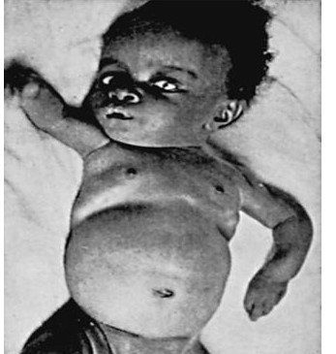
CHEST
  Rachitic rosary
  Harrison groove
  Respiratory infections and atelectasis
BACK
  Scoliosis
  Kyphosis
  Lordosis

Slide 97
EXTREMITIES
  Enlargement of wrists and ankles
  Valgus or varus deformities
  Windswept deformity (combination of valgus deformity of 1 leg with varus deformity of the other leg)
  Anterior bowing of the tibia and femur Coxa vara
  Leg pain
HYPOCALCEMIC SYMPTOMS
  Tetany
  Seizures
  Stridor due to laryngeal spasm

Slide 98
Diagnosis
Laboratory findings include
  increased levels of alkaline phosphatase,
  PTH,
  and 1,25-D
  Calcium levels may be normal or low

Slide 99
Treatment
Treatment focuses on providing adequate calcium, typically as a dietary supplement
doses
  700 [1-3 yr age],
  1,000 [4-8 yr age],
  1,300 [9-18 yr age] mg/day of elemental calcium.
Vitamin D supplementation is necessary if there is concurrent vitamin D deficiency.
Prevention – discouraging early cessation of breastfeeding and increasing dietary sources of calcium.

Slide 100
MAGNESIUM

Slide 101
Essential for
  bionergic reactions controlling fuel oxidation,
  membrane transport and
  signal transmission

Slide 102
Sources
Green vegetables
Legumes
Nuts
Banana
Whole grains
Meat
Hard water

Slide 103
Requirement
0 – 6 mo – 40-50 mg/day
6 – 12 mo – 60 mg/day
>12 mo – 200 mg/day

Slide 104
Deficiency
Regulation depends on renal tubular absorption
GI disorders
Renal disorders

Slide 105
Clinical manifestations
Hypomagnesemia causes secondary hypocalcemia
by impairing the release of PTH and by blunting the tissue response to PTH.
The dominant manifestations of hypomagnesemia are caused by hypocalcemia:
  tetany,
  presence of Chvostek and Trousseau signs,
  and seizures.
However, with severe hypomagnesemia, these same signs and symptoms may be present despite normocalcemia.

Slide 106
Treatment
Severe hypomagnesemia is treated with parenteral magnesium.
Magnesium sulfate is given at a dose of 25-50 mg/kg

Slide 107
THANKYOU

Slide 108
MCQS

Slide 109
Q1) What is the daily allowance of Mg >12 months ?
A) 100 mg/day
B ) 200mg/day
C) 300mg /day
D) 400mg/ day

Slide 110
Q2 ) What is the daily recommended intake for Iodine for school children (6-12 yrs) ?
A) 90 micrograms
B) 100 micrograms
C) 150 micrograms
D) 120 micrograms

Slide 111
Q3) What is the dose given to treat vitamin B2 deficiency?
A. Oral 3-5 mg/day
B. Oral 3-10 mg/day
C. Oral 10- 15 mg/day
D. Oral 20 mg/day

Slide 112
Q4) What is the Recommended daily intake of Calcium in pregnant and lactating women ?
A. 400 mg/day
B. 500mg/day
C. 600mg/day
D. 350mg /day

Slide 113
Q5) What is the dose given to treat vitamin B9 deficiency (folic acid) with vitamin B12 supplements?
A ) 5-10 mg/day for 3 – 4weeks
B ) 10 – 20 mg / day for 3 – 4 weeks
C) 1-5 mg / day for 3 – 4 weeks
D) 25 mg/day for 3 – 4 weeks

