Slide 1
RADIATION SAFETY
Dr. Medha Wadhwa

Slide 2
EXPOSURE SOURCES
Primary: Beam itself..from the tube to the intensifier
Leakage: from the covering of the machine
Scatter: bounces off the patient

Slide 3
RADIATION SAFETY
Inter-professional team:
Create and maintain the radiation safety program
Determine qualifications for the equipment operator for each type of radiologic device
Evaluate and select new radiology equipment
Determine the unit of measure to be used for monitoring the radiation dose and the peak value for notifying the operator

Slide 4
RADIATION SAFETY PROGRAM
List of the approved equipment operators
Documentation and record retention requirements
List of measures for protecting patients and personnel from unnecessary exposure to ionizing radiation
Procedures for handling and disposing of body fluids and tissue that may be radioactive
Requirements for using radiation monitoring devices (eg, dosimeters)

Slide 5
Processes and requirements for the selection of equipment at the time of purchase
Requirements for personnel education and competency assessment
Quality assurance and improvement program
Frequency of and processes for testing of protective devices
Requirements for patient education

Slide 6
Radiation Safety Officer
Oversees the radiation safety program
Assists in creating and enforcing policies and procedures
Determines methods for monitoring and recording occupational exposure
Determines which individuals require monitoring devices
Identifies radiation safety problems
Stops unsafe practices
Initiates, recommends, provides, and verifies implementation of corrective actions

Slide 7
Radiation Safety for Patients
Move extraneous body parts out of the path of the radiation beam
Collaborate regarding the use and placement of shielding
Assess the pregnancy status of all premenopausal patients
Place shielding between the fetus and the source of radiation

Slide 8
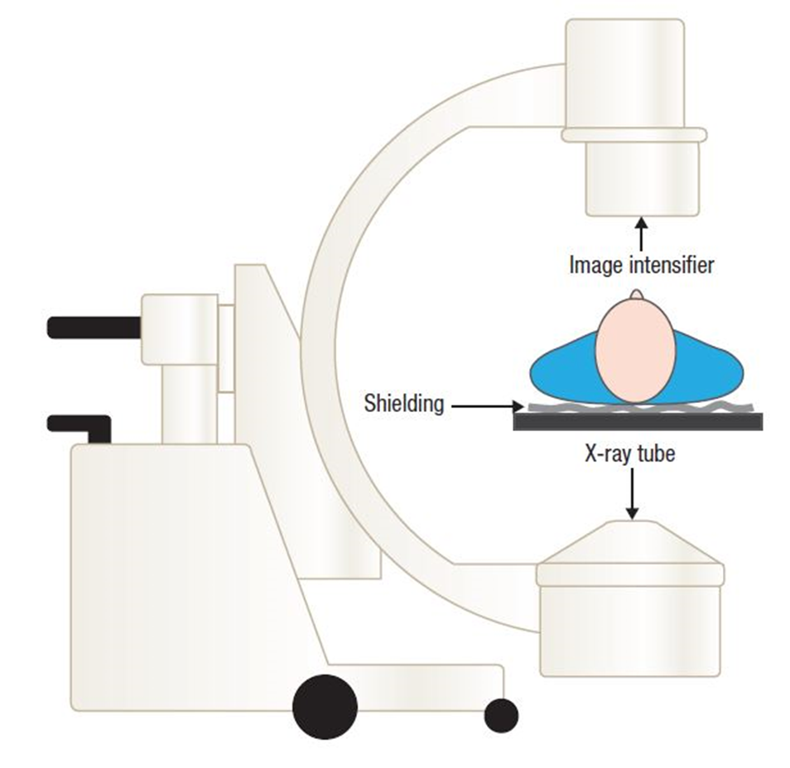

Slide 9
Radiation Safety for Staff
Should you leave the OR when radiation is being used?
A: Yes
B: No

Slide 10
PRINCIPLES
Time
Distance
Shielding

Slide 11
Pregnant Staff Safety
Follow standard radiation protection techniques
Declare the pregnancy to the radiation safety officer or through other appropriate facility channels
Wear radiation monitors at the waist under shielding during times of exposure to radiation

Slide 12
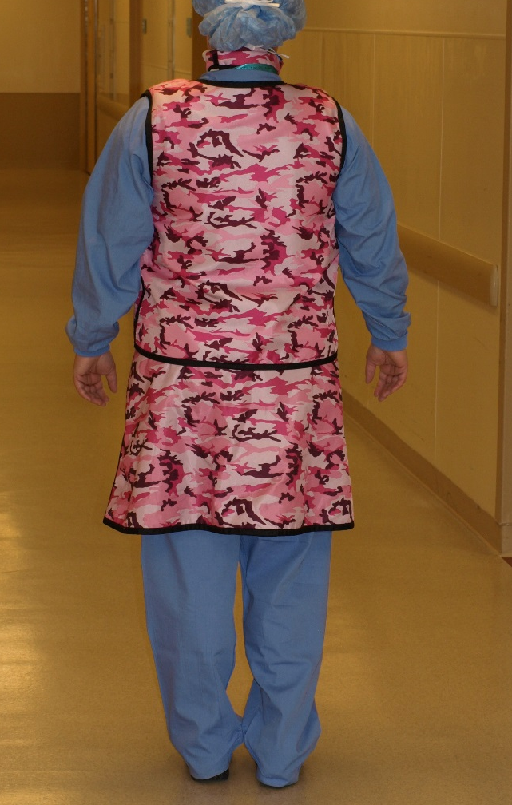
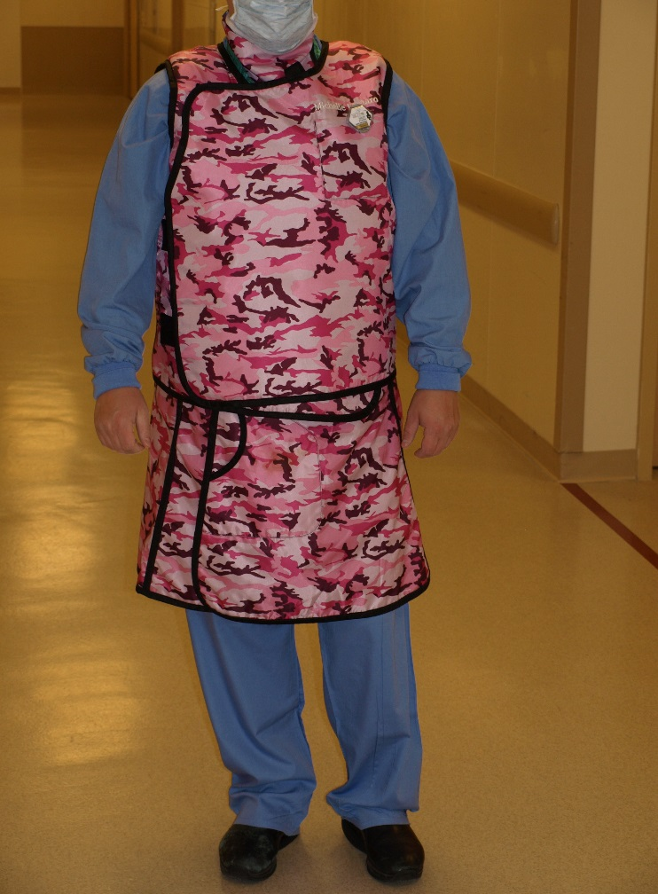

Slide 13
Shielding Devices
Architectural (ie, fixed) shielding
Equipment-mounted or mobile shields
Personal protective devices
Composed of :
  Lead
  Lead-equivalent material (eg, tungsten antimony, bismuth antimony

Slide 14
Personal protective devices
Aprons
Thyroid shields
Leaded eye protection
Protective gloves
Sterile radiation shield drapes
Protective caps

Slide 15
Protective devices should be
Visually inspected
  At the time of purchase
  Before use
X-rayed
  At the time of purchase
  At least annually for defects related to wear
  Whenever damage is suspected
Labeled with the last test date

Slide 16
Radiation Exposure Education
Minimizing exposure to radiation (ie, as low as reasonably achievable [ALARA])
Dosimeter use and monitoring
Care of patients receiving radioactive nuclides
Handling radioactive nuclides
Controlling and providing security for the material (ie, constant surveillance)
Emergency response to spills

