Slide 1
TECHNICAL ANALYSIS
Prepared by:
Ms. Mital Thakkar
Assistant Professor
Department of Management
SVDU

Slide 2

Introduction
Technical analysis is a means of examining and predicting price movements in the financial markets, by using historical price charts and market statistics. It is based on the idea that if a trader can identify previous market patterns, they can form a fairly accurate prediction of future price trajectories.
It is based purely on the price charts of an asset. It is solely the identification of patterns on a chart that is used to predict future movements.
A process of identifying trend reversals at an earlier stage to formulate the buying and selling strategy.
Technical analyst study the relationship between price-volume and supply-demand for the overall market and the individual stock.

Slide 3
Assumptions
The market value of the scrip is determined by the interaction of supply and demand.
The market discounts everything.
The market always moves in trend.
History repeats itself. It is true to the stock market also.

Slide 4
Difference
Fundamental Analysis | Technical Analysis
Demand/Supply Analysis | Study the price action
Gather news | Study historical and current price movements
Examine economy data | Compare the current with historical price movements
Study the related industry | Use this comparison as a tool to forecast future price action
Study related markets | Study the effect i.e. historical price movement
Study the cause of market movement

Slide 5
Dow Theory
Dow developed his theory to explain the movement of the indices of Dow Jones Averages.
The theory is based on certain hypothesis:
The first hypothesis is that no single individual or buyer can influence the major trend of the market.
The second hypothesis is that market discounts everything.
The third hypothesis is that the theory is not infallible.
According to Dow theory the trend is divided into:
Primary
Intermediate/Secondary
Short term/Minor

Slide 6
Primary Trend
The security price trend may be either increasing or decreasing.
When the market exhibits the increasing trend, it is called ‘bull market’ and when it exhibits a decreasing trend it is called ‘bear market’.
Bull Market:
The bull market shows three clear-cut peaks.
Each peak is higher than the previous peak.
The bottoms are also higher than the previous bottoms.
Bear Market:
The market exhibits falling trend.
The peaks are lower than the previous peaks.
The bottoms are also lower than the previous bottoms.

Slide 7
Secondary Trend
The secondary trend or the intermediate trend moves against the main trend and leads to correction.
The correction would be 33% to 66% of the earlier fall or increase.
Compared to the time taken for the primary trend, secondary trend is swift and quicker.

Slide 8
Minor Trends
Minor trends or tertiary moves are called random wriggles.
They are simply the daily price fluctuations.
Minor trend tries to correct the secondary trend movement.

Slide 9
Criticisms of Dow Theory
Dow theory generally misses 20% to 25% of a move before generating a signal.
Signals in Dow theory are generally generated during the second phase of the uptrend.
It was primarily used as an indicator of Economy which was substituted to stocks and other underlying assets.
Subjectivity and difficulty in distinguishing the various phases of trends.
An investor is more concerned about his investments, rather than just depending upon the movements in market returns.
It may not help a trader following intermediate trend.

Slide 10
Types of Trend
The trend is a primary concept in Technical Analysis. The trend can be defined as “The directional movement of a commodity price or a financial instrument”.
It Can Be Classified Into Three Categories In A Market.
Uptrend
Downtrend
Sideways trend

Slide 11
Uptrend
Whenever the direction movement makes higher highs and higher lows it can be said as Silver Chart Uptrend. Consecutive peaks higher than the previous peaks is termed as “Higher highs”. The bottoms higher than the previous peaks is termed as “Higher lows”.
Generally, when the fundamental and psychological factors improve, it forms an Upward Trend. The Uptrend may last as short as a few weeks to few years depending on the source and duration of the driver.
Trend Line: The line connecting the higher lows and higher highs is called Trend line.
Resistance Line: “The higher highs” trend line is alternatively called as Resistance line.
Support Line: “The higher lows” trend line is alternatively called as Support line.Buy every lower of trend line or nearby support line and expected Target will be a new high.
The chart above shows Silver chart uptrend.

Slide 12
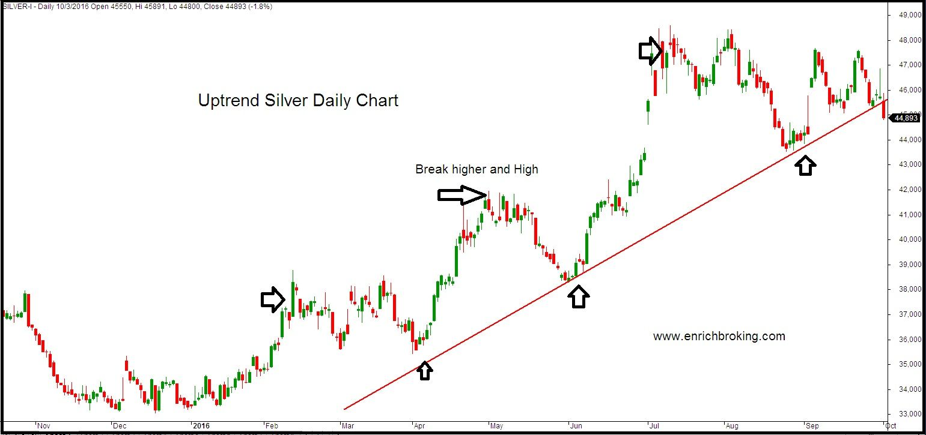

Slide 13
Downtrend
Lower highs and lower lows made by crude oil are in a Downtrend. When the crude previous peak is higher than the current peak, it is termed as “Lower highs”. Similarly, when the current bottom is lower than the previous bottom it is termed as “Lower lows”.Crude oil that are making lower highs and lower lows are in a downtrend. Lower highs mean the crude previous peak is higher than the current peak. Lower lows mean the current bottom is lower than the previous bottom.The Following Chart Shows The Downtrend In Crude Oil Prices:

Slide 14
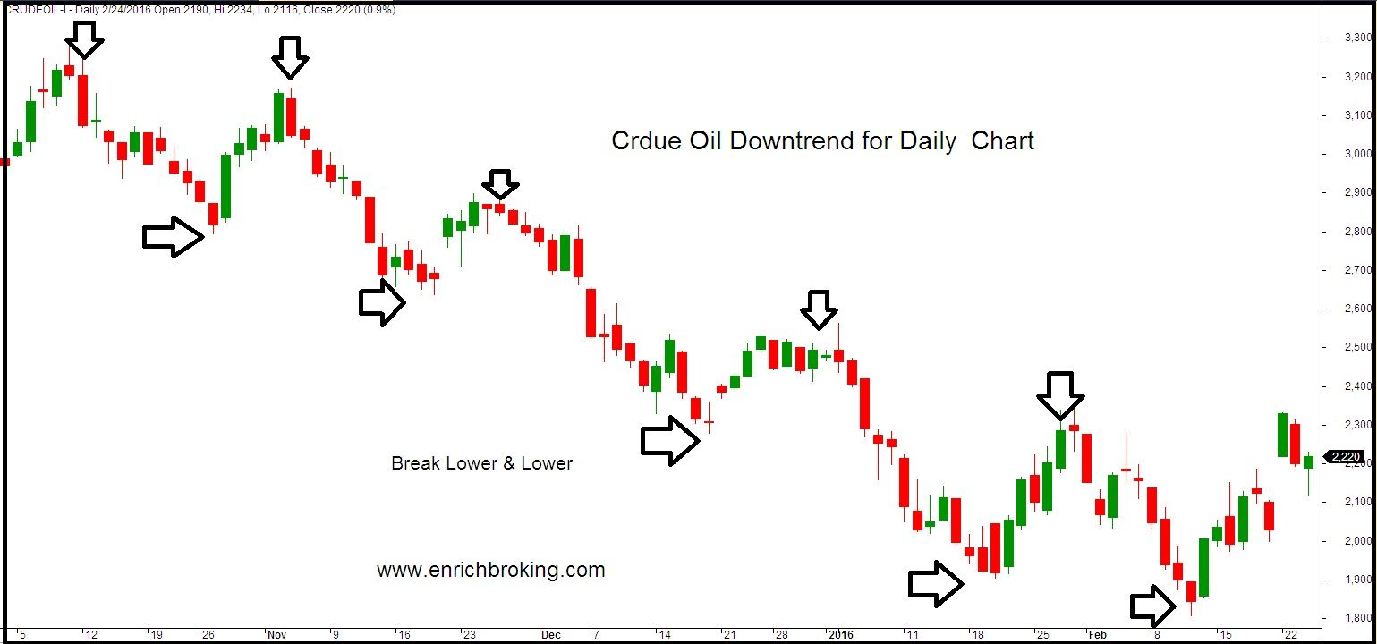

Slide 15
Sideways Trend
The horizontal price movement that occurs when the forces of supply and demand are nearly equal is termed as “Sideways trend”.
Natural Gas that trade in a range is in a sideways trend. Natural Gas trading in a sideways trend trade between strong levels of support and resistance.
The Following Chart Below Shows The Sideways Trend For Natural Gas:
It’s advisable to buy Natural Gas at support levels and sell at the resistance level.
Once the support or resistance is broken, take fresh position and target will be considered over all wedge of support resistance.

Slide 16
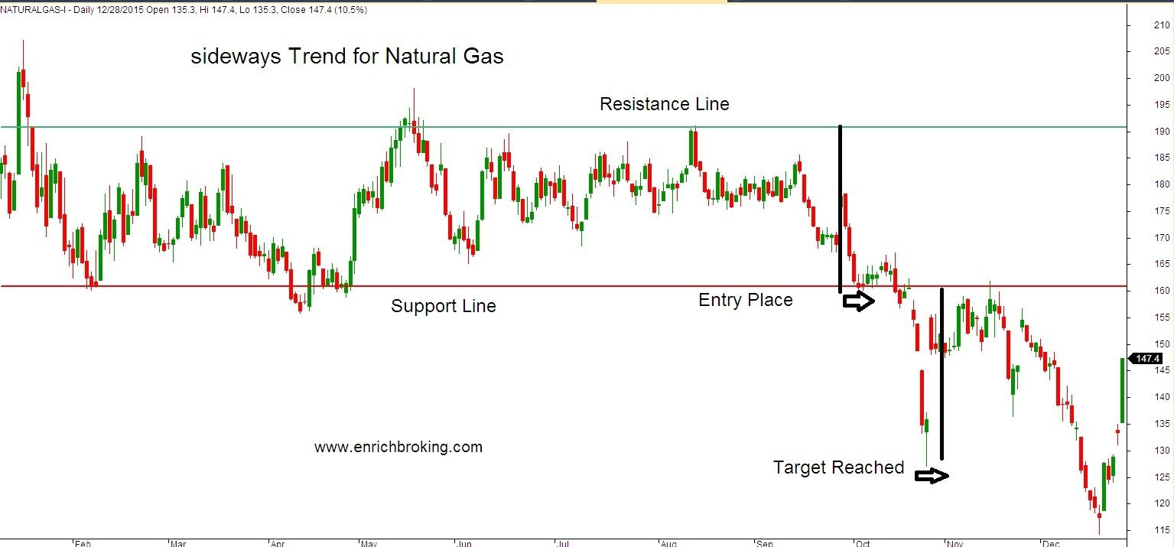

Slide 17
Chart Types
Charts provide visual assistance in detecting the emerging and changing patterns of price behaviour.
Technical analyst uses three basic types of charts:
Bar Charts
Line Charts
Point and Figure Charts

Slide 18
Bar Charts
The bar chart is made up of a series of vertical lines that represent each data point.
This vertical line represents the high and low for the trading period, along with the closing price.
The close and open are represented on the vertical line by a horizontal dash. The opening price on a bar chart is illustrated by the dash that is located on the left side of the vertical bar.
The close is represented by the dash on the right.

Slide 19
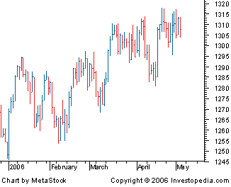

Slide 20
Line Charts
The most basic of the charts is the line chart. It represents only the closing prices over a set period of time.
The line is formed by connecting the closing prices over the time frame.
The closing price is often considered to be the most important price in stock data compared to the high and low for the day and this is why it is the only value used in line charts.

Slide 21
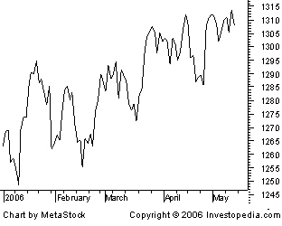

Slide 22
Point and Figure Chart
It predicts the extent and direction of the price movements of a stock or market index.
These Charts are on dimensional without any indication of time or volume.
They show price changes in relation to previous prices
It consists of a series of Xs and Os
The Xs represent upward price trends and the Os represent downward price trends.

Slide 24
Limitations of Charts
The trouble with most chart patterns is that they cause their followers to change their opinion so frequently. Most chart services change like the wind. One day they put out a strong buy signal, two weeks later, they see a change in the pattern and tell their clients to sell, then two weeks later, they tell them to buy again. The result is that these patterns force their followers in and out of the market time and time again. Though this is great for brokers’ commission, but not so great for the investor.
Another disadvantage and a great one which exists in charting is that decisions are almost always made on the basis of the chart alone. Most buyers under this method have no idea why they are buying a company’s stock.

Slide 25
They rely alone on a stock’s action, assuming that the people who have caused or are currently causing this action really know something about the company. This is generally negative thinking simply because, as more and more chartists are attracted to a stock, there are simply more and more owners who know little or nothing about the company.

Slide 26
Moving Averages
A moving average (MA) is a widely used technical indicator that smooths out price trends by filtering out the “noise” from random short-term price fluctuations.
Moving averages can be constructed in several different ways, and employ different numbers of days for the averaging interval.
The most common applications of moving averages are to identify trend direction and to determine support and resistance levels.
When asset prices cross over their moving averages, it may generate a trading signal for technical traders.
While moving averages are useful enough on their own, they also form the basis for other technical indicators such as the moving average convergence divergence.

Slide 27
Exponential Moving Average
Exponential moving averages are designed to see price trends over specific time frames like 50 or 200 days.
Compared to simple moving averages, EMAs give greater weight to recent (more relevant) data.
Computing the exponential moving average involves applying a multiplier to the SMA (Simple Moving Average).
Moving average ribbons allow traders to see multiple EMAs at the same time.

Slide 28
Technical Analysis Indicators
Technical indicators are chart analysis tools that can help traders better understand and act on price movement. There is a huge range of technical analysis tools available that analyse trends, provide price averages, measure volatility and more.
There are two basic types of technical indicators:
Overlays: Technical indicators that use the same scale as prices are plotted over the top of the prices on a stock chart. Examples include moving averages and Bollinger Bands®.
Oscillators: Technical indicators that oscillate between a local minimum and maximum are plotted above or below a price chart. Examples include the stochastic oscillator, MACD or RSI.

Slide 29
Oscillator
An oscillator is a technical analysis tool that constructs high and low bands between two extreme values, and then builds a trend indicator that fluctuates within these bounds.
Traders use the trend indicator to discover short-term overbought or oversold conditions.
When the value of the oscillator approaches the upper extreme value, technical analysts interpret that information to mean that the asset is overbought, and as it approaches the lower extreme, technicians consider the asset to be oversold.

Slide 30
THANK YOU

