Slide 1
Theory of Aggregate Demand and Supply
Prepared By:
Ms. Mital Thakkar
Assistant Professor
Department of Management
SVDU

Slide 2
Introduction
Aggregation refers to the connection between economic interactions at the micro and the macro levels. The micro level refers to the behaviour of individual economic agents. The macro level refers to the relationships that exist between economy-wide totals, averages or other economic aggregates.
Macro economics is the study of aggregate economic behaviour of the economy as a whole. Macro economics deals with the output, (total volume of goods and services produced) levels of employment and unemployment, average prices of goods and services.

Slide 3
INTRODUCTION
It also deals with the economic growth of the country, trade relationship with other countries and the exchange values of the currency in the international market.
The major factors influencing these outcomes are international market forces like population growth, consumption behaviour of the country, external forces like, natural calamities, political instability and policy related changes such as tax policy, government expenditure (budget) money supply and various other economic policies of the country. Therefore it is essential to know the aggregate demand and aggregate supply of the country.

Slide 4
Aggregate demand
It is the amount of total spending on domestic goods and services in an economy.
The downward-sloping aggregate demand curve shows the relationship between the price level for outputs and the quantity of total spending in the economy.
● Aggregate demand includes all four components of demand:
-Consumption
-Investment
-Government spending
-Net exports—exports minus imports

Slide 5
a) PRIVATE (HOUSEHOLD) CONSUMPTION EXPENDITURE (C )
It comprises of households’ expenditure on the consumption of goods and services.
These goods can be durable, semi-durable or non-durable.
Consumption of households depends upon their Disposable Income & MPC.
(b) INVESTMENT EXPENDITURE ( I )
It refers to the expenditure incurred by firms on the purchase of capital goods like machines, plant, equipment, etc. to increase the production capacity.
Investment decision depends upon the Rate of Return & ROI (Rate of Interest).

Slide 6
(c) GOVERNMENT EXPENDITURE (G)
It refers to expenditure incurred by the government on the purchase of consumer goods and capital goods to satisfy the collective wants of the society.
For example– Public parks, hospitals, Roads, etc. Government expenditure depends upon the priorities of the government.
(d) NET EXPORTS (X-M)
It is the difference between exports and imports.
It reflects the net demand for a domestic product by rest of the world.
Net exports depend upon many things like Foreign Trade Policy, Foreign Exchange Rate, Comparative Prices & Quality, etc

Slide 7
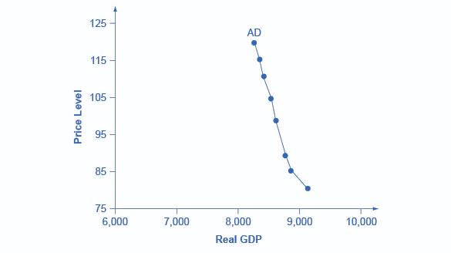
An aggregate demand curve, the horizontal axis shows real GDP and the vertical axis shows price level. But there's a big difference in the shape of the AD curve—it slopes down. This downward slope indicates that increases in the price level of outputs lead to a lower quantity of total spending.
when price level increases lead to lower spending, we need to understand how changes in the price level affect the different components of aggregate demand. Remember, the following components make up aggregate demand:
C consumption spending
I investment spending
G government spending
X spending on export
M minus export
Aggregate demand = C + I + G + ( X – M)

Slide 8
Reason for a decreasing in demand
Consumption : Rise in taxes, fall in income, rise in interest, desire to save more, decrease in wealth, fall in future expected income
Investment : Fall in expected rate of return, rise in interest rates, drop in business confidence
Government : Reduction in government spending, increase in taxes
Net exports : Decrease in foreign demand, relative price increase of US goods

Slide 9
Reasons for an increase in aggregate demand
Consumption : Decrease in taxes, increase in income, fall in interest rates, desire to save less, rise in wealth, rise in future expected income
Investment : Rise in expected rate of return, drop in interest rates, rise in business confidence
Government : Increase in government spending, decrease in taxes
Net Export : Increase in foreign demand, relative price drop of S. goods

Slide 10
Reasons of increase and decrease in demand
Increase
Decrease
Consumption : Rise in taxes, fall in income, rise in interest, desire to save more, decrease in wealth, fall in future expected income
Investment : Fall in expected rate of return, rise in interest rates, drop in business confidence
Government : Reduction in government spending, increase in taxes
Net exports : Decrease in foreign demand, relative price increase of US goods
Consumption : Decrease in taxes, increase in income, fall in interest rates, desire to save less, rise in wealth, rise in future expected income
Investment : Rise in expected rate of return, drop in interest rates, rise in business confidence
Government : Increase in government spending, decrease in taxes
Net Export : Increase in foreign demand, relative price drop of S. goods

Slide 11
Aggregate supply
It is the total quantity of output firms will produce and sell—in other words, the real GDP.
The upward-sloping aggregate supply curve—also known as the short run aggregate supply curve—shows the positive relationship between price level and real GDP in the short run.
The aggregate supply curve slopes up because when the price level for outputs increases while the price level of inputs remains fixed, the opportunity for additional profits encourages more production.

Slide 12
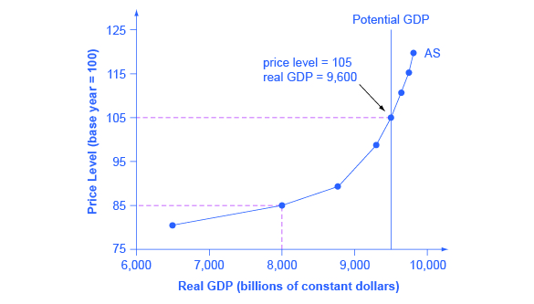
The horizontal axis of the diagram shows real GDP—that is, the level of GDP adjusted for inflation. The vertical axis shows the price level. Price level is the average price of all goods and services produced in the economy.

Slide 13
Potential GDP, or full-employment GDP, is the maximum quantity that an economy can produce given full employment of its existing levels of labor, physical capital, technology, and institutions

Slide 14
Components of Aggregate Supply
Main components of aggregate supply are two, namely, consumption and saving.
A major portion of income is spent on consumption of goods and services and the balance is saved.
Thus, national income (Y) or aggregate supply (AS) is sum of
consumption expenditure (C) and savings (S).
AS = C + S, i.e., Y = C + S

Slide 15
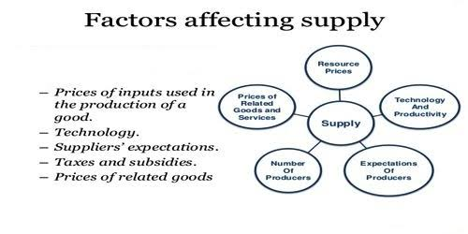

Slide 16
Role of Government
Increased government spending is likely to cause a rise in aggregate demand (AD). It can potentially lead to inflation.
Higher government spending will also have an impact on the supply-side of the economy – depending on which area of government spending is increased. If spending is focused on improving infrastructure, this could lead to increased productivity and a growth in aggregate supply. If spending is focused on welfare benefits or pensions, it may reduce inequality, but it could crowd out more productive private sector investment.

Slide 17
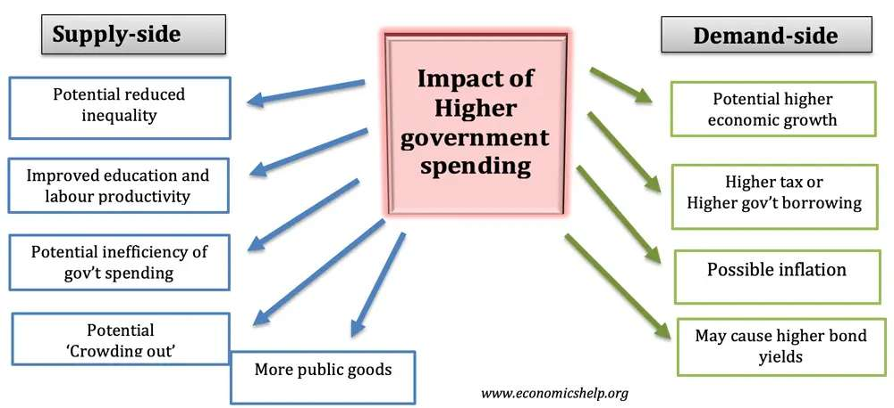

Slide 18
Different targets of government spending
Welfare benefits – this spending will help to reduce levels of inequality. For example, benefits to the unemployed enable them to maintain a minimum income and avoid absolute poverty.
  There is a potential higher welfare benefit could reduce incentives to work, but on the other hand, welfare benefits can also help the labour market to function more efficiently.
Pension spending – An ageing population, requires higher government spending, – pensions and health care spending. But pension spending has no impact on boosting productivity
Education and training – If successfully targetted on improving skills and education, government spending can increase labour productivity and enable higher long-term economic growth.
Infrastructure investment – Higher spending on roads and railways can help remove supply bottlenecks and enable greater efficiency. This can also boost long-term economic growth.
Higher debt interest payments – If the government has higher debt and higher bond yields, then it can cause increased costs of borrowing. This spending will go to investors and have no benefit for the economy.

Slide 19
Evaluation of higher government spending
How is spending financed? It depends on how government spending is financed. If government spending is financed by higher taxes, then tax rises may counter-balance the higher spending, and there will be no increase in aggregate demand (AD).
Crowding out. If the economy is close to full capacity, higher government spending can lead to crowding out. This is when the government spends more, but it has the effect of reducing private sector spending. For example, if the government borrow from the private sector, the private sector has lower savings for private investment.
Inefficiency of gov’t spending. Some free-market economists argue gov’t spending has a significant potential to be more inefficient than the private sector spending. In the government sector, there may be poor information and lack of incentives, which leads to misallocation of resources. Therefore, bigger gov’t sector could lead to less efficient economy as gov’t spending takes place of private-sector spending.
Depends on the state of the economy. The impact of government spending also depends on the state of the economy. If the economy is close to full capacity, then higher government spending may cause inflationary pressures and little increase in real GDP. If the economy is in recession, and the government borrows from the private sector, it can act as an expansionary fiscal policy to boost economic growth

Slide 20
Thank you

