Slide 1
The Consumer Protection Act, 1986

Slide 2
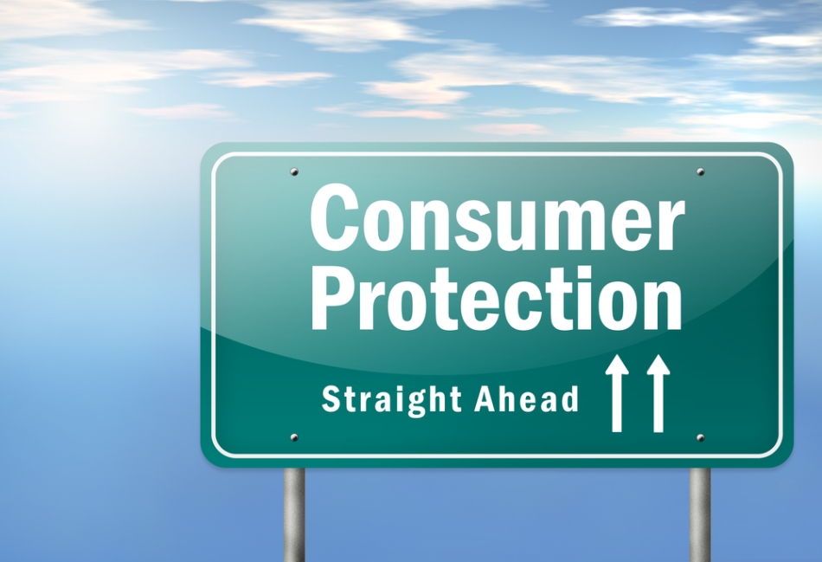

Slide 3
index
Introduction
Objective
Who is a consumer?
Consumers rights
Composition of redressal agencies
Appeals
Complain
Negligence
comment

Slide 4
what is Consumer Protection Act ?
Legal definition:-”A state or federal law designed to protect Consumers against improperly described, damaged, faulty and dangerous goods and services as well as from unfair trade and credit practices”.
It is also called as COPRA. The Consumer Protection Act was established on 24th December1986.
From the year of 1995 the doctors were liable to be prosecuted in the Consumer Protection Act and also other medical professions.
It is made for the establishment of consumer councils and other authorities for the settlement of consumer grievances and matters connected there with it.

Slide 5
The act was renewed in 2019 which states
Establishment of the Central Consumer Protection Authority (CCPA)
Action against Mis -Leading Advertisements and liability of Endorsers
The New Act enhances the pecuniary jurisdictions of the following forums: –
  District Commission: – from Rupees 20 Lakhs to Rupees 1 Crore
  State Commission: – from Rupees 1 Crore to Rupees Ten Crore
  National Commission: – from Rupees 1 Crore to above 10 Crore
E-commers is also included

Slide 6
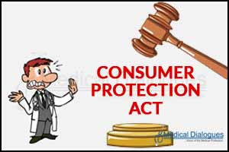
objective
The main objective of Consumer Protection Act is to provide speedy and simple redressal to consumer disputes.
It is one of the benevolent pieces of legislation intended to protect the consumers at large from exploitation.

Slide 7

Who is consumers?
Any person who:
Buys any goods for consideration which has been paid or will be paid.
Hires or avails any service for a consideration which has been paid or will be paid.
It does not involve a person who obtains goods for resale or any commercial purpose.

Slide 8


Slide 9
Consumer rights
Right to Safety-A consumer has aright to be protective against goods and services which are injurious to health and life.
Right to be informed-A consumer has the right to be informed about the ingredient, quality, quantity, purity, standard or grade, date of manufacture and price of the goods he/she intends to buy.
Right to choose-A consumer has the freedom to choose the goods needed from a variety of products.

Slide 10

Right to be Heard-A consumer has the right to file a complaint and to be heard by the manufactures, dealers, advertisers, government and public bodies in case of dissatisfaction with good or service.
Right to seek Redressal-If a consumer has a complaint or grievance due to unfair trade practices like charging higher price, selling of poor quality or unsafe products and so on, he as a right to get relief.
Right to consumer Education-Consumer education empowers consumer rights.

Slide 11
Composition of redressal agencies
Three-tier Grievance Redressal Machinery and Forums
  The District Forum
  The State Forum
  The National Commission

Slide 12
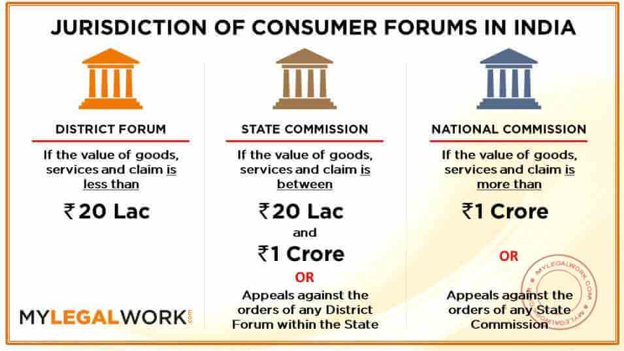

Slide 13
appeal
Appeals against
District Forum:- Within 30 days- in State Commission
State Forum:- Within 30 days- in National Commission
National Forum:- Within 30 days- in Supreme Court
There is no fee for filling appeals in the State and National Commissions.

Slide 14

Complaint
Definition of complaint:- means any allegation in writing made by a complaint that:
He has suffered a loss or damage as a result of any unfair trade practice adopted by any trader:
The goods/service mentioned in the complaint suffer from one or more defects.
A trader has charged for the goods mentioned in the complaint a price in excess of the price which is fixed by the law, displayed on the goods or displayed on any packet containing such goods.

Slide 15
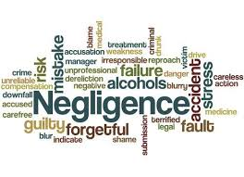

Slide 16
negligence
A failure to behave with the level of care that someone of ordinary prudence would have exercised under the same circumstances. The behaviour usually consists of actions, but can also consist of omissions when there is some duty to act (e.g., A duty to help victims of one's previous conduct).

Slide 17
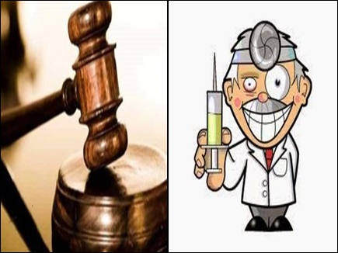
The supreme court declared that doctors were like any other service providers under contract, and therefore are under the same obligation to compensate the purchaser (patient) for any deficiency in the quality of the services.

Slide 18
Doctors in charitable clinics providing free services or Government hospitals who are rendering free services are exempted from The Consumer Protection Act.
Doctors with independent practice, private hospital charging all, and hospitals with paying patients, doctors/hospitals paid by an insurance firm/employer for treatment of a client, are liable for any negligence under The Consumer Protection Act.

Slide 19
comments
Old acts also requires to get registration of hospitals and nursing homes in allopathic system of medicine only. But new covers all system and beside all dispensaries and clinics.
District registration authority should have some representation from system of medicine also.
Fear of inspector rai and undue harassment is another factor concers to private practitioners.

Slide 20


